Slide 1
Object-oriented programming
Terence Parr
MSDS program University of San Francisco

Slide 2
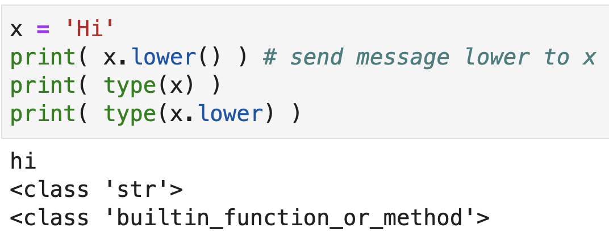
The big reveal
We've been working with functions and packages of functions, as well as defining our own functions
It turns out, though, that we've been working with objects all along, we just haven't recognized them as such

Slide 3
Classes and objects
A class is the blueprint for an object and is the name of the type
A class encapsulates the state (fields) and behavior of an object
An object is called an instance of the class
In common speech, we often use the terms interchangeably
Methods are just functions associated with classes (behavior)
Python has both functions and methods of object programming, which is why there is both x.lower() and len(x)
x.lower() is implemented as str.lower(x)
Objects came later in Python and the syntax is a bit awkward compared to other OO languages

Slide 4
Why OO programming?
Our hunter-gatherer brain views the world as a collection of objects that interact by sending messages
An OO programming paradigm maps well to real-world problems that we try to solve or simulate via computer
We are at our best when programming the way our minds are hardwired to think
Map real-world entities onto programming constructs; nouns become objects and verbs become methods

Slide 5
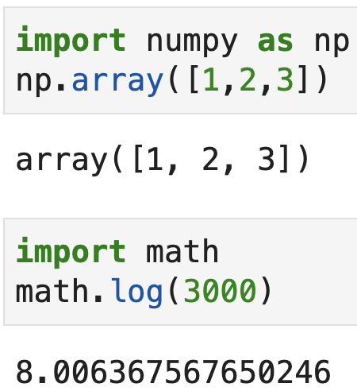
Package versus object members
The dot ’.’ operator is overloaded in Python to mean both package member and object member access
When we see a.f(), we don't know whether f is a member of the package identified by a or a method in the object referred to by a

Slide 6
Exercise
What are the various words, subexpressions here?
np.log(3)
np.linalg.norm(v)
from sklearn.ensemble import RandomForestRegressor
pd.read_csv("foo.csv")
pd.read_csv
'hi'.lower()
'hi'.lower
df_train.columns
np.pi
img = img.convert("L")
df["saledate"].dt.year
df_train.isnull().any().head(60)

Slide 7
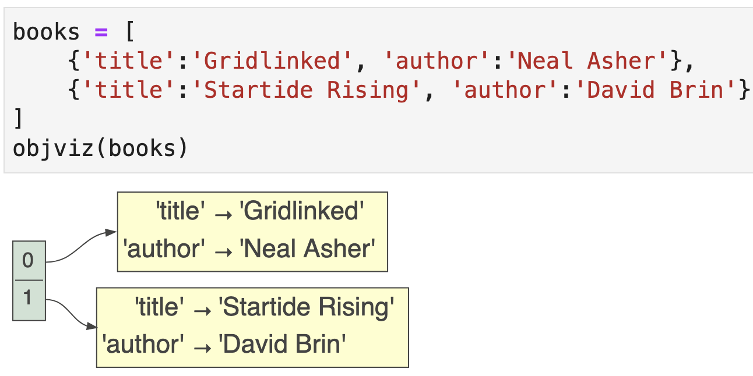
Objects group related values
Let’s baby step into the object-oriented world by associating an author and title for a few books; easiest way is with a dictionary

Slide 8
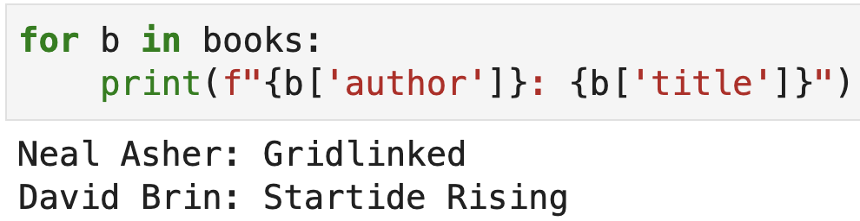
Accessing “fields” with dictionary approach
Using a small dictionary to group related values works, but has a number of significant disadvantages
There’s no template that guarantees each dictionary has the right key and value pairs
The notation is a bit awkward: b[‘author’]
There’s no way to associate functions with these dictionaries

