Slide 1
Packages and modules
Terence Parr
MSDS program University of San Francisco

Slide 2
Why we need the import statement
We've seen the use of some predefined functions, such as range() and len () that are available without doing anything special in your Python program
Now let's look at importing and using code libraries
There are a multitude of libraries on your disk and Python can't automatically load them all into memory; we must explicitly import the libraries we want to use in our program
This is like opening a specific cookbook of recipes

Slide 3
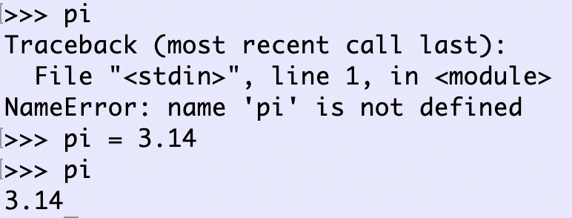
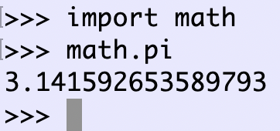
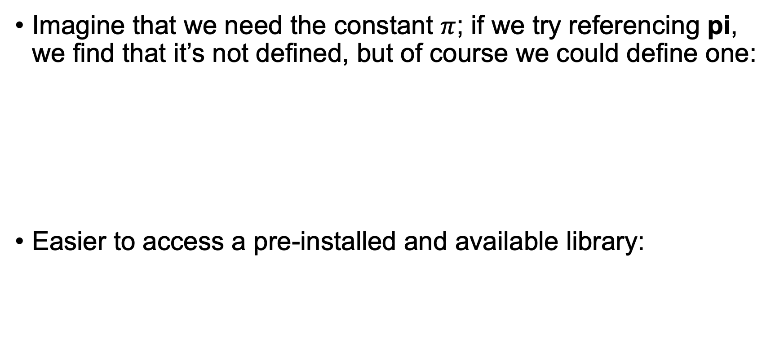
Accessing goodies from installed modules
Imagine that we need the constant $π$; if we try referencing pi, we find that it’s not defined, but of course we could define one:
Easier to access a pre-installed and available library:
Warning: ‘.’ is overloaded so a.b could mean package, module, or object accessor
Somewhere there’s a math.py file

Slide 4
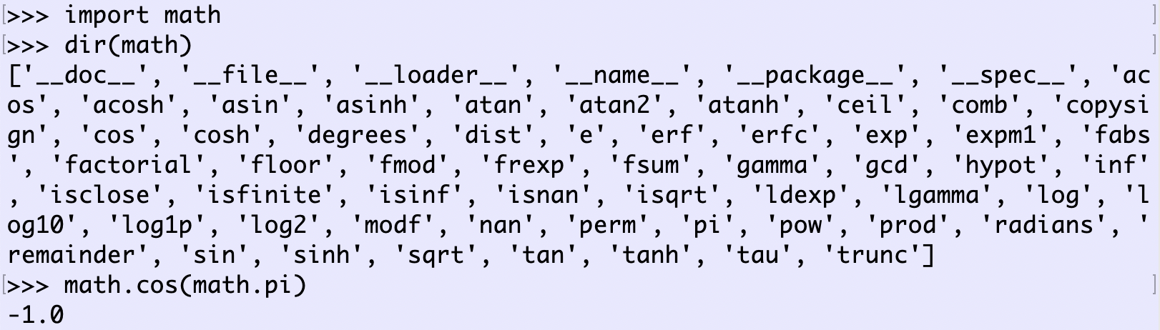
What’s in a module?
Use dir() to look at module contents (or google)
There are functions as well as variables in math.py:

Slide 5
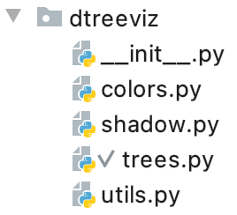
Some key terminology
A script .py file is also called a module; if a.py imports module b then a.py can access the variables and functions in file b.py
A directory containing module file(s) is called a package; if directory p contains module file m.py, then a script like foo.py can import p.m to access the goodies from m.py
Example from my dtreeviz package:
package
module
Tells Python this is a package vs a plain directory

Slide 6
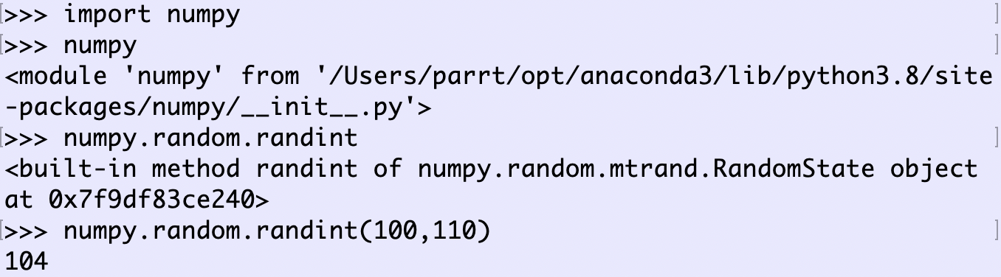
Example: numpy package
NumPy is a library whose outermost package is called numpy with a random module that has a randint() function:

Slide 7
Installing more libraries
We recommend that you install Anaconda’s Python bundle, which includes most of the stuff we need for machine learning
We can import any of the predefined Python libraries or the preinstalled libraries in Anaconda
There are a huge number of useful Python packages that are likely not currently installed on your machine; this is analogous to all of the uninstalled apps you see in the app store
To install library foo: pip install foo
There is another package manager called conda, which is more sophisticated than pip (can installed C++ code, etc…)

Slide 8
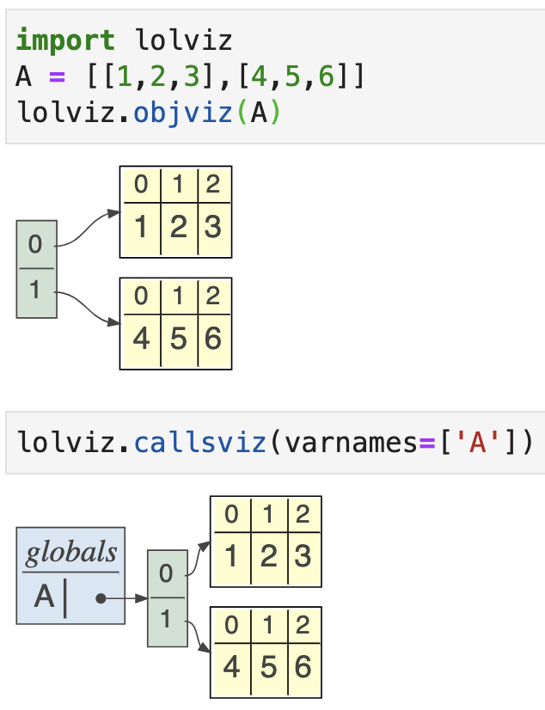
Example: installing lolviz
lolviz[1] is a package I built to display data structures
First, use the terminal to install graphviz, a program needed by my lolviz library: brew install graphviz
Then, pip install lolviz
Import lolviz and call objviz() etc…
[1] https://github.com/parrt/lolviz

Slide 9
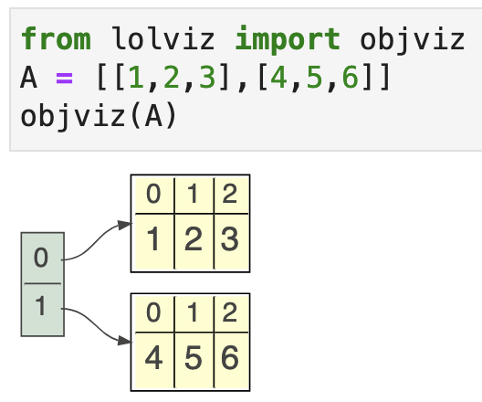
Fancier notation
With some new notation, we can create a shorthand to access functions of interest more easily from module import x, y, …, z
It’s also very handy to create a shorter name for a package: import numpy as np import pandas as pd A = np.sum([1,2,3])
Standard aliases

