Slide 1
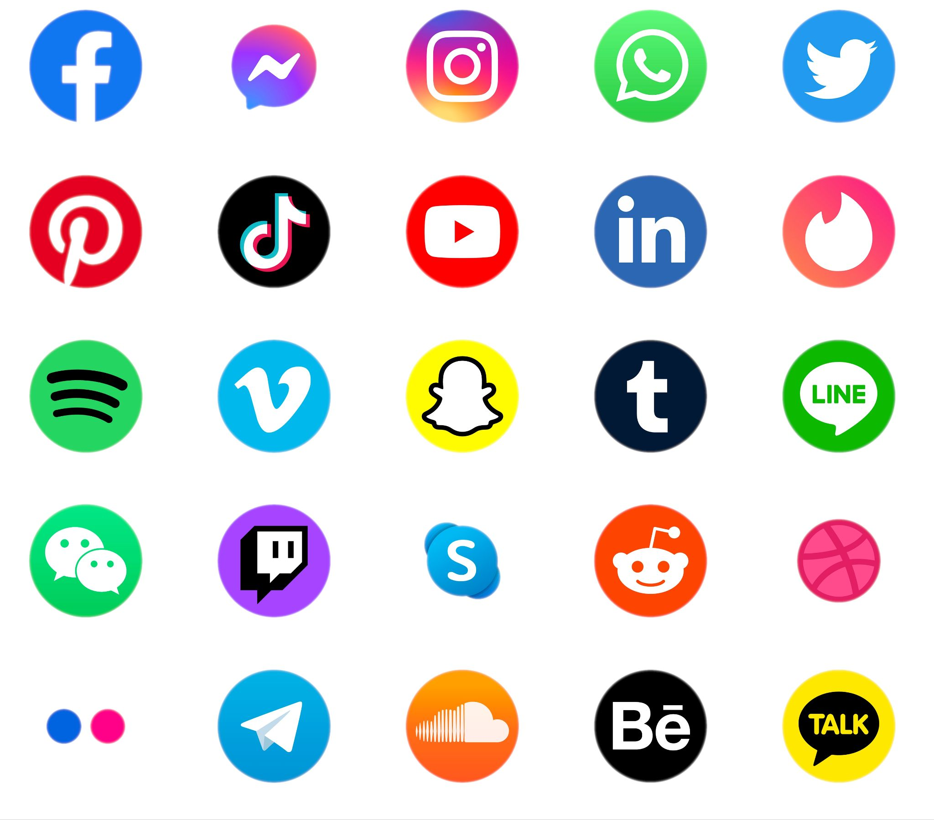
Operating System(Software)

Slide 2


Operating System(Software)
Applactions
Device Drivers
Kernel

Slide 3
Operating System(Software)
Applactions
Device Drivers
Kernel

Slide 4
Operating System(Software)
Applactions
Device Drivers
Kernel

Slide 5
Operating System(Software)
Applactions
Device Drivers
Kernel

Slide 6
Operating System(Software)
Applactions
Device Drivers
Kernel

Slide 7

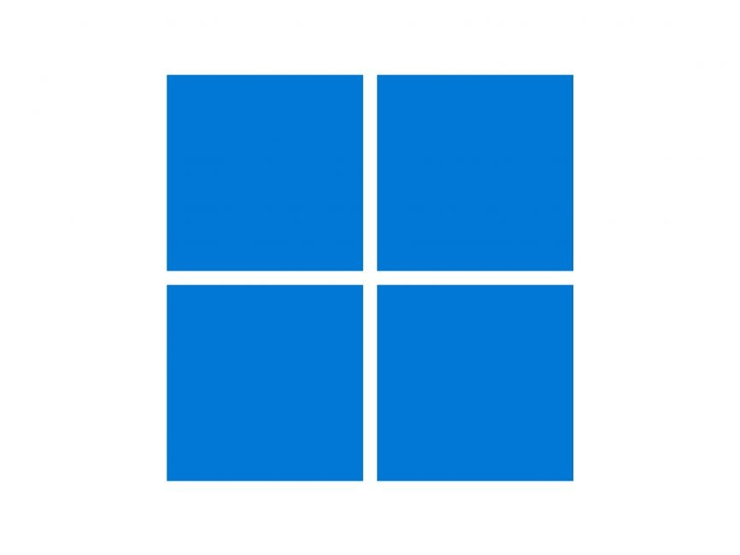
Operating System(Software)
Windows-11
Applactions
Kernel
MenuetOS
minimum hardware requirements:
Processor: 1 gigahertz (GHz) (2-cores)64-bit processor
Memory: 4 gigabytes (GB) or greater
Storage: 64 GB
Device Drivers
It can run smoothly on a --MHz processor with only --MB of RAM (MenuetOS, ----)

Slide 8
Operating System(Software)
Windows-11
MenuetOS
It can run smoothly on a 50MHz processor with only 32MB of RAM (MenuetOS, 2010)
minimum hardware requirements:
Processor: 1 gigahertz (GHz) (2-cores)64-bit processor
Memory: 4 gigabytes (GB) or greater
Storage: 64 GB

Slide 9
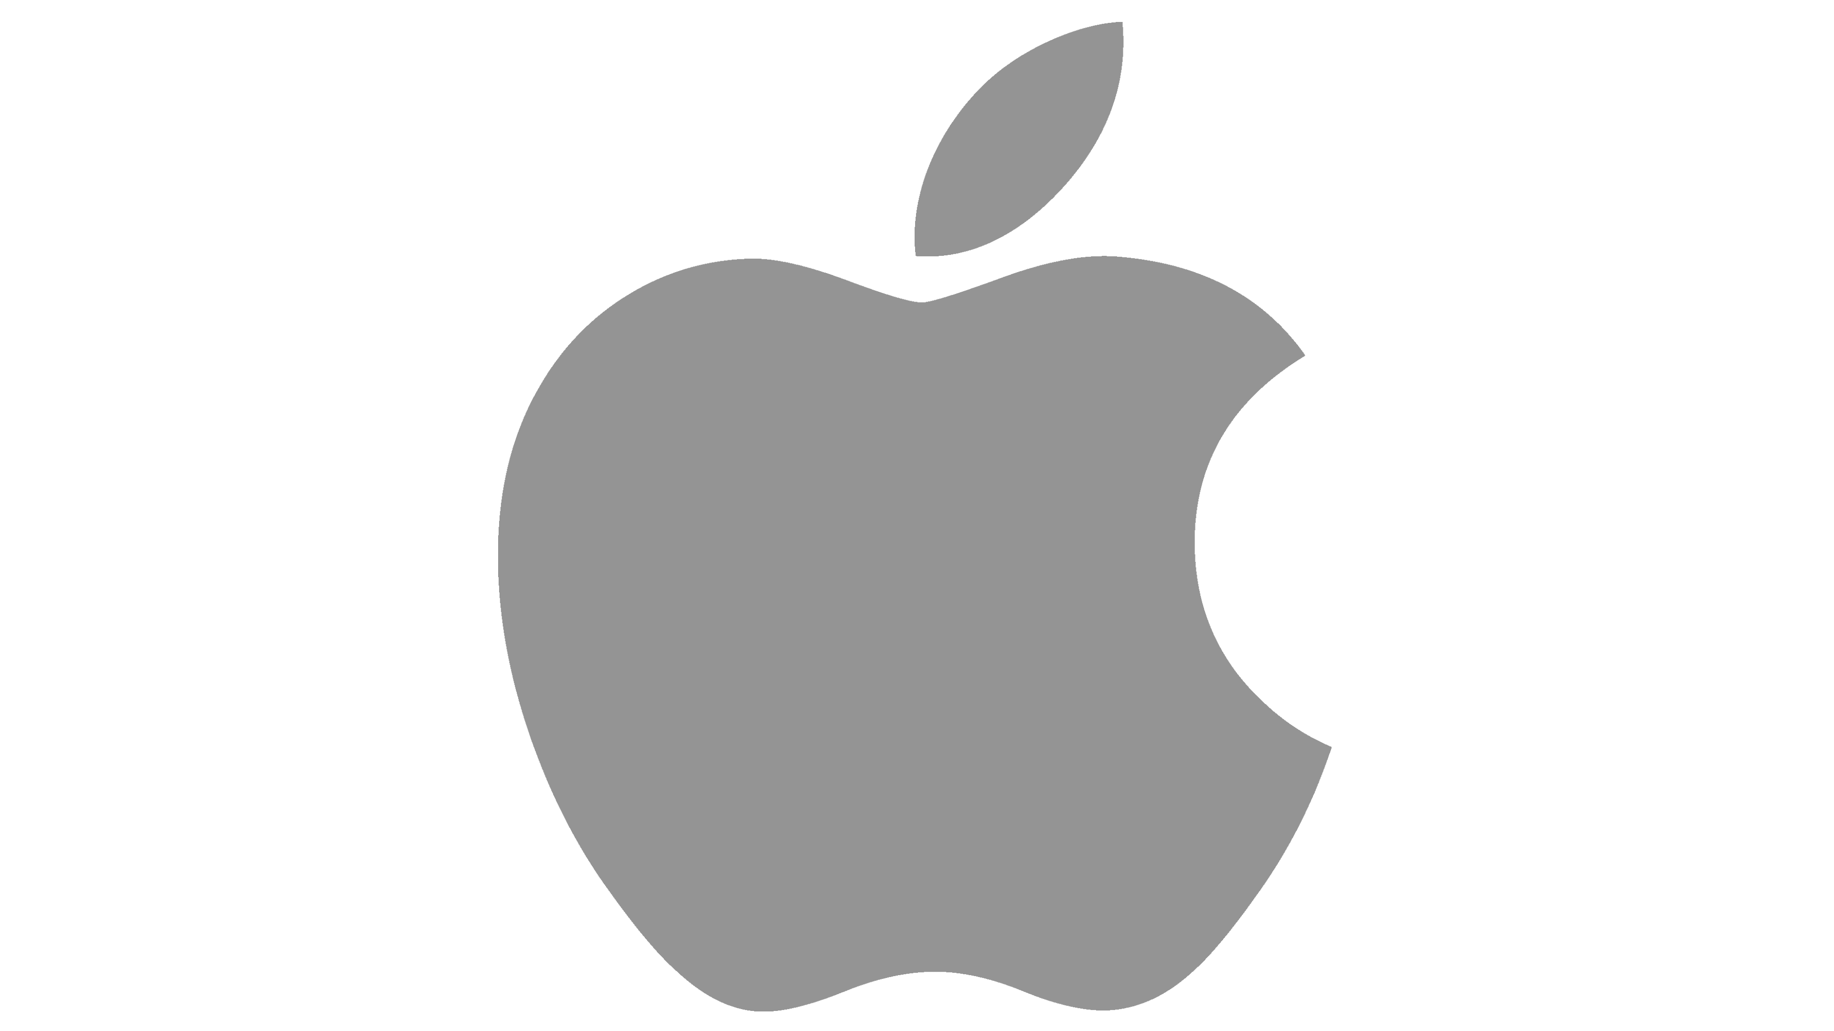
Operating System(Software)
GNU/Linux
OS X
Windows-11
MenuetOS
minimum hardware requirements:
Processor: 1 gigahertz (GHz) (2-cores)64-bit processor
Memory: 4 gigabytes (GB) or greater
Storage: 64 GB
It can run smoothly on a 50MHz processor with only 32MB of RAM (MenuetOS, 2010)
(Apple)

Slide 10

Operating System(Software)
(Microsoft )
MenuetOS
OS X
Windows-11
GNU/Linux
(Apple)
It can run smoothly on a 50MHz processor with only 32MB of RAM (MenuetOS, 2010)
minimum hardware requirements:
Processor: 1 gigahertz (GHz) (2-cores)64-bit processor
Memory: 4 gigabytes (GB) or greater
Storage: 64 GB
Windows
(opensource)

Slide 11

Operating System(Software)
OS X
GNU/Linux
(Microsoft )
(Apple)
(opensource)
Windows

Slide 12
Operating System(Software)
OS X
GNU/Linux
Windows
(Apple)
(opensource)
(Microsoft )

Slide 13
Operating System(Software)
GNU/Linux
Windows
(Microsoft )
OS X
(opensource)
(Apple)

Slide 14
Operating System(Software)
Windows
OS X
(Microsoft )
(Apple)
GNU/Linux
(opensource)

Slide 15

Operating System(Software)
Windows
GNU/Linux
(Microsoft )
OS X
(opensource)
(Apple)

Slide 16
Operating System(Software)
GNU/Linux
Windows
(Microsoft )
OS X
(opensource)
(Apple)

Slide 17
Operating System(Software)
GNU/Linux
Windows
(Microsoft )
OS X
(opensource)
(Apple)

Slide 18
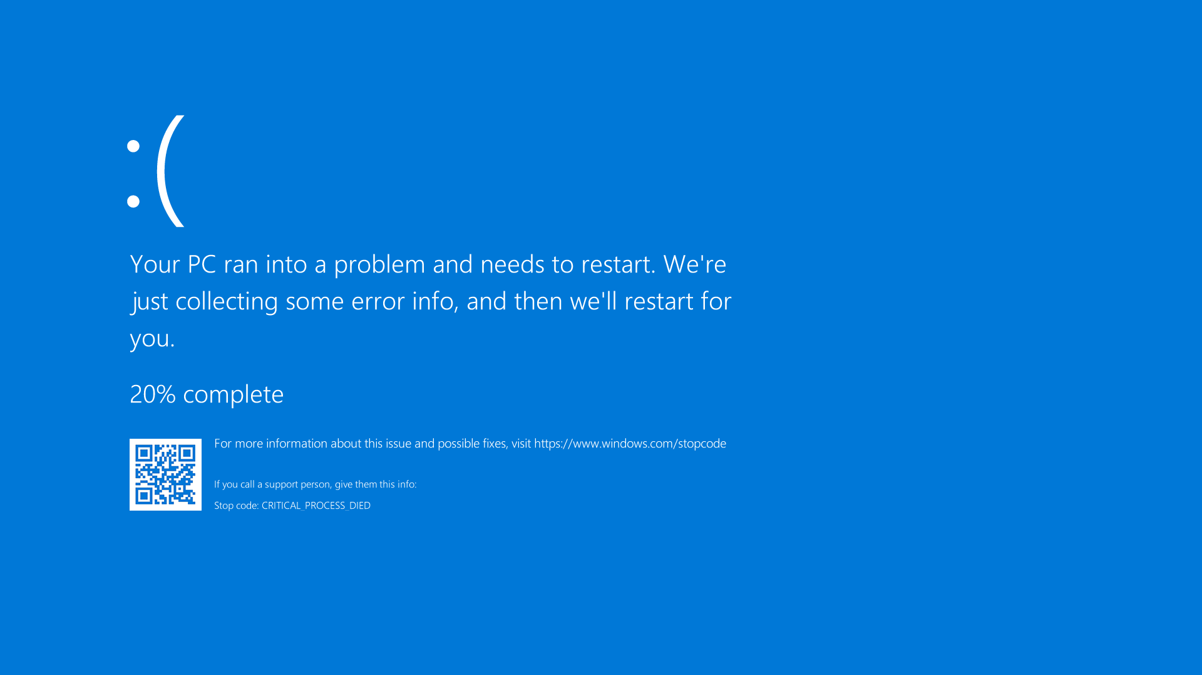
Operating System(Software)
GNU/Linux
Windows
(Microsoft )
OS X
(opensource)
(Apple)

