Slide 1

Predict Students' Dropout and Academic Success using Classification Models
LECTURER - ASST. PROF. DR. PRAPAPORN TECHAANGKOON
Linn Htet Aung
671615515
Linnhtetaung_1@cmu.ac.th

Slide 2
Motivation
Country GDP is highly influenced by the labor force
Especially skilled labor force
Country Economic Cycle is can be described by AD-AS diagram.
Aggregate Demand and Aggregate Supply
Aggregate supply is the total amount of goods (including services) supplied by businesses within a country at a given price level. (https://www.econlib.org/)
Land , Labor, Capital, Technology

Slide 3
Motivation
Changes in Education and Skills
Impact: A more educated and skilled workforce can produce more output and adapt to new technologies, enhancing long-run AS.
Examples:
Investments in STEM (Science, Technology, Engineering, and Mathematics) education leading to a more innovative workforce in countries like South Korea.
Vocational training programs in Germany that equip workers with specialized skills, increasing productivity.
University and colleges are places where skilled labor are produced.

Slide 4
How?
When skilled labor increases in the labor market, output in the market will rise, pushing the long-run aggregate supply (LRAS) to the right. This causes the long-term output level to increase, leading to higher GDP and a fall in the price level, which is a positive sign for the economy.
P
LRAS 1
LRAS 2
P1
P2
AD
YN 1
YN 2
Y

Slide 5
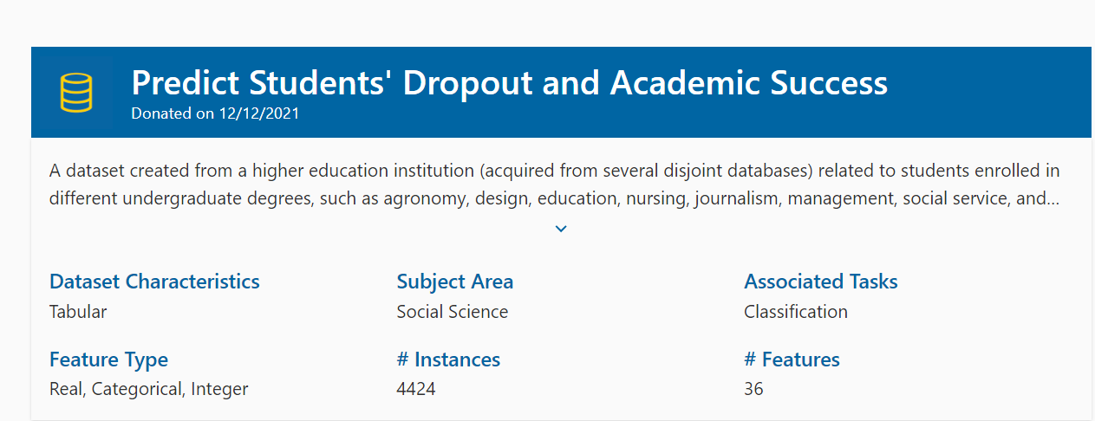
Dataset

Slide 6
Method
Dataset
Datapreprocessing
Train-Test splitting
Train Data
KNN5
KNN7
Decision Tree
Gaussian NB
Logistic Regression
Output
Evaluation of Model

Slide 7
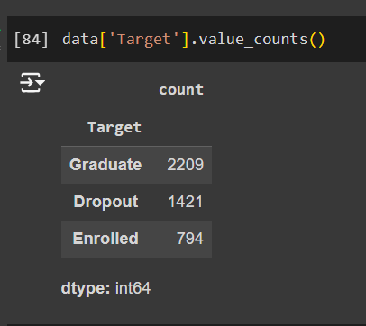
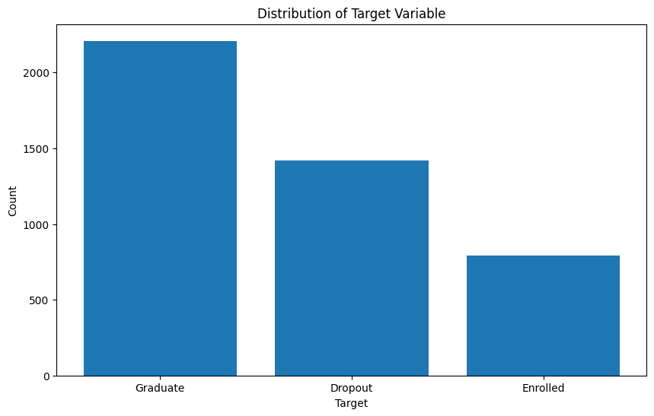
Target value

Slide 8
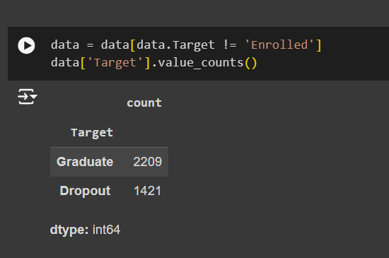
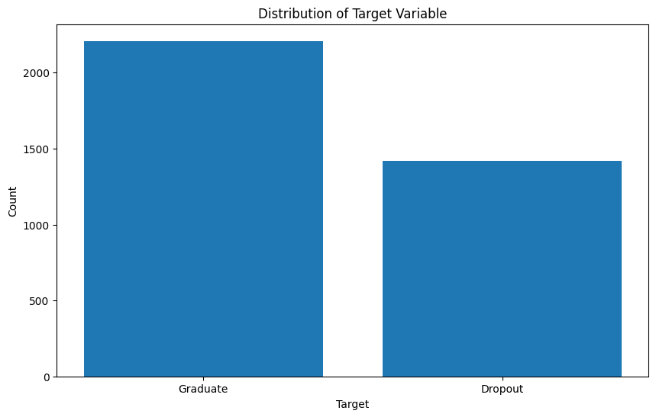
Drop the “enrolled” data

Slide 9
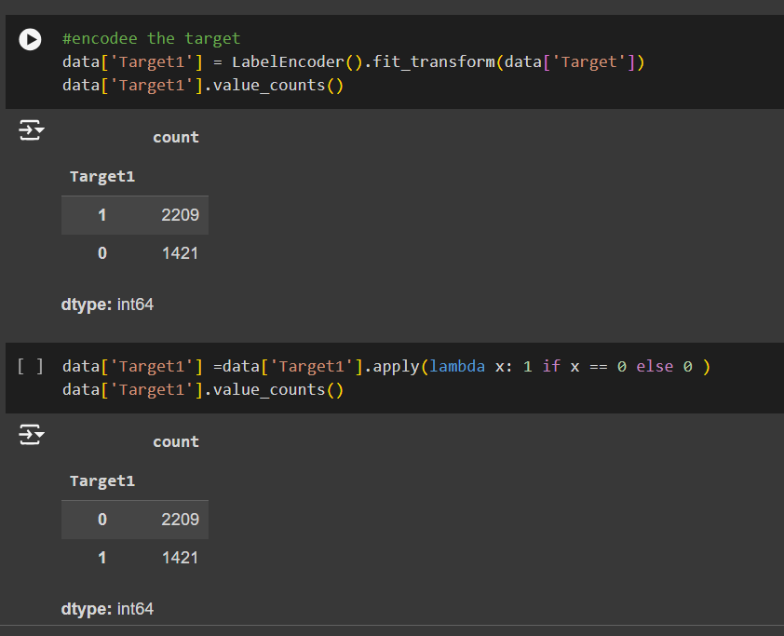
Encoding the data

Slide 10
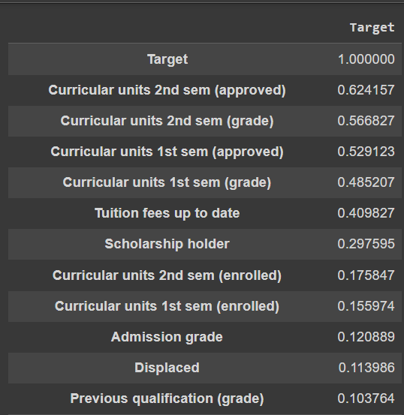
Correlation

Slide 11
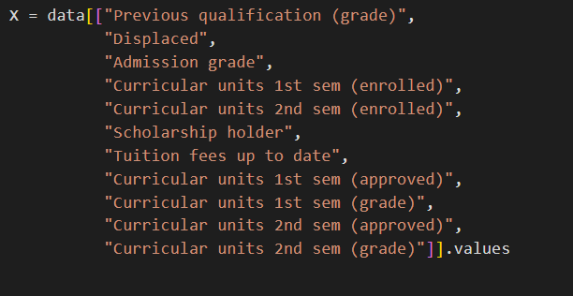
Choosing independent variables and Standardization

Slide 12
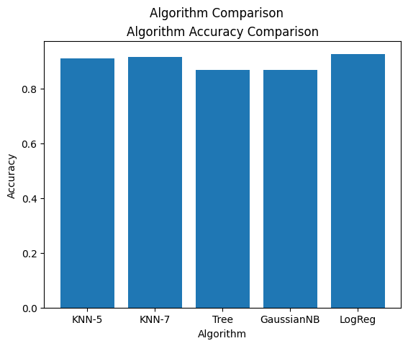
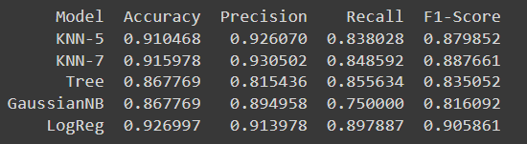
Results and Evaluation

Slide 13

Question ?

