Slide 1
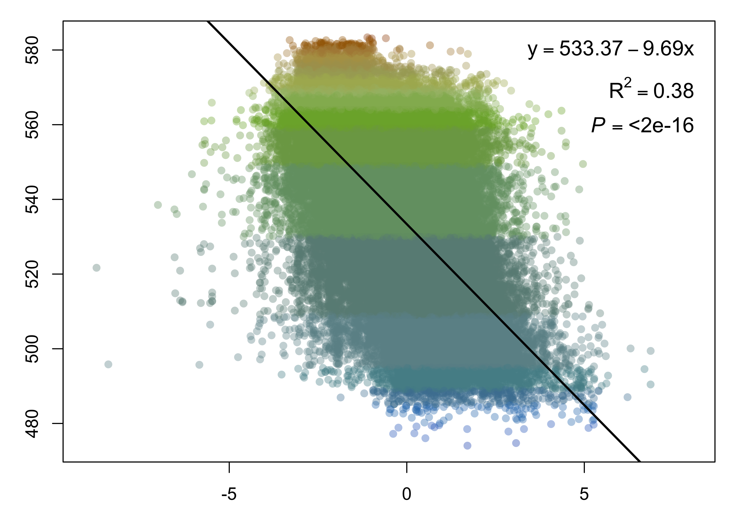
Average lake color (DWL)
forest cover (%)
open water (%)
average annual air temperature range
PC3
forest cover (%)
open water (%)
average annual air temperature range

Slide 2
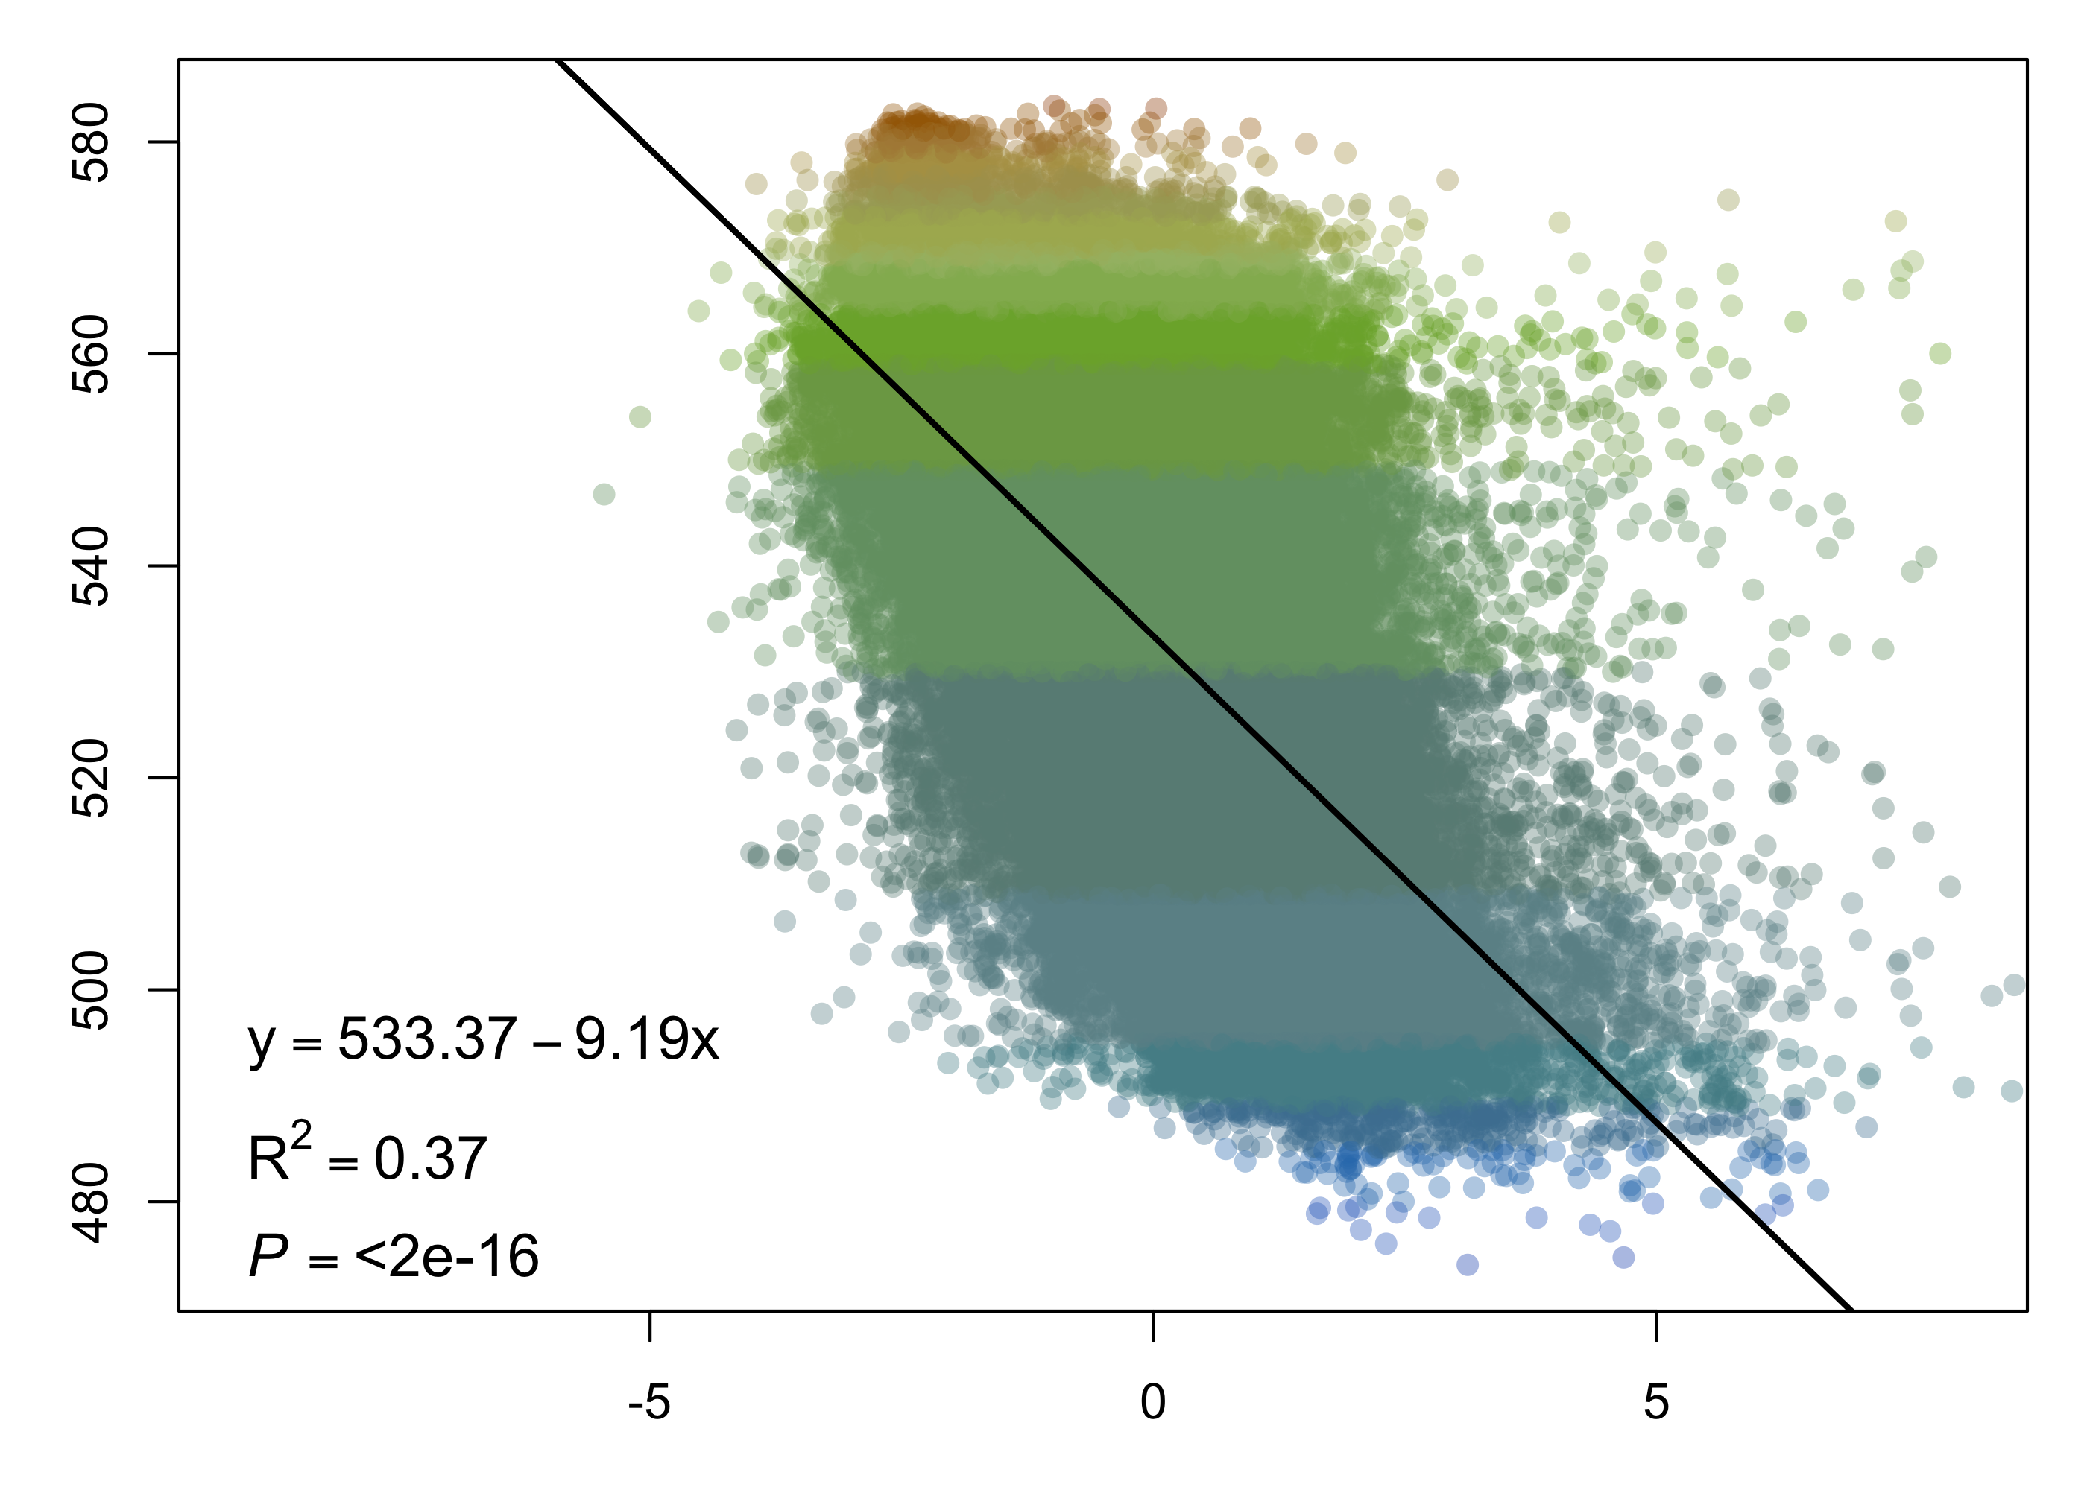
Average lake color (DWL)
forest cover (%)
shrub cover (%)
PC4
forest cover (%)
shrub cover (%)

