Slide 1
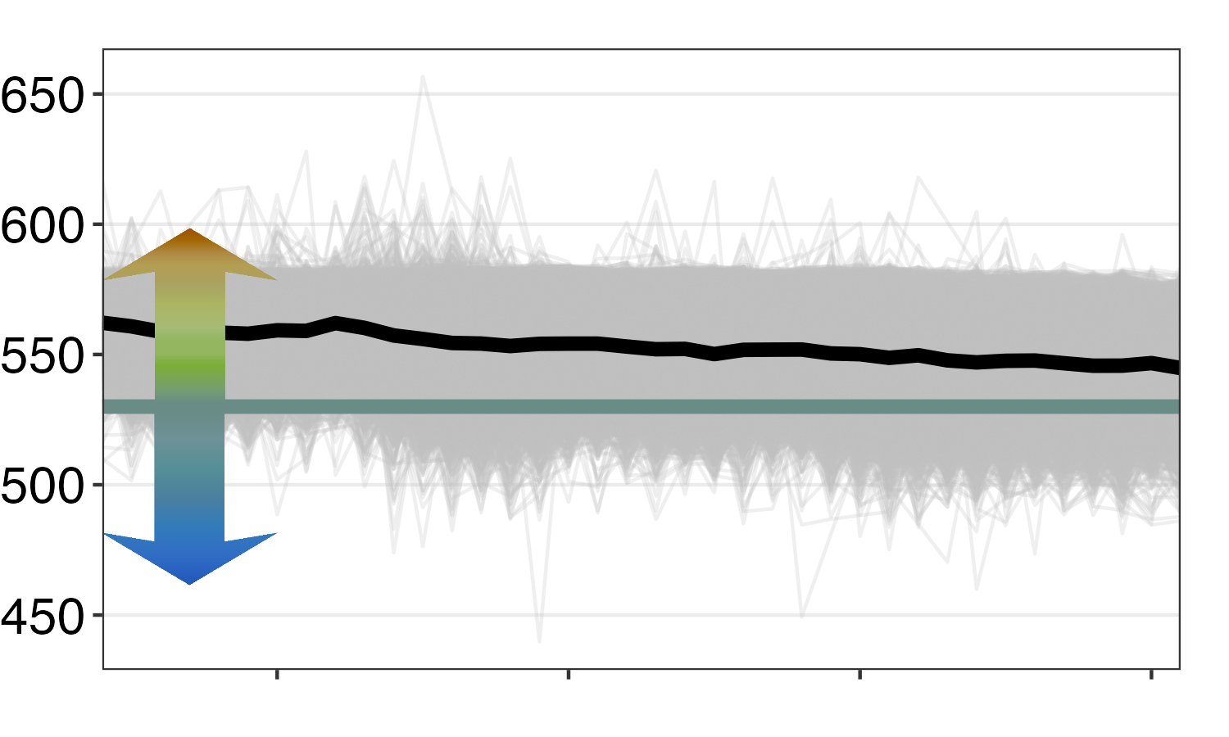
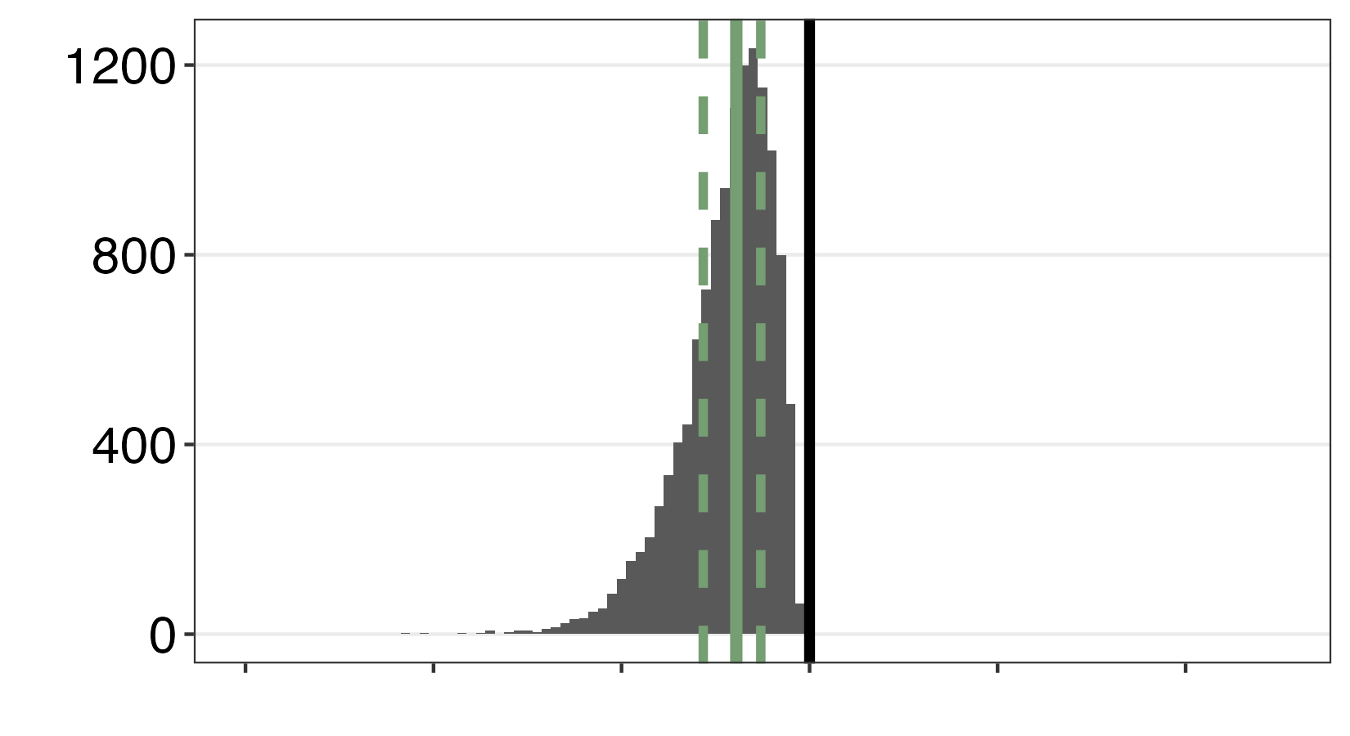
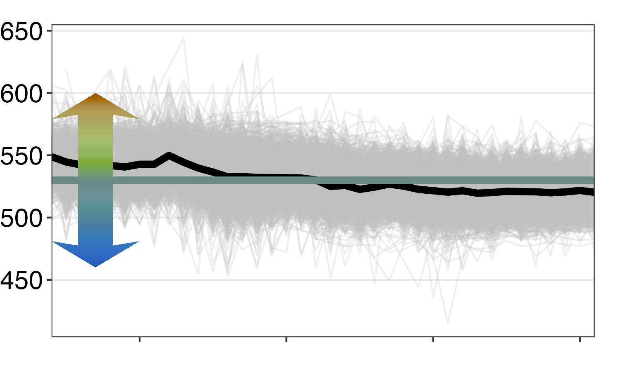
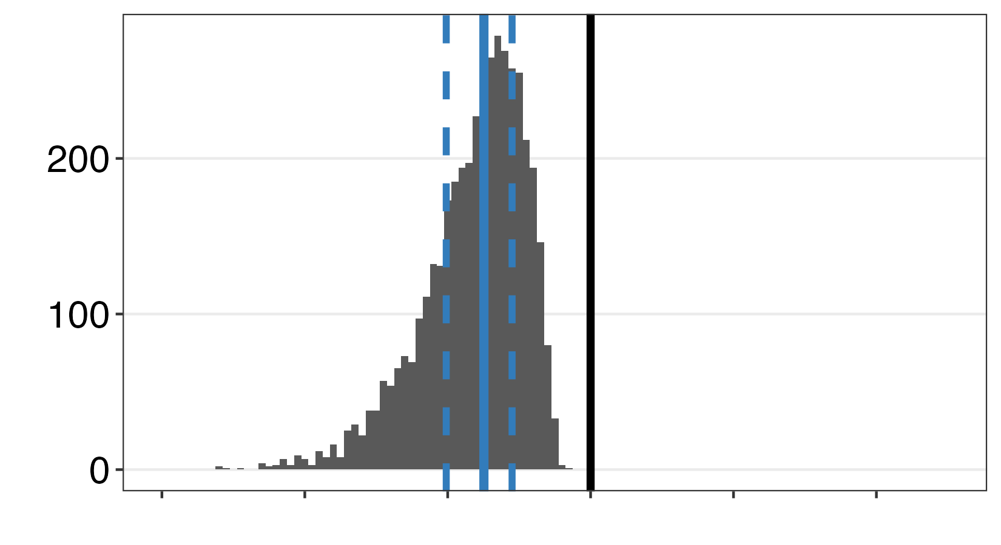
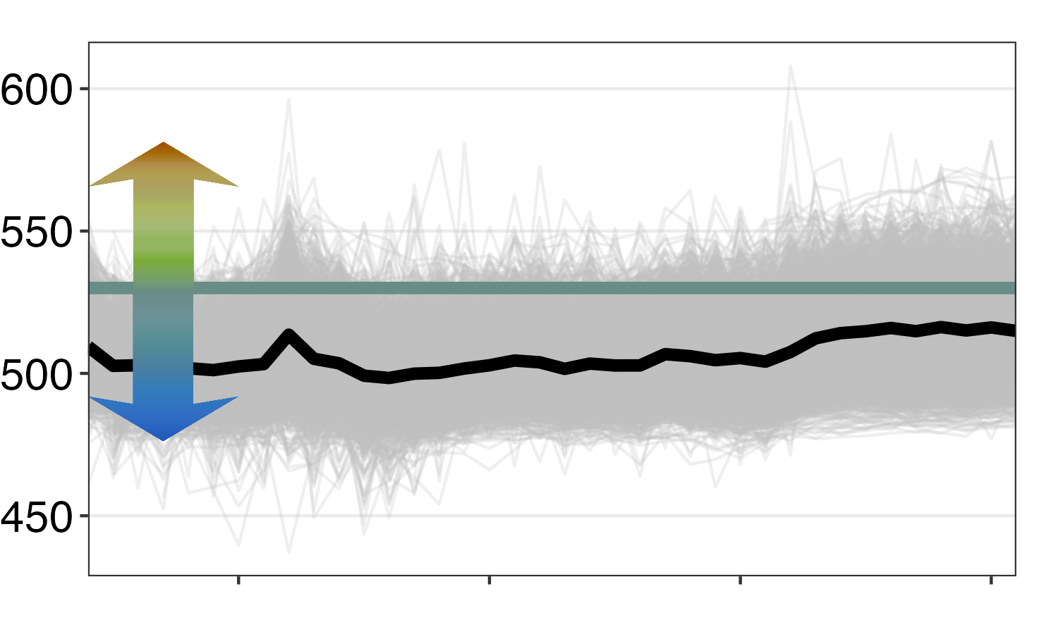
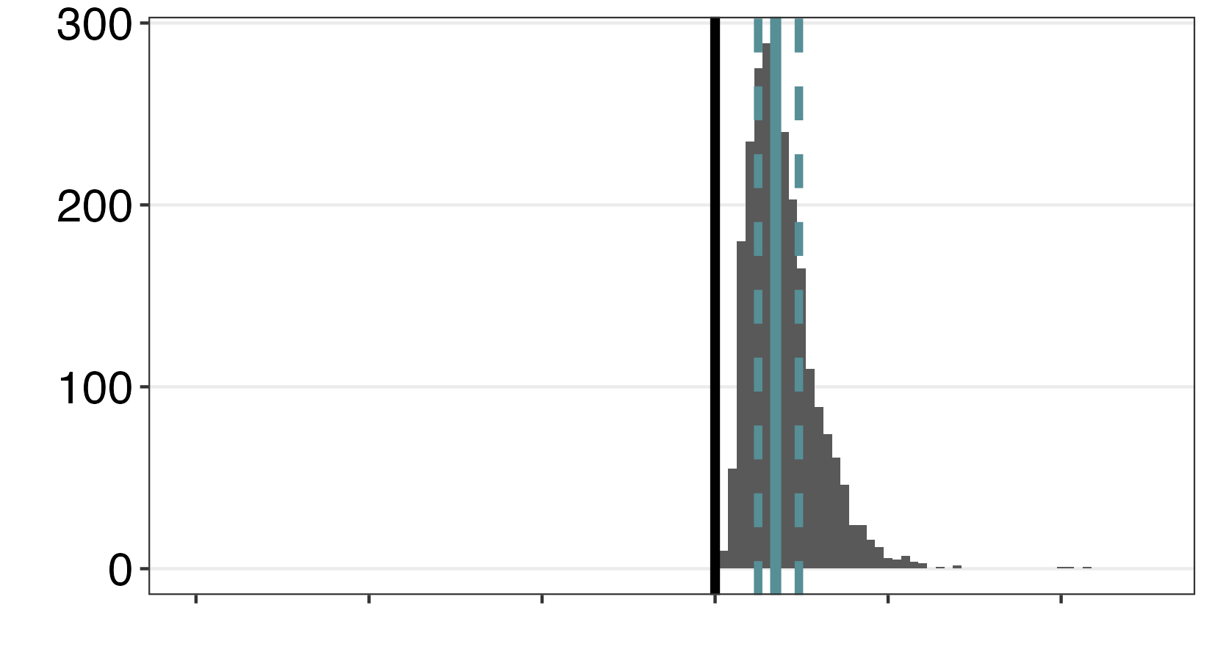
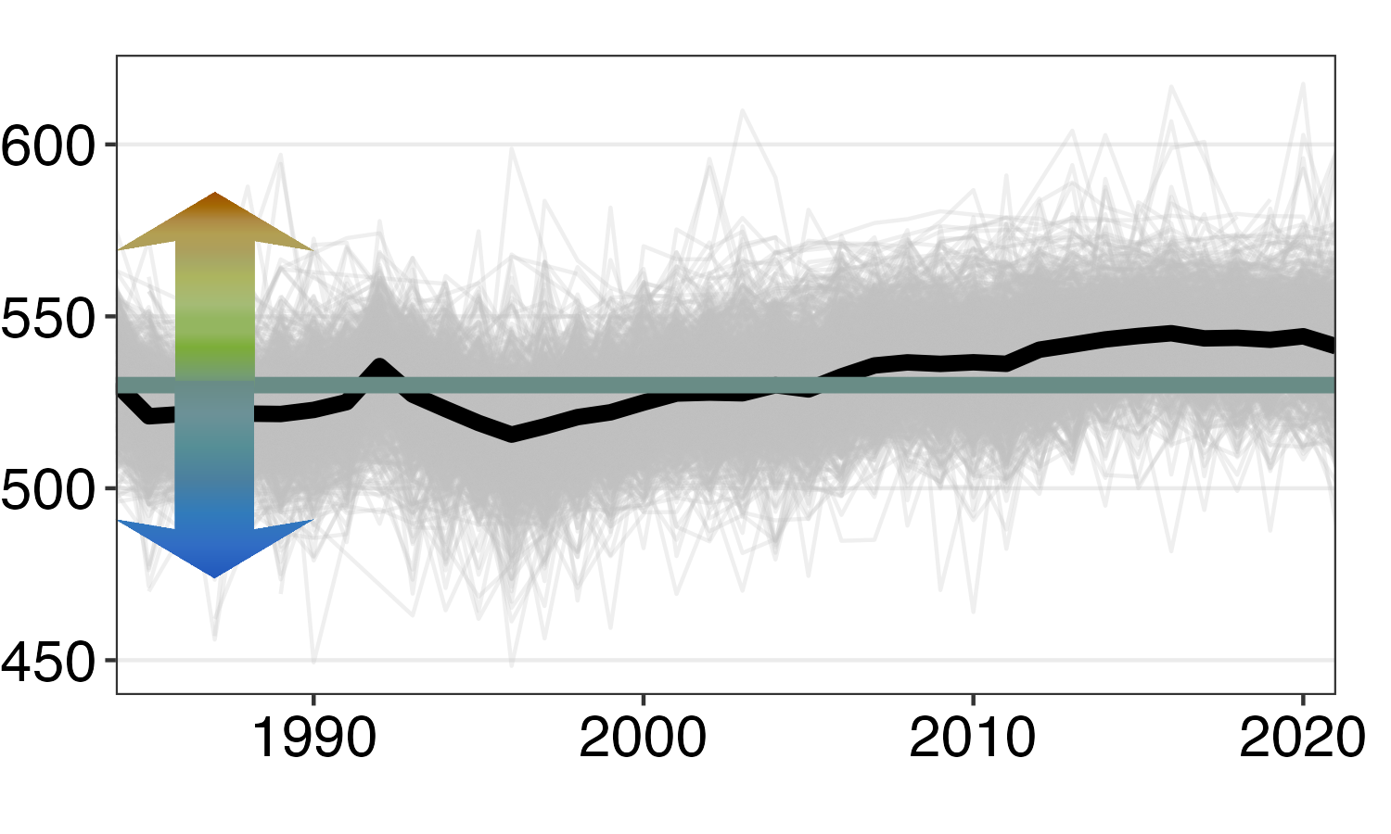
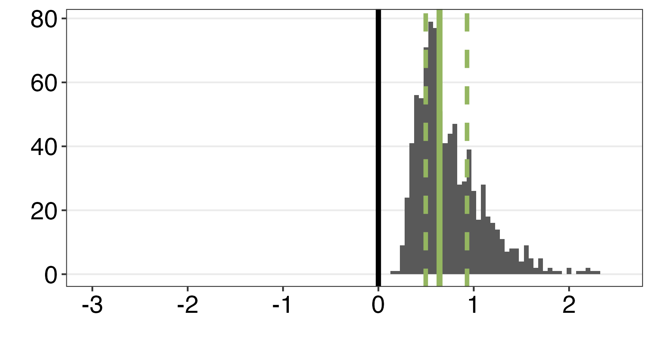
a)
Lakes trended towards blue, but stayed green
b)
Lakes switched from
green to blue
Dominant wavelength (DWL)
Number of lakes
c)
Lakes trended towards green, but stayed blue
d)
Lakes switched from
blue to green
Year
Slope of lake color over time

Slide 2
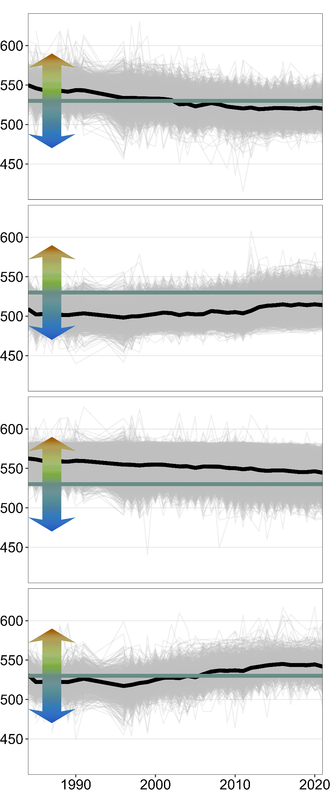
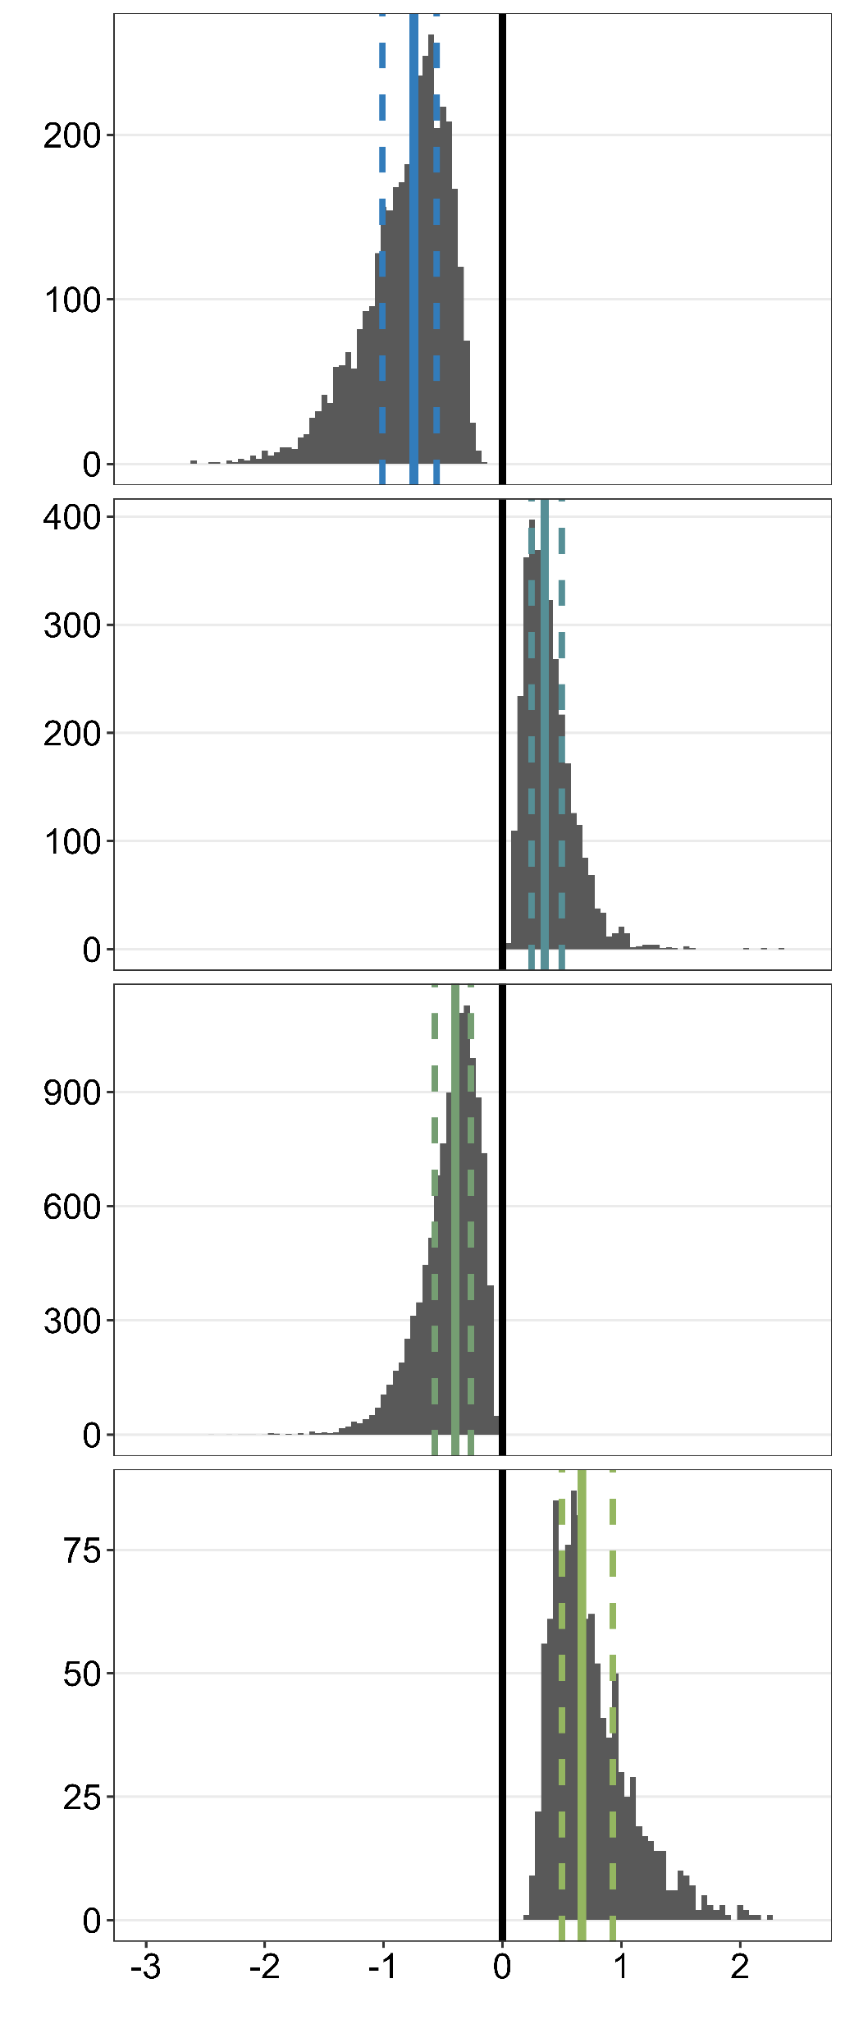
a)
Lakes switched from
green to blue
b)
Lakes trended towards green, but stayed blue
c)
Dominant wavelength (DWL)
Number of lakes
Lakes trended towards blue, but stayed green
d)
Lakes switched from
blue to green
Year
Slope of lake color over time

