Slide 1
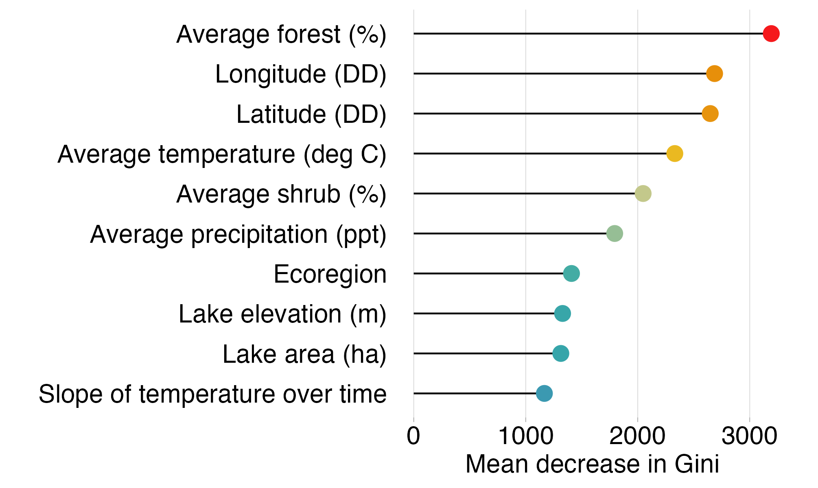
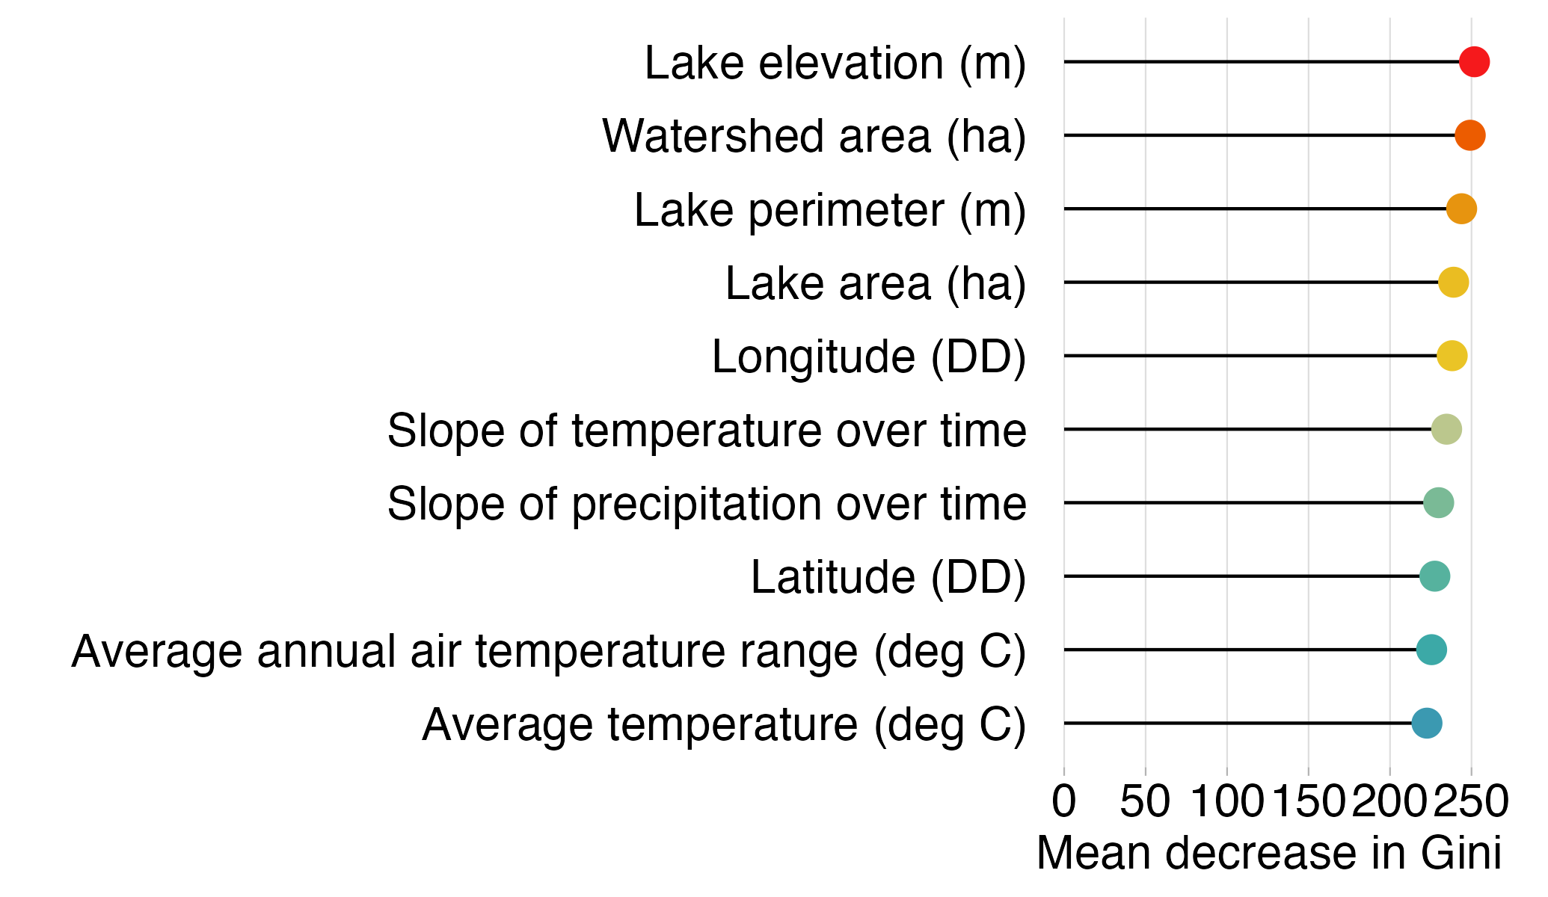
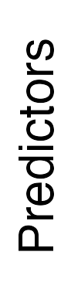
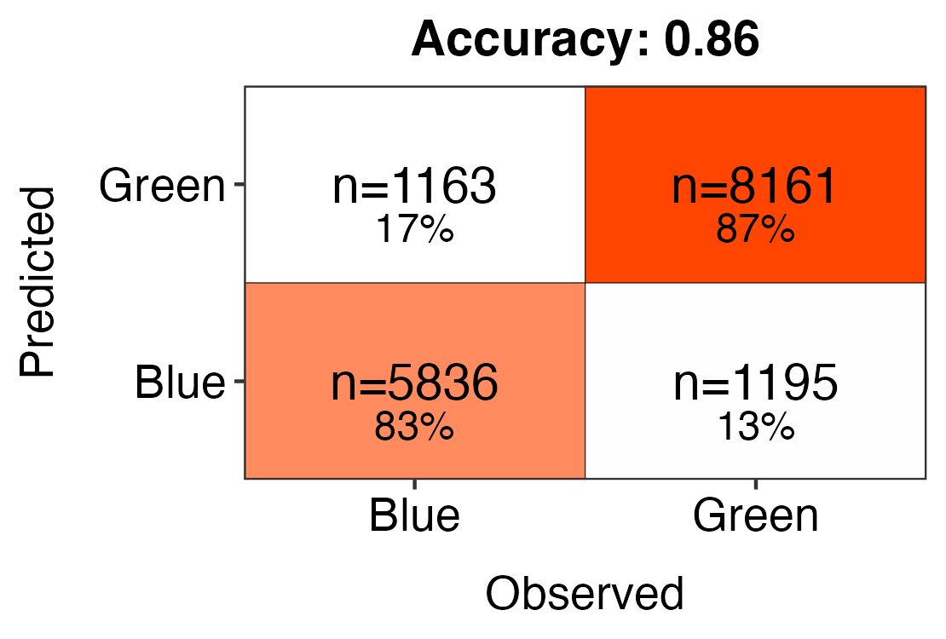
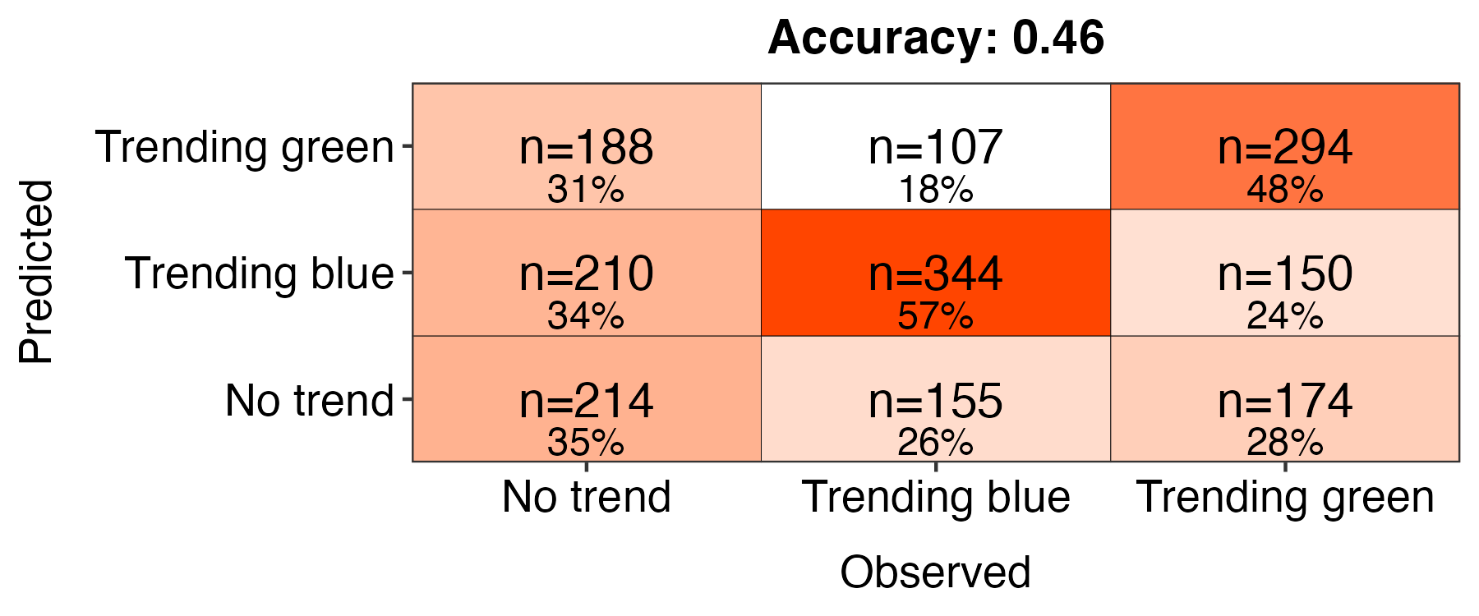
All lakes
n=81,773
Subset of lakes
n=9,180
Blue lakes
DWL < 530
82.1% correct classifications
Green lakes
DWL > 530
87.4% correct classifications
Trending blue
P ≤ 0.05
slope coef. < 0
55.6% correct classifications
No trend
P > 0.05
36.4% correct classifications
Trending green
P ≤ 0.05
slope coef. > 0
47.7% correct classifications
Notes:
cross val with training dataset

Slide 2
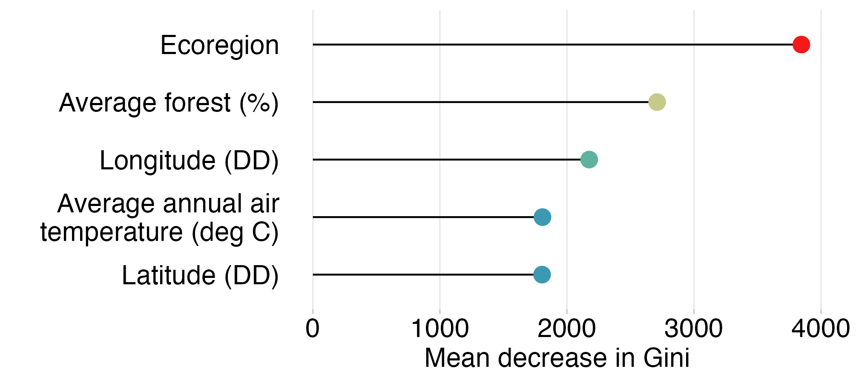
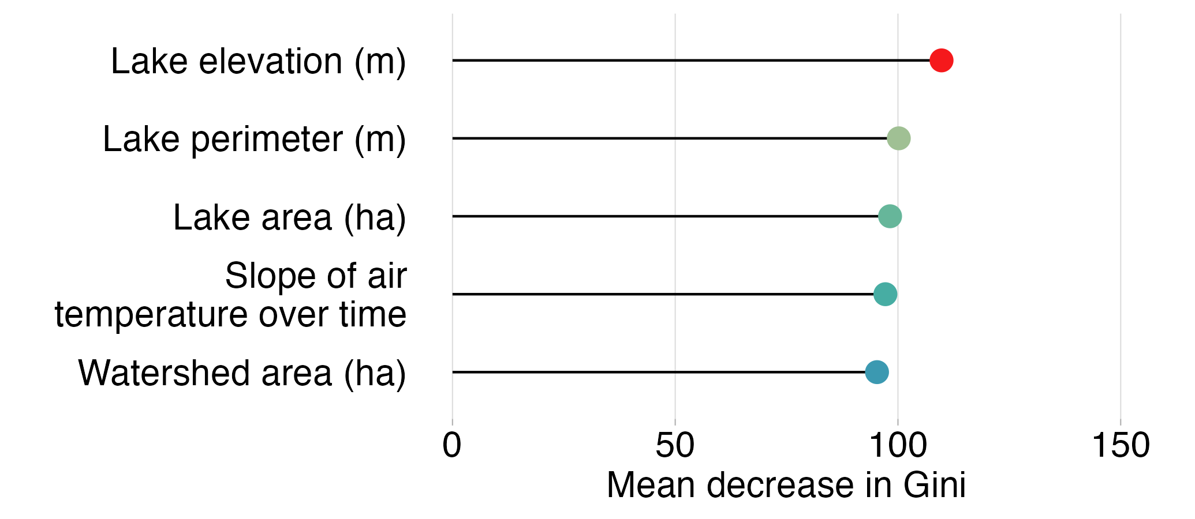

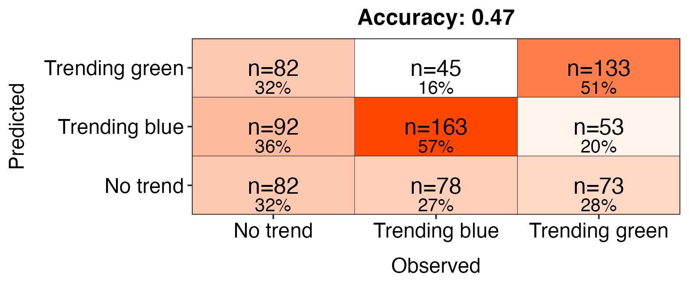
All lakes
n = 81,773
Subset of lakes
n = 3,996
Blue lakes
DWL < 530
82.2% correct classifications
Green lakes
DWL > 530
87.5% correct classifications
Trending blue
P ≤ 0.05
slope coef. < -0.4
53.3% correct classifications
No trend
P > 0.05
40.1% correct classifications
Trending green
P ≤ 0.05
slope coef. > 0.4
48.2% correct classifications
Notes:
cross val with training dataset

