Slide 1
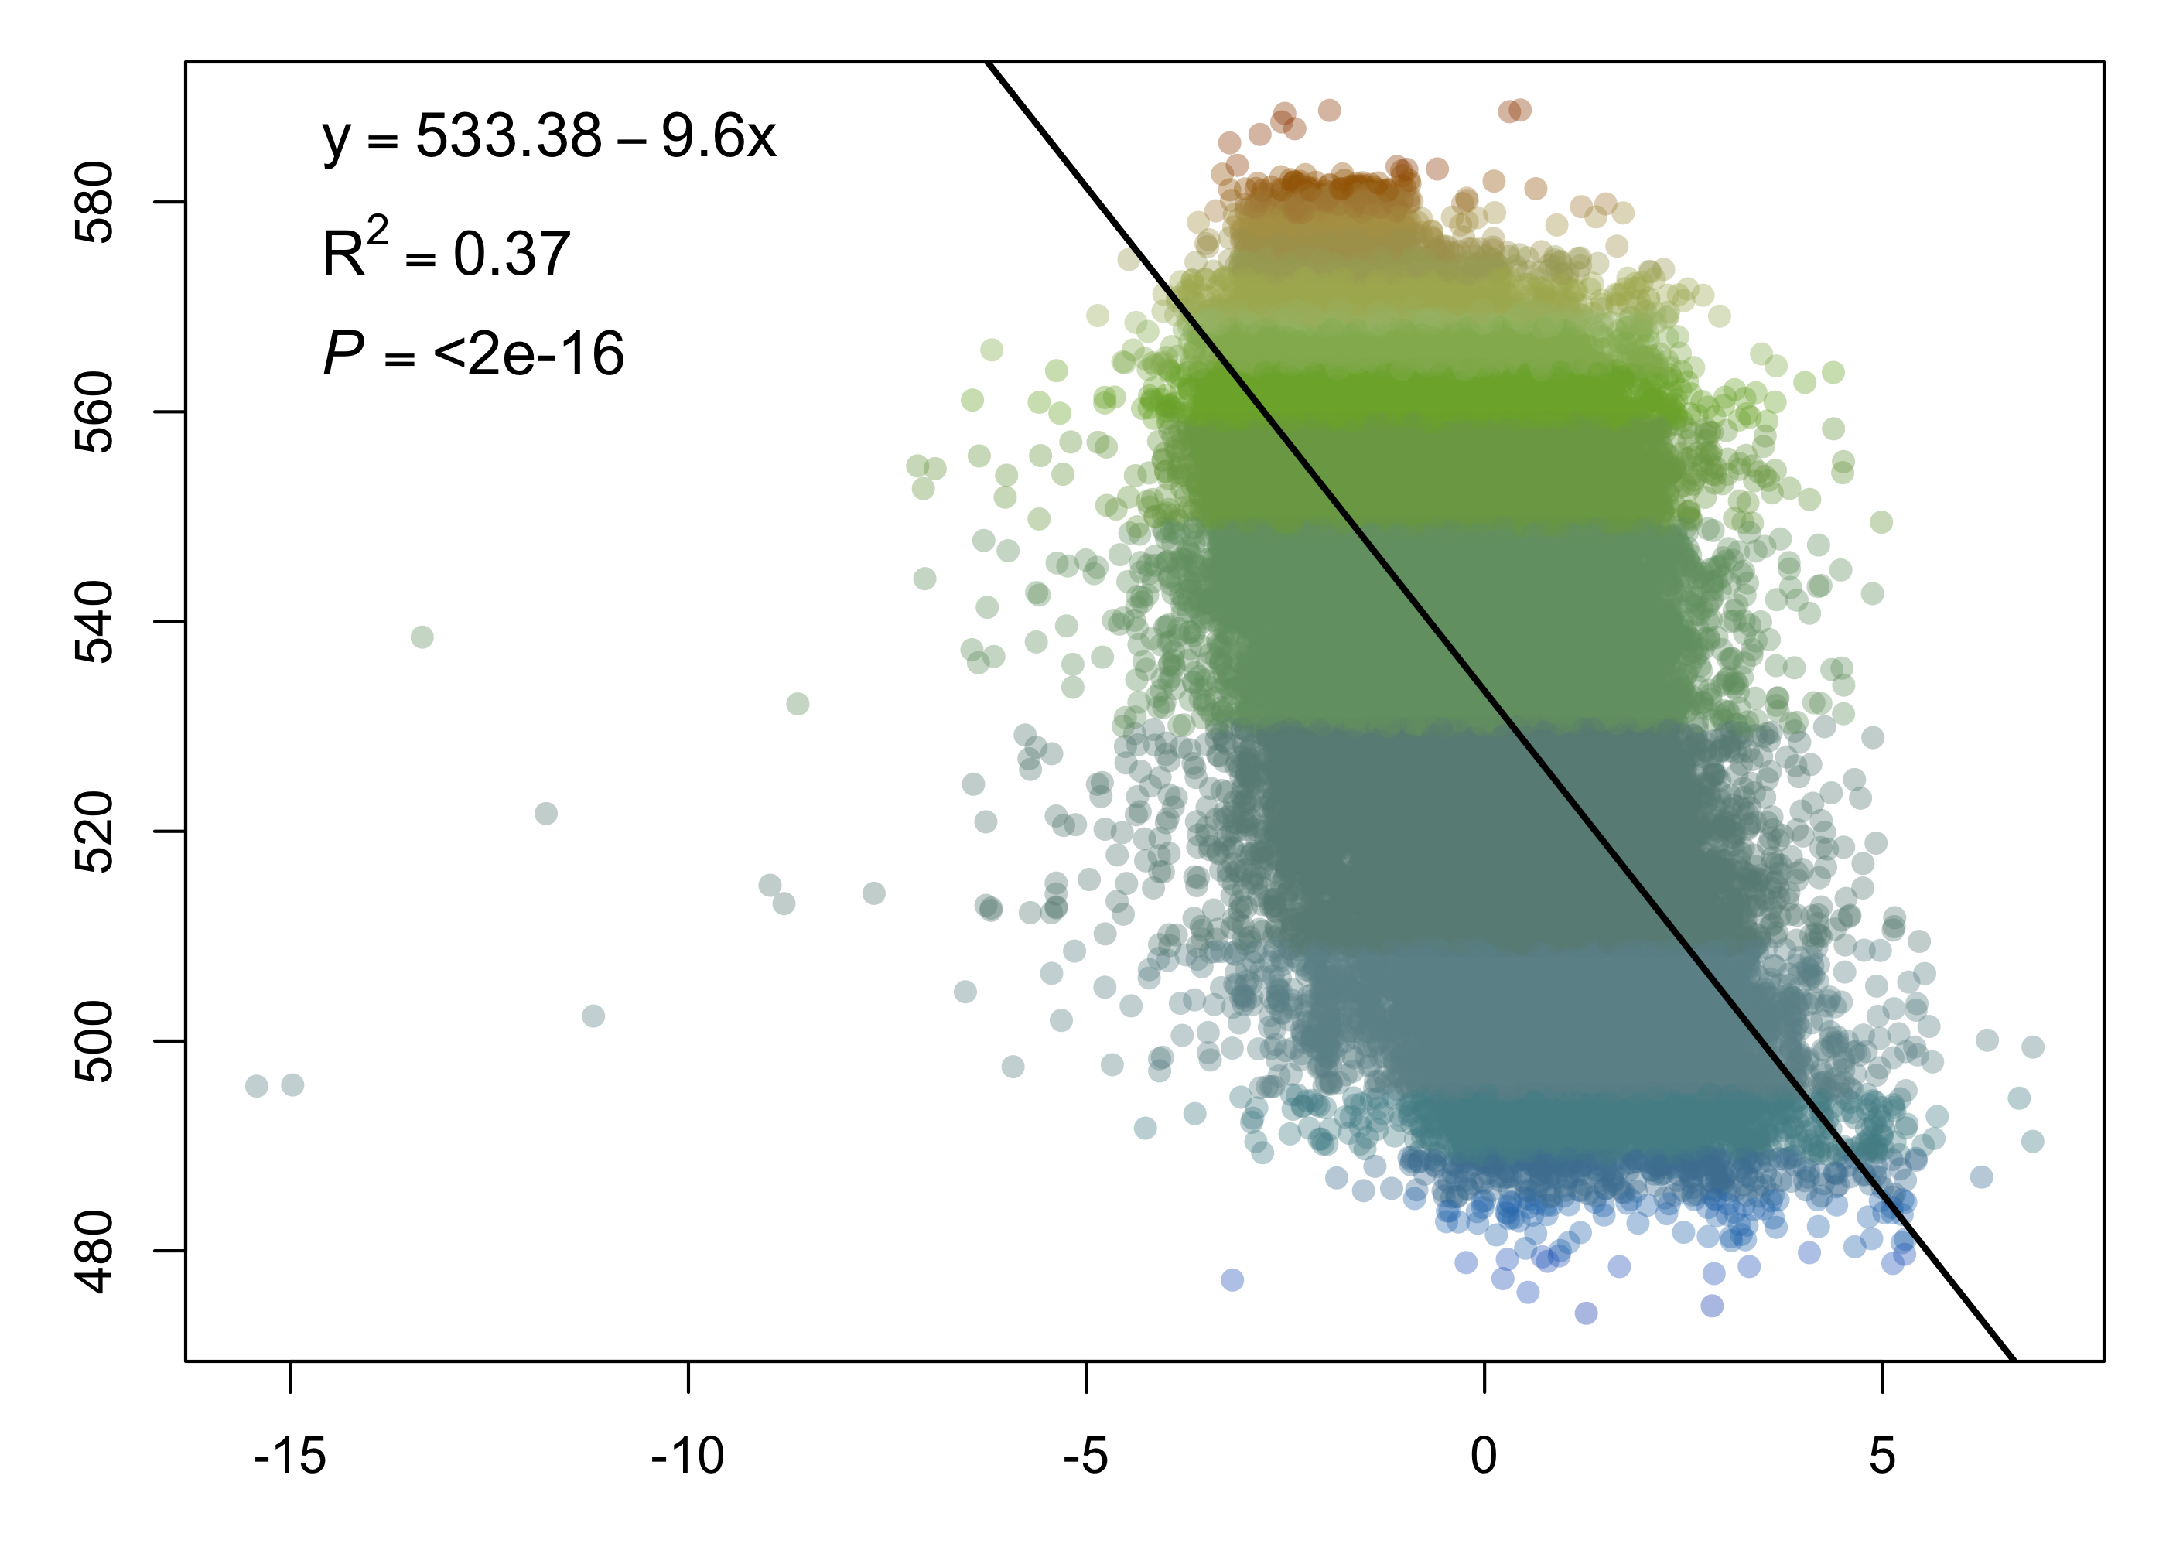
Average lake color (DWL)
forest cover (%)
open water (%)
mean range of annual air temperatures
PC3
forest cover (%)
open water (%)
mean range of annual air temperatures

