Slide 1
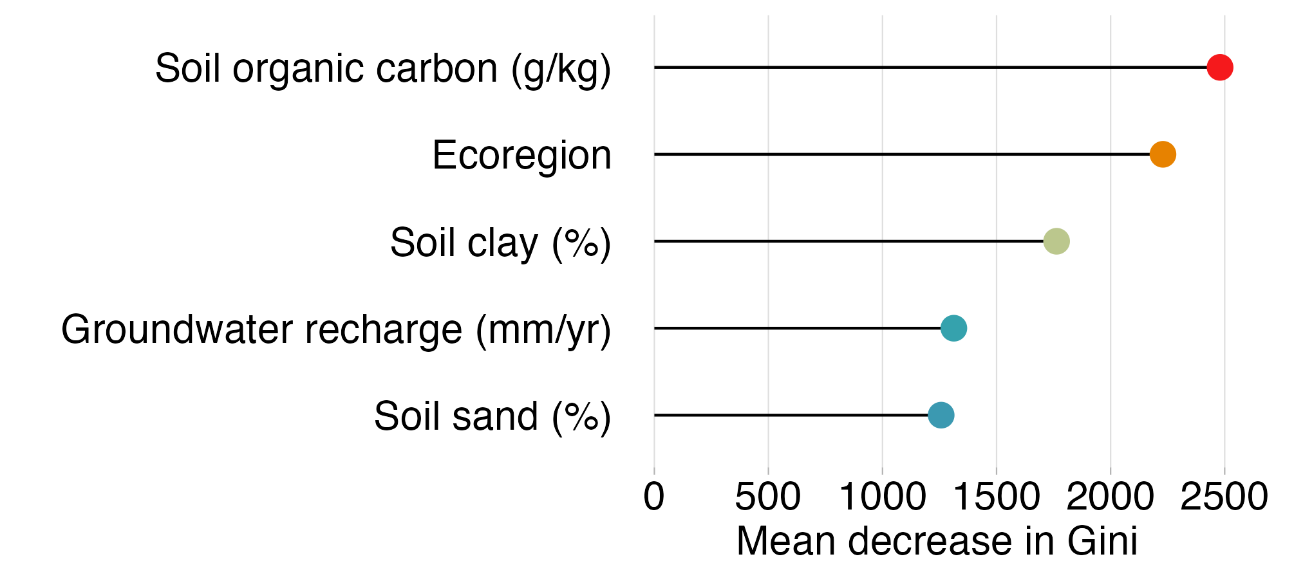
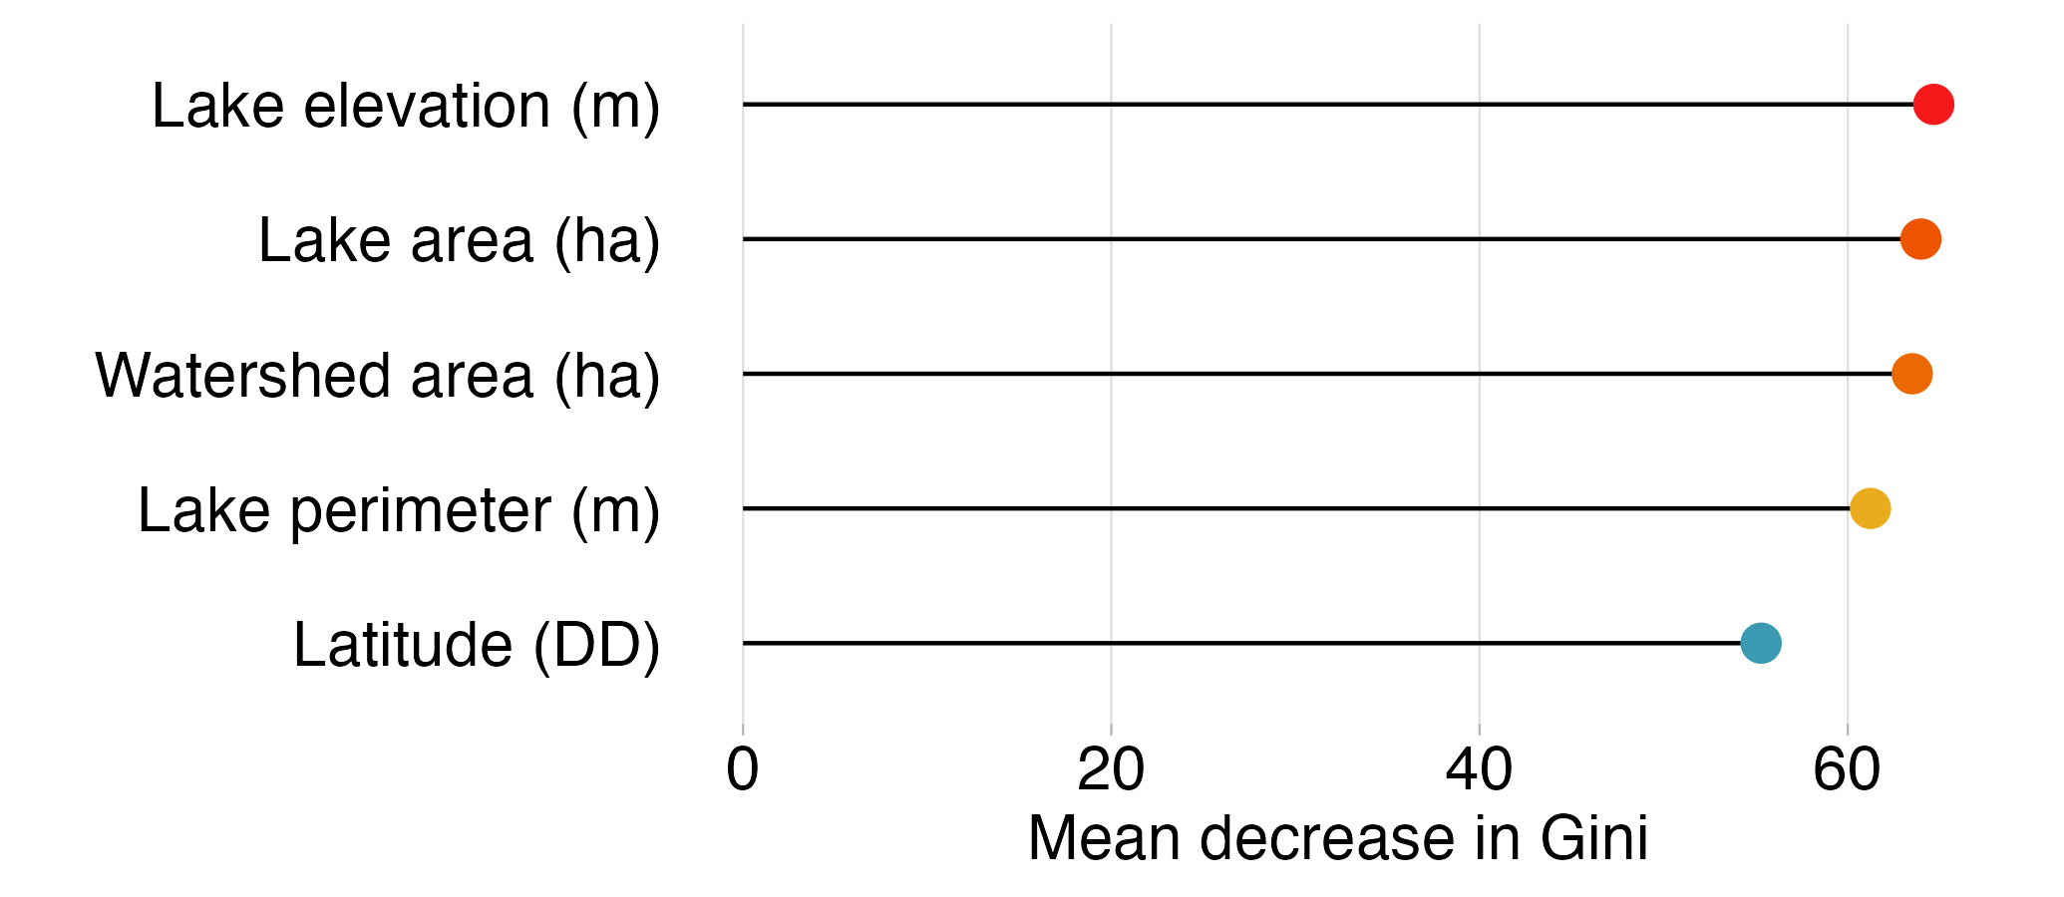
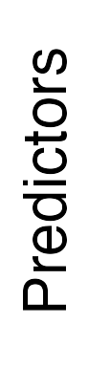
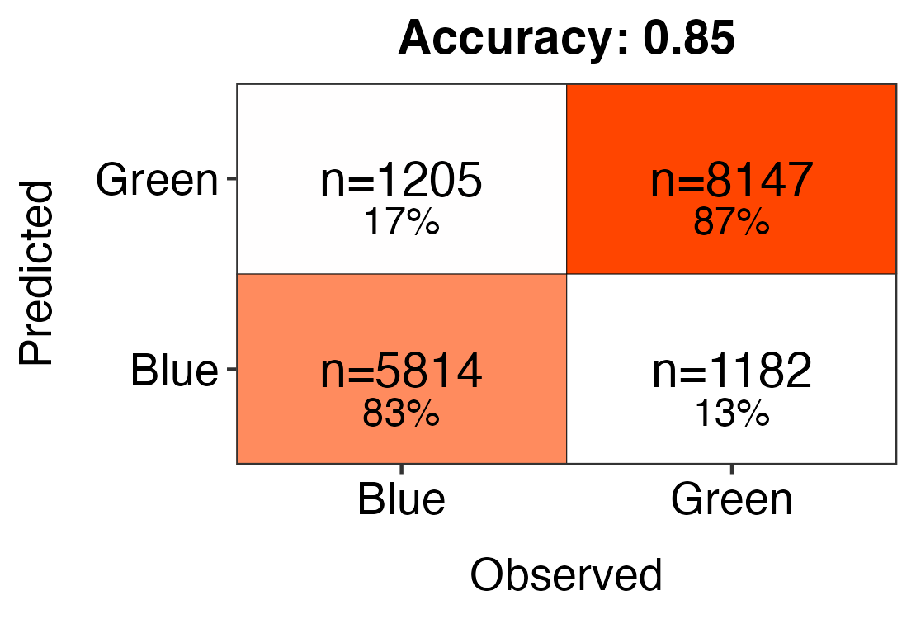
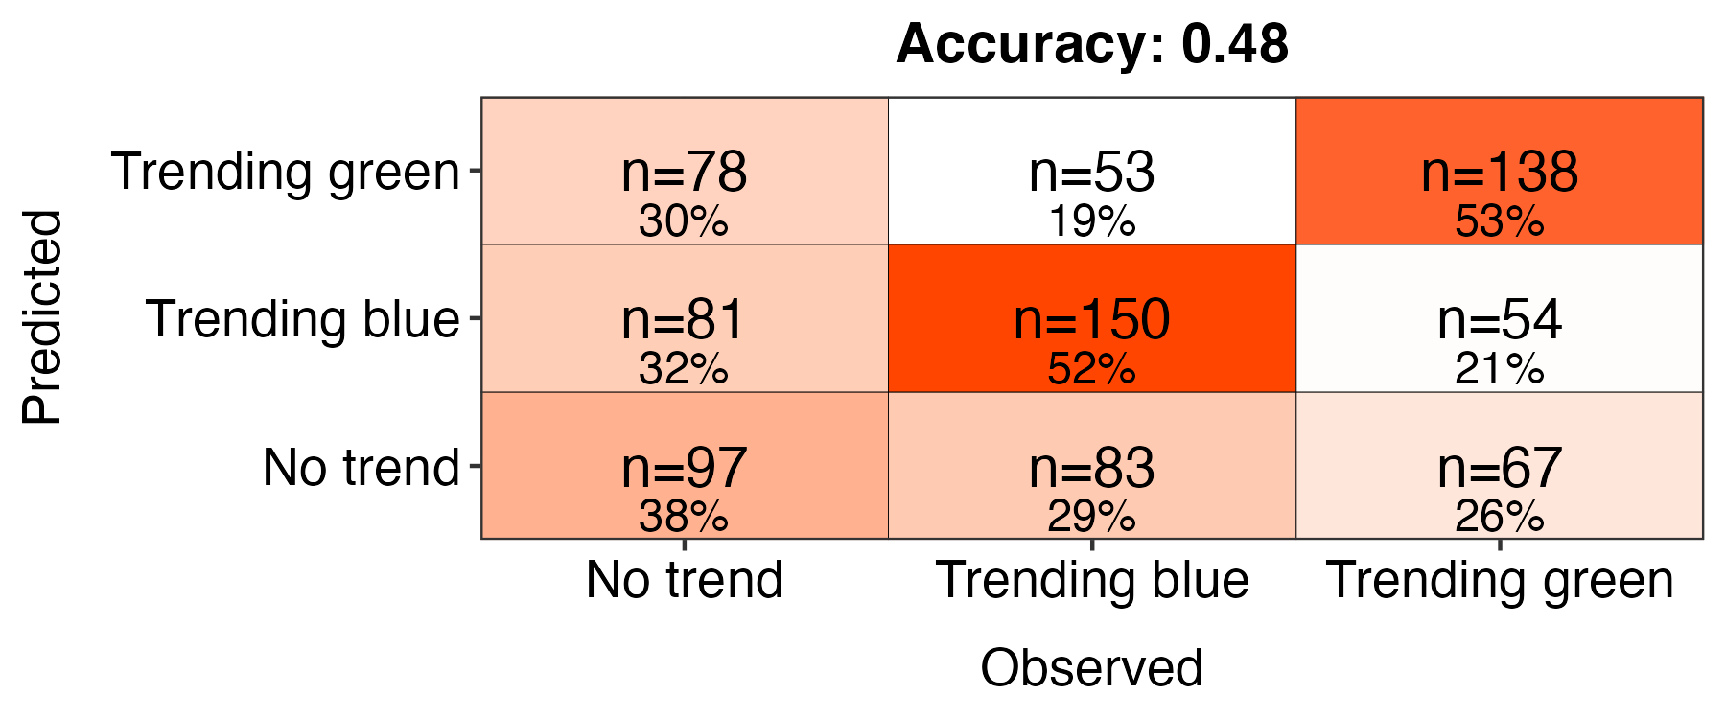
All lakes
n = 81,740
Subset of lakes
n = 3,996
Blue lakes
DWL < 530
82.2% correct classifications
Green lakes
DWL > 530
87.0% correct classifications
Trending blue
P ≤ 0.05
slope coef. < -0.4
52.6% correct classifications
No trend
P > 0.05
43.7% correct classifications
Trending green
P ≤ 0.05
slope coef. > 0.4
52.0% correct classifications
Notes:
all lakes

Slide 2
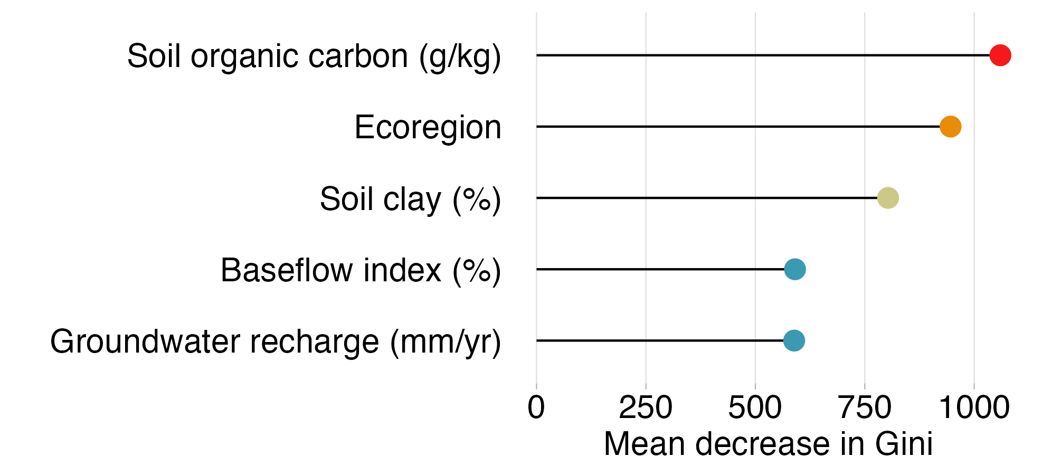
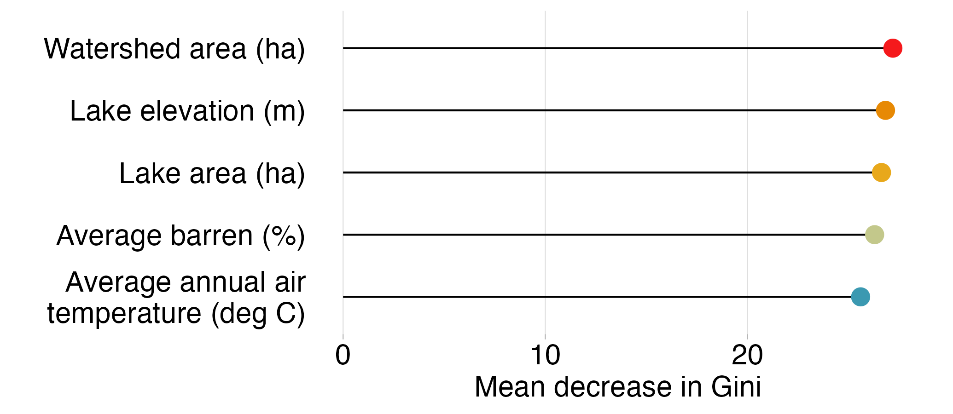
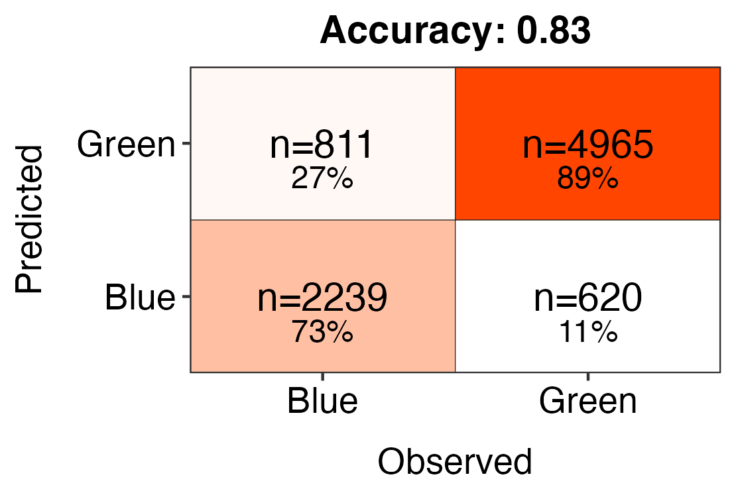
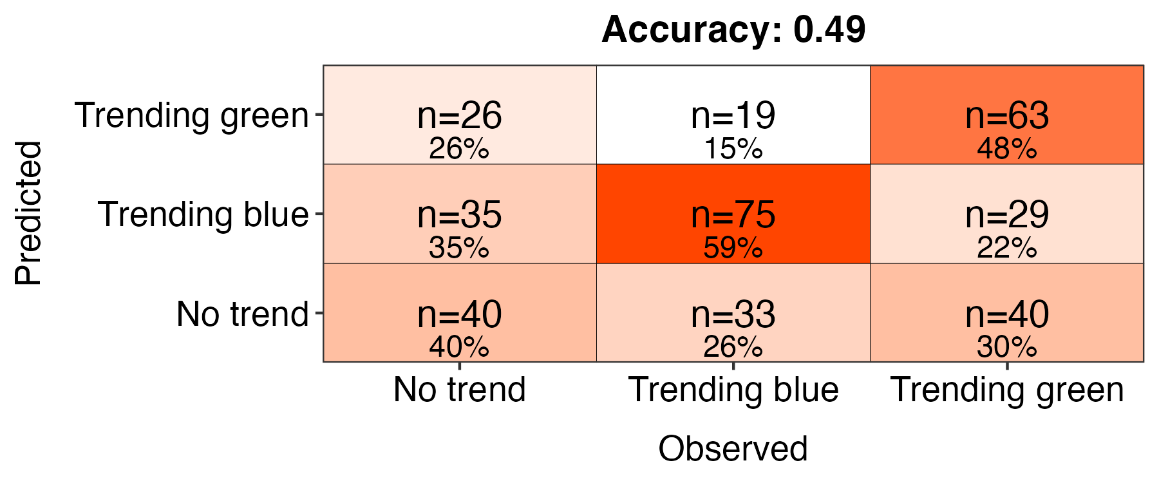
All lakes
n = 43,174
Subset of lakes
n = 1,809
Blue lakes
DWL < 530
74.8% correct classifications
Green lakes
DWL > 530
88.4% correct classifications
Trending blue
P ≤ 0.05
slope coef. < -0.4
49.6% correct classifications
No trend
P > 0.05
47.6% correct classifications
Trending green
P ≤ 0.05
slope coef. > 0.4
44.4% correct classifications
Notes:
small

Slide 3
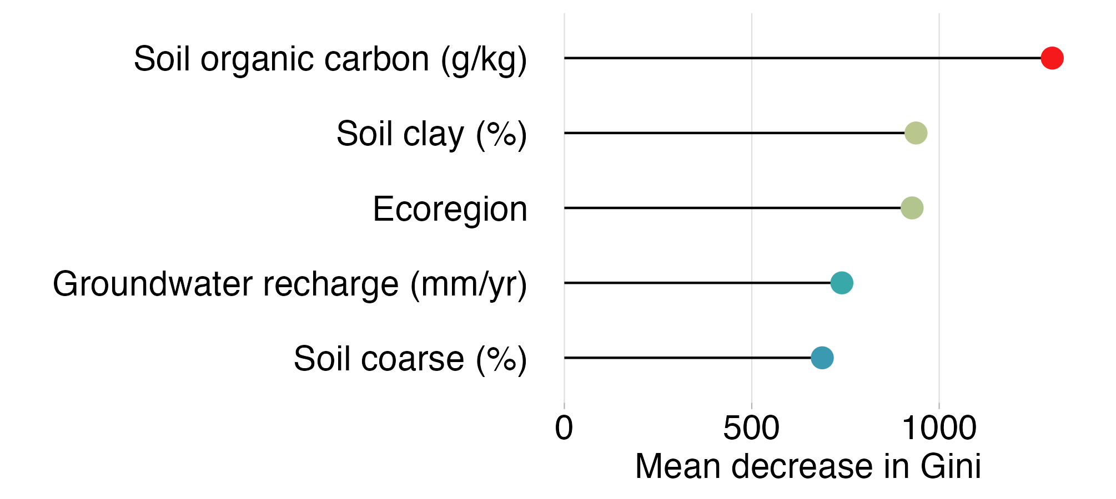
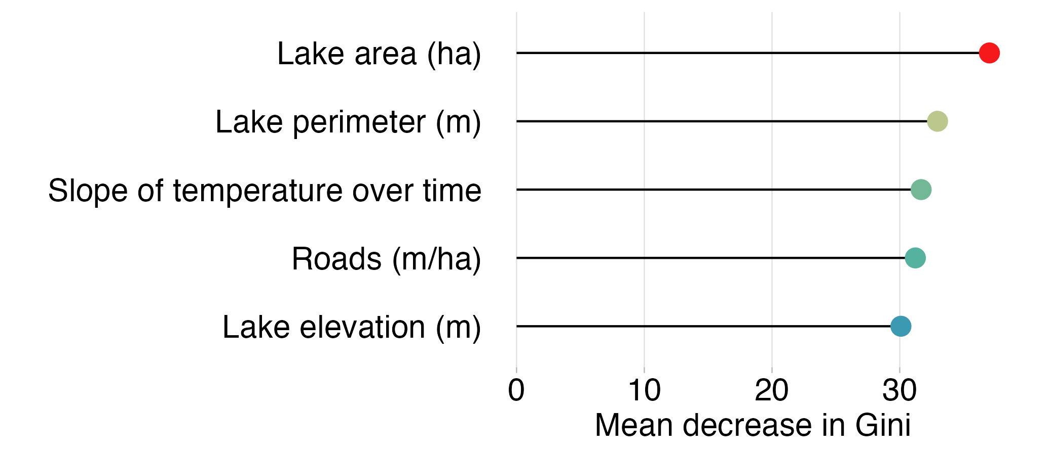
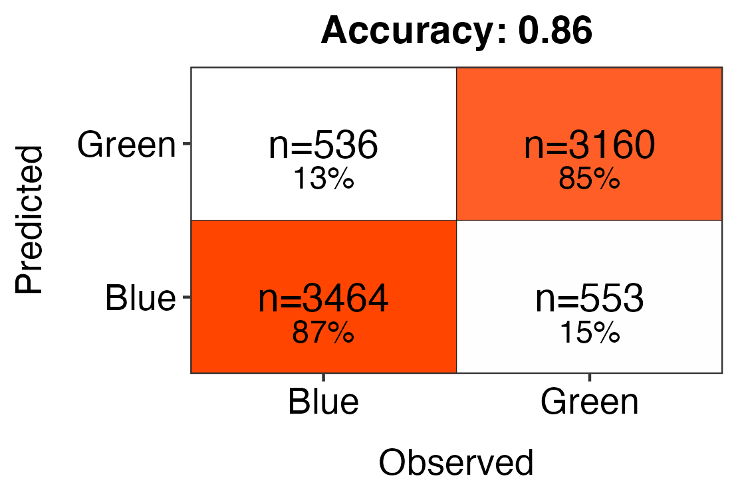
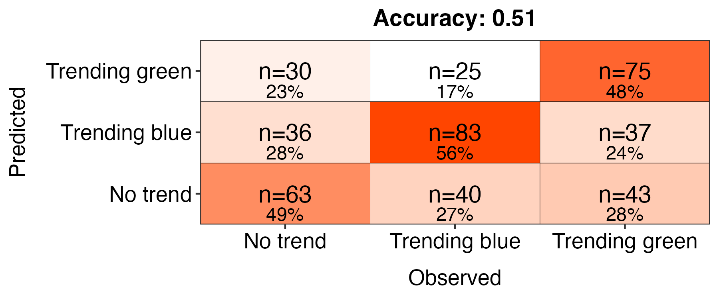
All lakes
n = 38,566
Subset of lakes
n = 2,160
Blue lakes
DWL < 530
86.8% correct classifications
Green lakes
DWL > 530
84.9% correct classifications
Trending blue
P ≤ 0.05
slope coef. < -0.4
54.5% correct classifications
No trend
P > 0.05
44.7% correct classifications
Trending green
P ≤ 0.05
slope coef. > 0.4
52.9% correct classifications
Notes:
small

