Slide 1
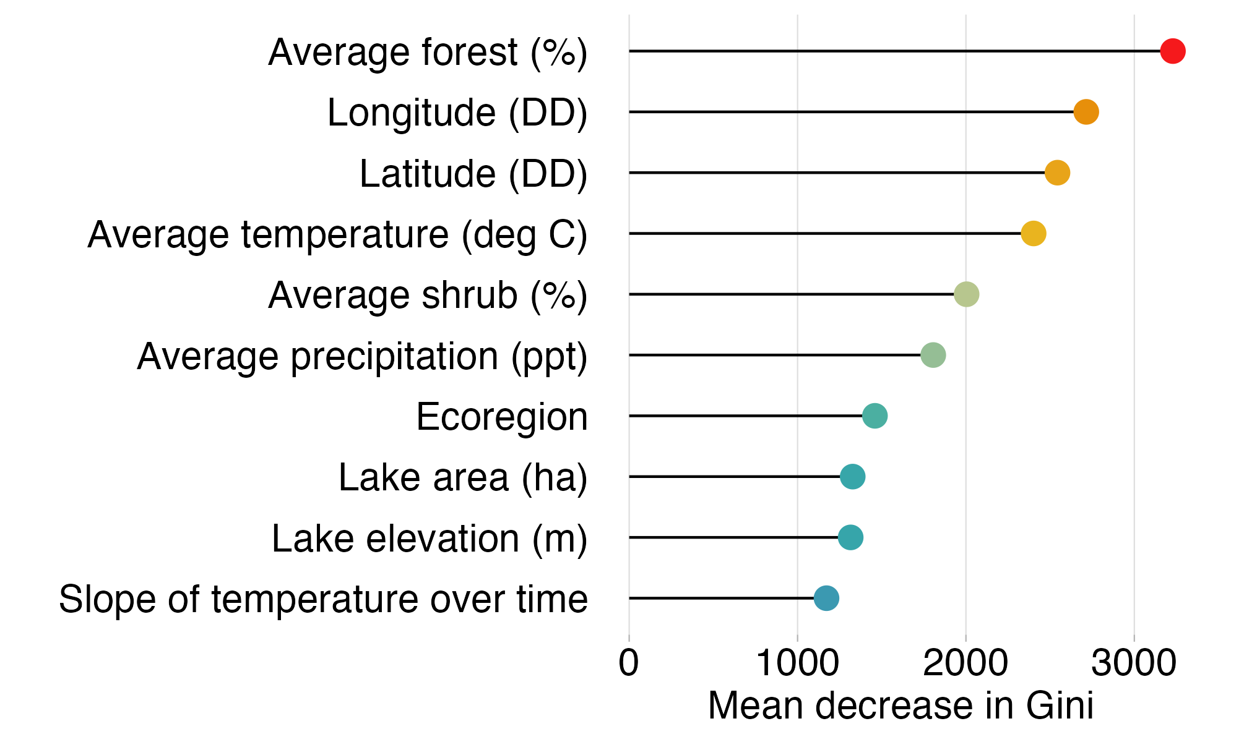
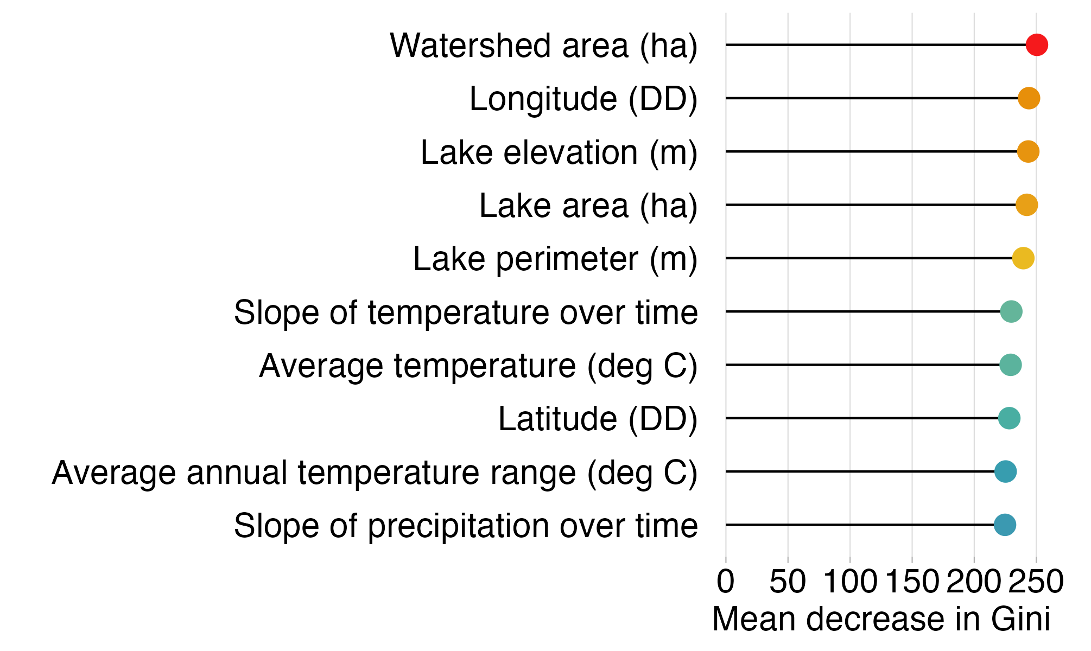
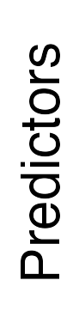
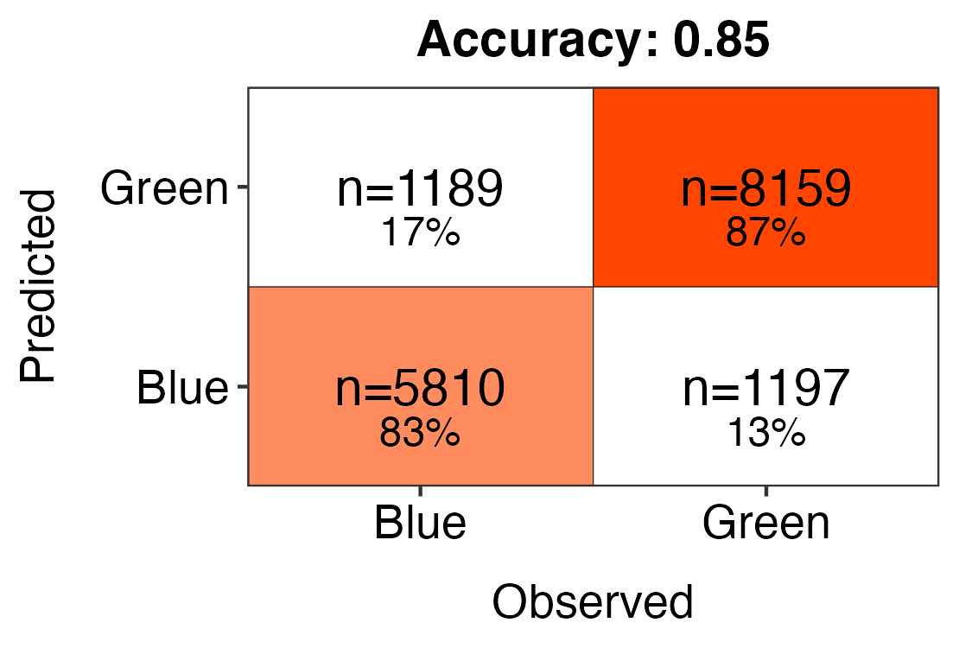
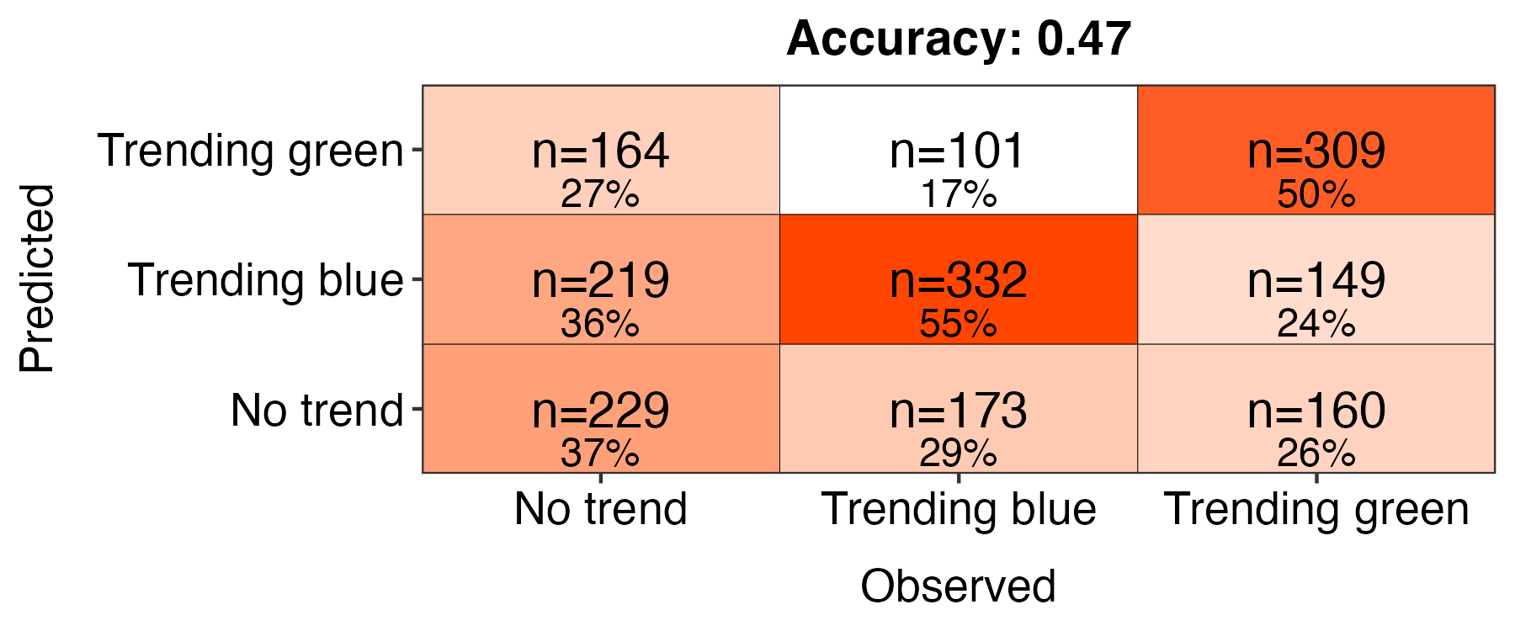
All lakes
n=81,773
Subset of lakes
n=9,180
Blue lakes
DWL < 530
82.0% correct classifications
Green lakes
DWL > 530
87.4% correct classifications
Trending blue
P ≤ 0.05
slope coef. < 0
54.4% correct classifications
No trend
P > 0.05
36.3% correct classifications
Trending green
P ≤ 0.05
slope coef. > 0
48.4% correct classifications
Notes:
cross val with training dataset

