Slide 1
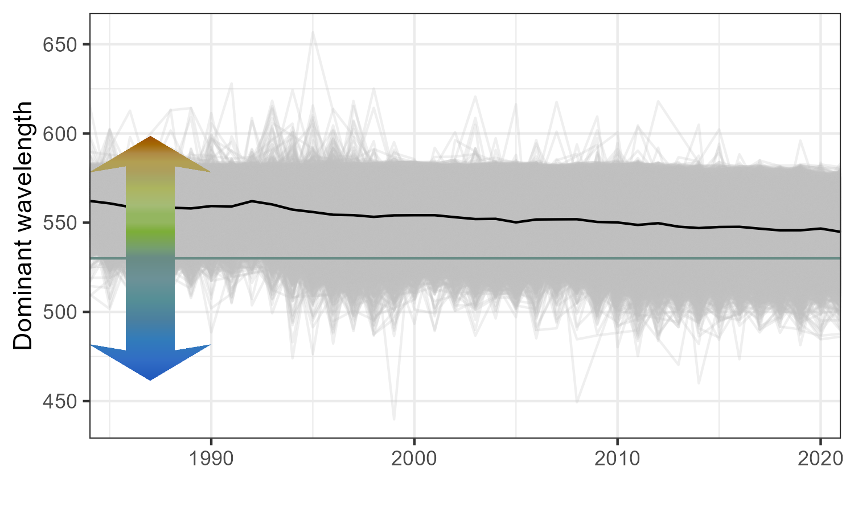
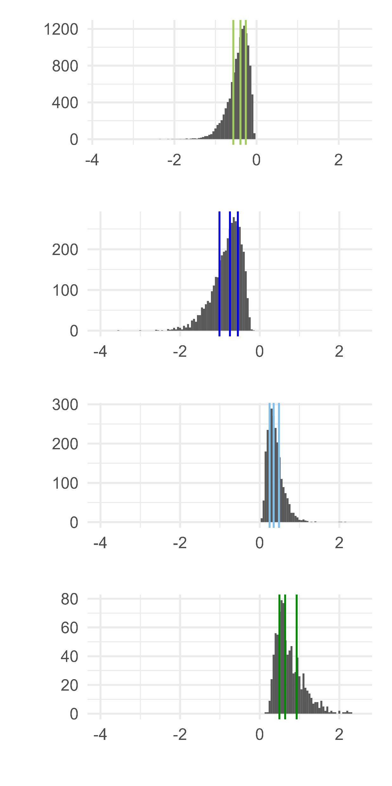
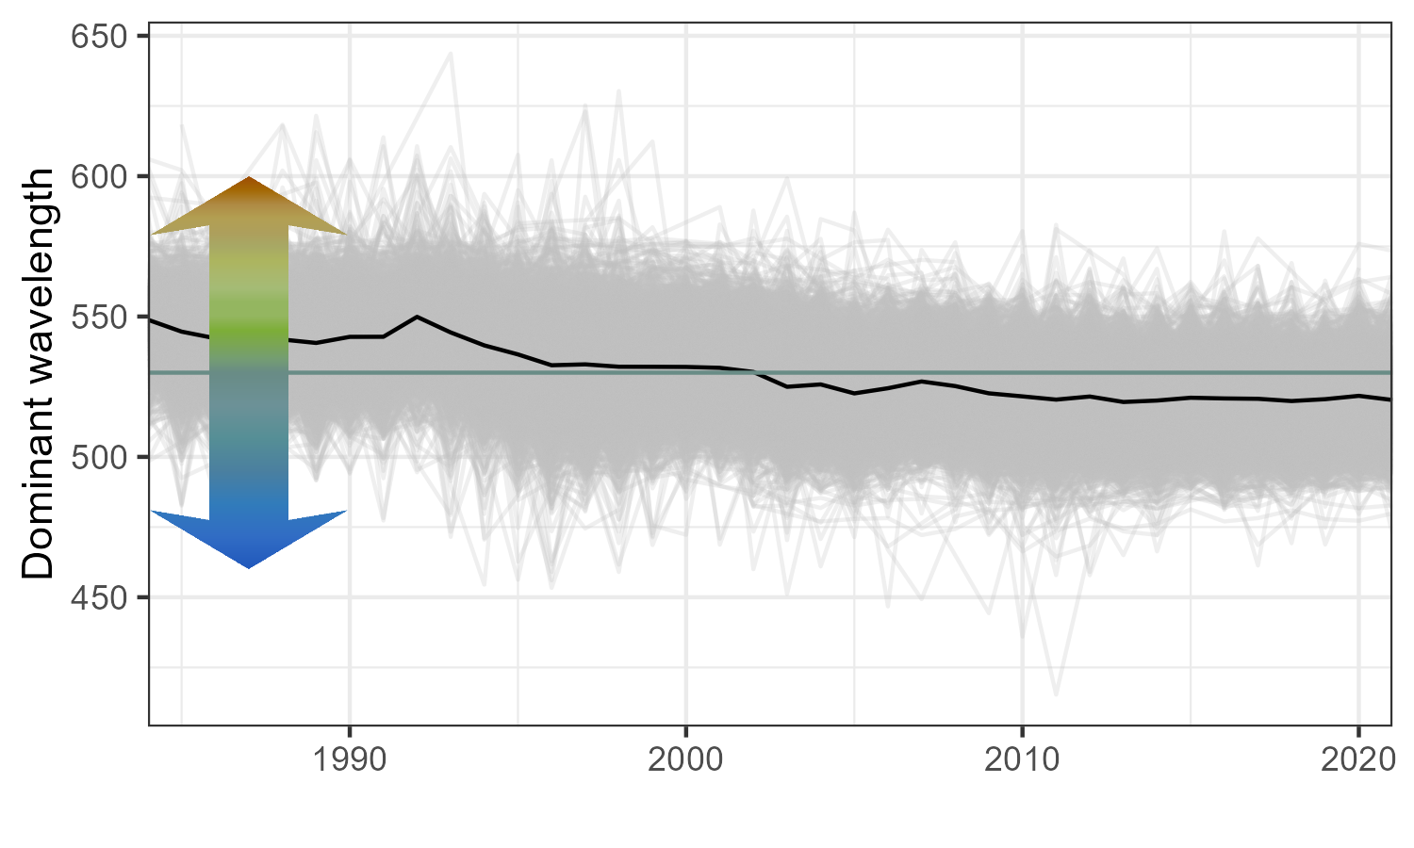
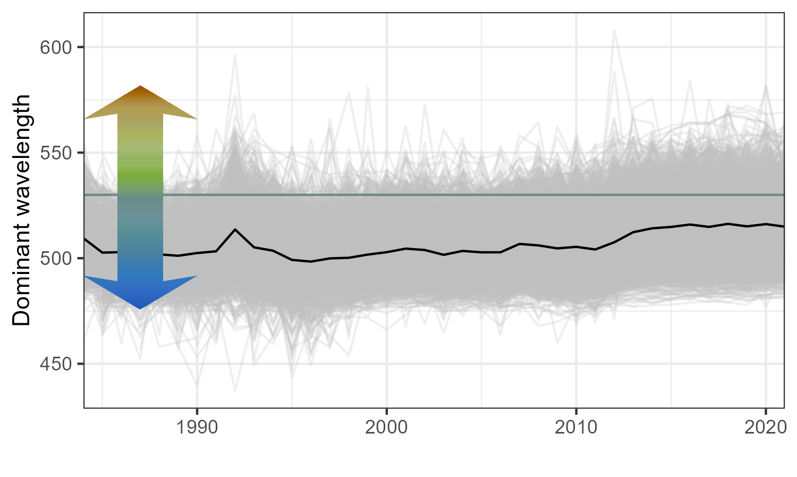
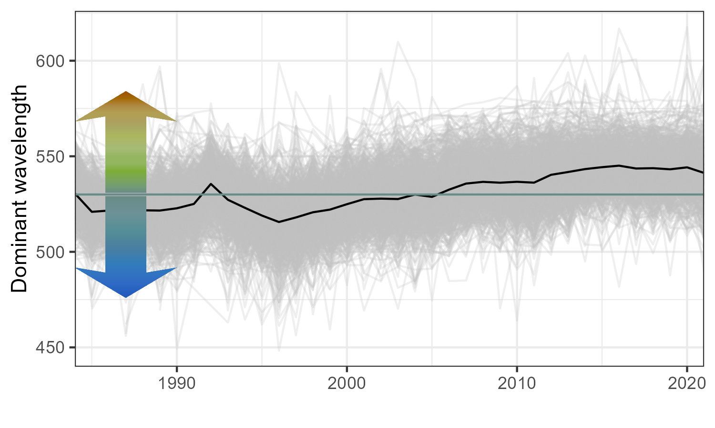
a)
Lakes trending less green
b)
Lakes switched from
green to blue
c)
Lakes trending less blue
d)
Lakes switched from
blue to green
Slope

Slide 2
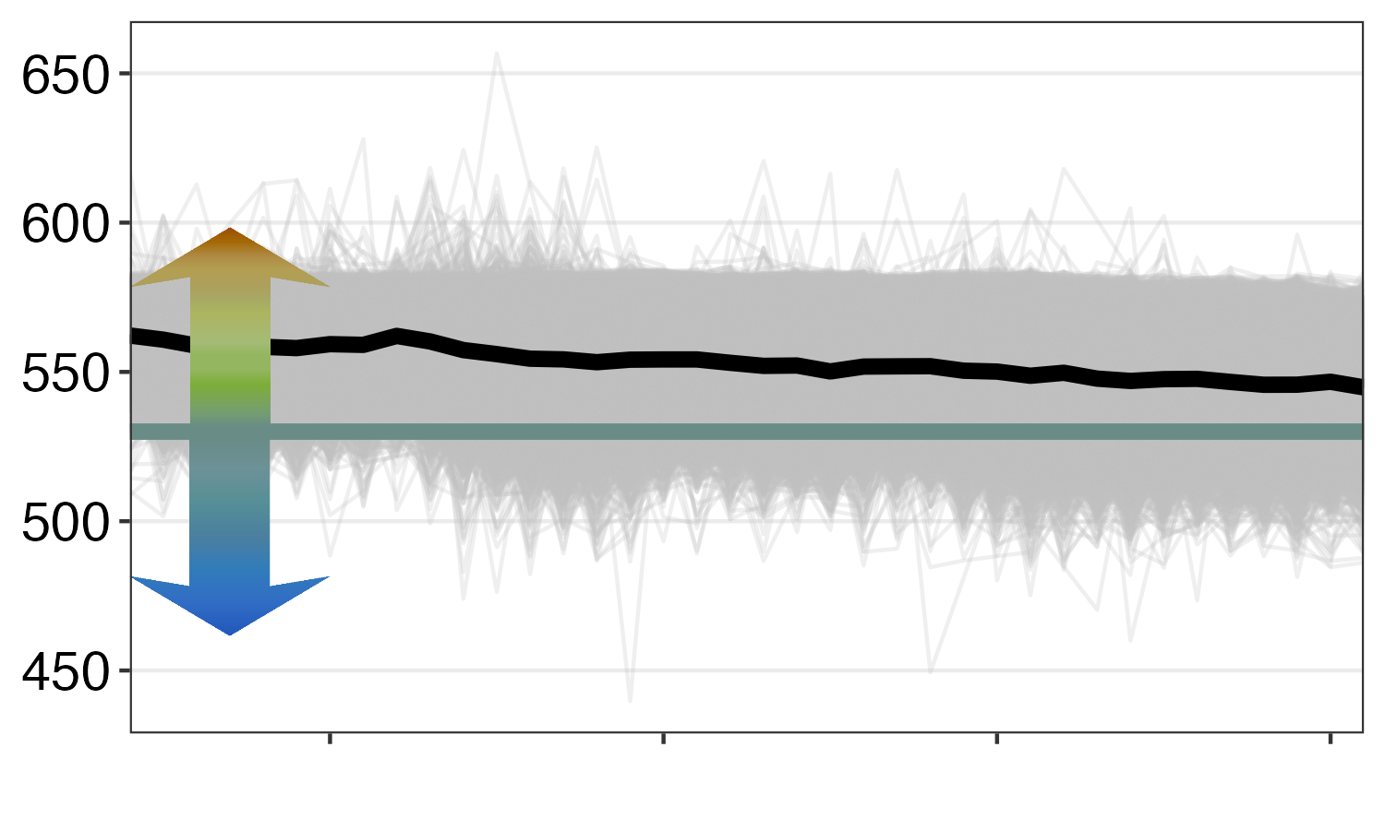
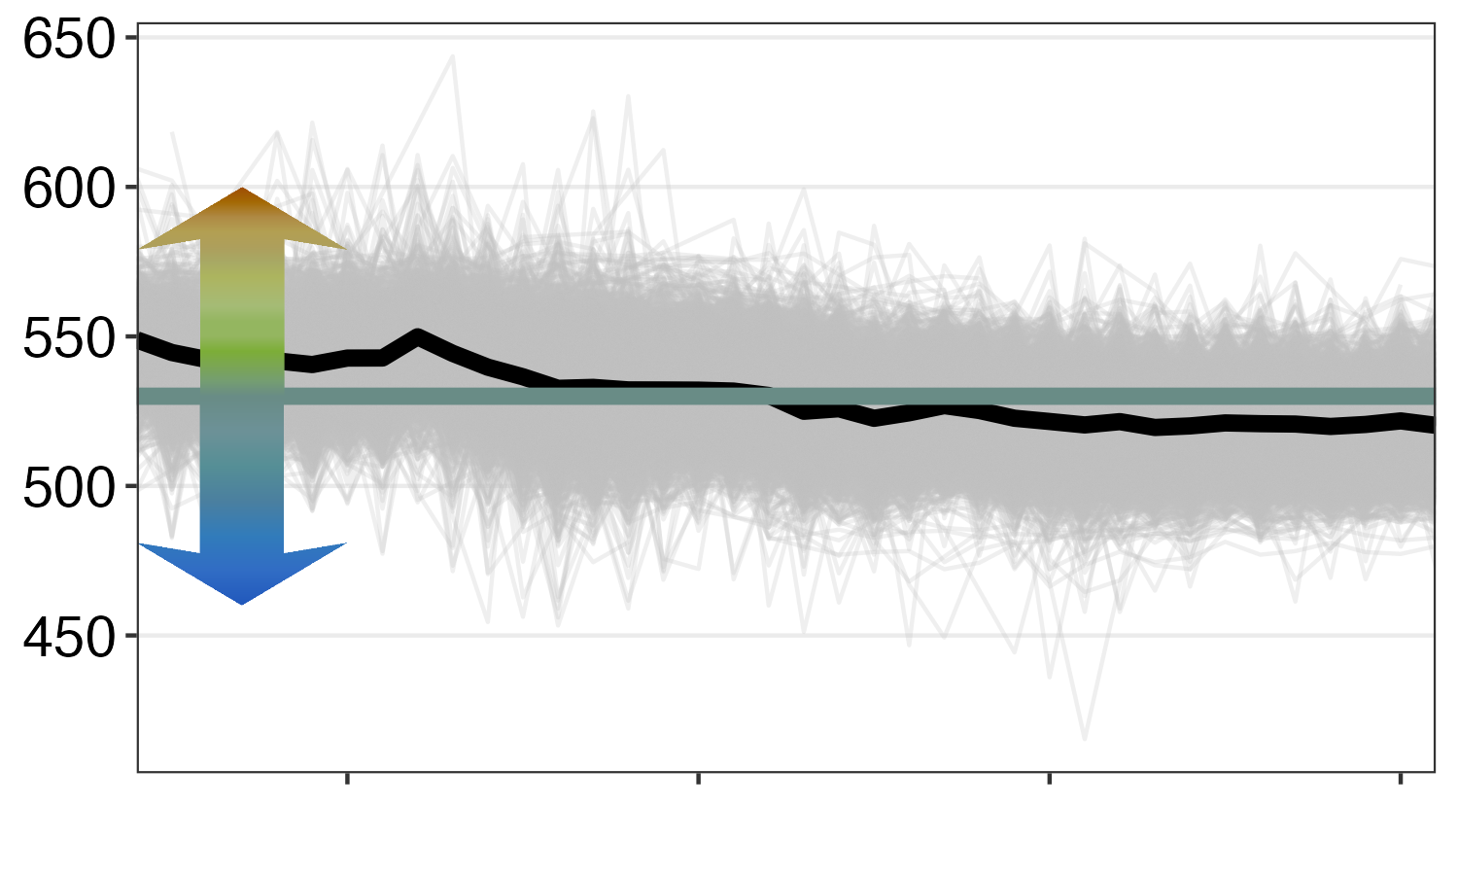
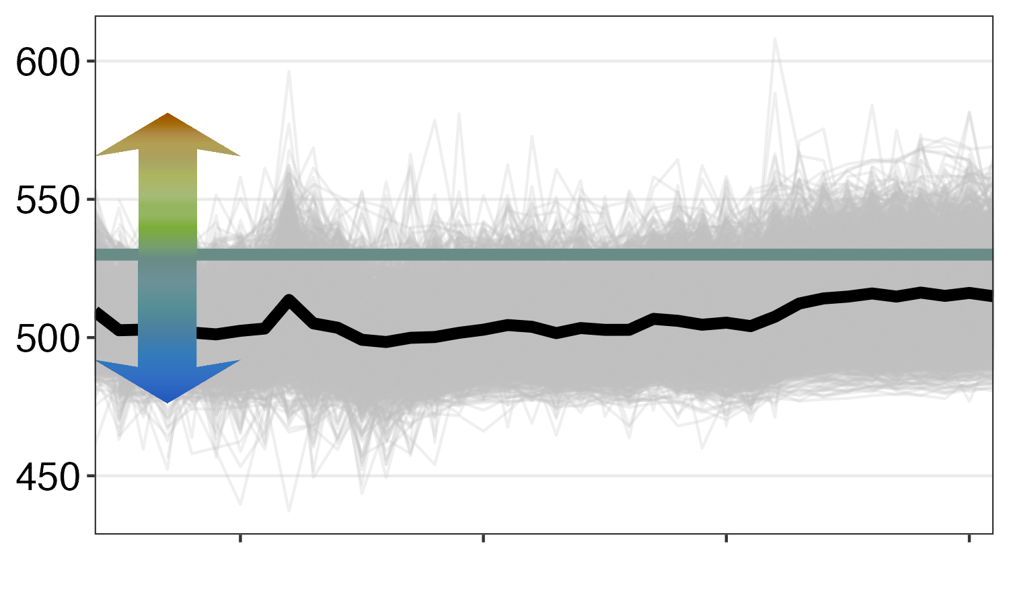
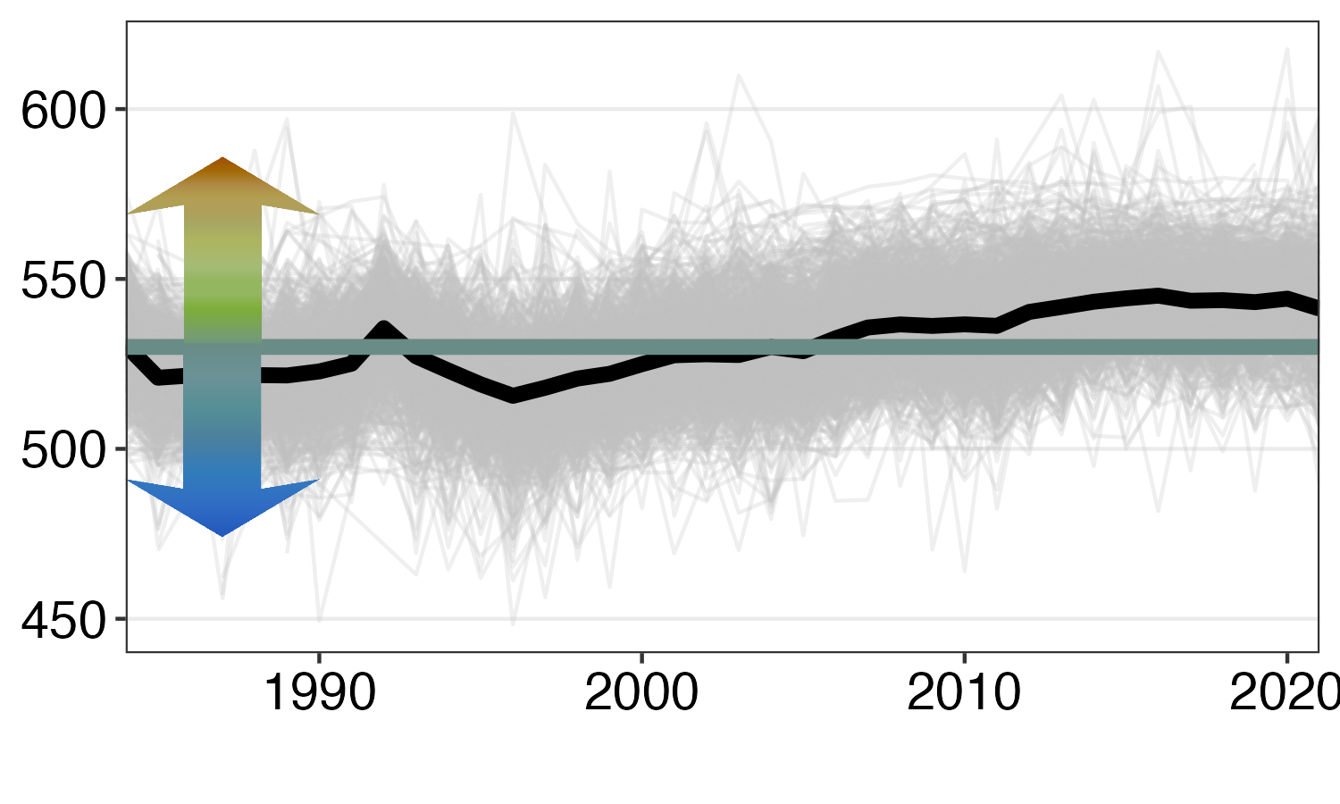
a)
Lakes trended towards blue, but stayed green
b)
Lakes switched from
green to blue
c)
Dominant wavelength (dwl)
Lakes trended towards green, but stayed blue
d)
Lakes switched from
blue to green
Year (Common Era)

Slide 3
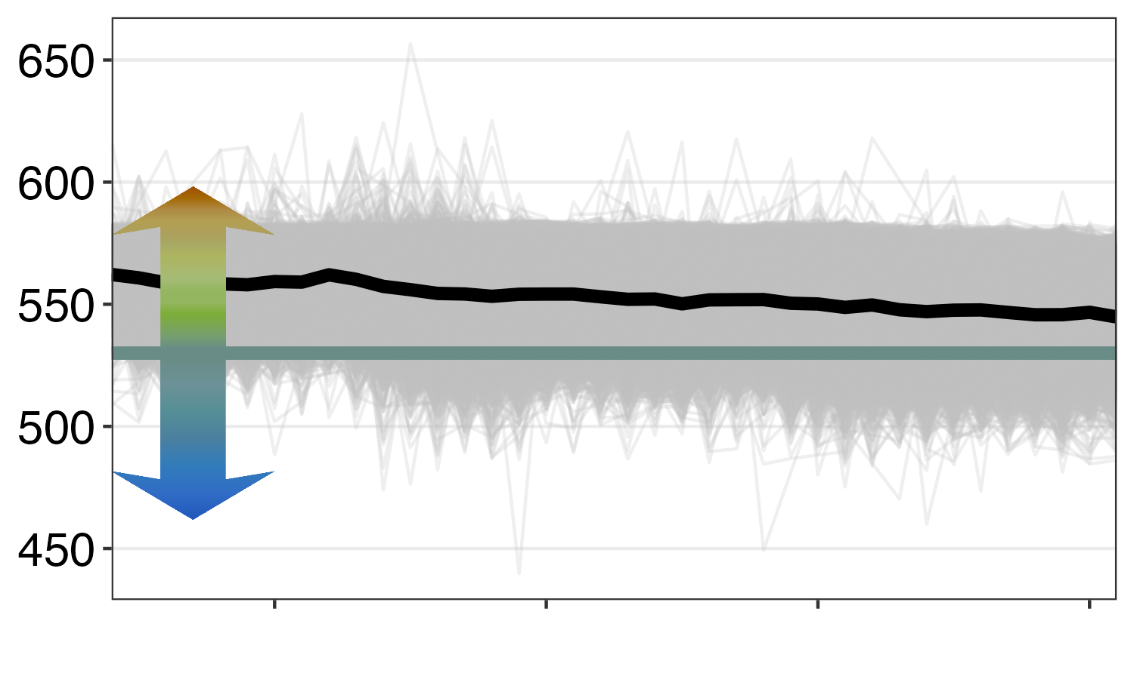
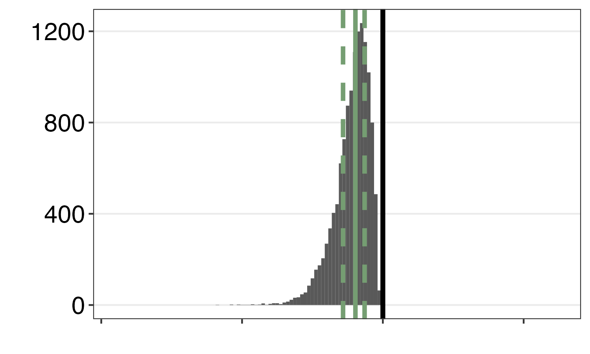
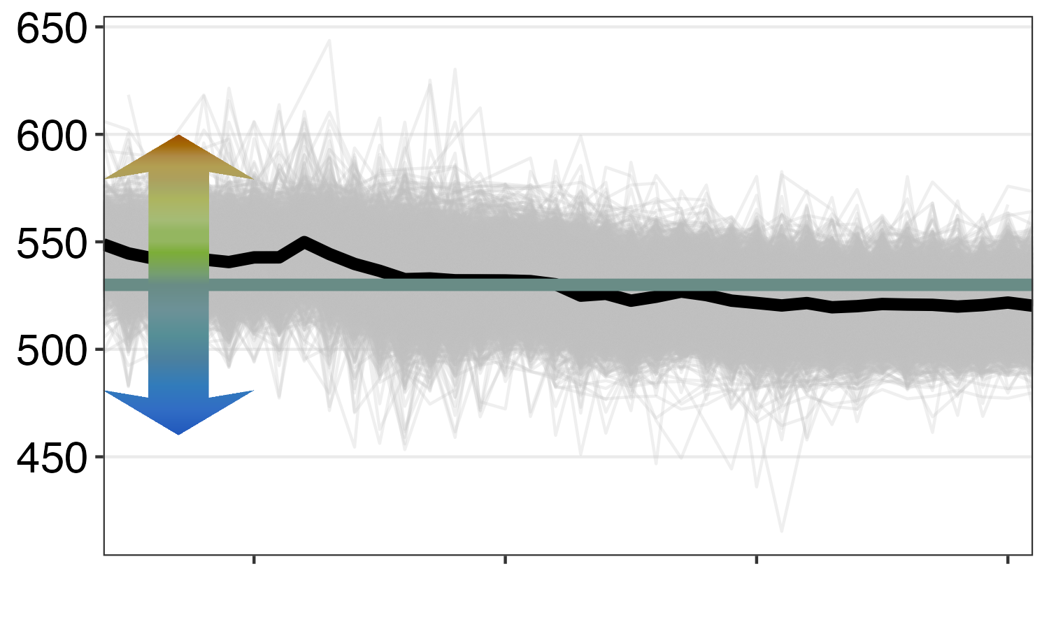
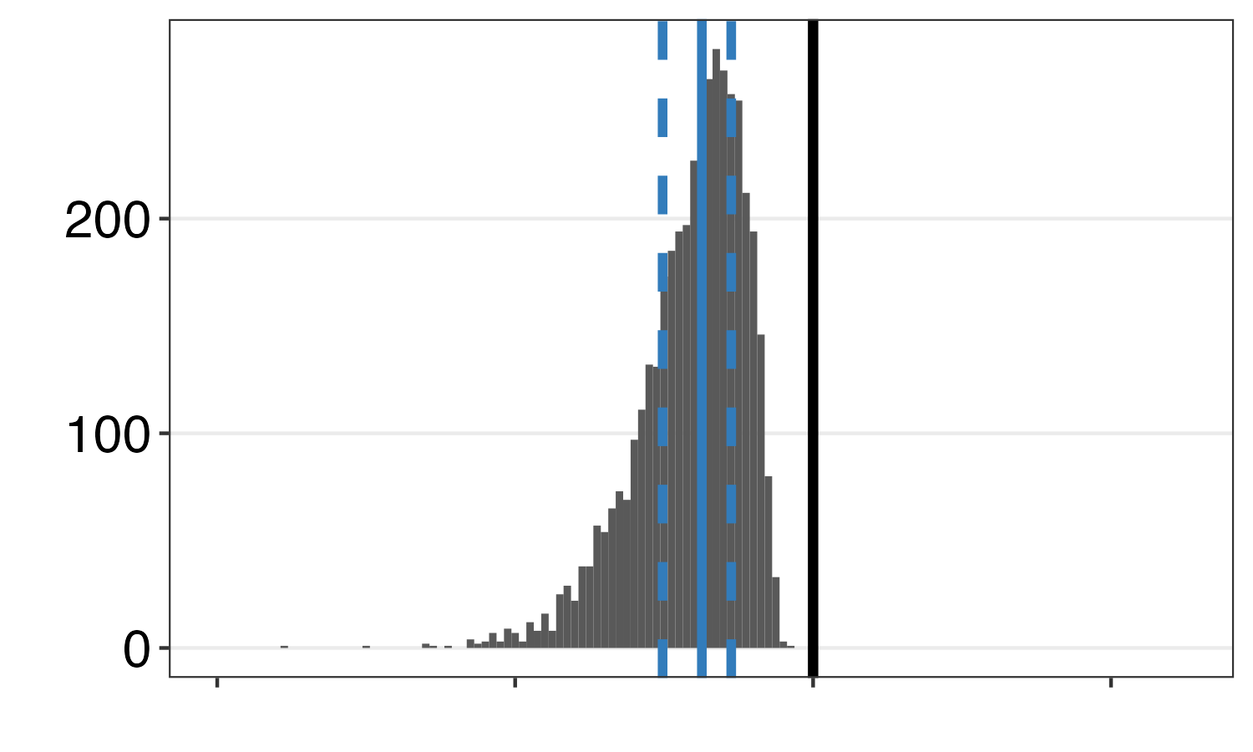

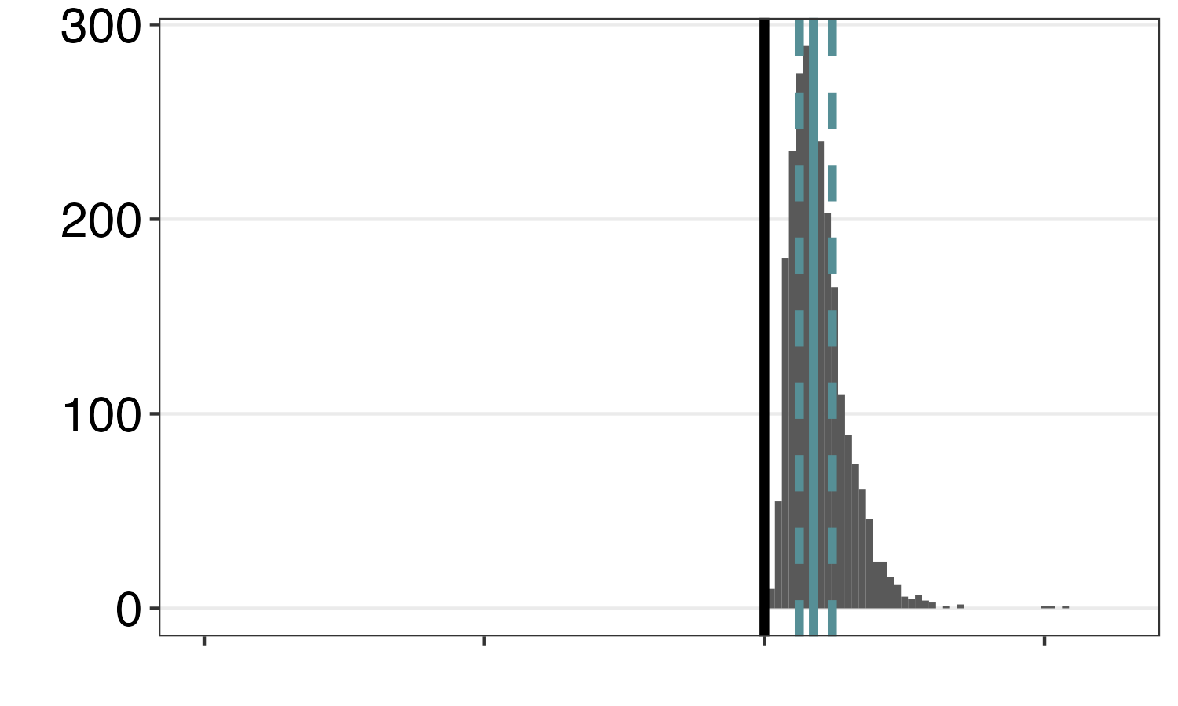

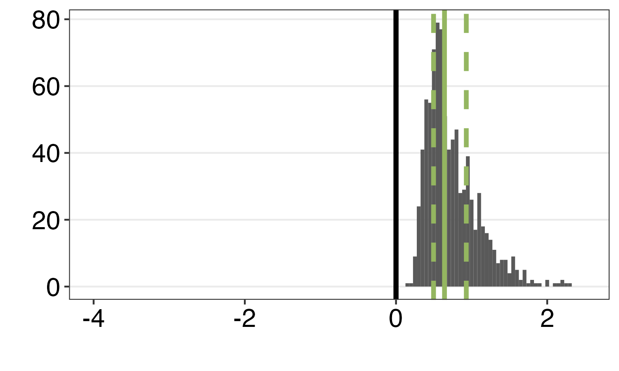
a)
Lakes trended towards blue, but stayed green
b)
Lakes switched from
green to blue
Dominant wavelength (dwl)
Number of lakes
c)
Lakes trended towards green, but stayed blue
d)
Lakes switched from
blue to green
Year (Common Era)
Slope of lake color over time

