Slide 1
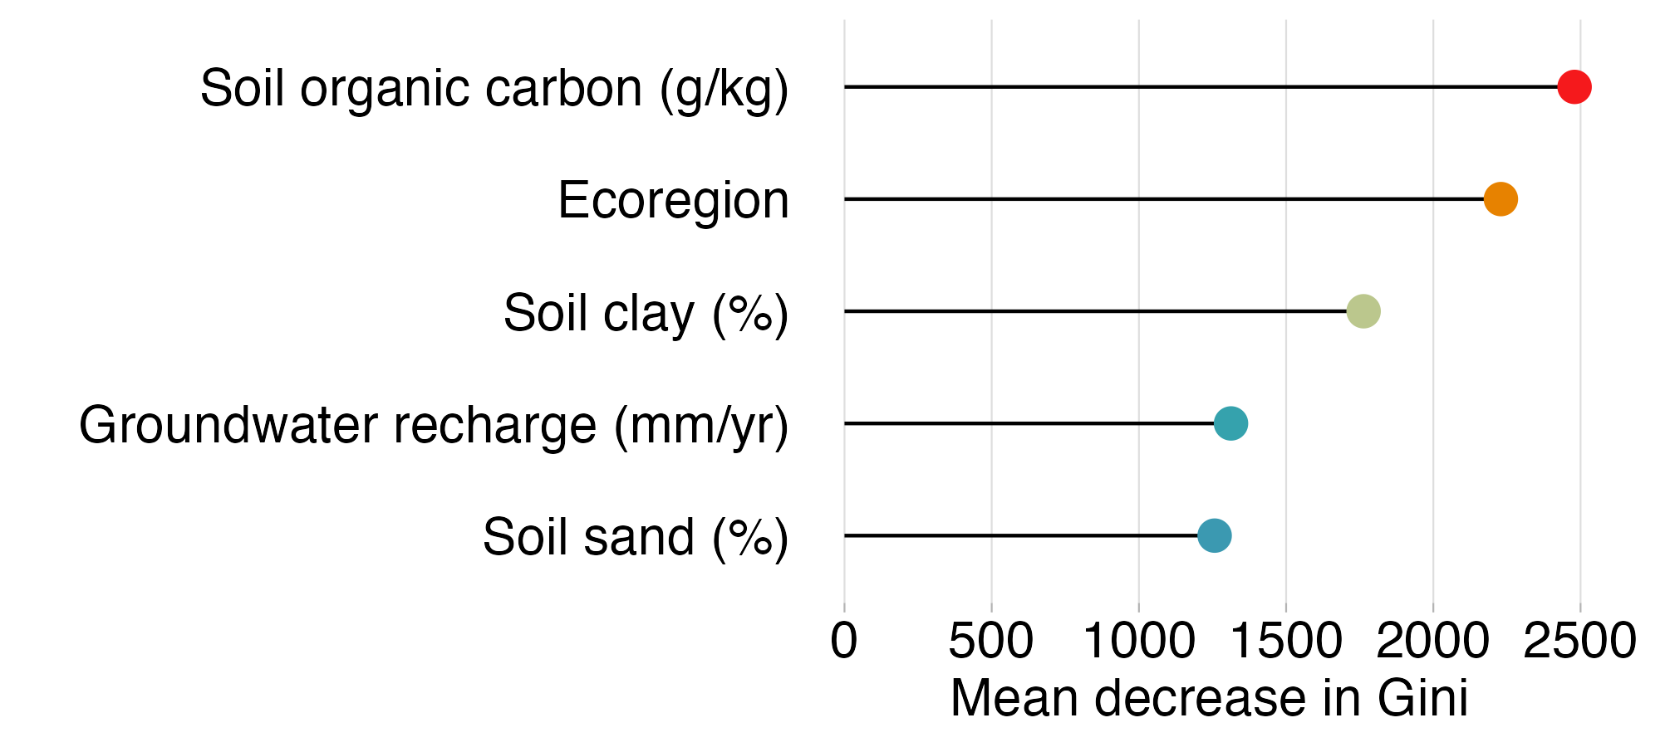
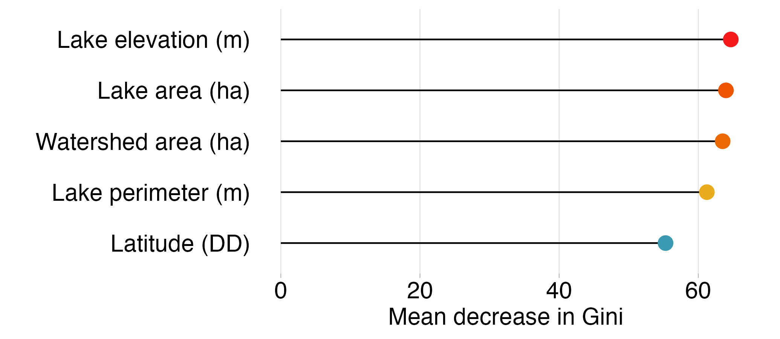
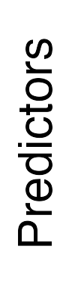
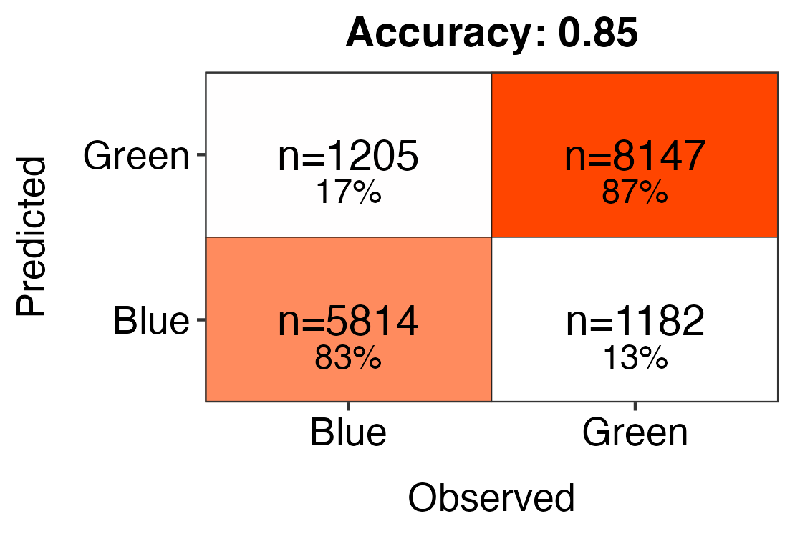
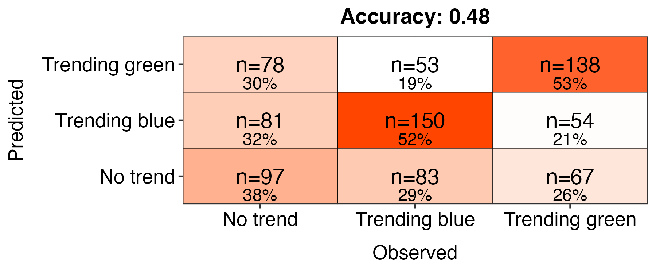
All lakes
n = 81,740
Subset of lakes
n = 3,996
Blue lakes
DWL < 530
82.2% correct classifications
Green lakes
DWL > 530
87.0% correct classifications
Trending blue
P ≤ 0.05
slope coef. < -0.4
52.6% correct classifications
No trend
P > 0.05
43.7% correct classifications
Trending green
P ≤ 0.05
slope coef. > 0.4
52.0% correct classifications
Notes:
all lakes

