Slide 1
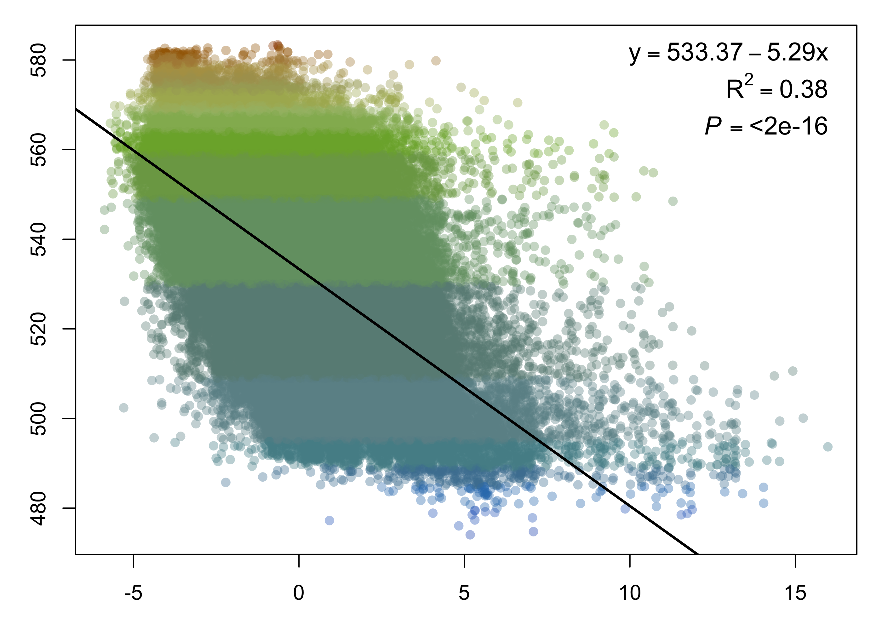
Average lake color (DWL)
PC2
Groundwater recharge (mm/yr)
Runoff (in/yr)
Soil organic carbon (g/kg)
Forest cover (%)
Soil clay (%)
Notes:
all

