Slide 1

Using ES and NARS data to examine nutrient limitations across the US
EPA NARS data challenge 2022

Slide 2
Agenda
What is the challenge?
National Aquatic Resource Survey data
What I want to do

Slide 3
The Challenge
Support efforts to assess nutrient water quality and more effectively protect and restore waters from nutrient pollution.
Contribute to the continuous improvement of NARS and other monitoring and programs.
Scope: results should have broad regional or national implications
Notes:
EPA is inviting scientists to examine questions using data from the National Aquatic Resource Surveys (NARS) relating to national priorities including climate change, environmental justice, nutrient management, and other water quality challenges.

Slide 4
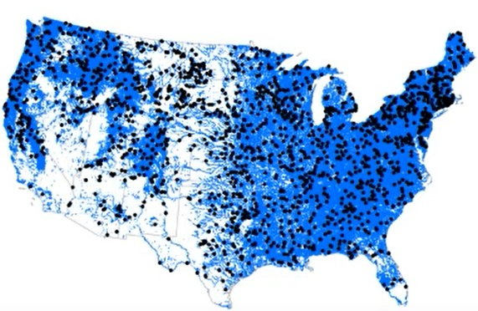
NARS Data
NLA data
2007, 2012, 2017
NRSA data
2008-9, 2013-14, 2018-19
Notes:
EPA randomly samples 1000 waters in the lower 48 states each year and they rotate through waterbodies: lakes, rivers, wetlands, coastal waters
Sampling takes place during the summer (May through October)
~10% of sampled waters are revisited in the year that they are sampled. And some waters are revisited multiple years
Weights -- # lakes , miles stream (like any survey)
example: in the recent nrsa, they sampled 1853 river/stream locations over the 2 years, and that represents 1.2 million miles of rivers/streams;
small lakes tend to have a larger weight than large lakes

Slide 5
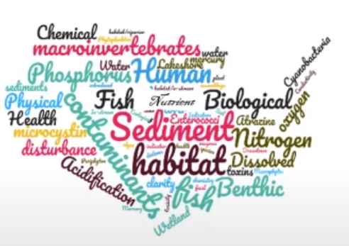
Parameters
Biological data
Macroinverts, zoops, fish, vegg
Rec/human health indicator data
Hg, PFAS, pathogens, cyanos
Chemical/physical data
Nutrients, sediments, habitat
Image from EPA

Slide 6
Research Plan
SPATIAL:
Use N:P ratios to assess nutrient limitation
National scale
WATER QUALITY:
Analyze limitations in relation to trophic and impairment status
Status based on TN, TP, chlorophyll-a
TEMPORAL:
Examine stoichiometric shifts across time
Across years
Regional scales:
HUC 8
EPA nutrient regions
Within years
Also relate to zoops and macroinverts?
Notes:
At all levels of analysis, use the weights to extrapolate the results to a broader, more general national/regional extent .

Slide 7
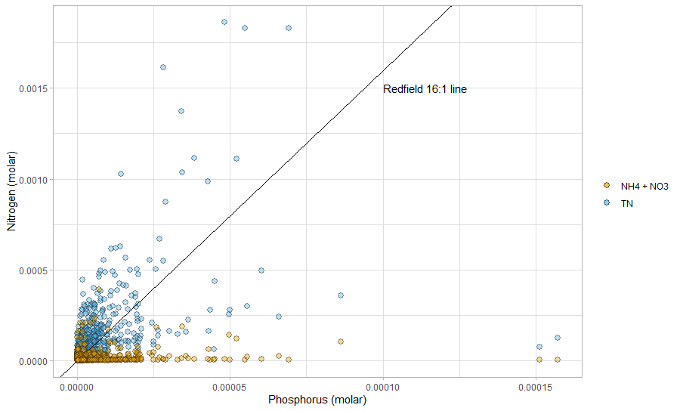
Notes:
Questions:
How to/should I incorporate the bioavailable forms of nitrogen since trophic and impairments status are based on TN?
How to characterize nutrient limitation?

Slide 8
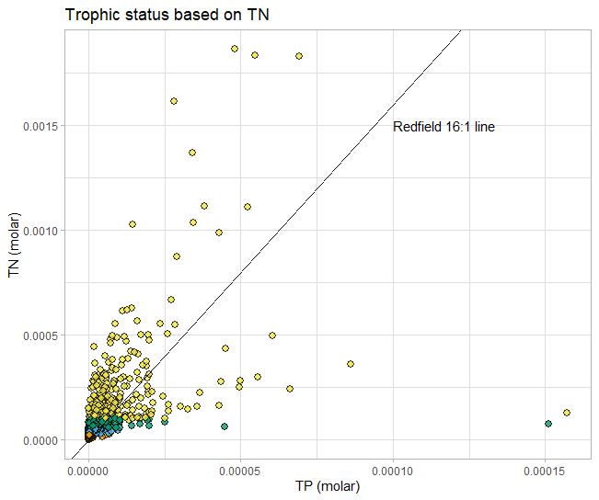
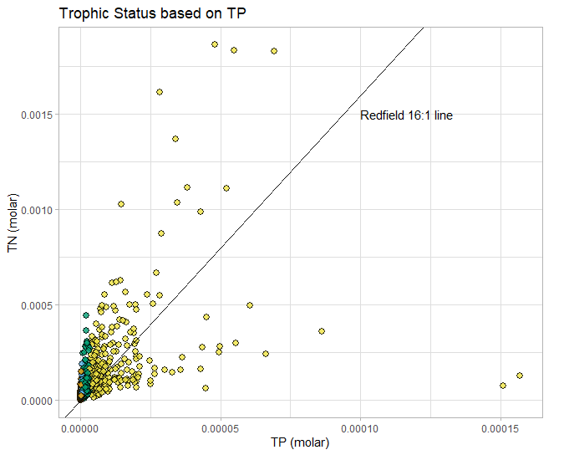
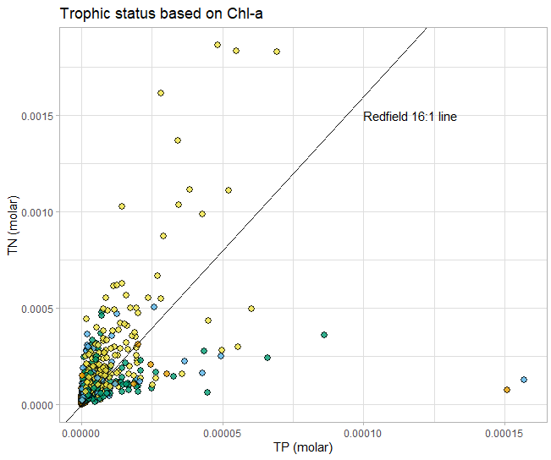
Notes:
Opinions about trophic status criteria?

Slide 9
Thanks and thoughts?

