Slide 1
What are the trends of nutrient stoichiometry and trophic levels across scales of space (ecoregional and national) and time (3 survey years)?

Slide 2
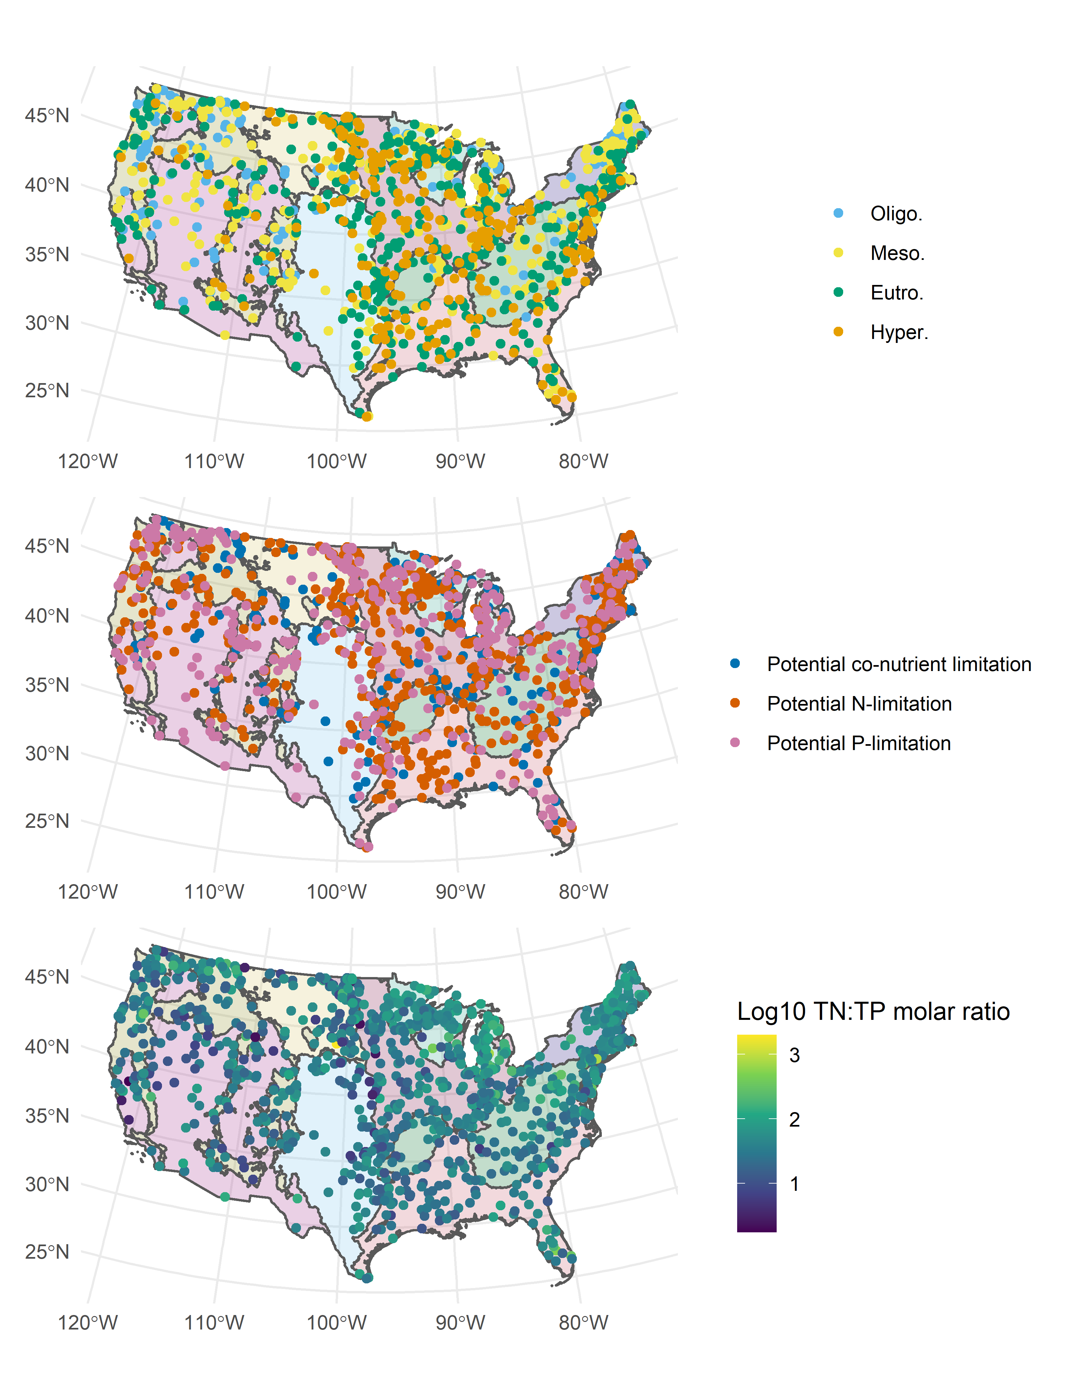
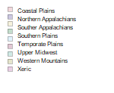
Current (2017) survey results
N:P ratios vary significantly over the years Ratios tend to be highest among P-limited lakes and lowest among N-limited lakes
N:P ratios vary significantly between trophic states as well, except between mesotrophic and oligotrophic lakes
Decreasing trend with increasing trophic state (consistent with previous findings)
This trend applies within each limitation status as well, except in the case of N-limitation, where oligotrophic lakes have a lower N:P
Looking across ecoregions, the Xeric region has the lowest ratios, whereas the Upper Midwest followed by the Northern Appalachians had the highest ratios.
Trend holds true across varying limitations as well

Slide 3
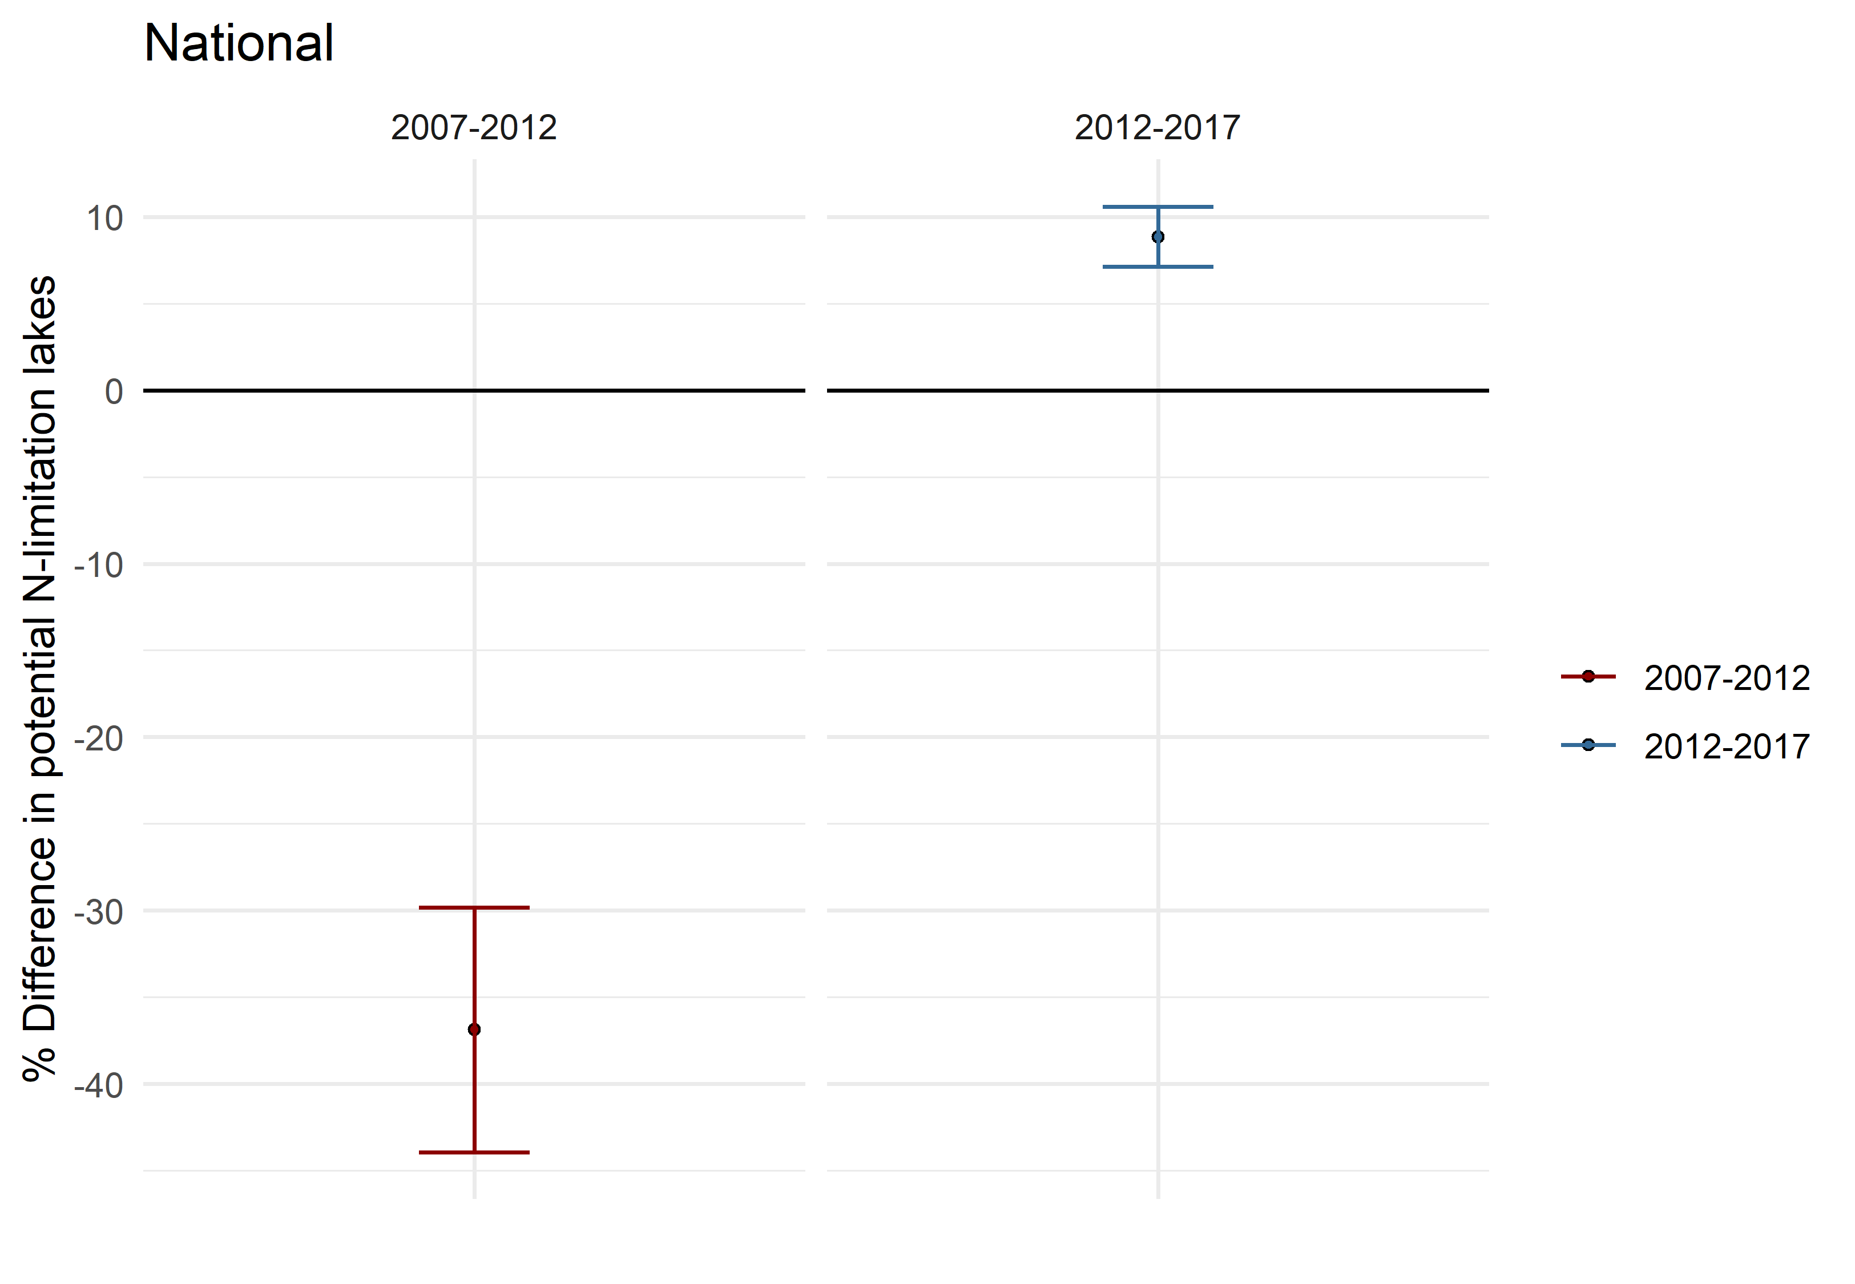
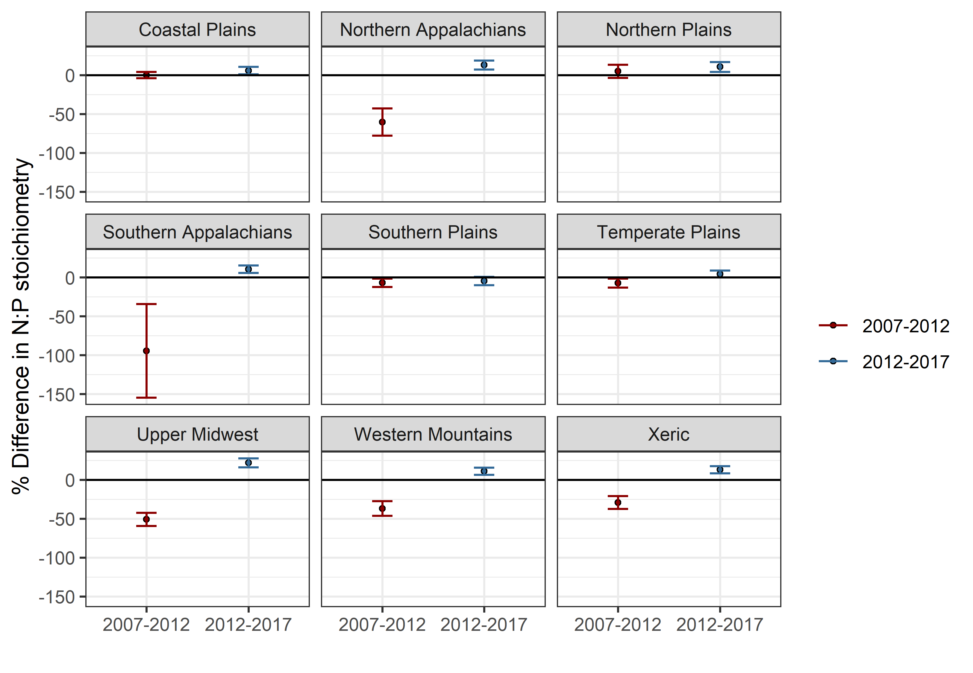
Change analysis for shifts in nutrient stoichiometry
If error bar crosses 0 line, the change is insignificant
Overall, N:P stoichiometry had great decrease from 2007-2012, then a smaller increase in 2017
Significant at the national level, but significance varies across the ecoregions. The greatest shifts were observed in the Northern and Southern Appalachians
Notes:
Add weighted number of lakes to the figures

Slide 4
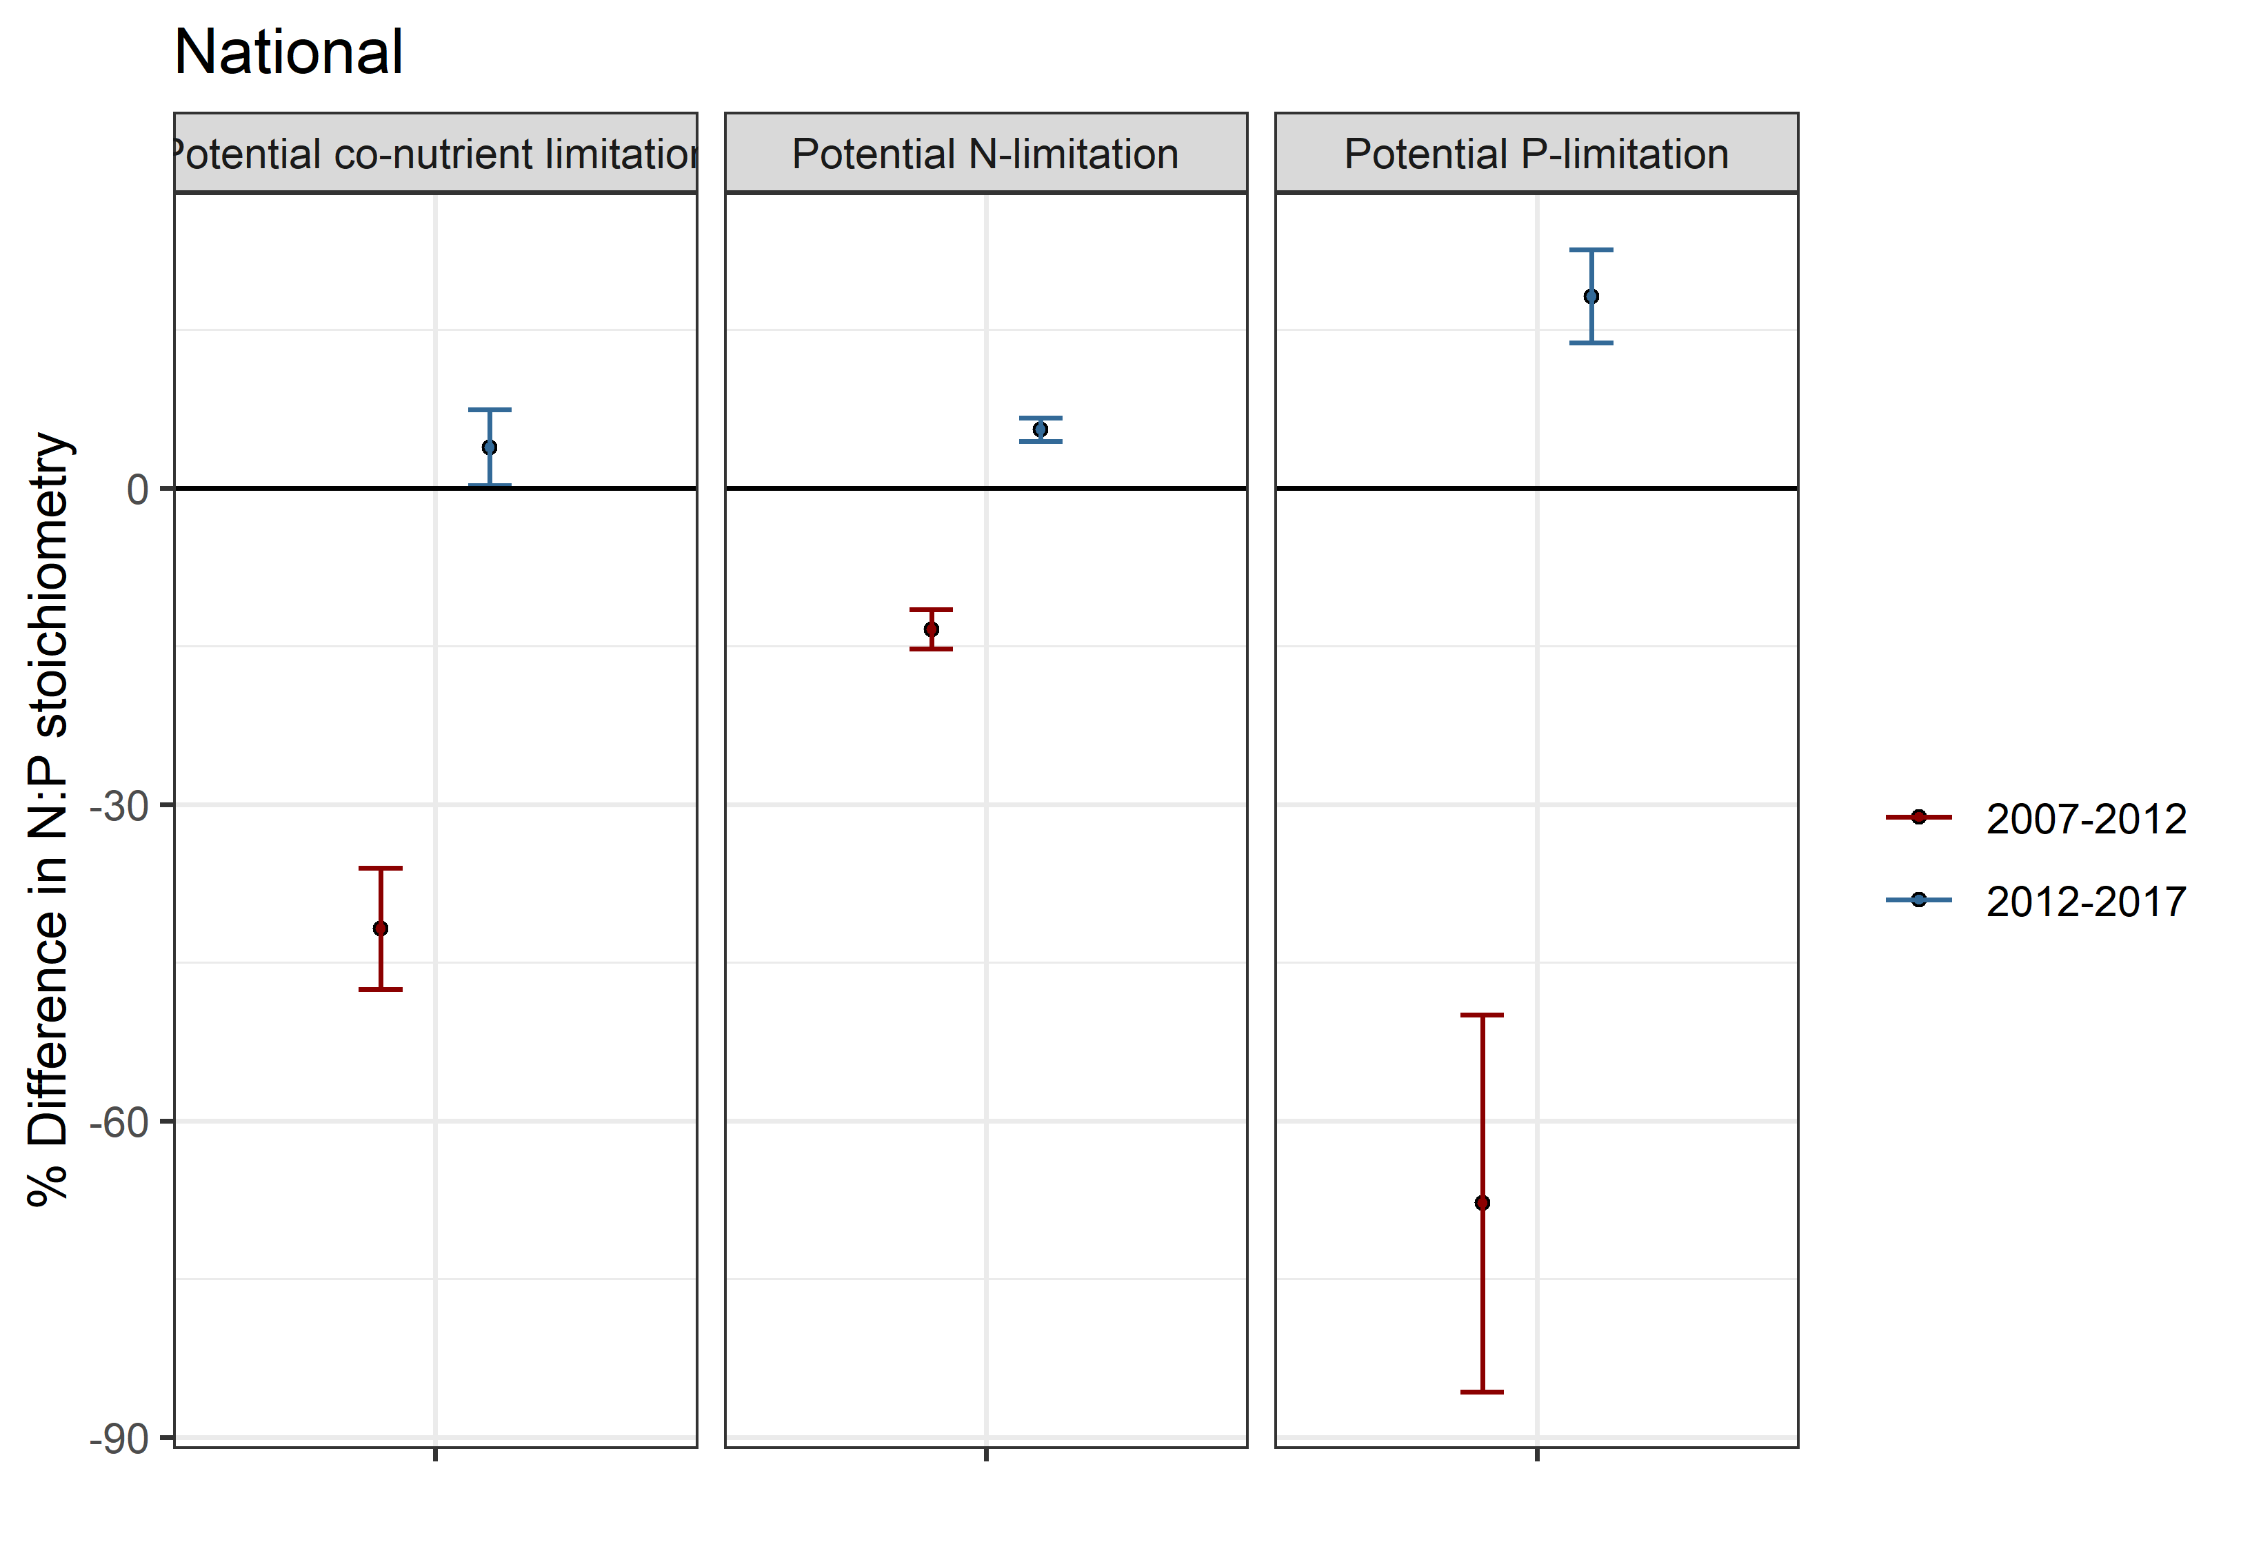
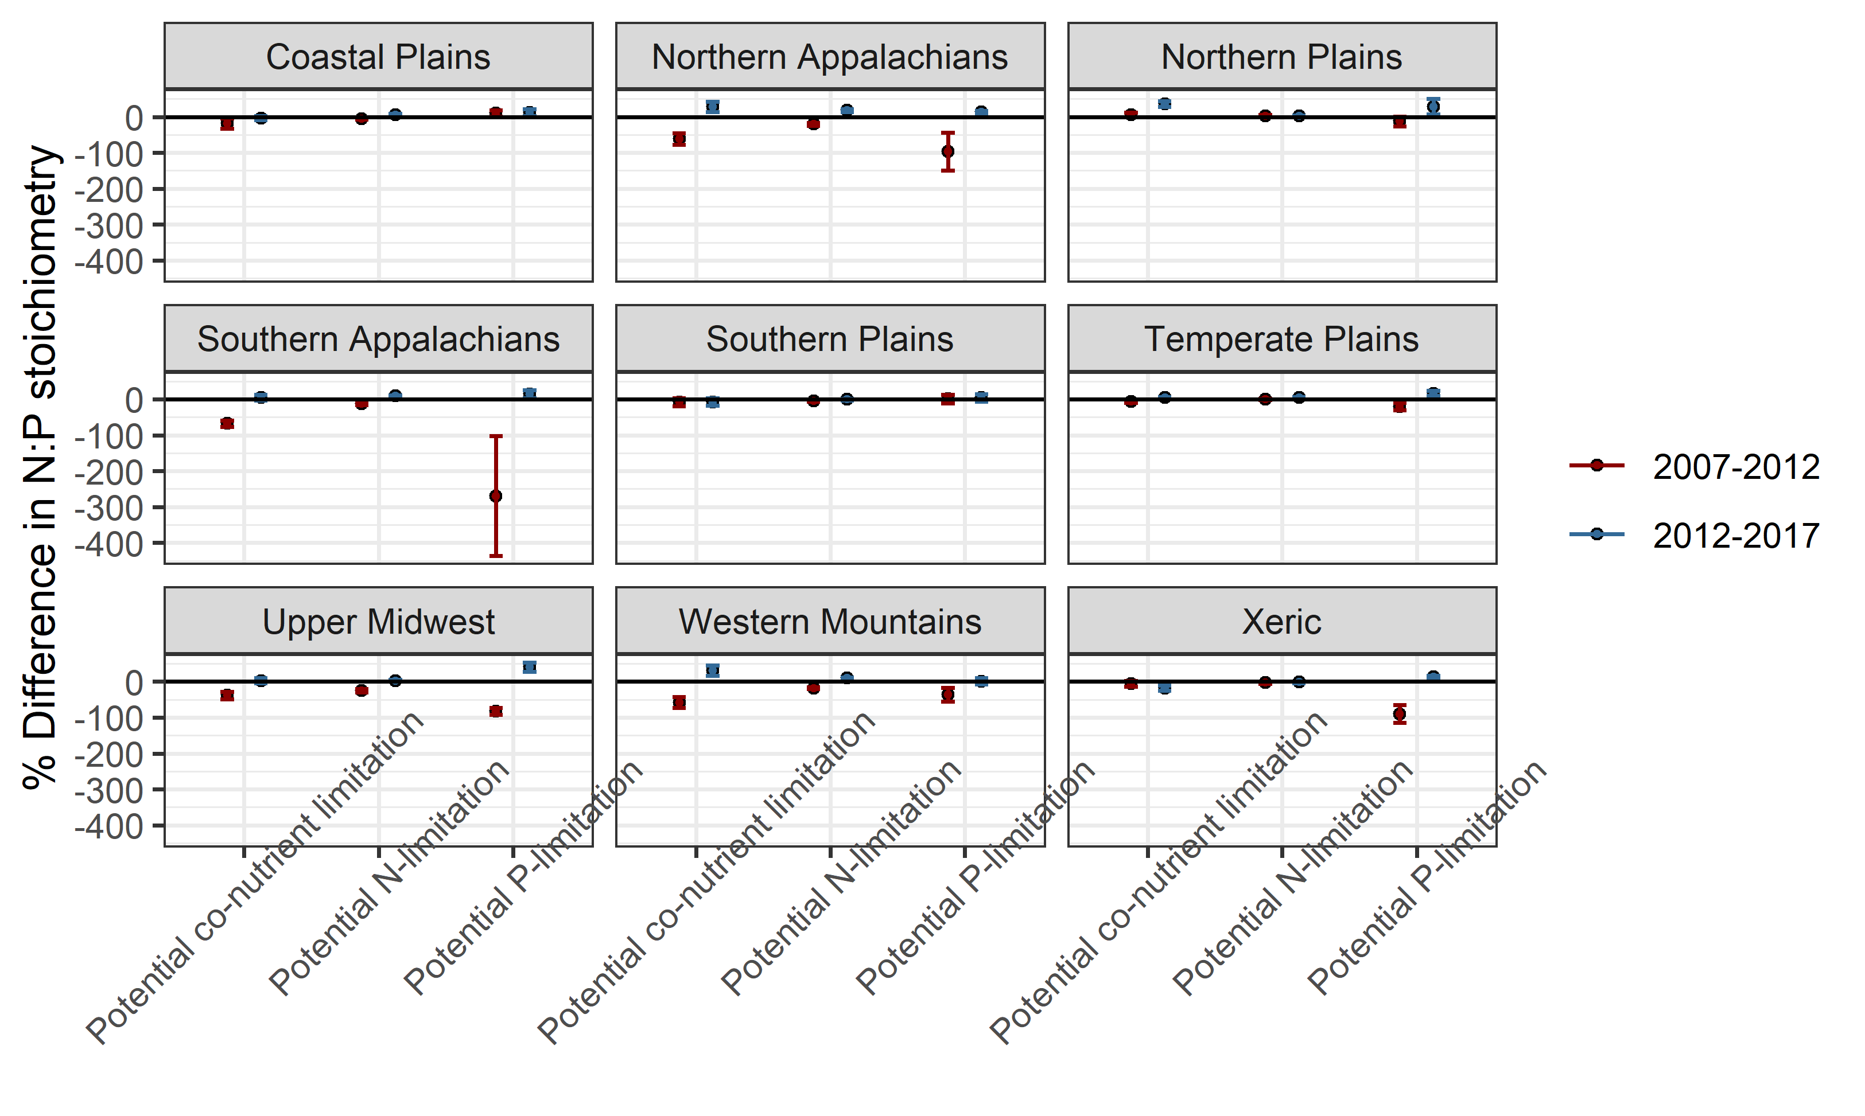
Change analysis for shifts in nutrient stoichiometry within nutrient limitation status
If error bar crosses 0 line, the change is insignificant
Similar trends as previous
Many nonsignificant or slightly significant results
P-limitation stands out showing large decreases 2007-2012 in N & S Appalachians.
Xeric and Upper Midwest also who larger decrease here (relative to other ecoregions)
Notes:
Need to fix axis labels on ecoregion plot and make scales free on y axis
On national plot, “Potential co-nutrient limitation” does not fit. Change wording to “Potential co-limitation” or something.
Add weighted number of lakes to the figures

Slide 5
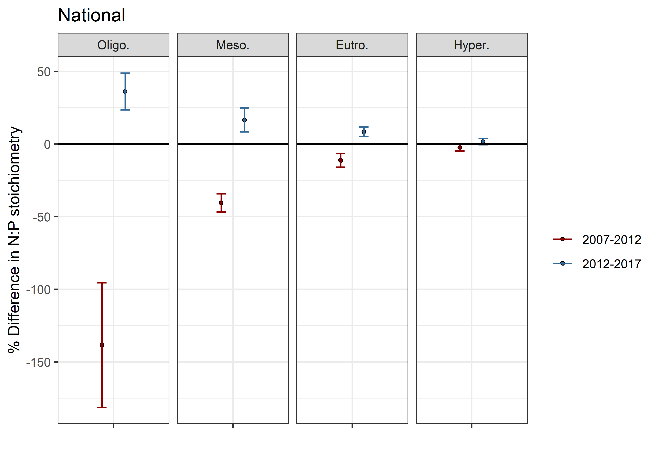
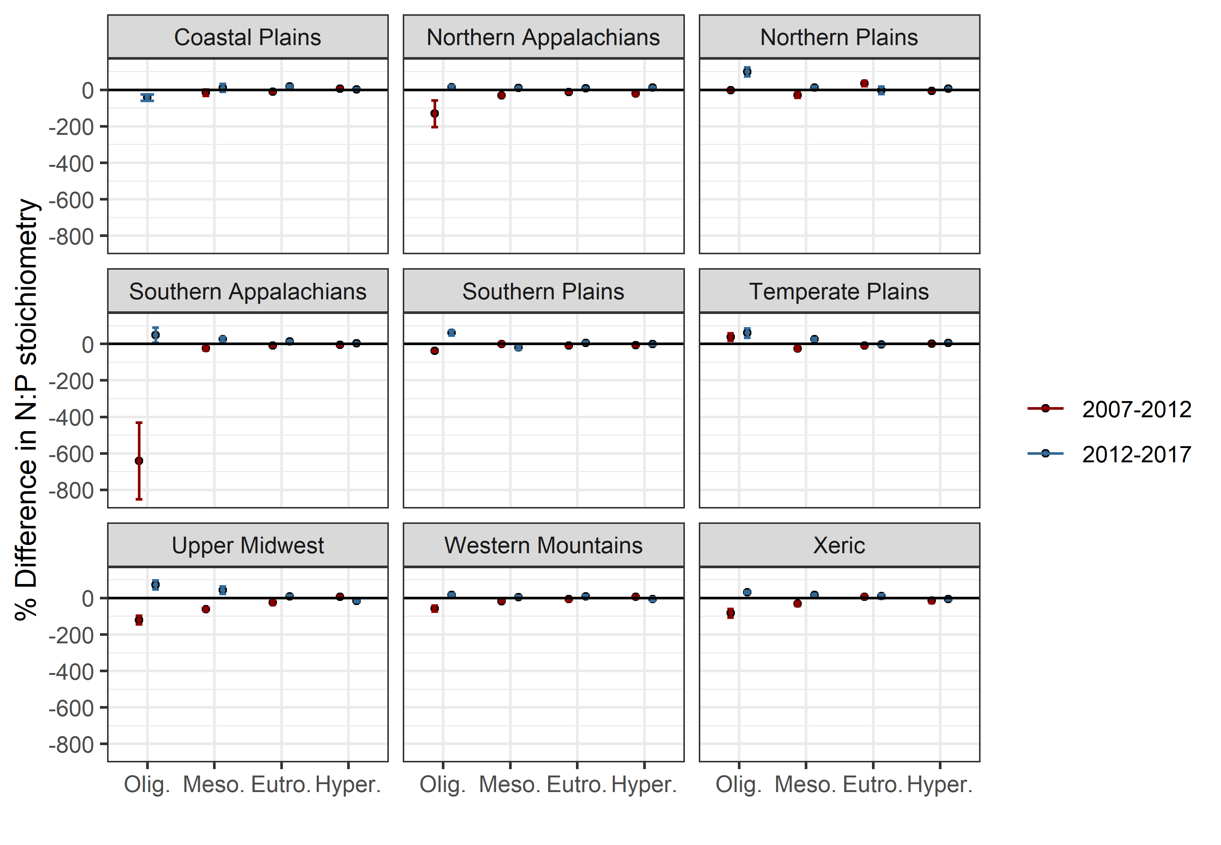
Change analysis for shifts in nutrient stoichiometry within trophic status
If error bar crosses 0 line, the change is insignificant
Similar trends as previous
N:P shifts decrease with increasing trophic state and there is no change in Hypereutrophic lakes
Oligotrophic lakes stand out showing large decreases 2007-2012 in N & S Appalachians.
Notes:
Free y-axis scales on ecoregion plots
Add weighted number of lakes to the figures

Slide 6
Takeaways
P-limited and oligotrophic lakes show the greatest changes in N:P stoichiometry over time.
P is the main driver of stoichiometric shifts in lakes across the US??
Southern followed by Northern Appalachians demonstrated the largest swings in stoichiometry, especially in 2007-2012
Why??
Notes:
Need to investigate why these regions are different from the rest or what was different in 2012

Slide 7
How does nutrient limitation relative to trophic state vary spatially (ecoregional and national) and temporally(3 survey years)?
This portion is fuzzy for me & I’m not sure what to do to make it better :/

Slide 8
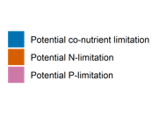
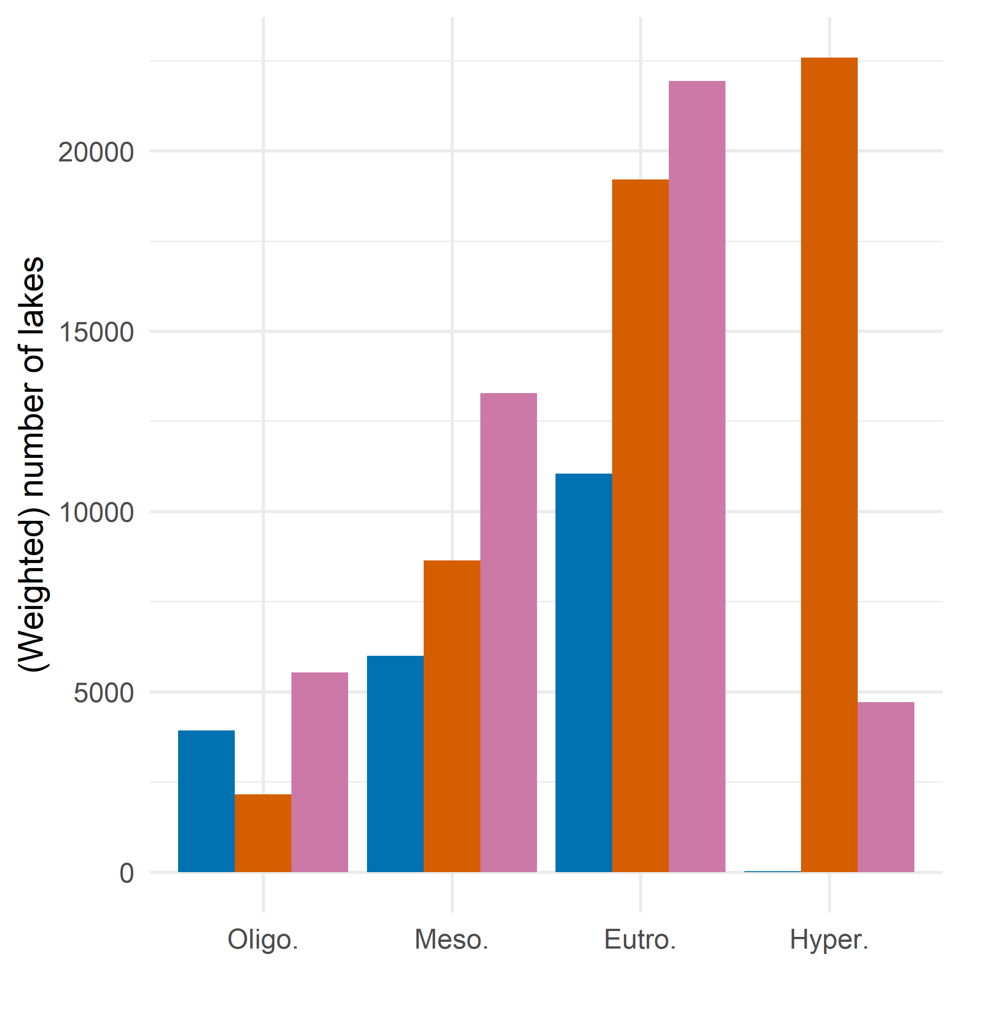
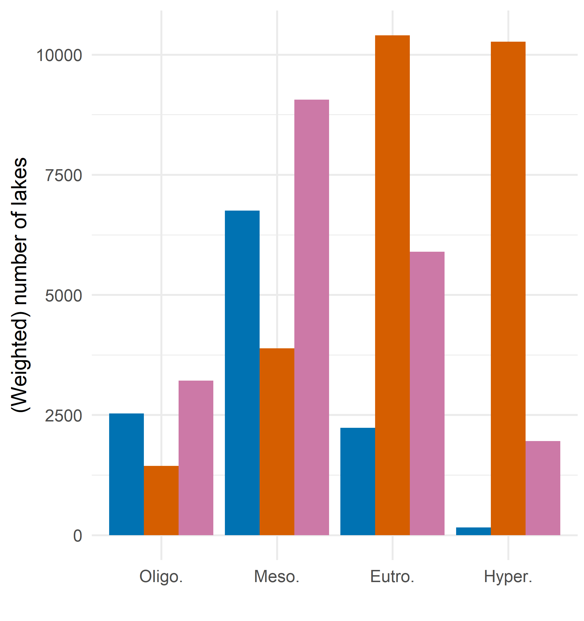
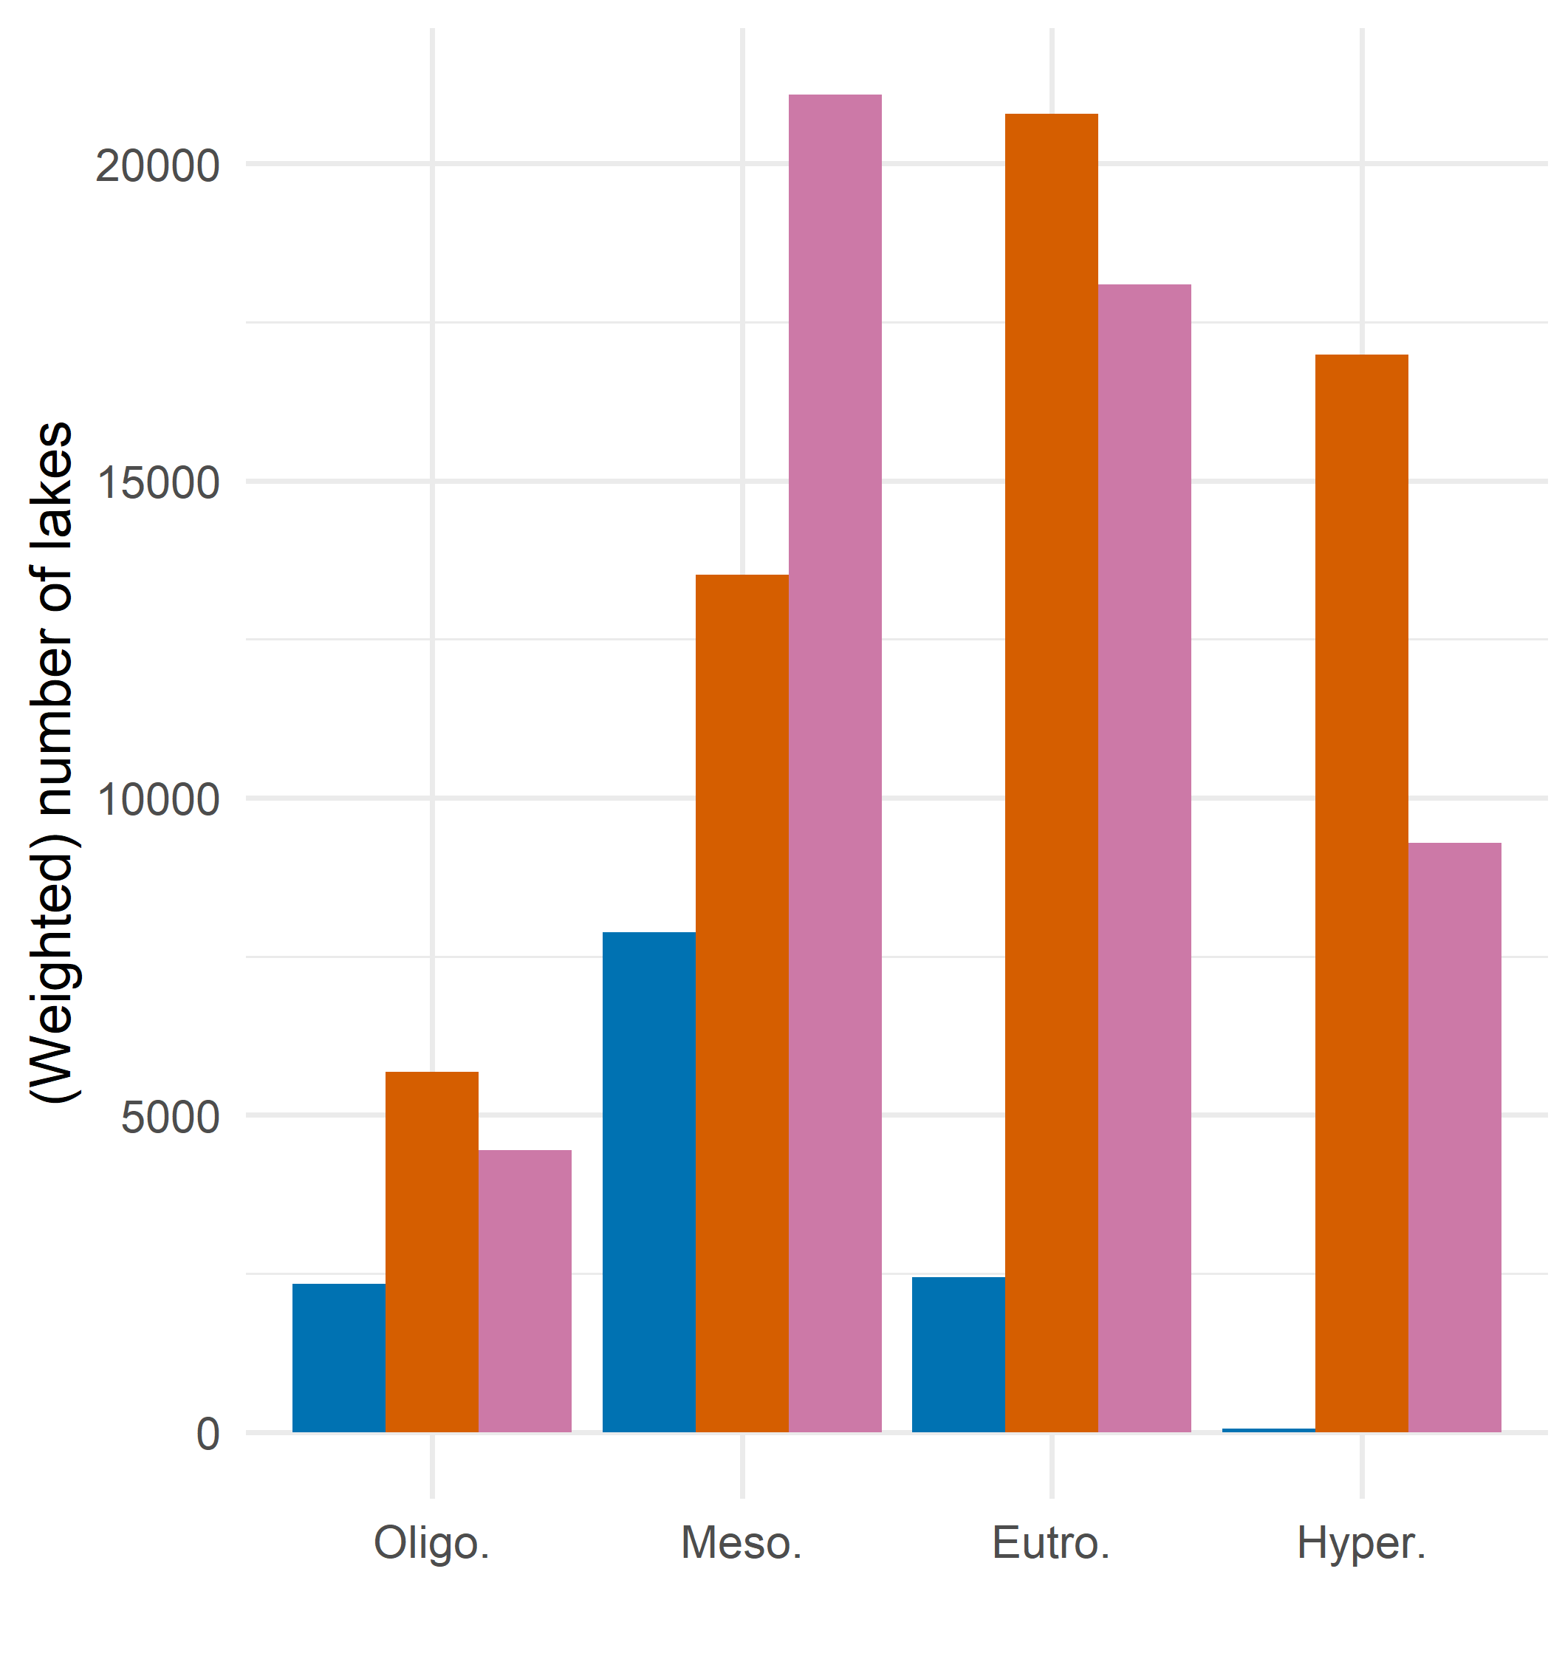
Co-nutrient limitation is negligible among hypereutrophic lakes – mostly occurs in mesotrophic and oligotrophic lakes.
Mesotrophic, oligotrophic lakes are mainly P-limited – opposite of eutrophic and hypereutrophic
eutrophic lakes can be either N or P-limited
2007
2012
2017

Slide 9
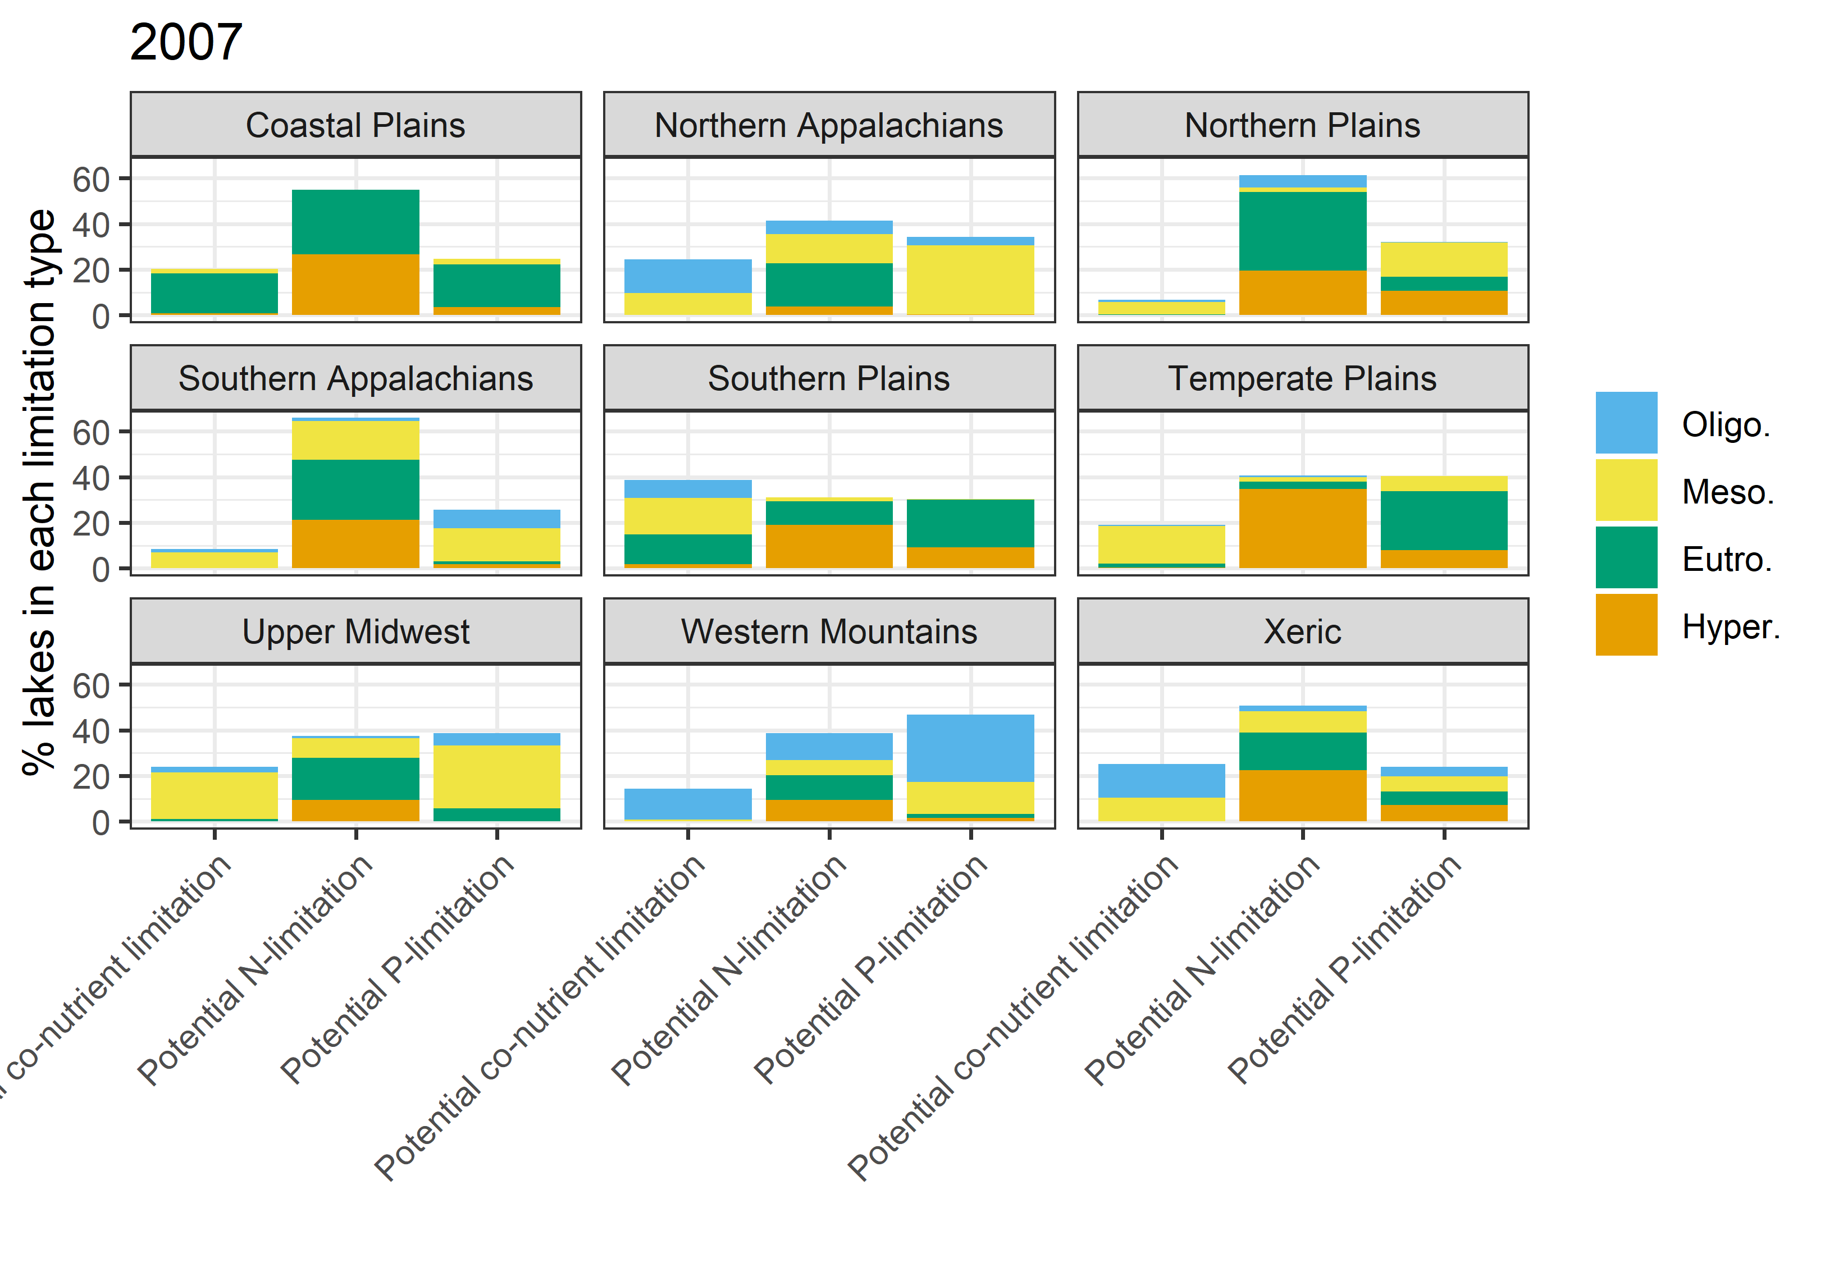
Flip between this and the next two slides to see the shifts over the 3 survey years
Notes:
Change “Potential co-nutrient limitation” to “Potential co-limitation” or something

Slide 10
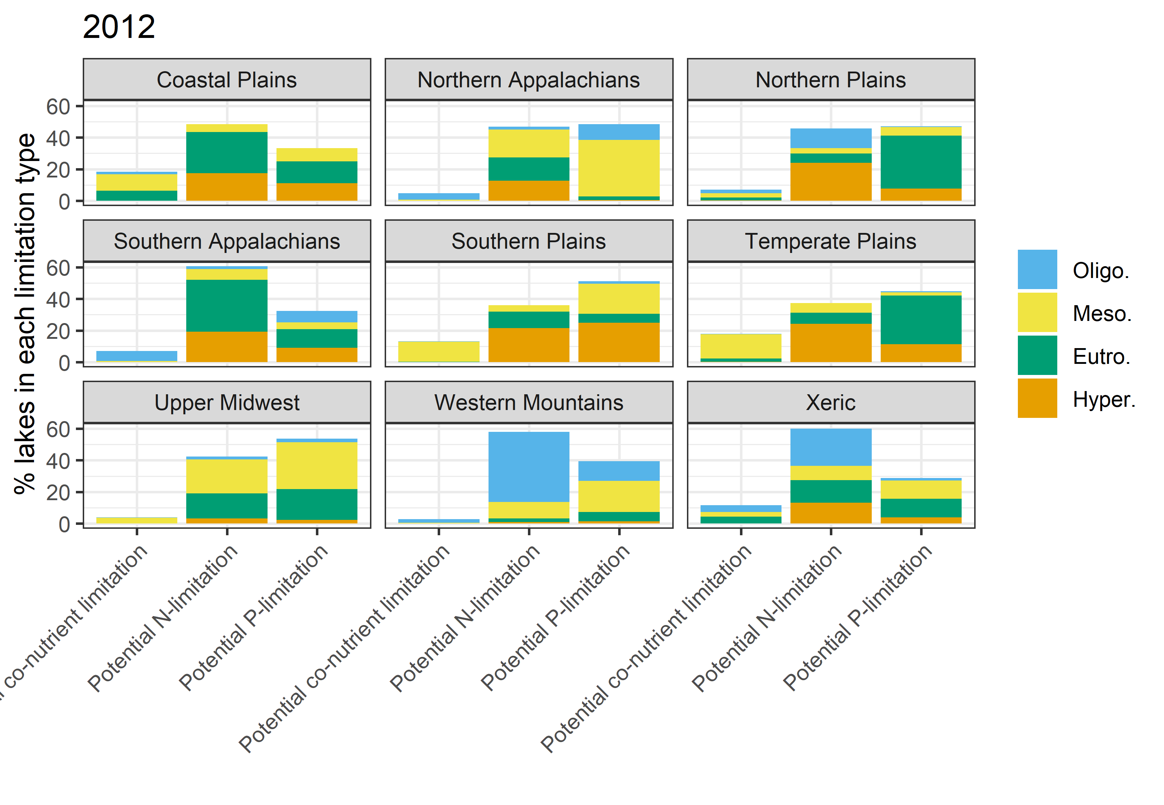
Notes:
Change “Potential co-nutrient limitation” to “Potential co-limitation” or something

Slide 11
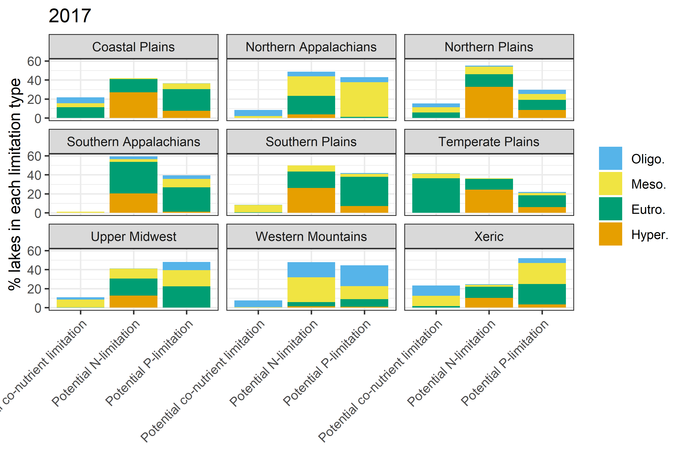
Notes:
Change “Potential co-nutrient limitation” to “Potential co-limitation” or something

Slide 12
Takeaways from ecoregion bar charts
Coastal plains – lakes shifting from N-limited to P-limited, still highest proportion of lakes are N-limited
Most lakes eutrophic/hypereutrophic
Northern Appalachians – % co-limited lakes decreased in favor of single nutrient limitation (evenly distributed in 2007)
Most lakes mesotrophic, many oligotrophic and eutrophic
Northern Plains – Most lakes N-limited
Many eutrophic/hypereutrophic
Southern Appalachians – by far highest % N-limited
Most eutrophic, then hypereutrophic
Southern Plains – % co-limited lakes decreased in favor of single nutrient limitation (evenly distributed in 2007)
Many eutrophic/hypereutrophic
Temperate Plains – shifting from nutrient limited to co-limited
Trophic status increasing
Upper Midwest – Most lakes P-limited
P-limitation is where oligotrophic lakes are observed
Western Mountains – few lakes are co-limited
Many oligotrophic + mesotrophic lakes
Xeric – lakes shifting from N to P-limited
Fairly even distribution of trophic states

Slide 13
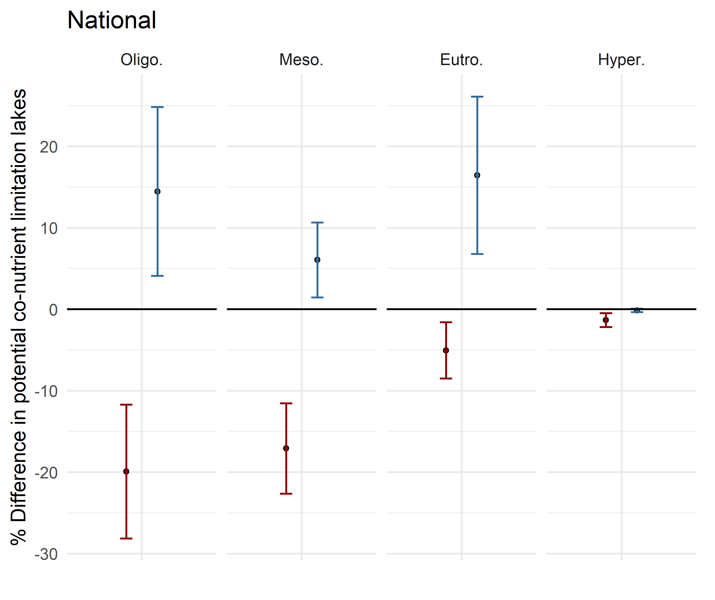
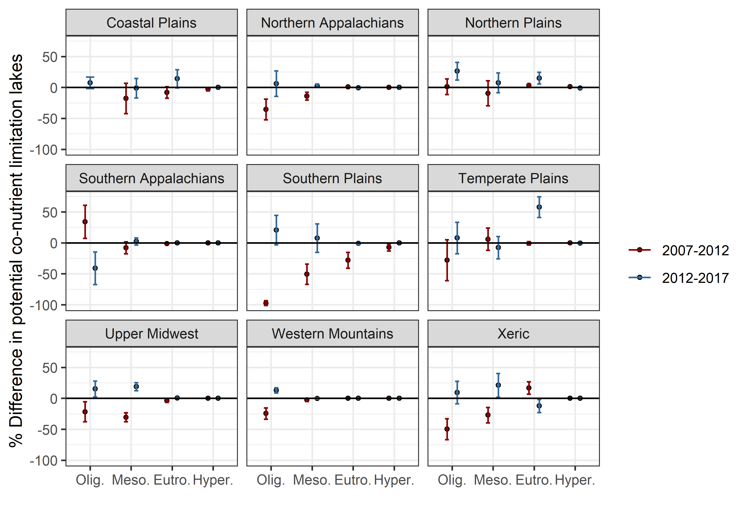
At the national scale, %co-limited lakes all trophic levels significantly decreased in 2007-2012 then increased in 2012-2017. Hypereutrophic lakes showed no change in latter years and very small change in early years, likely due to small number of hypereutrophic lakes that are co-limited.
Although significant at national scale, most changes at ecoregional scale were insignificant. These trends also varied greatly, demonstrating the spatial complexity
At ecoregion scale, many shifts are actually 0 (small # co-lim lakes)
Change analysis for shifts in co-limited lakes within trophic status
If error bar crosses 0 line, the change is insignificant
Notes:
Add weighted number of lakes to the figures

Slide 14
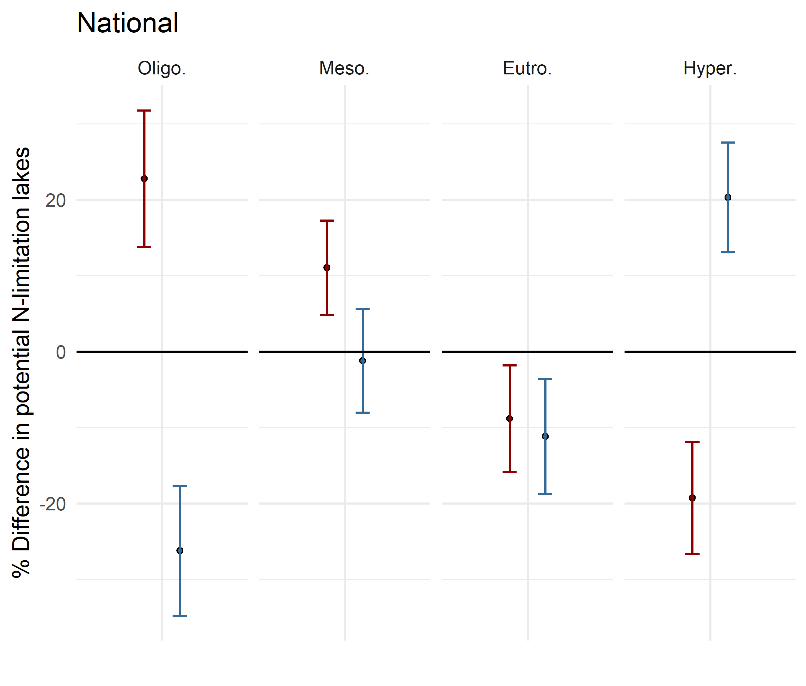
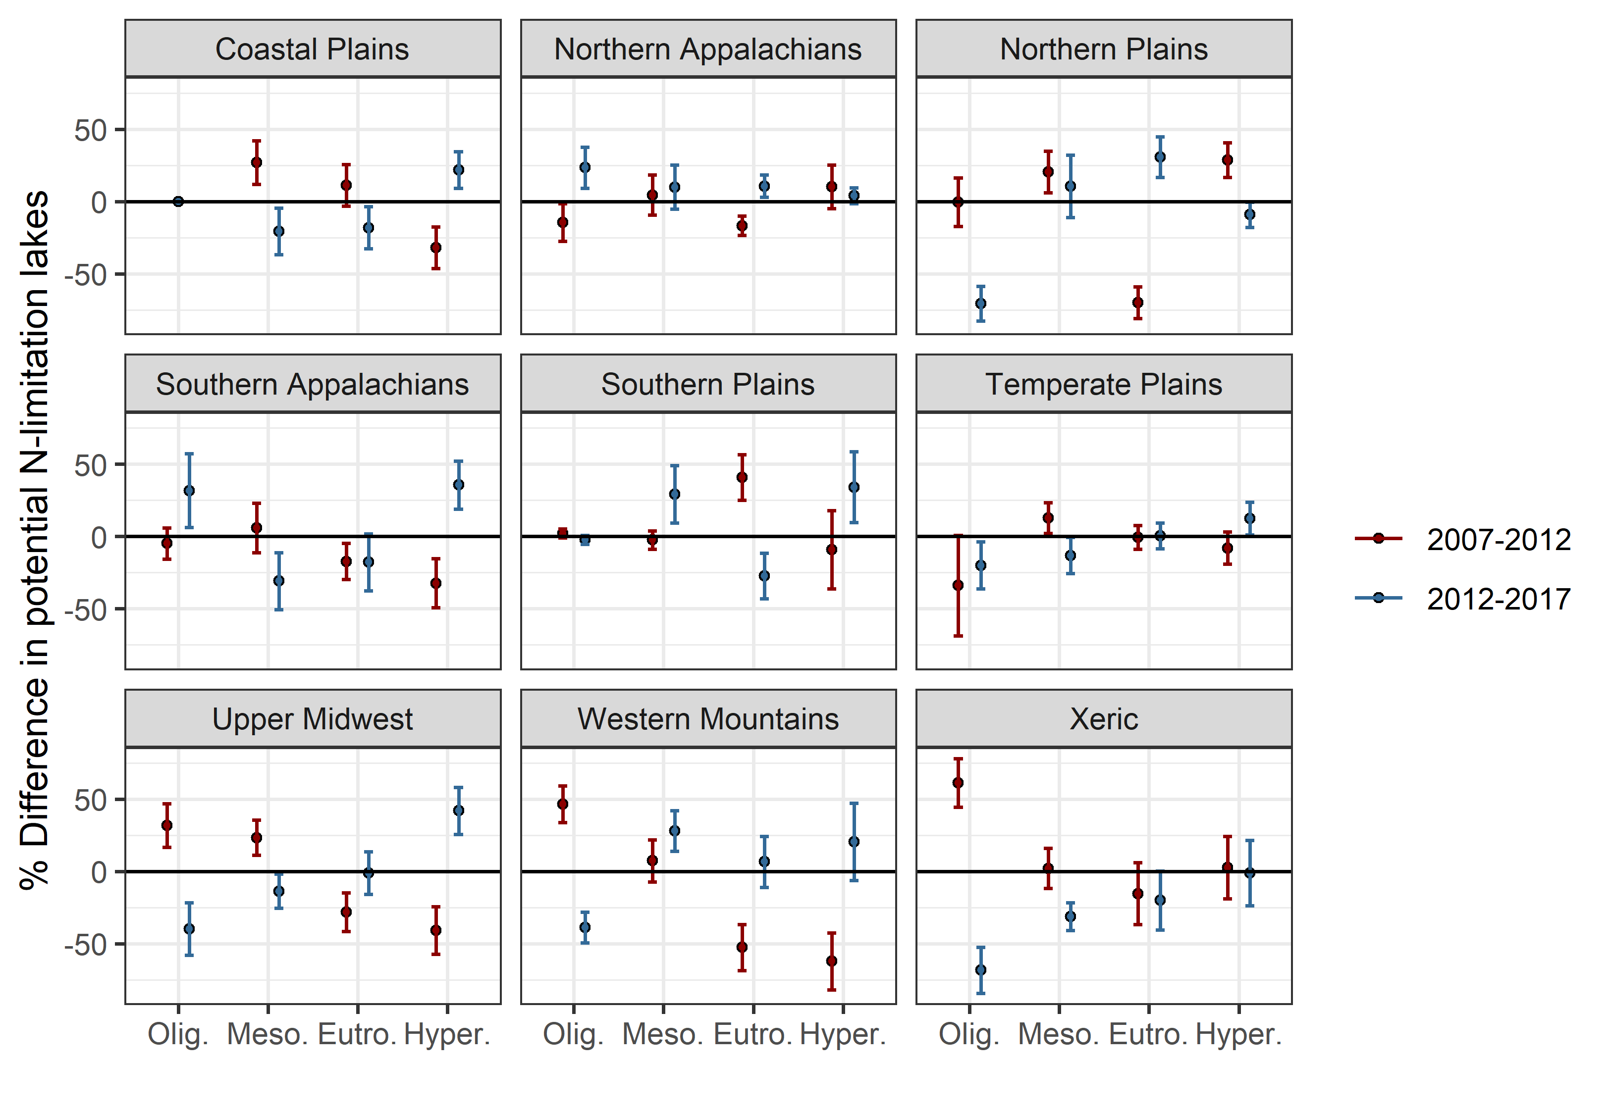
Change analysis for shifts in N-limited lakes within trophic status
If error bar crosses 0 line, the change is insignificant
At the national scale, % differences in N-limited lakes varied across the years with mostly significant changes except in mesotrophic lakes 2012-2017.
N-limited lakes in 2007-2012 decreased in trophic level (less eutro/hyper, more oligo/meso). 2012-2017 showed additionally a decrease in oligo lakes and an increase in hyper lakes
Eutrophic N-limited lakes are decreasing
Notes:
Add weighted number of lakes to the figures

Slide 15
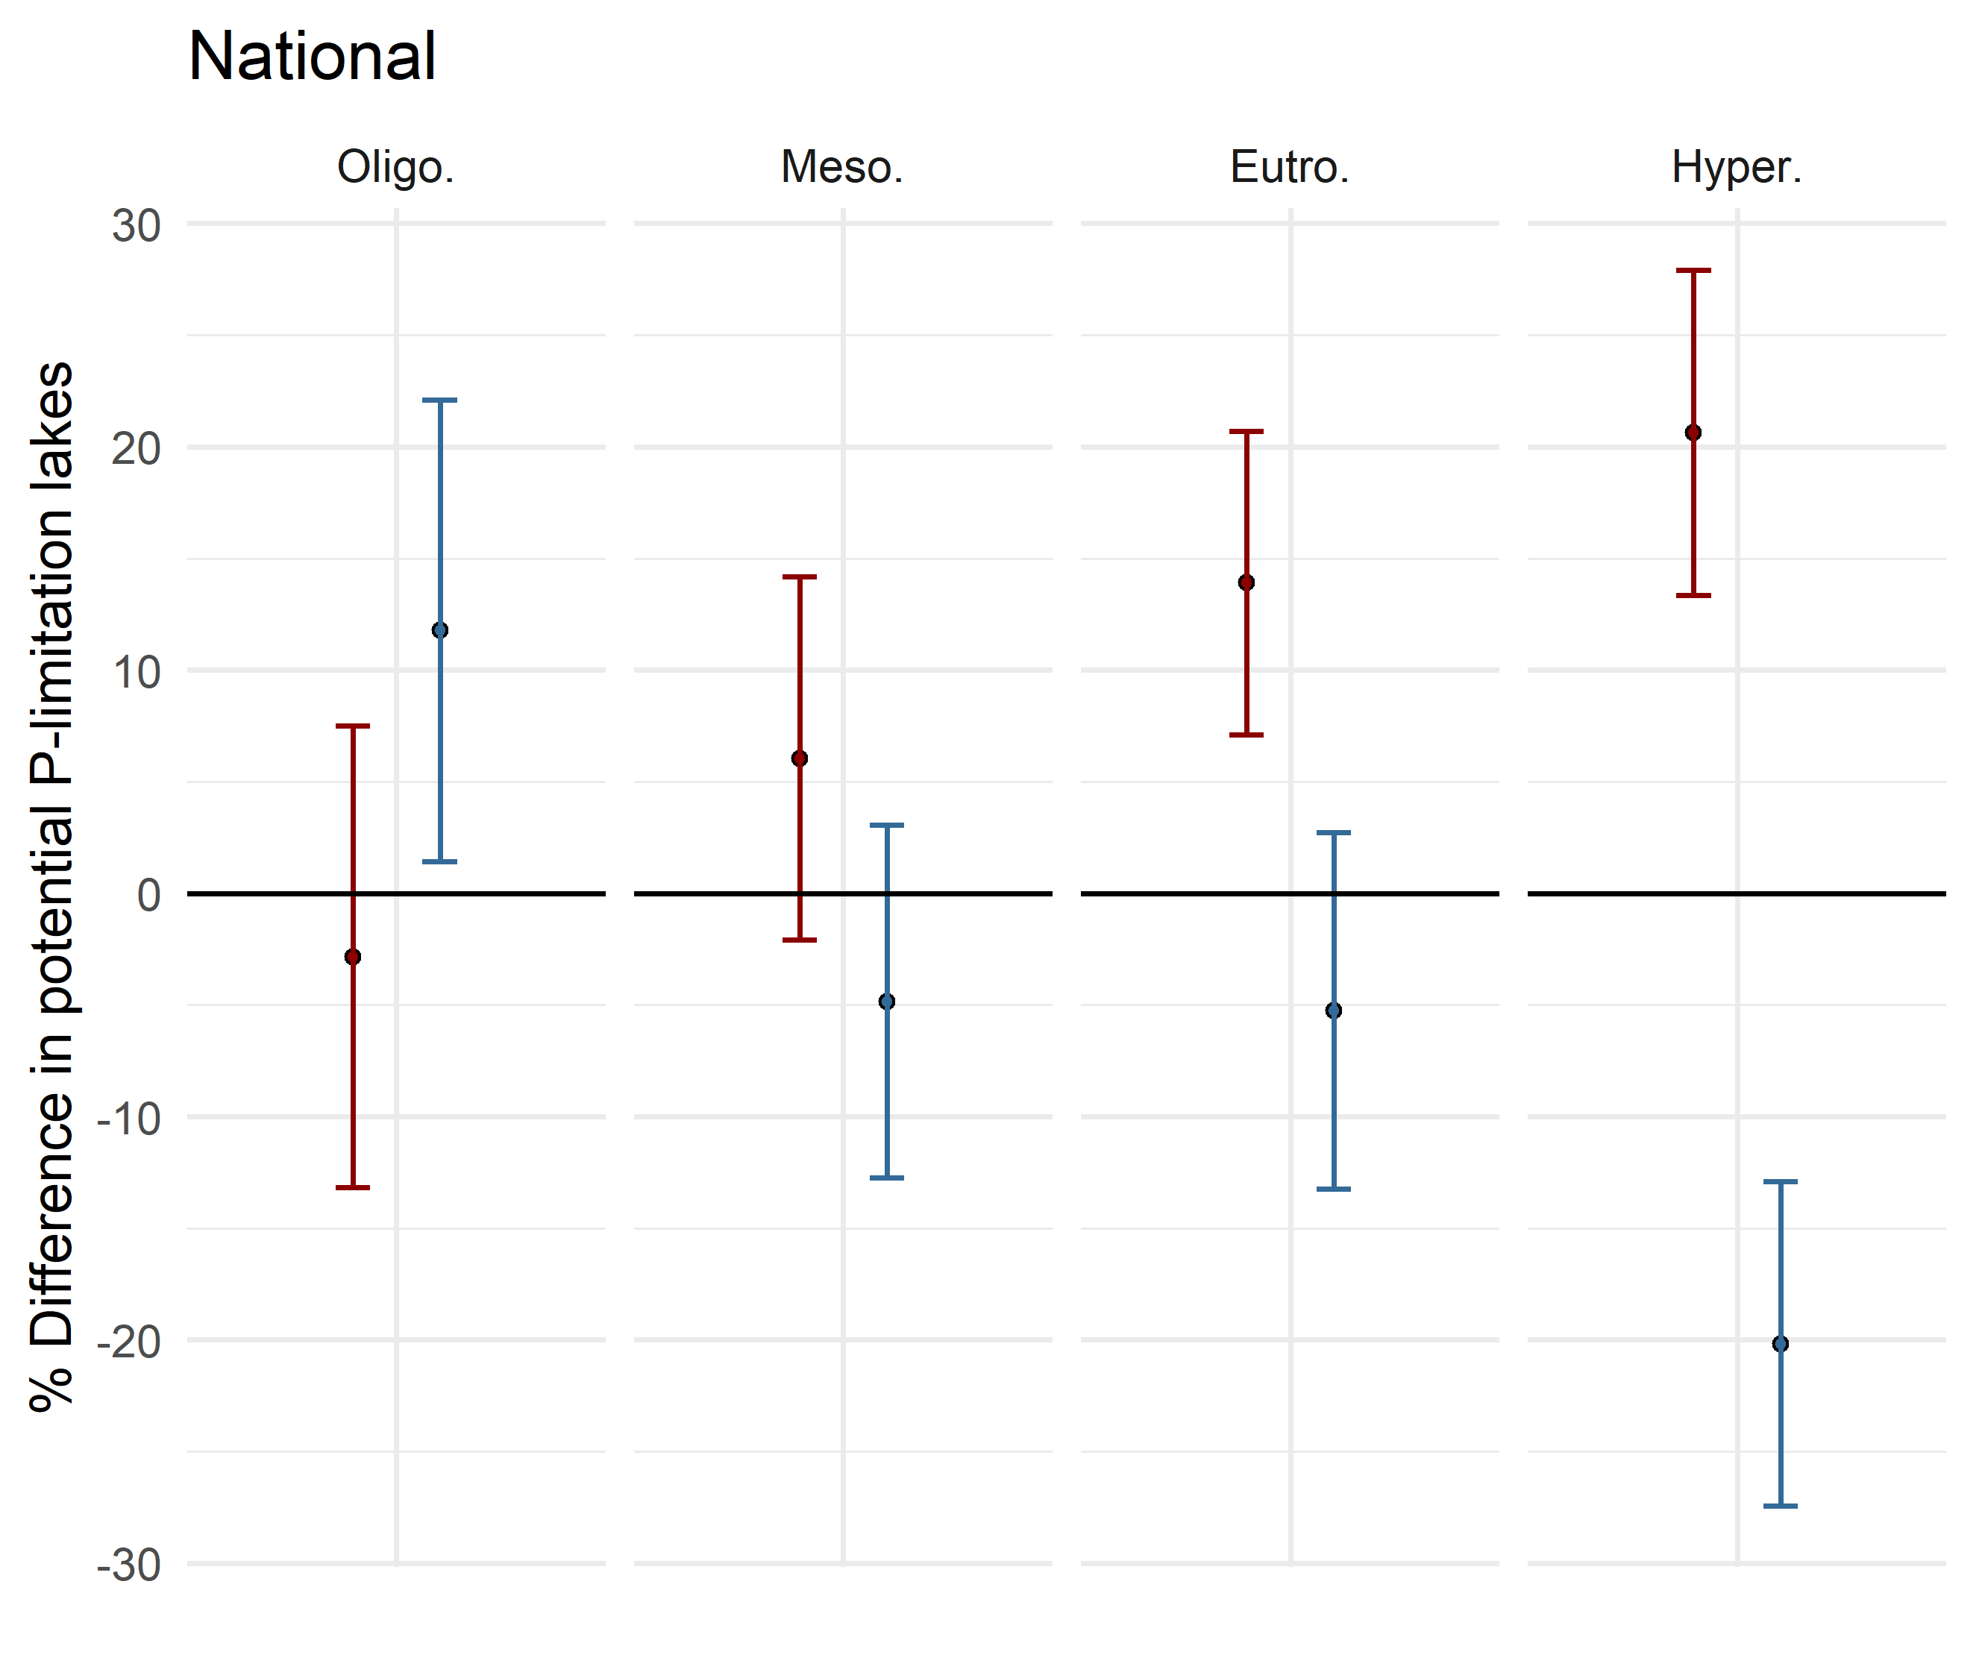
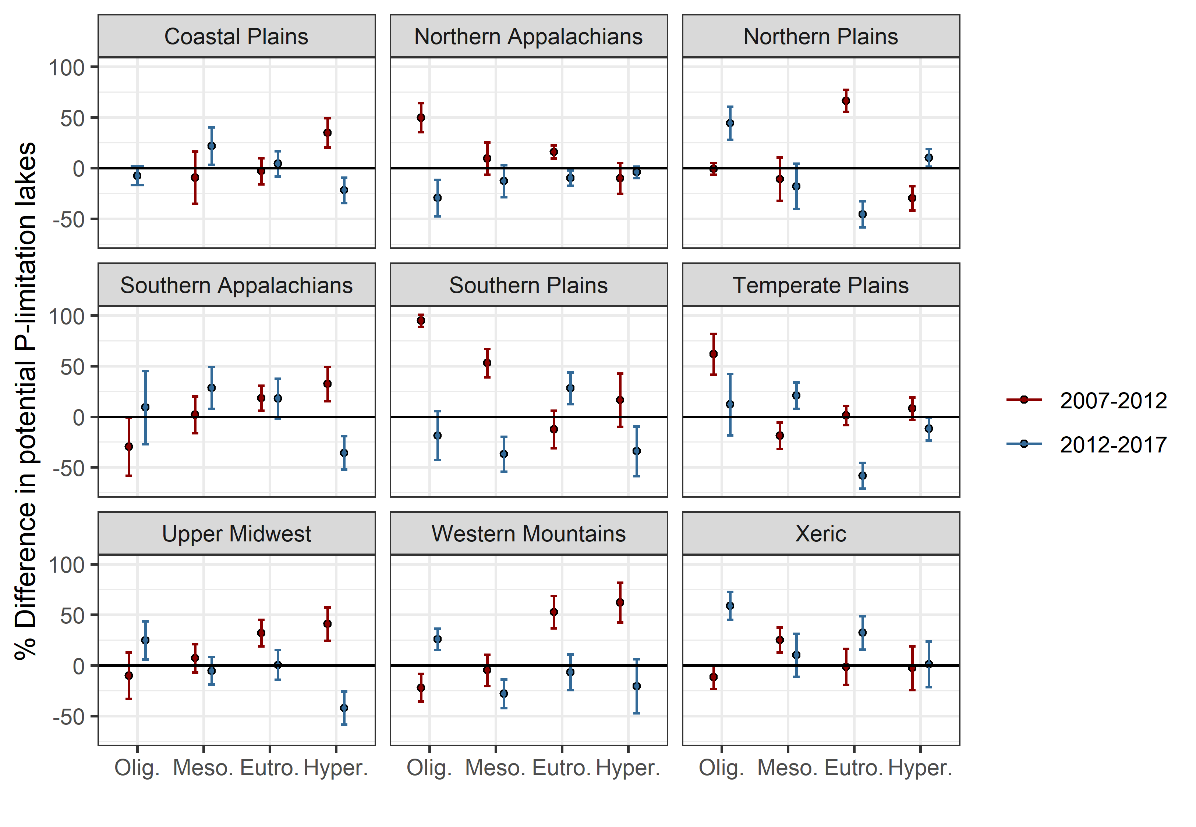
Change analysis for shifts in P-limited lakes within trophic status
If error bar crosses 0 line, the change is insignificant
At the national scale, oligotrophic P-limited lakes increased and hypereutrophic P-limited lakes decreased between 2012-2017. Between 2007-2012, Eutrophic and hypereutrophic P-limited lakes increased.
Regionally, N vs P limitation within these trophic groups tend to have the opposite change sign (+vs.-), indicating shifting between these two nutrient limitation statuses
Notes:
Add weighted number of lakes to the figures

Slide 16
Is trophic level (based on chlorophyll-a concentration) more influenced by nitrogen or phosphorus?

Slide 17
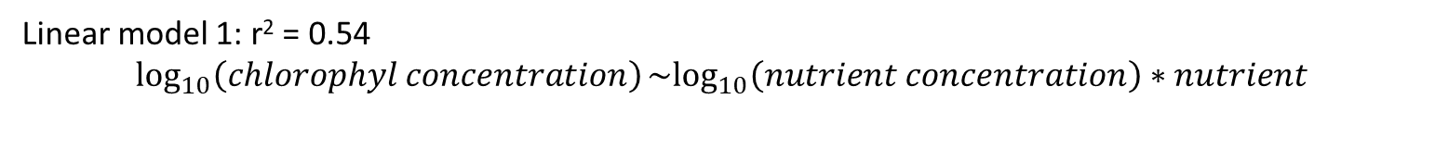
Using chlorophyll-a as a proxy for trophic status since trophic status is determined by chlorophyll concentration.
Linear model 1: r² = 0.54
$$\log_{10}\left(chlorophyl concentration\right)\sim \log_{10}\left(nutrient concentration\right)∗nutrient$$
Linear model 2: r² = 0.59
$$\log_{10}\left(chlorophyl concentration\right)\sim \log_{10}\left(nutrient concentration\right)∗nutrient type ∗ecoregion$$
Comparison
$anova\left(model1, model2\right)$ - p-value is < 0.0001, indicates that adding ecoregion creates a much better model and is likely an important variable

Slide 18
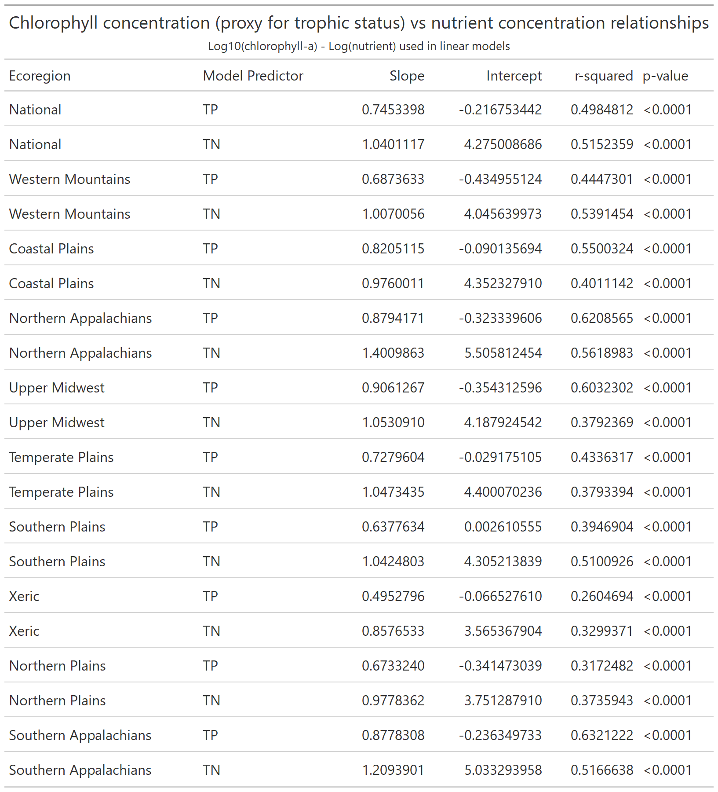
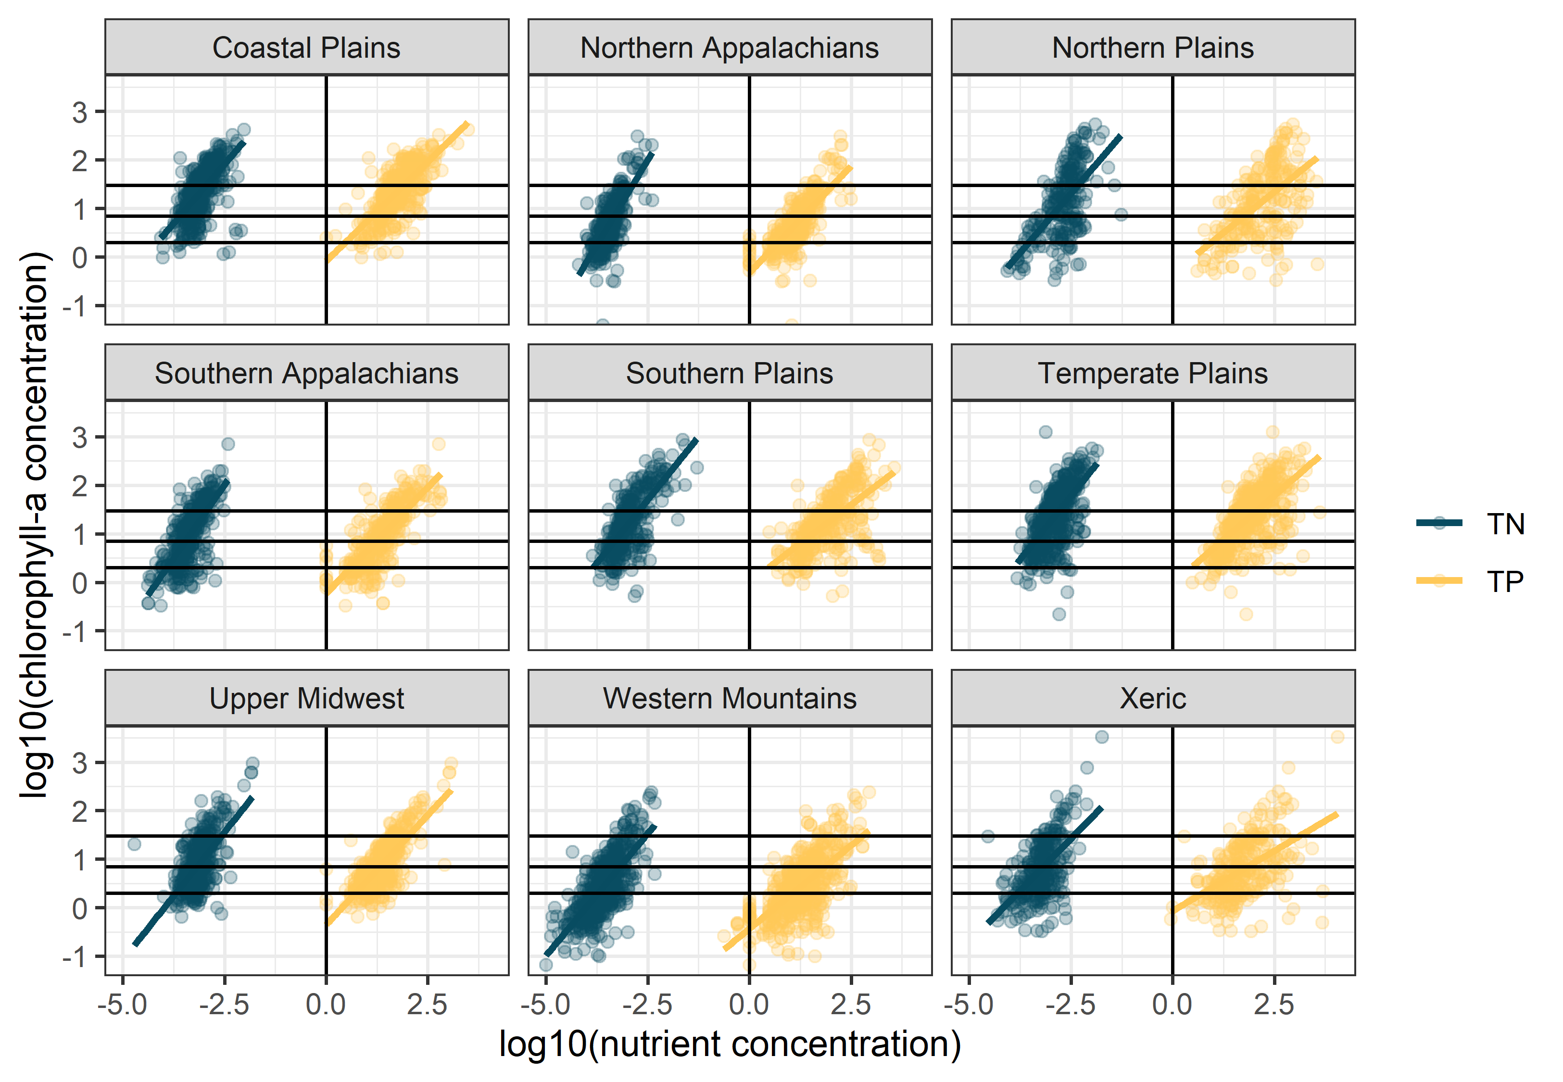



Horizontal lines indicate trophic levels from oligotrophic to hypereutrophic
TP is “better” predictor
TN is “better” predictor

Slide 19
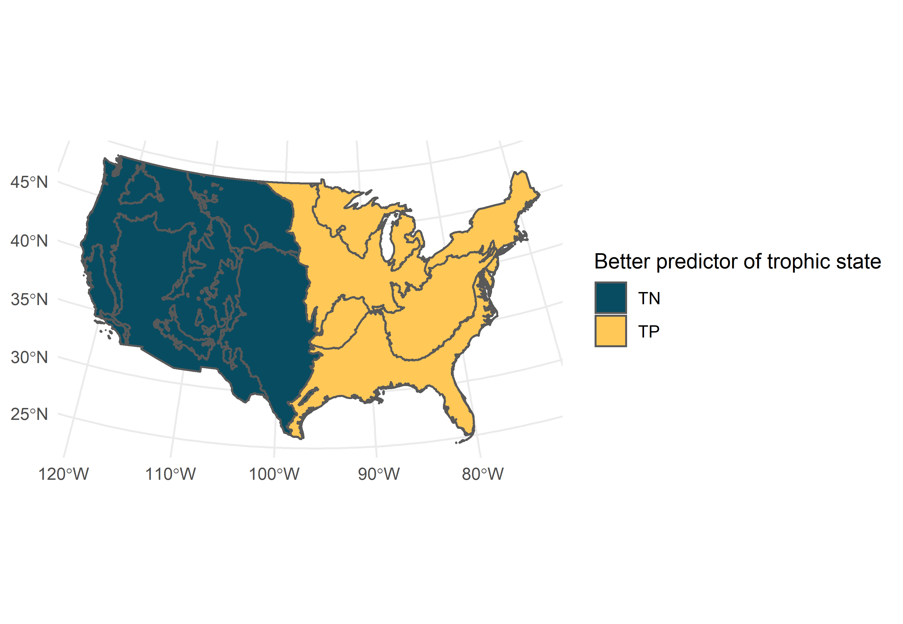
This seems a little too perfect and I’m suspicious. But I guess it is kind of obvious it would be this way.
Takaways:
TN and TP vary in their ability to predict trophic status
r-squared values indicate varying strength, and comparing r-squared values in each ecoregion shows variation in if one is “better” than the other
i.e., in Upper Midwest, the difference is significant, whereas not so much in the Xeric
Ecoregion is an important variable to consider. In the eastern US, TP is a greater driver and in the western US, TN is a greater driver
Notes:
Maybe a mean limitation type in each ecoregion map would be useful here too.

