Slide 1
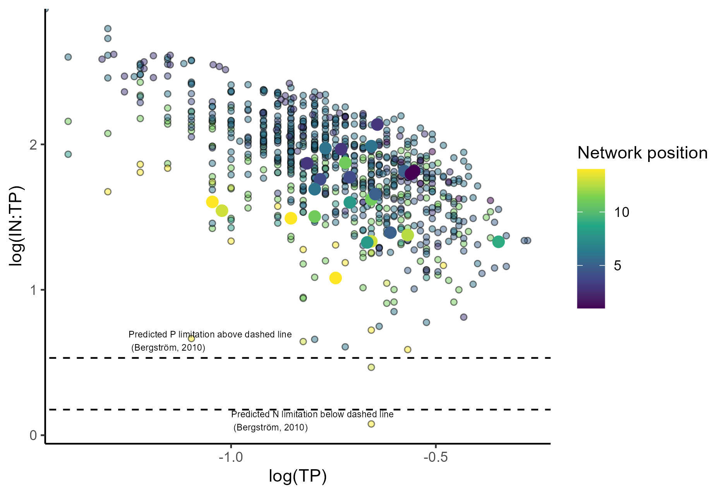
Mann Kendal trend test: log(IN:TP~network position)
p < 0.0001
Sen’s slope = -0.0002

