Slide 1
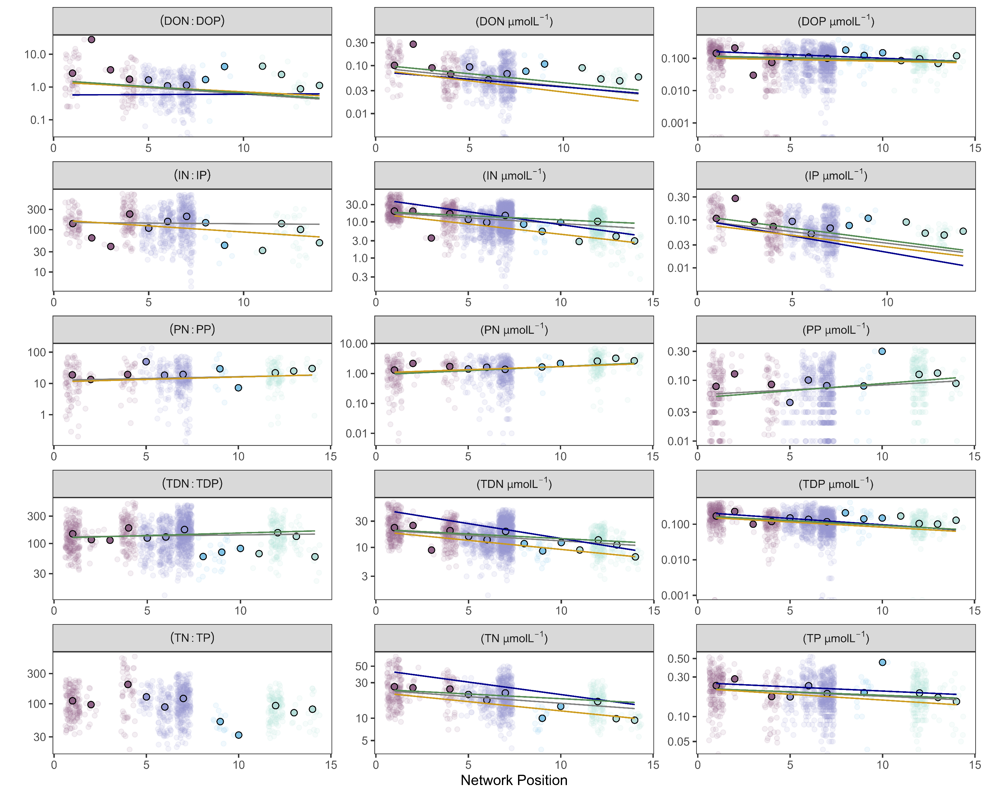
Subwatershed
GL5
GL4
GL3
ALB
Seasonal slope
Global
Winter
Snowmelt runoff
Summer

