Slide 1
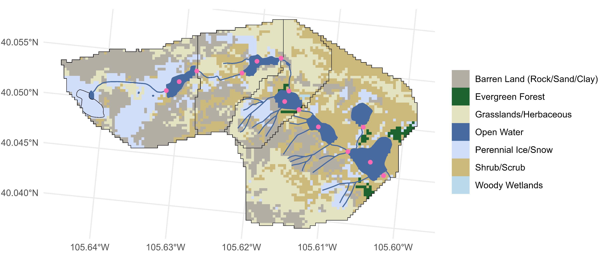
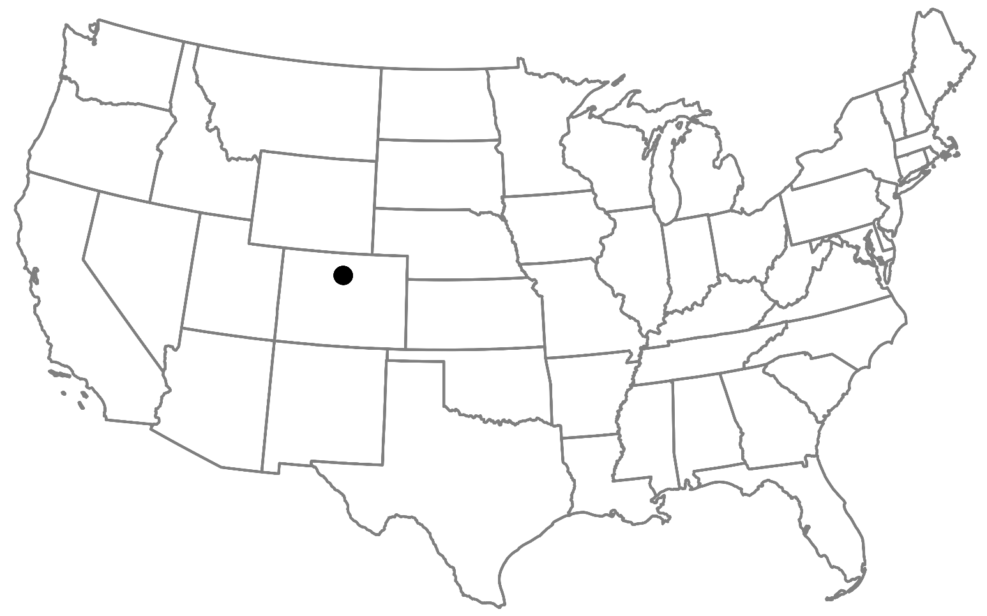
GL4
GL3
Total drainage area: 5.5 km²
Elevation: 3748 m at Arikaree Glacier to 3352 m at Albion outlet
GL5
ALB
27.3%
1.25%
23.8%
Arikaree Glacier
5.17%
14.8%
27.6%
0.07%
Flow direction

Slide 2
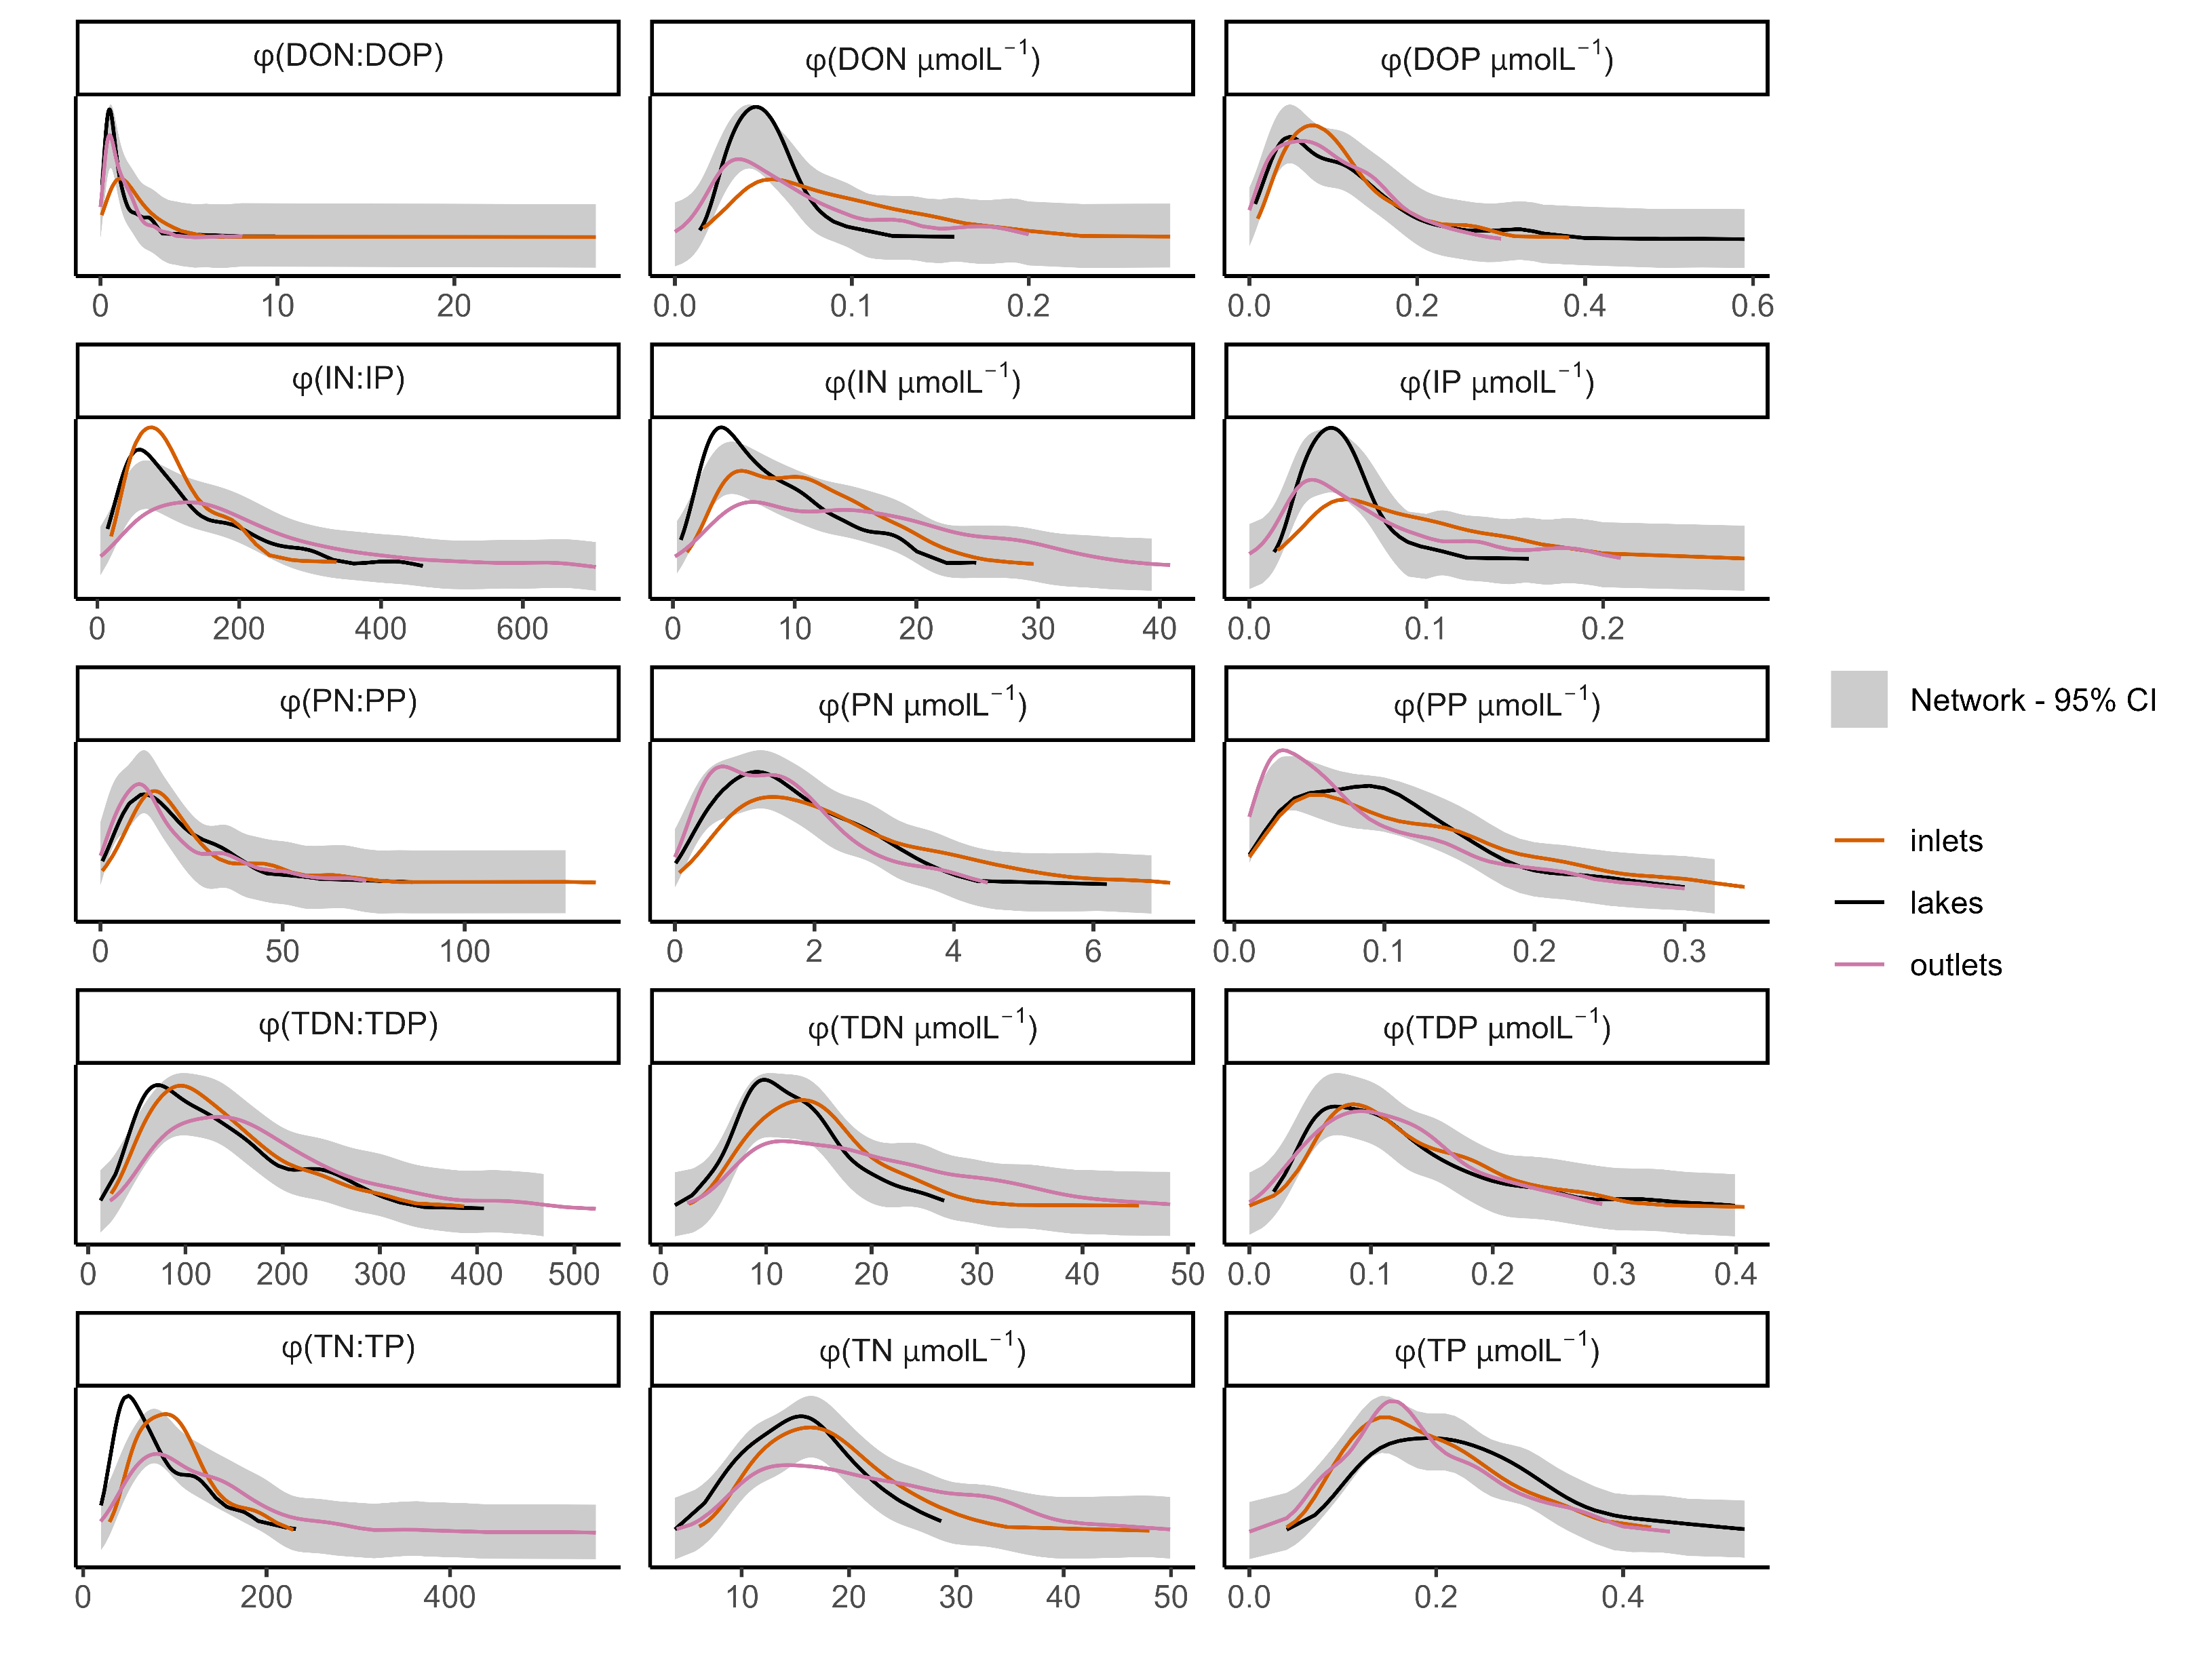
a, b, b
a, b, c
a, b, ab
a, ab, c
a, b, c
a, b, c
a, ab, b
a, b, b
a, a, b
a, a, b
a, b, c
a, a, a
a, b, c
a, b, c
a, b, a

Slide 3
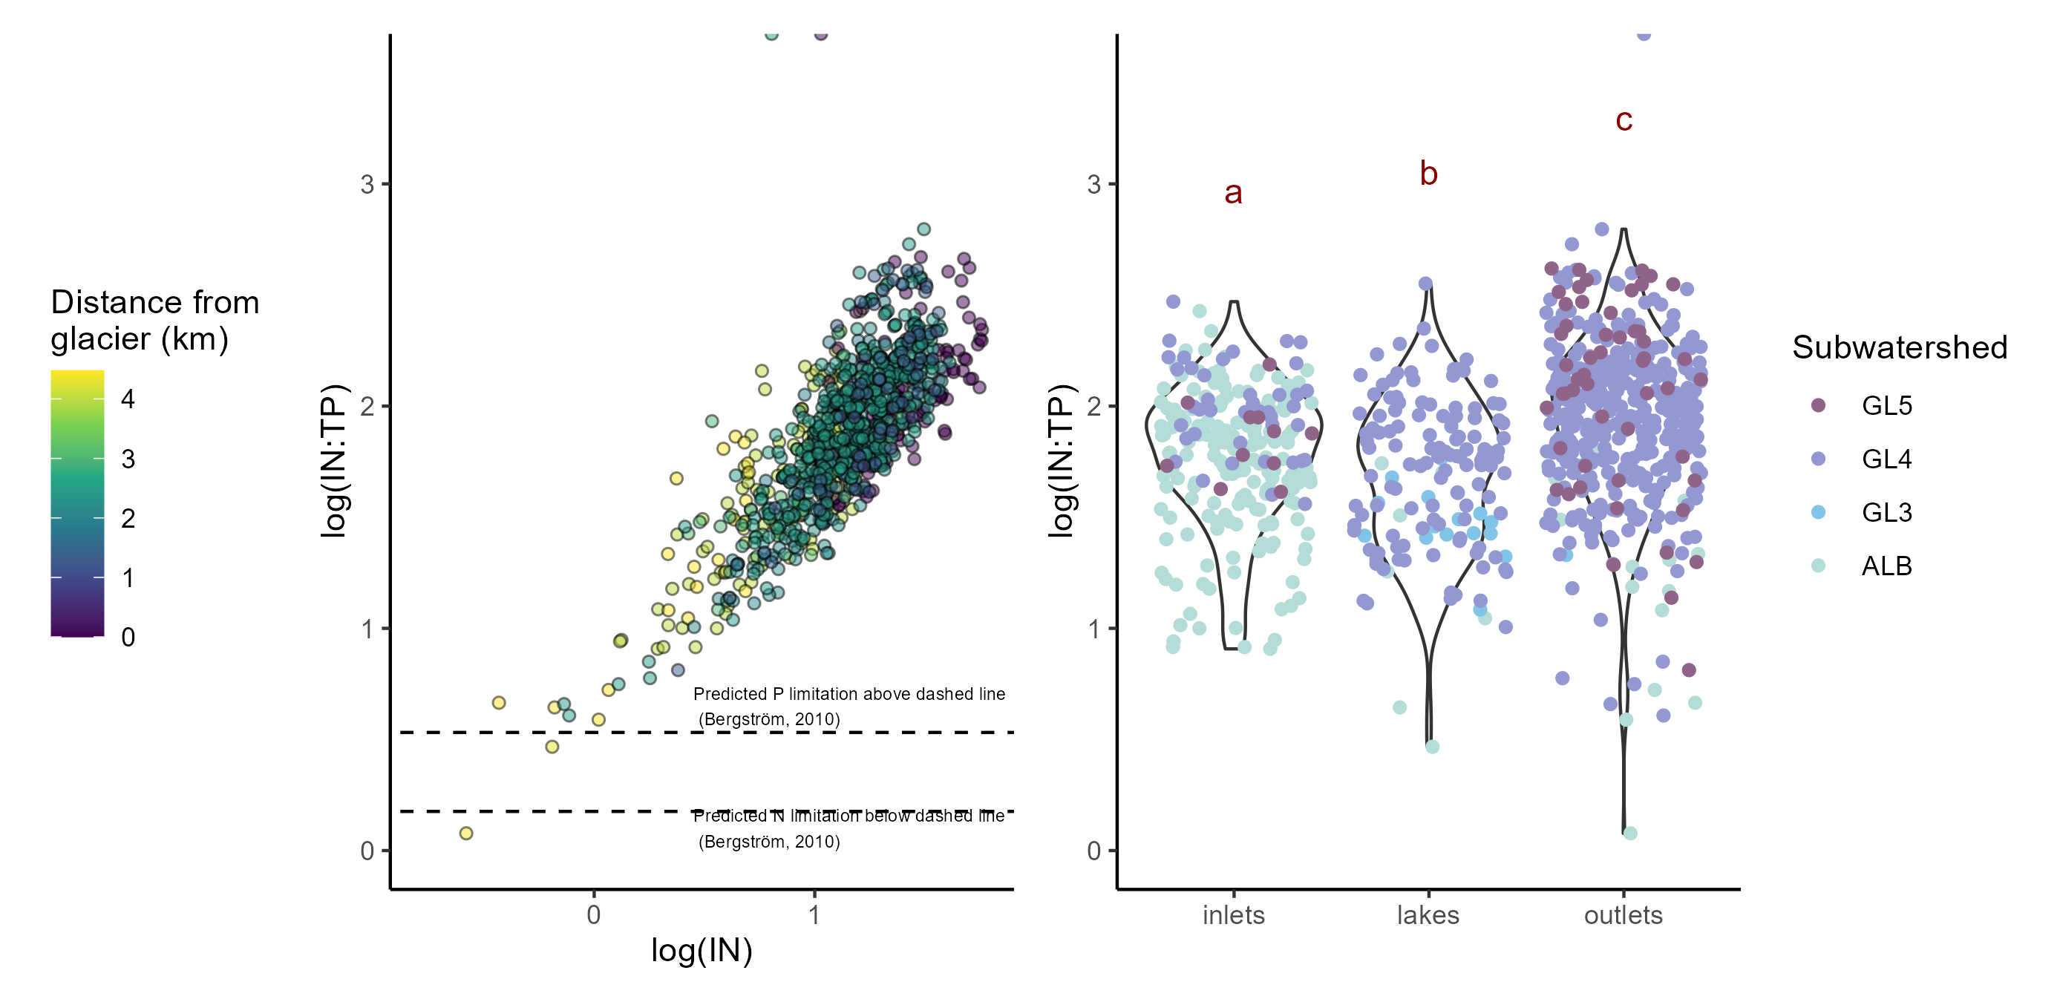
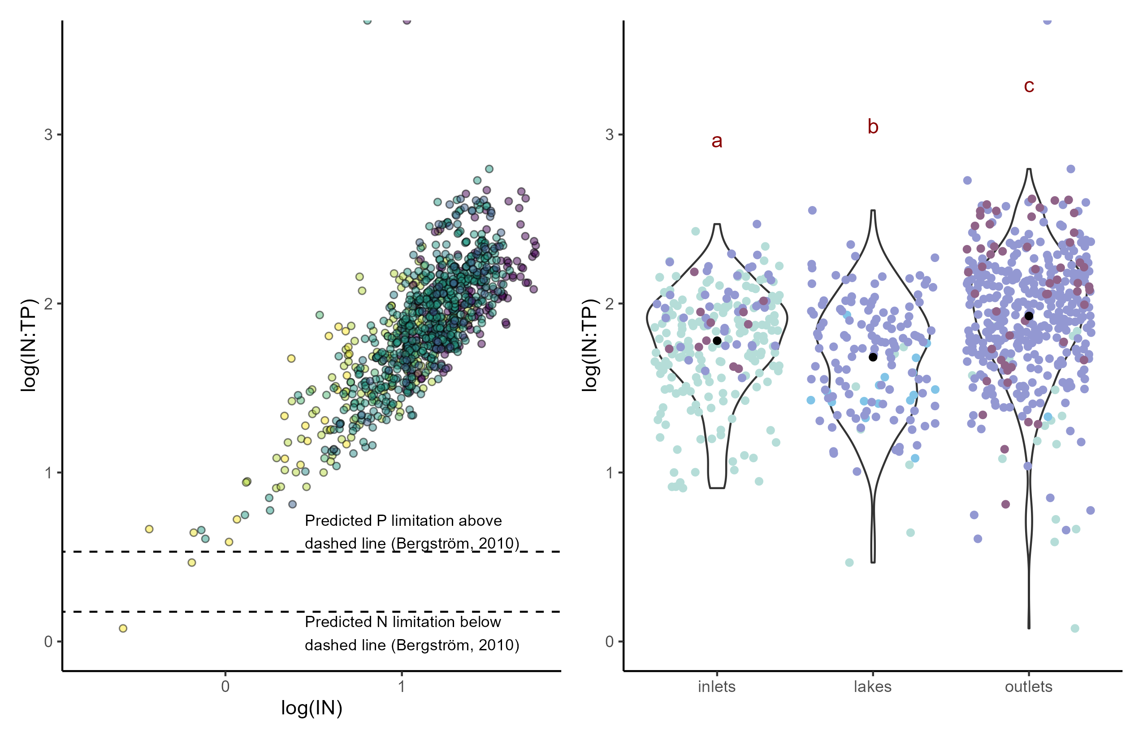
a)
b)

