Slide 1
JavaScript ES6 EcmaScript 2015

Slide 2
let operator
function func() {
if (true) {
let tmp = 123;
}
console.log(tmp); // ReferenceError: tmp is not defined
}
function func() {
if (true) {
var tmp = 123;
}
console.log(tmp); // 123
}

Slide 3
const
let operator
function func() {
let foo = 5;
if (···) {
let foo = 10; // shadows outer `foo`
console.log(foo); // 10
}
console.log(foo); // 5
}
let foo = 'abc';
foo = 'def';
console.log(foo); // def
const foo2 = 'abc';
foo2 = 'def'; // TypeError

Slide 4
Arrow function
f = v => v + 1;
Usage example:
var arr = [1,2,3];
arr.forEach(i=>console.log(i));
Arrow function with multiple parameters
f = (x,y) => x+y;
f(1,2) === 3;
Arrow function with function body
f = (x,y) => {
console.log(x,y);
return x+y;
}
var f = function (v) { return v + 1; })

Slide 5
Property Shorthand
obj = { x, y }
same as obj = { x: x, y: y };
Computed Property Names
obj = {
foo: "bar",
[ "prop_" + foo() ]: 42
}
obj = { foo: "bar" };
obj[ "prop_" + foo() ] = 42;
Method Properties
obj = {
foo (a, b) { … },
bar (x, y) { … },
*quux (x, y) { … }
}
obj = {
foo: function (a, b) { … },
bar: function (x, y) { … },
// quux: no equivalent in ES5 …
};

Slide 6
var list = [ 1, 2, 3 ];
var a = list[0], b = list[2];
var tmp = a; a = b; b = tmp;
var tmp = getASTNode();
var op = tmp.op;
var lhs = tmp.lhs;
var rhs = tmp.rhs;
var list = [ 7, 42 ];
var a = list[0] !== undefined ? list[0] : 1;
var b = list[1] !== undefined ? list[1] : 2;
var c = list[2] !== undefined ? list[2] : 3;
var d = list[3] !== undefined ? list[3]
: undefined;
Array matching
var list = [ 1, 2, 3 ]
var [ a, , b ] = list
[ b, a ] = [ a, b ]
Object matching
var { op, lhs, rhs } = getASTNode()
Fail-soft matching
var list = [ 7, 42 ]
var [ a = 1, b = 2, c = 3, d ] = list // a === 7 b === 42
// c === 3 d === undefined

Slide 7
Array: new functions
[ 1, 3, 4, 2 ].find(x => x > 3) // 4
Object assigning
var dst = { quux: 0 }
var src1 = { foo: 1, bar: 2 }
var src2 = { foo: 3, baz: 4 }
Object.assign(dst, src1, src2)
dst.quux === 0
dst.foo === 3
dst.bar === 2
dst.baz === 4
String searching
"hello".startsWith("ello", 1) // true "hello".endsWith("hell", 4) // true "hello".includes("ell") // true "hello".includes("ell", 1) // true "hello".includes("ell", 2) // false
[ 1, 3, 4, 2 ].filter(function (x) {
return x > 3; })[0]; // 4
var dst = { quux: 0 };
var src1 = { foo: 1, bar: 2 };
var src2 = { foo: 3, baz: 4 };
Object.keys(src1).forEach(function(k) {
dst[k] = src1[k]; }); Object.keys(src2).forEach(function(e) {
dst[k] = src2[k]; });
"hello".indexOf("ello") === 1; // true "hello".indexOf("hell") === (4 - "hell".length);
"hello".indexOf("ell") !== -1; // true "hello".indexOf("ell", 1) !== -1; // true "hello".indexOf("ell", 2) !== -1; // false

Slide 8
Set
let s = new Set()
s.add("hello").add("goodbye").add("hello")
s.size === 2
s.has("hello") === true
for (let key of s.values()) // insertion order console.log(key)
Map
let m = new Map()
m.set("hello", 42)
m.set(s, 34)
m.get(s) === 34
m.size === 2
for (let [ key, val ] of m.entries()) console.log(key + " = " + val)
WeakSet/WeakMap
var weakSet = new WeakSet()
a = {}; // only objects allowed
weakSet.add(a);
weakSet.has(a); // true
a = null; // now a can be garbage collected
for (e in weakSet) console.log(e); // not working: WeakSet is not itarable

Slide 9
String Interpolation
var customer = { name: "Foo" }
var card = { amount: 7,
product: "Bar",
unitprice: 42 }
message = `Hello ${customer.name}, want to buy ${card.amount} ${card.product} for a total of ${card.amount * card.unitprice} bucks?`
var customer = { name: "Foo" };
var card = { amount: 7,
product: "Bar",
unitprice: 42 };
message = "Hello " + customer.name + ",\n" + "want to buy " + card.amount + " " + card.product + " for\n" + "a total of " + (card.amount * card.unitprice) + " bucks?";

Slide 10
New number functions
Number.isNaN(42) === false
Number.isNaN(NaN) === true
Number.isFinite(Infinity) === false
Number.isFinite(-Infinity) === false
Number.isFinite(NaN) === false
Number.isFinite(123) === true
Number.isSafeInteger(42) === true
Number.isSafeInteger(9007199254740992) === false
console.log(0.1 + 0.2 === 0.3) // false
console.log(Math.abs((0.1 + 0.2) - 0.3) < Number.EPSILON)
// true

Slide 11
Default Parameter Values
function f (x, y, z) {
if (y === undefined) y = 7;
if (z === undefined) z = 42;
return x + y + z;
}
f(1) === 50;
function f (x, y) {
return (x + y) * (a.length-2);
}
f(1, 2, "hello", true, 7) === 9;
function f (x, y = 7, z = 42) {
return x + y + z
}
f(1) === 50
Rest Parameters
function f (x, y, ...a) {
return (x + y) * a.length
}
f(1, 2, "hello", true, 7) === 9
Spread Operator
var params = [ "hello", true, 7 ]
var other = [ 1, 2, ...params ] // [ 1, 2, "hello", true, 7 ]
f(1, 2, ...params) === 9

Slide 12
Using this in callbacks
arr = [1,2,3];
arr.summarize = function() {
this.sum = 0;
this.forEach(function(e) { this.sum = this.sum+e; } );
// Callbacks are executed in their own context, this points to function, not arr
}
workaround:
arr.summarize = function() {
this.sum = 0;
var self = this;
this.forEach(function(e) { self.sum = self.sum+e; } );
}
another workaround:
this.forEach(function(e) { this.sum = this.sum+e; }.bind(this) );
lexical scoping “this”
arr.summarize = function() {
this.sum = 0; this.forEach(e=>{ this.sum = this.sum+e; });
}

Slide 13
Using classes
class Shape {
constructor (id, x, y) {
this.id = id
this.move(x, y)
}
move (x, y) {
this.x = x
this.y = y
}
}
Inheritance
class Rectangle extends Shape {
constructor (id, x, y, width, height) {
super(id, x, y)
this.width = width
this.height = height
}
}
class Circle extends Shape {
constructor (id, x, y, radius) {
super(id, x, y)
this.radius = radius
}
}
var Shape = function (id, x, y) {
this.id = id;
this.move(x, y);
};
Shape.prototype.move = function (x, y) {
this.x = x;
this.y = y;
};

Slide 14
Base class access
class Shape {
…
toString () {
return `Shape(${this.id})`
}
}
class Rectangle extends Shape {
constructor (id, x, y, width, height) {
super(id, x, y)
...
}
toString () {
return "Rectangle > " + super.toString()
}
}
class Circle extends Shape {
constructor (id, x, y, radius) {
super(id, x, y)
...
}
toString () {
return "Circle > " + super.toString()
}
}

Slide 15
Static members
class Circle extends Shape {
static defaultCircle () {
return new Circle("default", 0, 0, 100)
}
}
var defRectangle = Rectangle.defaultRectangle()
var defCircle = Circle.defaultCircle()
Getters/setters
class Rectangle {
constructor (width, height) {
this._width = width
this._height = height
}
set width (width) { this._width = width }
get width () { return this._width }
set height (height) { this._height = height }
get height () { return this._height }
get area () { return this._width * this._height }
}
var r = new Rectangle(50, 20)
r.area === 1000

Slide 16
Modules import/export
//lib/math.js
export function sum (x, y) { return x + y }
export var pi = 3.141593
// someApp.js
import * as math from "lib/math"
console.log("2π = " + math.sum(math.pi, math.pi))
// otherApp.js
import { sum, pi } from "lib/math"
console.log("2π = " + sum(pi, pi))
Marking a value as the default exported value
// lib/mathplusplus.js
export * from "lib/math"
export var e = 2.71828182846
export default (x) => Math.exp(x)
// someApp.js
import exp, { pi, e } from "lib/mathplusplus"
console.log("e^{π} = " + exp(pi))

Slide 17
Promises: built-in support
function msgAfterTimeout (msg, who, timeout) {
return new Promise((resolve, reject) => {
setTimeout(() => resolve(`${msg} Hello ${who}!`), timeout)
})
}
msgAfterTimeout("", "Foo", 100).then((msg) =>
msgAfterTimeout(msg, "Bar", 200)
).then((msg) => {
console.log(`done after 300ms:${msg}`)
});

Slide 18
Generators
function* range (start, end, step) {
while (start < end) {
yield start
start += step
}
}
for (let i of range(0, 10, 2)) {
console.log(i) // 0, 2, 4, 6, 8
}
function* genFunc() {
yield 'a';
yield 'b';
return 1;
}
genObj = genFunc();
genObj.next() // {value: "a", done: false}
genObj.next() // {value: "b", done: false}
genObj.next() // {value: 1, done: true}
arr = [...genFunc()]; // ['a', 'b']

Slide 19
Generators: example of use
function* objectEntries(obj) {
// In ES6, you can use strings
// or symbols as property keys,
// Reflect.ownKeys() retrieves both
let propKeys = Reflect.ownKeys(obj);
for (let propKey of propKeys) {
yield [propKey, obj[propKey]];
}
}
let jane = { first: 'Jane', last: 'Doe' };
for (let [key,value] of objectEntries(jane)) {
console.log(`${key}: ${value}`);
}
// Output:
// first: Jane
// last: Doe

Slide 20
Generators: recursion
function* foo() {
yield 'a';
yield 'b';
}
function* bar() {
yield 'x';
yield* foo();
yield 'y';
}
// Collect all values yielded by bar() in an array
let arr = [...bar()];
// ['x', 'a', 'b', 'y']

Slide 21
Generators: yielding arrays
function* bla() {
yield 'sequence';
yield* ['of', 'yielded'];
yield 'values';
}
let arr = [...bla()];
// ['sequence', 'of', 'yielded', 'values']

Slide 22
throw() signals an error
function* genFunc1() {
try {
console.log('Started');
yield; // (A)
} catch (error) {
console.log('Caught: ' + error);
}
}
> let genObj1 = genFunc1();
> genObj1.next()
Started
{ value: undefined, done: false }
> genObj1.throw(new Error('Problem!'))
Caught: Error: Problem!
{ value: undefined, done: true }

Slide 23
Generators for async calls
function asyncAdd(x, y) {
setTimeout(function() { it.next(x+y);}, 1000);
}
function *process() {
var res = yield asyncAdd(1,2);
var res2 = yield asyncAdd(res,3);
console.log(res2);
}
it = process();
it.next();
function asyncAdd(x, y, f) {
setTimeout(function() { f(x+y);}, 1000);
}
asyncAdd(1, 2, function(res) { asyncAdd(res, 3, function(res) { console.log(res); })
});
Notes:
https://davidwalsh.name/async-generators

Slide 24
Generators for async calls
function add(x,y) {
return new Promise(function(resolve,reject) {
setTimeout(()=>resolve(x+y), 1000);
});
}
run(function *main() {
var res1 = yield add(1,2);
var res2 = yield add(res1, 3);
console.log(res2);
});
function run(g) {
var it = g(), ret;
var iterate = (val)=>{
ret = it.next(val);
if (!ret.done) ret.value.then( iterate ); // wait on the promise
else setTimeout(()=>iterate(ret.value), 0); // avoid synchronous recursion
}
iterate();
}

Slide 25
Generators for async calls: add reject processing
function run(g) {
var it = g(), ret;
var exception = (e)=>it.throw(e);
var iterate = (val)=>{
ret = it.next(val);
if (!ret.done) ret.value.then( iterate, exception); // wait on the promise
else setTimeout(()=>iterate(ret.value), 0); // avoid synchronous recursion
}
iterate();
}

Slide 26
Generators for async calls with exceptions
function add(x,y) {
return new Promise(function(resolve,reject) {
setTimeout(()=>x>0?resolve(x+y):reject("x should be >0"), 1000);
});
}
run(function *main() {
try {
var res1 = yield add(0,2);
} catch(err) { console.log( "Error: " + err ); return;
}
var res2 = yield add(res1, 3);
console.log(res2);
});

Slide 27
Example: fetchJson with promises
function fetchJson(url) {
return fetch(url)
.then(request => request.text())
.then(text => {
return JSON.parse(text);
})
.catch(error => {
console.log(`ERROR: ${error.stack}`);
});
}
fetchJson('http://example.com/some_file.json')
.then(obj => console.log(obj));

Slide 28
Example: fetchJson with co library
const fetchJson = co(function* () {
try {
let request = yield fetch(url);
let text = yield request.text();
return JSON.parse(text);
}
catch (error) {
console.log(`ERROR: ${error.stack}`);
}
});

Slide 29
Example: fetchJson with async/await (ES7+)
async function fetchJson(url) {
try {
let request = await fetch(url);
let text = await request.text();
return JSON.parse(text);
}
catch (error) {
console.log(`ERROR: ${error.stack}`);
}
}
async declaration:
Async function declarations: async function foo() {}
Async function expressions: const foo = async function () {};
Async method definitions: let obj = { async foo() {} }
Async arrow functions: const foo = async () => {};

Slide 30
Example: async/await in TypeScript
async function startup() {
if (!await fs.exists(metabasePath)) {
await fs.mkdir(metabasePath);
}
if (!await fs.exists(coverartPath)) {
fs.mkdir(coverartPath);
}
console.log("Loading metabase...");
var metabaseJson: string;
try {
metabaseJson = await fs.readFile(metabaseFile, 'utf8');
} catch (x) {
console.log("No existing metabase found");
}
}

Slide 31
EcmaScript 2016 / ES7

Slide 32
ES7 async/await
function add(x,y) {
return new Promise(function(resolve,reject) {
setTimeout(()=>x>0?resolve(x+y):reject("x should be >0"), 1000);
});
}
async function main() {
var res = await add(1, 2);
var res2 = await add (res, 3);
console.log( res2 ); //6
}
main();

Slide 33
Exponentiation operator
x ** y
produce the same result as Math.pow(x,y)

Slide 34
Trailing commas in function parameters and arrays/objects
let obj = {
first: 'Jane',
last: 'Doe',
};
let arr = [
'red',
'green',
'blue',
];
console.log(arr.length); // 3
function foo(
param1,
param2,
) {}
foo(
'abc',
'def',
);

Slide 35
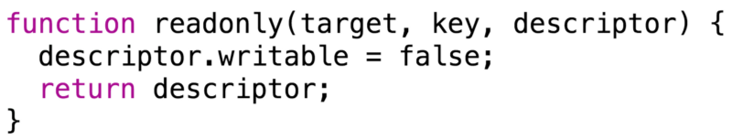
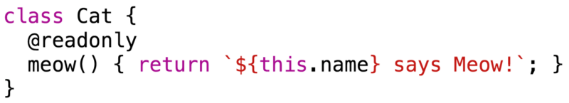
Decorators

Slide 36
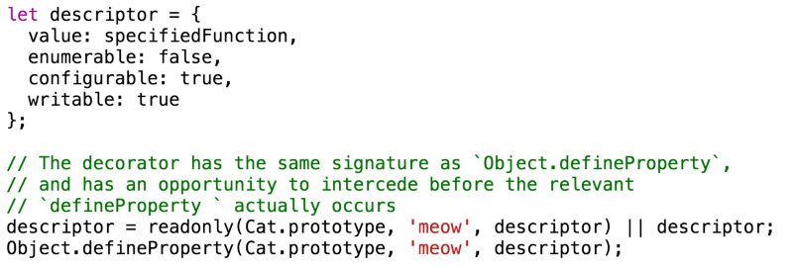
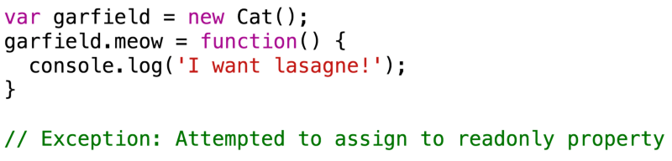
Decorators

Slide 37
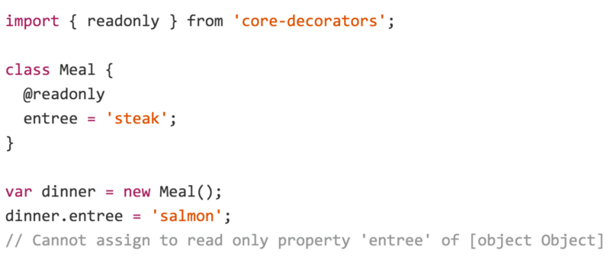
Decorators

Slide 38
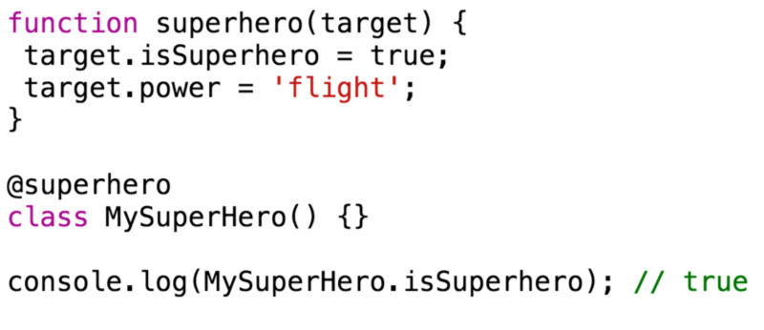
Decorating a class

Slide 39
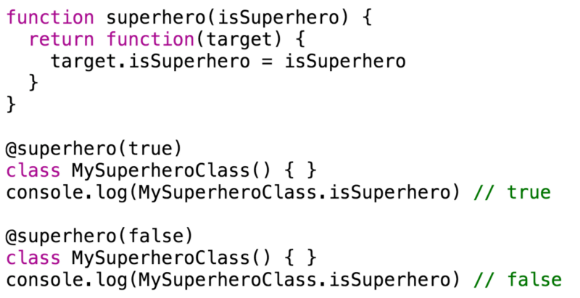
Decorator with the parameter

