Slide 1
Kickstarter Dataset… … when a crowdfunding campaign will be profitable?

Slide 2

Exploring the Platform Landscape
Kickstarter Dataset
Kickstarter is a dynamic global crowdfunding platform dedicated to bringing creative projects to life.
With $1.9 billion in pledges from 9.4 million backers, it has fueled 257,000 diverse projects, from films to technology.
It serves as the driving force behind transforming creative visions into reality worldwide... … but not every project is able to reach the goal...

Slide 3
The Purpose
Kickstarter Dataset
Only about 35% of the total projects
have raised successful fundings
Then, which projects can successfully achieve their goal?
Are there any key project characteristics that increases the chances of success?​

Slide 4
Launch-Date Deadline
Feature Extraction
year
month
day of launch
time interval
Title
length
use of "?!"
Country
continent

Slide 5
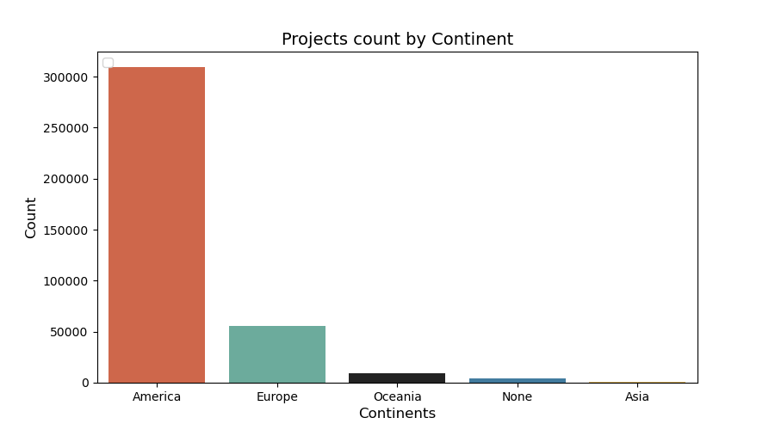
CONTINENT EXTRACTION & ANALYSIS
Looking for the continent with the highest number of projects
America dominates over other continents
Data are from Kickstarter, so these proportion don’t match reality

Slide 6
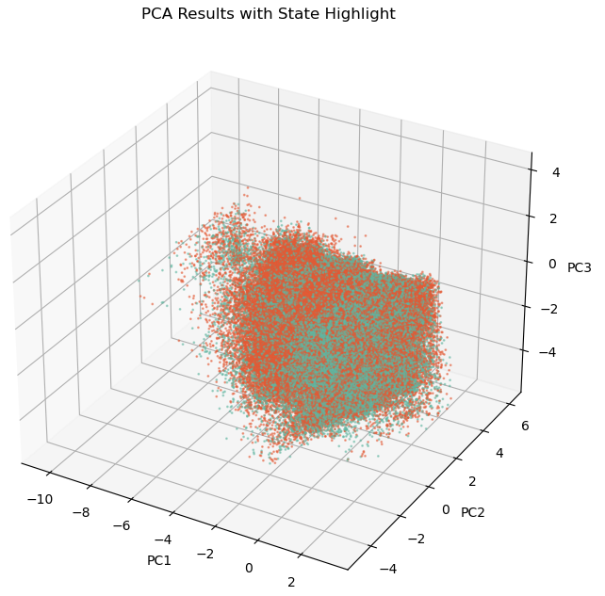
PCA - 3 Components
Features used
Goal - Year - Month – Day of week – Time interval – Length of title – Use of ?! - Category – Main Category - Currency - Continent
Fail
Success
Not very interesting…

Slide 7
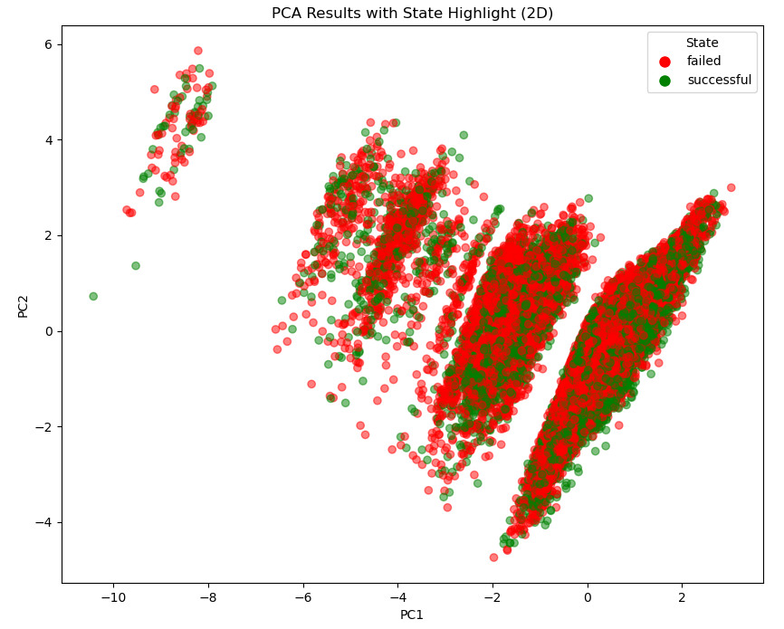
PCA - 2 Components
Features used
Goal - Year - Month – Day of week – Time interval – Length of title – Use of ?! - Category – Main Category - Currency - Continent
We can notice a clear separation between some areas of the points
Maybe some clustering technique can explain them better

Slide 8
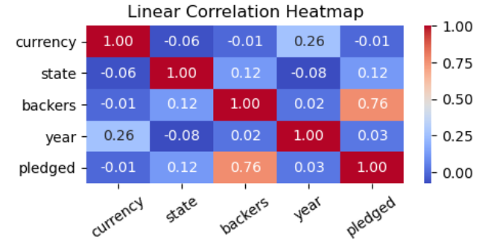
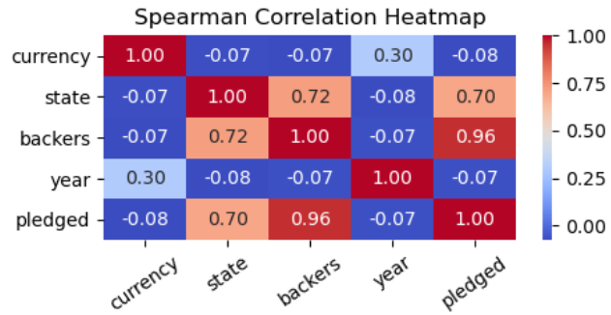
Correlation Analysis
Which variables are linearly correlated?
Can we find other variables
non-linear correlated?

Slide 9
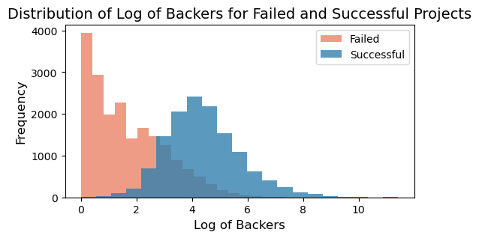
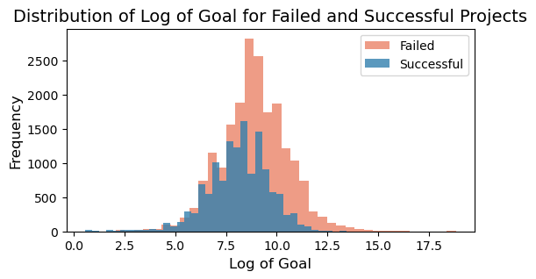
Correlation Analysis – Insight
0.72 correlation with number of backers
More supporters raise the probability of success
-0.22 correlation with the goal
Very high fundraising goals are difficult to achieve

Slide 10
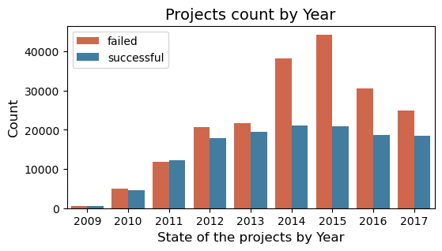
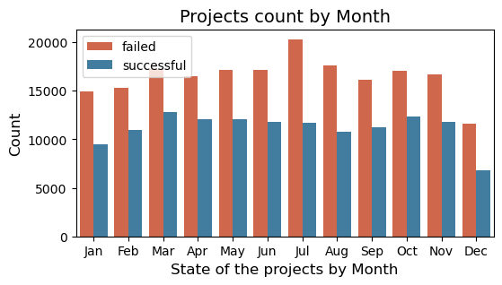
Temporal Analysis
How the period and the duration of a campaign influence the outcome?
Crowdfunding platforms have followed a growing trend
Less interesting information can be extrapolated from a seasonal analysis

Slide 11
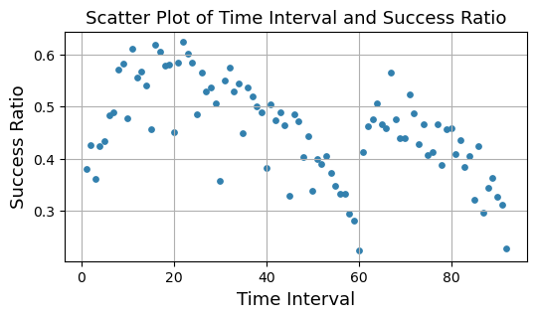
Temporal Analysis
Relation between the duration and the success rate
The bivariate distribution shows a bimodal behavior
A short-medium interval seems to be the best choice

Slide 12
Categories Analysis – A Big Picture
Best and worst categories for success/fail ratio
Rank | Category | Success/Fail Ratio
1 | Dance | 1.9
2 | Theater | 1.8
... | ... | ...
14 | Journalism | 0.32
15 | Technology | 0.31
niche but very attractive
(3500 projects)
more frequent but less attractive
(27000 projects)
Niche categories gather more support while the more widespread ones have a lower success rate​

Slide 13
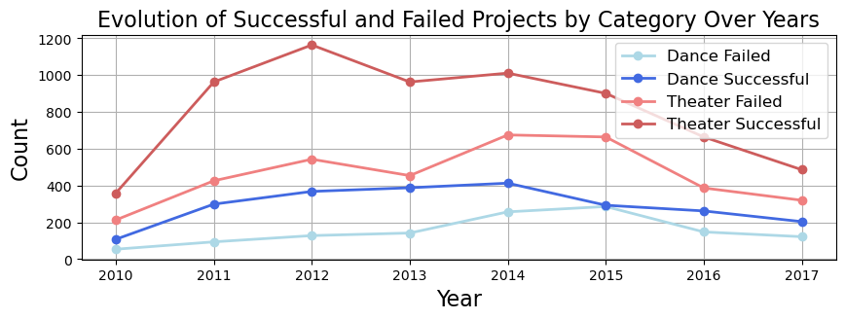
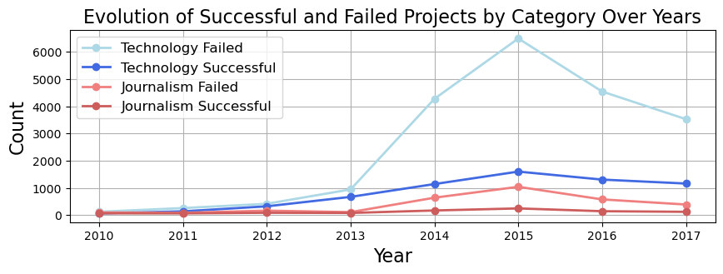
Categories Analysis – Trend
Examining category success growth over the years, distinguishing successful from unsuccessful, two patterns emerge:
Less frequent categories remain stable over time, maintaining a consistent success/failure ratio
Popular categories align with the overall trend each year: failures exceed successes in growth

Slide 14
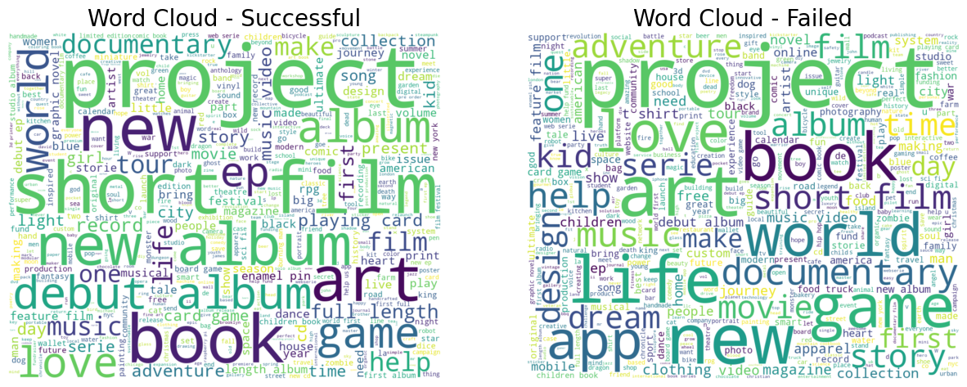
Title Analysis – most used words

Slide 15
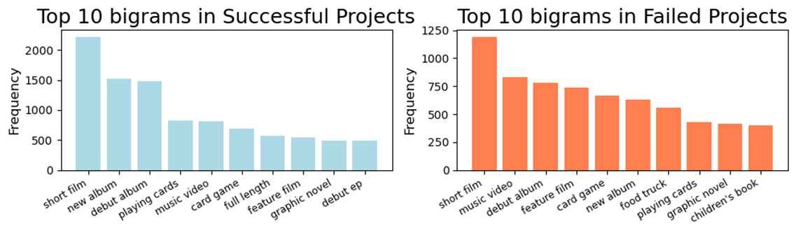

Title Analysis - Bigrams
Bigrams are two consecutive words that appear in a sentence
Similar bigrams but different frequencies
Bigram | Success rate | Fail rate
new album | 70.8% | 29.2%
debut album | 65.4% | 34.6%
short film | 65.1% | 34.9%

Slide 16
Classification - performance
Hyperparameter tuning: Grid search with Cross Validation (4 folds)
Backers, Pledged are a posteriori info: excluded from input features
MODEL | F1-score | AUROC | Accuracy
Decision Tree | 0.56 | 0.65 | 0.67
Gradient Boosting Trees | 0.68 | 0.75 | 0.69
Neural Network | 0.63 | 0.68 | 0.64
Logistic Regression | 0.59 | 0.65 | 0.62

Slide 17
Classification – Insight
Neural Network
Lack of flexibility in hidden’s activation functions
DT & GBT
Few descriptive features.
Shallow Tree structure
parameters
Hidden layers: (6,4,2)
stepsize = 0.01
DT
depth = 15
MinInstancePerNode = 80
GBT
depth = 5
stepsize = 0.2

Slide 18
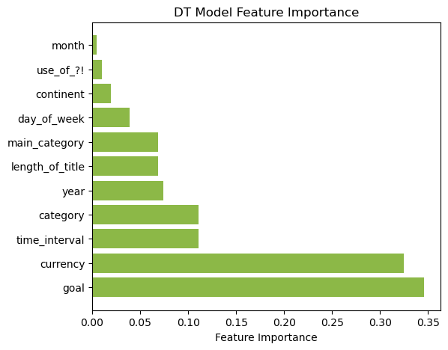
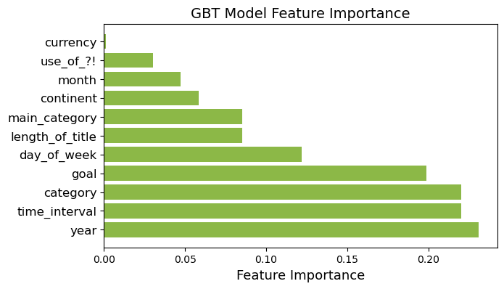
Classification - Feature Importance
goal, time_interval, category are the most important for both models
Feature extracted from title don't influence the outcome of a project

Slide 19
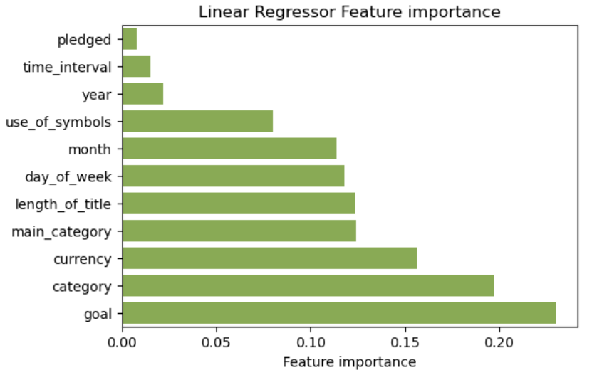
Linear Regression
Performance
Features not considered:
continent and backers
RMSE | 0.36
R^2 | 0.48
Features not considered:
continent, backers and pledged
Performance
Additional parameter: regularization value.
RMSE | 0.49
R^2 | 0.004
Feature importance

Slide 20
Conclusion
Our analysis tells an insightful story about crowdfunding projects, from 2011 to 2018
Annual and seasonal trends reveal significant shifts in the ratio between fundraisers and backers
Some categories outperform, particularly niche ones (Dance, Theater and Comics)
The title words and punctuation do not influence donors
Fundraiser tip: Choose goal and duration wisely
However, training a model to predict campaign outcomes in advance is challenging,
due to the limited availability of project informations

