Slide 1
Bar-Ilan University
Course - Advance Programming 2
Course Number - 818921101

Slide 2


Flight Gear Controller
Yair Yardeni
Linoy Sela

Slide 3
Information
In this project we implemented a joystick for flying a plane.
This Android application connects to Flight-Gear server, and give you a joystick, Rudder and Throttle Sliders to control the plane.
The application was written in Kotlin.

Slide 4
Information
We also use the MVVM architecture and divide the project to 3 main folders:
Model
ViewModel
View

Slide 5
Model
This part responsible on the logic behind our project.
The Client take care of the connection to the server.
The FlightControls has the functions for the plane that will be used in the FlightModel.
The FlightModel contains an objects of FlightControls and Client. Every action run in the same thread pool which contains one thread .

Slide 6
ViewModel
The ViewModel responsible on passing information on the flight from the View to the Model.

Slide 7
View
The View divide to the MainActivity file and to the Joystick file. The View handles the canvas drawings and touch events of the joystick and the sliders.
Every touch of the screen causes updates in the viewModel that updates the model (databinding).

Slide 8
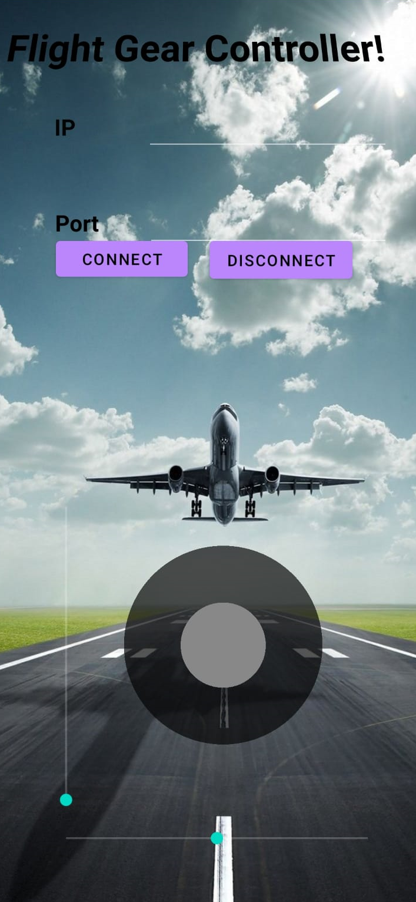
Enjoy!

