Slide 1
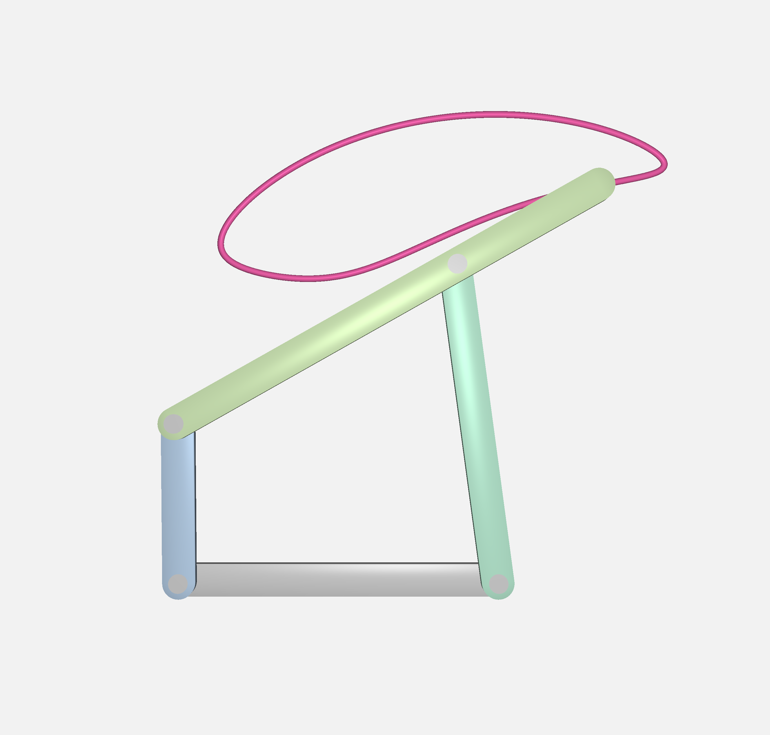
2
Joint 3
Link 3
y
x
Link 2
2
Joint 2
Link 1
x
1
y
x
y
Link 0
2
Joint 0
Joint 1
(a)
(b)
(c)

