Slide 1


MarvelBook

Slide 2

MarvelBook Outline
MarvelBook an exclusive social media for Super Heroes
Data set overview
Data structures overview
Walk-throughs feedback
Demo of Project
Q & A

Slide 3

MarvelBook Overview
MarvelBook is the special social media for Superheroes.
Functionality of MarvelBook:
Each of superheroes has own unique ID number and Login
Search a new friends by their names
Searching a new friends by their interests
Add or remove new or current friends
Check friend’s list of their friends
View friend’s profiles
Get friend’s recommendations from MarvelBook database

Slide 4
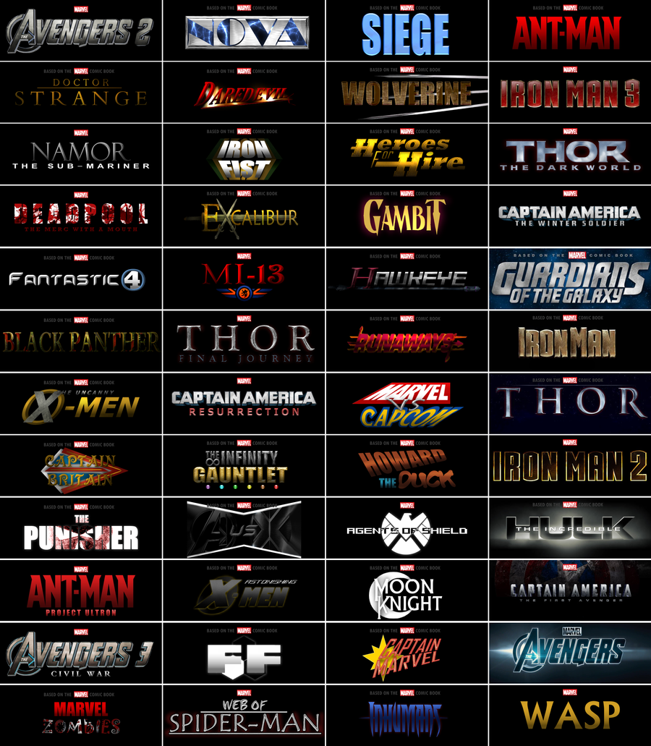



DATA SET
Sources of data set:
Marvel and DC movies
Marvel.com
Marveluniverselive.com
Fields of the data set:
First Name
Last Name
ID
City
Login and Password
Interests

Slide 5


Walk-through MarvelBook
Good job! Very efficient program
Easy to follow all steps of the program
You should not recommend to add person into your friend’s list if this person already there
Output should be more organized

Slide 6
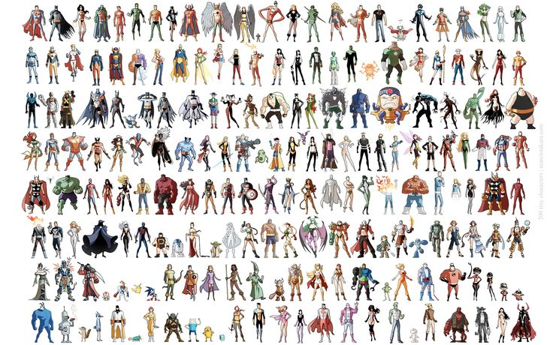
Live Demo of Project

Slide 7

Q & A

