Slide 1
ShopEasy Marketing Analytics
Linsi Zhong

Slide 2
INTRODUCTION
Business Challenges
Customer engagement and conversions are falling.
Marketing spend is increasing but ROI is weak.
Customer reviews suggest dissatisfaction, but no structured analysis has been done.
Objective
Diagnose the root causes of the 2024 performance drop.
Provide data-driven recommendations to improve marketing ROI, engagement, and conversions.

Slide 3
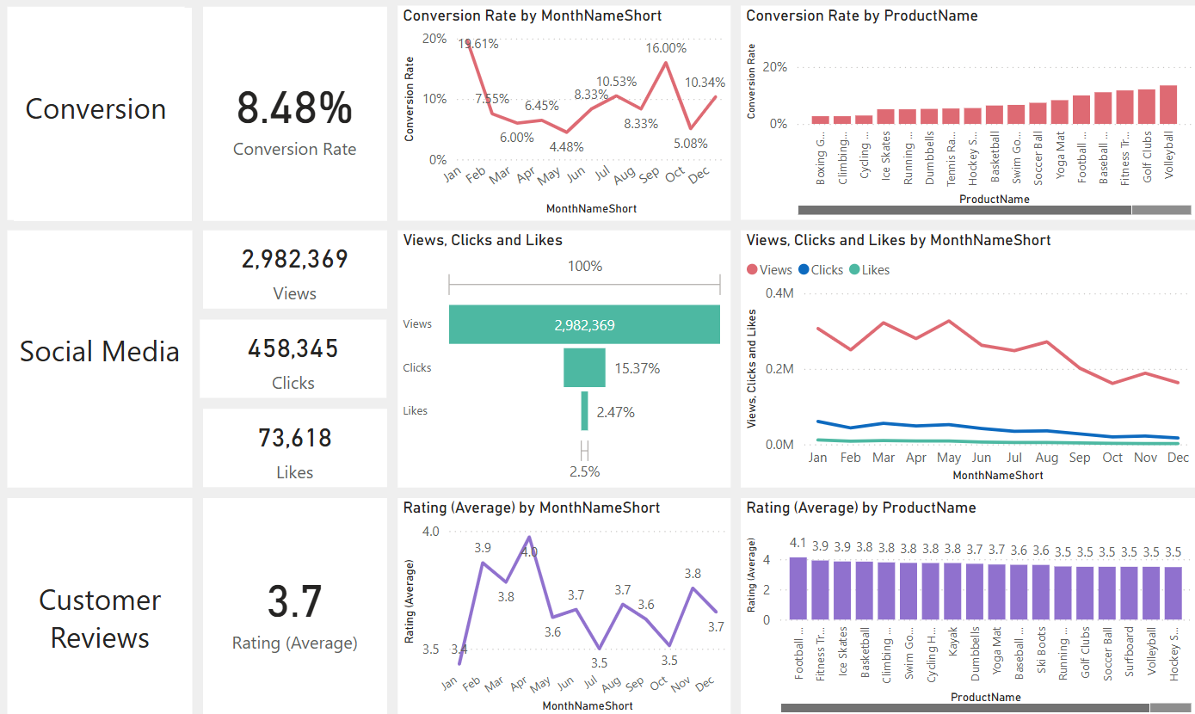
Key Insights - Overall
Decreased Conversion Rate: it had a rebound in September, but then experienced a notable drop
Reduced Customer Engagement
The average rating is below the target of 4.0

Slide 4
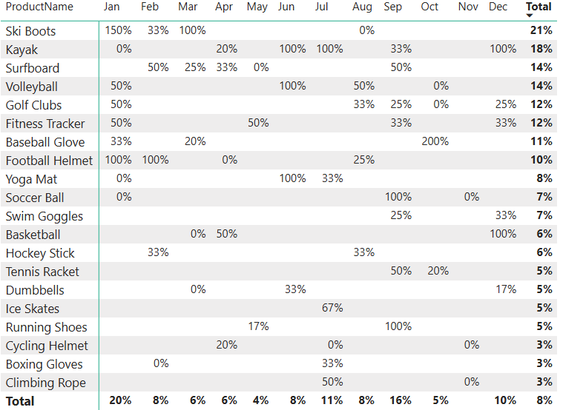
Key Insights – Conversion Rates
Seasonality Drives Conversions
Ski Boots dominate winter, Kayaks & Surfboards dominate summer, team sports gear spikes during their respective seasons.
Marketing Gaps
Many products only see short bursts of conversions, so campaigns may not sustain engagement year-round.
Opportunities
Focus on promoting underperforming products outside their peak season with bundled offers.
Leverage holiday sales (Oct–Dec) for fitness-related products.

Slide 5
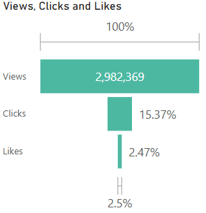
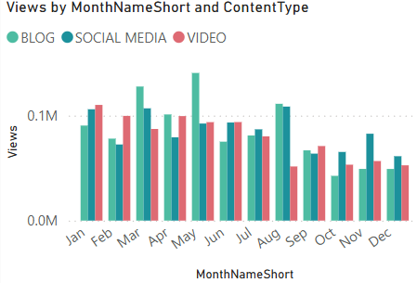
Key Insights – Customer Engagement
High Reach, Low Interaction
While total views (~3M) are strong, only 15% convert to clicks and 2.5% to likes.
Blogs & Social Media Work Best
Consistently higher engagement than video, which underperforms after early 2024.
Seasonal Gaps
Weak engagement during summer and holiday months.
Missing out on periods where competitors may be capturing attention.

Slide 6
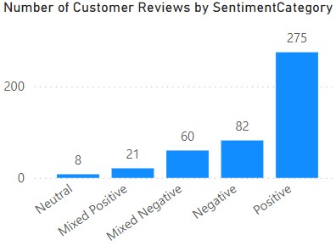
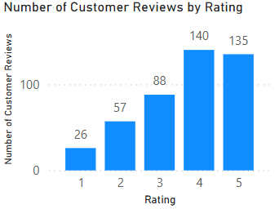
Key Insights – Customer Feedback
Sentiment Trends
Of the 446 analyzed reviews, over a quarter (28%) have a negative or mixed-negative sentiment.
many of these negative comments are related to specific issues, like "Terrible customer service," "Not worth the money," or "Did not meet my expectations."
Rating Distribution
The high number of 1, 2, and 3-star reviews directly impacts our average rating.

Slide 7
Recommendations
Leverage Seasonal Opportunities
Create year-round campaigns for products that currently only see seasonal conversion spikes, using bundled offers and promotions to sustain interest.
Capitalize on the holiday season (October–December) by promoting fitness-related products with targeted ads and special sales.
Optimize Marketing Channels
Shift marketing spend away from underperforming channels, specifically video, and reallocate resources to channels with higher engagement, such as blogs and social media.
Focus on quality of content to increase clicks and likes rather than just aiming for views.
Enhance Customer Satisfaction
Address common pain points in negative and mixed-negative reviews, such as unclear instructions, products not meeting expectations, and late deliveries.
Implement a proactive customer feedback loop to resolve issues before they result in a negative review.

