Slide 1


Slide 2


Slide 3
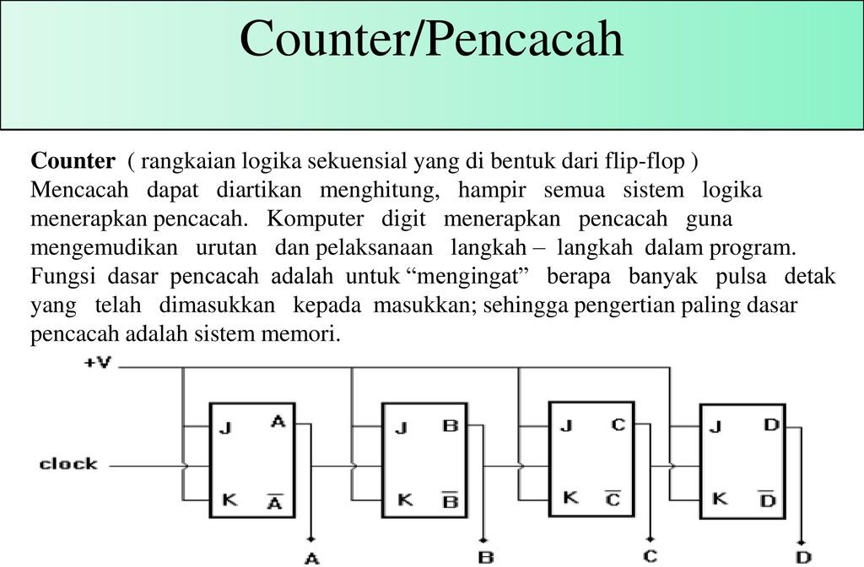

Slide 4
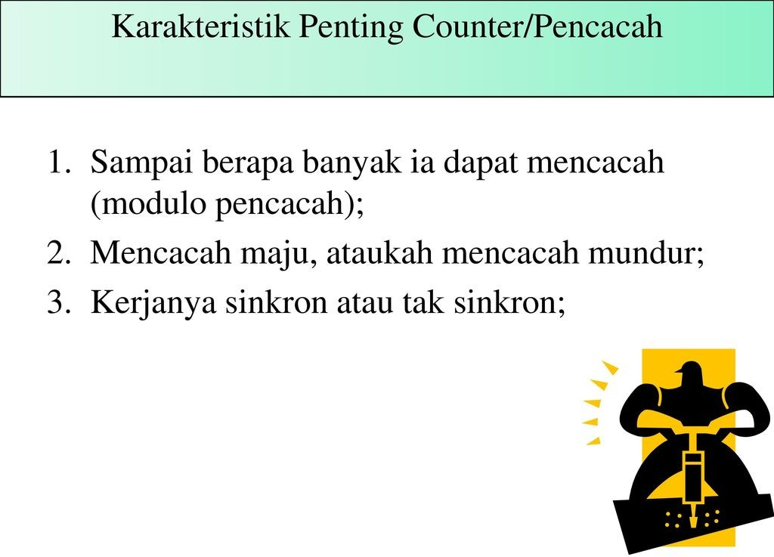

Slide 5
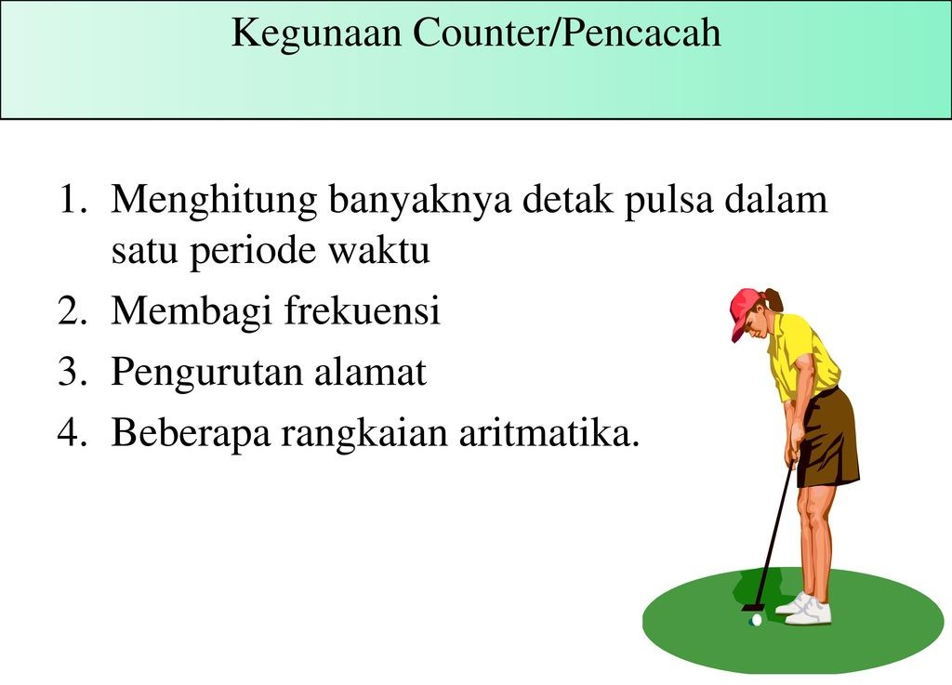

Slide 6
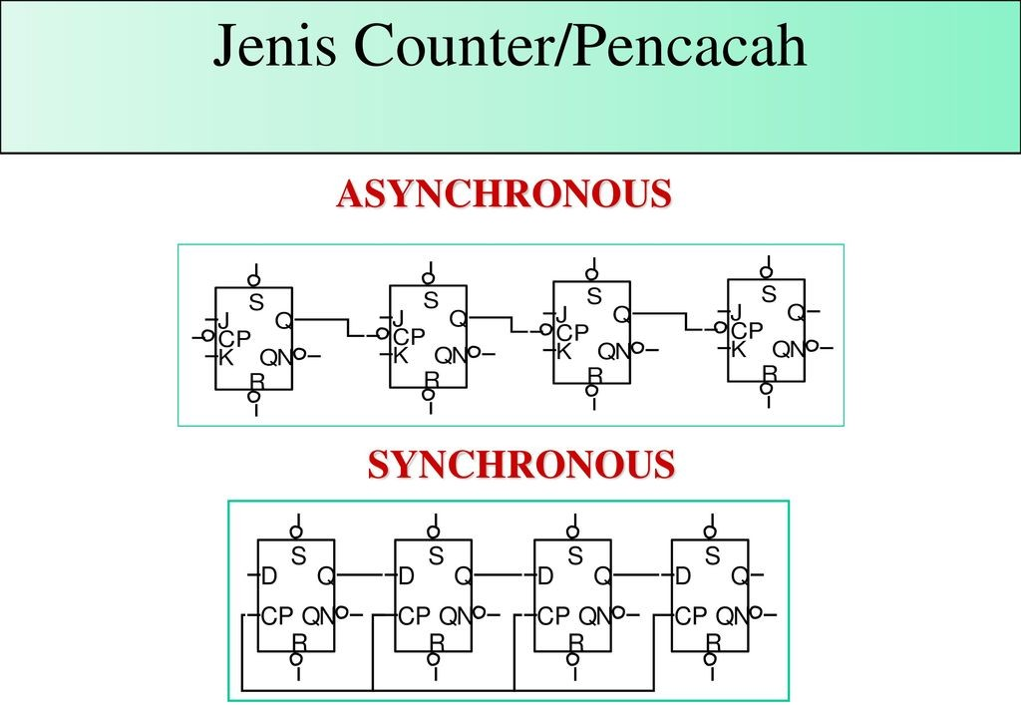

Slide 7
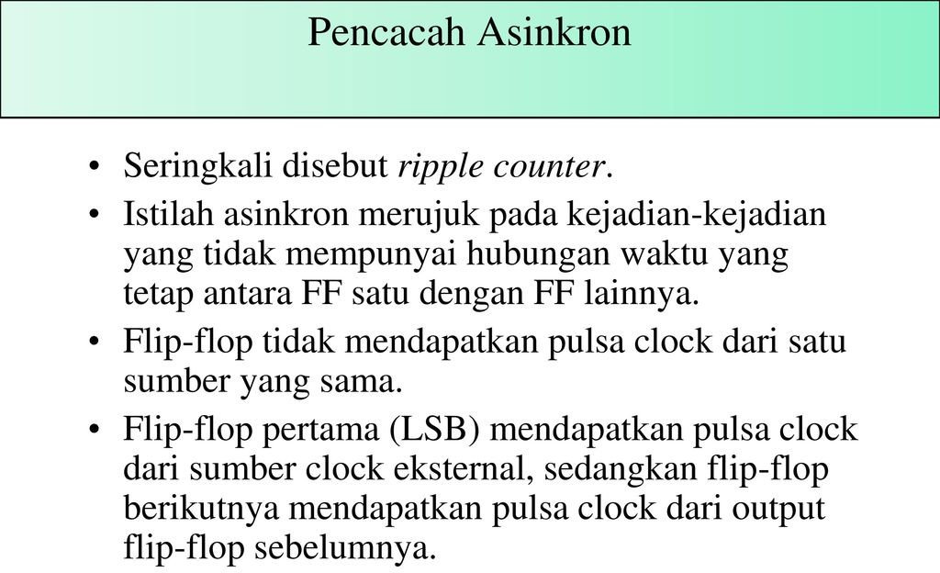

Slide 8
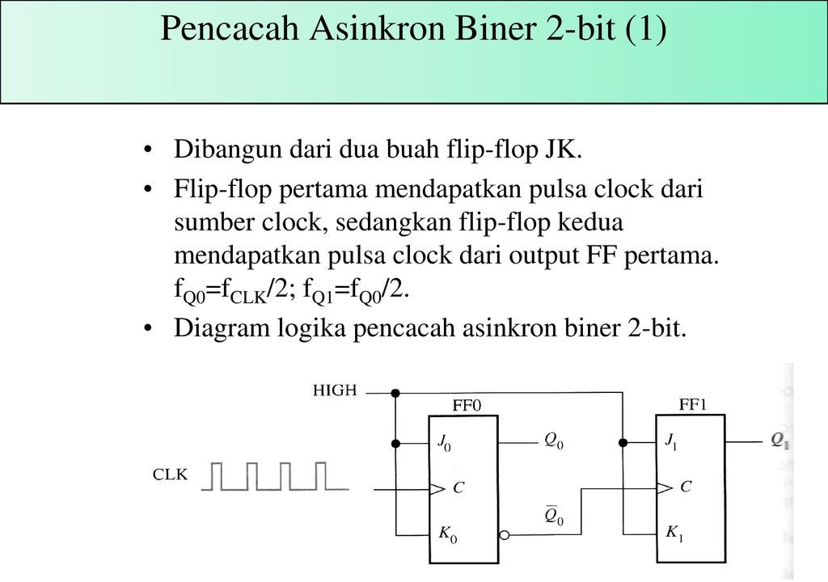

Slide 9
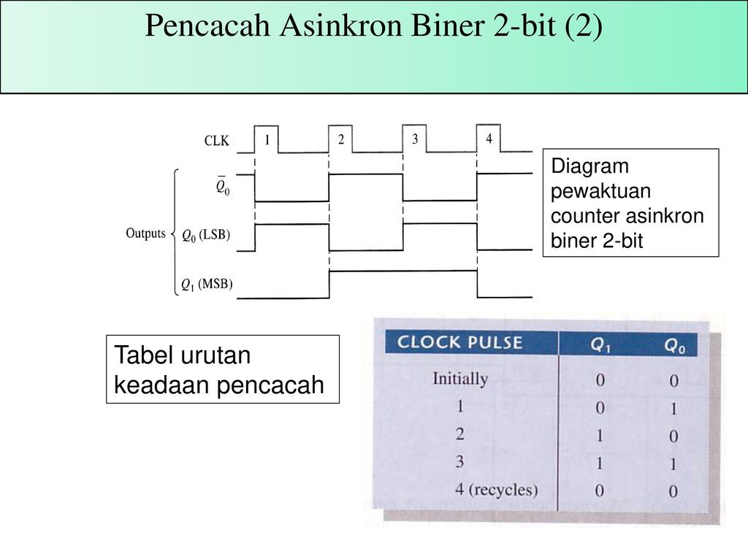

Slide 10
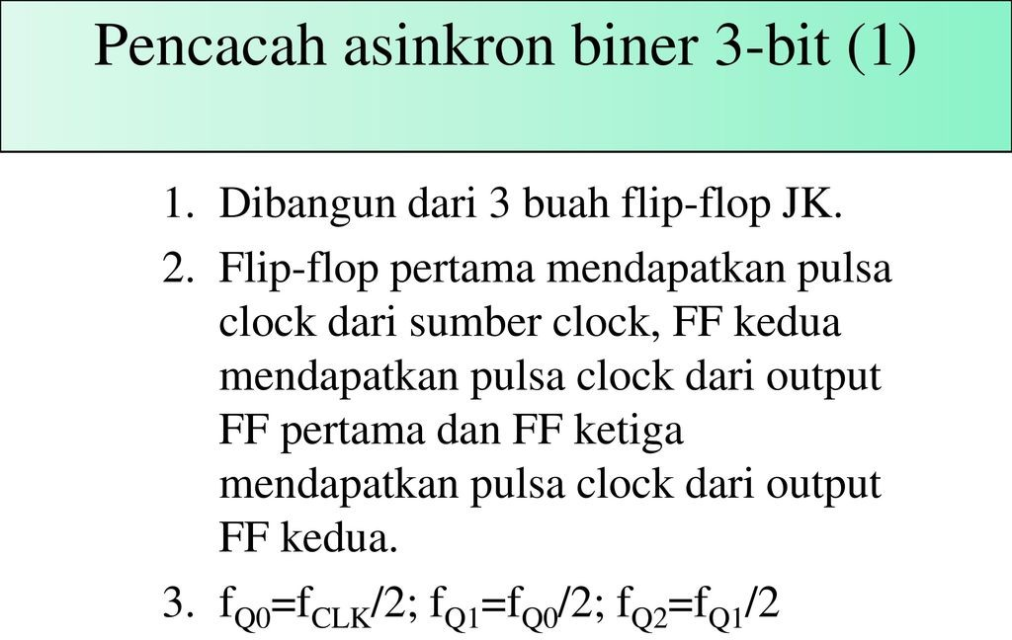

Slide 11
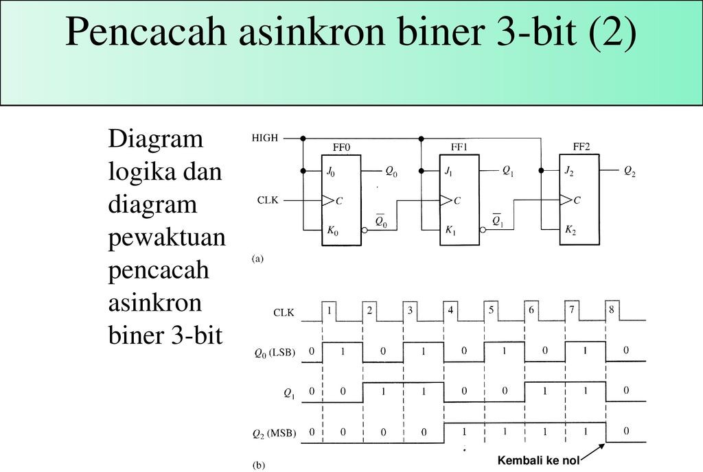

Slide 12
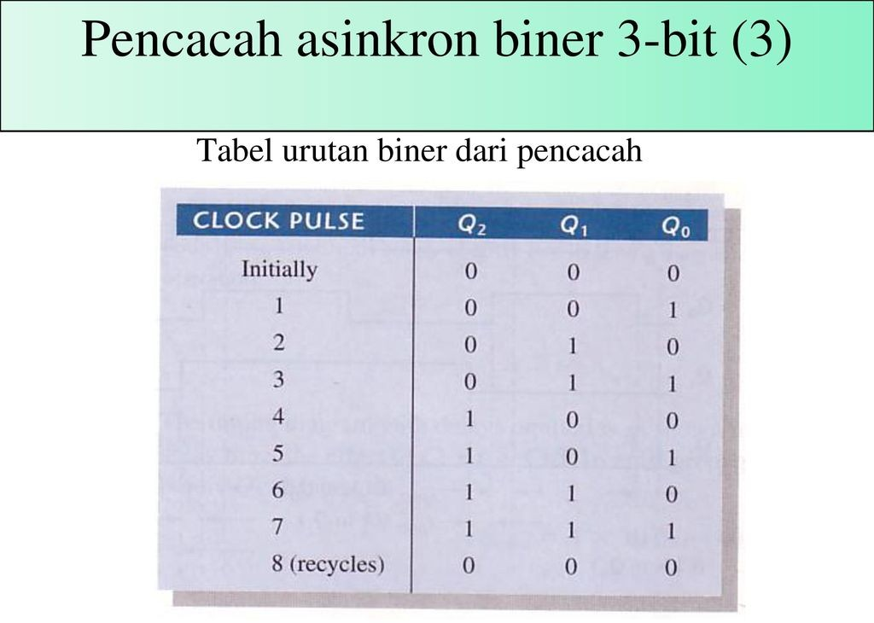

Slide 13
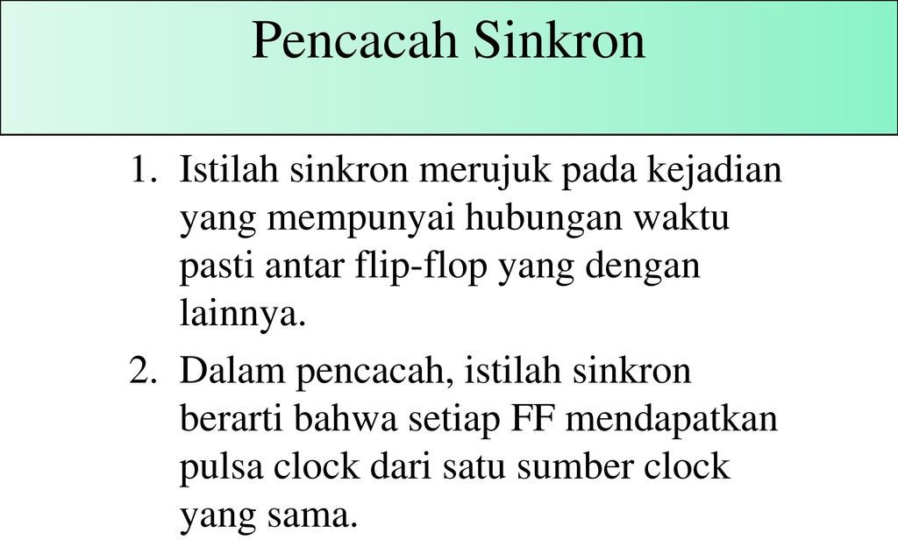

Slide 14
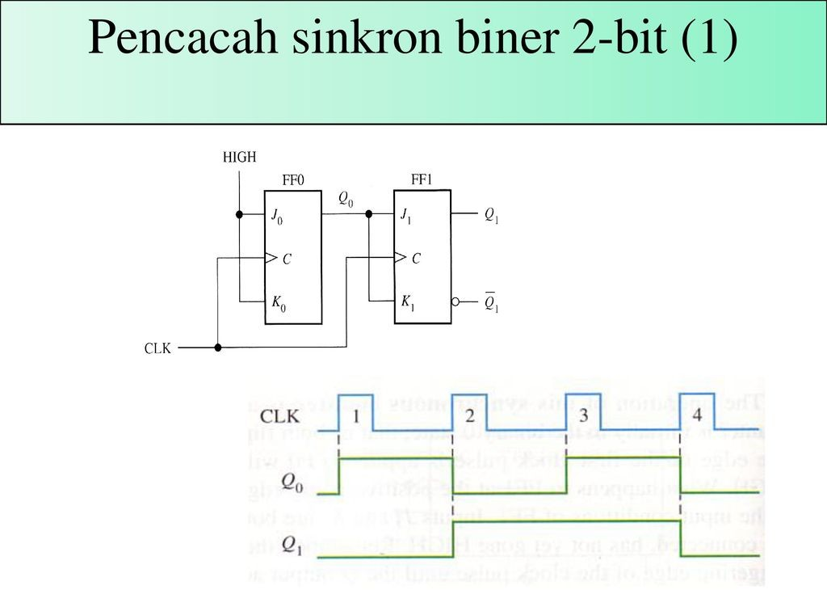

Slide 15
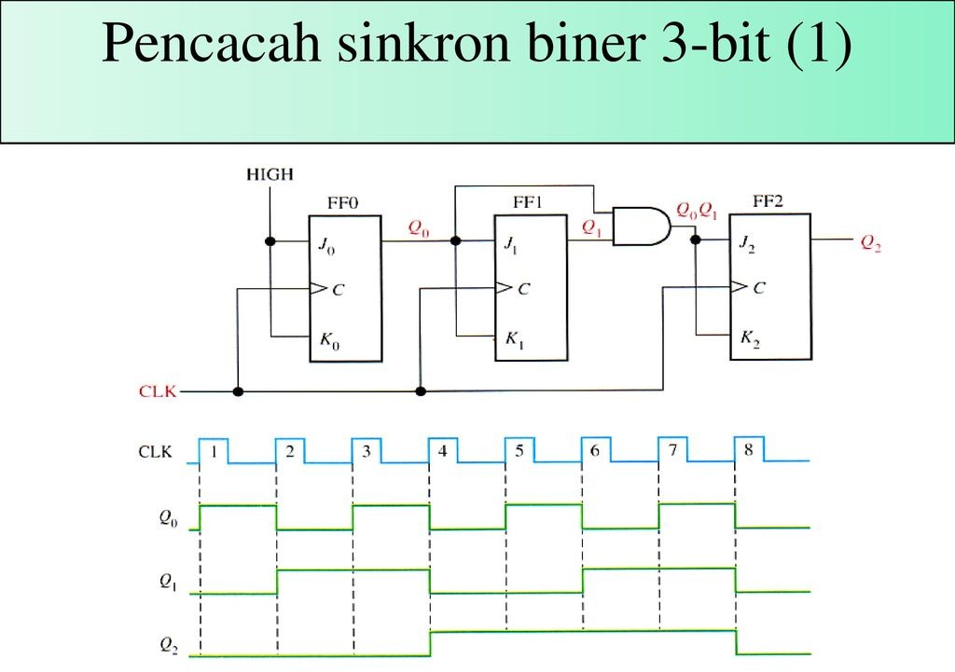

Slide 16
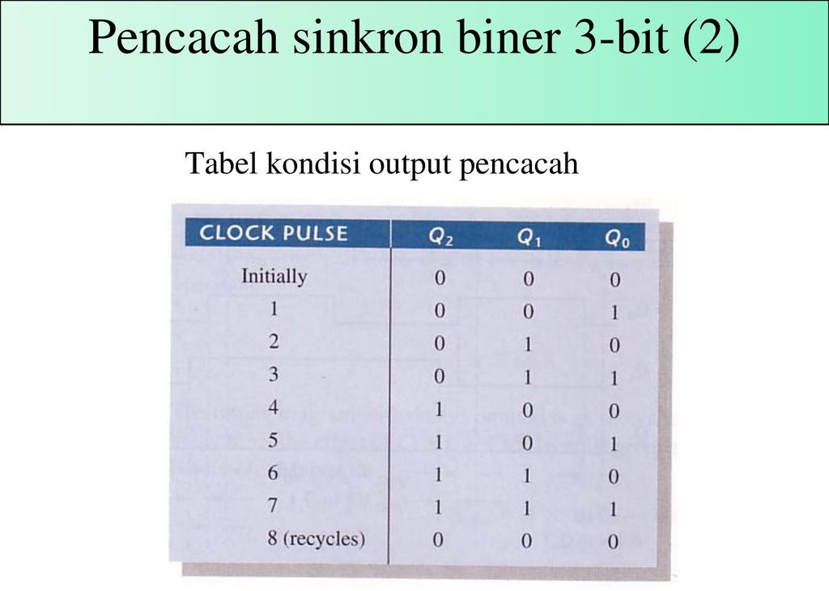

Slide 17
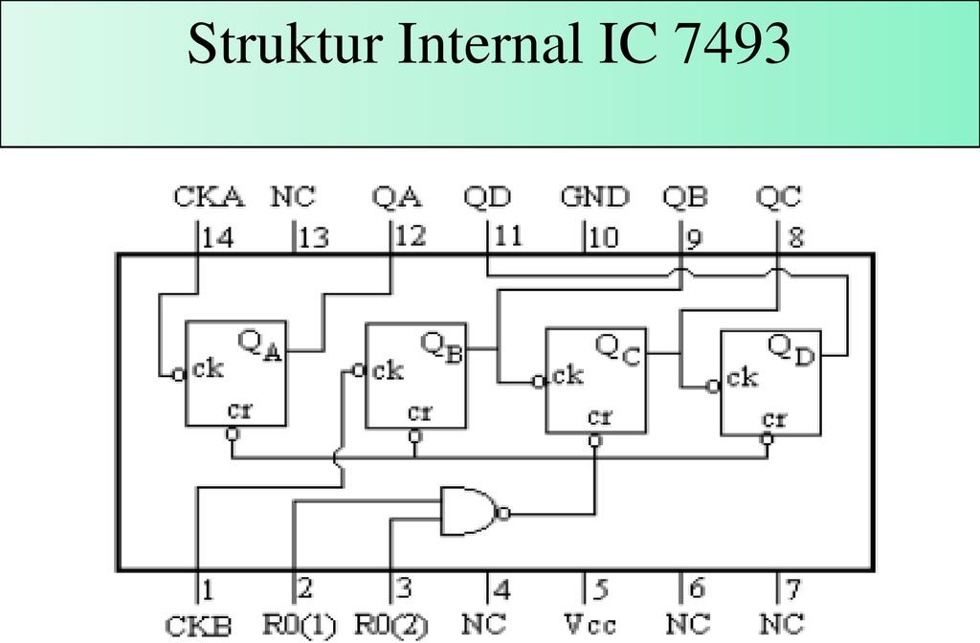

Slide 18
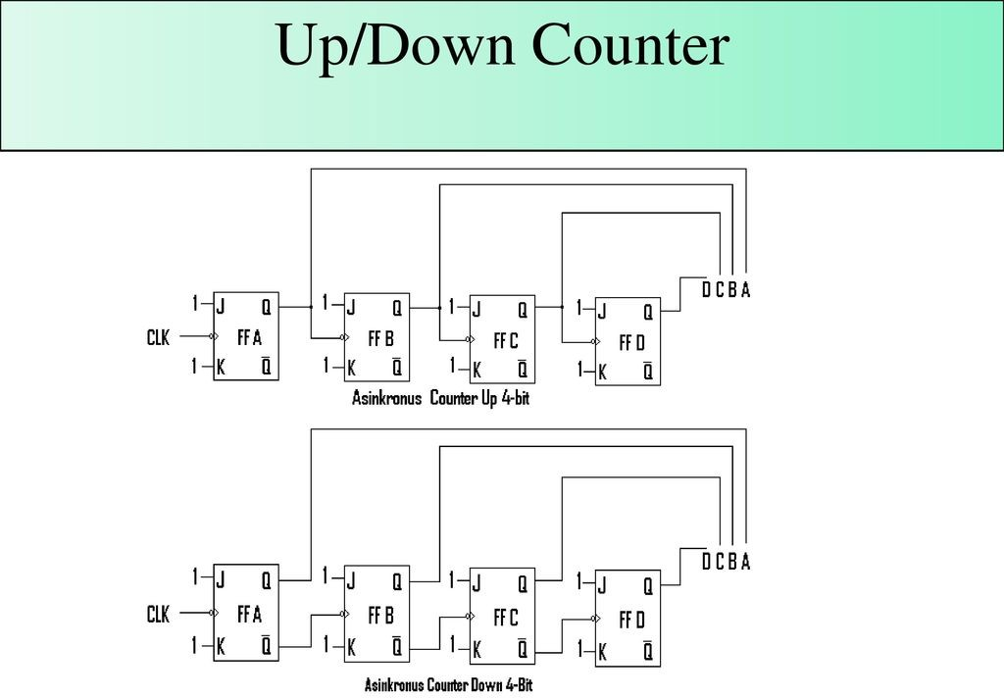

Slide 19
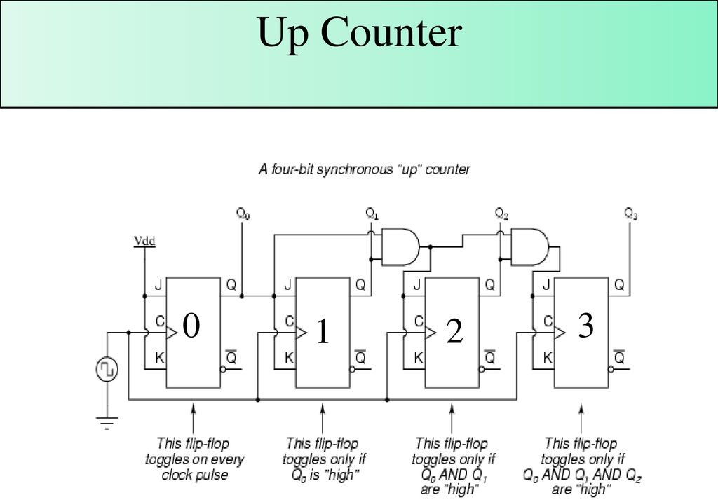

Slide 20
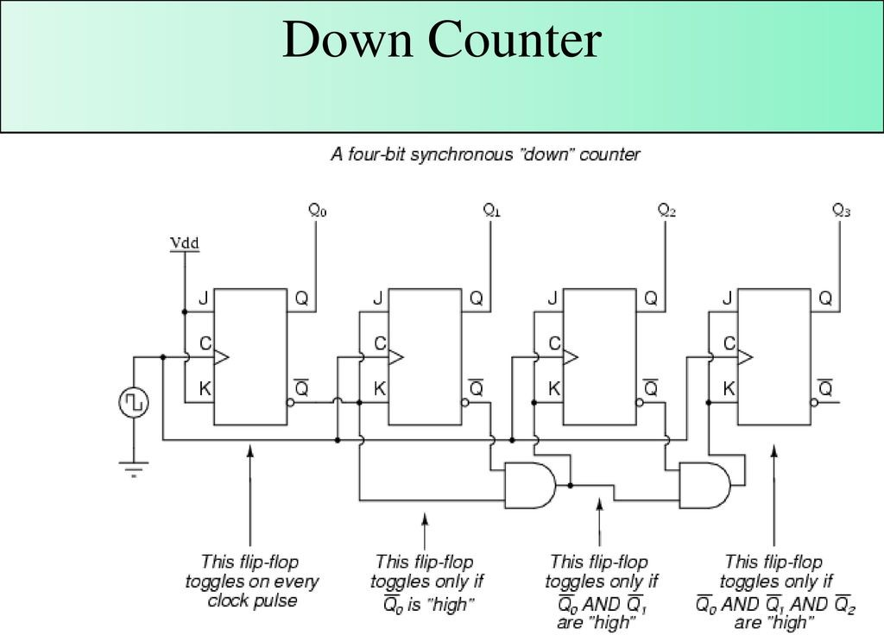

Slide 21
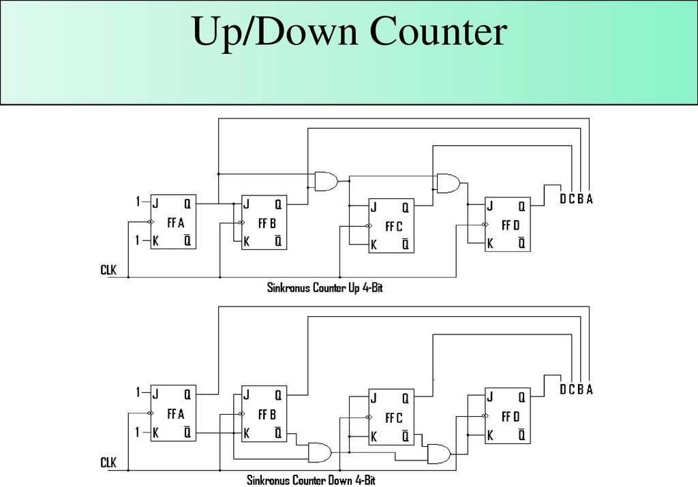

Slide 22
J | K | Q | Q’
0 | 0 | Q_{t-1} | Q’_{t-1}
0 | 1 | 0 | 1
1 | 0 | 1 | 0
1 | 1 | Q’_{t-1} | Q_{t-1}
Q | J | K | Q’
0 | 0 | 0
0 | 0 | 1
0 | 1 | 0
0 | 1 | 1
1 | 0 | 0
1 | 0 | 1
1 | 1 | 0
1 | 1 | 1
Q | Q’_{t+1} | J | K
0 | 0
0 | 1
1 | 0
1 | 1

