Slide 1
Symbolic Execution and
Program Testing
James C. King
IBM Thomas J. Watson Research Center
Speaker: Lintian Shi
2020/12/4
Notes:
大家好，我今天小组报告的题目是DSLabs平台介绍

Slide 2
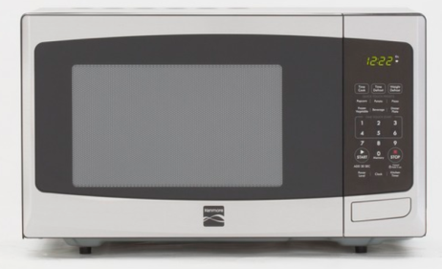


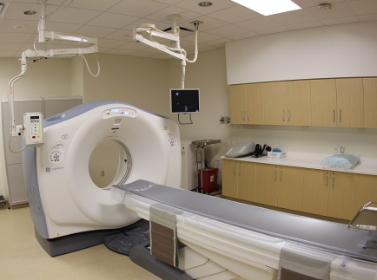


Program is everywhere
In our daily life
Medical treatment, finance, aerospace
Notes:
From daily life, medical, spacecraft

Slide 3
Unreliable programs bring losses
The destruction of NASA Mariner 1
Ignorance of an overbar in a written resulting in the coding of an incorrect formula in its Fortran software
Lost at least US$18.5 million
Therac-25 Accidents
A bug in the code controlling the Therac-25 radiation therapy machine
Directly responsible for at least five patient deaths
We need reliable programs!

Slide 4
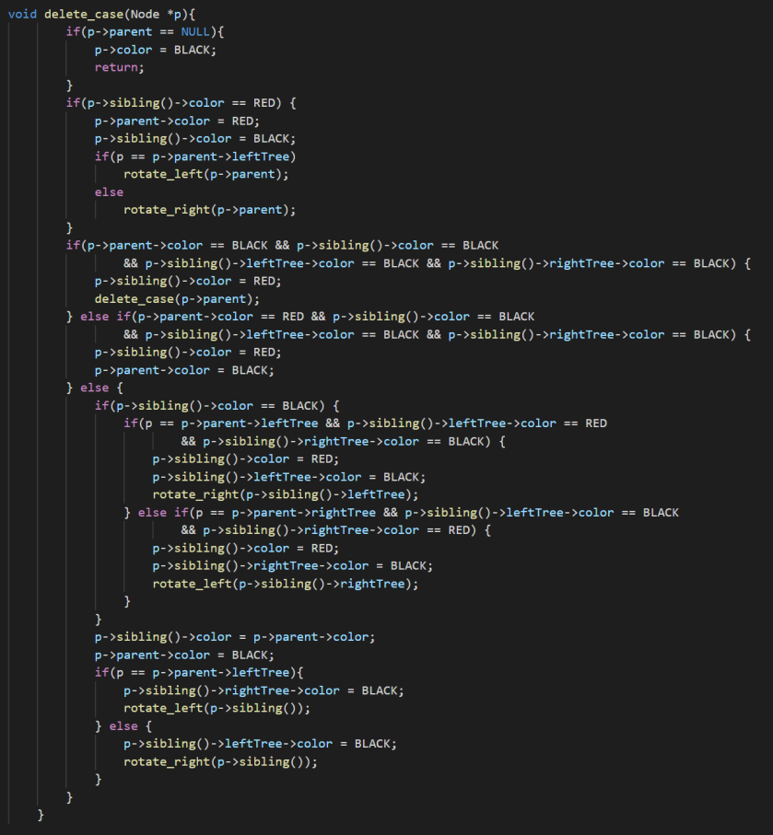
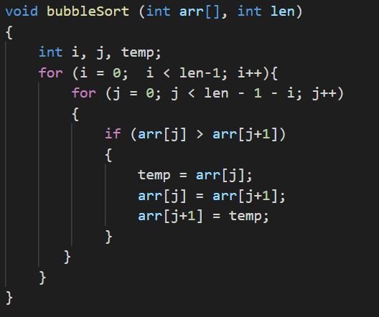
Motivation
The large-scale production of reliable programs is a challenging problem in 1970s and even today.
But it is difficult to verify the correctness of a program!
Is this bubble sort correct?
Is this red–black tree’s delete function correct?

Slide 5
Existing technology
Program proving
The programmer formally proves that the program meets its specification for all executions.
The practical accomplishments fall short of a tool for routine use.
There is no proof assistant in 1970s. Coq was first release in 1989 and TLA+ was introduced in 1999.
The confidence depends on the creation of the specification and the construction of proof steps, which are both error-prone.

Slide 6
Existing technology
Program testing
If the program is judged to produce correct results for some small sample data, it is assumed to be correct.
It is a big question of how to choose the sample. The sample data may not cover all executions.
“Program testing can be used to show the presence of bugs, but never to show their absence!” — Edsger W. Dijkstra

Slide 7
Existing technology
Program testing
Program proving
Being required to execute the program
Without being required to execute the program
The correct execution for inputs not in the sample being in doubt
Proving the program meets its specification for all executions
Easy to use
Difficult and tricky

Slide 8
Symbolic execution
This paper describes a practical approach between two extremes which is an enhanced testing technique.
Instead of executing programs on a set of sample inputs
A program is “symbolically” executed for a set of classes of inputs
Each symbolic execution result may be equivalent to a large number of normal test cases

Slide 9
Symbolic execution
This paper describes a practical approach between two extremes which is an enhanced testing technique.
Instead of executing programs on a set of sample inputs
A program is “symbolically” executed for a set of classes of inputs
Each symbolic execution result may be equivalent to a large number of normal test cases

Slide 10
Symbolic execution
The class of inputs characterized by each symbolic execution is determined by the dependence of the program’s control flow on its inputs

Slide 11
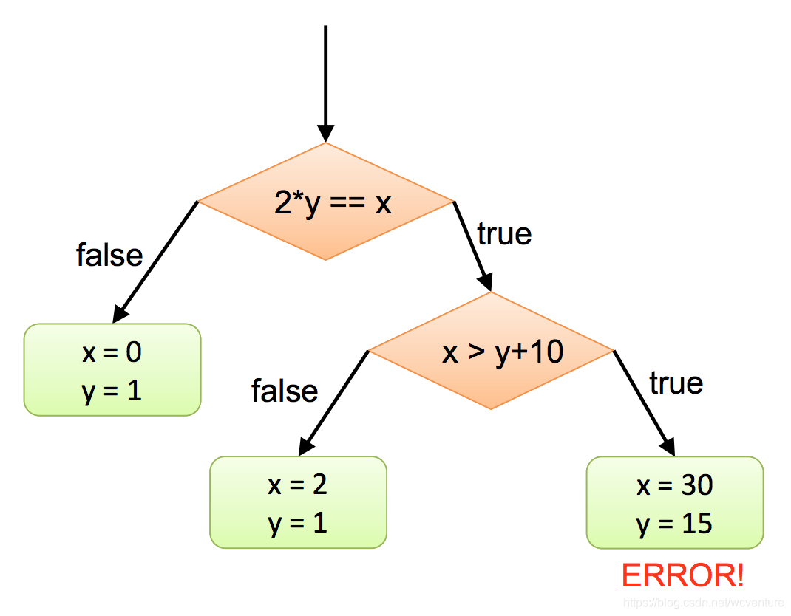
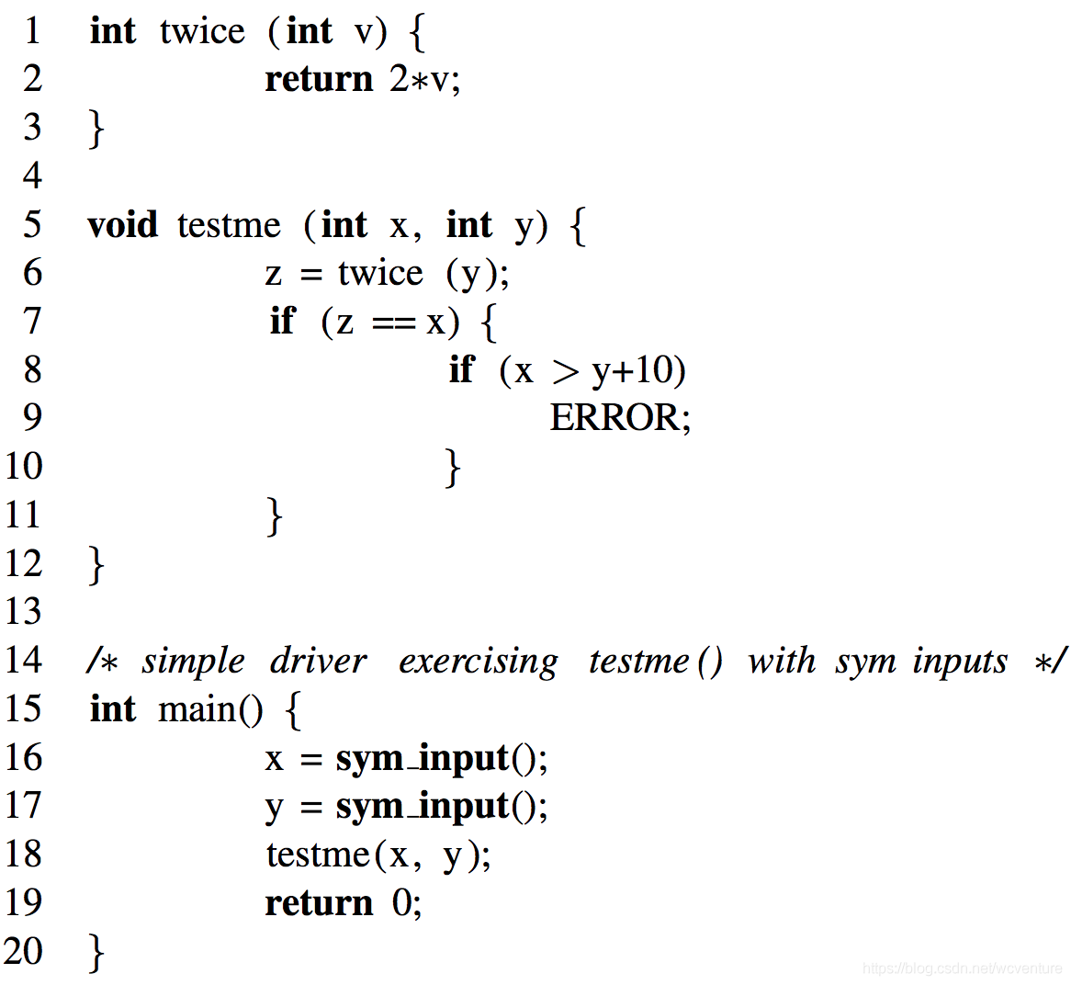

Slide 12
Effigy
An interactive symbolic execution system developed by the author and his colleagues
An “exhaustive” test manager systemtically explores the alternatives in the symbolic execution tree.
Then, the system can automatically checks test case results.
Final, the system offers a program verifier which uses symbolic execution and user supplied assertions to generate the verification condition.

Slide 13
Effigy
Tracing. The user can see the statement number, the source statement, the computational results, or any combination.
Breakpoints. The use can insert “breakpoints” between statements. At these points execution is interrupted and control passes the user’s terminal.
State saving. As a user explores the various paths, he can save the state of execution to explore alternative paths using “SAVE” and use “RESTORE” to return later.

Slide 14
Effigy
Whenever the system encounters a forking execution of an IF statement, the user can:
Type “go true”, and the system follows the THEN alternative changing pc .
Type “go false”, and the system follows the ELSE alternative changing pc .
Type “assume (P)”; go.
Type | pc update | Next statement
go true | (a > 0) & (a > 5) | S1
go false | (a > 0) & ¬(a > 5) | S2
ASSUME (a>10) | (a > 0) & (a > 10) | re-execute IF statement

Slide 15
Practical issues
It is a problem of finding a practical way to deal with variable storage-referencing.
The conflict between discrete aspects of computer arithmetic and the continuous nature of real numbers.

Slide 16
Conclusion
One symbolic execution represents a large class of normal executions. This can help program testing and debugging.
The author built an interactive debugging system called Effigy, which embodies symbolic execution.
Symbolic execution is also useful in other forms of program analysis.

Slide 17
Thank you
Q & A

Slide 18
Effigy
The user may define arbitrary identifiers as symbolic program inputs.
CALL SUM (1, 3, 5); | Normal execution over integers
CALL SUM (“A”, “B”, “C”); | Symbolic execution using the symbols A, B, and C
CALL SUM (“A”, 3, 5); | A combination

Slide 19
variable X has the value a
pc has the value a > 0
IF X > 5 THEN S1 ELSE S2
First check:
(a) a > 0 → (a > 5) nor
a > 0 → ¬(a > 5)
If type “go true”, pc is updated to
(a > 0) & (a > 5) and S1 is next.
If type “go false”, pc is updated to
(a > 0) & ¬(a > 5) and S2 is next.
If type “ASSUME (a>10)”, pc is updated to (a > 0) & (a > 10) and re-execute IF statement.

