Slide 1
Symbolic Execution and
Program Testing
James C. King
IBM Thomas J. Watson Research Center
Speaker: Lintian Shi
2020/12/4
Notes:
Hello, everyone! My name is Shi Lintian.
Today I will give a speech on Symbolic Execution and Program Testing written by James C.King.

Slide 2
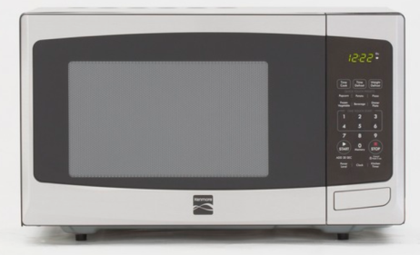





Program is Everywhere
In our daily life
Medical treatment, finance, aerospace
Notes:
Nowadays, program or software is almost everywhere.
From our daily life to medical treatment, finance, aerospace and so on and so on.

Slide 3
Unreliable Programs Bring Losses
The destruction of NASA Mariner 1
Ignorance of an overbar in a written resulting in the coding of an incorrect formula in its Fortran software
Lost at least US$18.5 million
Therac-25 Accidents
A bug in the code controlling the Therac-25 radiation therapy machine
Directly responsible for at least five patient deaths
We need reliable programs!
Notes:
However, programs with mistakes are potentially dangerous to human.
Unreliable programs may bring huge losses.
A booster went off course during launch, resulting in the destruction of NASA Mariner 1. Because a transcriber failed to notice an overbar in a written specification for the guidance program, resulting in the coding of an incorrect formula in its FORTRAN software.
A bug in the code controlling the Therac-25 radiation therapy machine was directly responsible for at least five patient deaths in the 1980s when it administered excessive quantities of beta radiation.
Because of these, we need reliable programs!

Slide 4
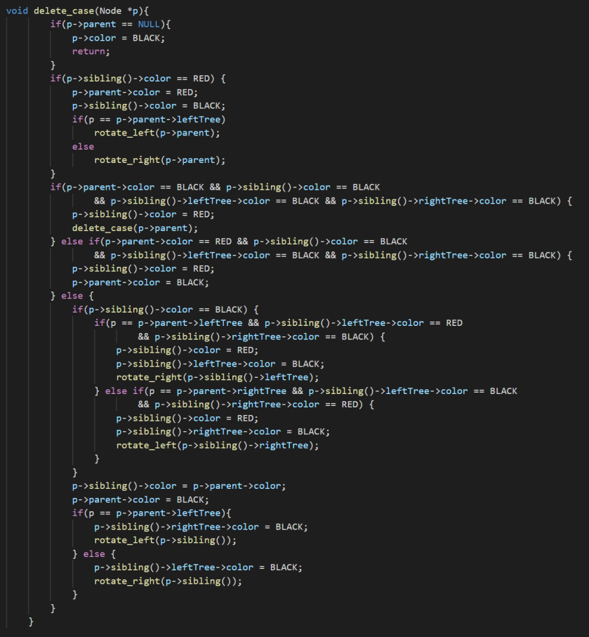
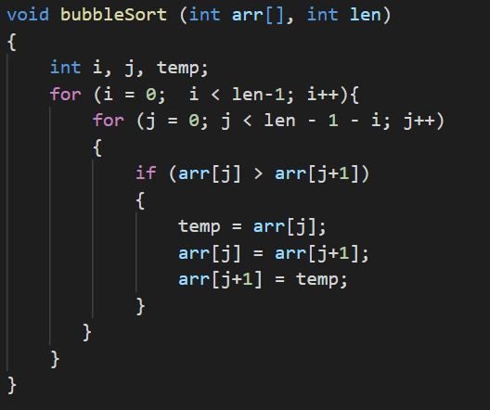
Motivation
The large-scale production of reliable programs is a challenging problem in 1970s and even today.
But it is difficult to verify the correctness of a program!
Is this bubble sort correct?
Is this red–black tree’s delete function correct?
Notes:
However, the large-scale production of reliable programs is a challenging problem in 1970s and even today.
It is difficult to verify the correctness of a program!
Is this bubble sort correct? Maybe you think it is trivial, or you can use loop invariant to give a proof.
But what about this red-black tree’s delete function? Maybe it is difficult for programmer to check out.
Even more what about the program working in a real scenario?

Slide 5
Existing Technology
Program testing
If the program is judged to produce correct results for some small sample data, it is assumed to be correct.
It is a big question of how to choose the sample. The sample data may not cover all executions.
“Program testing can be used to show the presence of bugs, but never to show their absence!” — Edsger W. Dijkstra
Notes:
The current technology in this area is basically a testing technology.
That is, some small sample of the data is presented to program.
If the program is judged to produce correct results for some small sample data, it is assumed to be correct.
But the sample data may not cover all executions. Much work focuses on the question of how to choose this sample.
And Dijkstra said :“Program testing can be used to show the presence of bugs, but never to show their absence!” .

Slide 6
Existing Technology
Program proving
The programmer formally proves that the program meets its specification for all executions.
The practical accomplishments fall short of a tool for routine use.
There is no proof assistant in 1970s. Coq was first release in 1989 and TLA+ was introduced in 1999.
The confidence depends on the creation of the specification and the construction of proof steps, which are both error-prone.
Notes:
Another technology is program proving.
The programmer formally proves that the program meets its specification for all executions.
Though formal proving shows great promise, the practical accomplishments fall short of a tool for routine use.
There is no proof assistant in 1970s. Coq was first release in 1989 and TLA+ was introduced in 1999.
And the confidence of program proving depends on the creation of the specification and the construction of proof steps, which are both done by human and error-prone.

Slide 7
Existing Technology
Program testing
Program proving
Being required to execute the program
Without being required to execute the program
The correct execution for inputs not in the sample being in doubt
Proving the program meets its specification for all executions
Easy to use
Difficult and tricky
Notes:
Program testing and program proving can be considered as extreme alternatives.
Firstly, for testing, a programmer can be assured the sample tests work correctly by carefully checking the results. But the correct execution for inputs not in the sample is still in doubt.
while program proving guarantees all executions of the program meets its specification.
Secondly program testing is required to execute the program while program proving not.
Thirdly, in generally speaking program testing is easy to use while program proving is tough and sometimes tricky.

Slide 8
Symbolic Execution
This paper describes a practical approach between two extremes which is an enhanced testing technique.
The key idea is to use symbolic values, instead of concrete data values as input and to represent the values of program variables as symbolic expressions.
A key goal of symbolic execution in software testing is to:
explore as many different program paths as possible in a given amount of time
for each path to generate a set of concrete input values
Notes:
This paper describes a practical approach named Symbolic Execution between these two extremes. From one simple view, it is an enhanced testing technique.
The key idea is to use symbolic values, instead of concrete data values as input and to represent the values of program variables as symbolic expressions.
The program is "symbolically" executed for a set of classes of inputs. That is, each symbolic execution result may be equivalent to a large number of normal test cases.
A key goal of symbolic execution in software testing is to:
explore as many different program paths as possible in a given amount of time
for each path to generate a set of concrete input values

Slide 9
Symbolic Execution
From a test generation perspective, it allows the creation of high-coverage test suites.
From a bug-finding perspective, it provides developers with a concrete input that triggers the bug.
?
Notes:
From a test generation perspective, symbolic execution allows the creation of high-coverage test suites,
while from a bug-finding perspective, symbolic execution provides developers with a concrete input that triggers the bug, which can be used to confirm and debug the error.
There is an illustration. The box represents the whole space of executions of a program. We sample some points as the test cases which distributes uniformly. From the picture, these test cases seem to cover all the execution paths of the program.
If every area represents an execution path, we can figure out that these test cases don’t cover all the paths.
Symbolic execution tries to explore all the execution paths and each symbolic execution result may be equivalent to a large number of normal test cases.

Slide 10
Symbolic Execution Tree
An execution path is a sequence of true and false.
A value of true (respectively false) at the i th position in the sequence denotes that the i th conditional statement encountered along the execution path took the “then” (respectively the “else”) branch.
All the execution paths of a program can be represented using a tree, called the execution tree.
Notes:
An execution path is a sequence of true and false, where a value of true at the ith position in the sequence denotes that the ith conditional statement encountered along the execution path took the “then” branch,
respectively a value of false at the ith position took the “else” branch
All the execution paths of a program can be represented using a tree, called the execution tree.

Slide 11
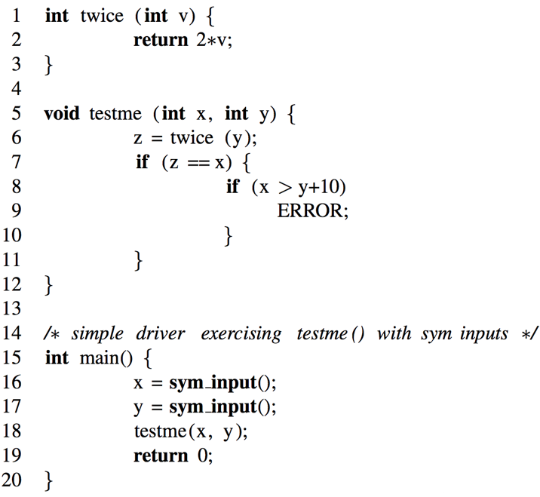
Symbolic Execution Tree
2*y == x
false
true
x > y+10
false
true
Each terminal leaf in the tree corresponds to a completed execution path potentially and there may exist a particular concrete input which will trace the same path.
Symbolic execution aims to explore as many terminal leaf as possible.
Notes:
For example, the function testme() has three execution paths. the statement z equals x has two branches. And the then branch has another IF-Statement x greater than y plus 10 which has two branches too.
Each terminal leaf in the tree corresponds to a potential execution path and there may exist a particular concrete input which will trace the same path.
Symbolic execution aims to explore as many terminal leaf as possible.

Slide 12
Symbolic Execution Semantics
Symbolic execution maintains:
A symbolic state σ, which is empty initially and maps variables to symbolic expressions
A symbolic path constraint pc, a formula over symbolic expressions, which is initialized to true.
Both σ and pc are updated during the course of symbolic execution.
When a symbolic execution along a program execution path ends, the pc constraint will be solved to generate concrete input values.
If the program is executed on these concrete input values, it will take exactly the same path as the symbolic execution and terminate in the same way.
Notes:
Symbolic execution maintains a symbolic state \sigma, which maps variables to symbolic expressions,
and a symbolic path constraint PC, which is a quantifier-free first-order formula over symbolic expressions.
At the beginning of a symbolic execution, \sigma is initialized to an empty map and PC is initialized to true.
Both \sigma and PC are updated during the course of symbolic execution.
At the end of a symbolic execution along an execution path of the program, PC is solved using a constraint solver to generate concrete input values.
If the program is executed on these concrete input values, it will take exactly the same path as the symbolic execution and terminate in the same way.

Slide 13
Symbolic Execution Semantics
At every assignment v = e, symbolic execution updates σ by mapping v → σ(e).
σ = {x→x0 , y→y0, z→2*y0}, pc : true
σ = {}, pc : true
At every read statement var = sym_input() that receives program input, symbolic execution adds the mapping var → s to σ, where s is a fresh symbolic value .
σ = {x→x0 , y→y0}, pc : true
Notes:
For example, the symbolic execution starts with an empty symbolic state and with symbolic path constraint is true.
At every read statement sym_input() assigns to var that receives program input, symbolic execution adds the mapping var to s into σ, where s is a fresh symbolic value. In this program, we assume that input values are x0, y0.
At every statement e assigns to v, symbolic execution updates σ by mapping v to σ(e).

Slide 14
Symbolic Execution Semantics
σ = {x→x0 , y→y0, z→2*y0}, pc : true
At every conditional statement if (e) S1 else S2
pc is updated to pc∧σ(e) for “then” branch
and a fresh path constraint pc’ is created and initialized to pc∧¬σ(e) for “else” branch
2*y == x
false
true
pc : ¬(2* y0 == x0)
If a symbolic execution is terminated, a satisfying assignment to the current symbolic path constraint is generated.
x = 0
y = 1
pc : (2*y0 == x0)
x > y+10
false
true
pc : (2* y0 == x0) ∧¬(x0 > y0+10)
pc : (2* y0 == x0) ∧(x0 > y0+10)
x = 2
y = 1
x = 30
y = 15
Notes:
At every conditional statement if (e) then S1 else S2
pc is updated to pc∧σ(e) for “then” branch
and a fresh path constraint pc’ is created and initialized to pc∧¬σ(e) for “else” branch
If a symbolic execution instance hits an exit statement or an error.
the current instance of symbolic execution is terminated and a satisfying assignment to the current symbolic path constraint is generated.

Slide 15
Effigy
An interactive symbolic execution system developed by the author and his colleagues
An “exhaustive” test manager systemtically explores the alternatives in the symbolic execution tree.
The system can automatically checks test case results.
Finally, the system offers a program verifier which uses symbolic execution and user supplied assertions to generate the verification condition.
Notes:
The author and his colleagues have developed an interactive symbolic execution system called EFFIGY.
Basic debugging and testing facilities are provided for symbolic program execution.
An "exhaustive“ test manager is available for systematically exploring the alternatives presented in the symbolic execution tree.
The system can automatically check test case results against output assertions if they are supplied.
Finally, the system offers a program verifier which uses symbolic execution and user supplied assertions to generate the verification conditions

Slide 16
Effigy
Tracing. The user can see the statement number, the source statement, the computational results, or any combination.
Breakpoints. The use can insert “breakpoints” between statements. At these points execution is interrupted and control passes the user’s terminal.
State saving. As a user explores the various paths, he can save the state of execution to explore alternative paths using “SAVE” and use “RESTORE” to return later.
Notes:
A full complement of interactive debugging facilities is also available, including
1. Tracing. The user can request to see the statement number, the source statement, the computational results, or any combination.
2. Breakpoints. The user can insert "breakpoints" to interrupt the symbolic execution and get the control. The user can then examine the state of the execution, set variables, and resume execution.
3. State saving. As a user explores the various paths of his program he may wish to save the state of execution to later return and explore alternative paths. "SAVE" and "RESTORE" are provided for this purpose.

Slide 17
Effigy
Whenever the system encounters a forking execution of an IF statement, the user can:
Type “go true”, and the system follows the THEN alternative changing pc .
Type “go false”, and the system follows the ELSE alternative changing pc .
Type “assume (P)”; go.
variable X has the value a
pc has the value a > 0
IF X > 5 THEN S1 ELSE S2
First check:
(a) pc (a > 5) nor
(b) pc ¬(a > 5)
Type | pc update | Next statement
go true | (a > 0) & (a > 5) | S1
go false | (a > 0) & ¬(a > 5) | S2
ASSUME (a>10) | (a > 0) & (a > 10) | re-execute IF statement
Notes:
Whenever the system encounters an IF statement (both alternatives being possible) it notifies the user and allows him to choose. He may:
1. Type "go true" and the system follows the THEN branch changing pc accordingly,
2. Type "go false" and the system follows the ELSE branch changing pc accordingly, or
3. Type "assume(P)”
In the third form P is a predicate which is first evaluated using the current values of program variables and then added to the pc.
And the system will re-execute the IF statement using the modified pc.
Here is an example. suppose the program variable X has the value a, pc has the value a > 0, and the IF statement being executed has the form:
IF X > 5 THEN s1 ELSE s2;
If choose go true, pc is updated to (a > 0) & (a > 5) , next statement to be executed is S1
If choose go false, pc is updated to (a > 0) & not(a > 5) , next statement to be executed is S2
If choose assume a > 10, pc is updated to (a > 0) & (a > 10) , and re-execute the IF statement

Slide 18
Effigy
The user may define arbitrary identifiers as symbolic program inputs.
CALL SUM (1, 3, 5); | Normal execution over integers
CALL SUM (“A”, “B”, “C”); | Symbolic execution using the symbols A, B, and C
CALL SUM (“A”, 3, 5); | A combination
Notes:
The user may define arbitrary identifiers to be symbolic program inputs, and using them in place of specific integer
constants.
For example, the user could invoke a procedure SUM for testing by:
Normal execution over integers
Symbolic execution using the symbols A, B, and C
Or a combination

Slide 19
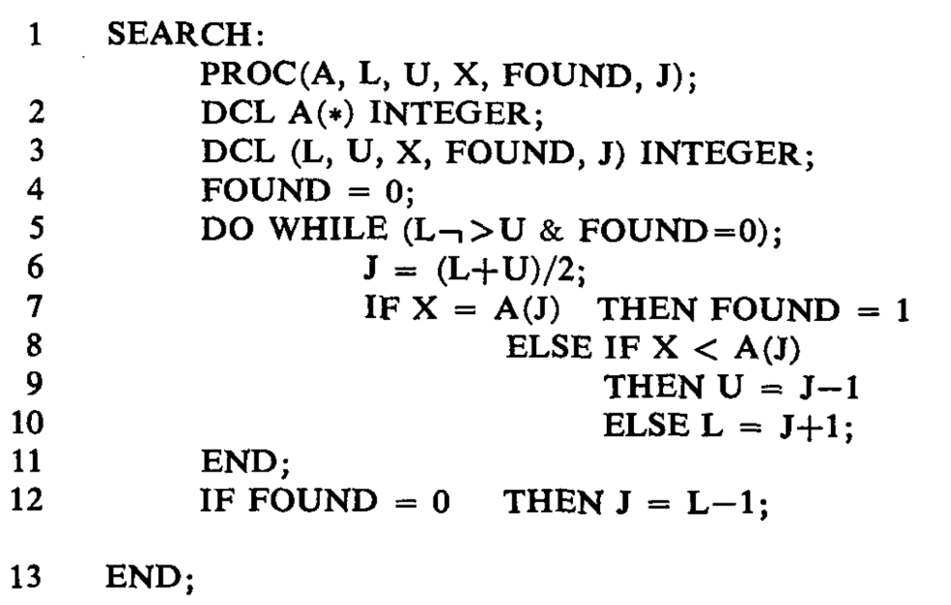
Effigy
The program SEARCH was written to perform a binary search for an argument X in an ascending-order array A.
If a match is found, the index of X is returned in J and FOUND is set to 1. Otherwise, FOUND is set to 0 and J is set to the value such that A(J) < X < A(J+1).
CALL SEARCH (A, 1, 5, FOUND, J)
Notes:
Here is an example of how the program of SEARCH, could be checked out on EFFIGY follows.
The program SEARCH was written to perform a binary search for an argument X in an ascending-order array A.
The search is confined to the array elements with subscripts from L up to and including U.
If a match is found, the subscript value of the array element matching X is returned in J and FOUND is set to 1.
Otherwise, FOUND is set to 0 and J is set to the value such that A(J) < X < A(J+1).

Slide 20
Effigy
The program SEARCH was written to perform a binary search for an argument X in an ascending-order array A.
If a match is found, the index of X is returned in J and FOUND is set to 1. Otherwise, FOUND is set to 0 and J is set to the value such that A(J) < X < A(J+1).
CALL SEARCH (A, 1, 5, FOUND, J)
Notes:
The test of SEARCH might take the form: CALL SEARCH (A, 1, 5, "X", FOUND, J).
Assume the elements of the array have been set to symbolic values "A(1)", "A(2)", . . , "A(5)".
The constants 1, 5, and "X“ are input arguments and FOUND and J are integer variables which will return the results from SEARCH.
Symbolic execution will proceed until statement 7, at which point the user is asked whether or not "X" = "A(3)".
If in response to the system's query the user types "save; go true",
the current execution state will be saved as state 1 and the execution will run to completion determining that pc = ("X" = "A(3)"), FOUND = 1, and J = 3.
Now by typing "restore 1; go false" the user may examine the other possibility when "X" # "A(3)".
Continuing in this manner the user may explore the finite subtree determined by inputs 1 and 5, and in this case find eleven terminal leaves:
The user could also cause the system to generate these eleven outputs automatically by use of the TEST
facility in EFFIGY: TEST (200) SEARCH (A, 1, 5, "A", FOUND, J)
The 200 is used to limit the exhaustive search of the symbolic execution tree to those paths traversing less than 200 statement executions.

Slide 21
Effigy
The program SEARCH was written to perform a binary search for an argument X in an ascending-order array.
If a match is found, the index of X is returned in J and FOUND is set to 1. Otherwise, FOUND is set to 0 and J is set to the value such that A(J) < X < A(J+1).
CALL SEARCH (A, 1, 5, FOUND, J)
pc | FOUND | J
X = A(1) & X < A(3) | 1 | 1
X = A(2) & X > A(1) & X < A(3) | 1 | 2
X = A(3) | 1 | 3
X = A(4) & X > A(3) | 1 | 4
X = A(5) & X > A(4) & X > A(3) | 1 | 5
X < A(1) & X < A(3) | 0 | 0
X < A(2) & X > A(1) & X < A(3) | 0 | 1
X > A(2) & X > A(1) & X < A(3) | 0 | 2
X < A(4) & X > A(3) | 0 | 3
X < A(5) & X > A(4) & X > A(3) | 0 | 4
X > A(5) & X > A(4) & X > A(3) | 0 | 5
Notes:
The test of SEARCH might take the form: CALL SEARCH (A, 1, 5, "X", FOUND, J).
Assume the elements of the array have been set to symbolic values "A(1)", "A(2)", . . , "A(5)".
The constants 1, 5, and "X“ are input arguments and FOUND and J are integer variables which will return the results from SEARCH.
Symbolic execution will proceed until statement, at which point the user is asked whether or not "X" = "A(3)".
If in response to the system's query the user types "save; go true",
the current execution state will be saved as state 1 and the execution will run to completion determining that pc = ("X" = "A(3)"), FOUND = 1, and J = 3.
Now by typing "restore 1; go false" the user may examine the other possibility when "X" # "A(3)".
Continuing in this manner the user may explore the finite subtree determined by inputs 1 and 5, and in this case find eleven terminal leaves:
The user could also cause the system to generate these eleven outputs automatically by use of the TEST
facility in EFFIGY: TEST (200) SEARCH (A, 1, 5, "A", FOUND, J)
The 200 is used to limit the exhaustive search of the symbolic execution tree to those paths traversing less than 200 statement executions.

Slide 22
Practical Issues
It is a problem of finding a practical way to deal with variable storage-referencing.
The conflict between discrete aspects of computer arithmetic and the continuous nature of real numbers.
When the constraint expression growing complicated, constraint solving becomes a troubling problem.
Notes:
However, many of the troublesome issues arising in symbolic execution systems.
First, it is a problem of finding a practical way to deal with variable storage-referencing.
(For example the array notation A(I) references a different particular element of the array A depending on the value of I.
When the value of I is a symbolic expression, the particular element being referenced is a function of the initial program inputs. It makes the particular reference ambiguous.)
Second, The conflict between discrete aspects of computer arithmetic and the continuous nature of real numbers.
(For the convienience of analysis we want the programs to be simplified as much as possible )
Third, when the constraint expression growing complicated, constraint solving becomes a troubling problem.

Slide 23
Conclusion
Symbolic execution allows the creation of high-coverage test, which can help program testing and debugging.
The author built an interactive debugging system called Effigy, which embodies symbolic execution.
Notes:
In conclusion, this work describes Symbolic execution. It allows the creation of high-coverage test, which can help program testing and debugging.
Moreover, the author built an interactive debugging system called Effigy, which embodies symbolic execution.

Slide 24
Thank you
Q & A
Notes:
That’s all. Thanks for listening. If you have any question, you can ask me.

