Slide 1
Symbolic Execution and
Program Testing
James C. King
IBM Thomas J. Watson Research Center
Speaker: Lintian Shi
2020/12/4
Notes:
大家好，我今天小组报告的题目是DSLabs平台介绍

Slide 2
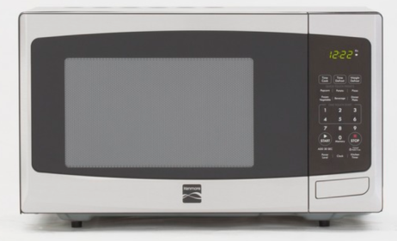





Program is everywhere
In our daily life
Medical treatment, finance, aerospace
Notes:
From daily life, medical, spacecraft

Slide 3
Unreliable programs bring losses
The destruction of NASA Mariner 1
Ignorance of an overbar in a written resulting in the coding of an incorrect formula in its Fortran software
Lost at least US$18.5 million
Therac-25 Accidents
A bug in the code controlling the Therac-25 radiation therapy machine
Directly responsible for at least five patient deaths
We need reliable programs!

Slide 4
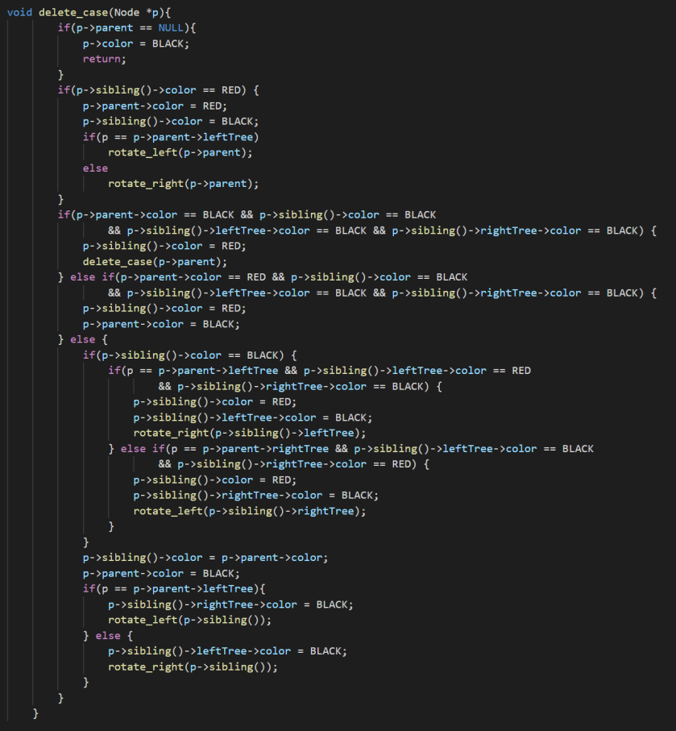
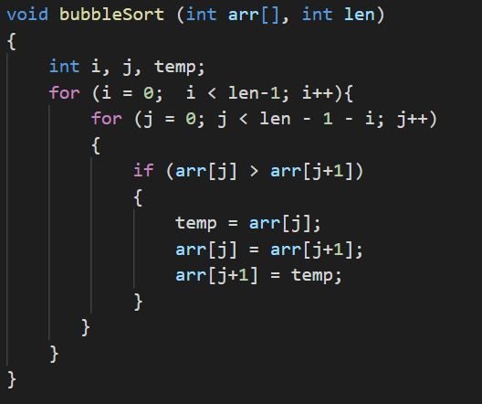
Motivation
The large-scale production of reliable programs is a challenging problem in 1970s and even today.
But it is difficult to verify the correctness of a program!
Is this bubble sort correct?
Is this red–black tree’s delete function correct?

Slide 5
Existing technology
Program testing
If the program is judged to produce correct results for some small sample data, it is assumed to be correct.
It is a big question of how to choose the sample. The sample data may not cover all executions.
“Program testing can be used to show the presence of bugs, but never to show their absence!” — Edsger W. Dijkstra

Slide 6
Existing technology
Program proving
The programmer formally proves that the program meets its specification for all executions.
The practical accomplishments fall short of a tool for routine use.
There is no proof assistant in 1970s. Coq was first release in 1989 and TLA+ was introduced in 1999.
The confidence depends on the creation of the specification and the construction of proof steps, which are both error-prone.

Slide 7
Existing technology
Program testing
Program proving
Being required to execute the program
Without being required to execute the program
The correct execution for inputs not in the sample being in doubt
Proving the program meets its specification for all executions
Easy to use
Difficult and tricky

Slide 8
Symbolic execution
This paper describes a practical approach between two extremes which is an enhanced testing technique.
Instead of executing programs on a set of sample inputs
A program is “symbolically” executed for a set of classes of inputs
Each symbolic execution result may be equivalent to a large number of normal test cases

Slide 9
Symbolic execution
This paper describes a practical approach between two extremes which is an enhanced testing technique.
Instead of executing programs on a set of sample inputs
A program is “symbolically” executed for a set of classes of inputs
Each symbolic execution result may be equivalent to a large number of normal test cases

Slide 10
Symbolic execution
The class of inputs characterized by each symbolic execution is determined by the dependence of the program’s control flow on its inputs

Slide 11
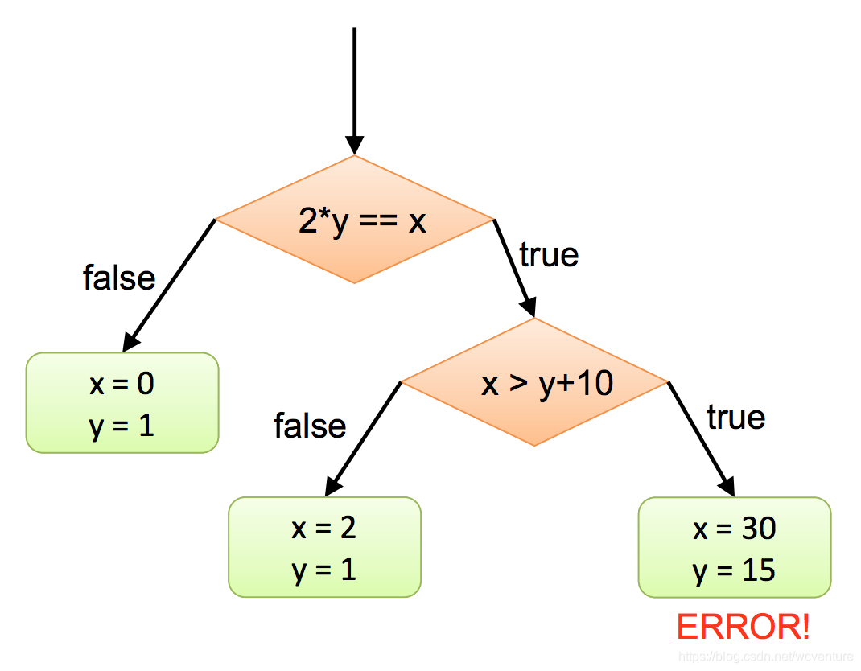
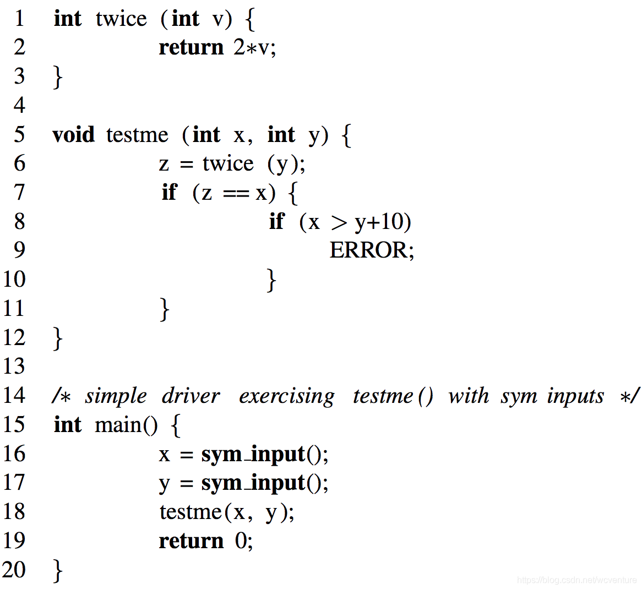

Slide 12
Effigy
An interactive symbolic execution system developed by the author and his colleagues

Slide 13
Conclusion
One symbolic execution represents a large class of normal executions. This can help program testing and debugging.
The author built an interactive debugging system called Effigy, which embodies symbolic execution.
Symbolic execution is also useful in other forms of program analysis.

Slide 14
Thank you
Q & A

