Slide 1
Symbolic Execution and
Program Testing
James C. King
IBM Thomas J. Watson Research Center
Speaker: Lintian Shi
2020/12/4
Notes:
Hello, everyone! My name is Shi Lintian.
Today I will give a speech on Symbolic Execution and Program Testing written by James C.King.

Slide 2
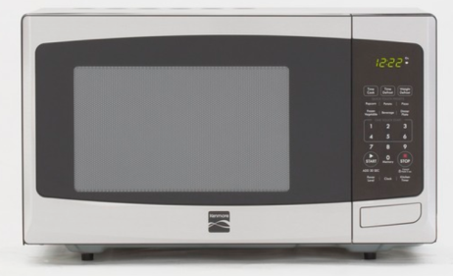


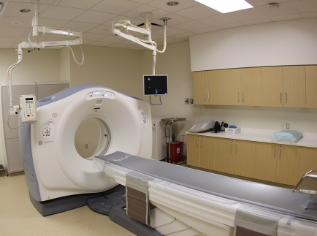


Program is Everywhere
In our daily life
Medical treatment, finance, aerospace
Notes:
Nowadays, program or software is almost everywhere.
From our daily life to medical, finance, aerospace and so on and so on.

Slide 3
Unreliable Programs Bring Losses
The destruction of NASA Mariner 1
Ignorance of an overbar in a written resulting in the coding of an incorrect formula in its Fortran software
Lost at least US$18.5 million
Therac-25 Accidents
A bug in the code controlling the Therac-25 radiation therapy machine
Directly responsible for at least five patient deaths
We need reliable programs!
Notes:
However, programs with mistakes are potential danger for people.
Unreliable programs may bring huge losses.
A booster went off course during launch, resulting in the destruction of NASA Mariner 1. This was the result of the failure of a transcriber to notice an overbar in a written specification for the guidance program, resulting in the coding of an incorrect formula in its FORTRAN software. (July 22, 1962). The initial reporting of the cause of this bug was incorrect.
A bug in the code controlling the Therac-25 radiation therapy machine was directly responsible for at least five patient deaths in the 1980s when it administered excessive quantities of beta radiation.
Because of these, we need reliable programs!

Slide 4
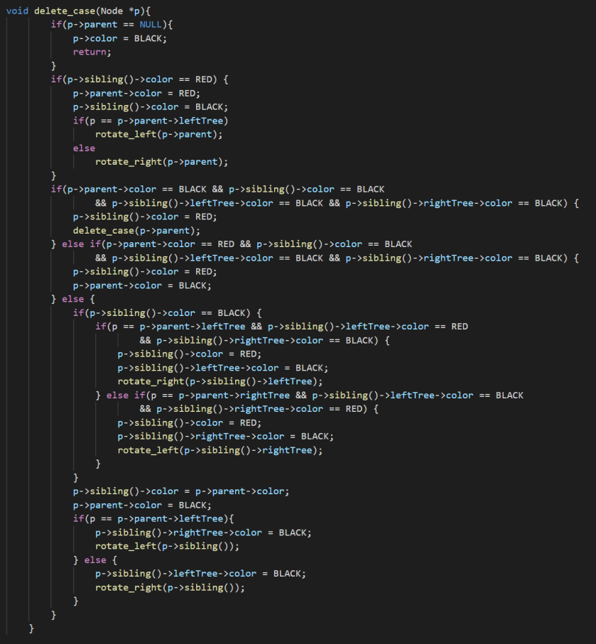
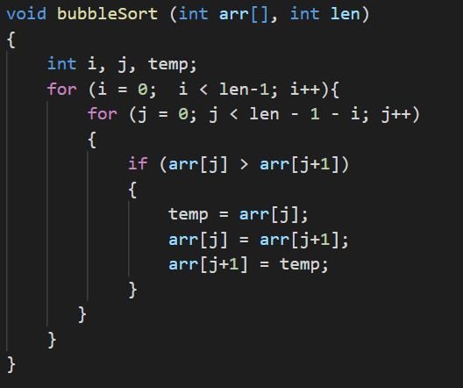
Motivation
The large-scale production of reliable programs is a challenging problem in 1970s and even today.
But it is difficult to verify the correctness of a program!
Is this bubble sort correct?
Is this red–black tree’s delete function correct?
Notes:
The large-scale production of reliable programs is a challenging problem in 1970s and even today.
But it is difficult to verify the correctness of a program!
Is this bubble sort correct? Maybe you think it is trivial, or you can use loop invariant to give a proof.
But what about this red-black tree’s delete function? Maybe it is difficult check out.
What about a program in real working scenario?

Slide 5
Existing Technology
Program testing
If the program is judged to produce correct results for some small sample data, it is assumed to be correct.
It is a big question of how to choose the sample. The sample data may not cover all executions.
“Program testing can be used to show the presence of bugs, but never to show their absence!” — Edsger W. Dijkstra
Notes:
The current technology in this area is basically a testing technology.
That is, some small sample of the data that a program is expected to handle is presented to program.
If the program is judged to produce correct results for some small sample data, it is assumed to be correct.
But the sample data may not cover all executions. Much work focuses on the question of how to choose this sample.
And Dijkstra said :“Program testing can be used to show the presence of bugs, but never to show their absence!” .

Slide 6
Existing Technology
Program proving
The programmer formally proves that the program meets its specification for all executions.
The practical accomplishments fall short of a tool for routine use.
There is no proof assistant in 1970s. Coq was first release in 1989 and TLA+ was introduced in 1999.
The confidence depends on the creation of the specification and the construction of proof steps, which are both error-prone.
Notes:
Another technology is program proving.
The programmer formally proves that the program meets its specification for all executions.
Though formal proving shows great promise, the practical accomplishments fall short of a tool for routine use.
There is no proof assistant in 1970s. Coq was first release in 1989 and TLA+ was introduced in 1999.
The confidence depends on the creation of the specification and the construction of proof steps, which are both error-prone.

Slide 7
Existing Technology
Program testing
Program proving
Being required to execute the program
Without being required to execute the program
The correct execution for inputs not in the sample being in doubt
Proving the program meets its specification for all executions
Easy to use
Difficult and tricky
Notes:
Program testing and program proving can be considered as extreme alternatives.
First, while tesing, a programmer can be assured the sample test runs work correctly by carefully checking the results.The correct execution for inputs not in the sample is still in doubt.
Alternatively, in program proving the programmer formally proves that the program meets its specification for all executions.
Second program testing is required to execute the program while program proving not.
Third, as usual program testing is easy to use while program proving is difficult and tricky sometimes.

Slide 8
Symbolic Execution
This paper describes a practical approach between two extremes which is an enhanced testing technique.
The key idea is to use symbolic values, instead of concrete data values as input and to represent the values of program variables as symbolic expressions.
A key goal of symbolic execution in software testing is to:
explore as many different program paths as possible in a given amount of time
for each path to generate a set of concrete input values exercising that path, and check for the presence of various kinds of errors

Slide 9
Symbolic Execution
From a test generation perspective, it allows the creation of high-coverage test suites.
From a bug-finding perspective, it provides developers with a concrete input that triggers the bug.
?

Slide 10
Symbolic Execution Tree
An execution path is a sequence of true and false.
A value of true (respectively false) at the i th position in the sequence denotes that the i th conditional statement encountered along the execution path took the “then” (respectively the “else”) branch.
All the execution paths of a program can be represented using a tree, called the execution tree.

Slide 11
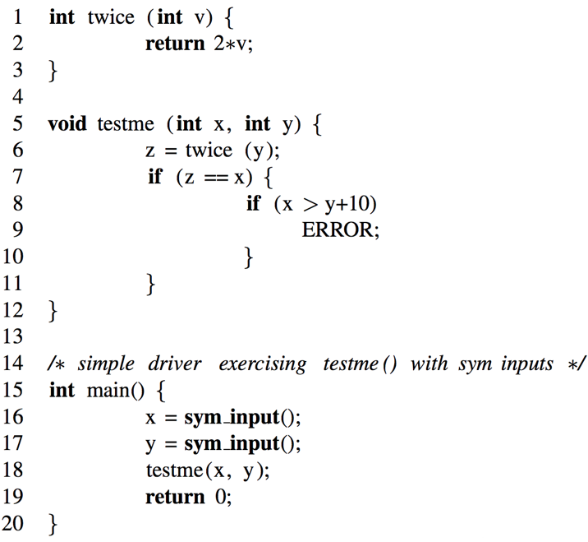
Symbolic Execution Tree
2*y == x
false
true
x > y+10
false
true
Each terminal leaf in the tree corresponds to a completed execution path potentially and there may exist a particular concrete input which will trace the same path.
Symbolic execution aims to explore as many terminal leaf as possible.

Slide 12
Symbolic Execution Semantics
Symbolic execution maintains:
A symbolic state σ, which is empty initially and maps variables to symbolic expressions
A symbolic path constraint pc, a formula over symbolic expressions, which is initialized to true.
Both σ and pc are updated during the course of symbolic execution.
When a symbolic execution along a program execution path ends, the pc constraint will be solved to generate concrete input values.
If the program is executed on these concrete input values, it will take exactly the same path as the symbolic execution and terminate in the same way.

Slide 13
Symbolic Execution Semantics
At every assignment v = e, symbolic execution updates σ by mapping v → σ(e).
σ = {x→x0 , y→y0, z→2*y0}, pc : true
σ = {}, pc : true
At every read statement var = sym_input() that receives program input, symbolic execution adds the mapping var → s to σ, where s is a fresh symbolic value .
σ = {x→x0 , y→y0}, pc : true

Slide 14
Symbolic Execution Semantics
σ = {x→x0 , y→y0, z→2*y0}, pc : true
At every conditional statement if (e) S1 else S2
pc is updated to pc∧σ(e) for “then” branch
and a fresh path constraint pc’ is created and initialized to pc∧¬σ(e) for “else” branch
2*y == x
false
true
pc : ¬(2* y0 == x0)
If a symbolic execution is terminated, a satisfying assignment to the current symbolic path constraint is generated.
x = 0
y = 1
pc : (2*y0 == x0)
x > y+10
false
true
pc : (2* y0 == x0) ∧¬(x0 > y0+10)
pc : (2* y0 == x0) ∧(x0 > y0+10)
x = 2
y = 1
x = 30
y = 15
Notes:
if the program is executed on these concrete input values, it will take exactly the same path as the symbolic execution and terminate in the same way.

Slide 15
Effigy
An interactive symbolic execution system developed by the author and his colleagues
An “exhaustive” test manager systemtically explores the alternatives in the symbolic execution tree.
The system can automatically checks test case results.
Finally, the system offers a program verifier which uses symbolic execution and user supplied assertions to generate the verification condition.

Slide 16
Effigy
Tracing. The user can see the statement number, the source statement, the computational results, or any combination.
Breakpoints. The use can insert “breakpoints” between statements. At these points execution is interrupted and control passes the user’s terminal.
State saving. As a user explores the various paths, he can save the state of execution to explore alternative paths using “SAVE” and use “RESTORE” to return later.

Slide 17
Effigy
Whenever the system encounters a forking execution of an IF statement, the user can:
Type “go true”, and the system follows the THEN alternative changing pc .
Type “go false”, and the system follows the ELSE alternative changing pc .
Type “assume (P)”; go.
variable X has the value a
pc has the value a > 0
IF X > 5 THEN S1 ELSE S2
First check:
(a) pc (a > 5) nor
(b) pc ¬(a > 5)
Type | pc update | Next statement
go true | (a > 0) & (a > 5) | S1
go false | (a > 0) & ¬(a > 5) | S2
ASSUME (a>10) | (a > 0) & (a > 10) | re-execute IF statement

Slide 18
Effigy
The user may define arbitrary identifiers as symbolic program inputs.
CALL SUM (1, 3, 5); | Normal execution over integers
CALL SUM (“A”, “B”, “C”); | Symbolic execution using the symbols A, B, and C
CALL SUM (“A”, 3, 5); | A combination

Slide 19
Effigy
The program SEARCH was written to perform a binary search for an argument X in an ascending-order array.
If a match is found, the index of X is returned in J and FOUND is set to 1. Otherwise, FOUND is set to 0 and J is set to the value such that A(J) < X < A(J+1).
CALL SEARCH (A, “N”, “N”+4, FOUND, J)
pc | FOUND | J
X = A(1) & X < A(3) | 1 | 1
X = A(2) & X > A(1) & X < A(3) | 1 | 2
X = A(3) | 1 | 3
X = A(4) & X > A(3) | 1 | 4
X = A(5) & X > A(4) & X > A(3) | 1 | 5
X < A(1) & X < A(3) | 0 | 0
X < A(2) & X > A(1) & X < A(3) | 0 | 1
X > A(2) & X > A(1) & X < A(3) | 0 | 2
X < A(4) & X > A(3) | 0 | 3
X < A(5) & X > A(4) & X > A(3) | 0 | 4
X > A(5) & X > A(4) & X > A(3) | 0 | 5

Slide 20
Practical Issues
It is a problem of finding a practical way to deal with variable storage-referencing.
The conflict between discrete aspects of computer arithmetic and the continuous nature of real numbers.
When the constraint expression growing complicated, constraint solving becomes a troubling problem.

Slide 21
Conclusion
Symbolic execution allows the creation of high-coverage test, which can help program testing and debugging.
The author built an interactive debugging system called Effigy, which embodies symbolic execution.
Symbolic execution is also useful in other forms of program analysis, including program optimization.

Slide 22
Thank you
Q & A
Notes:
That’s all. Thanks for listening. If you have any question, you can ask me.

