Slide 1
Operiq AI
Workplace Productivity Assistant
AI-powered platform for professionals: email drafting, meeting summaries, task planning, research, and intelligent chat.
v2.0.0

Slide 2
Problem Statement
Professionals spend up to 60% of their time on administrative and communication tasks
Repetitive activities: drafting emails, summarizing meetings, planning schedules, researching
These tasks divert attention from strategic work and creative problem-solving
Result: reduced productivity, delayed decision-making, professional burnout
Operiq AI solves this by automating and accelerating repetitive workplace tasks
Leveraging large language models and intelligent automation

Slide 3
Solution Overview
Smart Email Generator - Professional emails with tone/audience adaptation
Meeting Notes Summarizer - Key points, decisions, action items extraction
AI Task Planner - Structured daily/weekly plans with prioritization
AI Research Assistant - Article summarization with key insights
AI Chatbot Interface - Interactive multi-turn workplace assistant
All powered by advanced AI models with prompt engineering and responsible AI practices

Slide 4
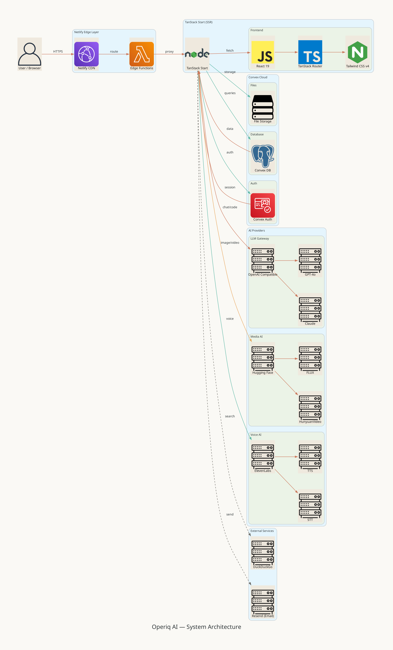
System Architecture
Netlify CDN + Edge Functions - Global deployment, request routing, security headers
Convex Serverless Backend - Real-time database, ACID transactions, built-in auth
AI Providers - OpenAI-compatible gateway, Hugging Face (images/video), ElevenLabs (voice)
External Services - Resend (email), DuckDuckGo (web search)
Architecture diagram available in documentation

Slide 5
Software Architecture
Frontend: React 19 + TanStack Start + Tailwind CSS v4 + shadcn/ui + lucide-react
State: Convex useQuery (real-time reactive) + React useState (UI) + @convex-dev/auth
Backend: Convex modules - schema, users, emailDrafts, summaries, plans, analyses, billing
Tool System: Registry-based with web_search, fetch_url, generate_image, generate_video
Agent Mode: ReAct loop with multi-step reasoning and tool execution

Slide 6
AI Pipeline
Model Routing: Task type determines model and provider selection
Prompt Assembly: System instructions + user context + output format + guardrails
Generation: Streaming responses with real-time display
Post-processing: Validation, markdown rendering, disclaimer injection
Provider Mix: OpenAI-compatible gateway, Hugging Face, ElevenLabs
Tool Integration: Agents can search web, fetch URLs, generate images/video

Slide 7
Prompt Engineering
System Instructions: Define persona, output format, boundaries, and tone
Context Injection: User-provided data clearly delineated from system instructions
Output Guardrails: Structured formats, validation checks, anti-hallucination rules
Email Prompt: Professional tone, audience-aware, no fabricated information
Meeting Prompt: Extract decisions, action items with assignees, deadlines
Planner Prompt: Time-optimized schedules with Eisenhower Matrix prioritization
Research Prompt: Key insights extraction, complexity simplification

Slide 8
Responsible AI
Bias Mitigation - Neutrality instructions in all prompts, output monitoring
Data Privacy - AI providers configured to never train on user data
Disclaimers - Every AI output includes review reminder and AI-generated label
Rate Limiting - Free tier: 50 AI requests/day; Pro/Enterprise: higher limits
Transparency - Clear labeling of AI-generated content throughout the platform
DevTools Protection - Production-only guard against casual code inspection

Slide 9
Evaluation Criteria
Problem Relevance (20%) - Addresses real workplace productivity challenges
Prompt Engineering (25%) - Structured, tested, refined prompts with guardrails
Functionality Accuracy (25%) - AI-powered features with validation checks
Innovation (15%) - Multi-agent loop, voice TTS/STT, image/video generation
Responsible AI (10%) - Bias detection, privacy safeguards, disclaimers
Presentation Clarity (5%) - Professional documentation with architecture diagrams

Slide 10
Tools & Technologies
AI/ML: OpenAI API, Hugging Face (FLUX, HunyuanVideo), ElevenLabs (TTS/STT)
Frontend: React 19, TanStack Start/Router, Tailwind CSS v4, shadcn/ui, lucide-react
Backend: Convex (real-time DB, auth, file storage), TypeScript
Infrastructure: Netlify (CDN, Edge Functions, serverless), Vite, Bun
External: Resend (email delivery), DuckDuckGo (web search), Stripe (demo billing)
Tool System: Registry-based agent tools (web_search, fetch_url, generate_image)

Slide 11
Sample Prompts & Outputs
Email: Input 'Update to John (Manager), Professional tone'
Output: Subject line, greeting, status update, next steps, closing
Meeting Summary: Input '30-min team sync: Q2 roadmap, hiring, sprint retro'
Output: Key Decisions, Action Items (with assignees), Discussion Highlights
Research: Input 'Summarize market trends in AI productivity tools 2025'
Output: Executive summary, key trends, competitive landscape, recommendations

Slide 12
Challenges & Solutions
SSR Auth: TanStack Start SSR + Convex auth. Solved with ConvexAuthProvider + AuthGate
AI Streaming: AI SDK streaming with custom tools. Solved with streamText + maxSteps
Netlify Deploy: Env vars in Workers. Solved with .server.ts request-time pattern
Multi-Provider: Multiple AI providers. Solved with unified interface + model mapping
Usage Tracking: Real-time without blocking. Solved with fire-and-forget mutations
Billing Reset: Period-based limits. Solved with auto-reset on period expiry check

Slide 13
Thank You
Operiq AI - Workplace Productivity, Reimagined
operiq.ai

