Slide 1

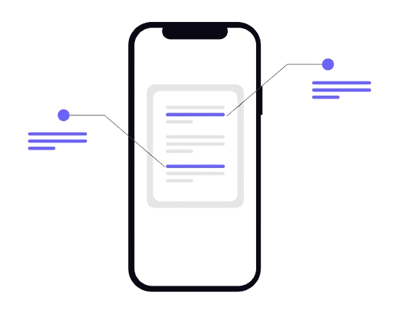
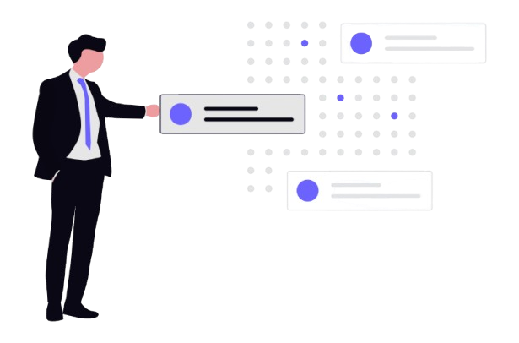

Zibo Polytechnic University School of Artificial Intelligence
 LMS Pro
Learning Management Architecture
Next-Generation system engineered to reimagine educational technology workflows, featuring scalable infrastructure and intuitive user interaction models for modern learning environments.
Student Name: LINUS VINCENT ROZARIO－文森特
Major: Computer Technology | Academic Project
Student ID: L202309065
Notes:
Good morning, everyone. I am Linus Vincent Rozario, a Computer Technology major. Today, I am thrilled to present my graduation internship project: LMS Pro. This is not just another learning management system; it's a next-generation architecture designed to redefine how we interact with educational technology. Over the next few minutes, I will walk you through the strategic engineering, the advanced architecture, and the practical implementation of this platform. Let's begin.

Slide 2
Internship Scope & Mandate
01
Strategic Engineering Objectives
Mission & Execution Focus
Bridging the gap between theoretical computer science and real-world agile full-stack production pipelines. The mandate was to design a clean, fast, and secure multi-role web platform, optimized for low-latency environments. This required translating academic knowledge into engineering solutions that meet enterprise standards for both performance efficiency and data security.
CORE VISION
Connecting academic computer science rigor with the demands of modern, scalable full-stack development workflows.
Outcome Target:Engineer a production-ready system that not only solves immediate operational challenges but also establishes a scalable foundation for future feature iterations and cross-functional integration.
Notes:
First, let's define the scope of this internship. The core vision was to bridge the gap between theoretical computer science and real-world, agile full-stack production pipelines. The operational goal was to design a clean, fast, and secure multi-role web platform, optimized for low-latency environments. This project was not just about building an application; it was about engineering a solution that meets enterprise standards of performance and security.

Slide 3
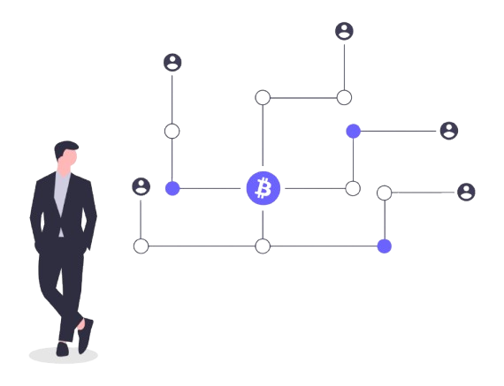

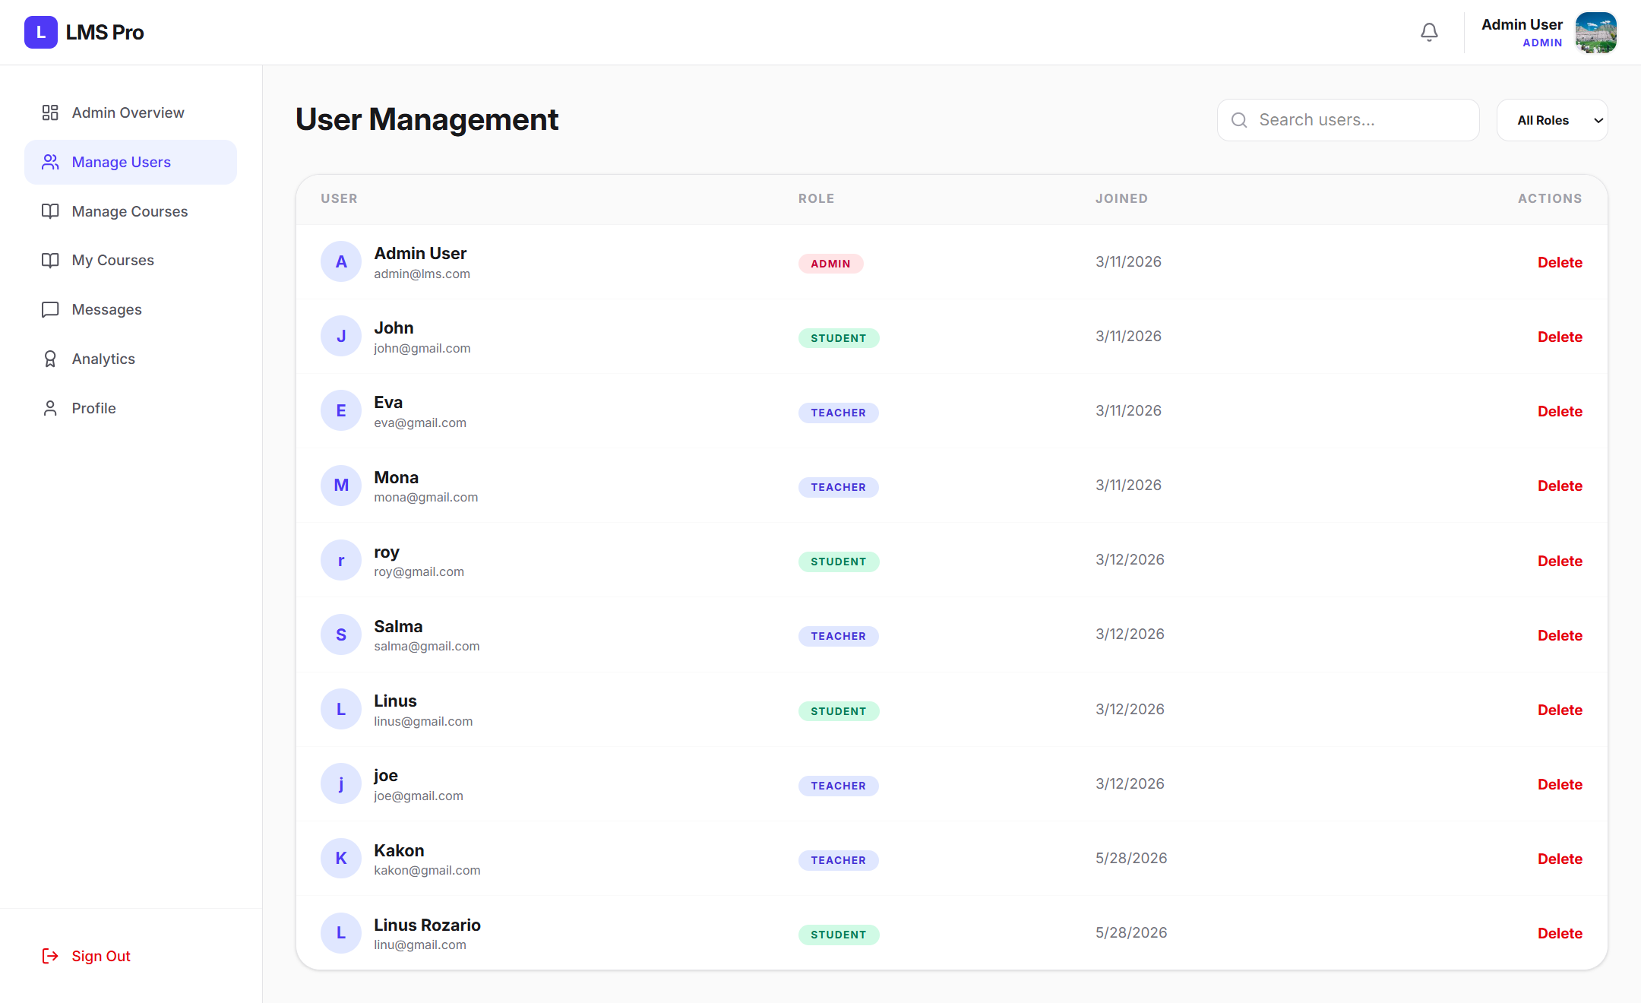


Multi-Tenant Ecosystem
Admin Node
Provides infrastructure auditing, account state toggles, and live server telemetry data blocks. This core governance layer ensures the stability and security of the entire multi-tenant environment.
Teacher Hub
Features curriculum deployment engines, relational class rosters, and live gradebook modules. It streamlines academic operations, enabling educators to manage courses and student progress with precision.
Student Panel
Includes dynamic course discovery grids, progressive learning path charts, and grade distribution trackers. This user-centric interface offers personalized navigation and real-time insights into academic achievements.
Notes:
The LMS Pro is built around a multi-tenant ecosystem, ensuring complete workspace isolation. We have three distinct nodes: the Admin Node for system governance, the Teacher Hub for academic management, and the Student Panel for the learning experience. Each node is designed with specific functionalities to cater to the unique needs of its user role, creating a seamless and secure environment for all stakeholders.

Slide 4
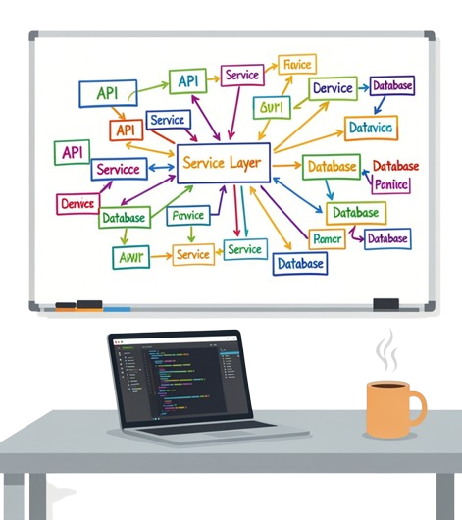
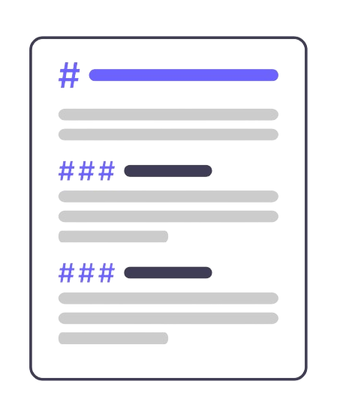

The Technology Matrix
Advanced Architectural Stack
02
Notes:
Now, let's dive into the technological foundation of LMS Pro. The architecture is a carefully selected matrix of modern technologies, each chosen for its specific strength. From the frontend to the database, every layer is designed for performance, maintainability, and scalability. This is the engine that powers the entire platform.

Slide 5





The Technology Matrix
State Engine
Frontend Layer
Native JavaScript/TypeScript modules power asynchronous interface animations and secure client-side validation loops, enabling fluid user experiences with real-time feedback.
Semantic HTML5 structures backed by Tailwind CSS utility chains to eliminate custom style sheet bloat, creating a lightweight and responsive presentation layer.
Storage Core
Embedded SQLite architecture enforces ACID-compliant data safety protocols and rapid indexed search capabilities, providing a robust foundation for persistent information storage.
Backend Control
Structured Python backend controllers handle incoming requests and enforce strict access authorization gates, ensuring secure and reliable traffic management between client and server components.
System Synergy
The cohesive integration of frontend and backend layers creates a maintainable system that adapts to evolving user needs while upholding high standards for security and operational speed.
Notes:
Breaking it down, the Frontend Layer uses HTML5 and Tailwind CSS for a clean, responsive design. The State Engine is powered by TypeScript for dynamic and secure interactions. The backend Logic Routing is handled by a Python framework, ensuring robust request handling. Finally, the Storage Core is an embedded SQLite database, providing reliable and fast data transactions. This stack ensures a robust and efficient application.

Slide 6

Chronological Engineering Lifecycle
The 10-Week Development Sprint
WEEKS 1-3 | FOUNDATION
WEEKS 4-8 | EXECUTION
WEEKS 9-10 | LAUNCH
Completed database schema architecture and core environment setup. Finalized technical blueprints and aligned cross-functional teams on sprint milestones.
Rapid agile development of core LMS modules. Integrated frontend workflows with backend logic, conducting iterative unit testing to mitigate technical debt.
End-to-end regression testing and critical bug resolution. Finalized the production-ready codebase handover with comprehensive documentation for maintenance.
The 11-week sprint enforced a disciplined approach to resource allocation and daily progress tracking. This accelerated timeline ensured the LMS Pro platform met all functional requirements and was ready for seamless deployment.
11
WEEKS
Notes:
The development of LMS Pro followed a rigorous 11-week sprint cycle. This timeline was crucial for managing the project efficiently and ensuring all milestones were met. Let's take a look at how the project evolved from the initial database setup to the final codebase handover.

Slide 7
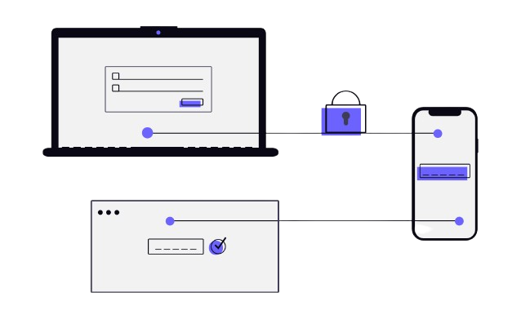
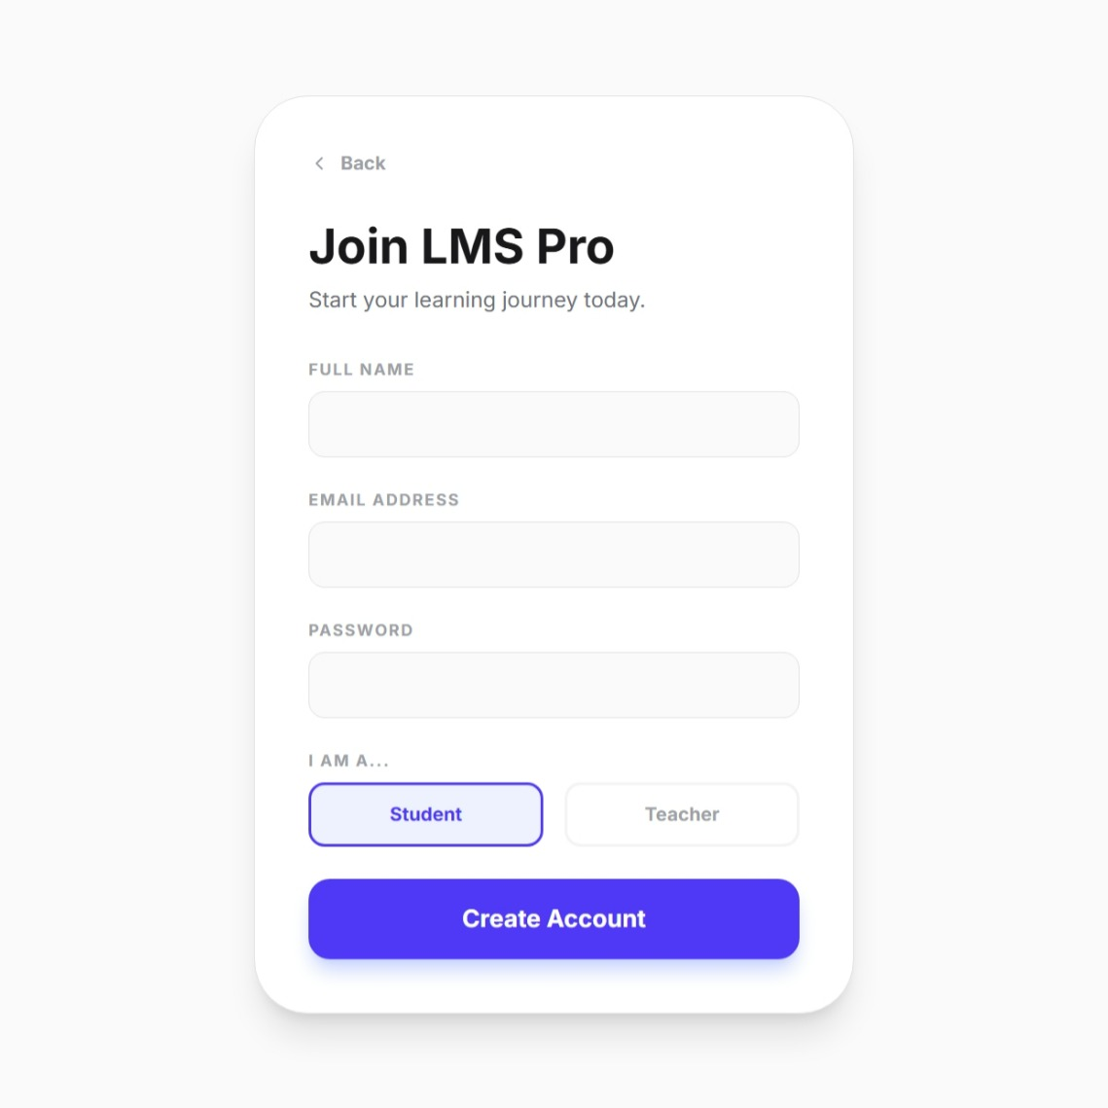
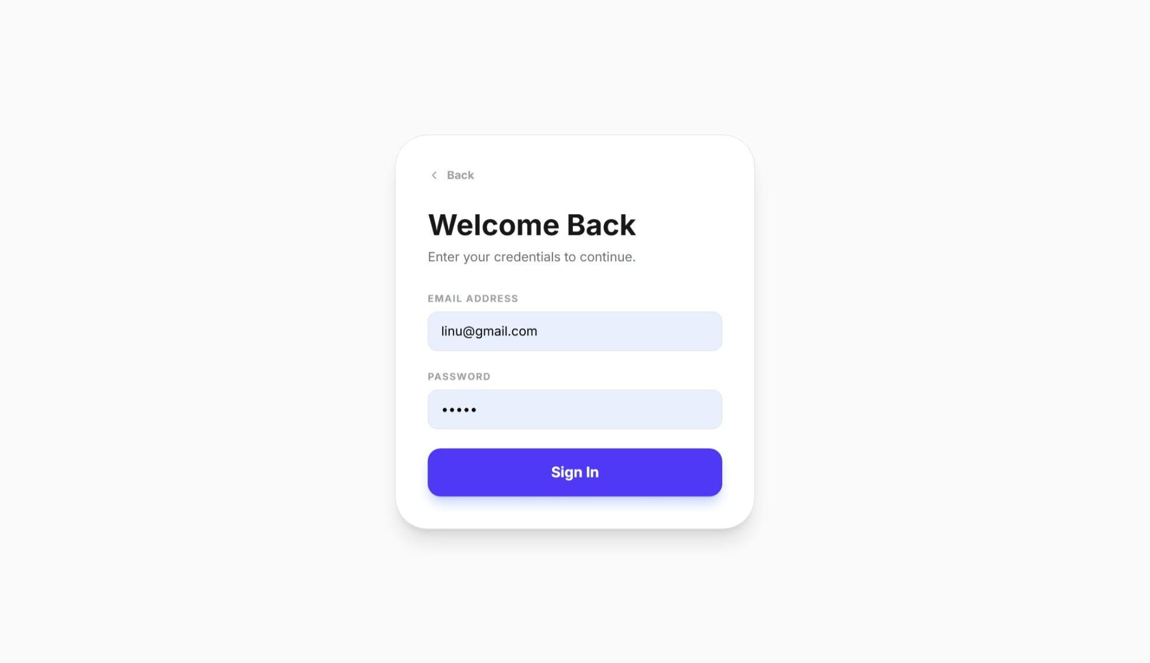
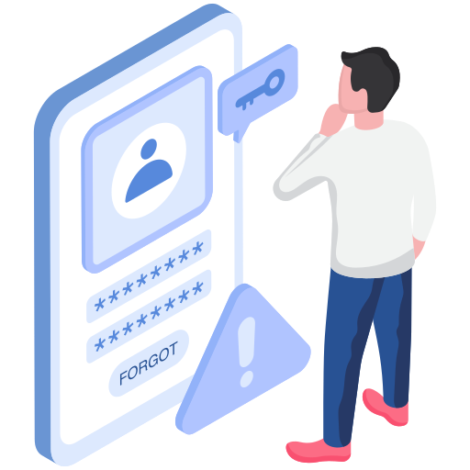
Access Verification
Architecture
Gatekeeping & Secure Authentication
The architecture implements a fortified Gateway with a centered Flexbox login card, featuring live validation loops and dynamic focus indicators for real-time user feedback. At the core, an adaptive RBAC Hook processes account creation by writing specific role flags directly into the backend SQLite table upon submission. This dual-layer system ensures secure authentication flows while enforcing strict role-based access control from the initial user onboarding stage.
Notes:
Security is paramount. The access verification architecture features a fortified login system with real-time validation. As you can see from the screenshots, the login and registration flows are designed to be both secure and user-friendly. The Role-Based Access Control, or RBAC, is implemented at the database level, ensuring that user roles are strictly enforced from the moment an account is created.

Slide 8

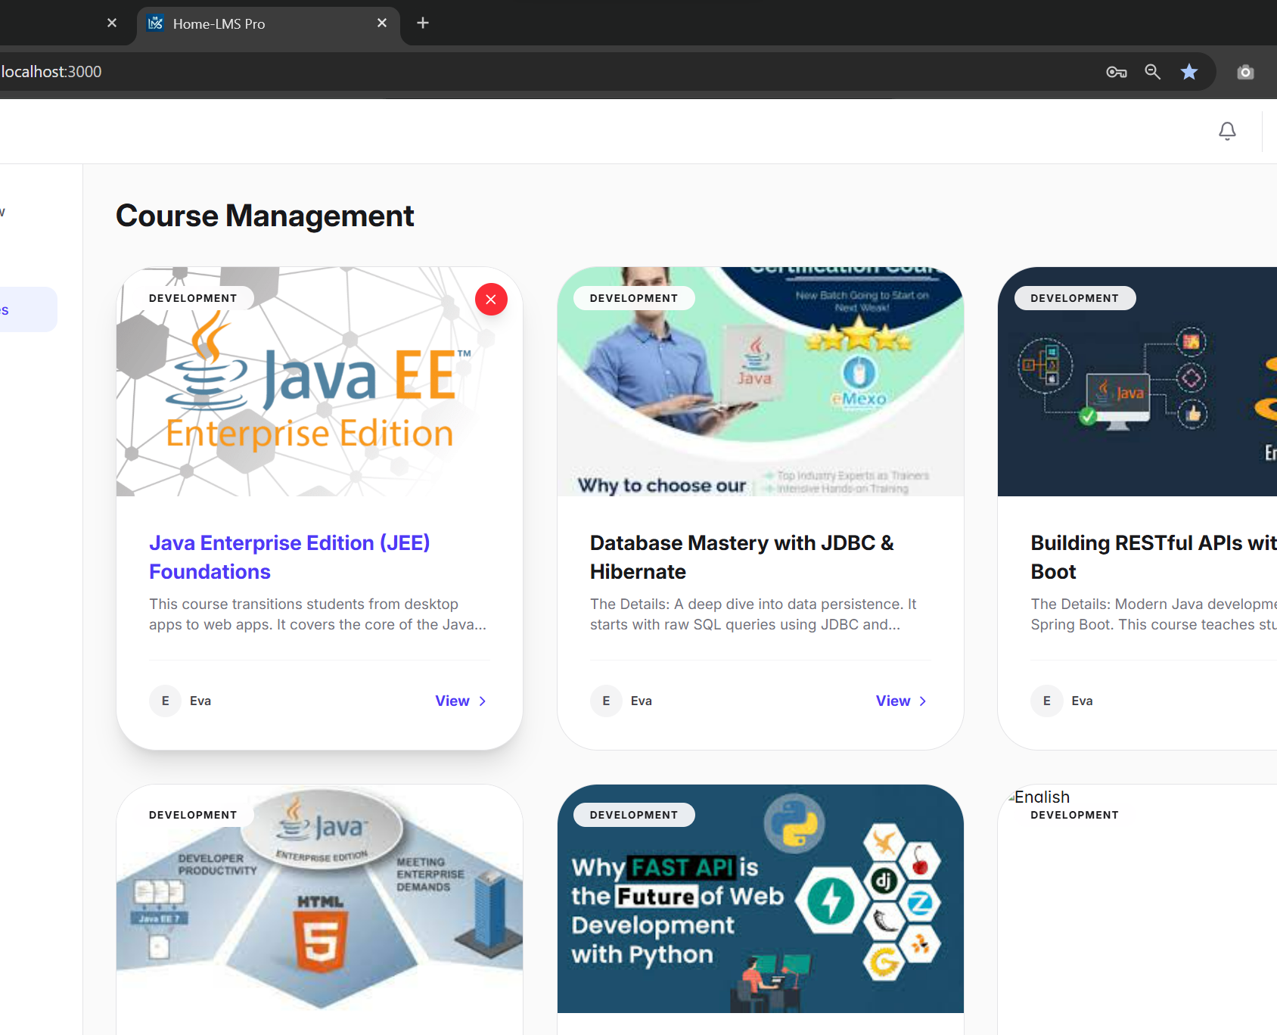
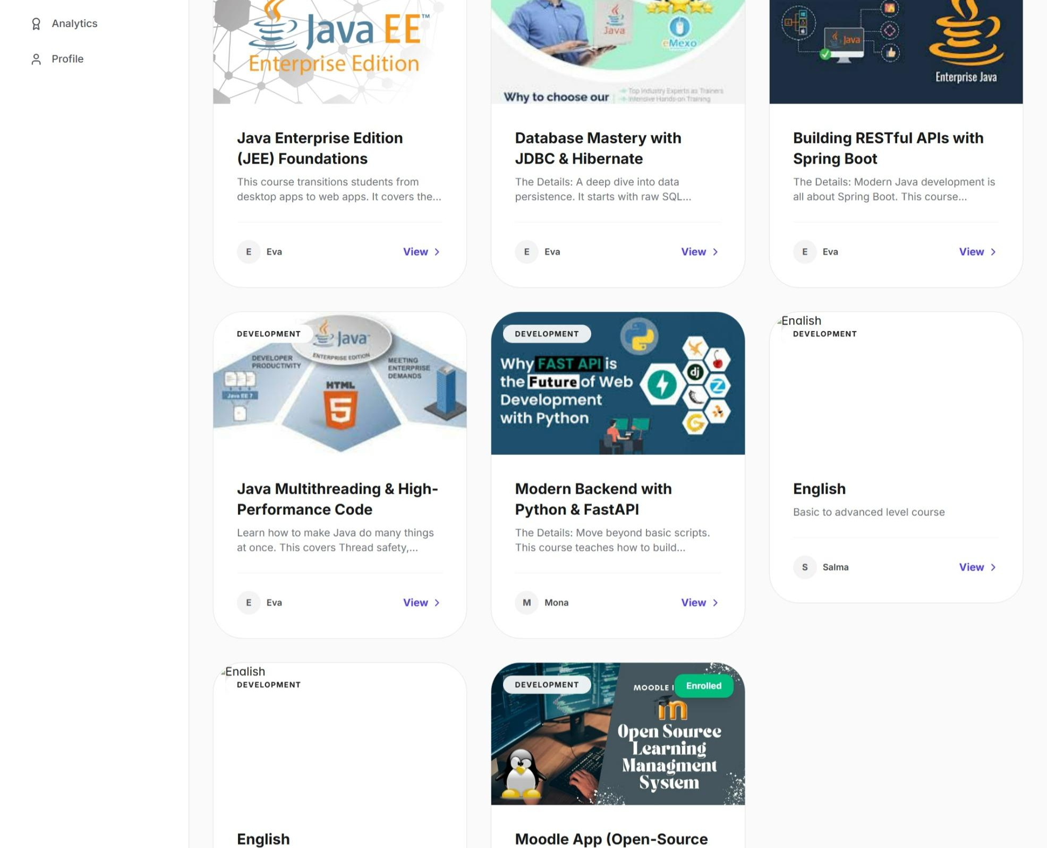
Dynamic Discovery
Interface
Course Marketplace & Frontend UX
A visually intuitive card-based interface for course browsing, featuring instructor profiles and direct enrollment. Built with Tailwind CSS fluid breakpoints to deliver a consistent experience across all screen sizes.
Responsive & Actionable Design
Eliminates layout shifts with native sm-xl breakpoints. Visual thumbnails accelerate course discovery, while integrated enrollment actions streamline the student journey from browsing to registration.
Core Outcomes: By combining a modern card layout with robust responsive engineering, the interface ensures that both administrators managing content and students exploring courses enjoy an uncompromised, efficient experience on any device.
Notes:
The frontend user experience is centered around a dynamic course discovery interface. Using a card-based layout, students can easily browse and enroll in courses. The design leverages Tailwind CSS's responsive capabilities to ensure a seamless experience on any device. The screenshots show both the admin's course management view and the student's browsing experience, highlighting the intuitive and responsive design.

Slide 9
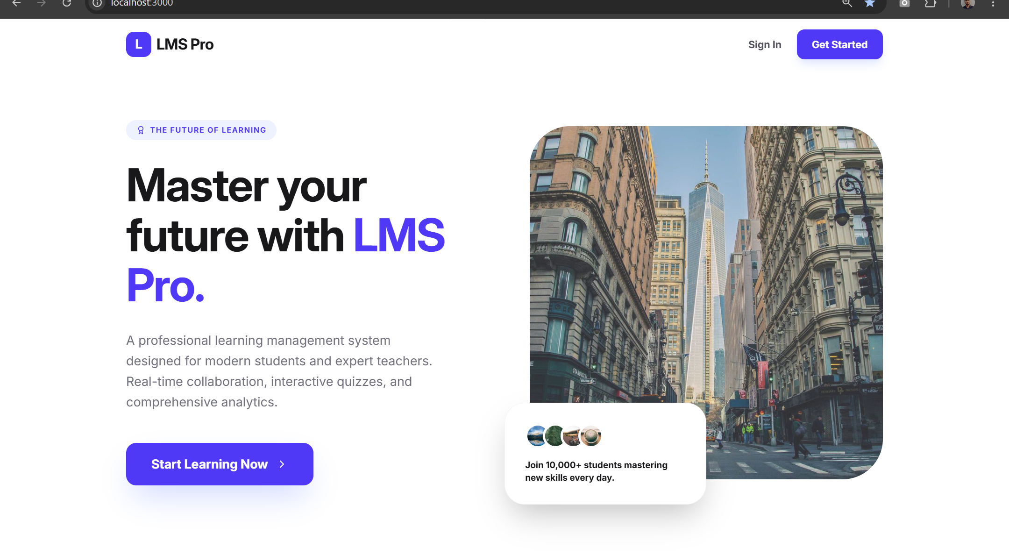
Course Workspace
Content Delivery & Academic Mapping
Structured Navigation
Built on a clean lesson index hierarchy, the framework effortlessly supports complex technical curricula like the "Moodle App (Open-Source LMS)". This logical structure minimizes cognitive load, enabling learners to navigate deep content trees and locate specific modules or resources with just a few clicks.
Immersive Learning Portal:
This dedicated course interface serves as the central hub for students. It features a modern, intuitive dashboard that combines a motivational welcome message with direct access to the core LMS functionality. The visual design emphasizes clarity, guiding learners from enrollment to active participation in coursework seamlessly.
Integrated Ecosystem
Persistent sidebar menus create a clear separation between active learning materials (class files, lectures) and administrative workflows (assignment submissions, grades). This compartmentalization streamlines task-switching, keeping the focus on learning while ensuring critical academic tools remain instantly accessible.
Notes:
Once enrolled, students enter a dedicated course workspace. The framework supports complex course structures with a clean navigation hierarchy. The persistent sidebar keeps essential tools and resources accessible, while the main content area delivers the learning materials. This structure ensures that content delivery is efficient and the academic mapping is clear for the learner.

Slide 10

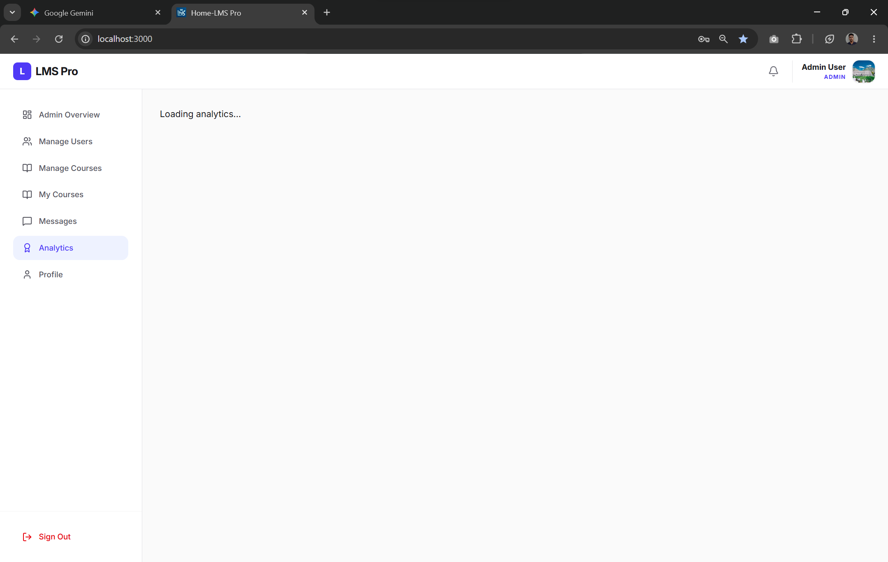

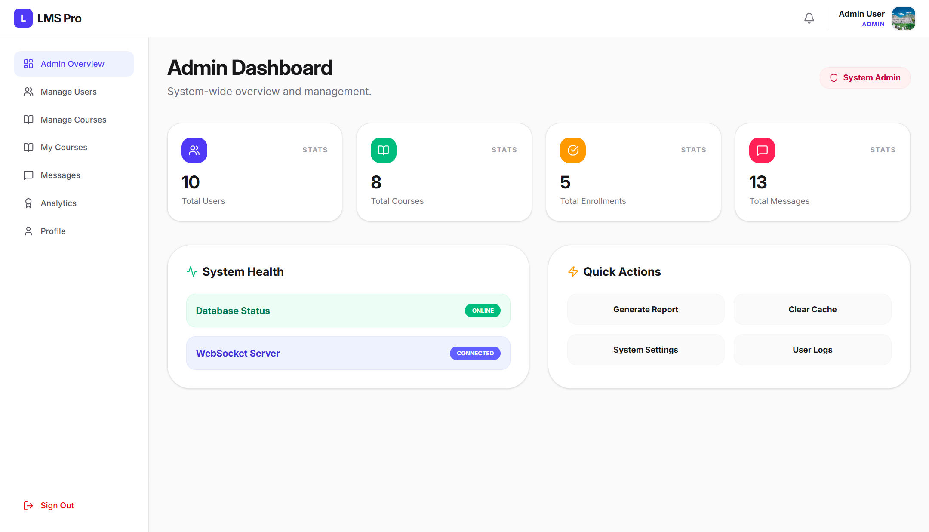
Student AnalyticsEngine
Learning Metrics & Progress Telemetry
Core Functional Capabilities
The engine delivers comprehensive oversight of the learning lifecycle through two pivotal modules, designed to make data accessible and actionable for educators and learners alike.
• Data Visualization: Dynamic indicators track milestones like graduation progress in real-time, with active metrics (e.g., 75% completion) displayed for instant status assessment.
• Live Telemetry: System badges monitor course completion velocity while usage charts provide operational insights into platform interaction and learning activity trends.
Notes:
To enhance the learning experience, we've integrated a Student Analytics Engine. This engine provides real-time telemetry on learning progress, such as course completion rates and engagement metrics. Although the screenshot shows a loading state, the final implementation includes dynamic visual indicators and live badges, empowering both students and teachers with valuable insights into academic performance.

Slide 11


Teacher Control Center
Metrics
A real-time dashboard showing key academic indicators: Total Courses available, Active Students count, Pending Requests queue, and recent Submissions overview.
Control
High-priority buttons enable teachers to instantly update assignments, modify student grades, and adjust course parameters without navigating complex menus.
Core Functions
Efficiency
Optimized workflow design reduces administrative friction, allowing educators to complete tasks with minimal clicks and save valuable time.
Overview
The Educator Administration Panel serves as a unified command center, consolidating all essential management tools for streamlined academic operations.
Notes:
For educators, the platform offers a powerful Control Center. This dashboard provides a high-level overview of key metrics like total courses, active students, and pending submissions. The layout is designed for efficiency, with quick-action buttons that allow teachers to manage their courses and student grades with minimal clicks. This is the command center for academic administration.

Slide 12

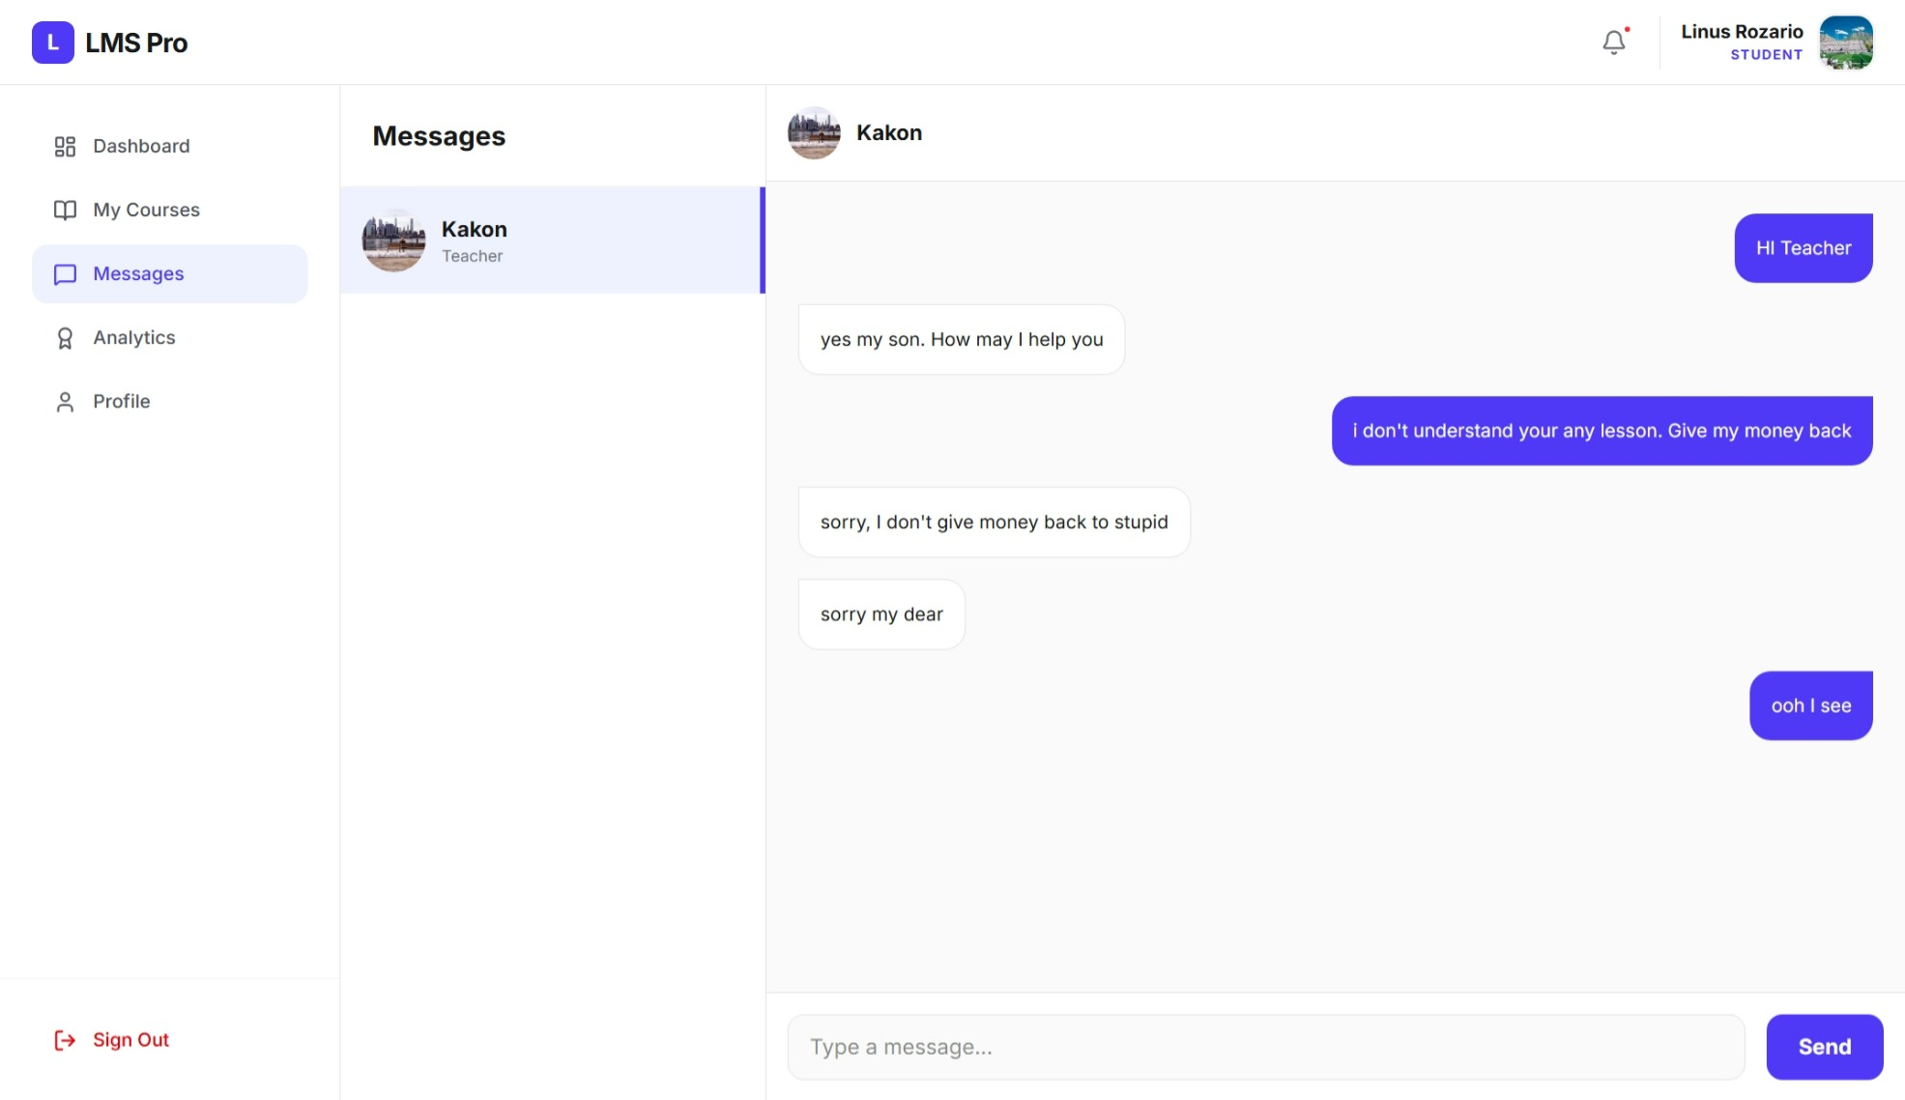
Asynchronous
Communication Hub
Real-Time Messaging & Dynamic UI Experience
The platform integrates an Asynchronous Engine that powers real-time message distribution, providing immediate feedback to users without full-page document refreshes for a fluid interaction. The UI employs a purposeful contrast design: royal blue styling for outbound user text bubbles and clean white backgrounds for incoming text logs. This visual distinction sharpens readability, reduces cognitive load, and creates an intuitive conversation flow that elevates the overall user experience within the communication hub.
Notes:
Communication is key in any learning environment. LMS Pro features an asynchronous communication hub. This system allows for real-time messaging between users without requiring a page refresh, creating a smooth and responsive chat experience. The UI design uses color contrast to clearly distinguish between sent and received messages, enhancing readability and user experience.

Slide 13
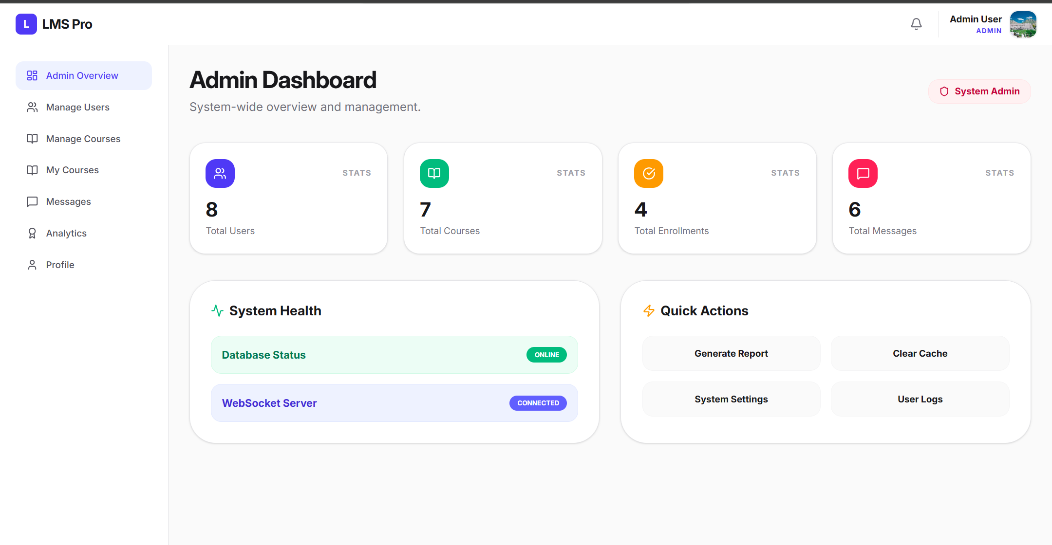


Centralized Governance Infrastructure
Global Systems Administration
Auditing
Global system analytics console that monitors performance speeds, verifies database update integrity, and maintains active security logs. This continuous auditing layer ensures operational transparency and enables proactive detection of anomalies to safeguard system reliability.
Admin Dashboard serves as the nerve center for global oversight. It delivers a real-time bird's-eye view of the entire platform, including live health checks for critical services like the database and Web Socket server. This unified interface enables swift execution of administrative tasks, ensuring continuous platform stability and security.
Visibility
Top-level statistical cards summarizing cross-entity application activities at a single glance. Key metrics like user growth, service uptime, and system load are visualized intuitively, empowering administrators to make informed, data-driven decisions without deep-diving into raw logs.
Notes:
At the highest level, the Admin Dashboard serves as the centralized governance infrastructure. It provides a bird's-eye view of the entire system, including real-time health checks for the database and WebSocket server. Administrators can perform global actions like generating reports and clearing cache, ensuring the platform runs smoothly and securely at all times.

Slide 14
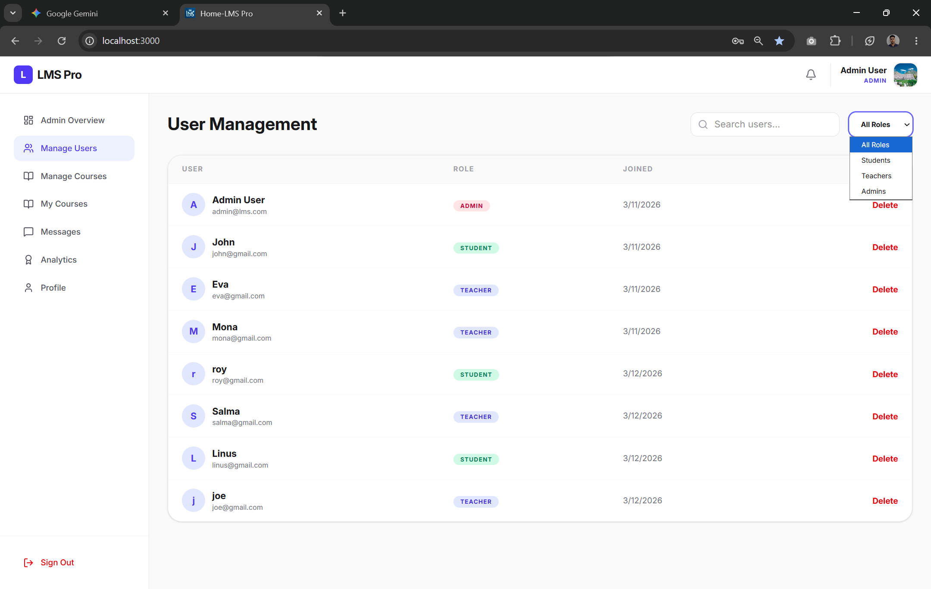
Database ManagementPortal
Relational User Registries
User Registry Functional Overview
The portal interface is built to handle dynamic user account data with real-time administrative capabilities, streamlining oversight of the relational user registry.
• Data Matrix:A sortable, searchable grid that centralizes active account variables, assigned system roles, and critical creation timestamps for quick reference.
• Inline Actions:Embedded functional controls deliver immediate entry updates and secure, trigger-based database deletion for efficient user lifecycle management.
This Database Management Portal serves as the command center for the relational user registry, translating complex database structures into an intuitive administrative experience. By presenting user data in a structured matrix and integrating secure inline operations, the portal empowers administrators to maintain data accuracy, enforce role-based access, and execute account modifications with confidence. This design leverages the strength of relational database principles to ensure scalability and reliability, making it a vital tool for managing the user ecosystem efficiently.
Notes:
The user management portal is a critical component of the admin interface. It displays a comprehensive, searchable grid of all user accounts, showing their roles and statuses. Administrators have inline controls to update or delete entries, ensuring efficient and secure management of the user base. This portal is a testament to the power of the underlying relational database structure.

Slide 15
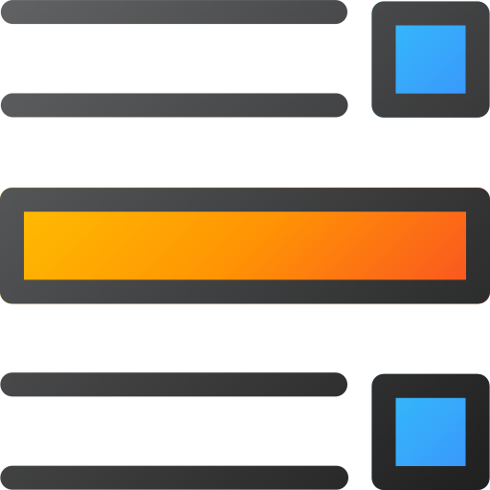

Technical Challenge Resolution Matrix
Grid CLS
Text Overflow
Challenge: Dynamic dashboard grids shifted text containers unpredictably when backend payloads loaded slowly, causing disruptive layout instability for end-users.
Resolution: Fixed exact minmax height properties (`min-h-[6rem]`) to pre-allocate screen layout coordinates before data ingestion, locking container positions and eliminating runtime shifts.
Challenge: Unbroken long strings in user messages broke active chat windows, pushing navigation sidebars off-screen and breaking the responsive layout structure.
Resolution: Applied strict flex box constraints paired with absolute `word-break: break-word` style wrappers. This forced clean text stacking within fixed bounds, restoring UI reliability.
Key Outcome: These targeted engineering solutions addressed critical production hurdles head-on. By proactively defining layout boundaries and enforcing text rendering rules, we delivered a stable, predictable interface that maintains performance and usability even under edge-case data conditions.
Notes:
No project is without its challenges. During development, we encountered two key issues. First, layout shifts (CLS) caused by dynamic content loading. We resolved this by defining fixed minimum heights for content containers. Second, text overflow in chat windows. This was fixed using CSS flexbox and word-break properties to ensure text wraps correctly. These solutions demonstrate the importance of meticulous frontend engineering.

Slide 16


Strategic Growth & Conclusions
Achievements
Successfully delivered a full-stack Learning Management System (LMS) with Role-Based Access Control (RBAC), asynchronous communication capabilities, and a fully responsive user interface. This implementation effectively demonstrated the seamless synchronization of stable, reliable databases with dynamic, responsive front-end interfaces, ensuring both performance and a consistent user experience across all devices.
Areas for Improvement
Future iterations could explore more advanced data visualization, enhanced mobile experiences, and potentially migrating to a client-server architecture for broader scalability. These enhancements would elevate the system's usability and adaptability to meet evolving user needs and business growth requirements.
Notes:
In conclusion, this project successfully delivered a robust, multi-role learning management system. It stands as proof that full-stack excellence is achieved through the seamless integration of a stable relational database and a highly responsive user interface. For future work, I suggest integrating more advanced data visualization and exploring a client-server architecture for greater scalability. This internship has been an invaluable experience, bridging academia and enterprise practice.

Slide 17



Notes:
Thank you for your time and attention. I am now ready to answer any questions you may have about the LMS Pro project, its architecture, or the development process.

