Slide 1

Automated Sickle Cell Anaemia Detector
Linus Castelino (05)
Gemmy George (22)
Date of Presentation: 09/04/2015
Under the guidance of: Mrs. Dakshata Panchal
Department of Computer Engineering,
St. Francis Institute of Technology

Slide 2

Introduction
Automated Sickle Cell Anaemia Detector (A.S.C.A.D.) is a software application that diagnoses ‘Sickle Cell Anaemia’ (drepanocytosis) from microscopic images of the patient’s blood smear.
It uses advanced image processing techniques to analyze the shape of ‘Red Blood Cells’ which are primary indicators of the disease.

Slide 3
Problem definition
In sickle celled disease, the abnormally shaped RBCs have a lower haemoglobin function.
This results in anaemia and other complications such as sickle cell crisis, haemolytic crisis, cholelithiasis, increased risk of infection, pulmonary hypertension, hypospleenism, renal failure, stroke and consequentially an increased risk of death.
Early detection of the disease thus becomes the pivotal antecedent for improving the patient’s longevity.
Automated Sickle Cell Anaemia Detector

Slide 4
Proposed solution
A.S.C.A.D provides a solution that is not just fast and inexpensive but also can be easily incorporated into routine blood-work performed at birth.
The solution to this lies in the use of image process
From a microscopic blood smear image, we filter out all the components in the human blood other than the RBCs and apply a metric calculation.
This gives us an estimate of the shape of RBCs in the blood.
With proper filtering and decision making, the software can be used to diagnose sickle cell anaemia.

Slide 5
Scope of project
A.S.C.A.D will directly accept microscopic image as a file input.
The software shall then perform various computations on the input file and display the result.
Images found on internet will be used as data to test the software on.
Accuracy will depend on the comparison of the output of the software with the predetermined results presented with the dataset.
Automated Sickle Cell Anaemia Detector

Slide 6
Review of literature
Sickle cell anaemia is a well understood medical condition. There is no widely available standard cure.
A study published on Science Direct named ‘Detection of Abnormal Findings in Human RBC in Diagnosing Sickle Cell Anaemia Using Image Processing’ authored by Pranati Rakshita and Kriti Bhowmikb treads along parallel ideologies as our project.
The proposed methodology in it involves preprocessing, edge detection and region selection.

Slide 7
Literature Review (cont.)
In a study by NIIT Rourkela, they use clustering algorithms for segmentation of images. One such algorithm is K-means clustering.
This algorithm moves objects between clusters until the sum cannot be decreased further. The result is a set of clusters that are as compact and well-separated as possible.
Another approach suggested here is the use of Fuzzy C-means clustering. It is one of the commonly used methods for image segmentation and its success is mainly due to the introduction of fuzziness for the belongingness of each image pixels.

Slide 8
Conventional Method
In a sick patient, consideration of anaemia as the likely diagnosis is based on symptoms exhibited.
Testing for sickle celled anaemia is done manually by pathological blood examinations, which have 2 intrinsic disadvantages.
It raises the possibility of human induced errors.
The whole process takes about 24-48 hours.
Moreover, such a lengthy process is not suitable when the patient has already begun manifestation of advanced symptoms.

Slide 9
System description
The software on being executed would go through the following phases:
Accepting details of the patient
Loading the microscopic image of the patient’s blood smear
Displaying results.
A detailed view of these phases can be explained as follows:

Slide 10
APPLICATION LAYER
PREPROCESSING (IMAGE ENHANCEMNET)
PROCESSING
DISTINGUISH BETWEEN VALID AND INVALID CELLS BY COMPUTING THE QUARTILE RANGE
FILLING OF VOID SPACES WITHIN EACH CELL.
ELIMINATION OF UNWANTED OBJECTS
COMPUTE THE AREAS AND PERIMETERS OF EACH OBJECTS
METRIC CALCULATION
DECISION MAKING

Slide 11
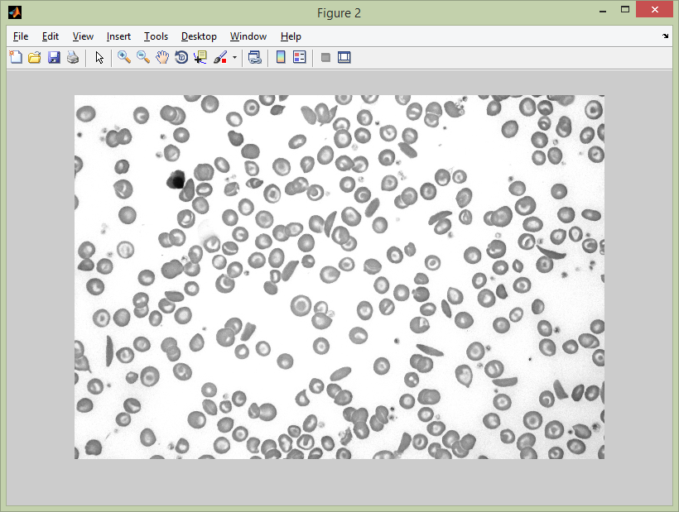
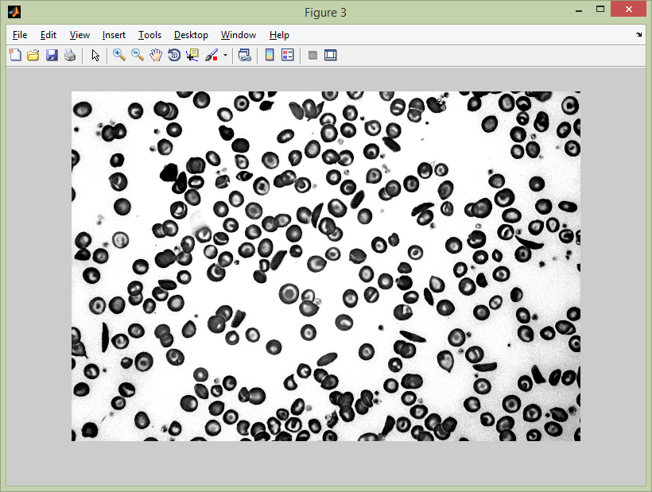
Explanation of Individual Blocks
Application Layer
Contains the GUI
Accepts the patient name, age, medical advisor and image.
Preprocessing (Image Enhancement)
Histogram Stretching (Improves Contrast)
performed in the software to obtain a clear distinction between a cell and its background.

Slide 12
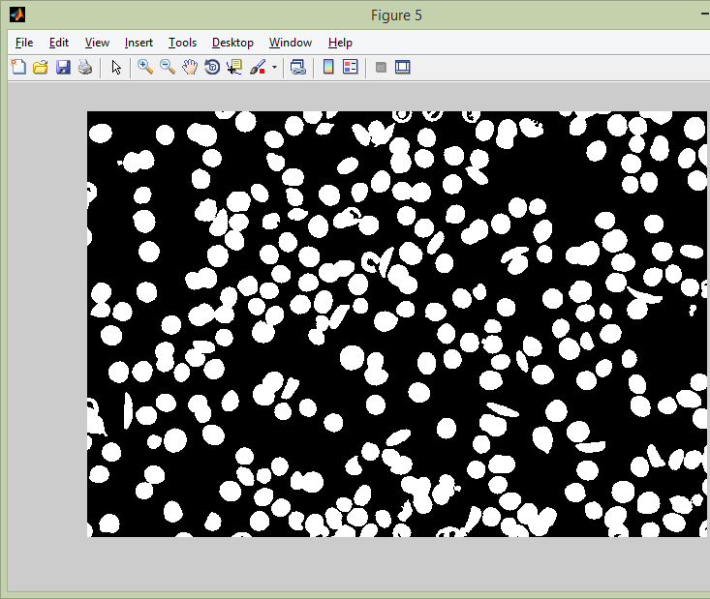
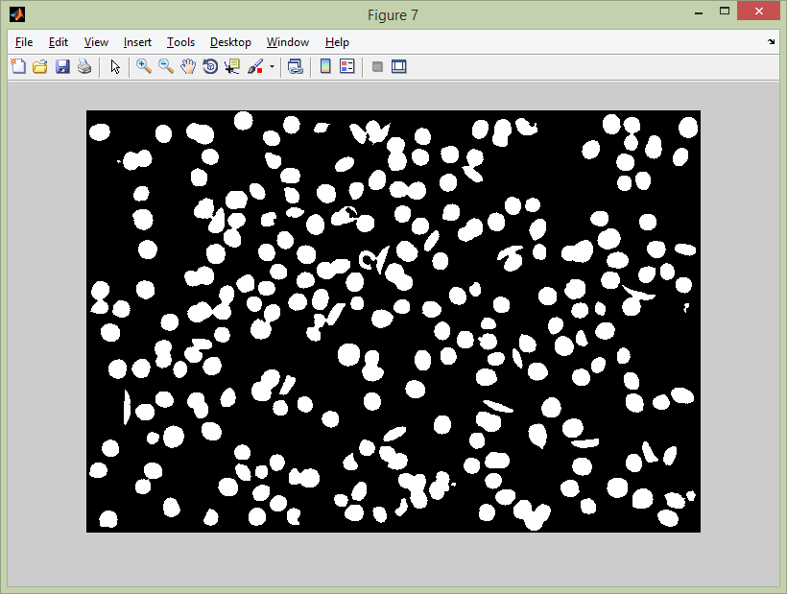
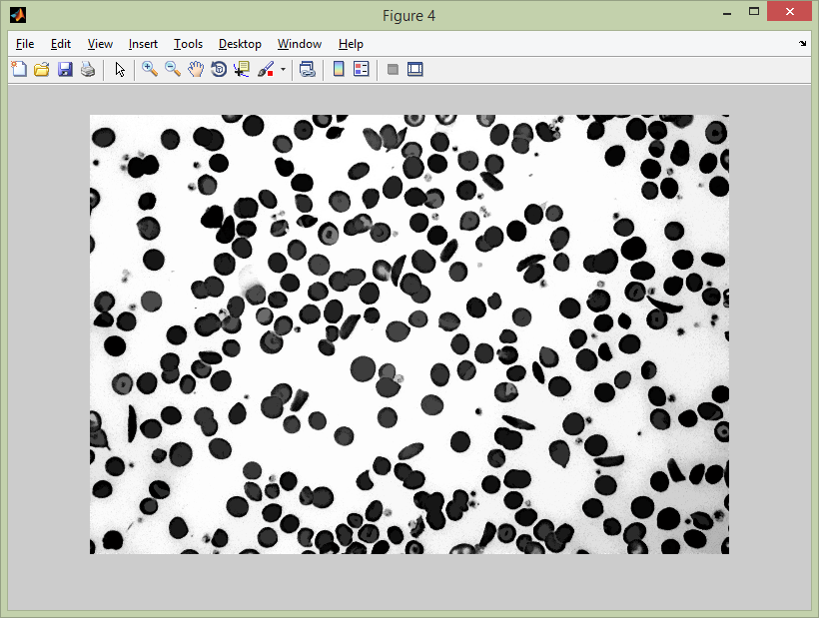
Explanation of Individual Blocks
Filling Void Space
Cells contain nucleus which is appears to be void due to its distinct contrast.
Filled (using imfill) to obtain an accurate area information.
Elimination of Unwanted Objects
Contains non RBC components and other minute particles.
These noises are are eliminated using bwareaopen function.
The boundary objects contain less information and is hence eliminated.
Also the individual cell boundaries are shrinked.

Slide 13
Explanation of Individual Blocks
Compute area and perimeter
Done by first detecting all the connected objects using bwconncomp
Then using regionprops function on the connected components.
Area and perimeter are used to calculate the metric.
Distinguish between valid and invalid cells
Based on the area obtained in the above step, we determine the cells that will be eligible for the metric calculation (which we term as a valid cell).
Now the objects that can be classified as an outlier based on statistical definition are not considered for further processing (which we term as an invalid cell).
The metric is applied on the resulting valid cells and we thus obtain the count of normal and abnormal cells.

Slide 14
Explanation of Individual Blocks
Metric Calculation
This metric is calculated by the formula 4*pi*area/perimeter², and its value ranges between 0 and 1.
Higher the value, more circular is the image. So a typical RBC would have a metric closer to 1 whereas an abnormally RBC would have a much lower metric of about 0.4 – 0.5.
The value thus indicates the circularity of the object and can be used to obtain the count of normal and abnormal cells.
Decision Making
Based on the metric above, a decision is made on whether the particular cell is normal or not.
A metric of 0.75 is used as the threshold lower-bound for classifying a cell as normal.
After obtaining the count of all the normal and abnormal cells, if the ratio of abnormal to normal is higher than 1:10, we arrive at the conclusion that the given sample is anaemic.

Slide 15
Hardware Requirements
A typical desktop PC would optimally run the program with the following specifications.
~2.0 Ghz Multi-core Processor or 2.6 Ghz Single core
1.5 GB or more RAM
2-3 GB of free space
128 MB of graphics memory
Automated Sickle Cell Anaemia Detector

Slide 16
Software Requirements
The following versions of operating systems are supported:
Windows XP, Vista, 7, 8
Mac OSX v10.7 or more
Linux Ubuntu 13+, RedHat 6+, Debian 7.x
In case of embedded systems, this algorithm can be automatically translated to C using emlc/codegen, a command-line tool in Real-Time Workshop that generates C code from Embedded MATLAB code. A microcontroller with an appropriate compiler for embedded C could be used to run this.

Slide 17
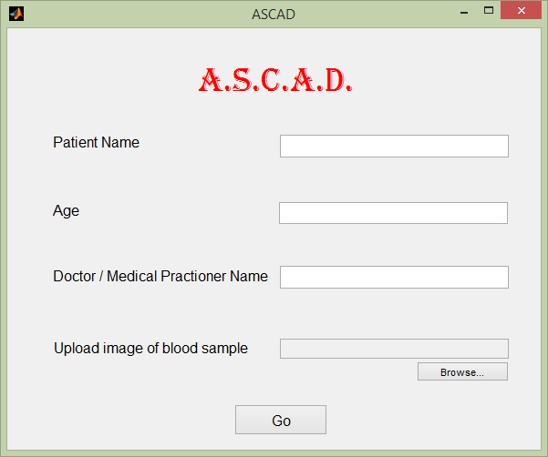
GUI Snapshots

Slide 18
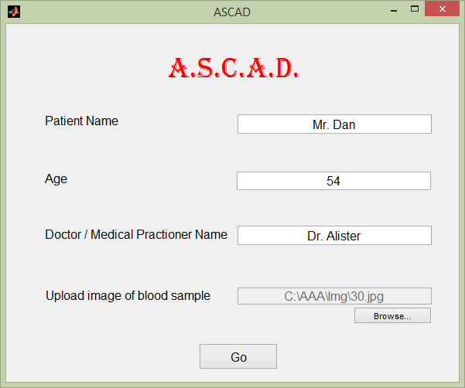
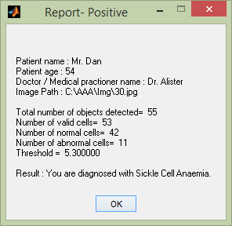
GUI Snapshot

Slide 19
Results and Discussion
The final result obtained was recorded for a dataset of 10 randomized images.
The findings were analyzed and the accuracy was calculated from it.
Image | Valid Cells Found/Total | Abnormal cells | Threshold | Observed Result | Actual Status
Exhibit 1 | 267/341 | 9 | 26.7 | Healthy | Healthy
Exhibit 2 | 256/333 | 11 | 25.6 | Healthy | Healthy
Exhibit 3 | 188/210 | 26 | 18.8 | Anaemic | Anaemic
Exhibit 4 | 164/188 | 18 | 16.4 | Anaemic | Anaemic
Exhibit 5 | 244/295 | 14 | 24.4 | Healthy | Healthy
Exhibit 6 | 189/216 | 29 | 18.6 | Anaemic | Anaemic
Exhibit 7 | 65/73 | 1 | 6.5 | Healthy | Healthy
Exhibit 8 | 46/53 | 4 | 4.6 | Healthy | Anaemic
Exhibit 9 | 186/209 | 25 | 18.6 | Anaemic | Anaemic
Exhibit 10 | 46/63 | 1 | 4.6 | Healthy | Healthy

Slide 20
Results and Discussion
From the above analysis, it is seen that ASCAD provided the expected results in 9 out of the 10 samples used.
We can therefore conclude that the software has an accuracy of about 90%.
However, a thorough analysis with a much larger dataset would be required before we can determine its real accuracy.
This was unfortunately not possible in our project owing to insufficient data available to us.

Slide 21
Conclusions
It is estimated that out of 1.27 billion people, 200 million suffer from some kind of disease at any given point of time.
In such a scenario, our solution to sickle-celled disease expedites the diagnostic processes.
Furthermore, A.S.C.A.D, if successful as a consumer product has the potential to open up a gateway to private R&D investment into automation in health-care sector.
Automated Sickle Cell Anaemia Detector

Slide 22
Future Scope
Looking beyond, this software has greater prospects when it can be optimized based on a larger sickle cell database.
Optimization can also be done by adjusting certain pre-defined values in A.S.C.A.D that can be generalized to work for a much wider range of input possibilities.
However, such modifications would need a much wider medical database, in contrast to what is available.
But on the whole, with a greater influence of digital technologies, A.S.C.A.D and similar software can only envision an upward trend of its utility and use.

Slide 23
Literature Cited
P. Rakshita, K. Bhowmikb, “Detection of Abnormal Findings in Human RBC in Diagnosing Sickle Cell Anaemia Using Image Processing”, International Conference on Computational Intelligence: Modeling, Techniques and Applications, Elsevier, 2013.
N. S. Aruna, S. Hariharan, “Edge Detection of Sickle Cells in Red Blood Cells”, International Journal of Computer Science and Information Technologies, Vol. 5 (3) 4140-4144, 2014.
S. S. Barpanda, “Use of Image Processing Techniques to Automatically Diagnose Sickle-Cell Anemia Present in Red Blood Cells Smear”, NIIT Rourkela, 2013.
D.J Weatherall, J.B Clegg, “Inherited haemoglobin disorders : an increasing global health problem” Bull. World Health Organ. 79: 704–12, 2001.
N Awasthy, K. C. Aggarwal, P. C. Goyal,M.S Prasad, M. Sharma, “Sickle cell disease: Experience of a tertiary care center in a nonendemic area” Ann Trop Med Public Health, 2008.
NCMH Background Papers—Burden of Disease in India (New Delhi, India), September 2005, Ministry of Health & Family Welfare, Nirman Bhawan, Maulana Azad Road, New Delhi 110011, India.

Slide 24
Acknowledgements
We thank Mrs. Dakshata Panchal, our internal guide, for her continuous support and guidance, for sharing her experience and knowledge, to ensure timely completion of all our project work.
We would also thank Mrs. Vincy Joseph and Mrs. Pradnya Rane for guiding us throughout the course of the project work.

Slide 25
Questions??
Thank You!

