Slide 1

Team Kenspring
Team Members :
Linus Castelino (linuscas@buffalo.edu)
Anand Gangar (agangar@buffalo.edu)
Ram Singh (ramvalla@buffalo.edu)
Harsh Gandhi (harshnar@buffalo.edu)
Yudhister (yudhiste@buffalo.edu)

Slide 2
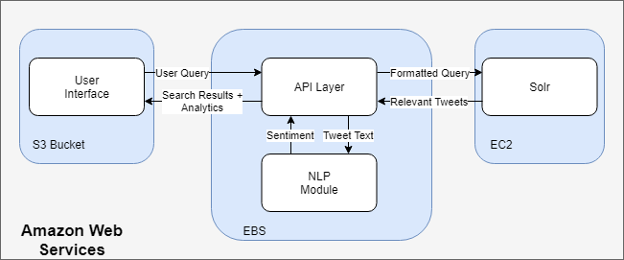
System Architecture

Slide 3
Technology Stack
Front End:
Angular 6
Bootstrap
Material API
Back End:
Spring Boot
Apache Solr
Stanford Core NLP
Google Cloud Natural Language API
Google Charts
NLTK
Maven
Jackson API
Google Translate API

