Slide 1
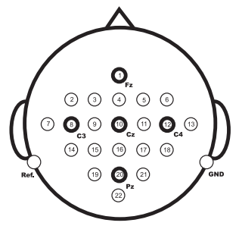
Posture prediction via EEG
Bidirectional LSTM
ConvNet
ConvNet with cropping

Slide 2
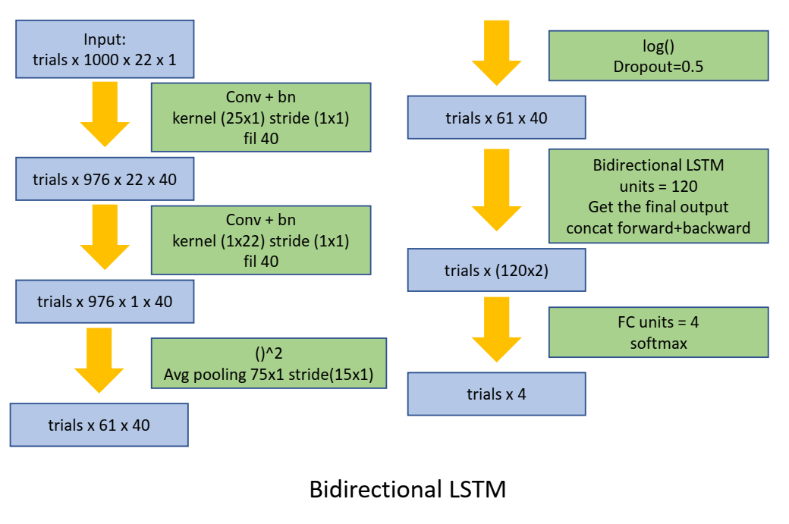
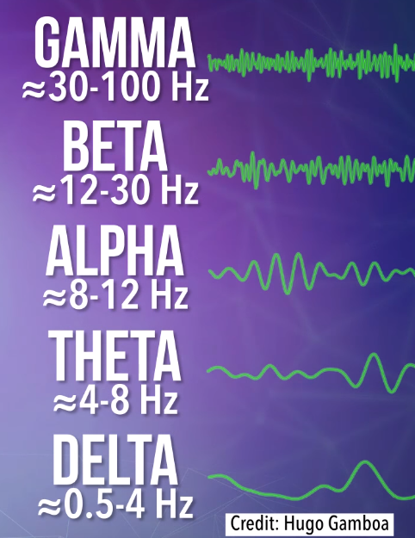
the frequencies range from 4 Hz to 30 Hz, which the periods are from 0.03 to 0.25
Sample rate 250Hz

Slide 3
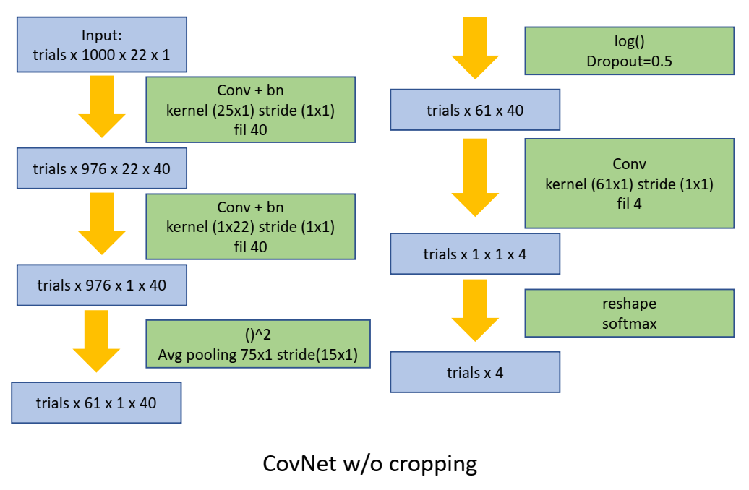

Slide 4
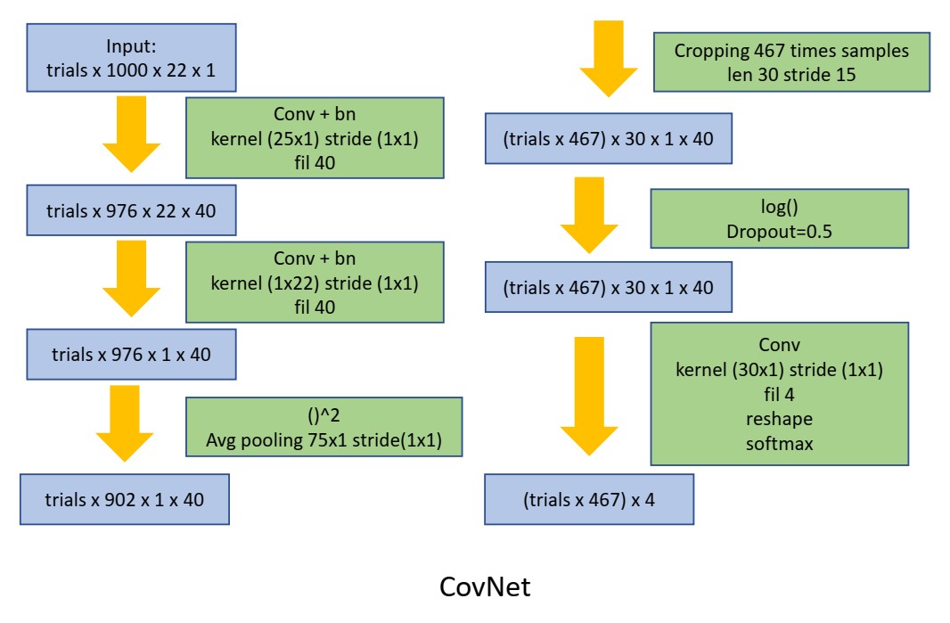

Slide 5
Results
Bidirectional LSTM
Set | noclip | clip5 | clip50 | Xa noclip
1 | 58 | 56 | 60 | 58
2 | 36 | 36 | 40 | 48
3 | 62 | 58 | 70 | 50
4 | 46 | 50 | 46 | 50
5 | 24 | 20 | 22 | 26
6 | 34 | 22 | 30 | 30
7 | 44 | 46 | 48 | 54
8 | 50 | 65 | 60 | 54
9 | 48 | 36 | 34 | 40
ConvNet no crop
Set | ---
1 | 62
2 | 38
3 | 60
4 | 58
5 | 48
6 | 44
7 | 68
8 | 50
9 | 74

Slide 6
Results
ConvNet with cropping
Set | idv | 1 v 8 | Mix
1 | 80 | 54 | 65
2 | 56 | 32
3 | 78 | 72
4 | 68 | 36
5 | 50 | 33
6 | 52 | 34
7 | 75 | 40
8 | 70 | 66
9 | 58 | 43
State of art on other data sets: 60~90%

