Slide 1
Jornal bearing testing at AMB Leoben
Testing lubricated journal bearings in repeated start stop cycles (for educational purpose)
Christopher Strablegg
28.04.22

Slide 2
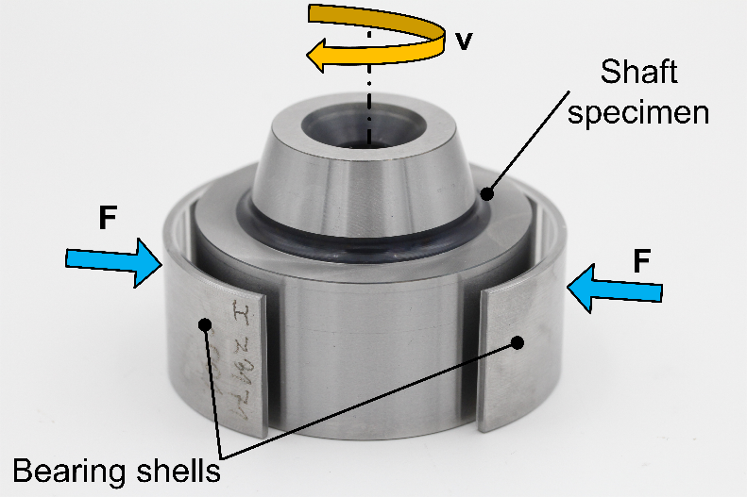
Basic description of tests
The goal of these journal bearing tests is to tests wear resistance, influence of different lubricants and other friction related phenomena.
The basic idea is to let the journal bearing system run in repeated start-stop cycles for a defined number of cycles. In the end the gravimetric wear (weight loss) and geometric wear (thickness loss of bearing shells) is evaluated.
Additionally, many variables are measured in every tests run (COF, temperatures, rotational speed, normal load, contact potential, acoustic emission RMS) with 10 Hz (for the whole test) and with 1 kHz for every 100th start-stop cycle (5000 cycles in total).
At following pages a description of the experimental set-up as well as pictures of the samples (before and after the test are available).
Figure 1: Specimens of JBA (journal bearing adapter) testing, in the middle the polished steel shaft, surrounded by 2x 120° bearing shells as used in real engine or machinery.

Slide 3
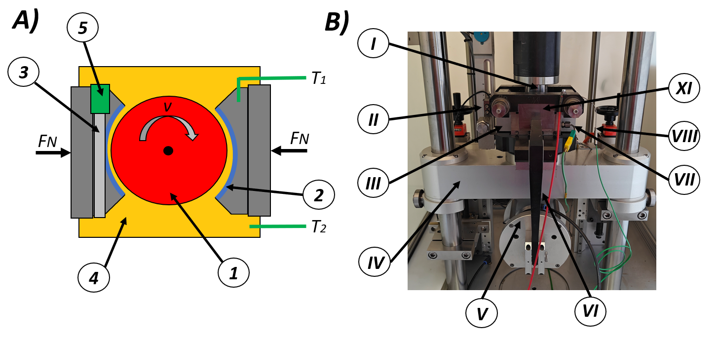
Test set-up and procedure
Test set-up:
To start with the JBA system, it consists in principle of two bearing shells and one corresponding shaft (see Fig. 2), simulating classical journal bearing operation, mostly operating in a hydrodynamic friction regime. Material paring can vary, the shaft with a diameter of approximately 48 mm consists most frequently of ordinary steel variations, while the bearing shells have a more complex structure, generally with more than one layer of material. The shaft is connected to an electric motor, while the bearing shells are fixed in place, only moving towards the rotating shaft. The force applicated behind the bearing shells towards the rotating shaft can be controlled finely. Bearing shells and shaft are submerged in lubricant, which the temperature of can be set by the controller. Also, the temperature at the back of one bearing shell is measured as specimen temperature. The frictional torque is measured via force sensor in the plane of rotation, calculating the Coefficient-of-friction (COF) in parallel. Additionally, the contact potential between shaft and bearing shells is recorded, indicating direct contact, respectively also the hydrodynamic floating. The AE senor is mounted on a steel bracket fixed on one of the bearing shell holders.
Figure 2: (A) Schematic of the JBA set-up from top view: (1) rotating shaft in red, (2) bearing shells in blue, (3) bracket for AE sensor, (4) heated oil bath, (5) AE sensor, T₁/T₂ specimen/oil-bath temperature sensors, force application behind both bearing shell adapters. Lubricant is represented by yellow color; (B) Test cell of the tribometer: (I) rotating shaft, (II) friction force sensor, (III) heated oil bath, (IV) movable crosshead, (V) air bellow used for force application, (VI) lever for force transfer, (VII) oil-bath temperature sensor, (VIII) specimen temperature sensor, (XI) journal bearing holder.

Slide 4
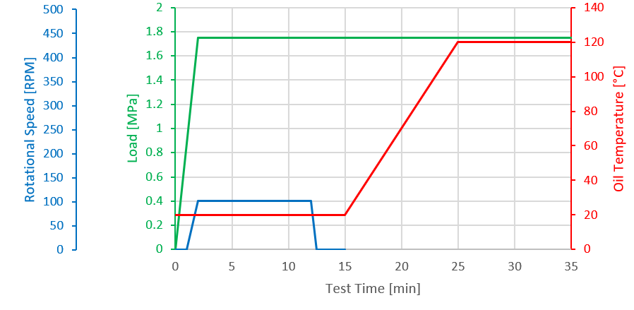
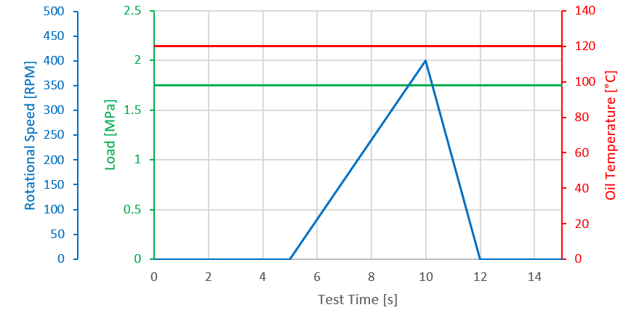
Test set-up and procedure
Start-stop testing with JBA:
For the JBA set-up one test-strategy was used. The start-stop testing begins with an initial running-in phase (see Fig. 3), where the load is set to 1.75 MPa and rotational speed to 100 RPM. The oil bath remains at room temperature, the whole phase lasts 10 min. After that, the rotation ends and lubricant temperature is increased to 120 °C. There is a stable period without movement at the end of the intended heating period to minimize temperature fluctuations. Thereafter, the start-stop cycles start.
These start-stop cycles (see Fig. 4) consist of a ramp to a maximum speed of 400 RPM in around before deaccelerating to standstill again. The test terminates after the final start-stop cycle, number of total cycles is 5000. AE high-speed measurements are triggered at every 100th start-stop cycle for the first few seconds of the acceleration phase. So, the breaking phase isn’t captured in the high-speed AE data.
Figure 3: Running-in and heating period for the start-stop testing with the JBA set-up.
Figure 4: Description of a single start-stop cycle with the JBA set-up.

Slide 5
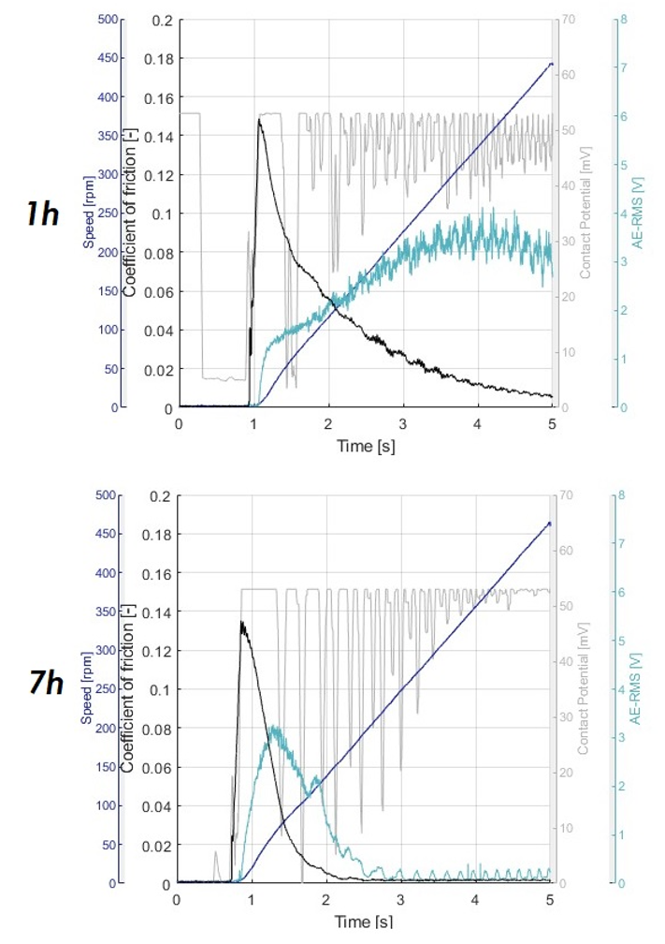
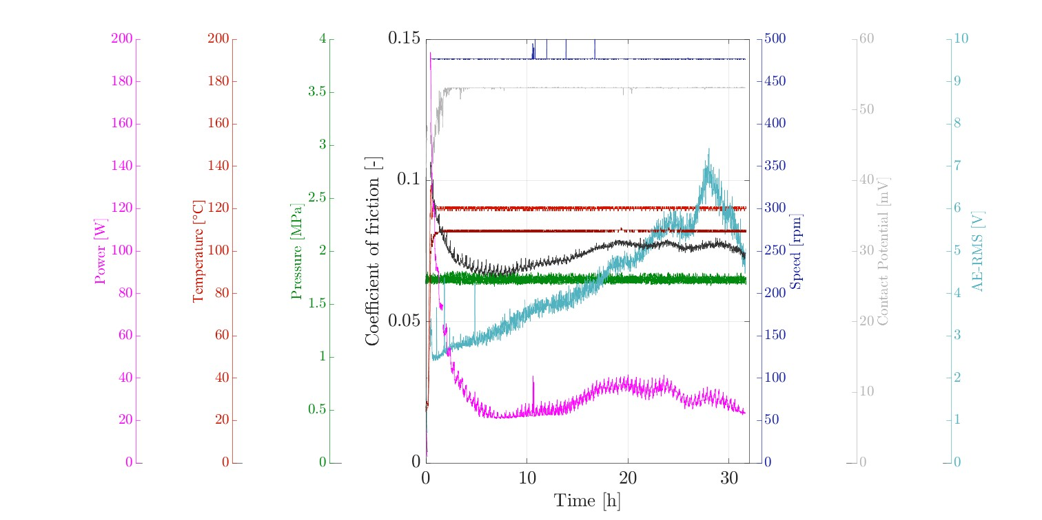
Evaluation of tests
Fig. 5 shows the test data for a full 5000 cycles tests (with the 10 Hz data) while Fig. 6 show different start-stop cycles in the course of the tests:
Figure 6: High-speed data (1 kHz) for start-stop cycles 1 hour and 7 hours into the tests-
Figure 5: Test graph of a start-stop JBA test with the following parameters: maximum COF per cycle (black), max. friction power per cycle (magenta), max. AE RMS per cycle (turquoise), max. contact potential per cycle (grey), pressure/load (green), specimen temperature (light red), contact temperature (dark red).

Slide 6
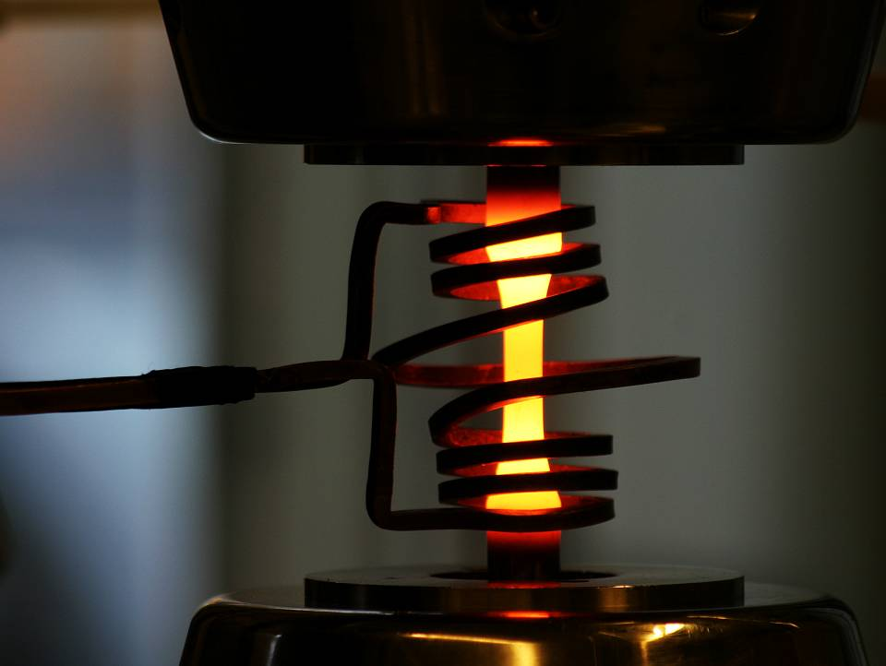

Montanuniversität Leoben
Chair of Mechanical Engineering
Head: Univ.-Prof. Dipl.-Ing. Dr. Florian Grün
Franz-Josef-Straße 18
A-8700 Leoben
+43 3842 402 1401
amb@unileoben.ac.at
https://amb.unileoben.ac.at/
Thank you very much for your attention!
5

