Slide 1
Ccaas Solution from Google CCAI
Contact Center AI (CCAI) Platform: Unified, AI-driven contact center solution
Conversational Insights: Natural language processing for call drivers, sentiment analysis, and popular questions
Agent Assist: Real-time, step-by-step assistance during customer interactions
Dialogflow CX: Advanced virtual agents for conversational flows
Omni-channel Routing: Intelligent routing across voice, chat, SMS, email, and social media

Slide 2
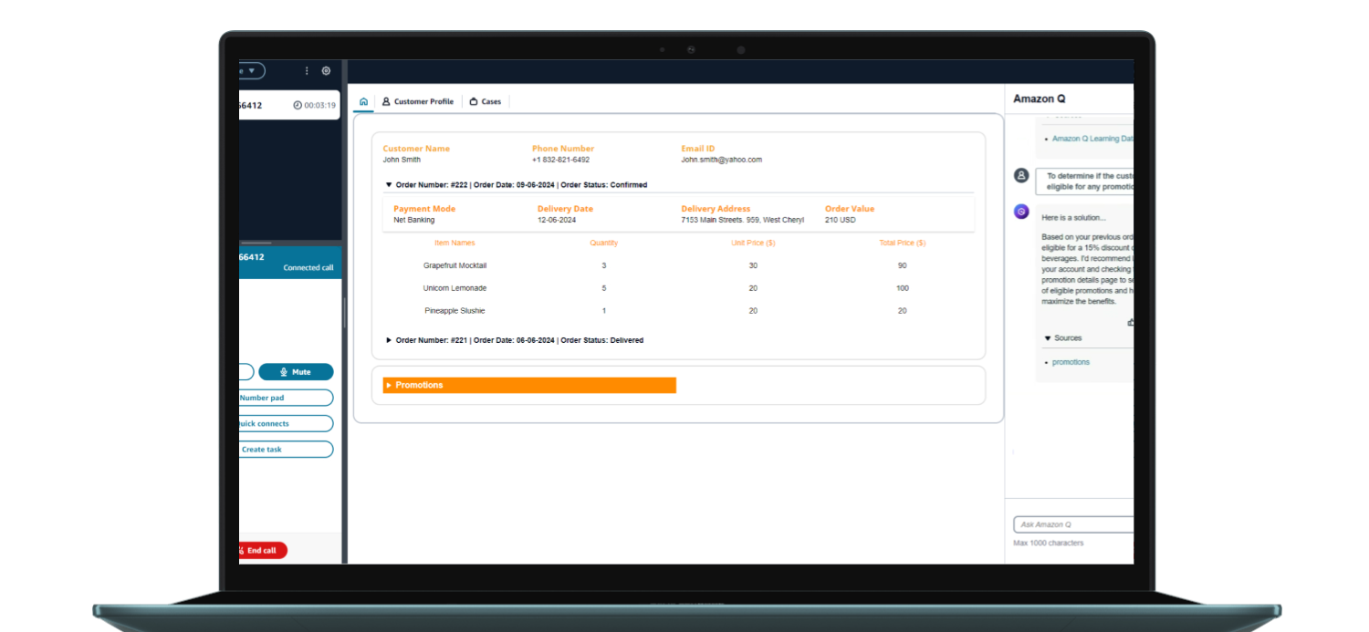
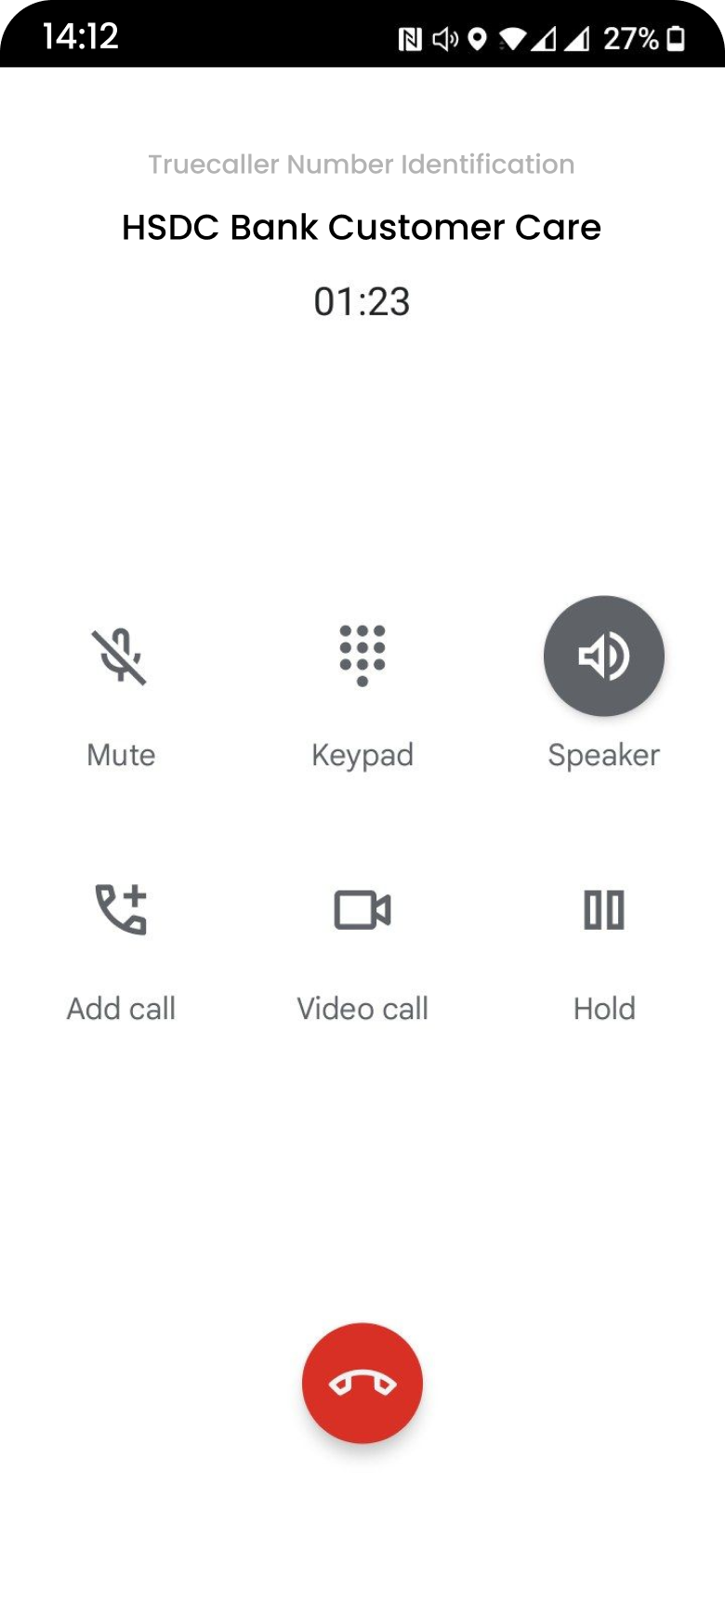


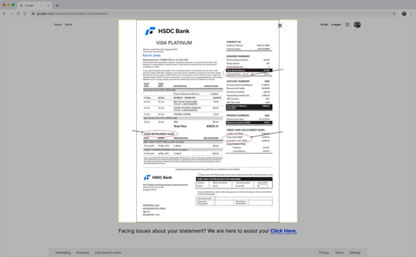
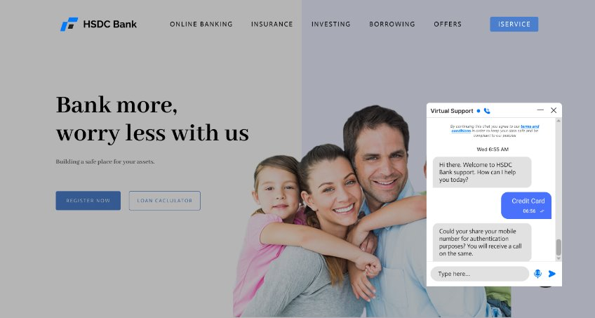

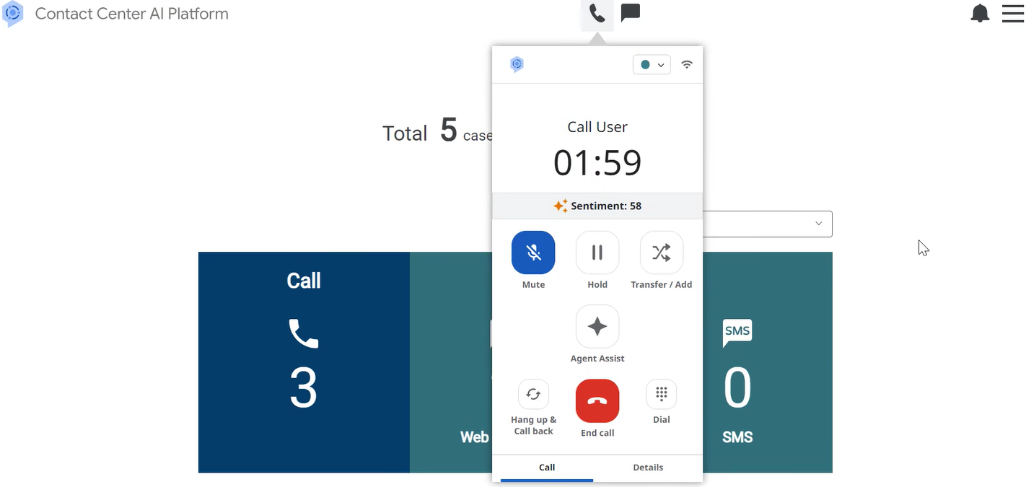
Gen-AI Supporting Agent For Amplified Customer Support
Contact Centre as a Service (CCaaS) : Banking & Financial Services Use case
Persona:
Kevin
Mobile: Call
Persona:
Peter
Web: Statement
Web: Chat
Kevin is a customer of HSDC bank who has a long-standing relationship with the bank. He uses their Credit Card and Savings Account.
He received his card statement via his email. He finds his balance high and wishes to connect with the HSDC team to enquire about it.
He initiates a chat via the website to get his query resolved. He requests to connect with a human agent to deep dive on details and request to waive off the charges on his card. Leaves his number for call back
Kevin gets a call from the Agent, as he leaves his contact number with the CSR
Peter is a CSR Agent for HSDC Bank, via Google Contact
Centre
Prototype Link

Slide 3



Customer Sentiment Analysis
Post Call Summarization
Customer 360 view
Gen-AI Supporting Agent For Amplified Customer Support
Contact Centre as a Service (CCaaS) : Banking & Financial Services Use case
Faster Call Resolutions with Google GCP
Current Call time : 4-5 mins
Google CCAI time: 2-3 mins
Highlights
Recommended for Banking & Financial Services to improve Resolution quality and delivery with minimal Agent training
Sentiment analysis during the call.
Summarisation Post call.
Customer 360 information (Possible with CRM Integration)
POC created by: POD of 5 Developers + 1 BA + 1 UX Time frame: 4 weeks (Including Self Paced Learning and Research)

Slide 4
Comparative View of Features
Contact Centre as a Service (CCaaS): Amazon Connect vs Google Contact Centre
Features developed | Google CCI | Comments
Gen AI based Agent Assist | LLMs yet to be integrated, working with Google support team
Customer 360 view | Yes, with CRM integration
Sentiment Analysis | Yes, on live call
Post Call Summary | Yes
Chat to chat Agent transfer | Yes
Video call with Agent | No | Not available on Google CCI
Translation feature – Customer to Agent and back | No
Agent Dashboard UI customization | No
Voice authentication | No
Voice call | WIP, team facing issues on CCI
Chat History transfer to Agent | Yes
Agent Assist | Yes | Still in development phase

Slide 5
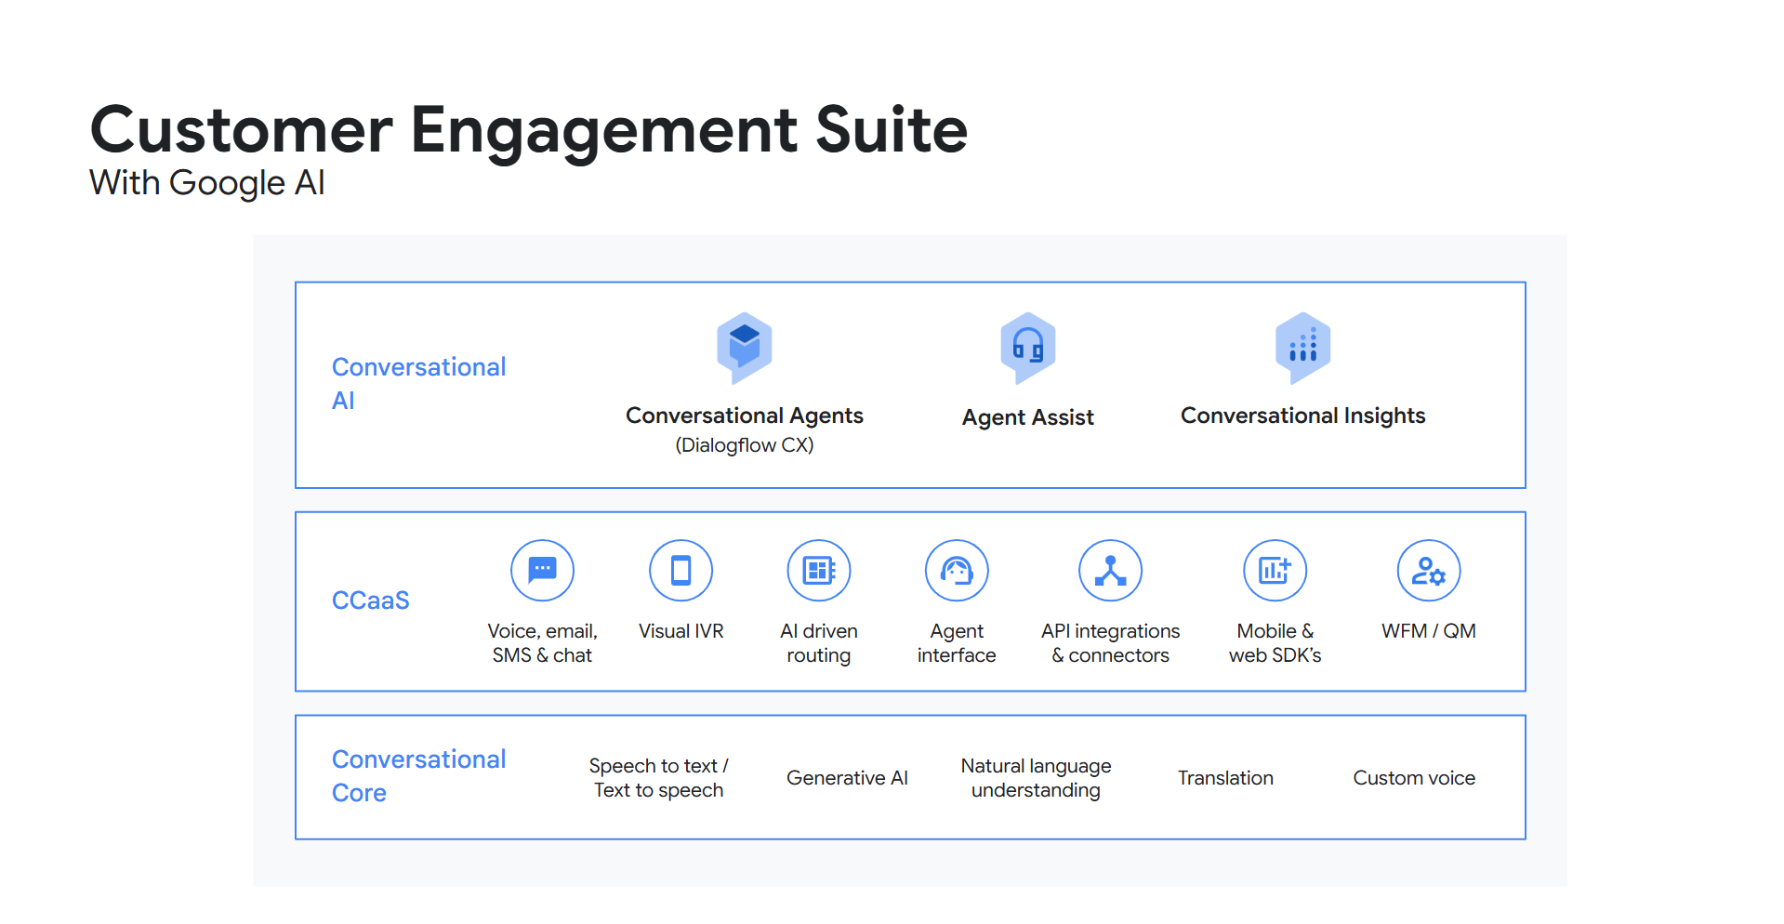

Slide 6
