Slide 1
Docker Manifests and Travis — Max Bender Linux Center of Competence

Slide 2
Agenda
What is a Docker Manifest?
Building a Manifest Manually…
Building a Manifest via Travis

Slide 3

What is a Manifest
A manifest list is a list of image layers that is created by specifying one or more (ideally more than one) image names. It can then be used in the same way as an image name in docker pull and docker run commands, for example. Architecture Agnostic
Multi-Arch Docker Images
Docker Registry MUST support Manifests to work

Slide 4
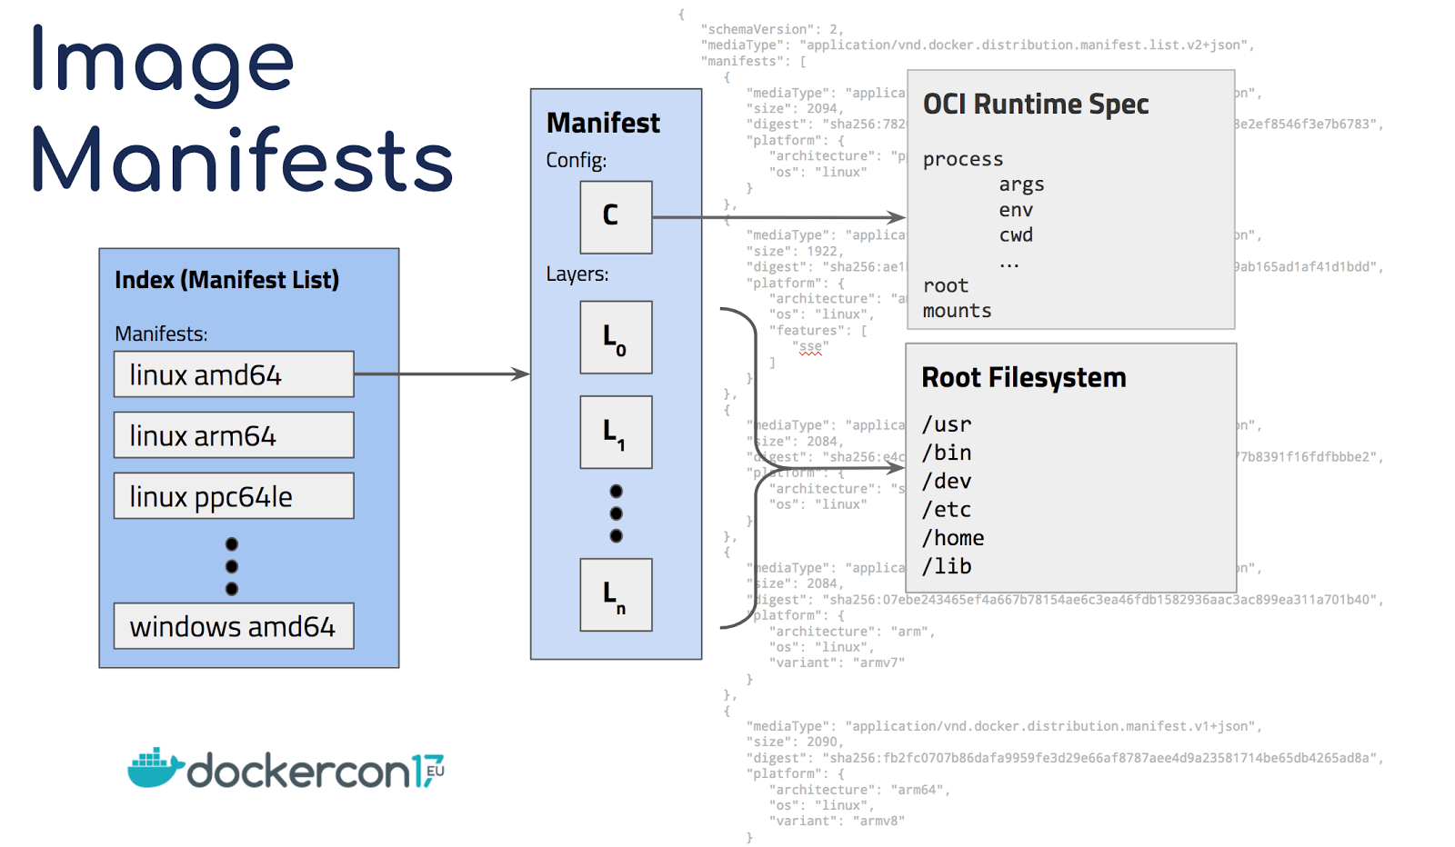

Slide 5
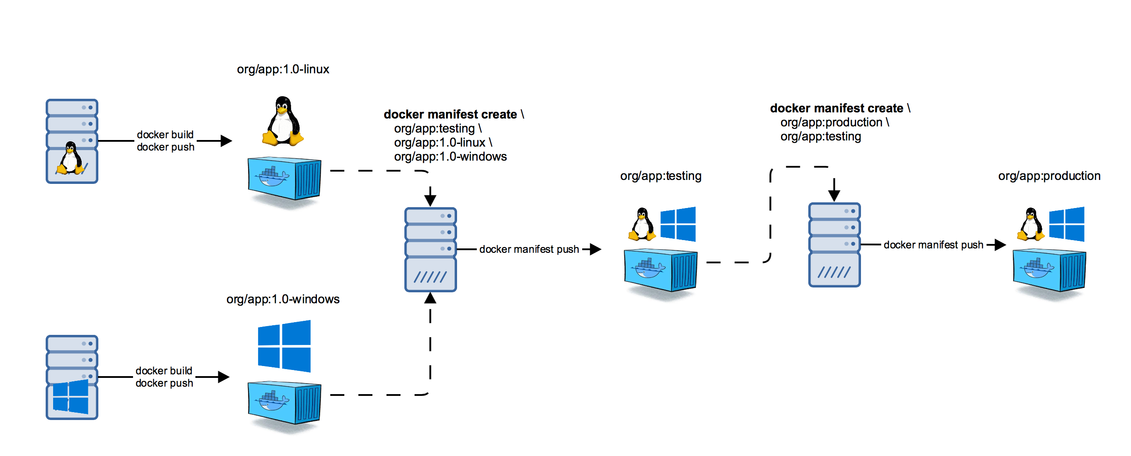
Manual

Slide 6

Automated

