Slide 1
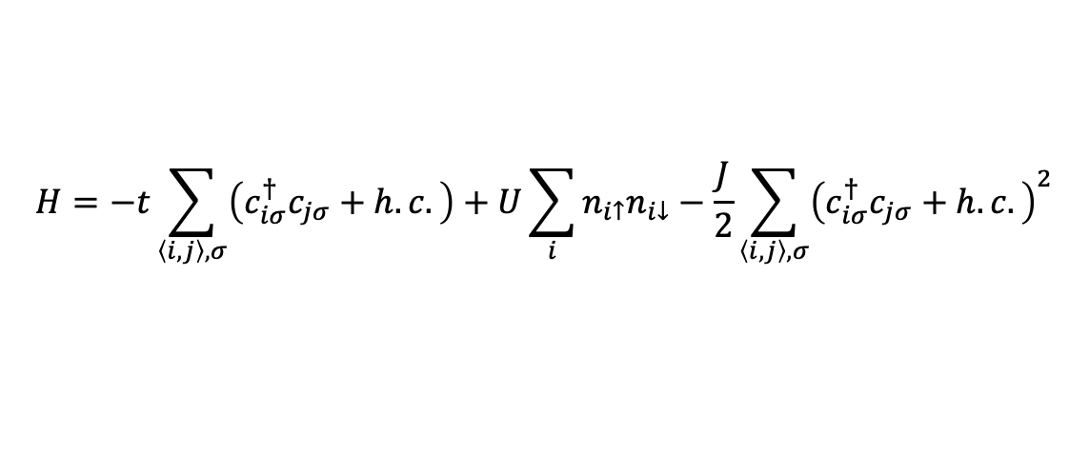
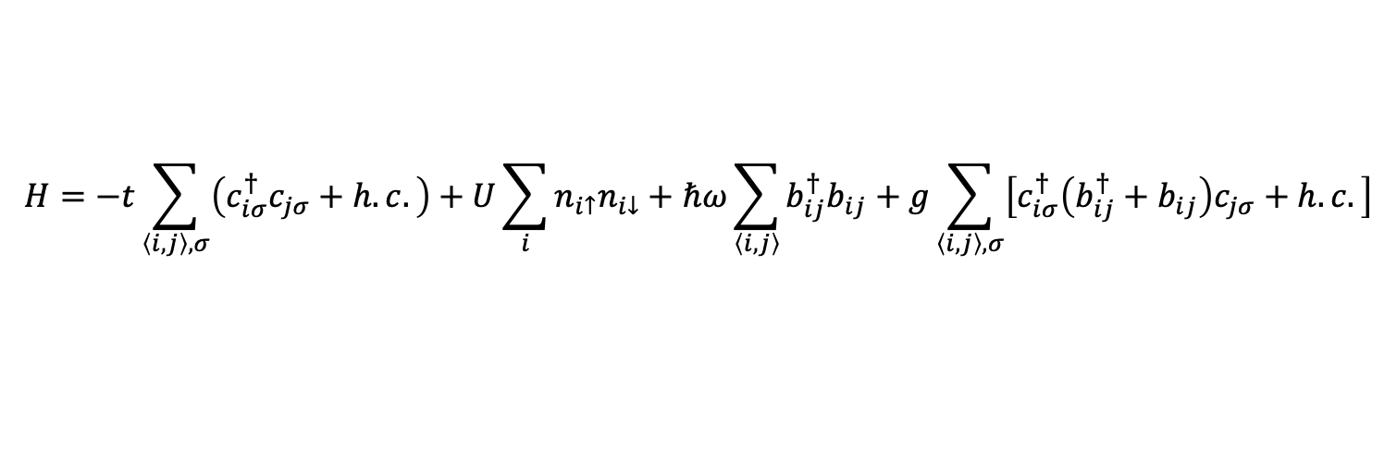

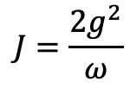
SSH-Hubbard model
$$H=−t\sum_{\left\langle i,j\right\rangle ,σ}{\left(c_{iσ}^{†}c_{jσ}+h.c.\right)}+U\sum_{i}{n_{i↑}n_{i↓}}+ℏω\sum_{\left\langle i, j\right\rangle }{b_{ij}^{†}b_{ij}}+g\sum_{\left\langle i, j\right\rangle ,σ}{\left[c_{iσ}^{†}\left(b_{ij}^{†}+b_{ij}\right)c_{jσ}+h.c.\right]}$$
$$H=−t\sum_{\left\langle i,j\right\rangle ,σ}{\left(c_{iσ}^{†}c_{jσ}+h.c.\right)}+U\sum_{i}{n_{i↑}n_{i↓}}−\frac{J}{2}\sum_{\left\langle i,j\right\rangle ,σ}{{\left(c_{iσ}^{†}c_{jσ}+h.c.\right)}^{2}}$$
$$J=\frac{2g^{2}}{ω}$$
$$λ=\frac{J}{W}, W=8t$$

Slide 2
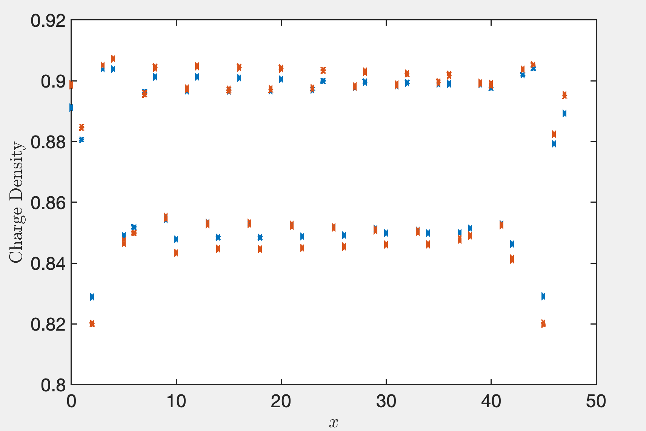
Lambda = 0.3, 0.4

Slide 3
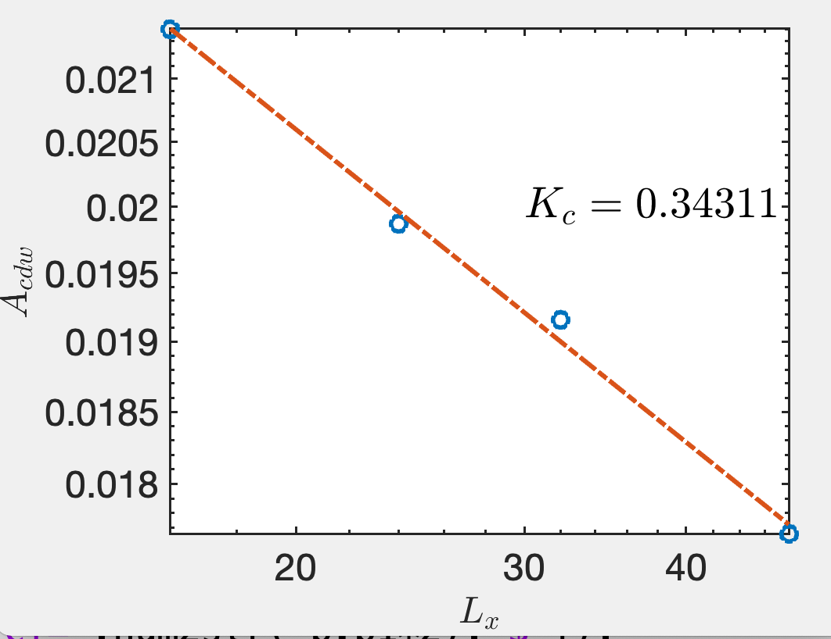
Bond dimension up to now
Lx | 16 | 24 | 32 | 40 | 48
D | 12000 | 14000 | 14000 | 12000 | 18000

Slide 4
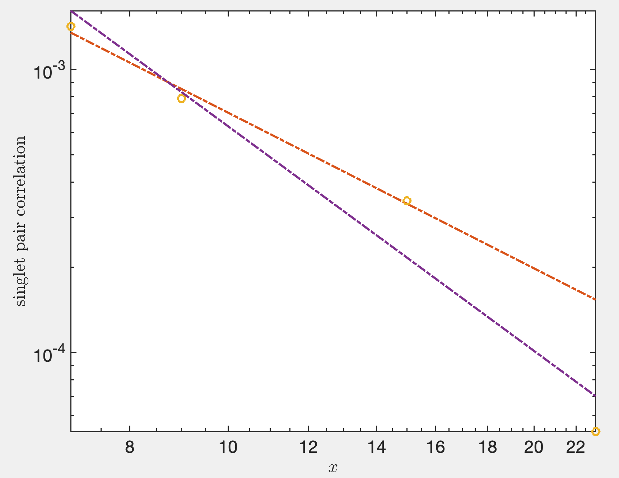
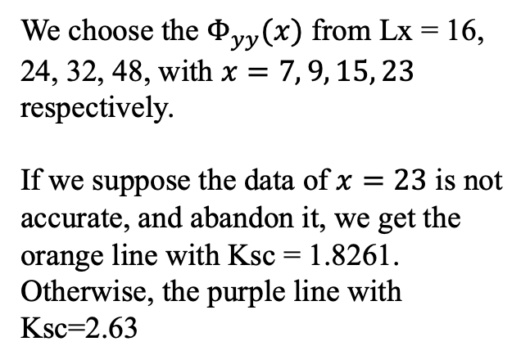
We choose the $Φ_{yy}(x)$ from Lx = 16, 24, 32, 48, with $x=7, 9, 15, 23$ respectively.
If we suppose the data of $x=23$ is not accurate, and abandon it, we get the orange line with Ksc = 1.8261. Otherwise, the purple line with Ksc=2.63

Slide 5
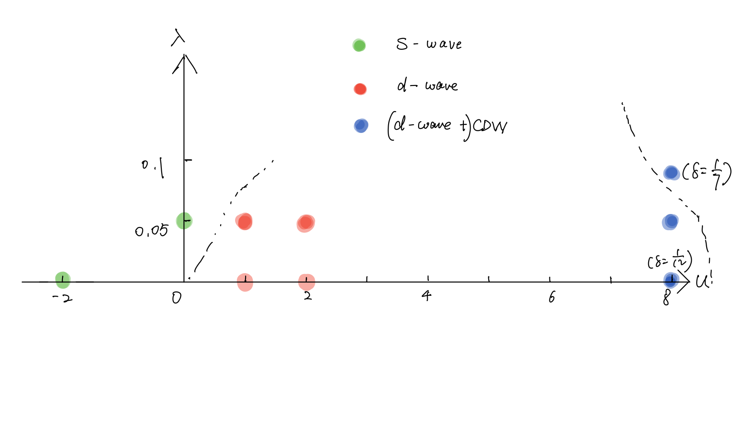
Landscape: 3-leg ladder, $δ=1/8$

Slide 6
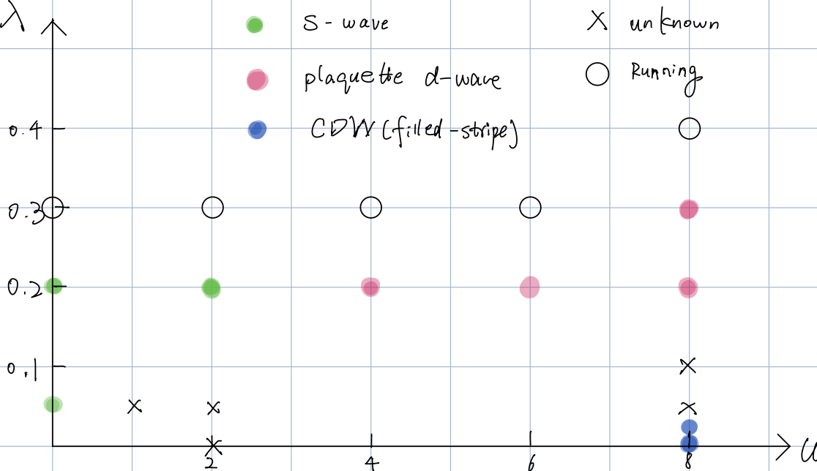

Landscape: 4-leg ladder, $δ=1/8$

