Slide 1
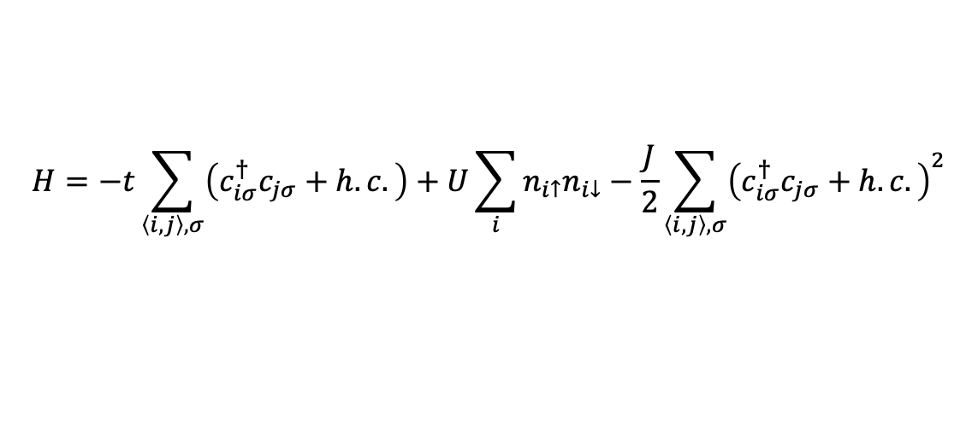
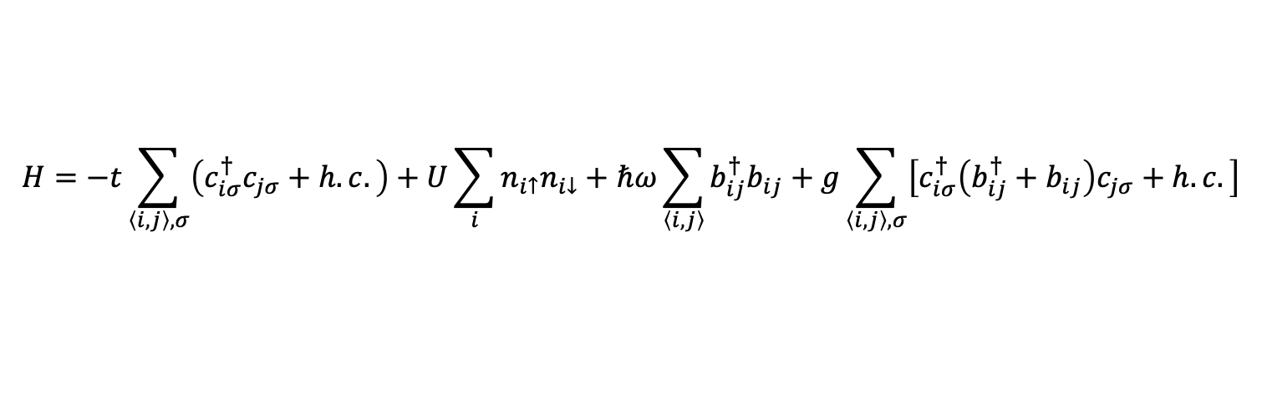

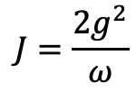
SSH-Hubbard model
$$H=−t\sum_{\left\langle i,j\right\rangle ,σ}{\left(c_{iσ}^{†}c_{jσ}+h.c.\right)}+U\sum_{i}{n_{i↑}n_{i↓}}+ℏω\sum_{\left\langle i, j\right\rangle }{b_{ij}^{†}b_{ij}}+g\sum_{\left\langle i, j\right\rangle ,σ}{\left[c_{iσ}^{†}\left(b_{ij}^{†}+b_{ij}\right)c_{jσ}+h.c.\right]}$$
$$H=−t\sum_{\left\langle i,j\right\rangle ,σ}{\left(c_{iσ}^{†}c_{jσ}+h.c.\right)}+U\sum_{i}{n_{i↑}n_{i↓}}−\frac{J}{2}\sum_{\left\langle i,j\right\rangle ,σ}{{\left(c_{iσ}^{†}c_{jσ}+h.c.\right)}^{2}}$$
$$J=\frac{2g^{2}}{ω}$$
$$λ=\frac{J}{W}, W=8t$$

Slide 2
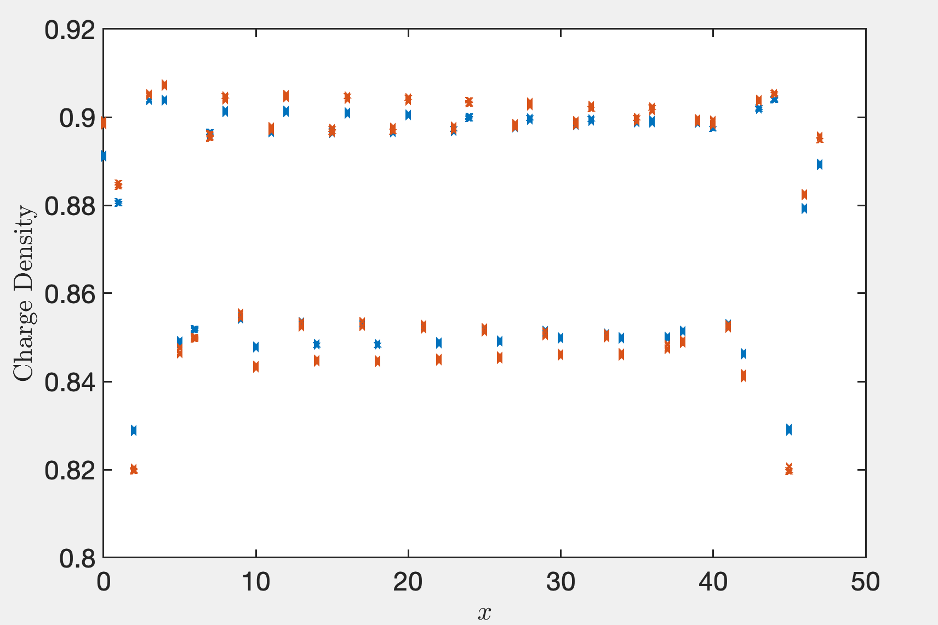
Lambda = 0.3, 0.4

Slide 3
Truncation error (1e-6), extract from the middle bond
Lx\D | 8000 | 10000 | 12000 | 14000 | 16000 | 18000 | 20000
16 | 3.37 | 2.82 | 2.45
24 | 3.44 | 2.79 | 2.41 | 2.17
32 | 3.70 | 2.96 | 2.61 | 2.49
40
48 | 3.16 | 2.67 | 2.34 | 2.08 | 1.95 | 1.78 | 1.47

Slide 4
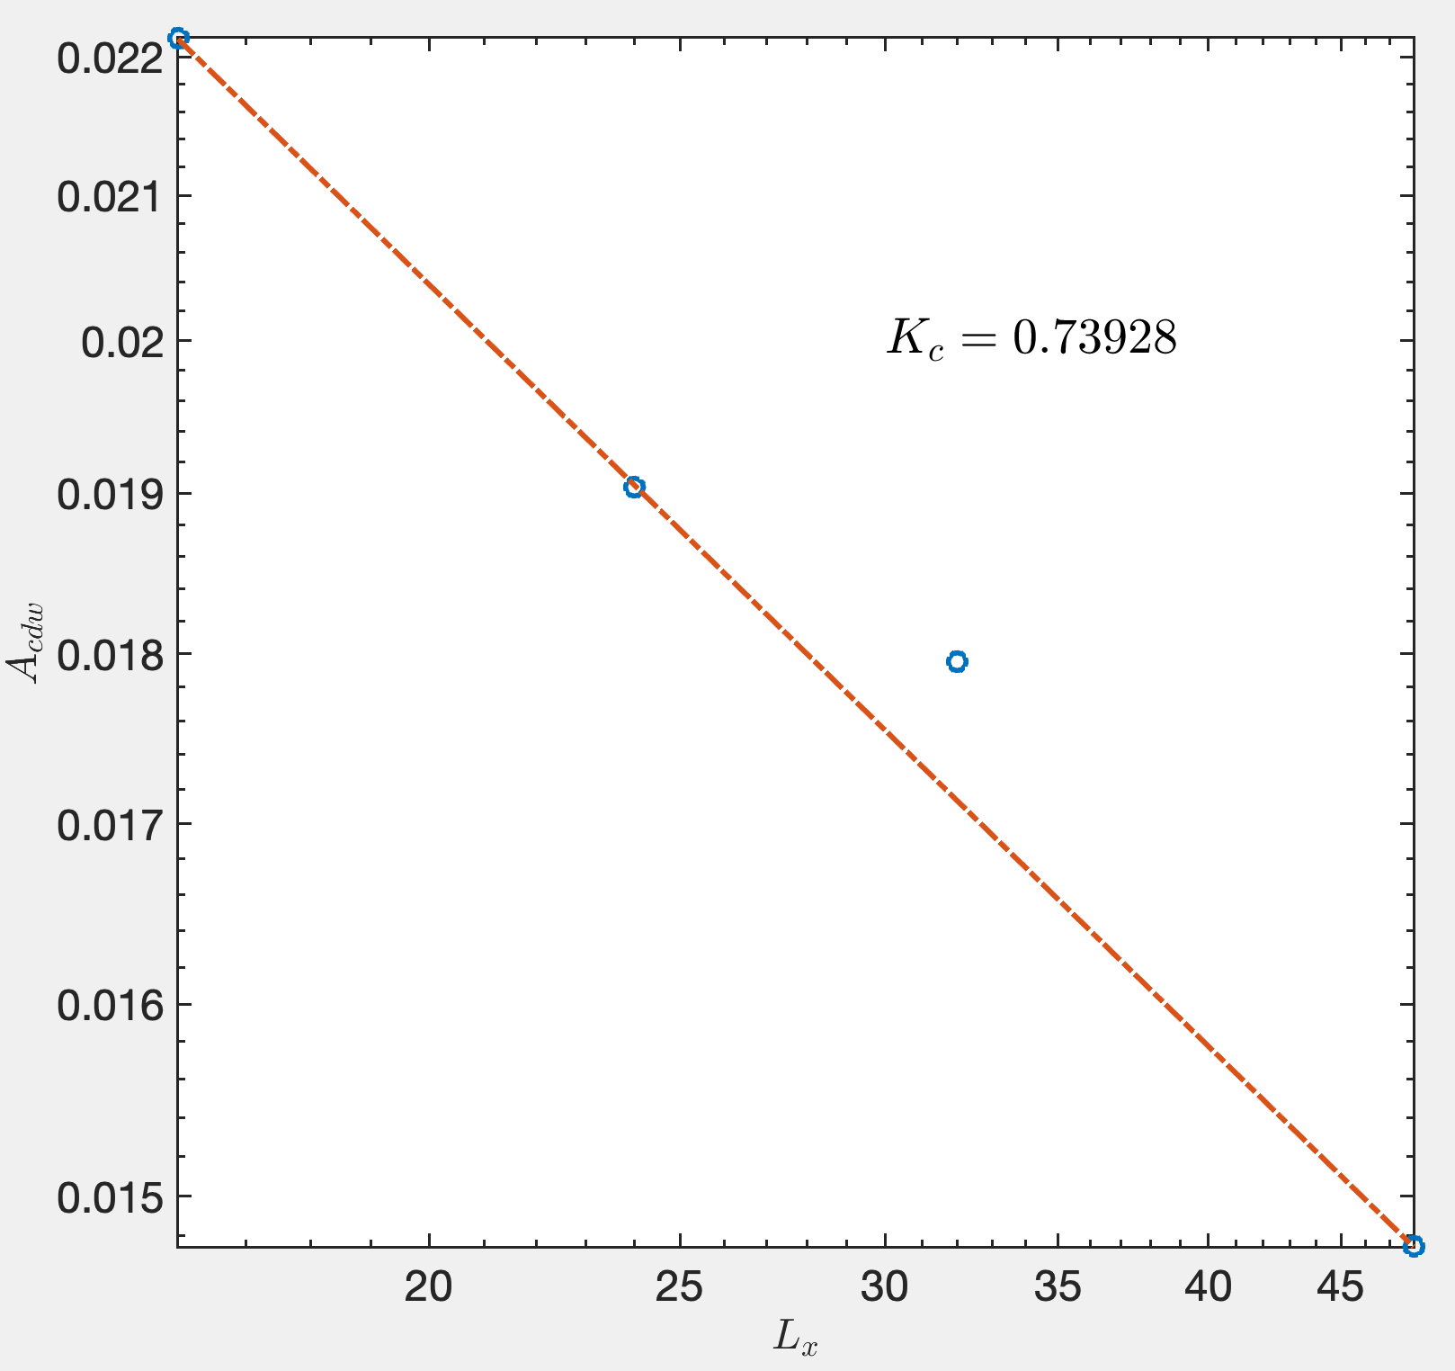

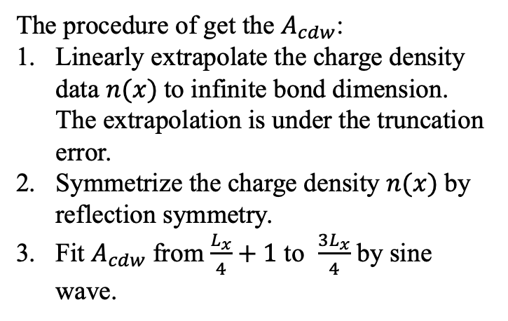

Fit $K_{c}$ from $A_{cdw}$
The procedure of get the $A_{cdw}$:
Linearly extrapolate the charge density data $n(x)$to infinite bond dimension. The extrapolation is under the truncation error.
Symmetrize the charge density $n(x)$by reflection symmetry.
Fit $A_{cdw}$from $\frac{L_{x}}{4}+1$ to $\frac{{3L}_{x}}{4}$ by sine wave.
$$\frac{1}{0.739}=1.3532$$

Slide 5
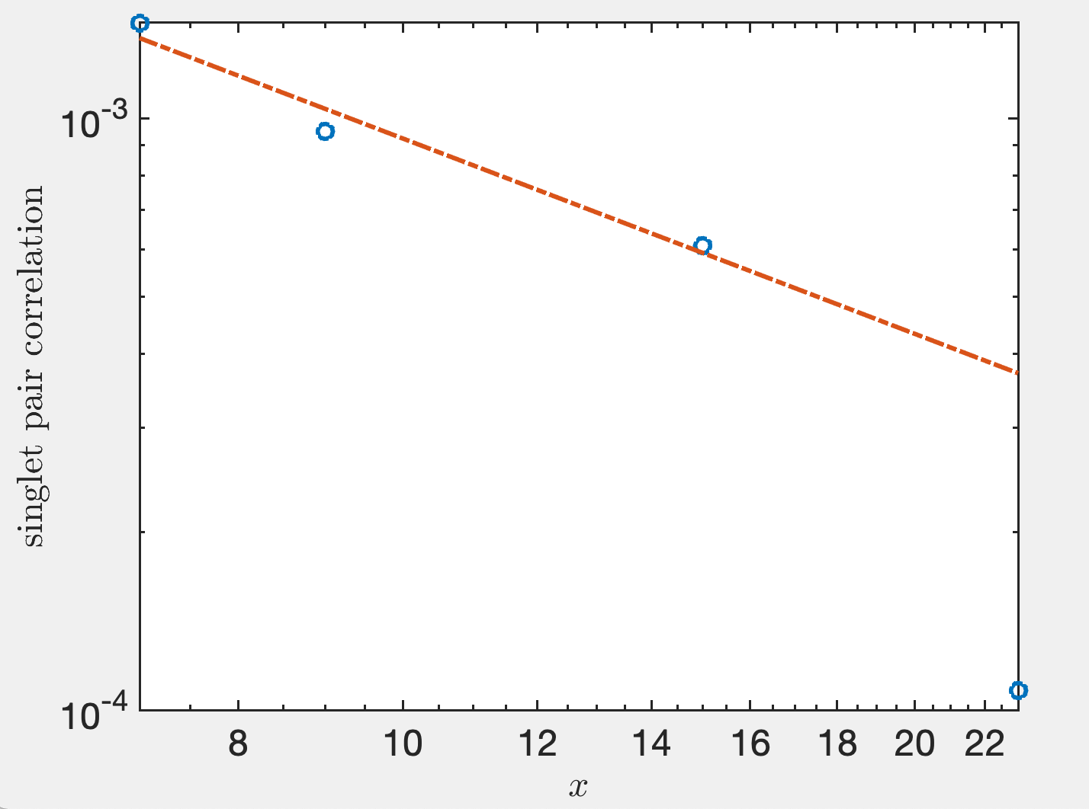
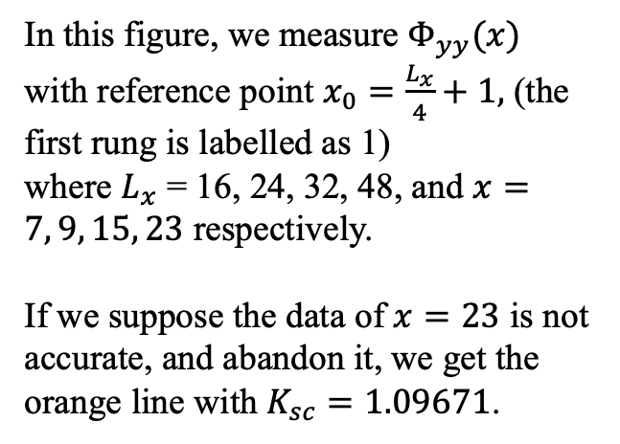
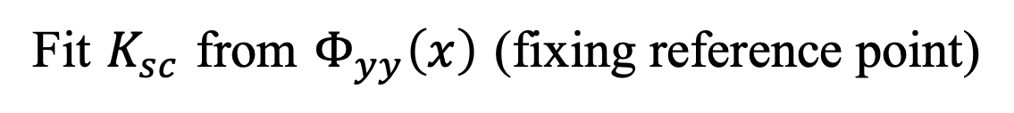
Fit $K_{sc}$ from $Φ_{yy}\left(x\right)$ (fixing reference point)
In this figure, we measure $Φ_{yy}(x)$ with reference point $x_{0}=\frac{L_{x}}{4}+1,$ (the first rung is labelled as 1)
where $L_{x}$ = 16, 24, 32, 48, and $x=7, 9, 15, 23$ respectively.
If we suppose the data of $x=23$ is not accurate, and abandon it, we get the orange line with $K_{sc}=1.09671$.

Slide 6
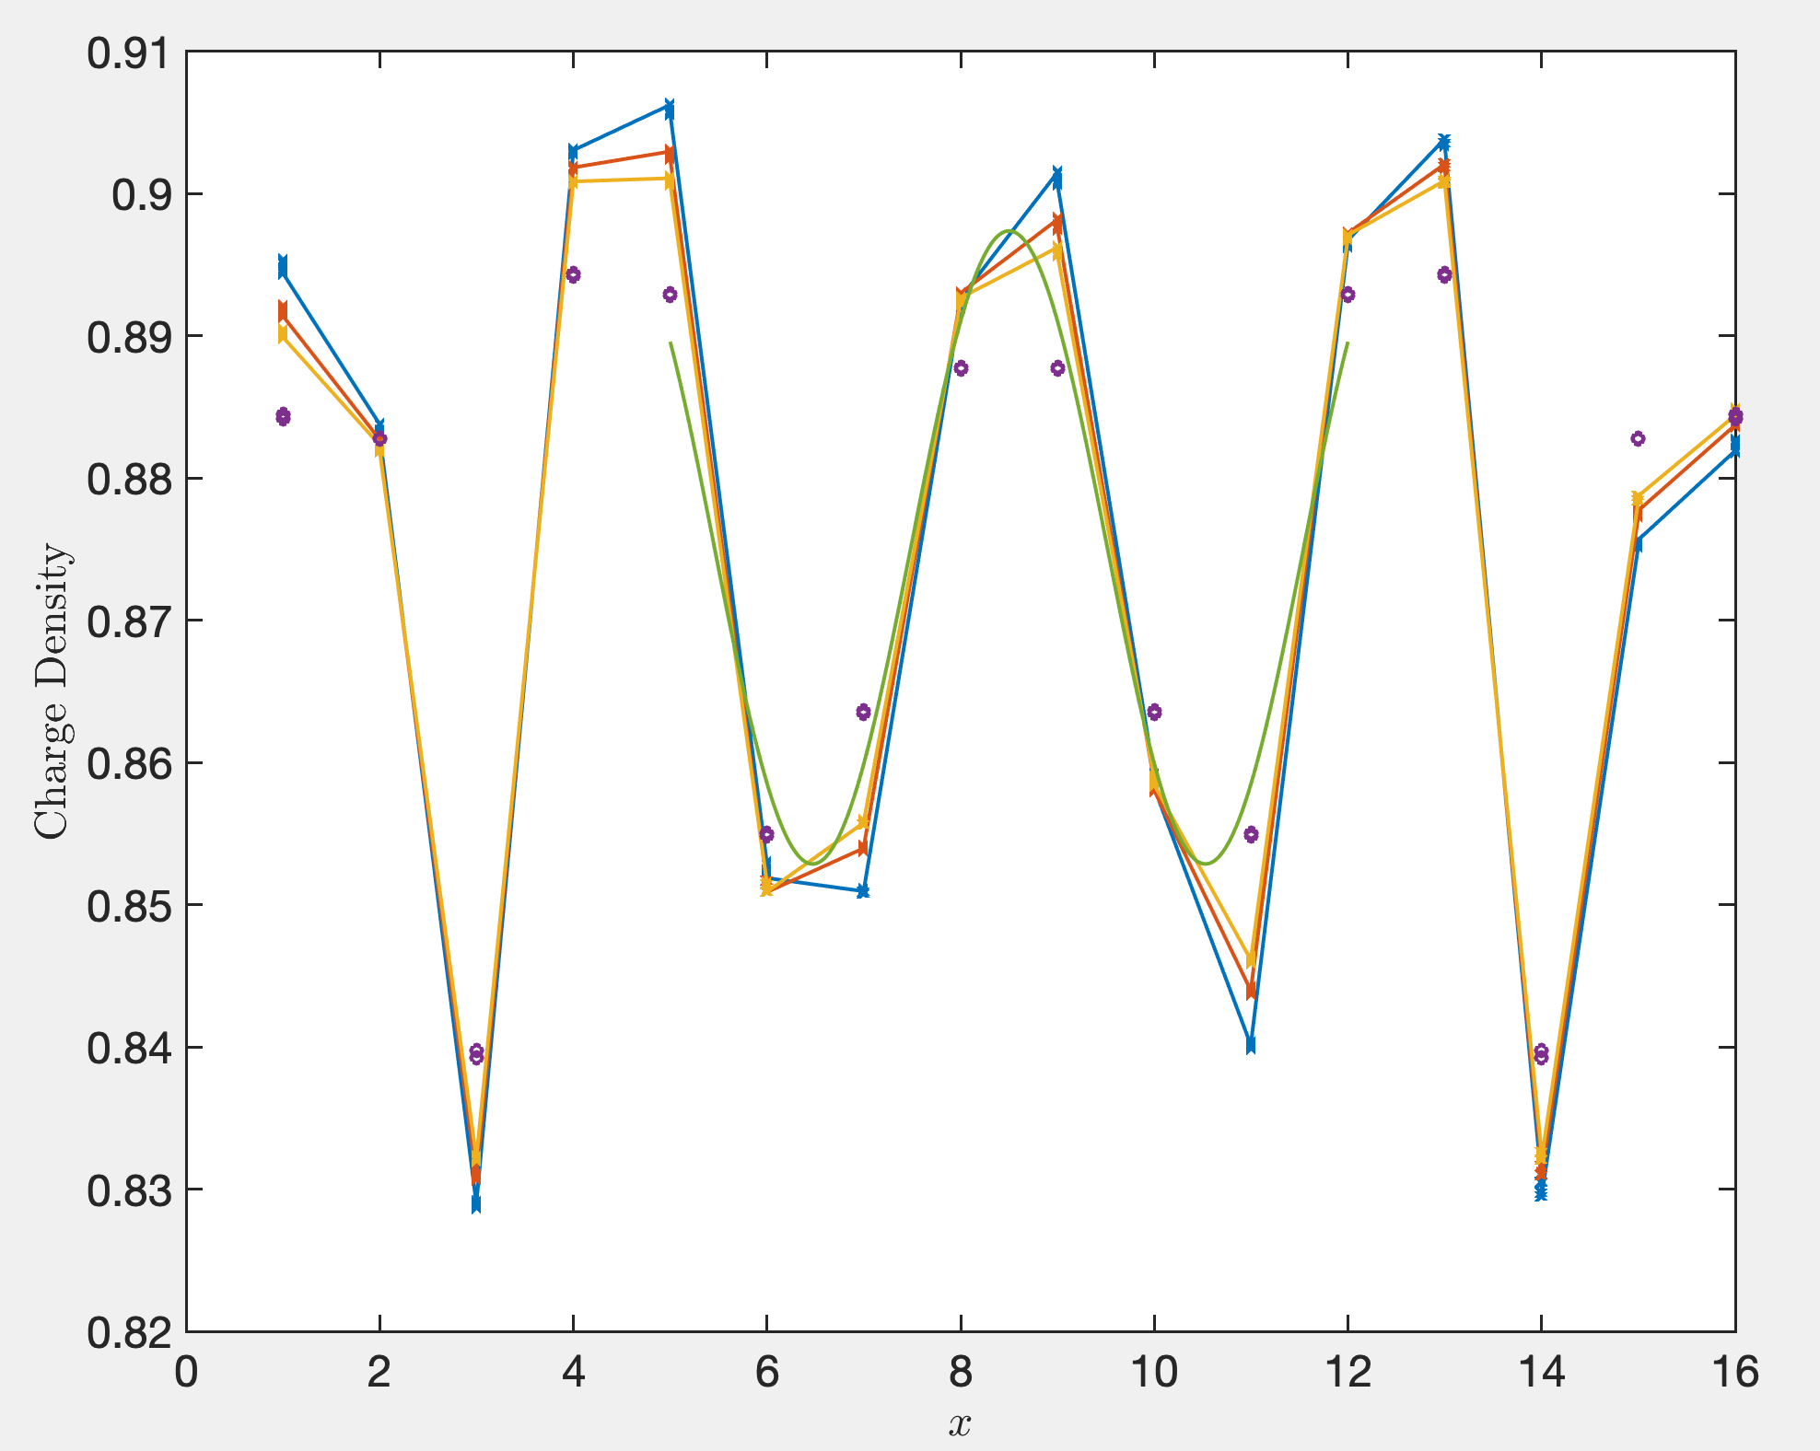
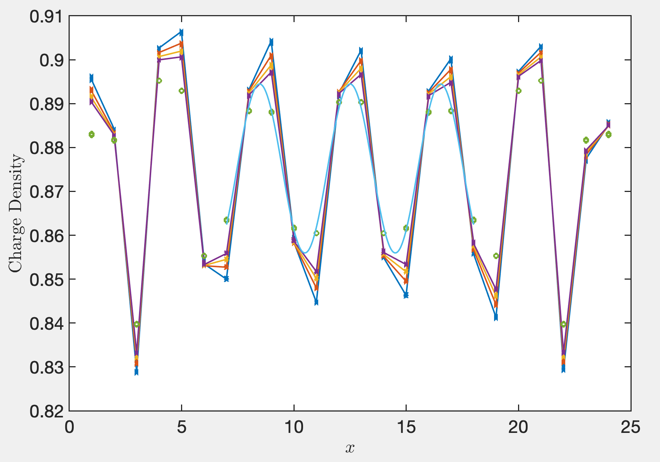
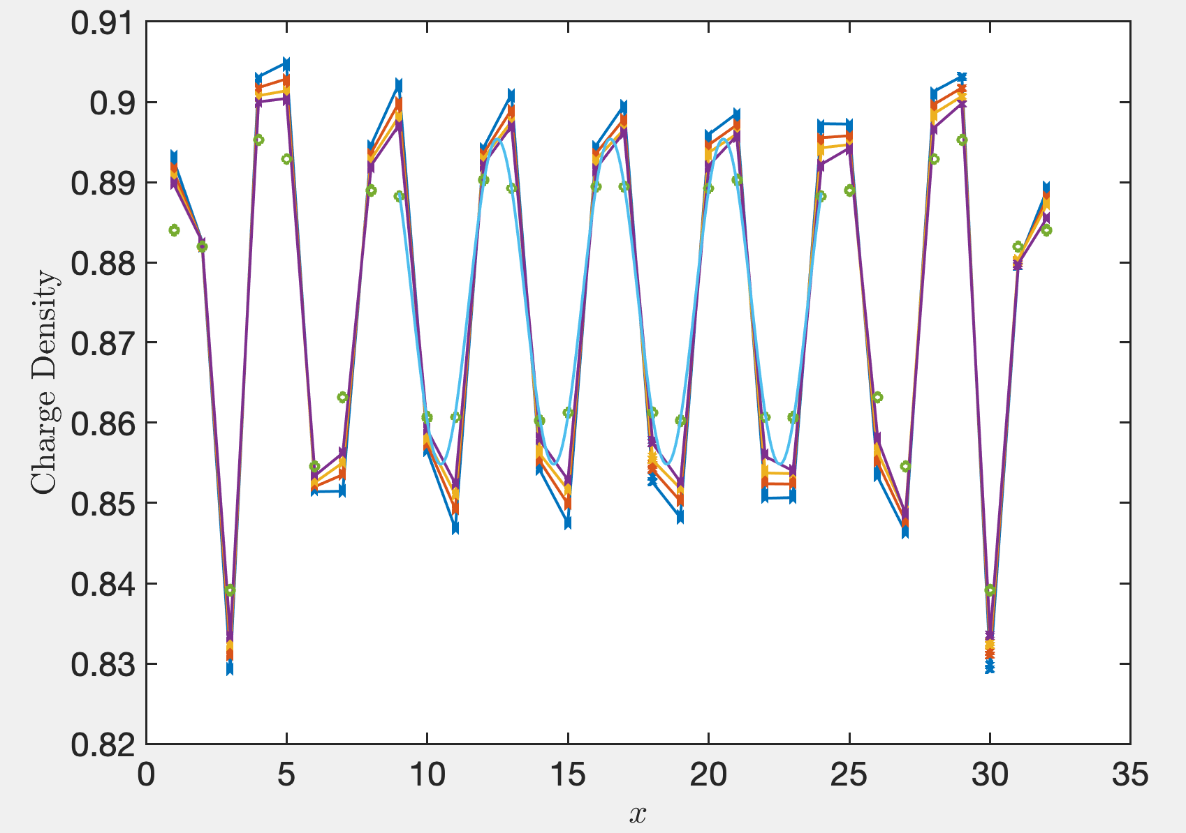
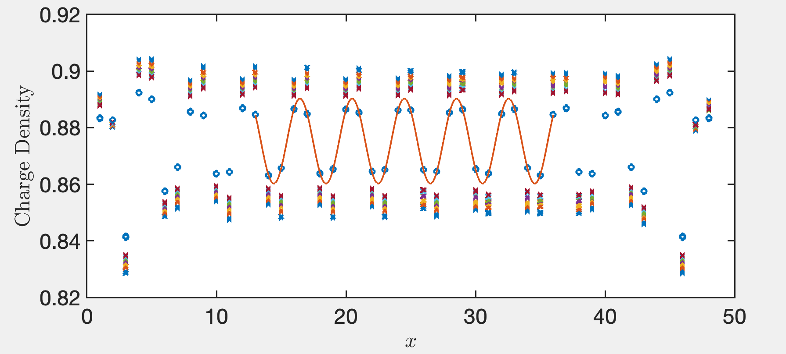




Charge density profile and reference point when measuring
$$L_{x}=16$$
$$L_{x}=24$$
$$L_{x}=32$$
8
4
8
$$L_{x}=48$$
12

Slide 7
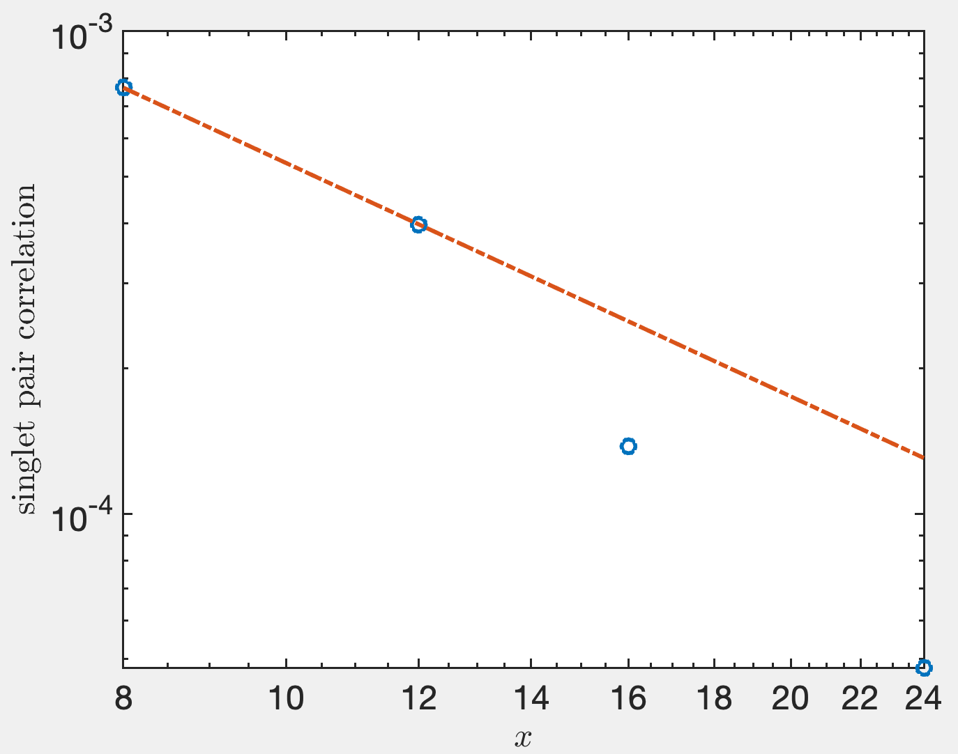

Fit $K_{sc}$from $Φ_{yy}\left(x\right)$ (fix $x=L_{x}/2$ )
$$x=\frac{L_{x}}{2},$$
$$K_{sc}=1.608$$

Slide 8
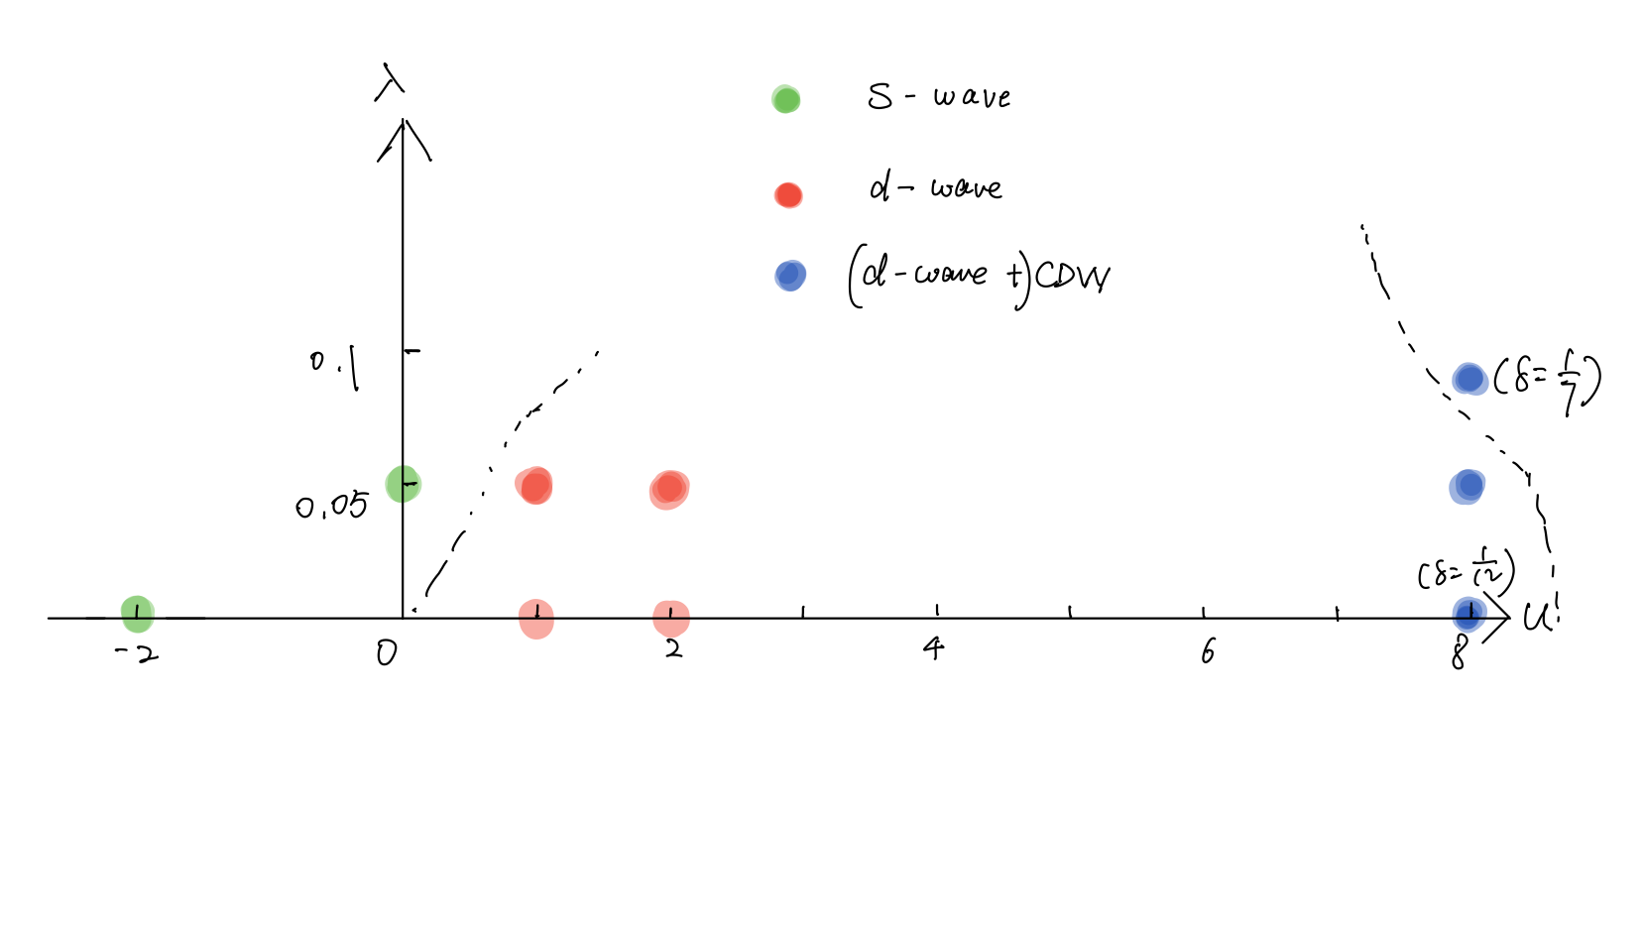
Landscape: 3-leg ladder, $δ=1/8$

Slide 9
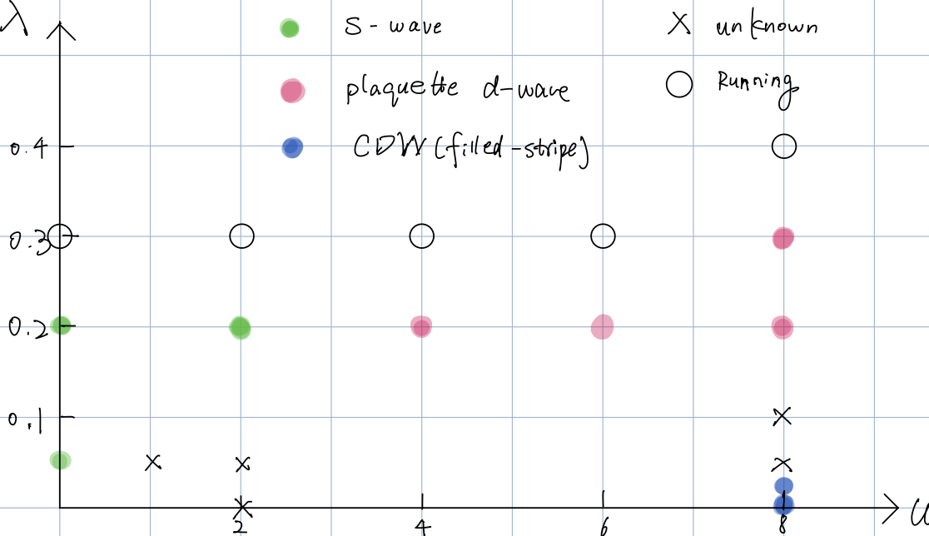

Landscape: 4-leg ladder, $δ=1/8$

