Slide 1
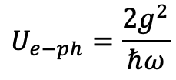
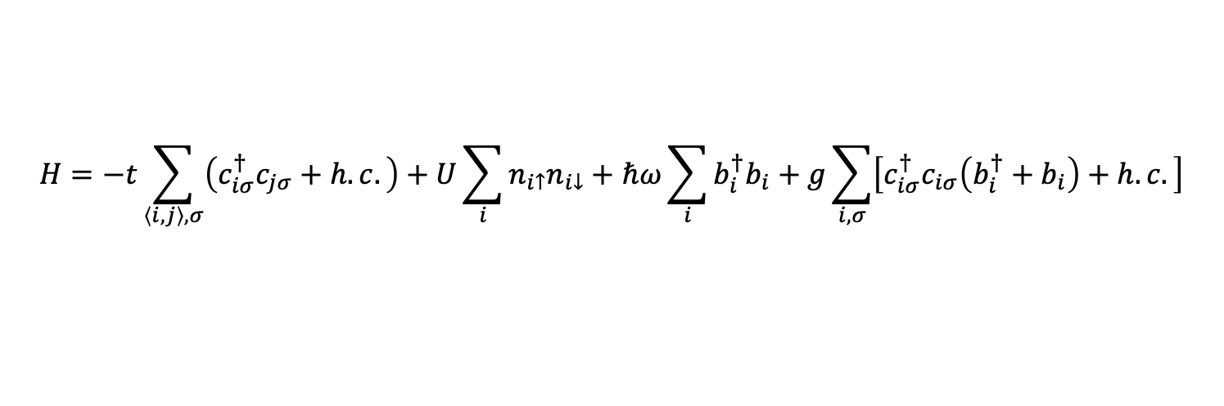
Holstein-Hubbard model
$$H=−t\sum_{\left\langle i,j\right\rangle ,σ}{\left(c_{iσ}^{†}c_{jσ}+h.c.\right)}+U\sum_{i}{n_{i↑}n_{i↓}}+ℏω\sum_{i}{b_{i}^{†}b_{i}}+g\sum_{i,σ}{\left[c_{iσ}^{†}c_{iσ}\left(b_{i}^{†}+b_{i}\right)+h.c.\right]}$$
$$U_{e−ph}=\frac{2g^{2}}{ℏω}$$

