Slide 1
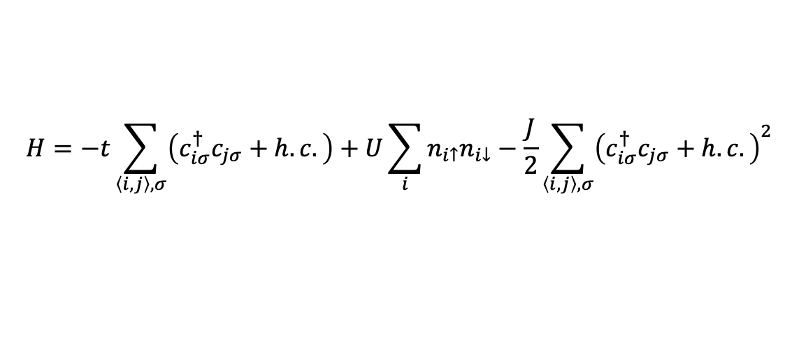
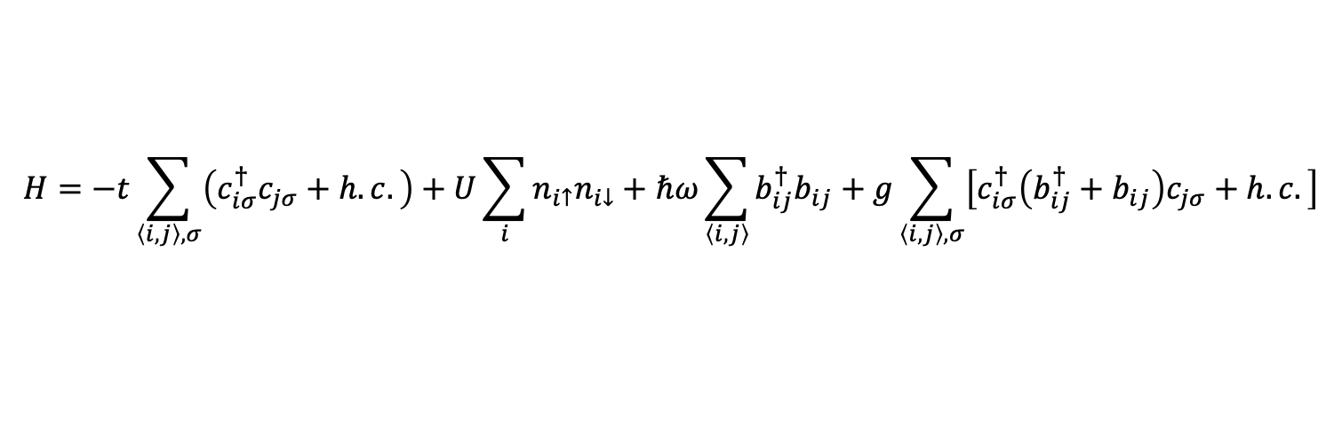

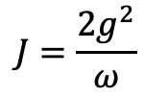
SSH-Hubbard model
$$H=−t\sum_{\left\langle i,j\right\rangle ,σ}{\left(c_{iσ}^{†}c_{jσ}+h.c.\right)}+U\sum_{i}{n_{i↑}n_{i↓}}+ℏω\sum_{\left\langle i, j\right\rangle }{b_{ij}^{†}b_{ij}}+g\sum_{\left\langle i, j\right\rangle ,σ}{\left[c_{iσ}^{†}\left(b_{ij}^{†}+b_{ij}\right)c_{jσ}+h.c.\right]}$$
$$H=−t\sum_{\left\langle i,j\right\rangle ,σ}{\left(c_{iσ}^{†}c_{jσ}+h.c.\right)}+U\sum_{i}{n_{i↑}n_{i↓}}−\frac{J}{2}\sum_{\left\langle i,j\right\rangle ,σ}{{\left(c_{iσ}^{†}c_{jσ}+h.c.\right)}^{2}}$$
$$J=\frac{2g^{2}}{ω}$$
$$λ=\frac{J}{W}, W=8t$$

Slide 2
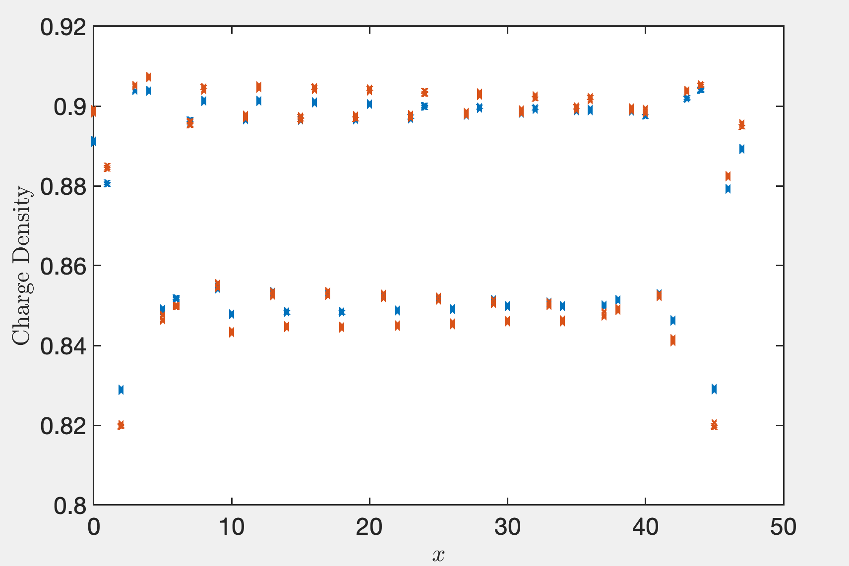
Lambda = 0.3, 0.4

Slide 3
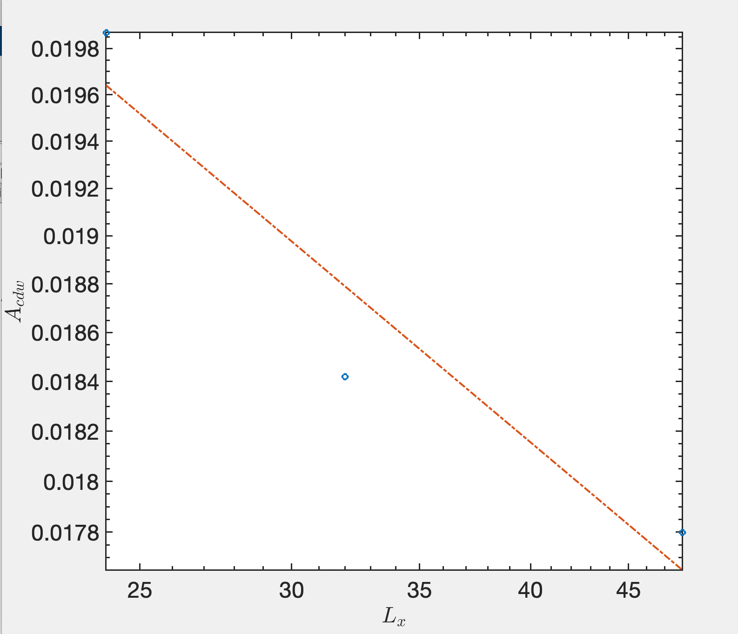
Kc=0.30785

Slide 4
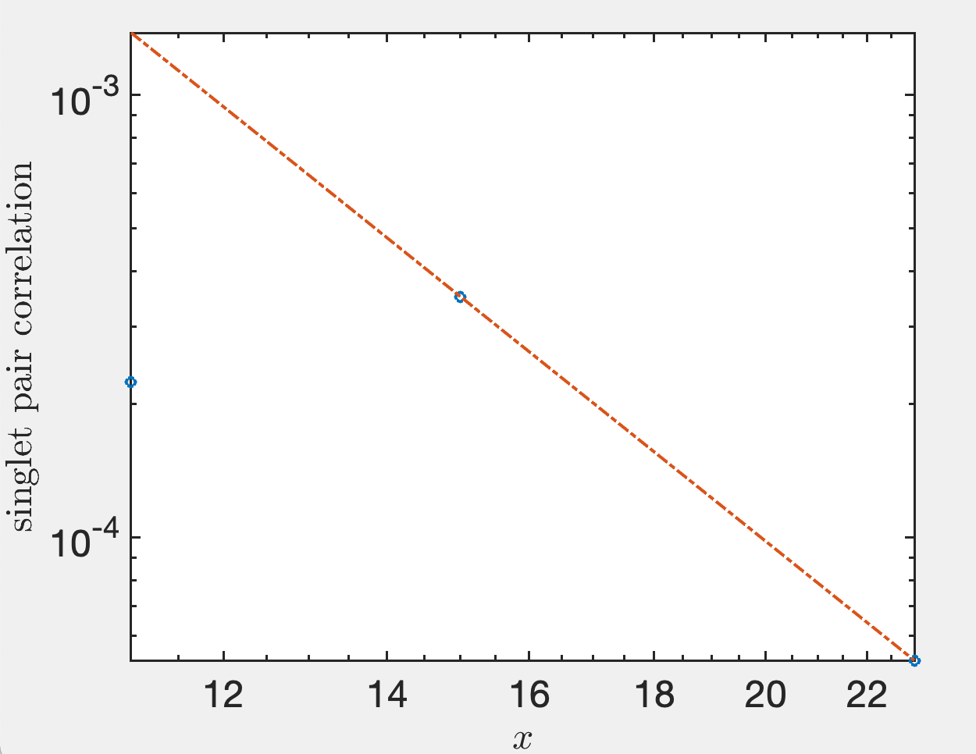
Ksc=4.43

Slide 5
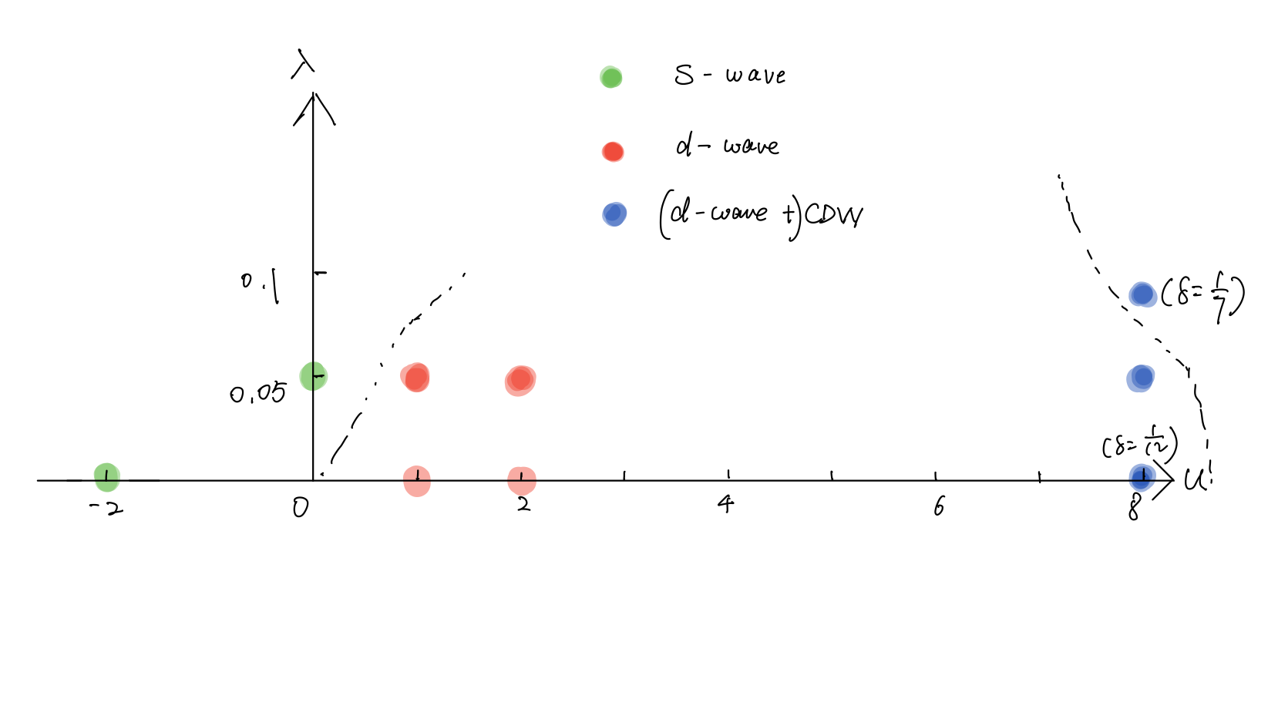
Landscape: 3-leg ladder, $δ=1/8$

Slide 6
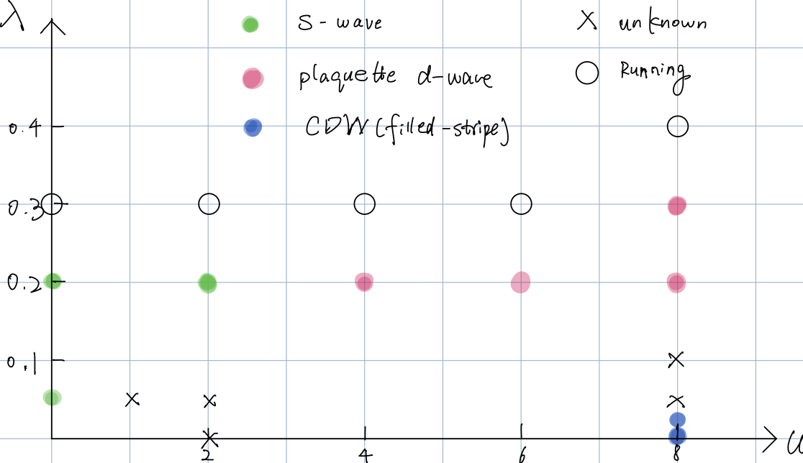

Landscape: 4-leg ladder, $δ=1/8$

