Slide 1
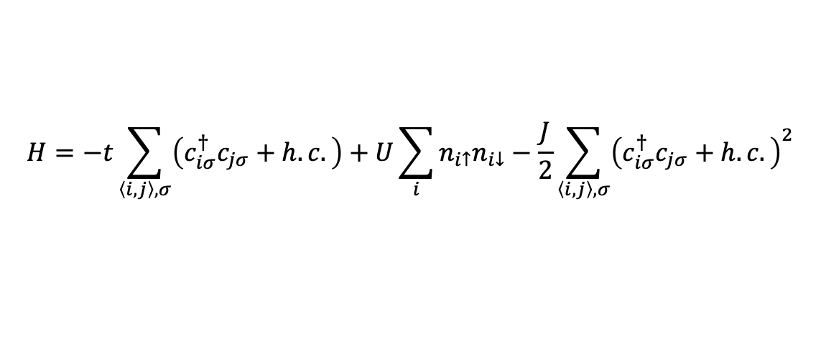
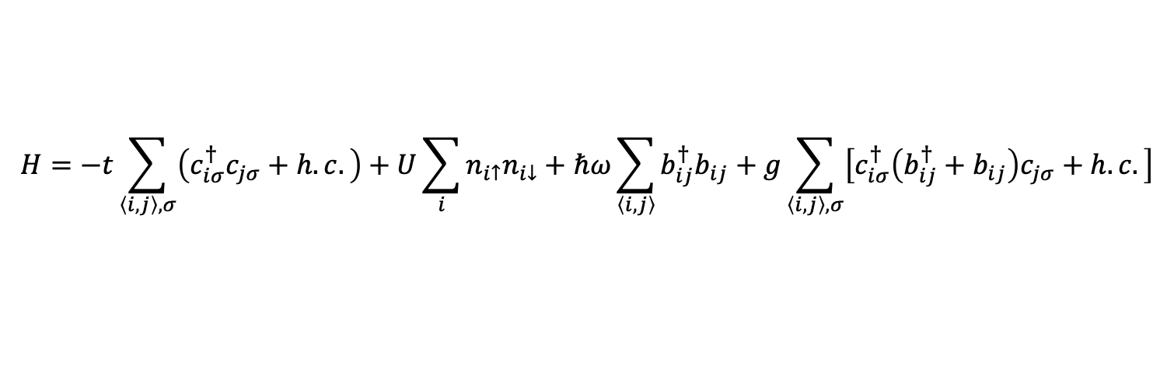

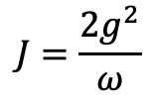
SSH-Hubbard model
$$H=−t\sum_{\left\langle i,j\right\rangle ,σ}{\left(c_{iσ}^{†}c_{jσ}+h.c.\right)}+U\sum_{i}{n_{i↑}n_{i↓}}+ℏω\sum_{\left\langle i, j\right\rangle }{b_{ij}^{†}b_{ij}}+g\sum_{\left\langle i, j\right\rangle ,σ}{\left[c_{iσ}^{†}\left(b_{ij}^{†}+b_{ij}\right)c_{jσ}+h.c.\right]}$$
$$H=−t\sum_{\left\langle i,j\right\rangle ,σ}{\left(c_{iσ}^{†}c_{jσ}+h.c.\right)}+U\sum_{i}{n_{i↑}n_{i↓}}−\frac{J}{2}\sum_{\left\langle i,j\right\rangle ,σ}{{\left(c_{iσ}^{†}c_{jσ}+h.c.\right)}^{2}}$$
$$J=\frac{2g^{2}}{ω}$$
$$λ=\frac{J}{W}, W=8t$$

Slide 2
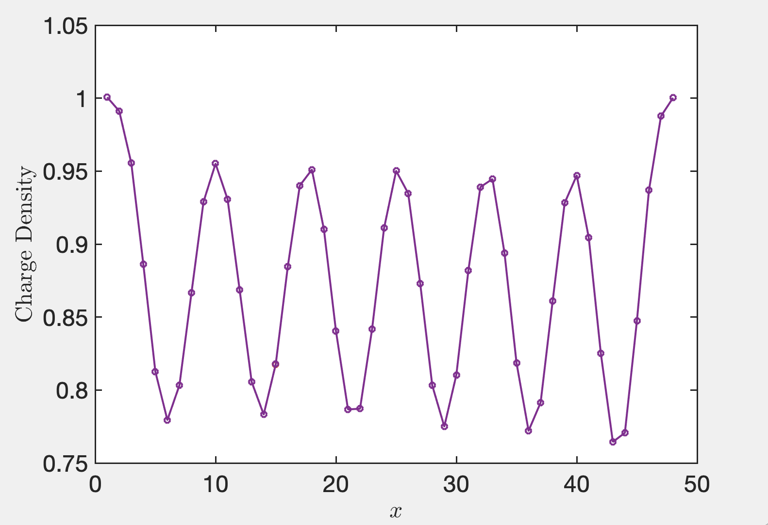
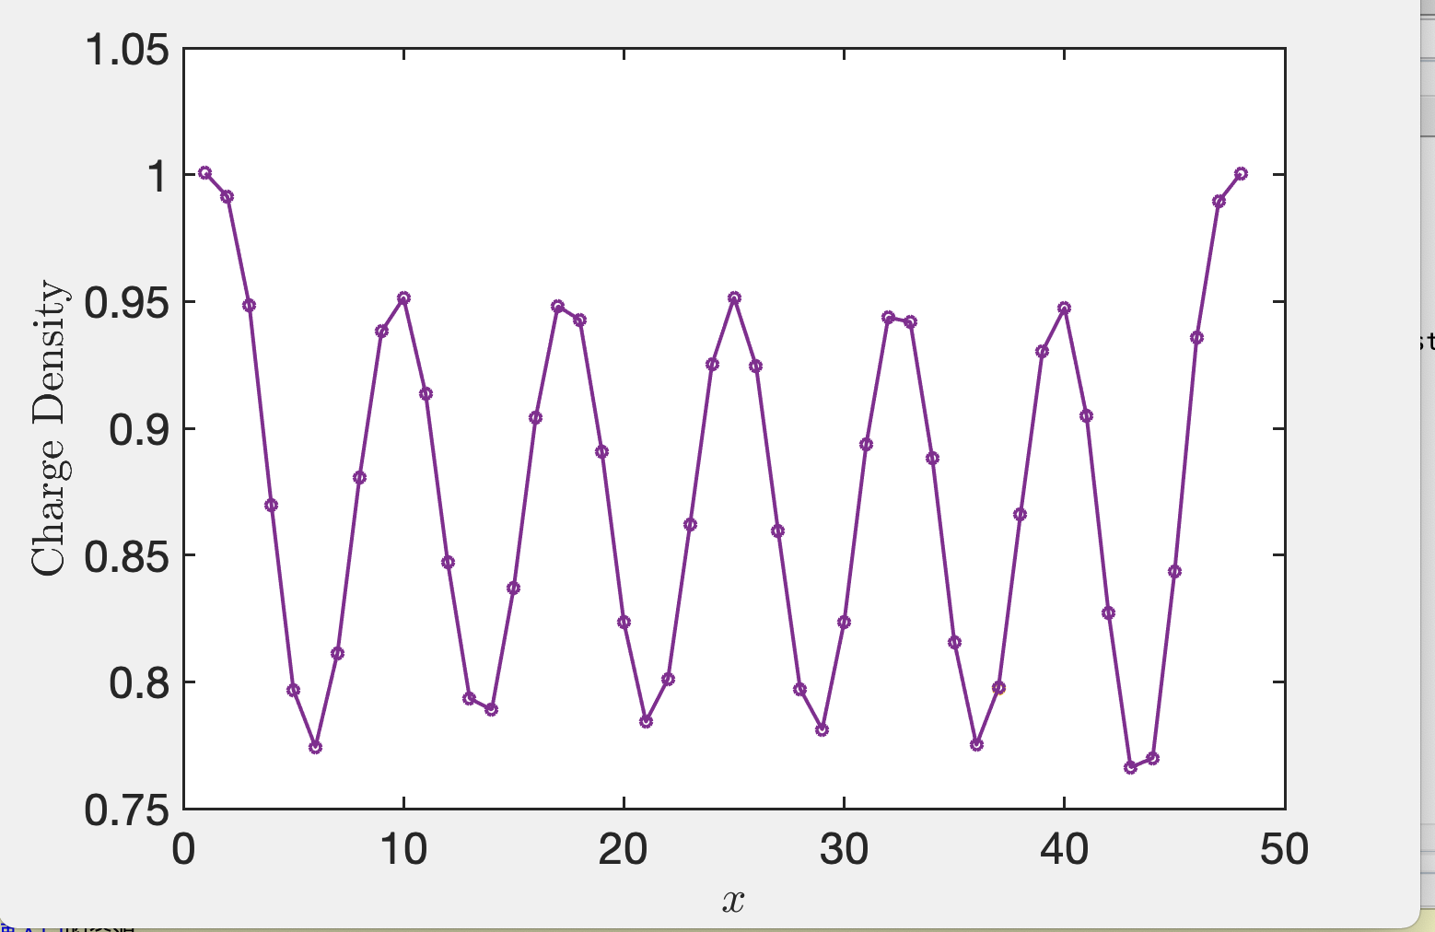
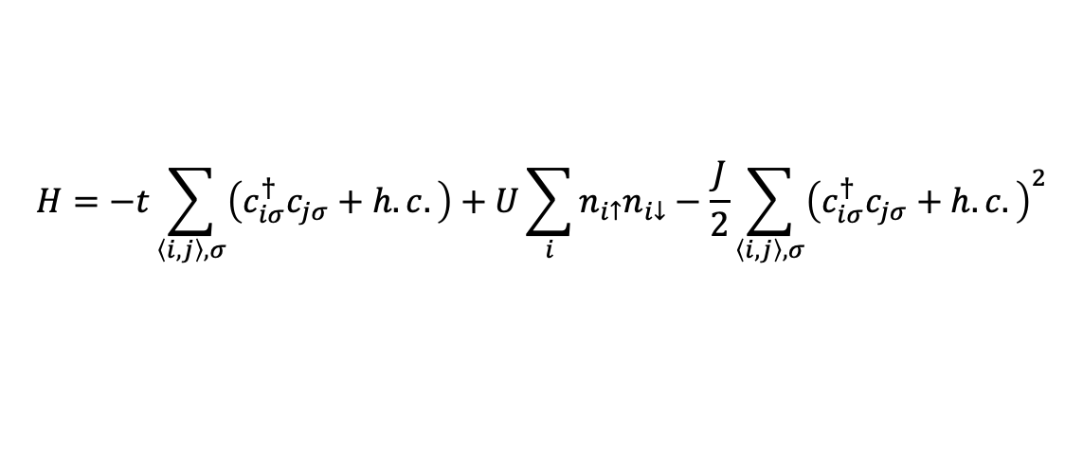

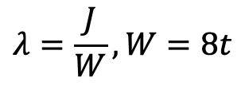
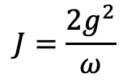

Effective fermionic model at anti-adiabatic limit $ω_{D}→∞$
$$H=−t\sum_{\left\langle i,j\right\rangle ,σ}{\left(c_{iσ}^{†}c_{jσ}+h.c.\right)}+U\sum_{i}{n_{i↑}n_{i↓}}−\frac{J}{2}\sum_{\left\langle i,j\right\rangle ,σ}{{\left(c_{iσ}^{†}c_{jσ}+h.c.\right)}^{2}}$$
$$J=\frac{2g^{2}}{ω}$$
$$λ=\frac{J}{W}, W=8t$$
$$λ=0.3, D=3000$$
$$λ=0.4, D=3000$$

Slide 3
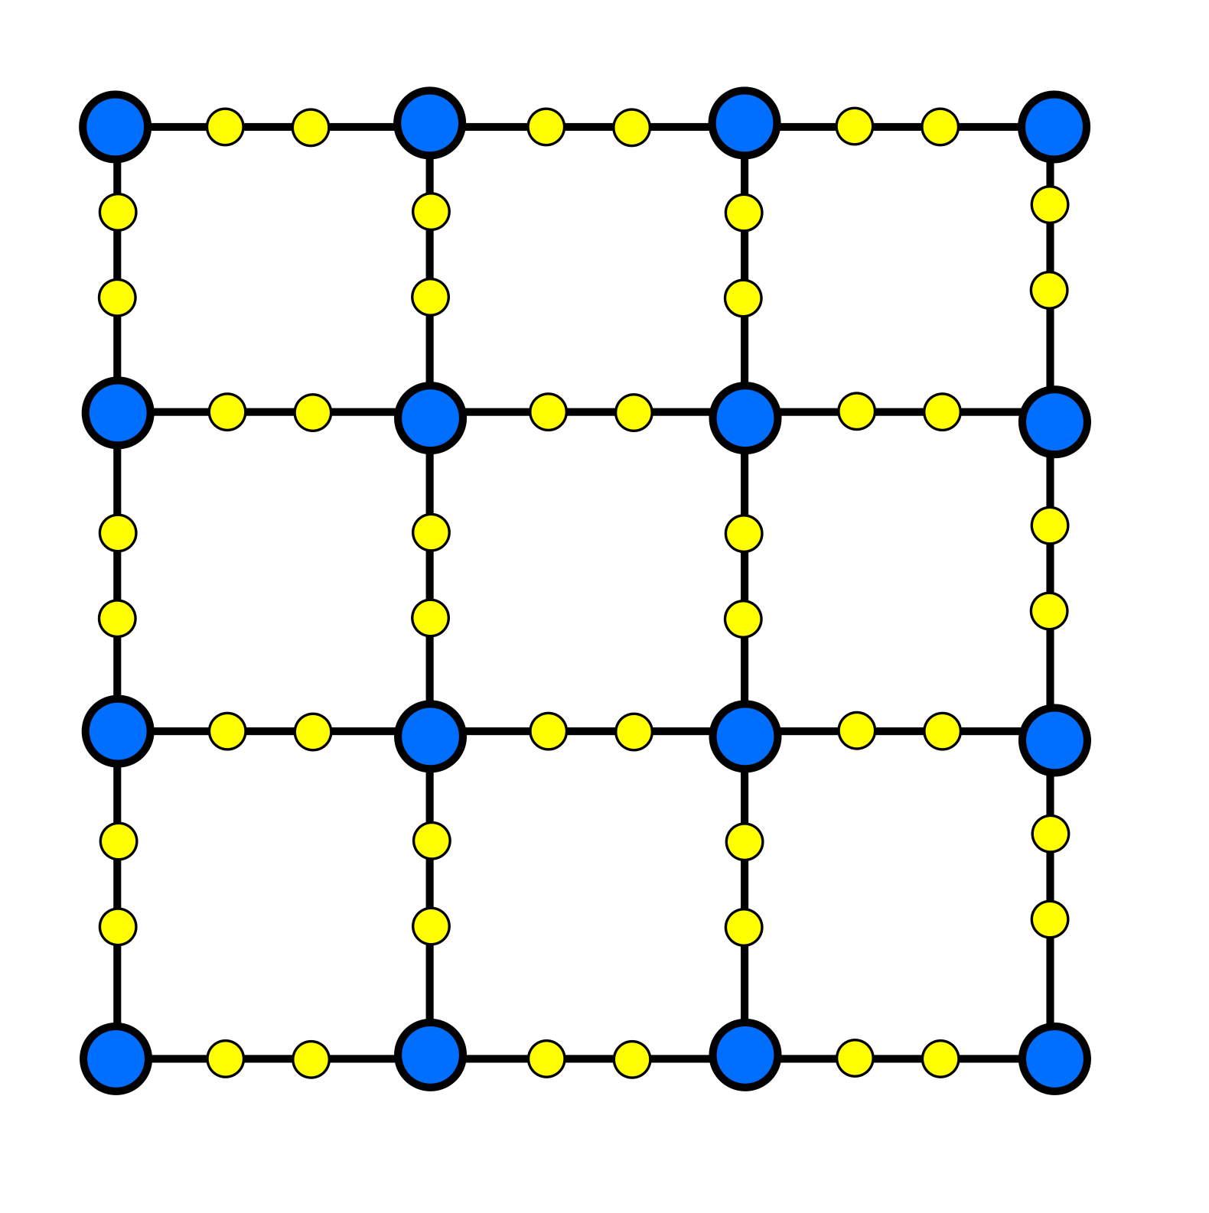
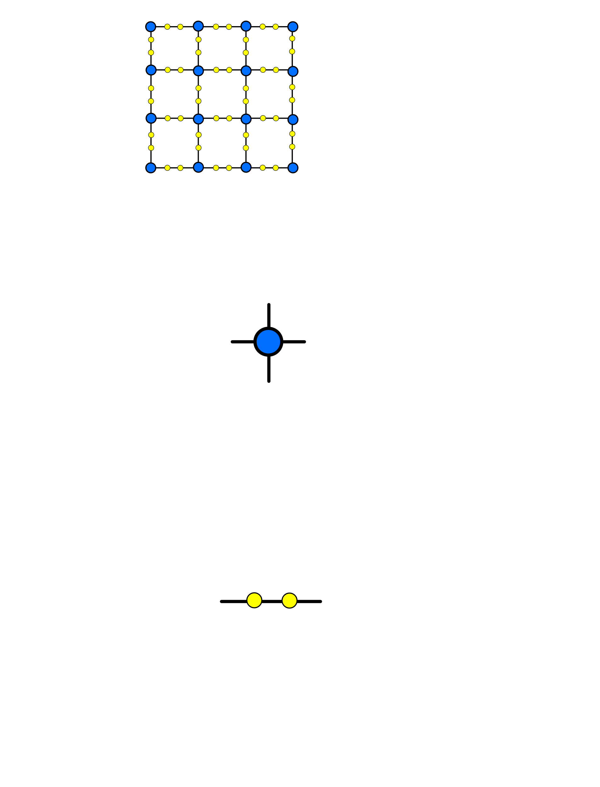
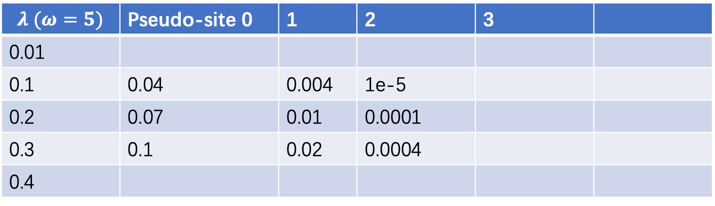
Phonon pseudo-site
PhysRevB.57.6376
$$λ (ω=5)$$ | Pseudo-site 0 | 1 | 2 | 3
0.01
0.1 | 0.04 | 0.004 | 1e-5
0.2 | 0.07 | 0.01 | 0.0001
0.3 | 0.1 | 0.02 | 0.0004
0.4
Fermionic site
Bosonic pseudo-site

Slide 4
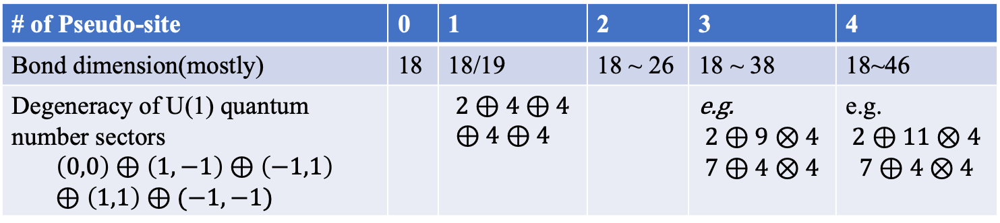
Matrix product operator for SSH-Hubbard model on 4-leg ladder
# of Pseudo-site | 0 | 1 | 2 | 3 | 4
Bond dimension(mostly) | 18 | 18/19 | 18 ~ 26 | 18 ~ 38 | 18~46
Degeneracy of U(1) quantum number sectors $$\left(0,0\right)⊕\left(1,−1\right)⊕\left(−1,1\right)⊕\left(1,1\right)⊕(−1,−1)$$ |  | $$2⊕4⊕4⊕4⊕4$$ |  | e.g. $$2⊕9⊗4$$ $$7⊕4⊗4$$ | e.g. $$2⊕11⊗4$$ $$7⊕4⊗4$$

Slide 5







Algorithm: single site update
$$α×$$
$$=$$
Lanczos
Find the noise term
$$⨁$$
$$=$$
$$U$$
$$S$$
$$Vt$$
expansion
Svd and truncate

Slide 6
Algorithm: single site update
Advantage:
Accelerating on Lanczos
Fast increasing bond dimension
Disadvantage
Efficiencies are suffered by fuse index, expansion and SVD, since MPO bond dimension is to large
Difficult to converge(?)

Slide 7




Algorithm: expanded two site update
$$α×$$
$$=$$
Lanczos
Find the noise term
$$\sim$$
$$⨁$$
$$=$$
$$U$$
$$S$$
$$Vt$$
Only expand new quantum sector on the right hand side bond
Svd and truncate

Slide 8
Algorithm: expanded two site update
Advantage:
Also some gains when increasing bond dimension
More robust to overcome local minimum(?)
SVD time is normal, most time is used on Lanczos
Disadvantage
Also difficult to converge(?)
When update the last pseudo-site phonon & fermion sites, the degeneracy on every quantum number sector is hardly to increase.
So, one strategy is using not sufficient phonon pseudo-site number, if the physics does not change.

Slide 9
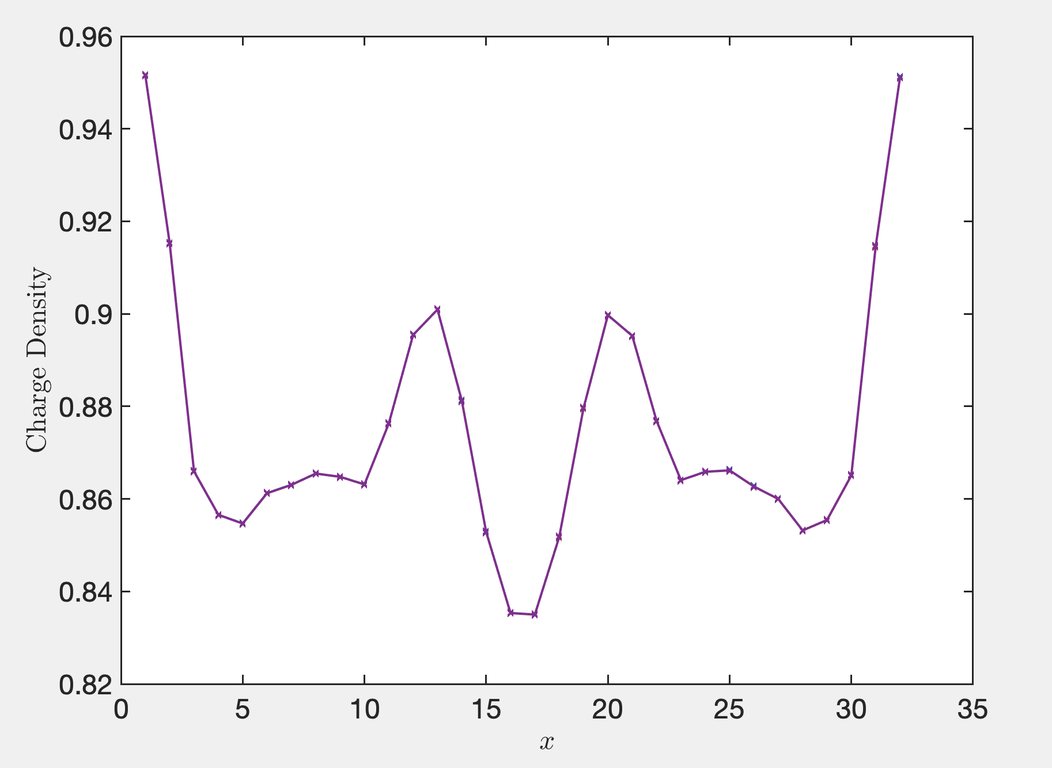
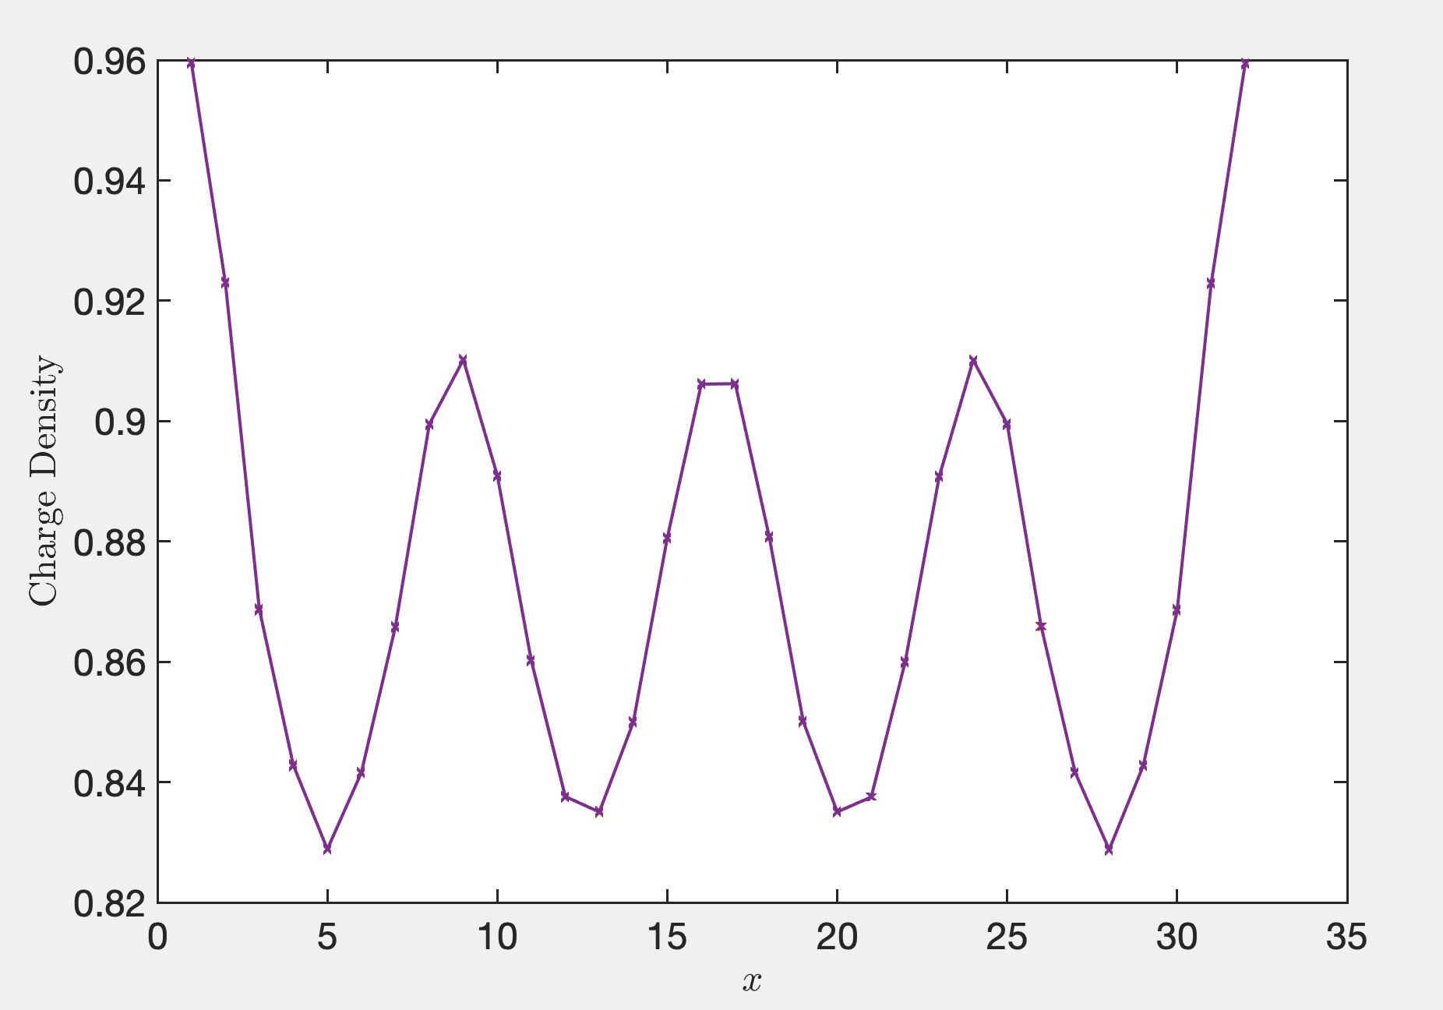
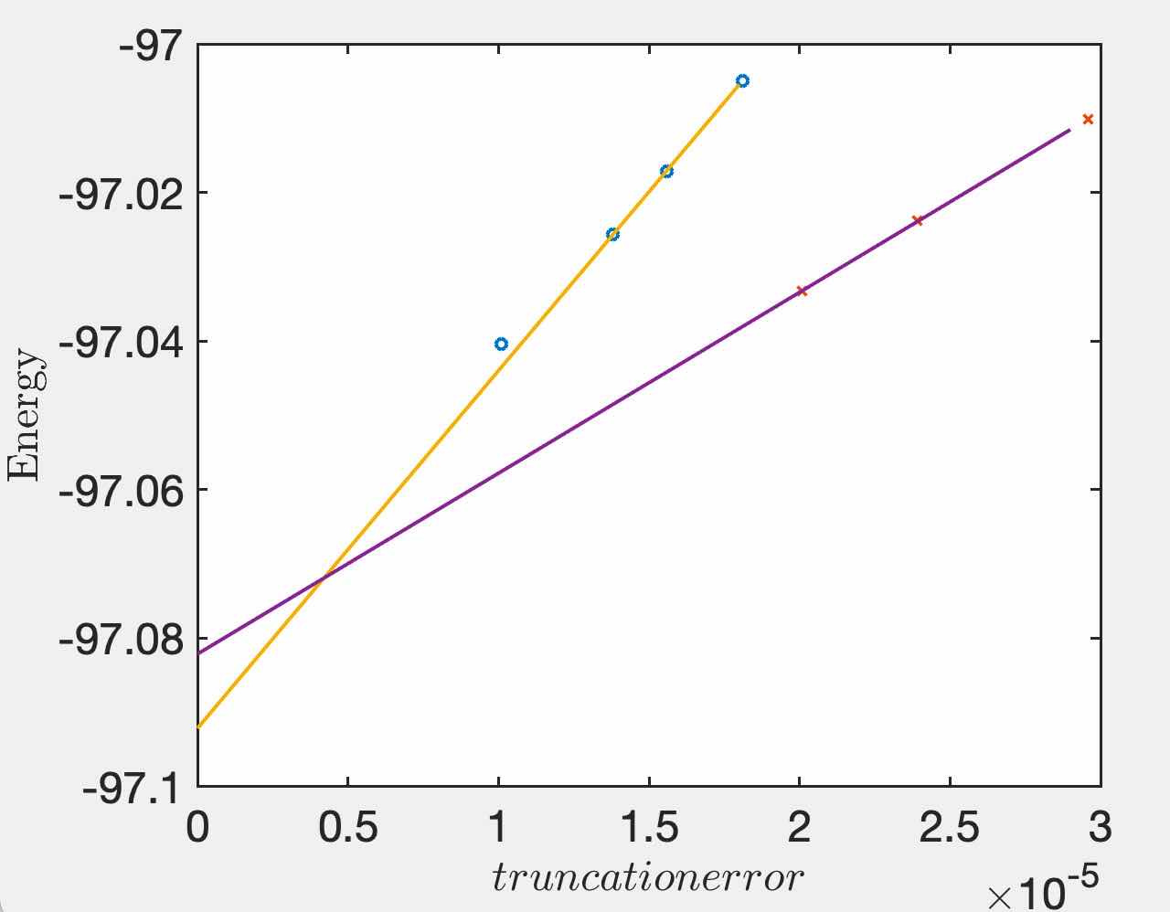
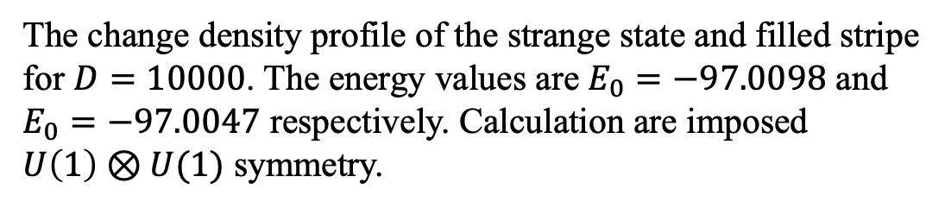
Test/benchmark: Hubbard model on $4×32$ lattice
Ground state of 1/8 dopped Hubbard model on $4×32$ lattice should be filled-stripe, but on finite bond dimension $D$, the lowest energy state is some strange state.
The change density profile of the strange state and filled stripe for $D=10000$. The energy values are $E_{0}=−97.0098$ and $E_{0}=−97.0047$ respectively. Calculation are imposed $U\left(1\right)⊗U(1)$ symmetry.
Energy values v.s. truncation error and extrapolations. Filled stripe finally have more lower energy.

Slide 10
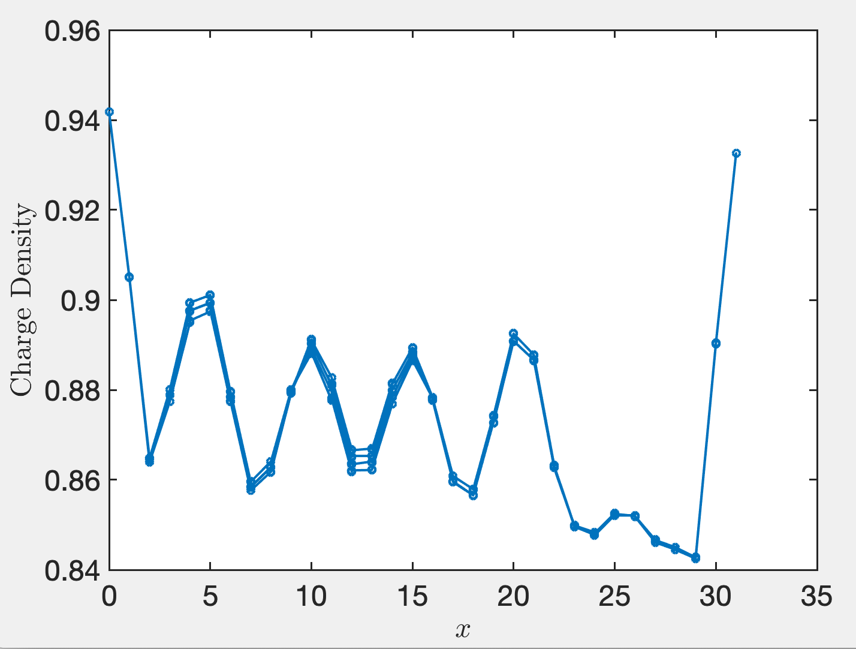
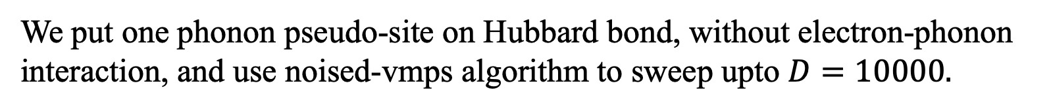
Test/benchmark: Hubbard model on $4×32$ lattice
We put one phonon pseudo-site on Hubbard bond, without electron-phonon interaction, and use noised-vmps algorithm to sweep upto $D=10000.$
Single site update

Slide 11
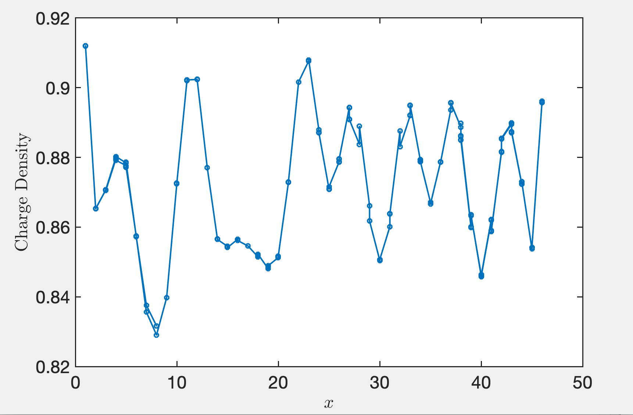


SSH-Hubbard, $λ=0.01, 4×48$
$$D≲9000$$
Algorithm: two-site update

Slide 12
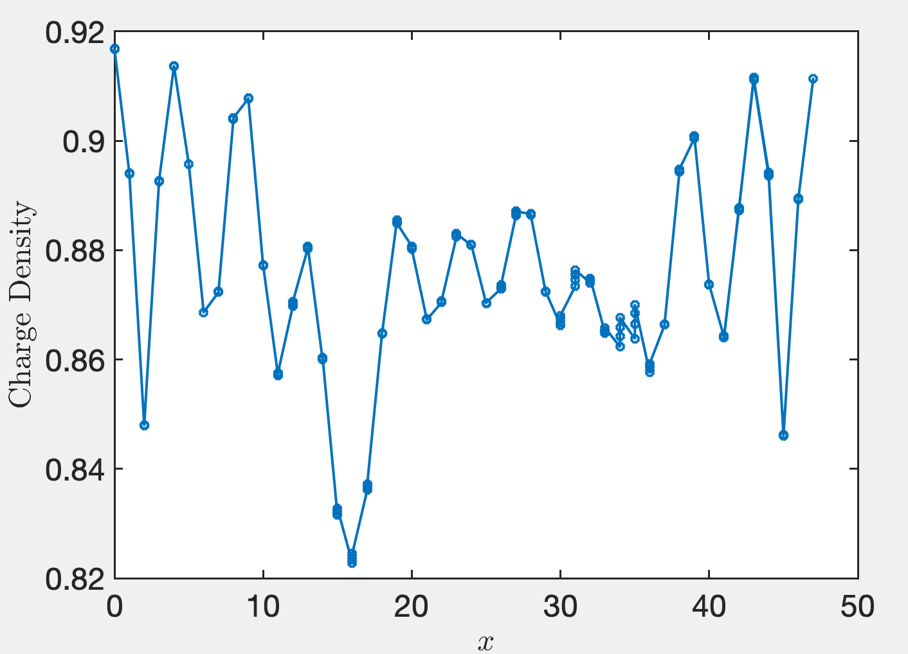


SSH-Hubbard, $λ=0.1, 4×48$
$$D∼7500$$
Algorithm: single-site update

Slide 13
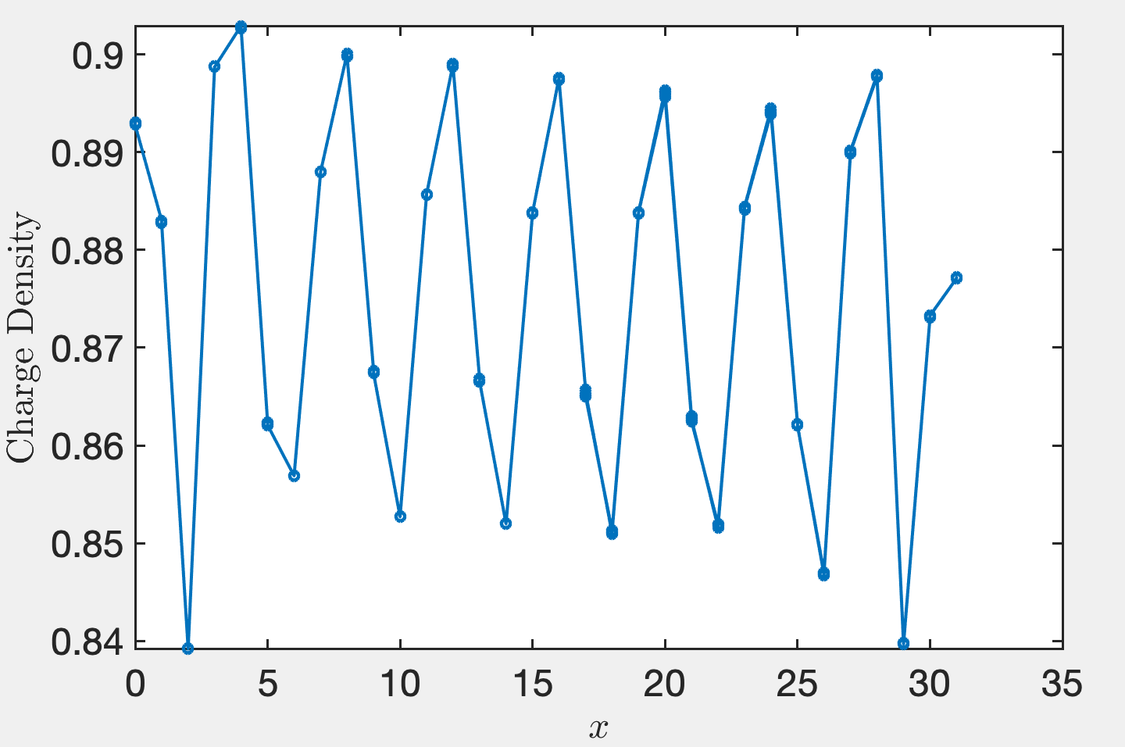



SSH-Hubbard, $λ=0.2, 4×32$
$$D∼14000$$
$$E_{0}=−288.4764$$
Algorithm: single-site update, date: Aug, 5, 4pm

Slide 14
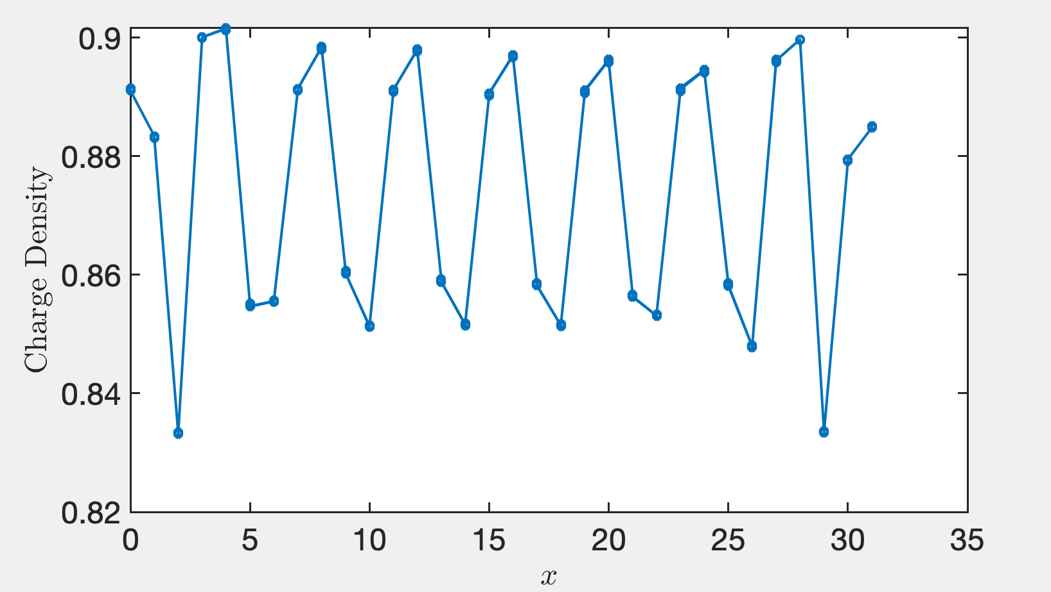


SSH-Hubbard, $λ=0.3, 4×32$
$$D∼14000$$
Algorithm: single-site update
date: Aug, 5, 4pm

Slide 15
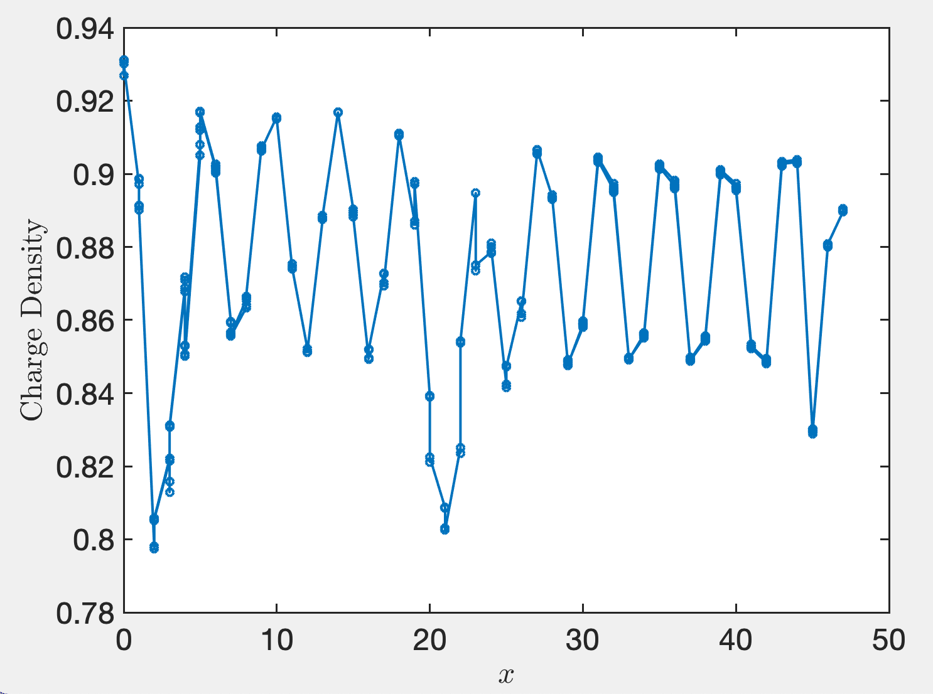


SSH-Hubbard, $λ=0.3, 4×48$
$$D≲10000$$
Algorithm: single-site update, date: Aug, 5, 4pm

Slide 16
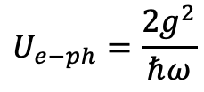
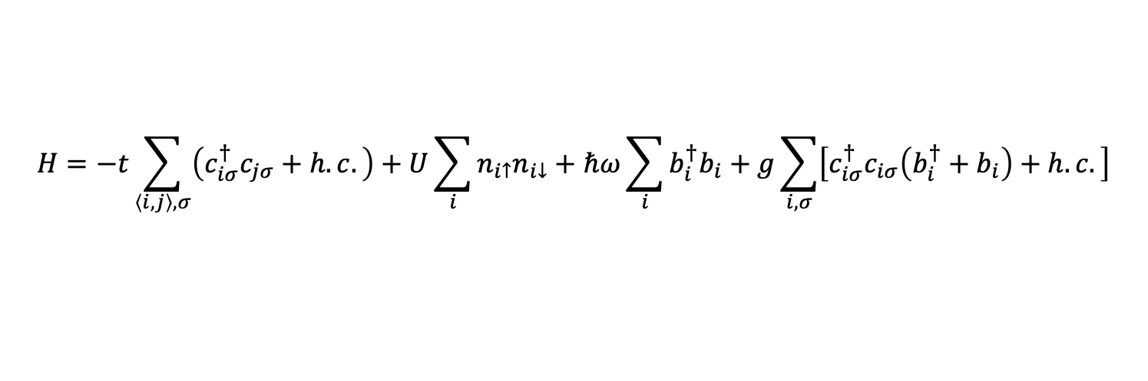
Holstein-Hubbard model
$$H=−t\sum_{\left\langle i,j\right\rangle ,σ}{\left(c_{iσ}^{†}c_{jσ}+h.c.\right)}+U\sum_{i}{n_{i↑}n_{i↓}}+ℏω\sum_{i}{b_{i}^{†}b_{i}}+g\sum_{i,σ}{\left[c_{iσ}^{†}c_{iσ}\left(b_{i}^{†}+b_{i}\right)+h.c.\right]}$$
$$U_{e−ph}=\frac{2g^{2}}{ℏω}$$

Slide 17
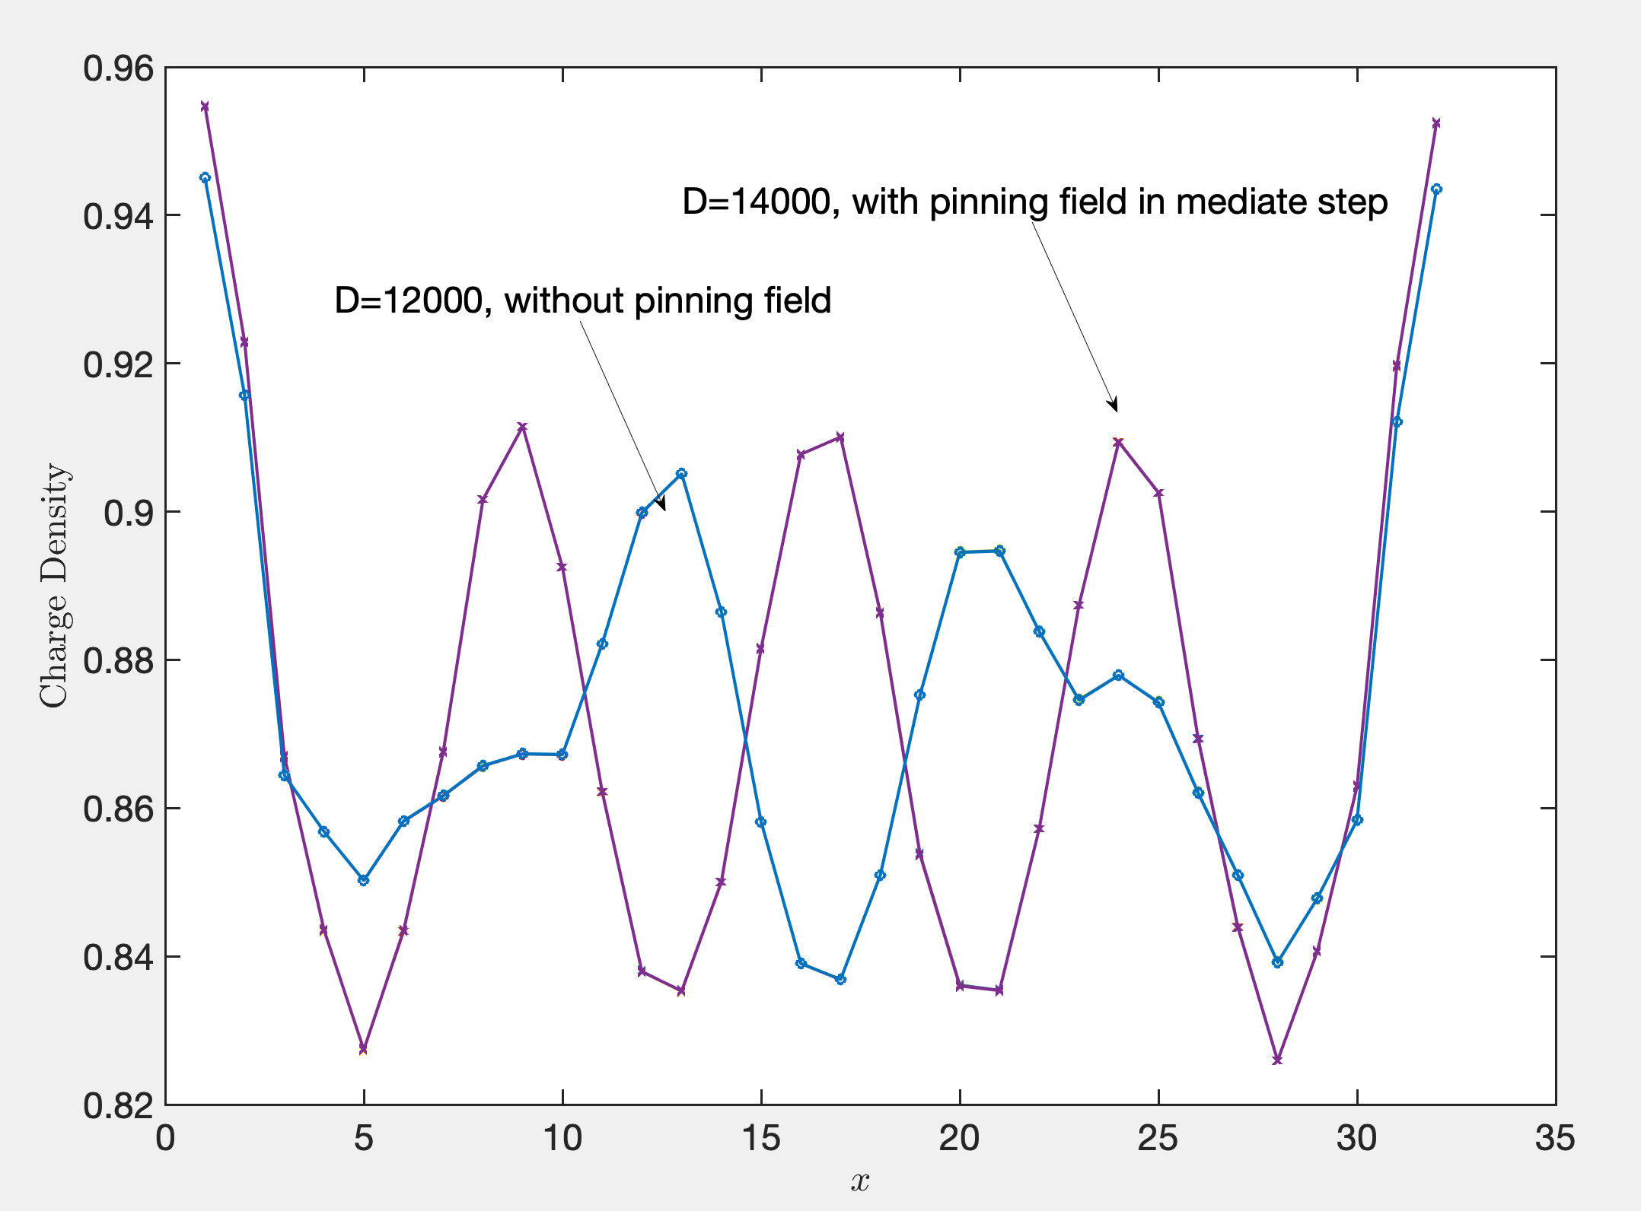
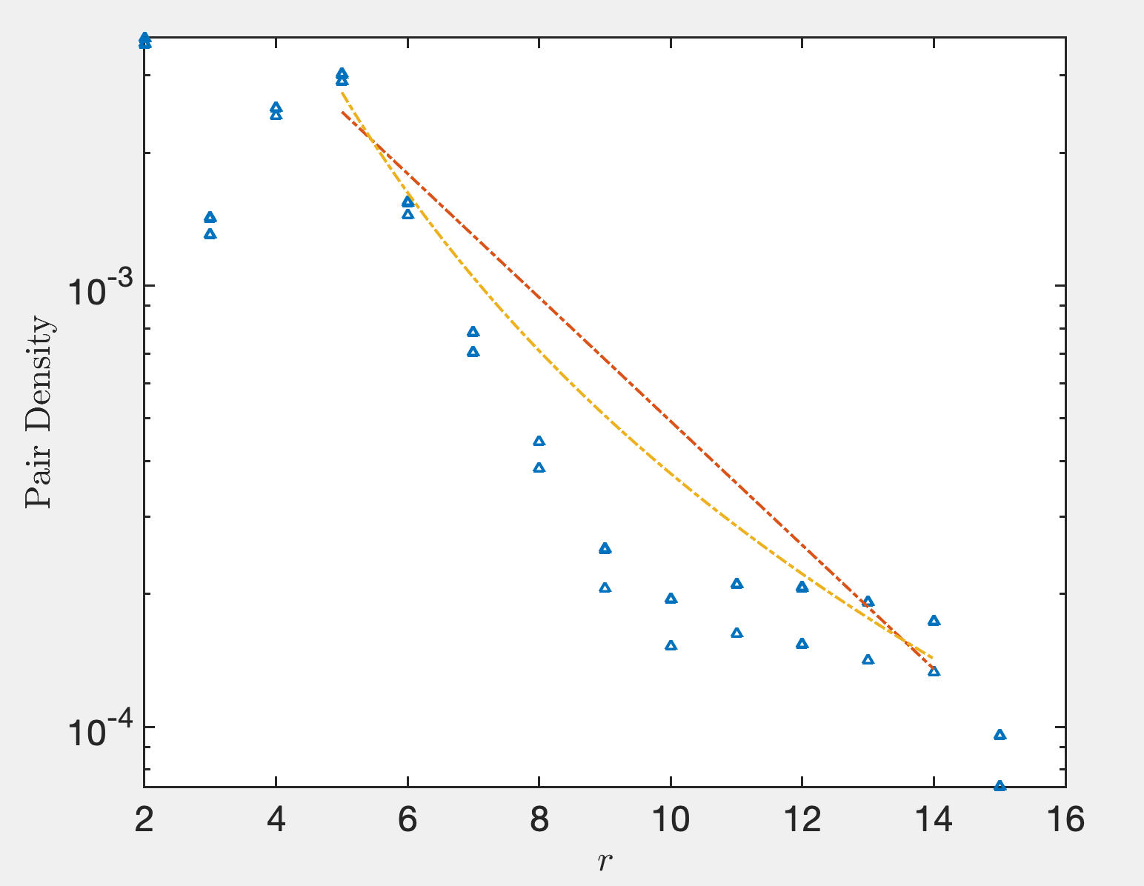
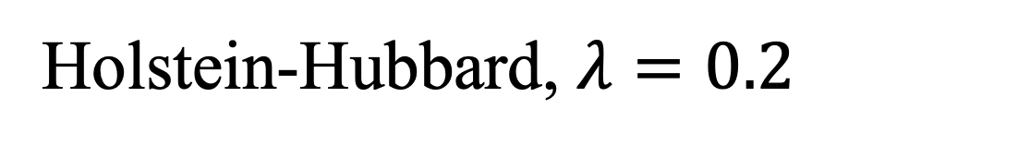
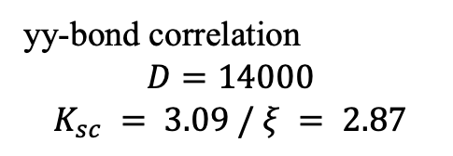
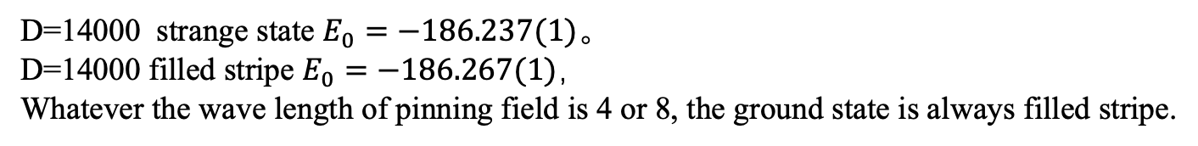
Holstein-Hubbard, $λ=0.2$
yy-bond correlation
$$D=14000$$
$$K_{sc} = 3.09 / ξ = 2.87$$
D=14000 strange state $E_{0}=−186.237(1)$。
D=14000 filled stripe $E_{0}=−186.267(1)$，
Whatever the wave length of pinning field is 4 or 8, the ground state is always filled stripe.

Slide 18
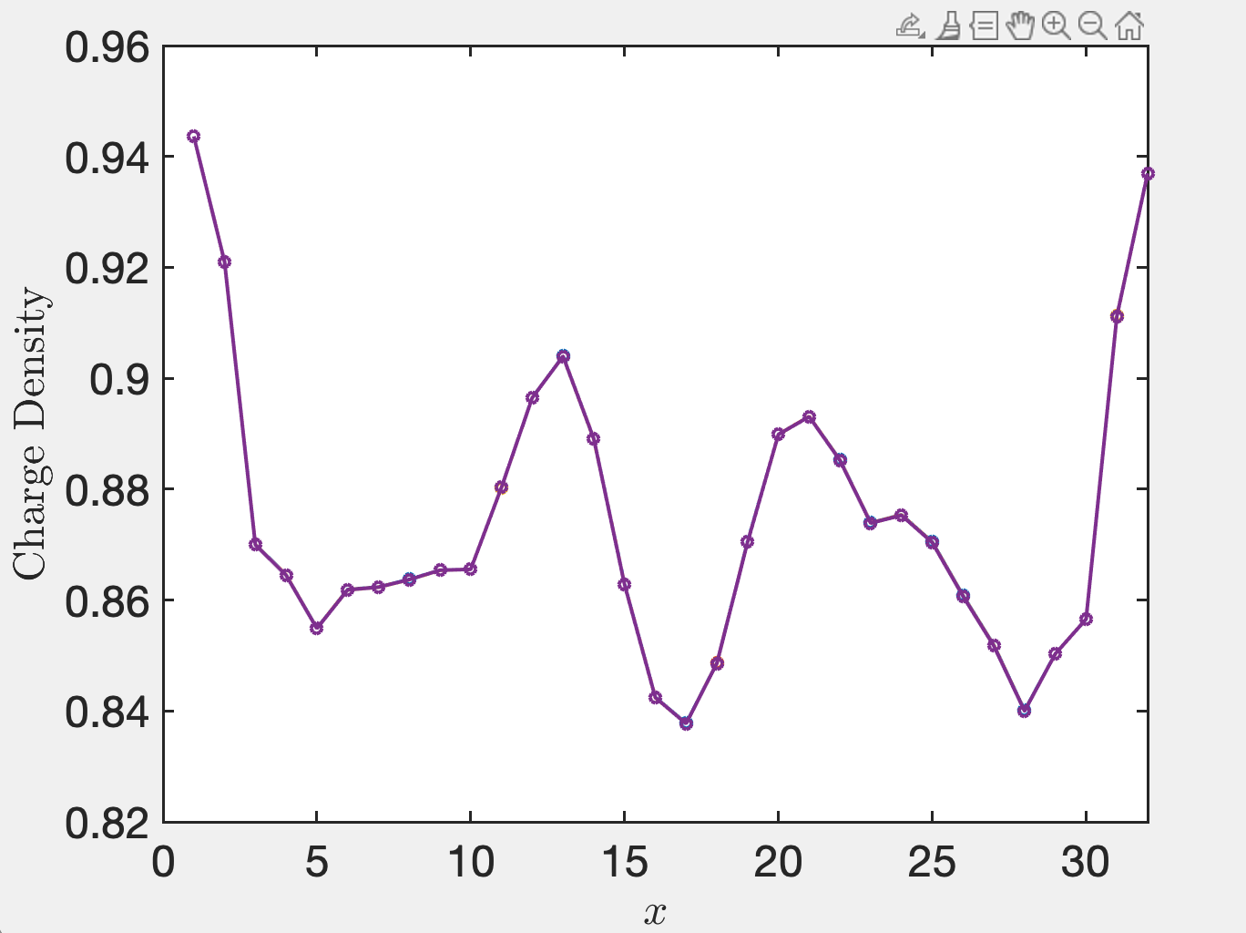
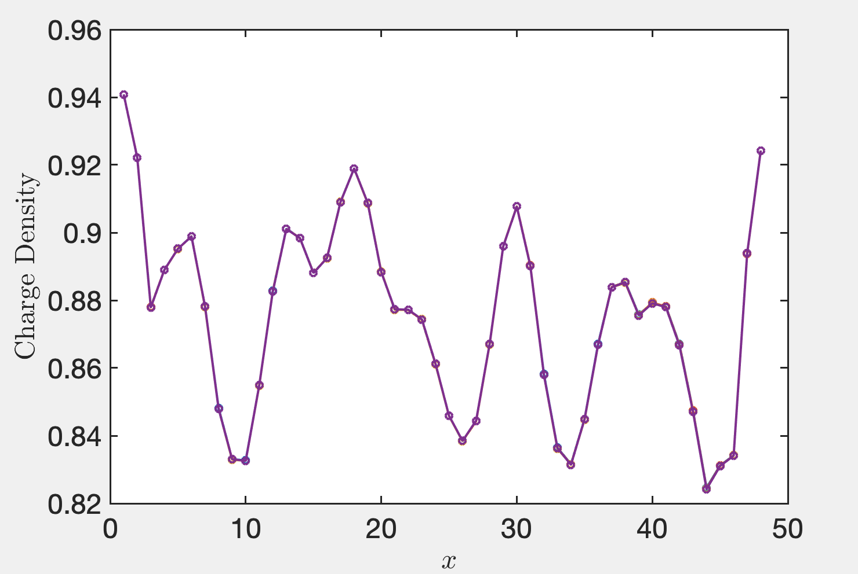


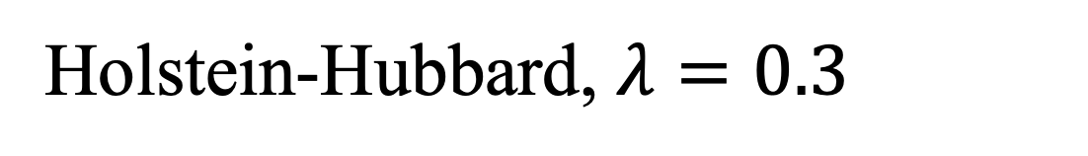


Holstein-Hubbard, $λ=0.3$
$$D=14000$$
$$D=7000$$
$$L_{x}=32$$
$$L_{x}=48$$
Up to now, we only get the strange state. We expect it is a filled stripe when we add the chemical potential.

