Slide 1
Discussion for the plaquette d-wave in the SSHH model

Slide 2
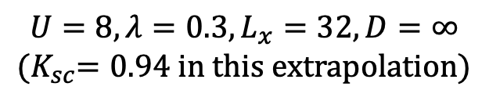




Based on our calculation, the plaquette d-wave state occurs in the ground state of SSHH model in the 4-leg ladder cylinders.
$$Δ_{yy}^{′′}$$
$$Δ_{yy}^{′}$$
$$Δ_{yx}$$
$$Δ_{yy}$$
Reference bond
$$U=8, λ=0.3, L_{x}=32, D=∞$$
$${(K}_{sc}=0.94 in this extrapolation)$$

Slide 3
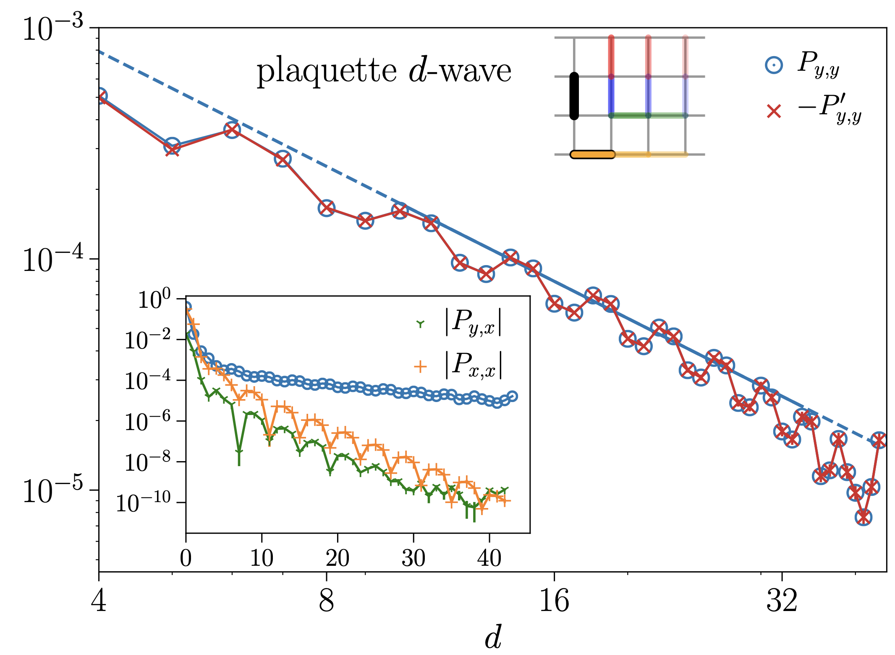
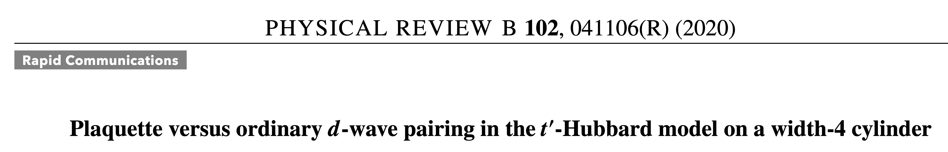
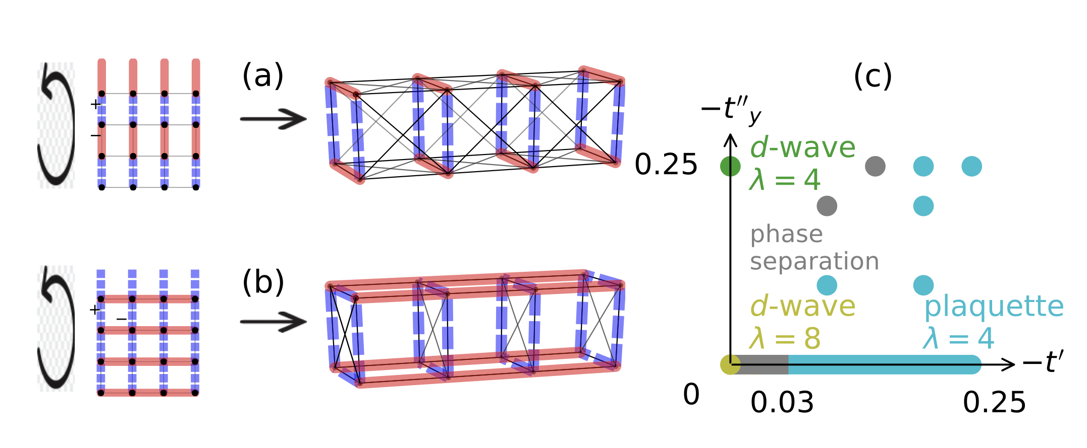
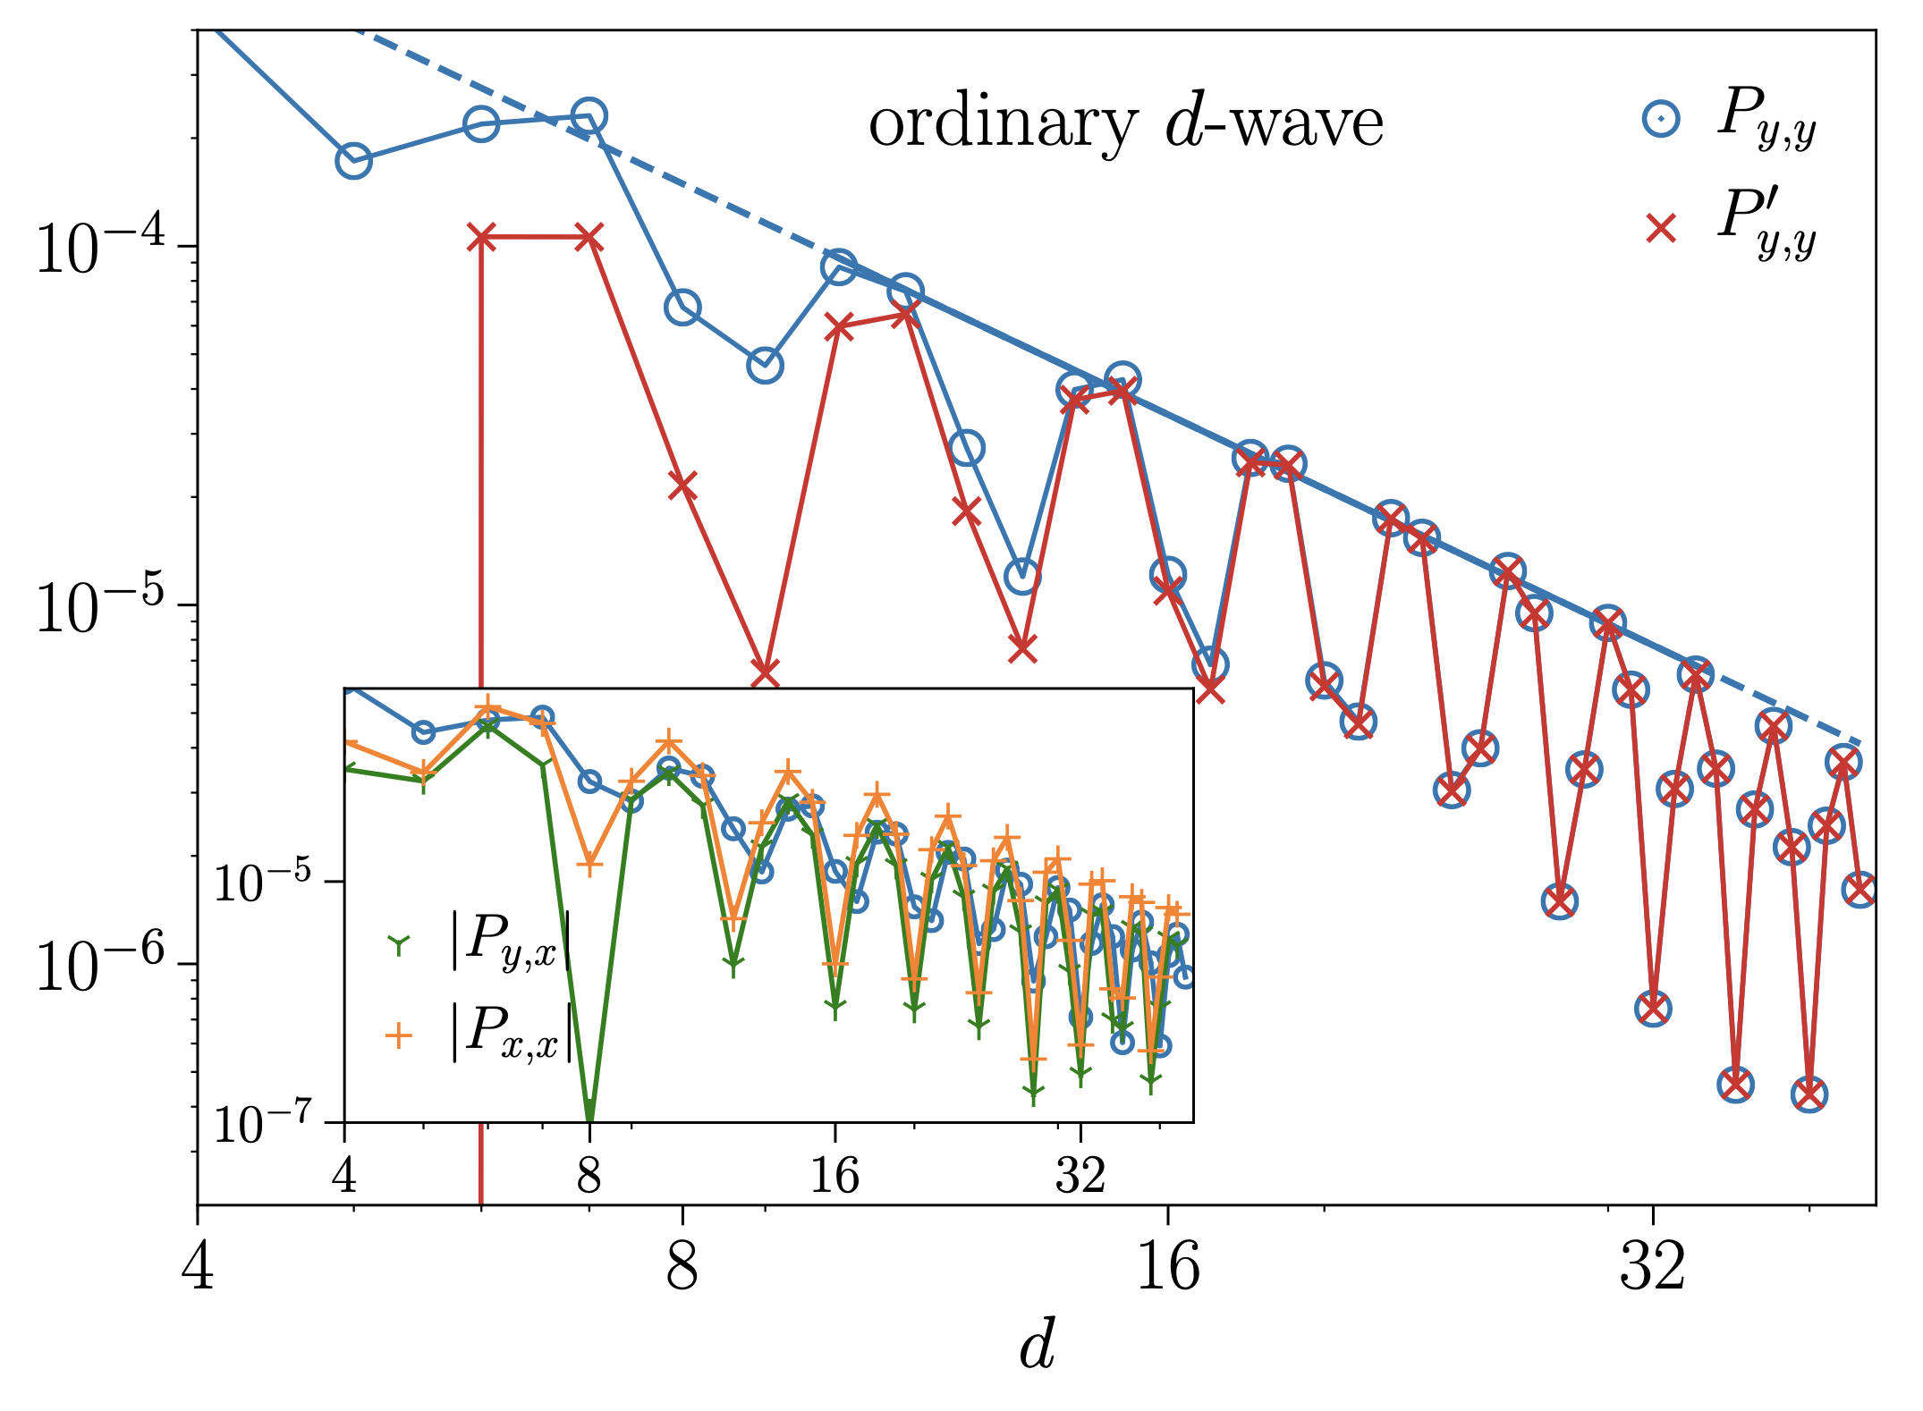
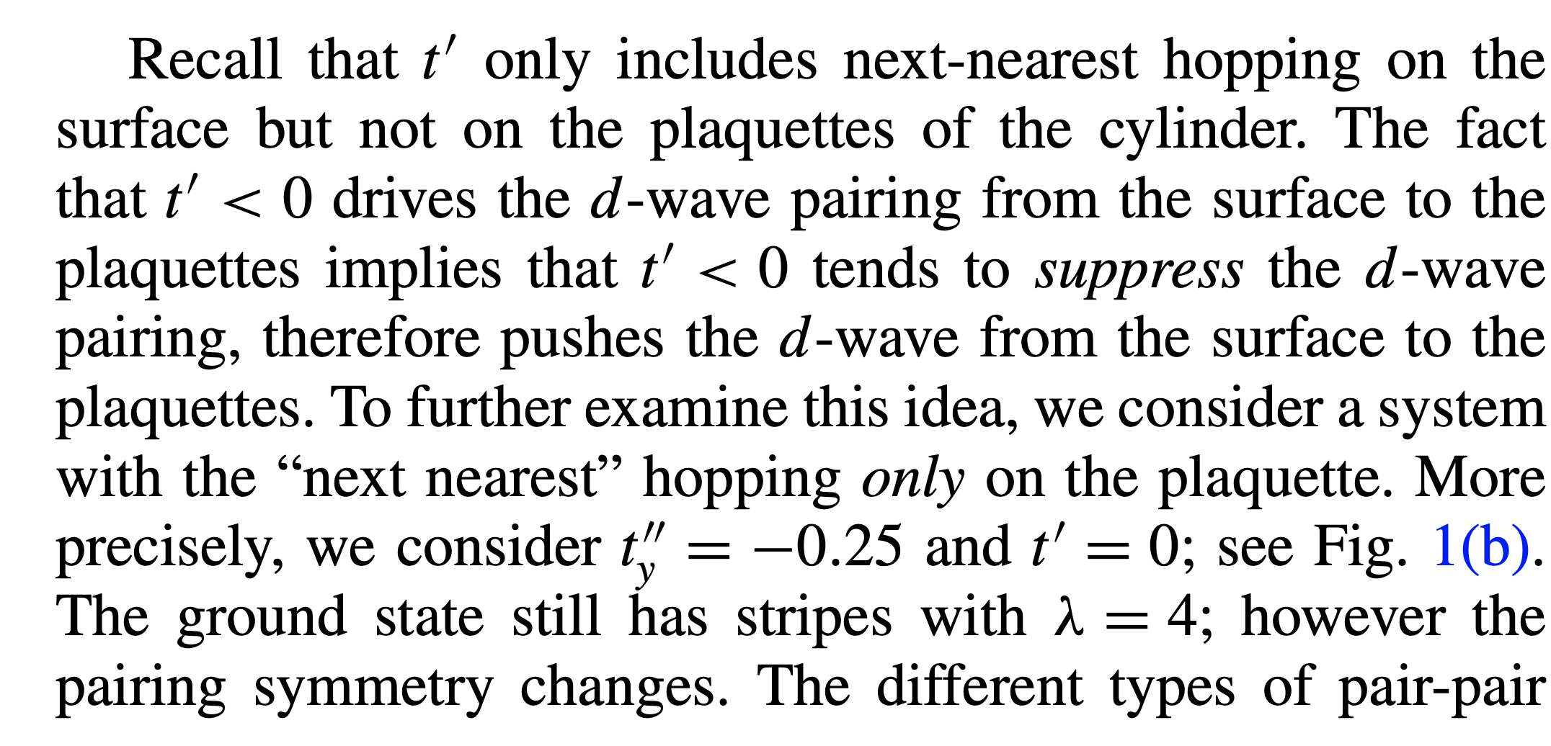
Discovery of the plaquette d-wave
t’
https://journals.aps.org/prb/pdf/10.1103/PhysRevB.102.041106
t’’

Slide 4
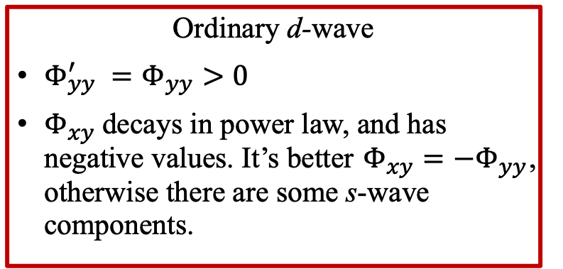
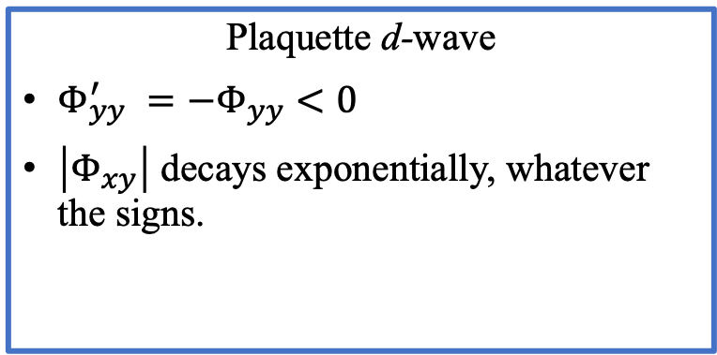
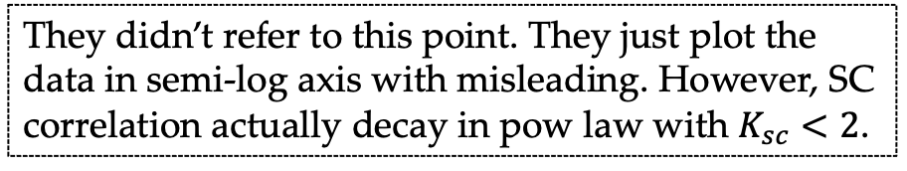
Plaquette d-wave versus Ordinary d-wave
Identification
Plaquette d-wave
$Φ_{yy}^{′} =−Φ_{yy}<0$
$\left|Φ_{xy}\right|$ decays exponentially, whatever the signs.
Ordinary d-wave
$Φ_{yy}^{′} =Φ_{yy}>0$
$Φ_{xy}$decays in power law, and has negative values. It’s better $Φ_{xy}=−Φ_{yy}$, otherwise there are some s-wave components.
More features of plaquette d-wave in White’s example
quasi-long-ranged SC order loses when
increasing width of cylinder
? using OBC in 4-leg cylinder
base on AFQMC and not sufficiently large keep state DMRG
They didn’t refer to this point. They just plot the data in semi-log axis with misleading. However, SC correlation actually decay in pow law with $K_{sc}<2$.
In White’s opinion, the appearance of plaquette d-wave indicates that the model suppresses 2d d-wave rather induces d-wave, which can be checked by t’’.

Slide 5
What can we discuss for the plaquette d-wave state, if we hope to argue the possibility of 2d d-wave in 2d limit?
The plausible solutions:
OBC in 4-leg ladder;
Mimic the terms t’’;
In small interactions limit, 2d d-wave appears by RG. If it is the same phase with large interaction limit, we can argue the state has possibility to turn to 2d d-wave when width increasing. However, it doesn’t work because the ground state of small interaction in 4-leg cylinder is not plaquette d-wave;
More width system, but we may only compare the energy with different charge density patterns.

Slide 6
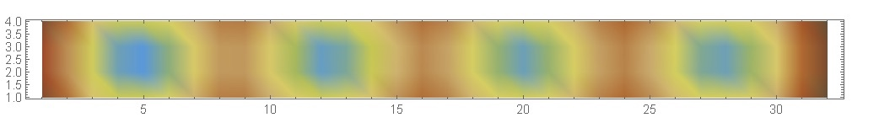
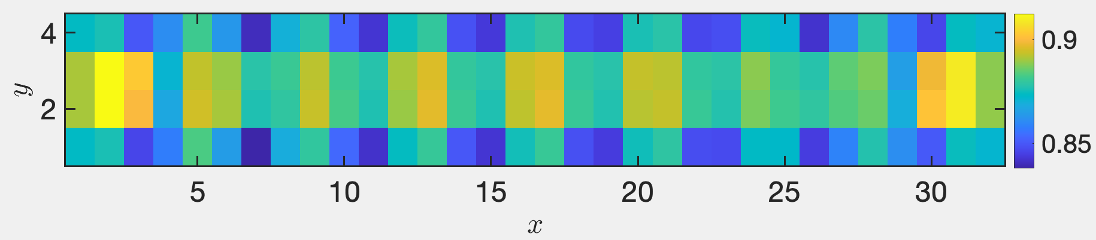
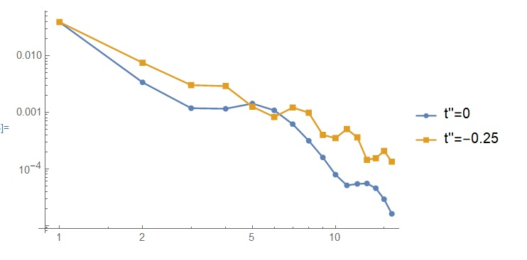
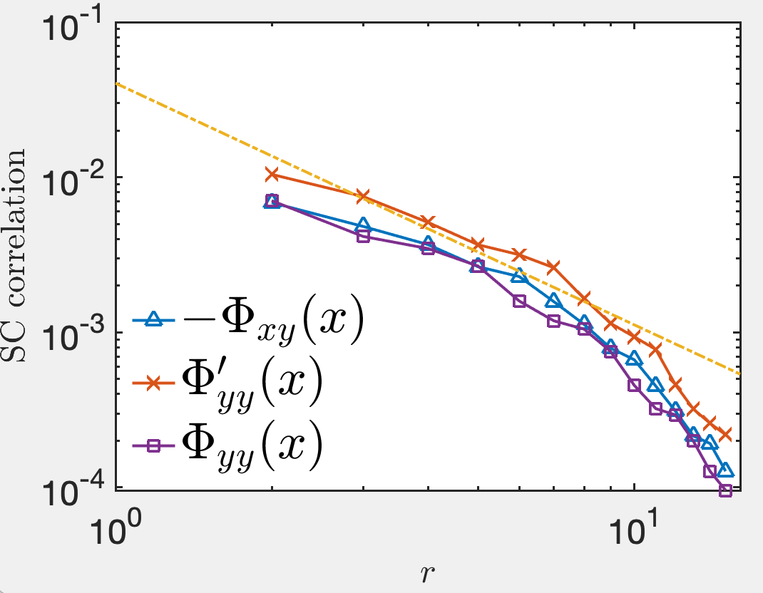
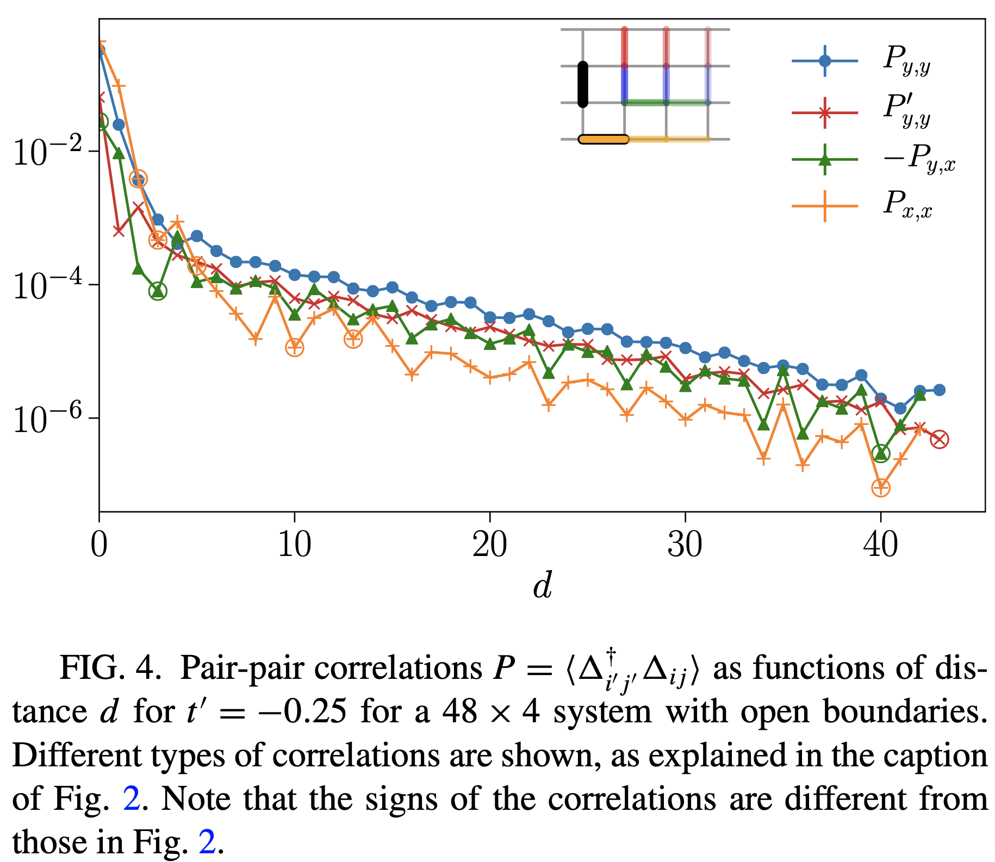

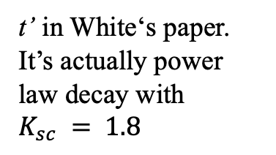
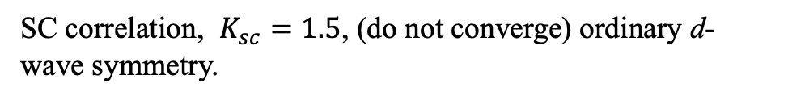
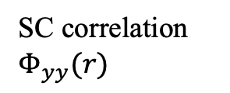
Open boundary in 4-leg ladder Model parameters: $U=8, λ=0.3$
t’’ and t’
t’’ Charge density profile, D=4000 (from Yifan Jiang)
SC correlation $Φ_{yy}(r)$
Charge density profile, D=8000, wave length = 4
t’ in White‘s paper. It’s actually power law decay with $K_{sc} = 1.8$
SC correlation, $K_{sc}=1.5$, (do not converge) ordinary d-wave symmetry.

Slide 7
Mimic the $t’’$
t’ -SSH
https://journals.aps.org/prb/pdf/10.1103/PhysRevB.102.041106
t’’ –
SSH phonon only in y-bond

Slide 8
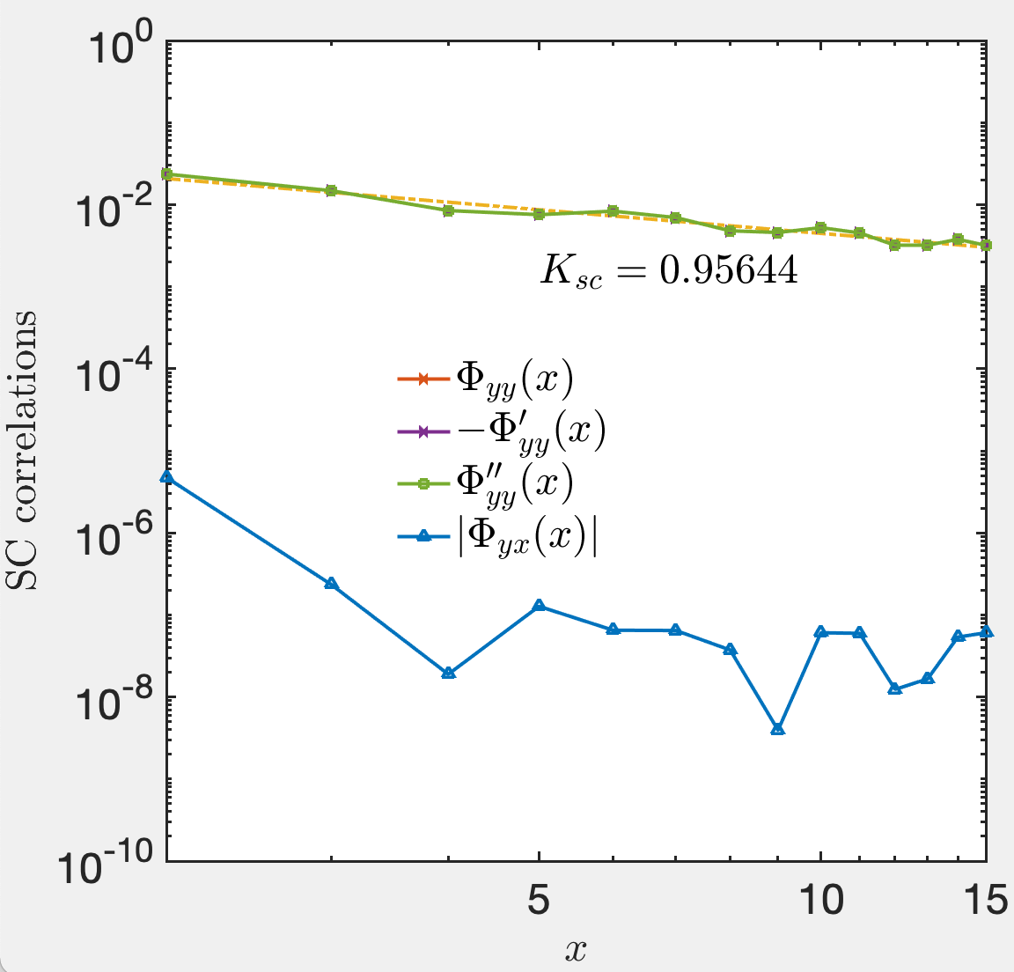
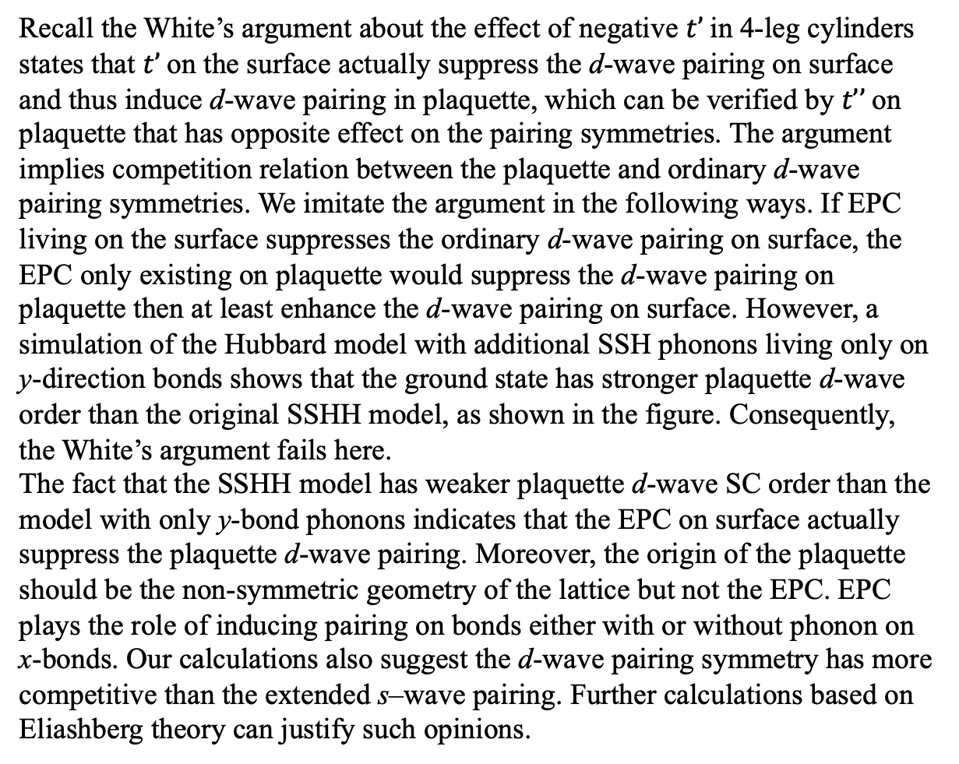
SSH phonons only living in y-bonds: plaquette d-wave state
Recall the White’s argument about the effect of negative $t’$in 4-leg cylinders states that $t’$on the surface actually suppress the d-wave pairing on surface and thus induce d-wave pairing in plaquette, which can be verified by $t’’$on plaquette that has opposite effect on the pairing symmetries. The argument implies competition relation between the plaquette and ordinary d-wave pairing symmetries. We imitate the argument in the following ways. If EPC living on the surface suppresses the ordinary d-wave pairing on surface, the EPC only existing on plaquette would suppress the d-wave pairing on plaquette then at least enhance the d-wave pairing on surface. However, a simulation of the Hubbard model with additional SSH phonons living only on y-direction bonds shows that the ground state has stronger plaquette d-wave order than the original SSHH model, as shown in the figure. Consequently, the White’s argument fails here.
The fact that the SSHH model has weaker plaquette d-wave SC order than the model with only y-bond phonons indicates that the EPC on surface actually suppress the plaquette d-wave pairing. Moreover, the origin of the plaquette should be the non-symmetric geometry of the lattice but not the EPC. EPC plays the role of inducing pairing on bonds either with or without phonon on x-bonds. Our calculations also suggest the d-wave pairing symmetry has more competitive than the extended s–wave pairing. Further calculations based on Eliashberg theory can justify such opinions.
D=6000

Slide 9
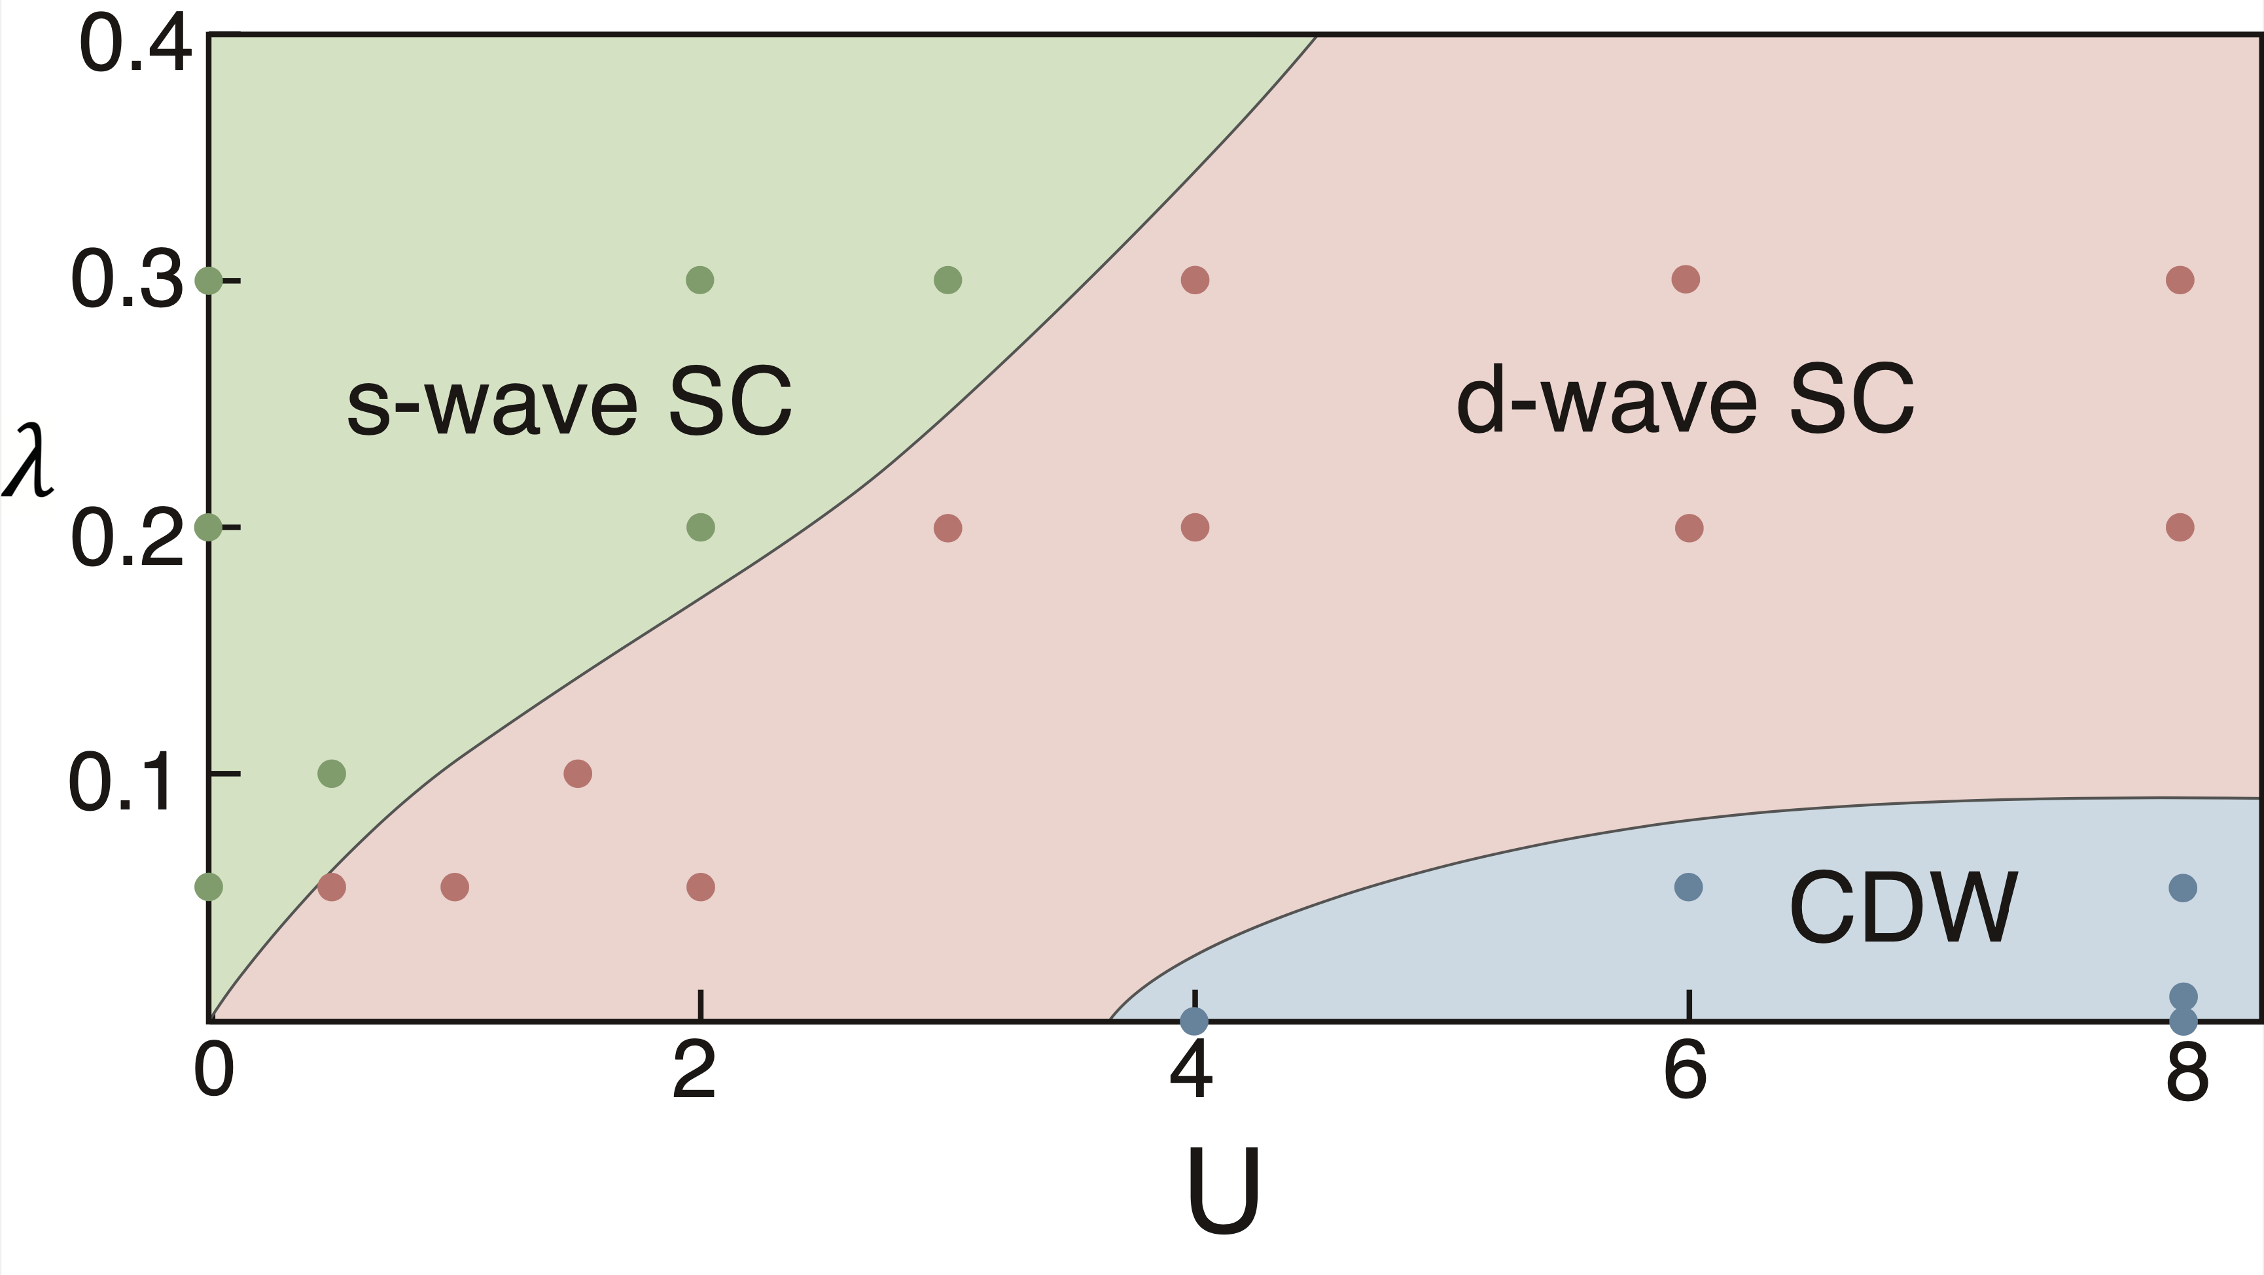
Plaquette
Ordinary
Plaquette
(Possibly not SC)
Plaquette
Plaquette
Ordinary
Ordinary (Possibly mixed)
Ordinary
Ordinary
Plaquette d-wave
Maybe filled-stripe
Plaquette
Plaquette
Ordinary (Possibly mixed)
Ordinary (Possibly mixed)

