Slide 1
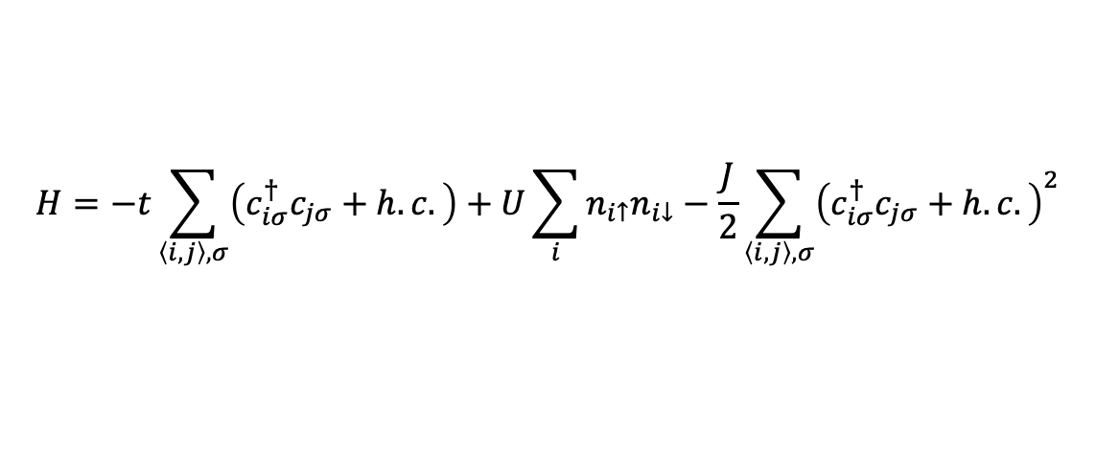
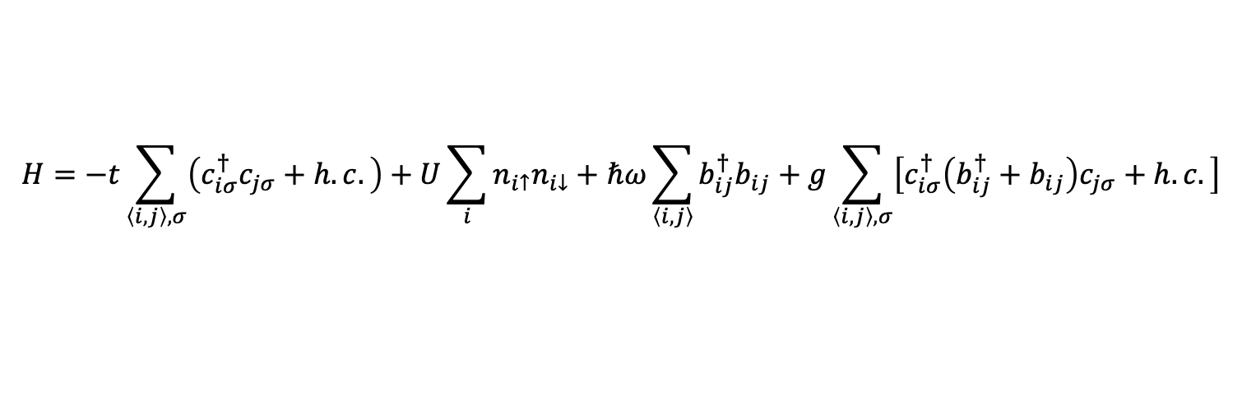

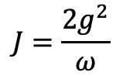
SSH-Hubbard model
$$H=−t\sum_{\left\langle i,j\right\rangle ,σ}{\left(c_{iσ}^{†}c_{jσ}+h.c.\right)}+U\sum_{i}{n_{i↑}n_{i↓}}+ℏω\sum_{\left\langle i, j\right\rangle }{b_{ij}^{†}b_{ij}}+g\sum_{\left\langle i, j\right\rangle ,σ}{\left[c_{iσ}^{†}\left(b_{ij}^{†}+b_{ij}\right)c_{jσ}+h.c.\right]}$$
$$H=−t\sum_{\left\langle i,j\right\rangle ,σ}{\left(c_{iσ}^{†}c_{jσ}+h.c.\right)}+U\sum_{i}{n_{i↑}n_{i↓}}−\frac{J}{2}\sum_{\left\langle i,j\right\rangle ,σ}{{\left(c_{iσ}^{†}c_{jσ}+h.c.\right)}^{2}}$$
$$J=\frac{2g^{2}}{ω}$$
$$λ=\frac{J}{W}, W=8t$$

Slide 2
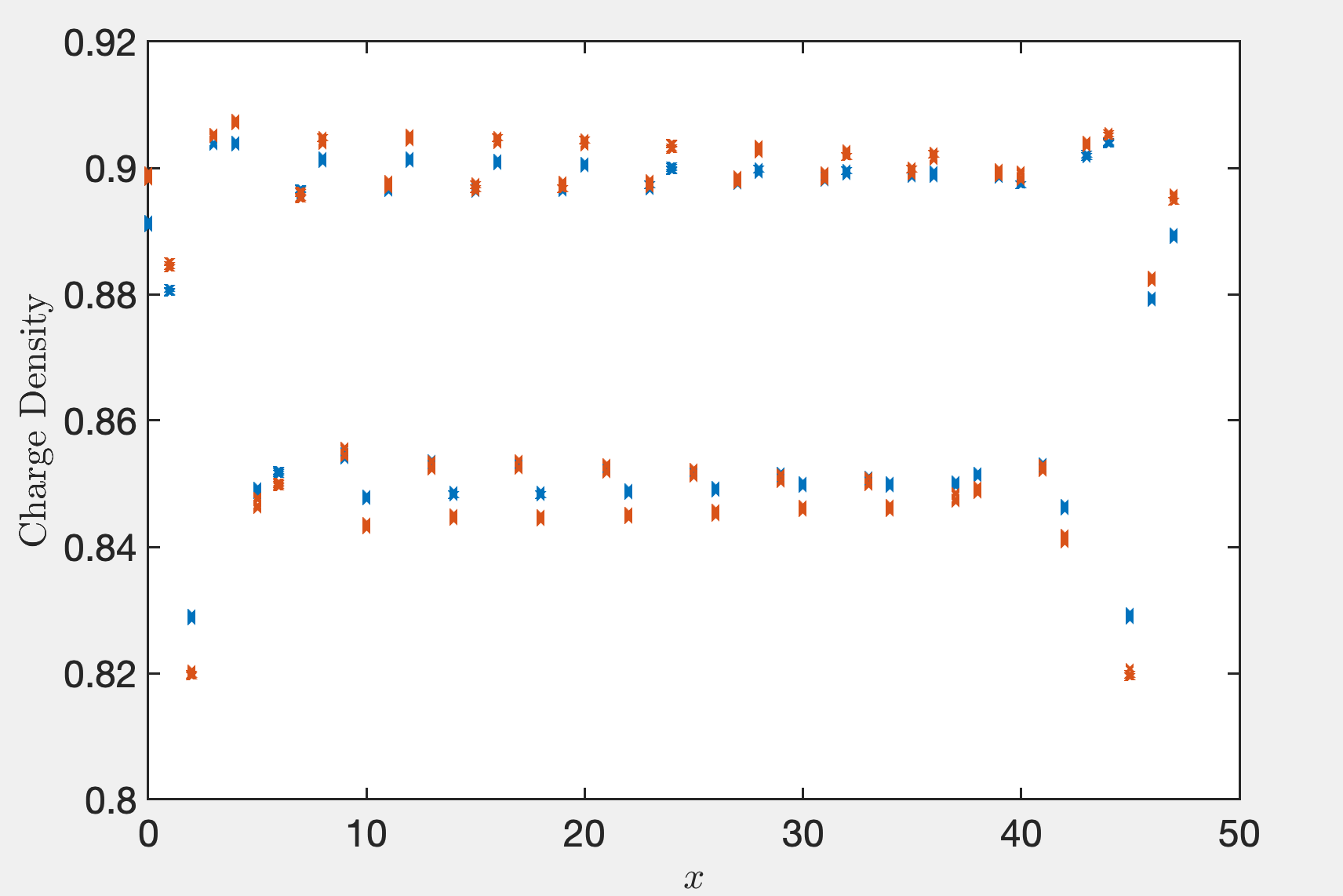
Lambda = 0.3, 0.4

Slide 3
Truncation error (1e-6)
Lx\D | 8000 | 10000 | 12000 | 14000 | 16000 | 18000 | 20000
16 | 3.37 | 2.82 | 2.46
24 | 3.44 | 2.79 | 2.41 | 2.14
32 | 3.70 | 2.96 | 2.60 | 2.49
40
48 | 3.16 | 2.67 | 2.34 | 2.08 | 1.95 | 1.77 | 1.47

Slide 4
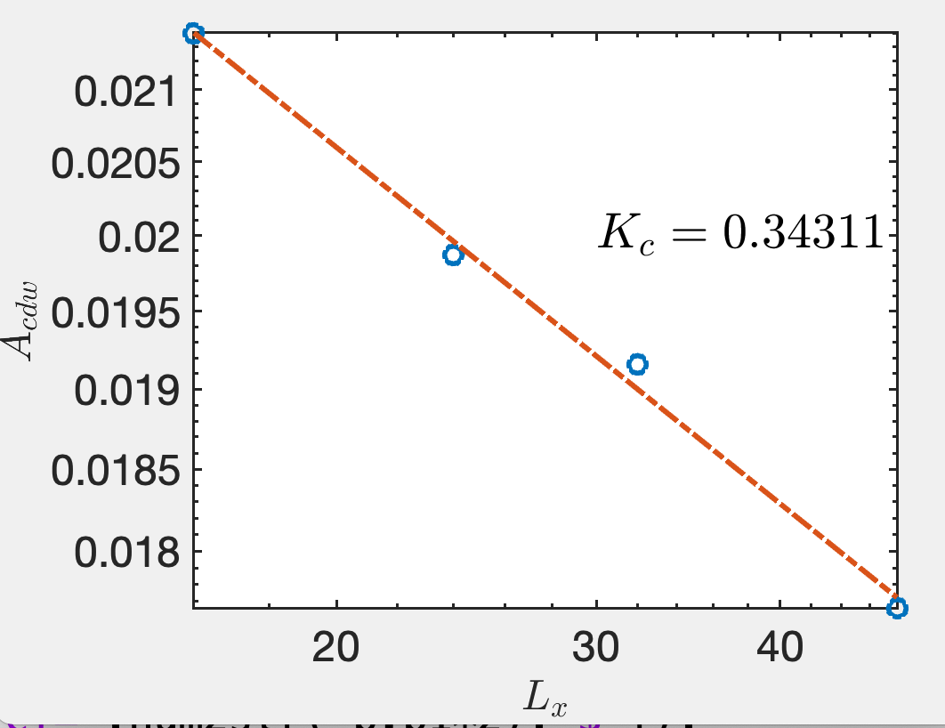
Bond dimension up to now
Lx | 16 | 24 | 32 | 40 | 48
D | 12000 | 14000 | 14000 | 12000 | 18000

Slide 5
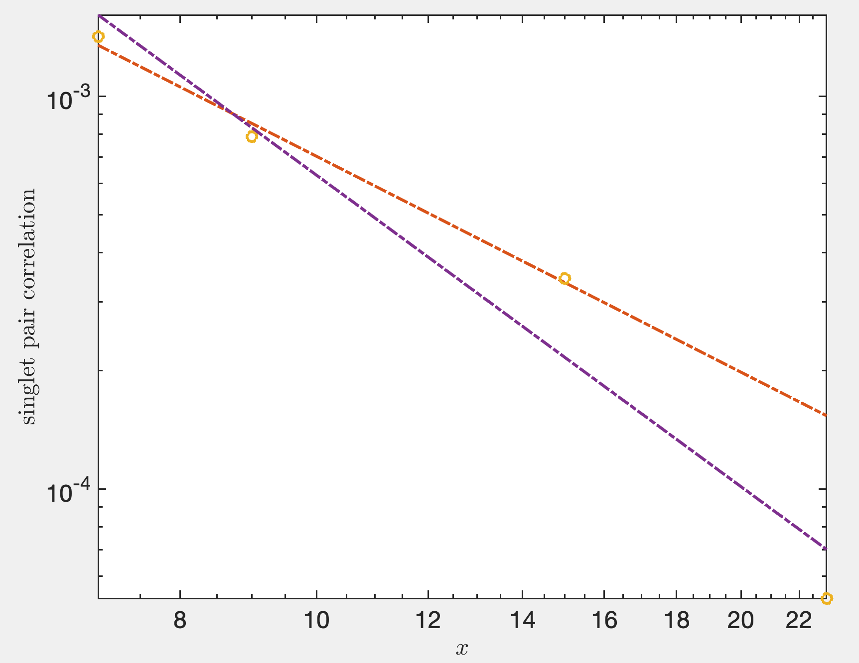
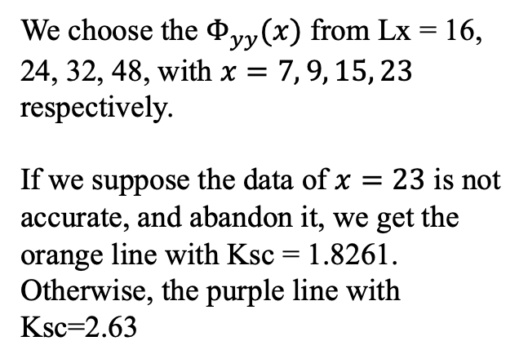
We choose the $Φ_{yy}(x)$ from Lx = 16, 24, 32, 48, with $x=7, 9, 15, 23$ respectively.
If we suppose the data of $x=23$ is not accurate, and abandon it, we get the orange line with Ksc = 1.8261. Otherwise, the purple line with Ksc=2.63

Slide 6
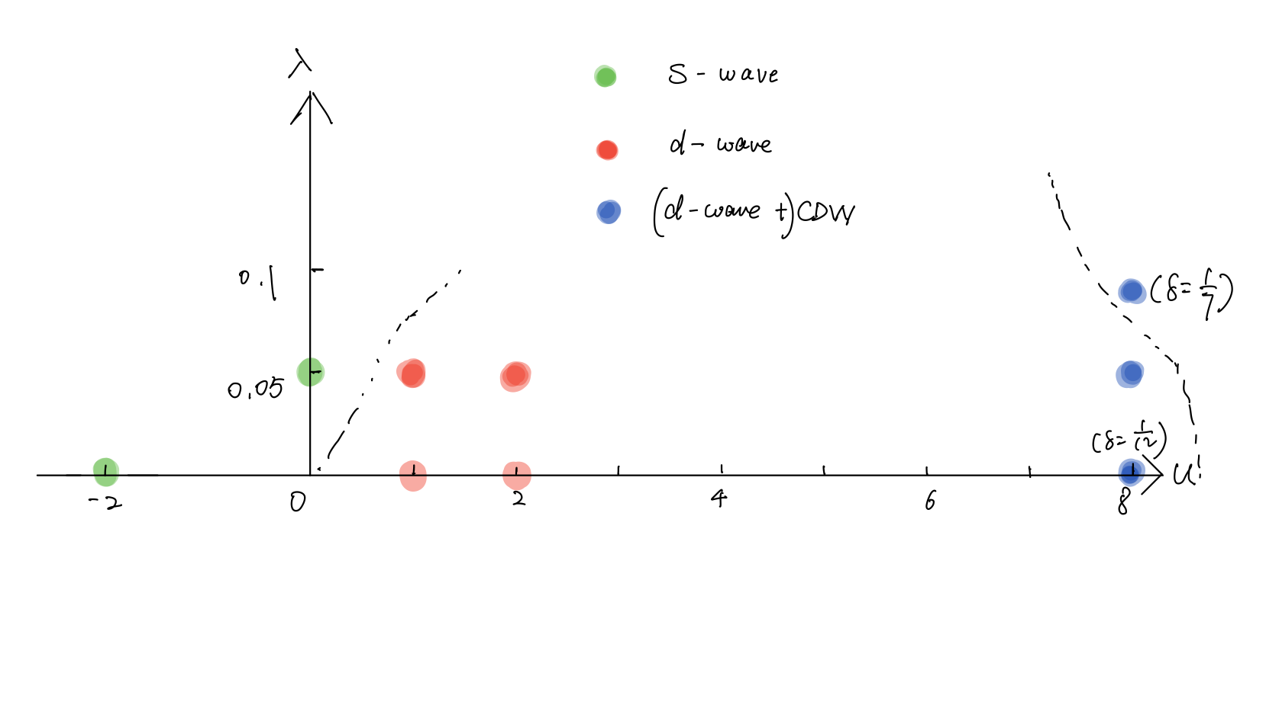
Landscape: 3-leg ladder, $δ=1/8$

Slide 7
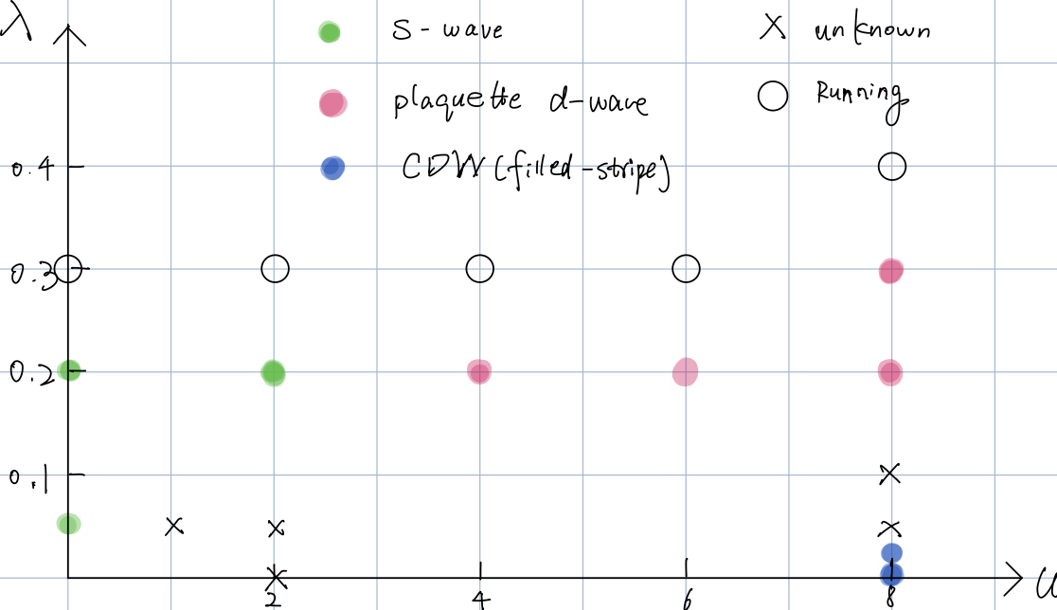

Landscape: 4-leg ladder, $δ=1/8$

