Slide 1
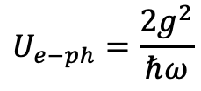
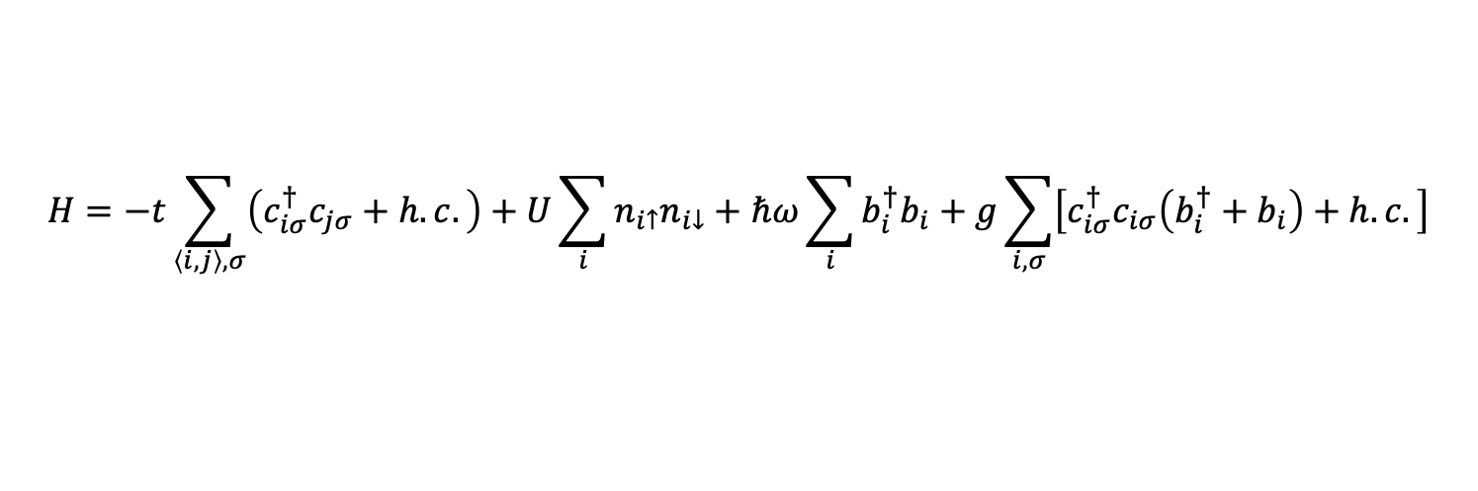
Holstein-Hubbard model
$$H=−t\sum_{\left\langle i,j\right\rangle ,σ}{\left(c_{iσ}^{†}c_{jσ}+h.c.\right)}+U\sum_{i}{n_{i↑}n_{i↓}}+ℏω\sum_{i}{b_{i}^{†}b_{i}}+g\sum_{i,σ}{\left[c_{iσ}^{†}c_{iσ}\left(b_{i}^{†}+b_{i}\right)+h.c.\right]}$$
$$U_{e−ph}=\frac{2g^{2}}{ℏω}$$

Slide 2
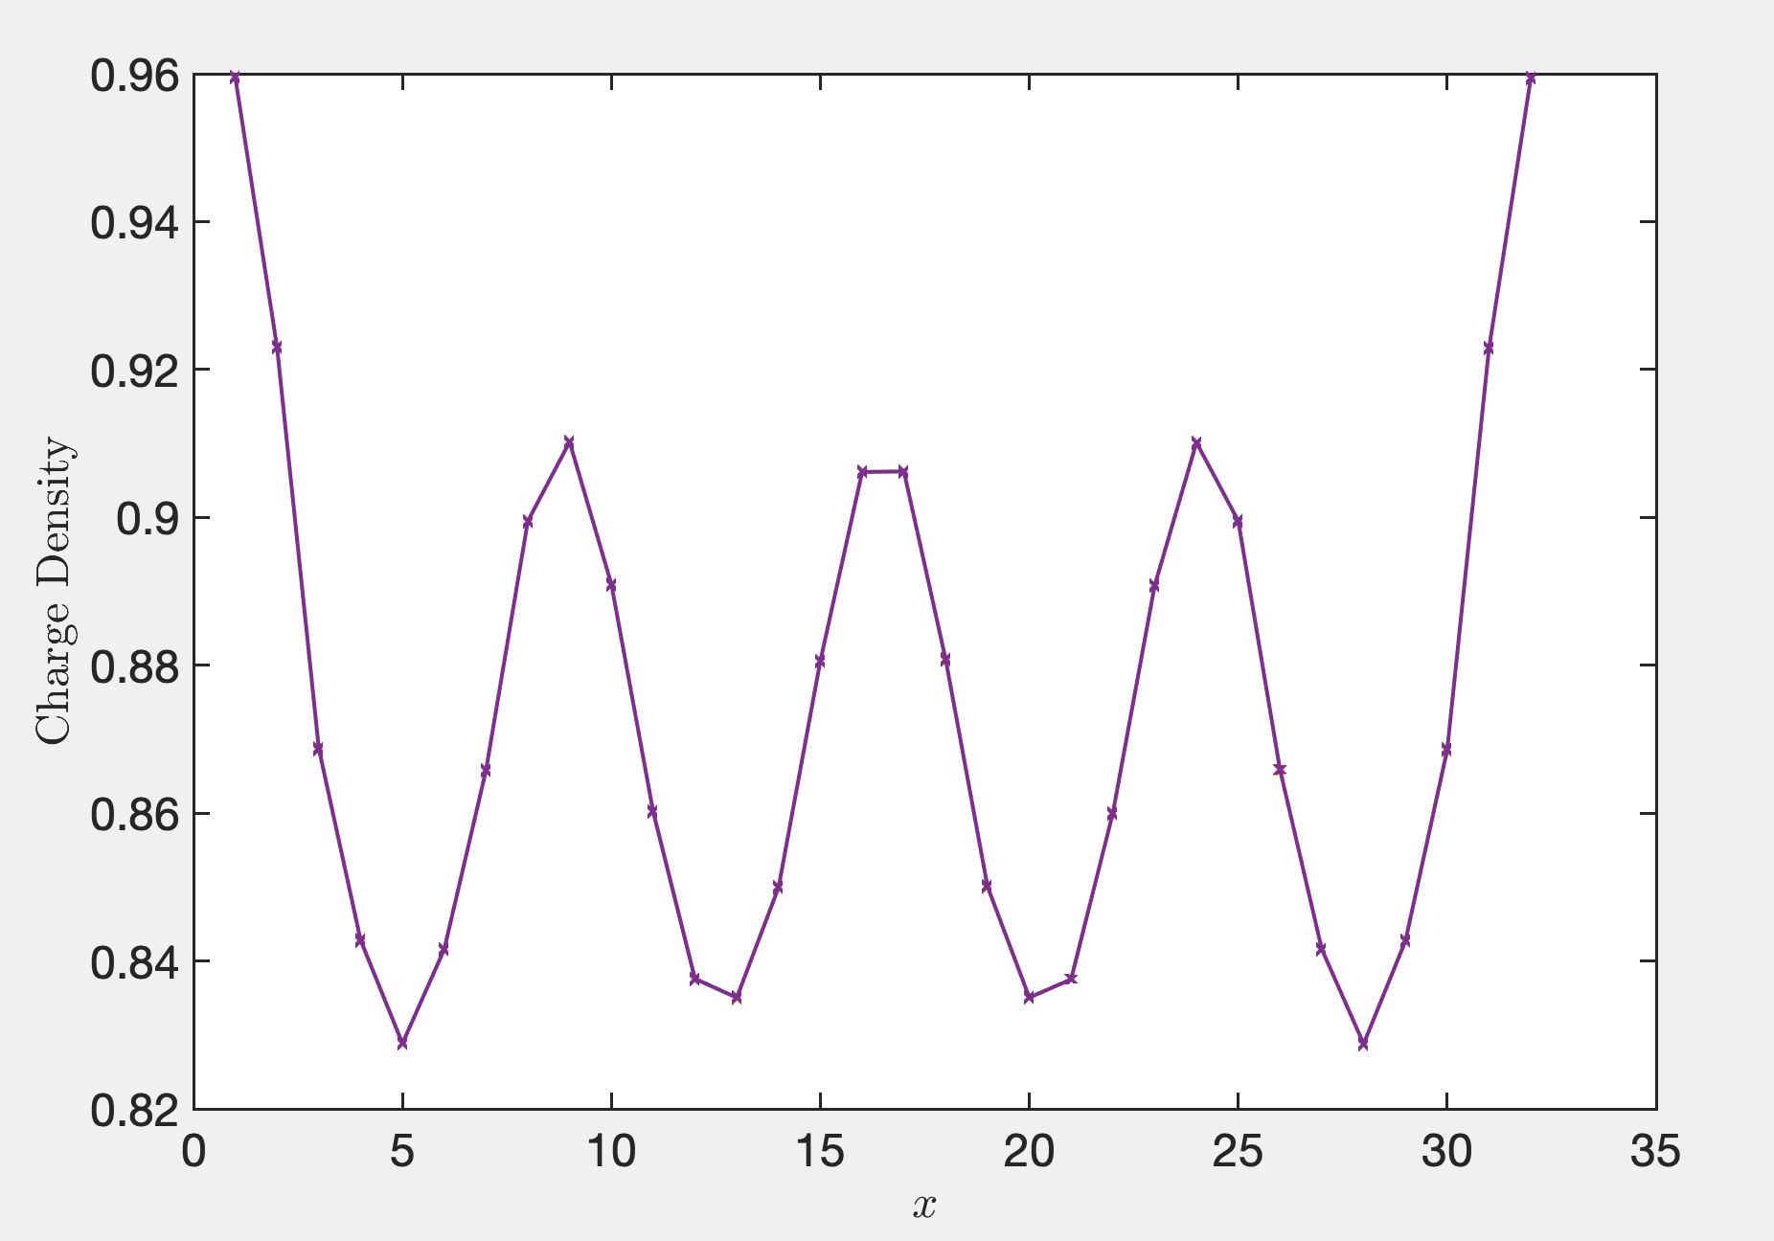
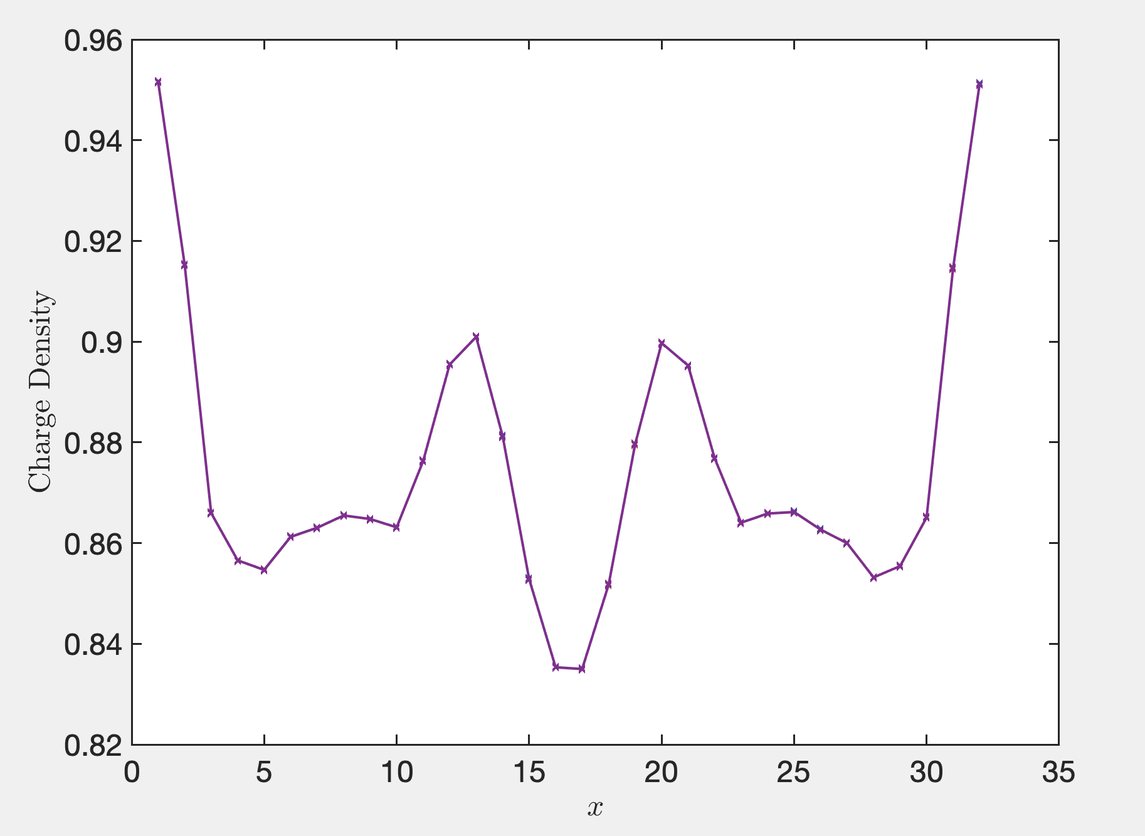
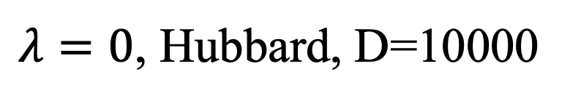
$λ=0$, Hubbard, D=10000
E0=-97.0098
E0 = -97.0047

Slide 3
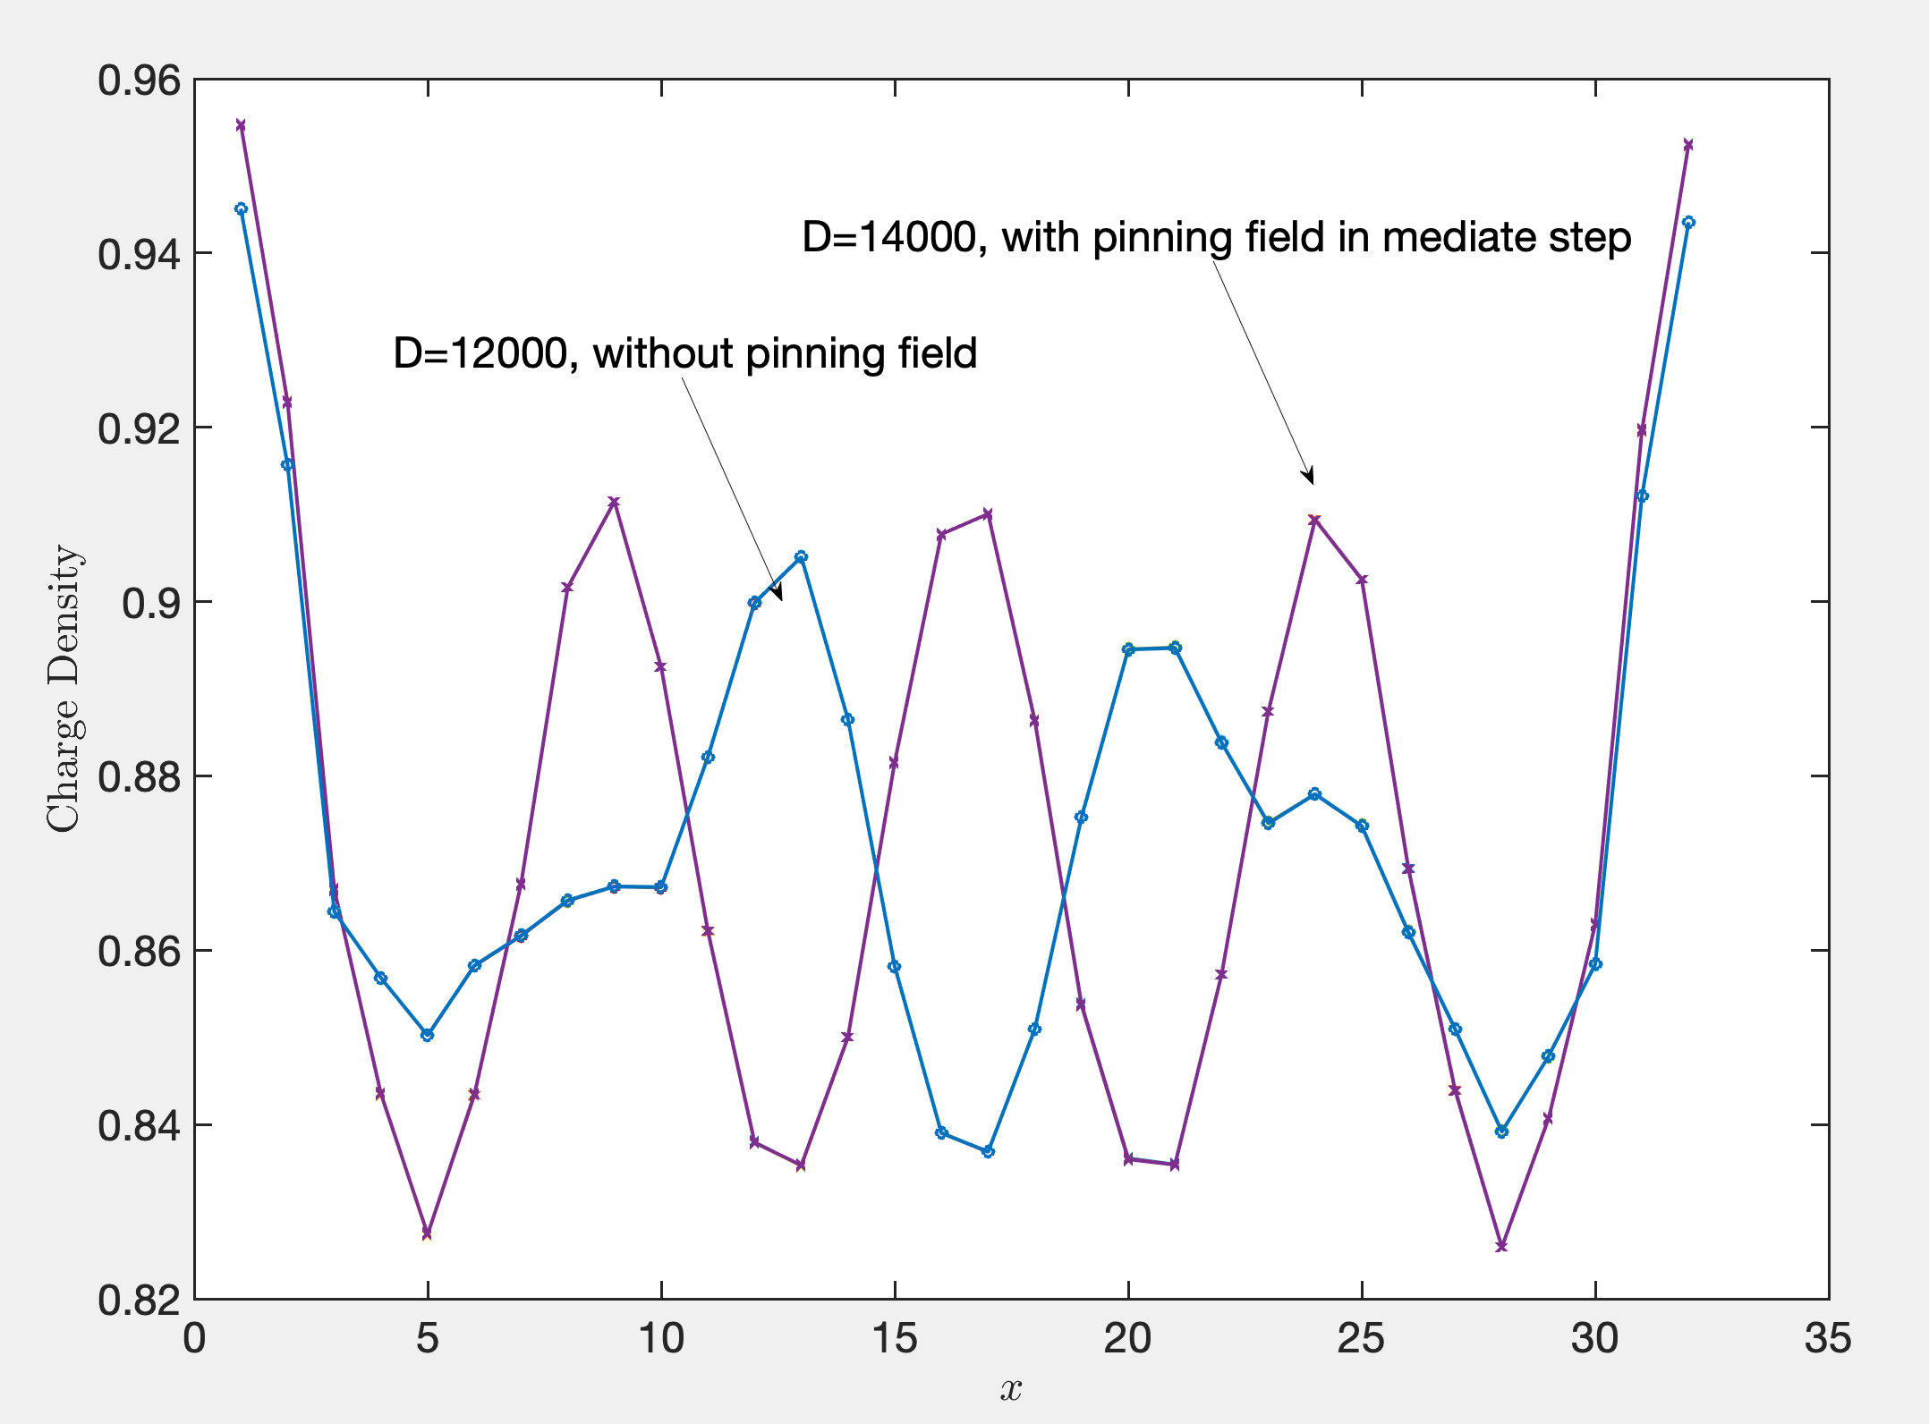
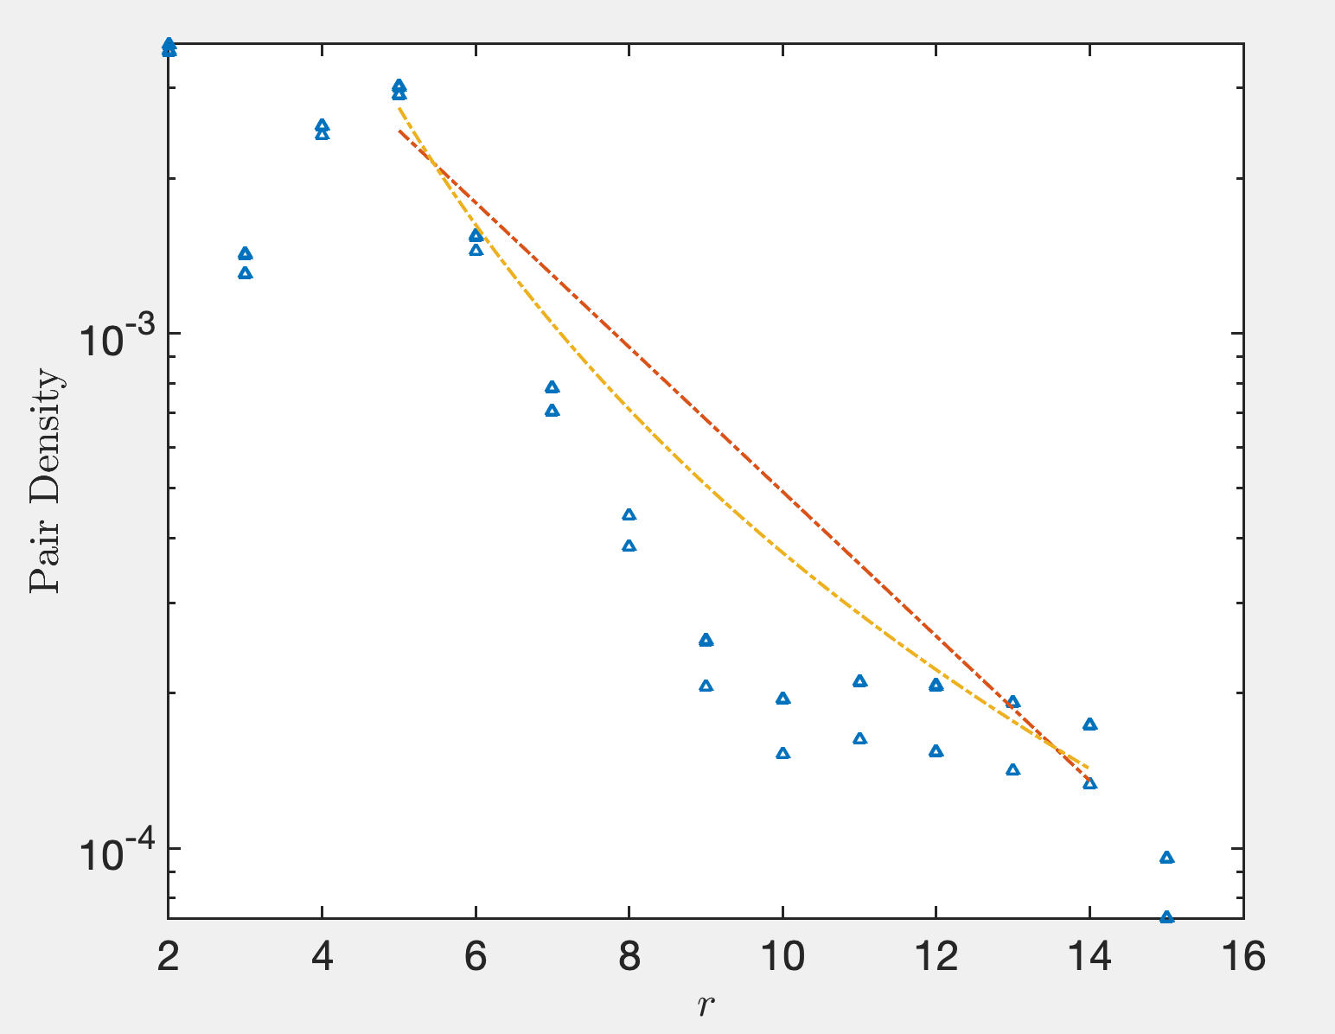
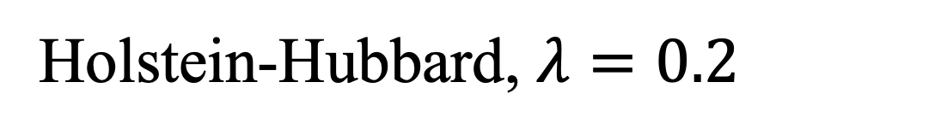
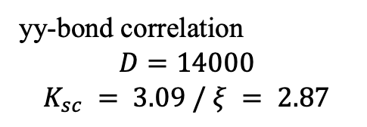
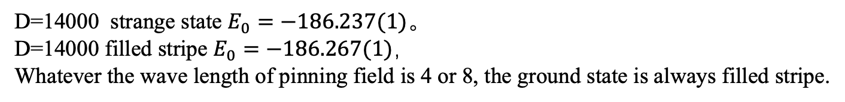
Holstein-Hubbard, $λ=0.2$
yy-bond correlation
$$D=14000$$
$$K_{sc} = 3.09 / ξ = 2.87$$
D=14000 strange state $E_{0}=−186.237(1)$。
D=14000 filled stripe $E_{0}=−186.267(1)$，
Whatever the wave length of pinning field is 4 or 8, the ground state is always filled stripe.

Slide 4
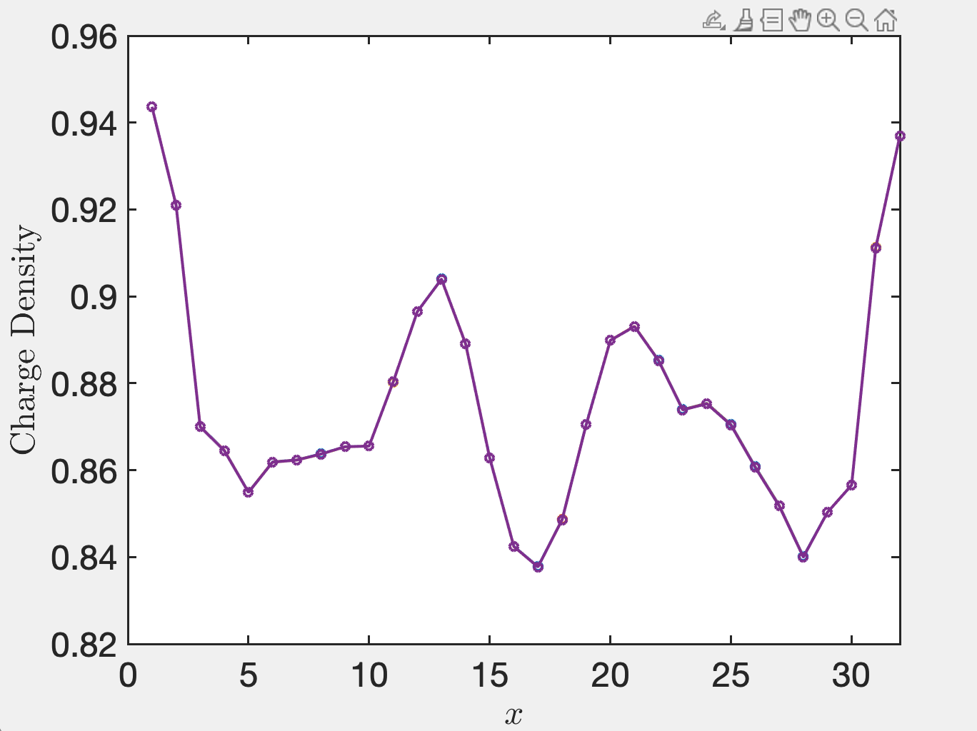
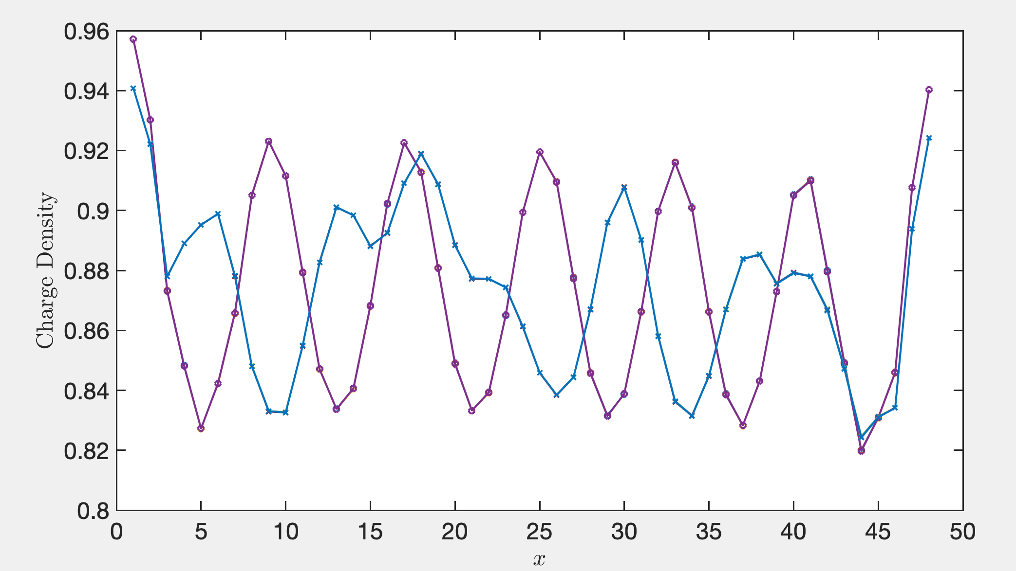

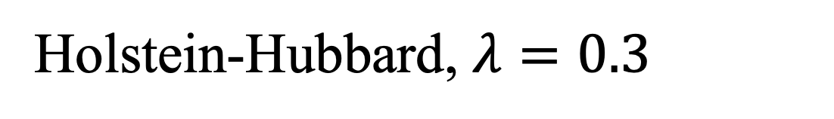



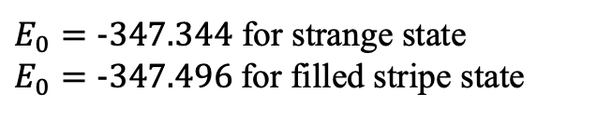
Holstein-Hubbard, $λ=0.3$
$$D=14000$$
$$L_{x}=48$$
$$D=7000$$
$$L_{x}=32$$
$E_{0}=-347.344$ for strange state
$E_{0}=-347.496$for filled stripe state
Up to now, we only get the strange state. We expect it is a filled stripe when we add the chemical potential.

