Slide 1
Technical Note

Slide 2
Performance when calculating square-hopping-Hubbard model in Paratera
Aug. 4, 2021
Parameter: J=3.2, system size $4×48$, mps&envs save and load on /tmp
Num core | JOBID | Num thread | 1st sweep time(D=1 to 16)(s) | 2nd (D=16 to 1000) | 3rd (D=1000) | 4th (D=1000) | 5th | 6th | 7th | 8th
4 | 320546 | 4 | 88 | 2241 | 18677 | 21873 | 19617 | 22347 | 20669 | 18529
28 | 320816 | 28 | 271 | 1771 | 12926 | 15403 | 13874 | 12947 | 11725 | 10092
28 | 320467 | 56 | 168 | 2968 | 44265 | 54019 | cut
Below lanczos iters are cutoff at 30
Num core | JOBID | Num thread | 1st (D=1000 to 3000) | 2nd (D=3000) | 3rd | 4th | 5th
14 | 322139 | 14 | 37088 | 36899 | 35905 | 31757 | 20889
28 | 322132 | 28 | 43456 | 37722 | 31037 | 28102 | 25129
56 | 322137 | 56 | 40966 | 34707 | 32429 | 28479 | 25859

Slide 3
Linux command
mpstat –P 31,32 1 10
查看31号和32号cpu的使用率，每1秒更新一次，更新10组数据。（如果无穷更新，不要那个10即可）
pidstat -p `pidof main` -t 1
查看进程名为main的进程cpu的使用率，一秒更新一次
taskset -p `pidof main`
查看进程main用了哪些cpu，显示的数字要转化成二进制，从右到左分别为0，1，2，……号cpu有没有被占用

Slide 4
MPI Communication
On Paratera, we have a test of MPI point-to-point transfer.
One log file is “~/test/323368.log”
The time of sending and receiving 1e7 double is about 0.142.
For tensor’s example, it seems like more quickly, especially when data size is larger.

Slide 5
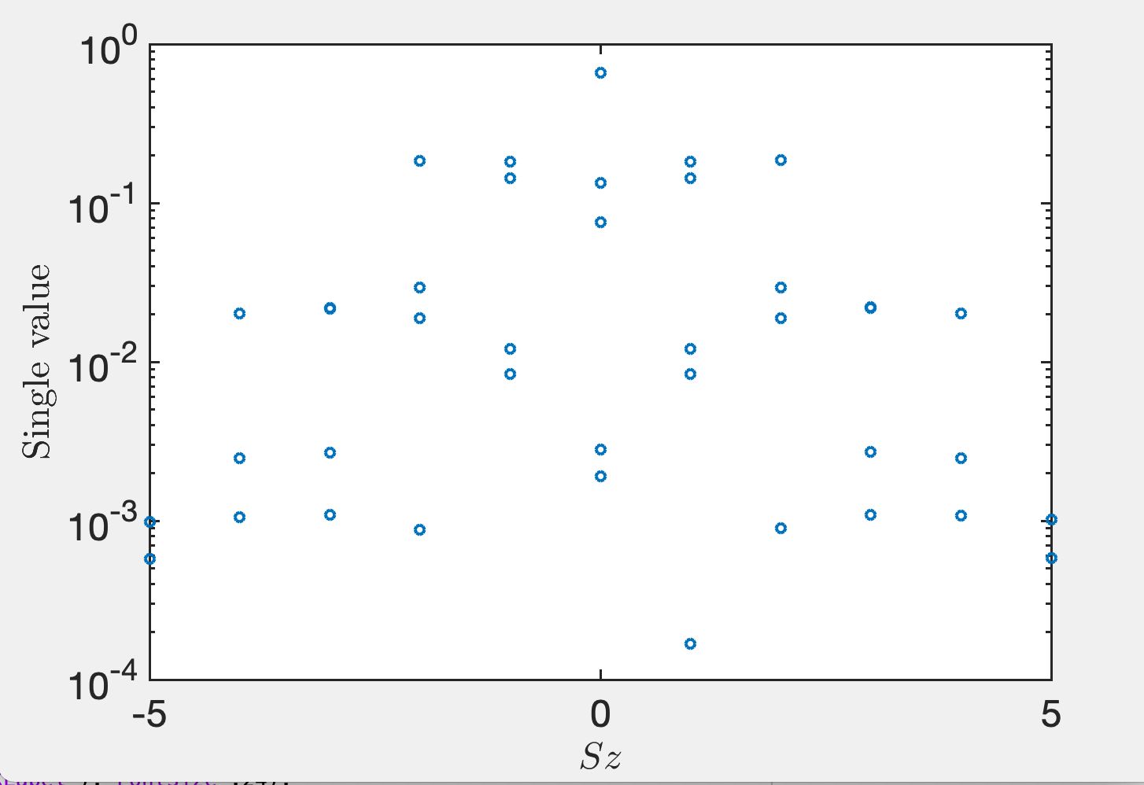
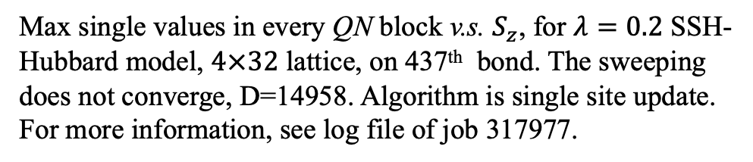
Max single values in every QN block v.s. $S_{z}$, for $λ=0.2$ SSH-Hubbard model, $4×32$ lattice, on 437th bond. The sweeping does not converge, D=14958. Algorithm is single site update. For more information, see log file of job 317977.

Slide 6
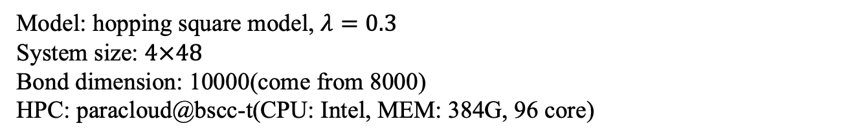
two site update MPI test
Model: hopping square model, $λ=0.3$
System size: $4×48$
Bond dimension: 10000(come from 8000)
HPC: paracloud@bscc-t(CPU: Intel, MEM: 384G, 96 core)
Num core | JOBID | Num thread | speed
4x48 | 382085 | 4x48 | The most slower in parallel group
4x48 | 382091 | 4x24 | The most fast
4x24 | 382123 | 4x24 | The second most fast
1x96 | 382267 | 1x24(binding cpus)
1x96 | 383428 | 1x48(binding cpus)

Slide 7
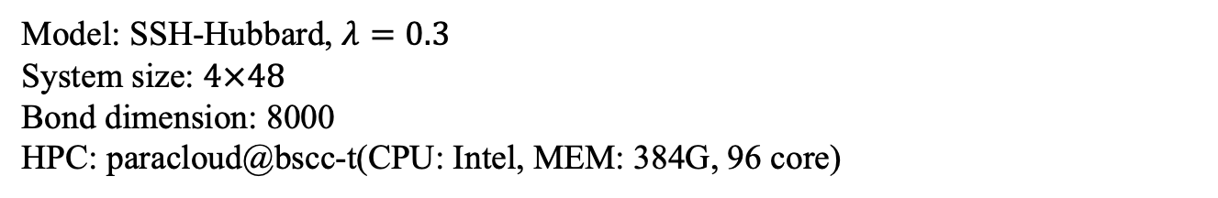
two site update phonon MPI test
Model: SSH-Hubbard, $λ=0.3$
System size: $4×48$
Bond dimension: 8000
HPC: paracloud@bscc-t(CPU: Intel, MEM: 384G, 96 core)
Num core | JOBID | Num thread | speed
2 exclusive nodes | 393458 | 8 process, each 24 threads
4 exclusive nodes | 393234 | 4 process, each 48 threads
Two exclusive nodes | 393210 | 4 process, each 48 threads
Exclusive node | 393123 | Single process, 48 threads, binding cpu
Exclusive node | 393045 | Single process, 24, threads, binding cpu
2 exclusive nodes | 391740 | 4 process, each 24 threads

