Slide 1
Discussion for the phase diagram of the SSHH model

Slide 2
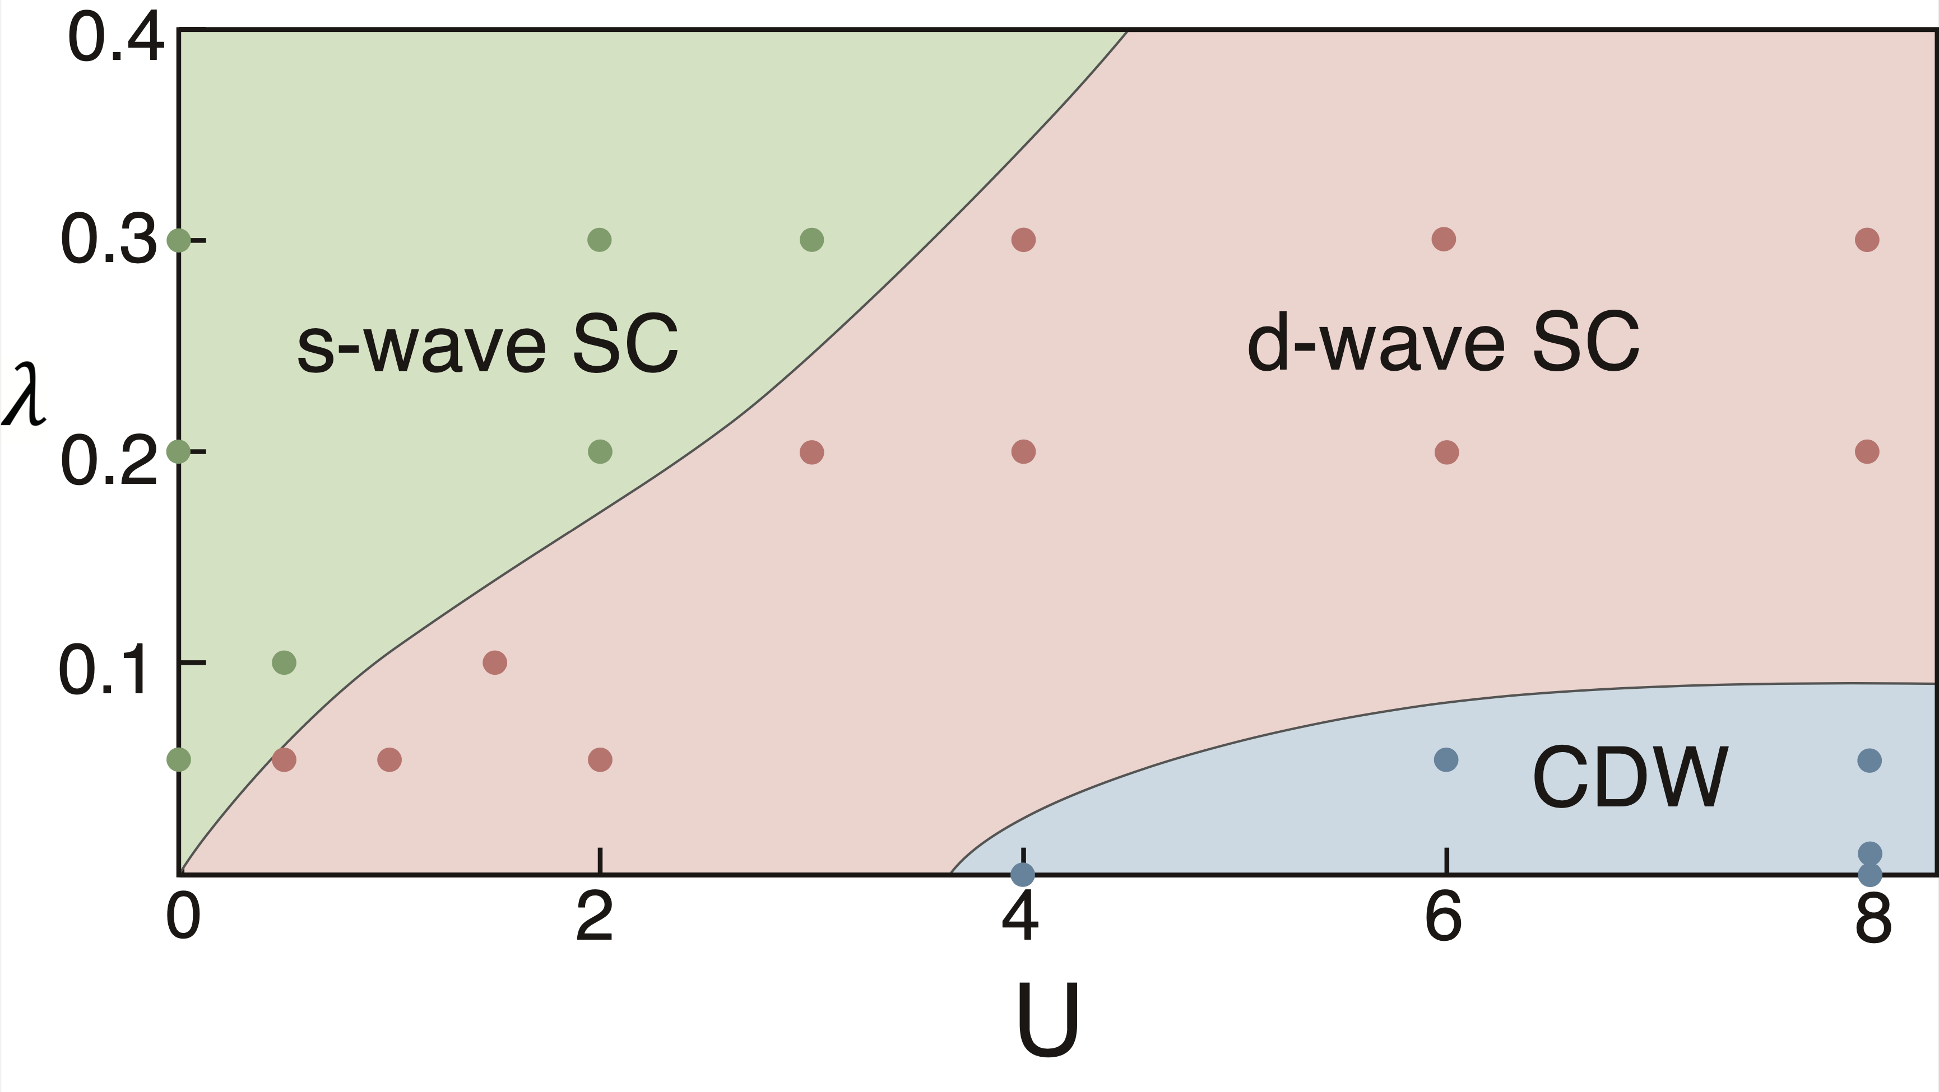
Plaquette
Ordinary
Plaquette
May not SC
Plaquette
Plaquette
Ordinary
Ordinary (Possibly mixed)
Ordinary
Ordinary
Plaquette d-wave
Maybe filled-stripe
Plaquette
Plaquette
Ordinary (Possibly mixed)
Ordinary (Possibly mixed)

Slide 3
s-wave phase

Slide 4
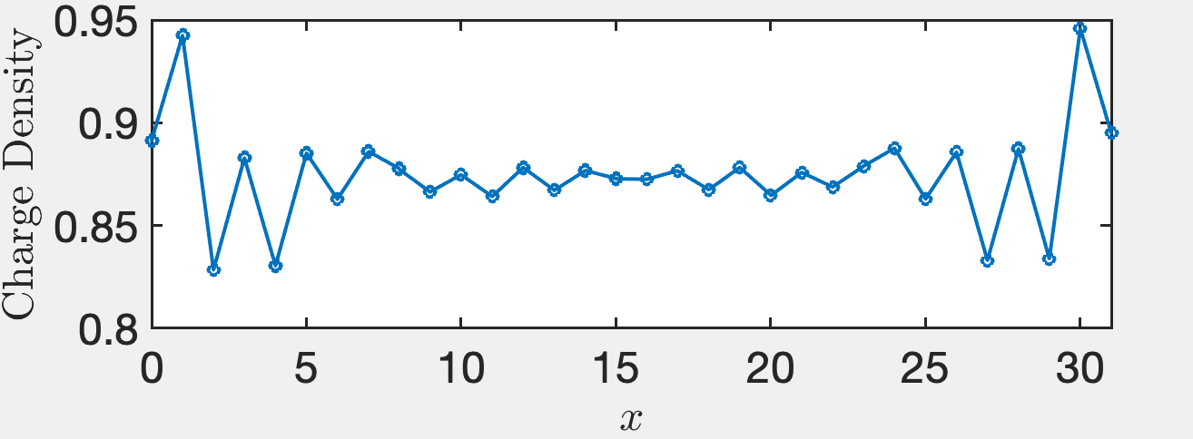
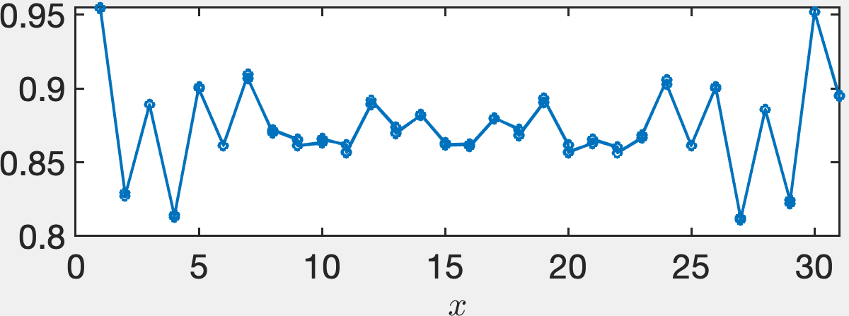
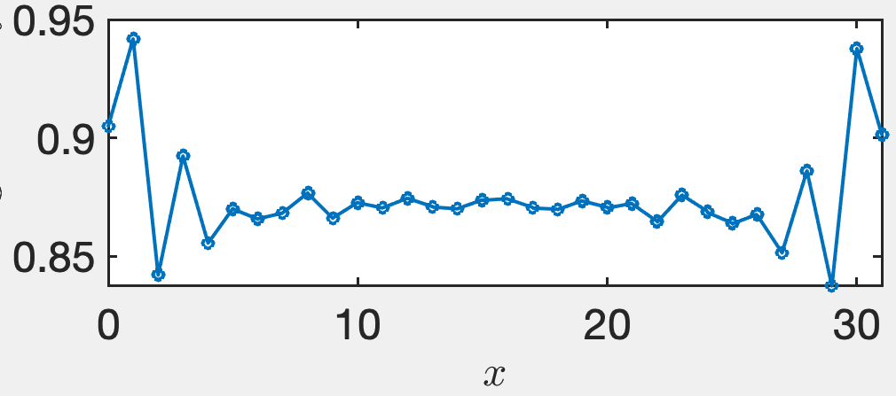
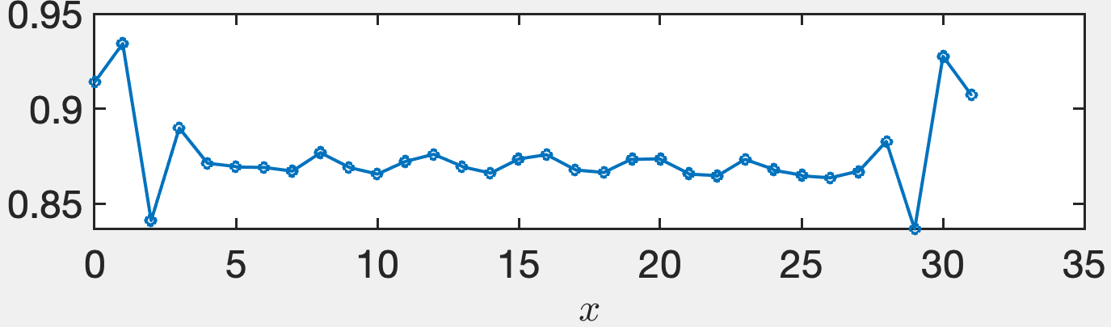
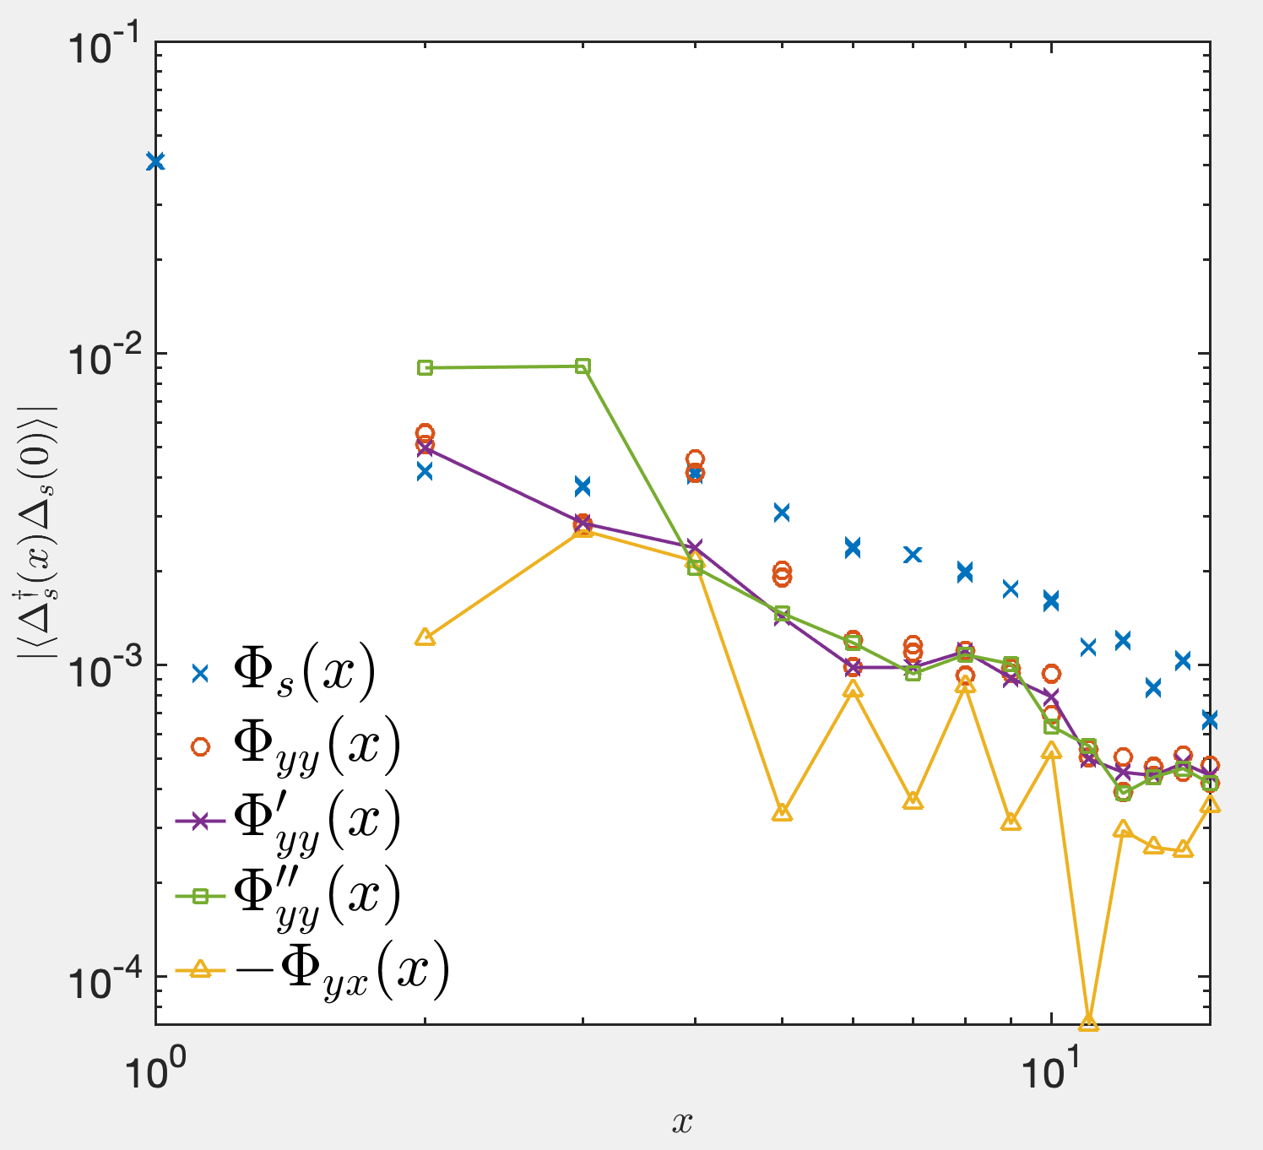
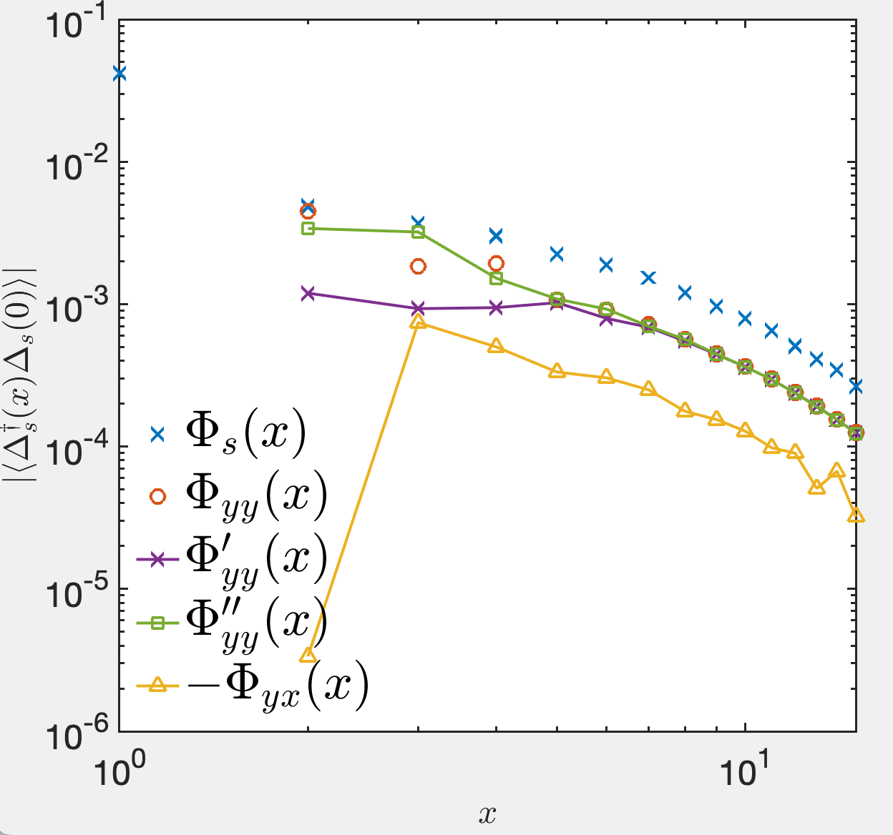
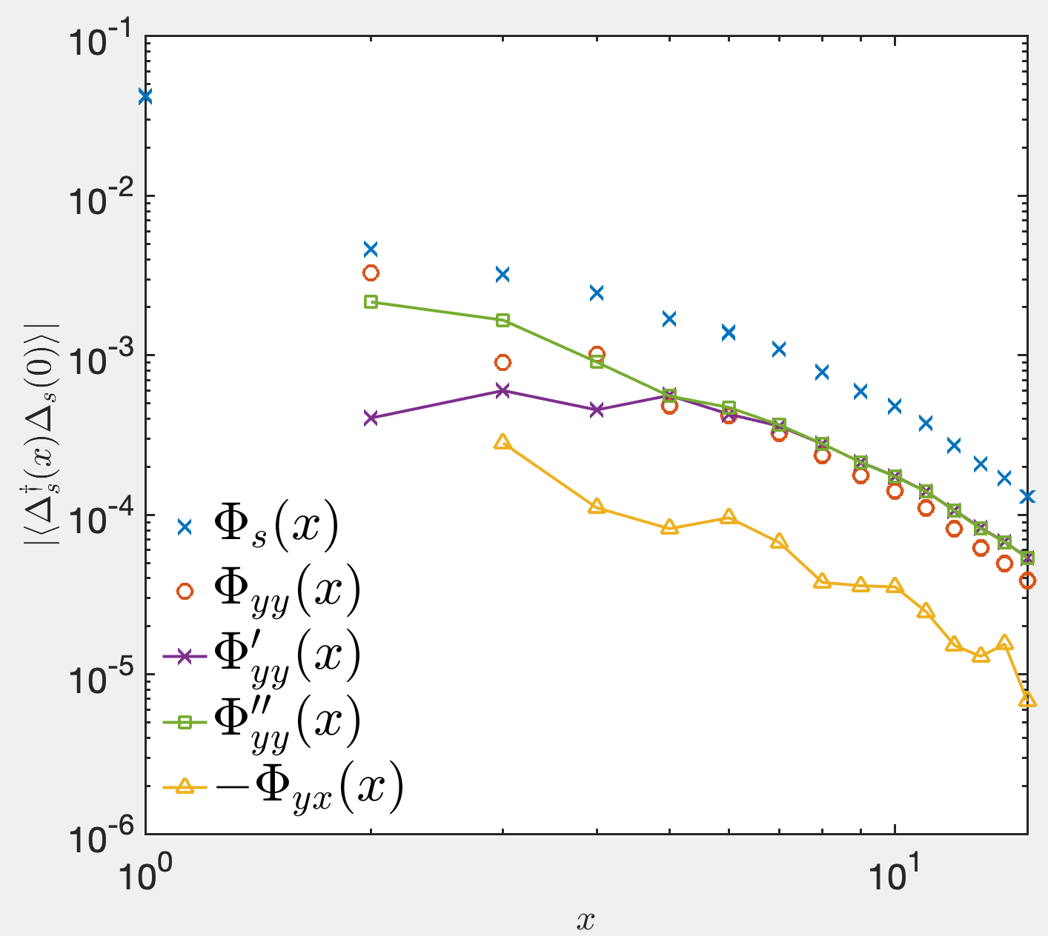
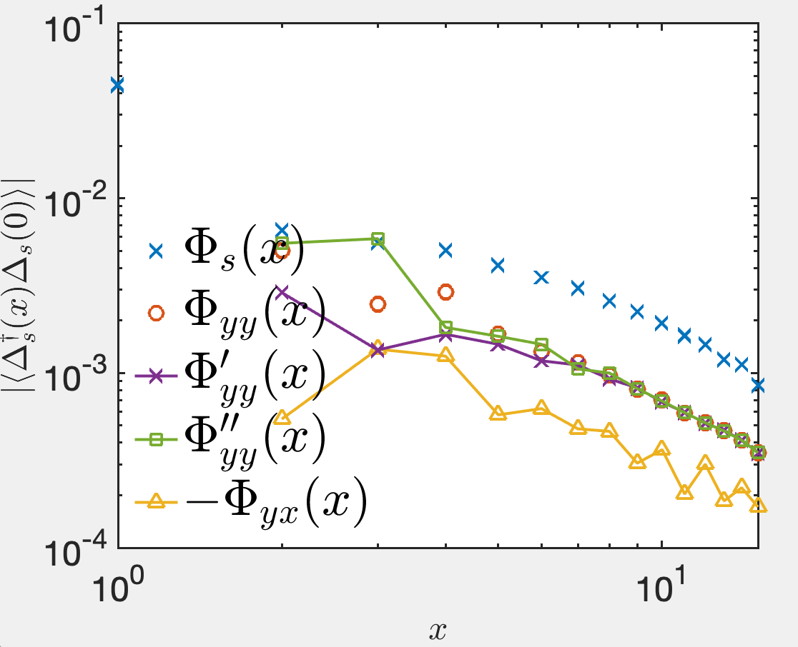




The leading SC correlation is the on-site pair-pair correlation. The secondary SC correlation is the ordinary d-wave SC correlation.
Charge density profiles and singlet pair-pair correlation functions
$$U=0, λ=0.05,D=8000$$
$$U=0.5, λ=0.1,D=8000$$
$$U=2, λ=0.2,D=8000$$
$$U=3, λ=0.3,D=8000$$

Slide 5
CDW phase

Slide 6
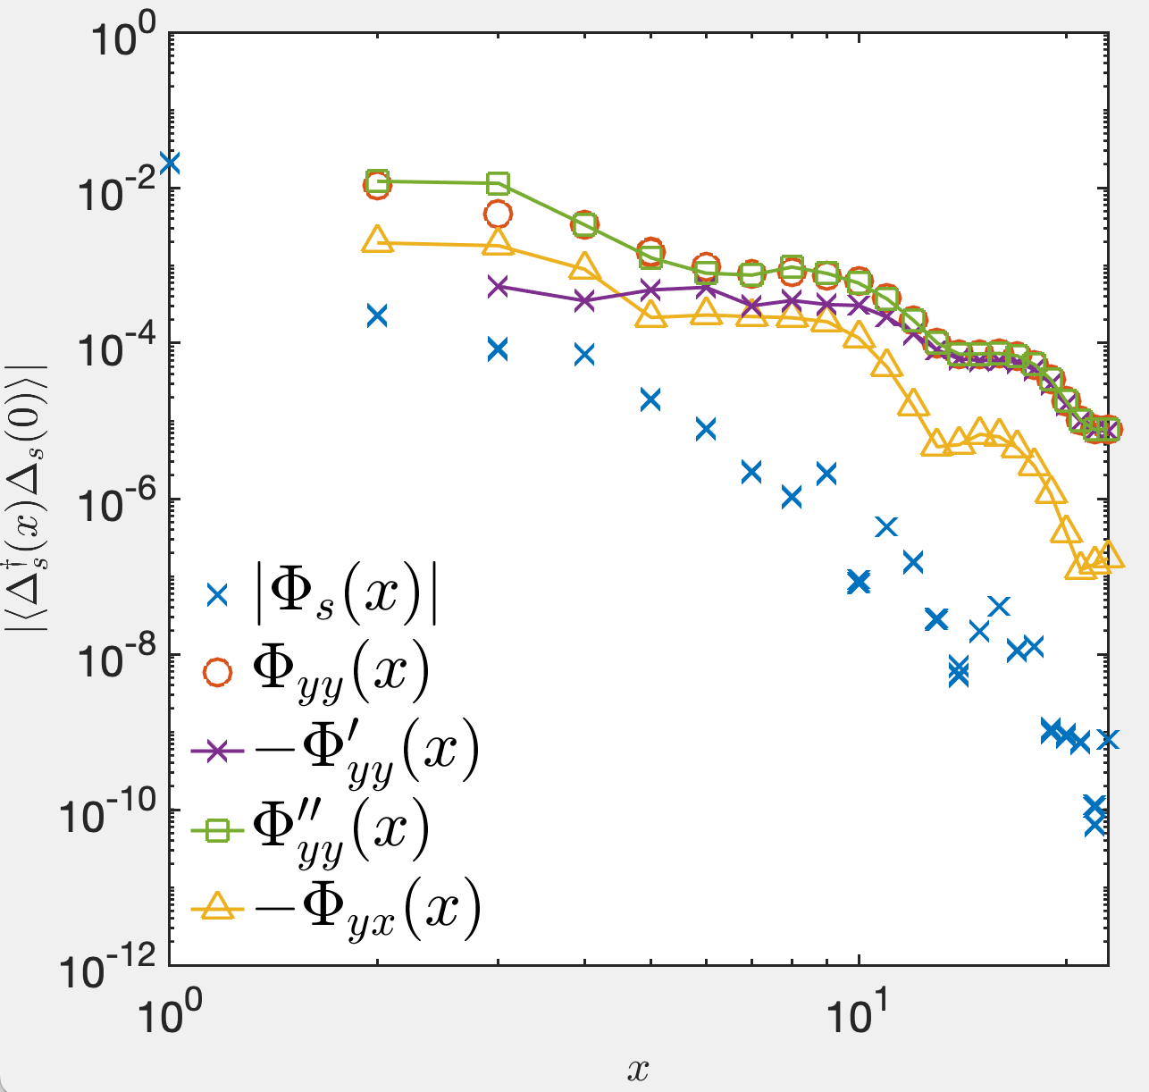

Pairing symmetry in CDW phase
Although the SC correlations decay exponentially in CDW phase, we can check the d-wave symmetry on the 4-leg cylinder. We show that the pairing symmetry is plaquette d-wave but not ordinary d-wave
$$U=8, λ=0.05,D=16000$$

Slide 7
d-wave phase

Slide 8
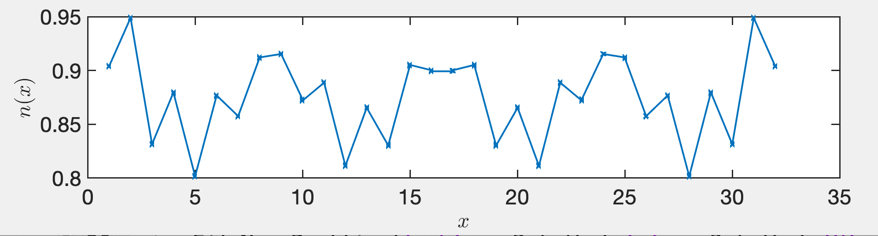
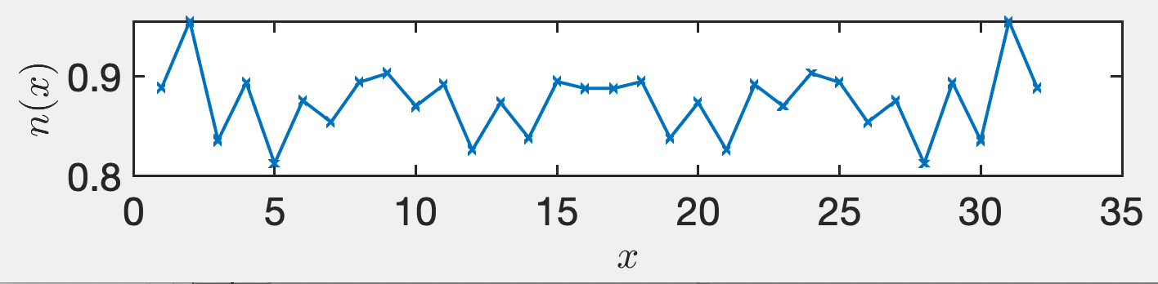
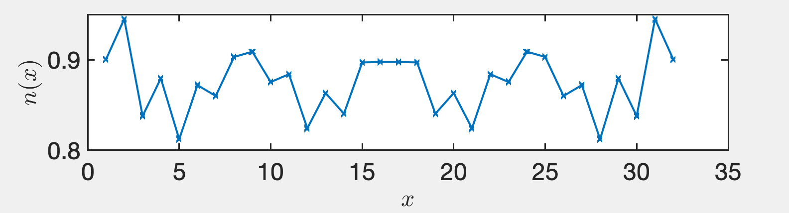
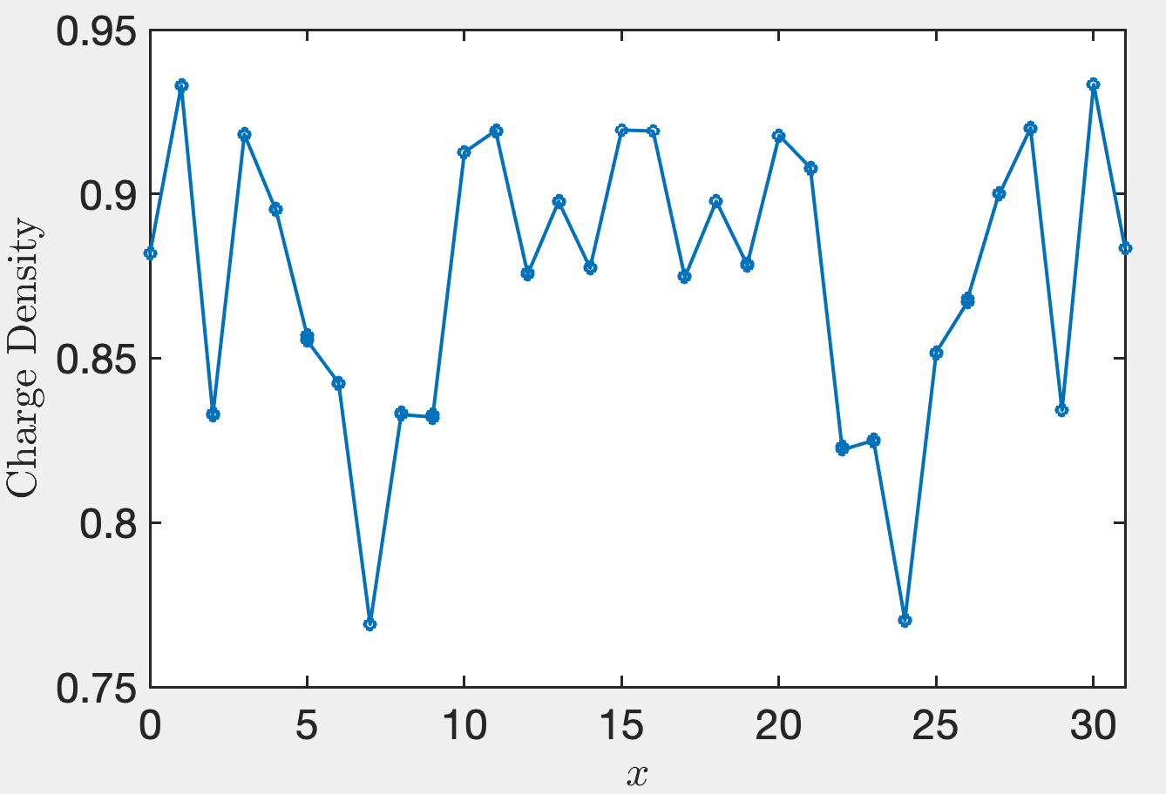
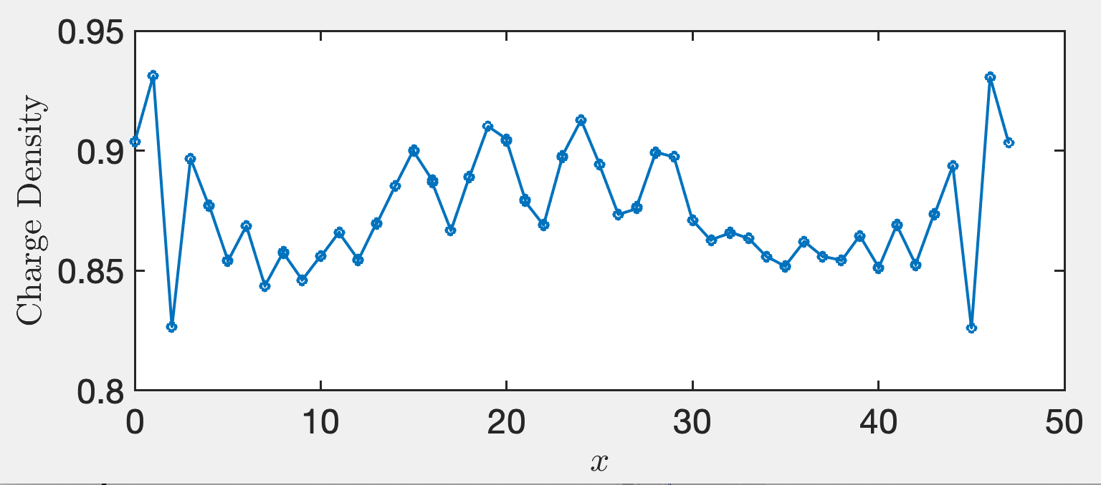
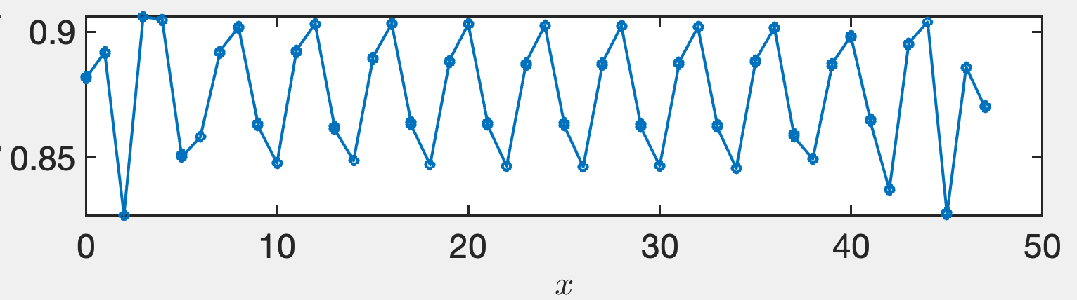






Charge density profile (Finite bond dimension)
$$U=1.5, λ=0.1$$
$$U=1, λ=0.05$$
$$U=2 λ=0.05$$
$$U=3, λ=0.2$$
$$U=4, λ=0.3$$
$$U=6, λ=0.3$$
For each parameter, we try different pinning fields and select a reasonable ground state with lowest energy.

Slide 9
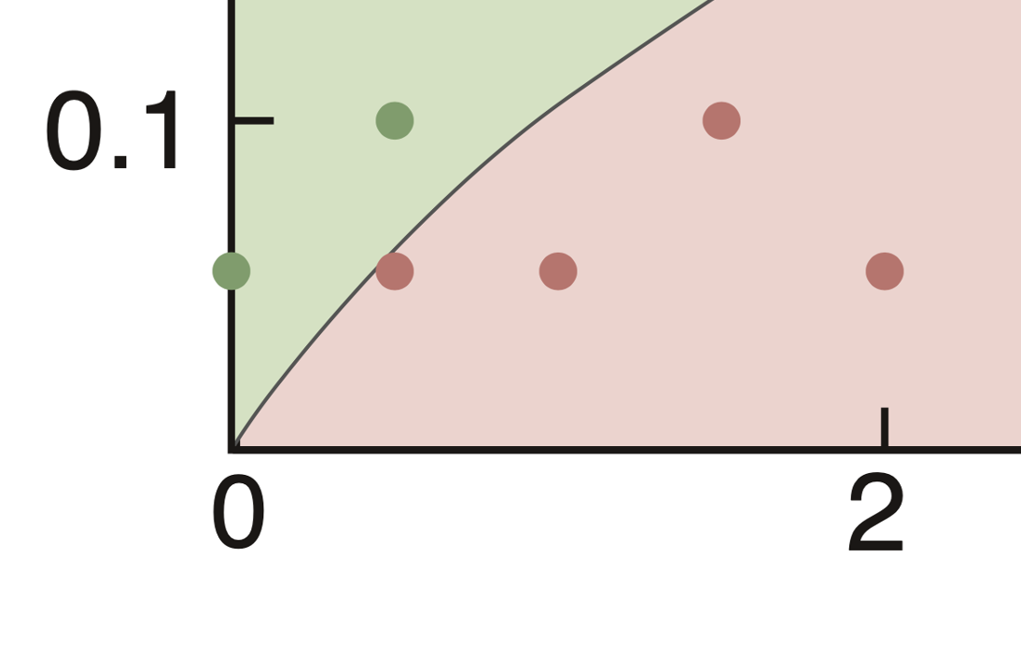
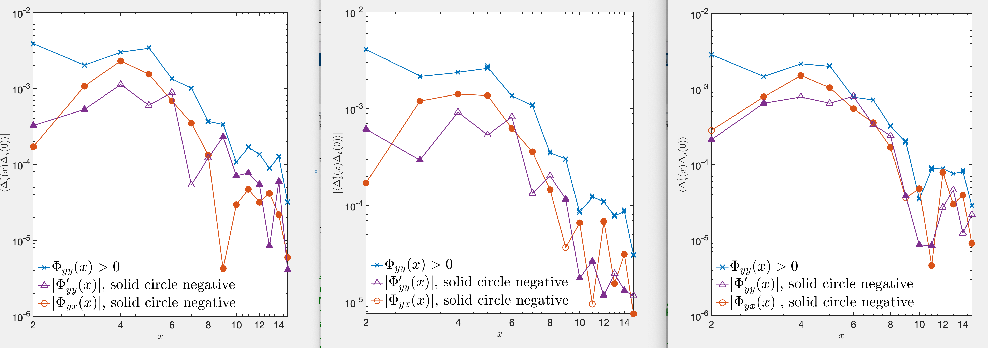



d-wave pairing in the small interaction region: possible mix ordinary and plaquette d-wave
$$U=2, λ=0.05,D=9000$$
$$U=1.5, λ=0.1, D=10000$$
$$U=1, λ=0.05, D=12000$$

Slide 10
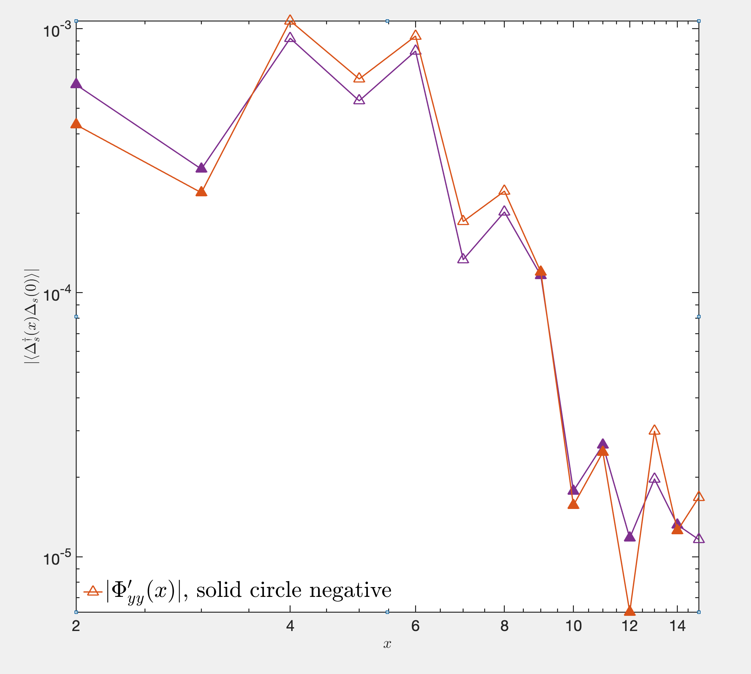

If we increase the bond dimension (from D=10000, purple triangular, to D=12000, orange triangular), how the data evolve.
Ordinary d-wave component enhances.
$$U=1.5, λ=0.1$$

Slide 11
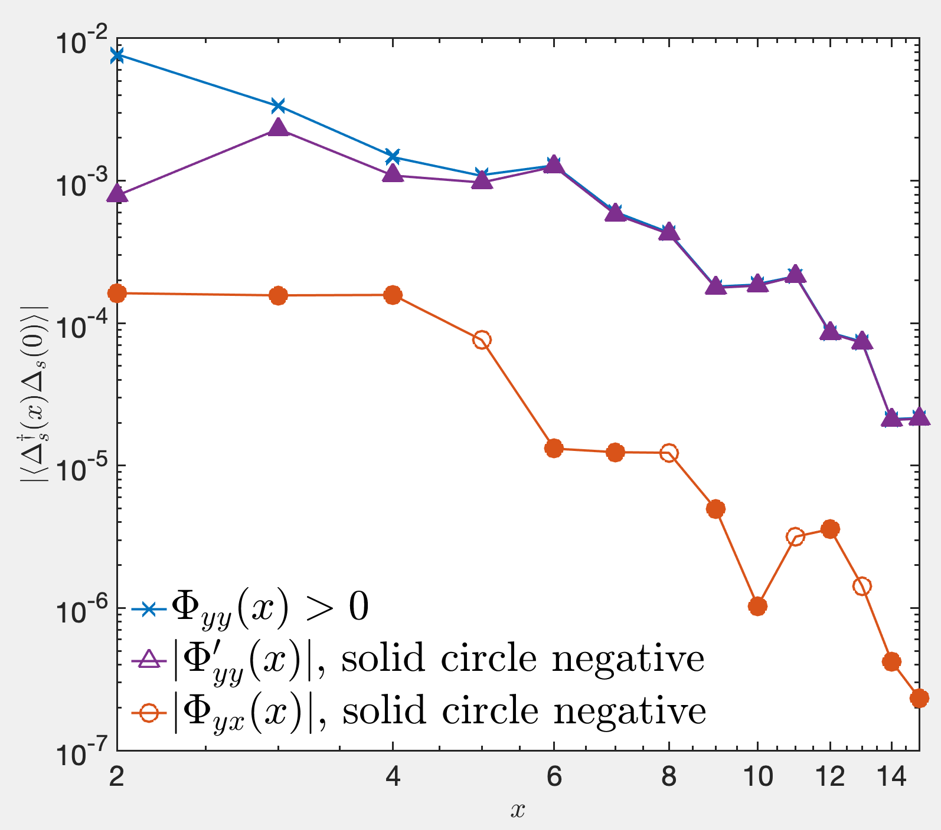
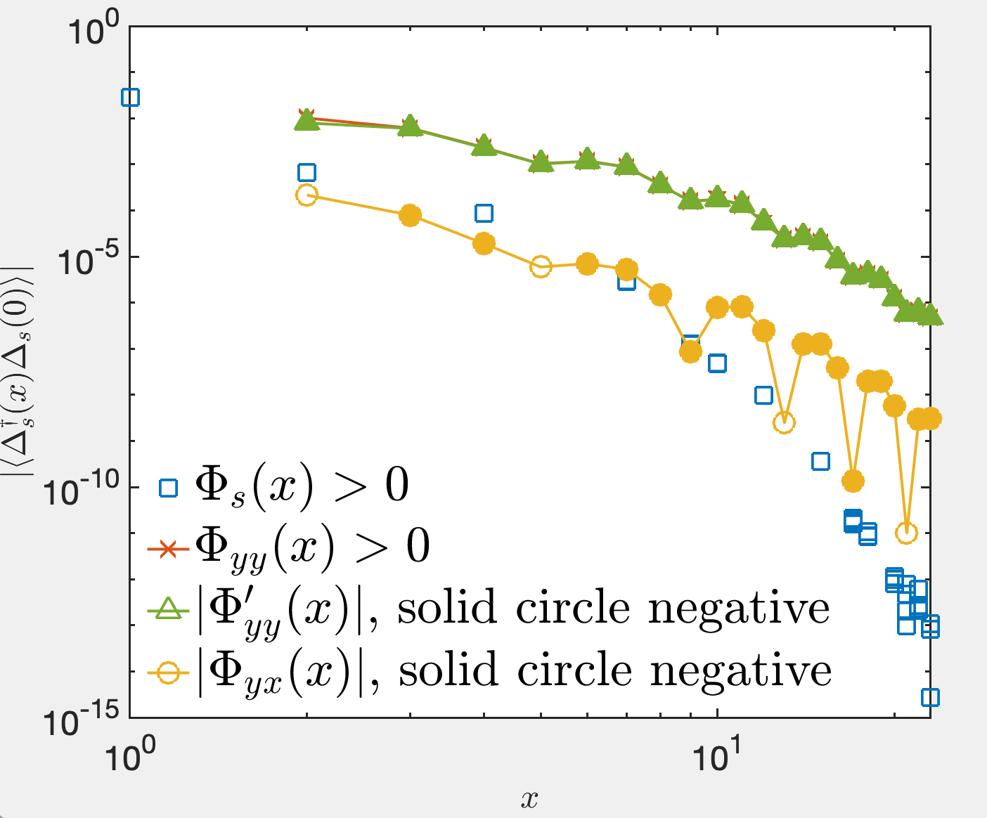


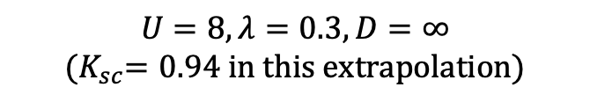
Plaquette d-wave state in large interaction region
$$U=3, λ=0.2,D=8000$$
$$U=6, λ=0.3,D=8000$$
$$U=8, λ=0.3,D=∞$$
$${(K}_{sc}=0.94 in this extrapolation)$$

Slide 12
Should we divide the d-wave phase into two parts?

