Slide 1
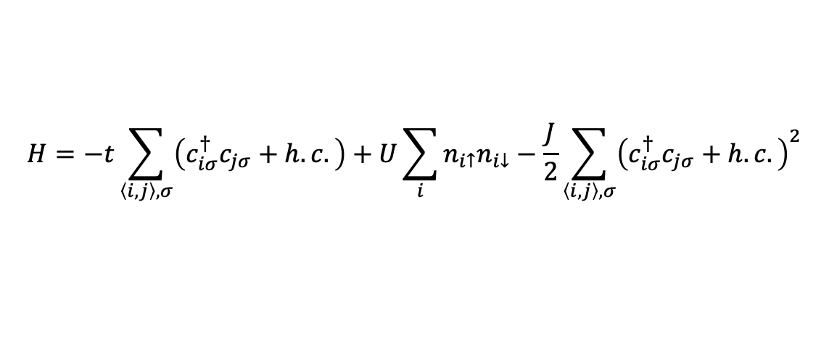
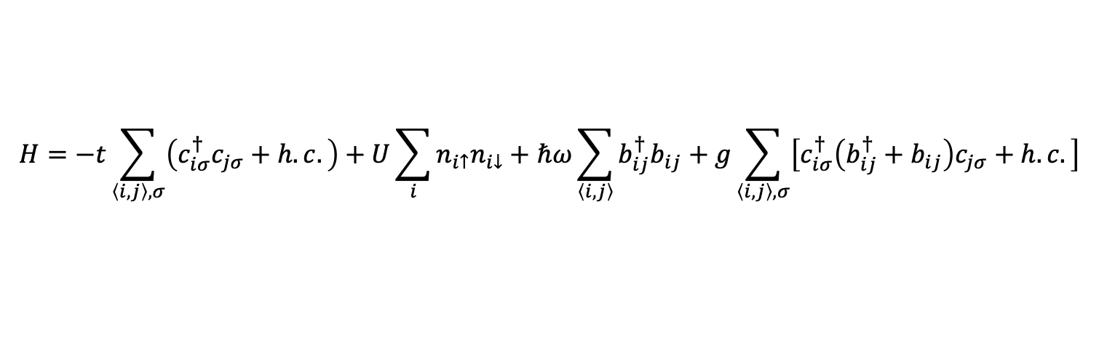

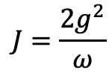
SSH-Hubbard model
$$H=−t\sum_{\left\langle i,j\right\rangle ,σ}{\left(c_{iσ}^{†}c_{jσ}+h.c.\right)}+U\sum_{i}{n_{i↑}n_{i↓}}+ℏω\sum_{\left\langle i, j\right\rangle }{b_{ij}^{†}b_{ij}}+g\sum_{\left\langle i, j\right\rangle ,σ}{\left[c_{iσ}^{†}\left(b_{ij}^{†}+b_{ij}\right)c_{jσ}+h.c.\right]}$$
$$H=−t\sum_{\left\langle i,j\right\rangle ,σ}{\left(c_{iσ}^{†}c_{jσ}+h.c.\right)}+U\sum_{i}{n_{i↑}n_{i↓}}−\frac{J}{2}\sum_{\left\langle i,j\right\rangle ,σ}{{\left(c_{iσ}^{†}c_{jσ}+h.c.\right)}^{2}}$$
$$J=\frac{2g^{2}}{ω}$$
$$λ=\frac{J}{W}, W=8t$$

Slide 2
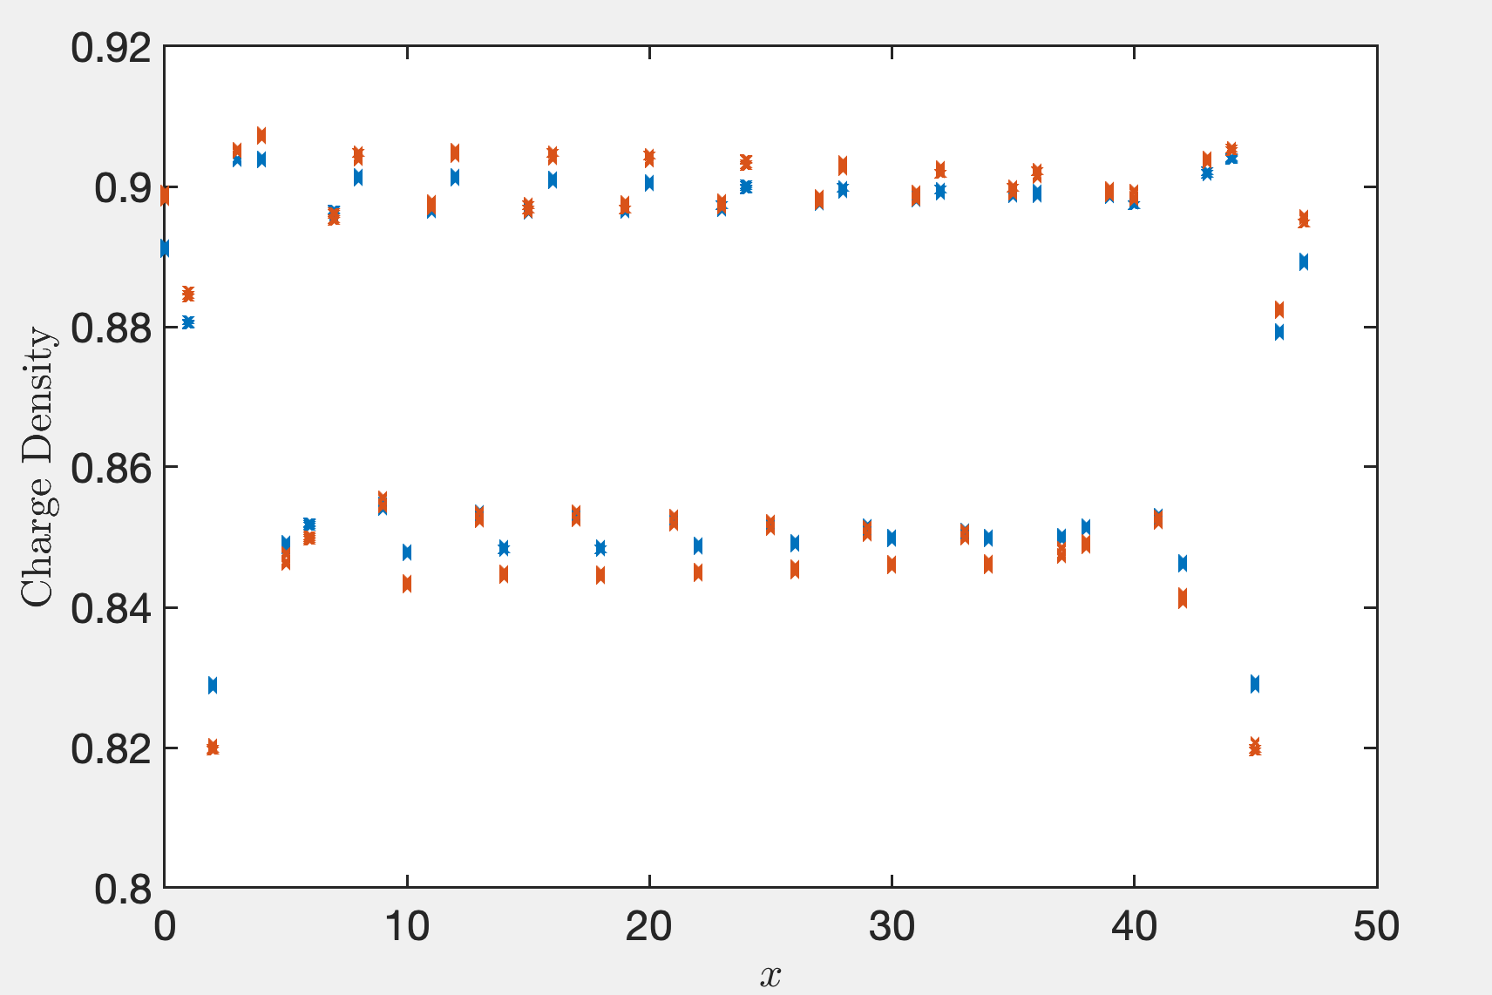
Lambda = 0.3, 0.4

Slide 3
Truncation error (1e-6), extract from the middle bond
Lx\D | 8000 | 10000 | 12000 | 14000 | 15000 | 16000 | 17000 | 18000 | 20000
16 | 3.37 | 2.82 | 2.45 | 2.18
24 | 3.44 | 2.79 | 2.41 | 2.17 |  | 2.00
32 | 3.70 | 2.96 | 2.61 | 2.27 |  | 2.07 | 1.97
40 | 3.46 | 2.86 | 2.47 | 2.19 | 2.03
48 | 3.16 | 2.67 | 2.34 | 2.08 |  | 1.92 |  | 1.78 | 1.47
I recalculated Lx = 48 on D = 8000. The energy value is lower than before by at least 0.02. The state of Lx=48 we get previously may be trapped to local minimum thus the correlation may not right.

Slide 4
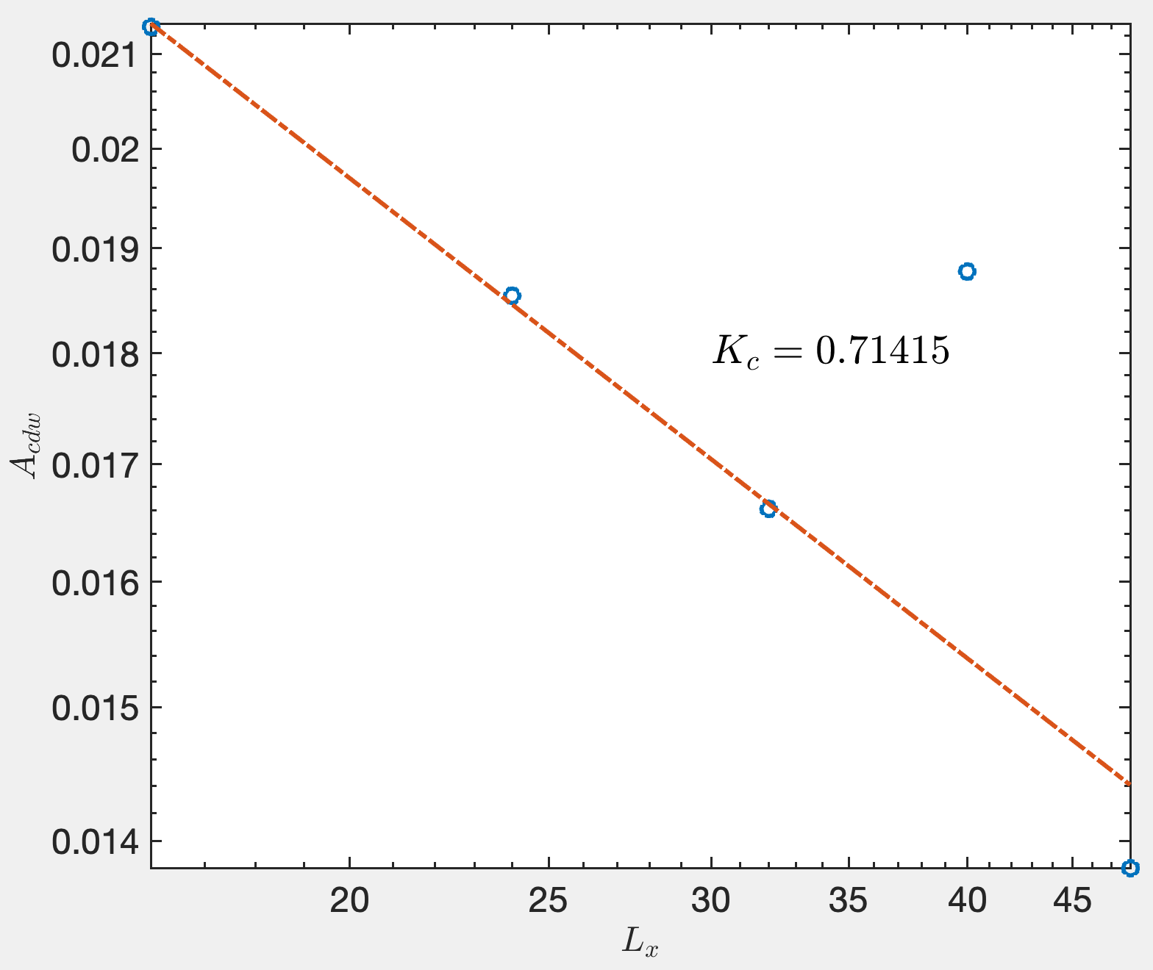
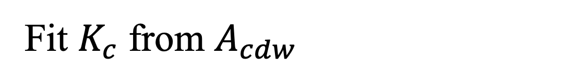
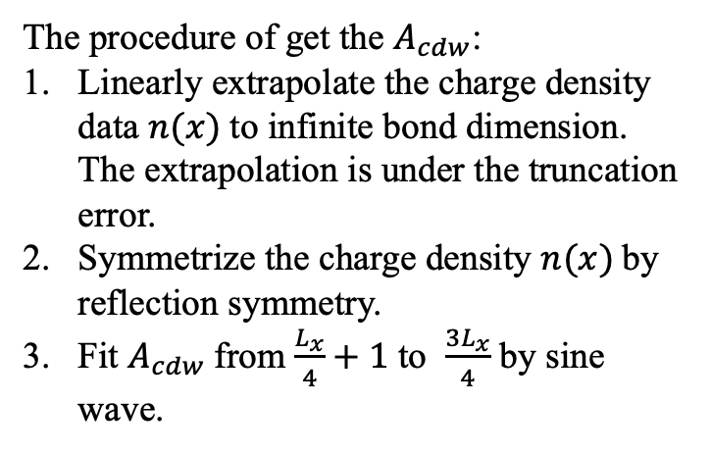
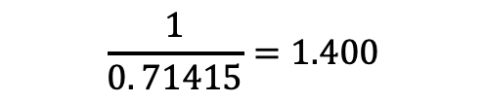
Fit $K_{c}$ from $A_{cdw}$
The procedure of get the $A_{cdw}$:
Linearly extrapolate the charge density data $n(x)$to infinite bond dimension. The extrapolation is under the truncation error.
Symmetrize the charge density $n(x)$by reflection symmetry.
Fit $A_{cdw}$from $\frac{L_{x}}{4}+1$ to $\frac{{3L}_{x}}{4}$ by sine wave.
$$\frac{1}{0. 71415}=1.400$$

Slide 5
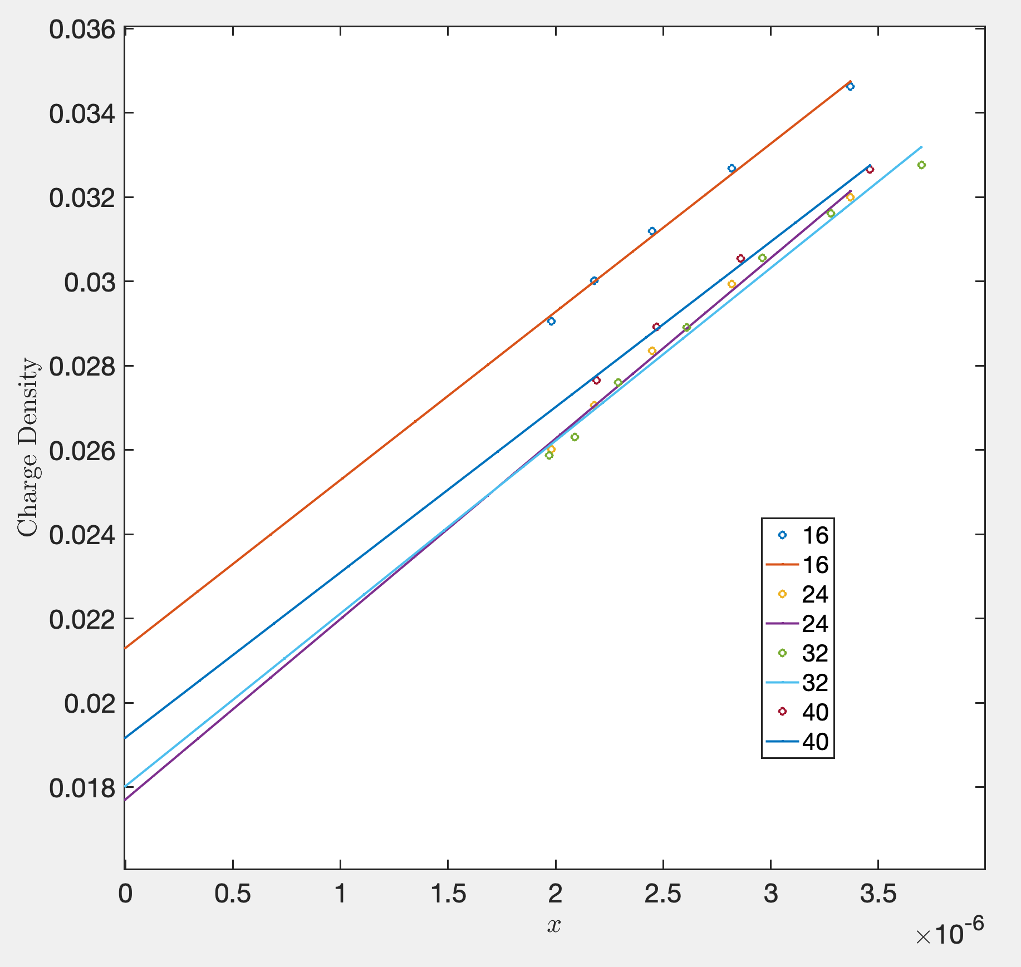
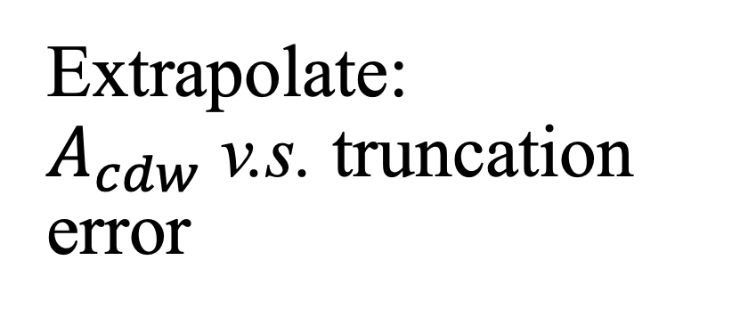
Extrapolate: $A_{cdw}$v.s. truncation error

Slide 6
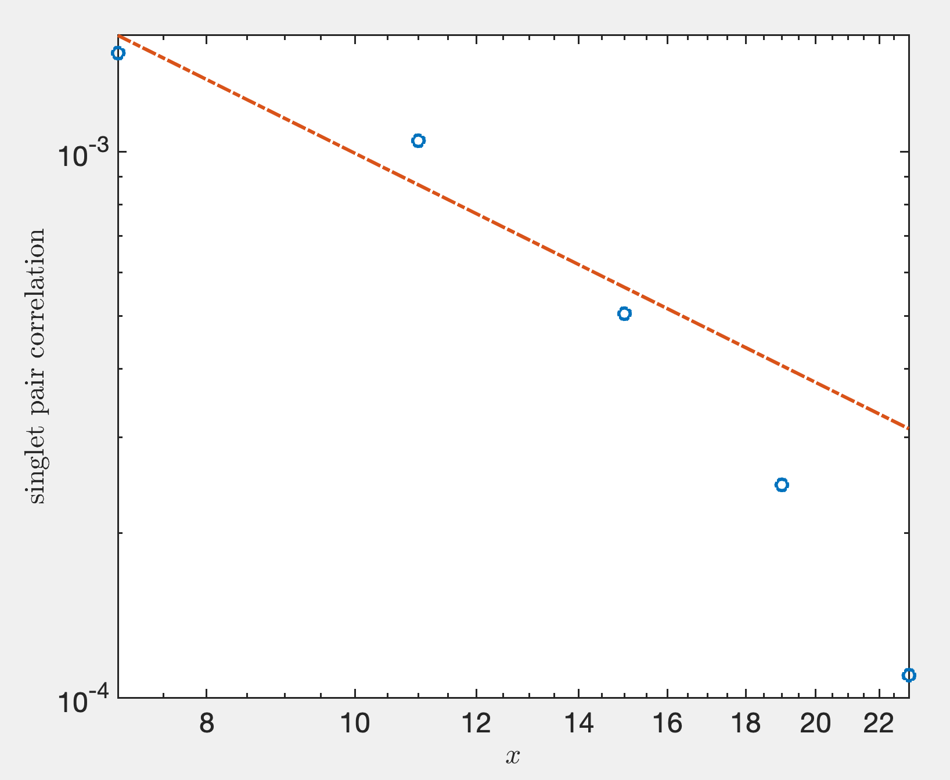
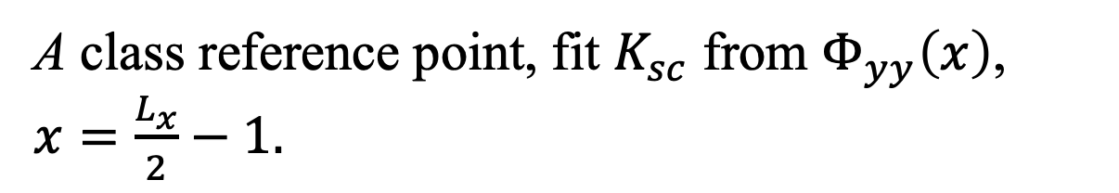
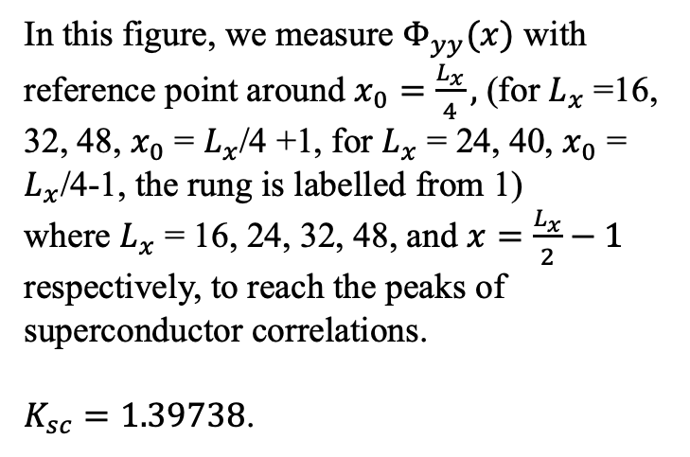
A class reference point, fit $K_{sc}$ from $Φ_{yy}\left(x\right)$, $x=\frac{L_{x}}{2}−1.$
In this figure, we measure $Φ_{yy}(x)$ with reference point around $x_{0}=\frac{L_{x}}{4},$ (for $L_{x}$ =16, 32, 48, $x_{0}$ = $L_{x}$/4 +1, for $L_{x}$ = 24, 40, $x_{0}$ = $L_{x}$/4-1, the rung is labelled from 1)
where $L_{x}$ = 16, 24, 32, 48, and $x=\frac{L_{x}}{2}−1$ respectively, to reach the peaks of superconductor correlations.
$K_{sc}=1.39738$.

Slide 7
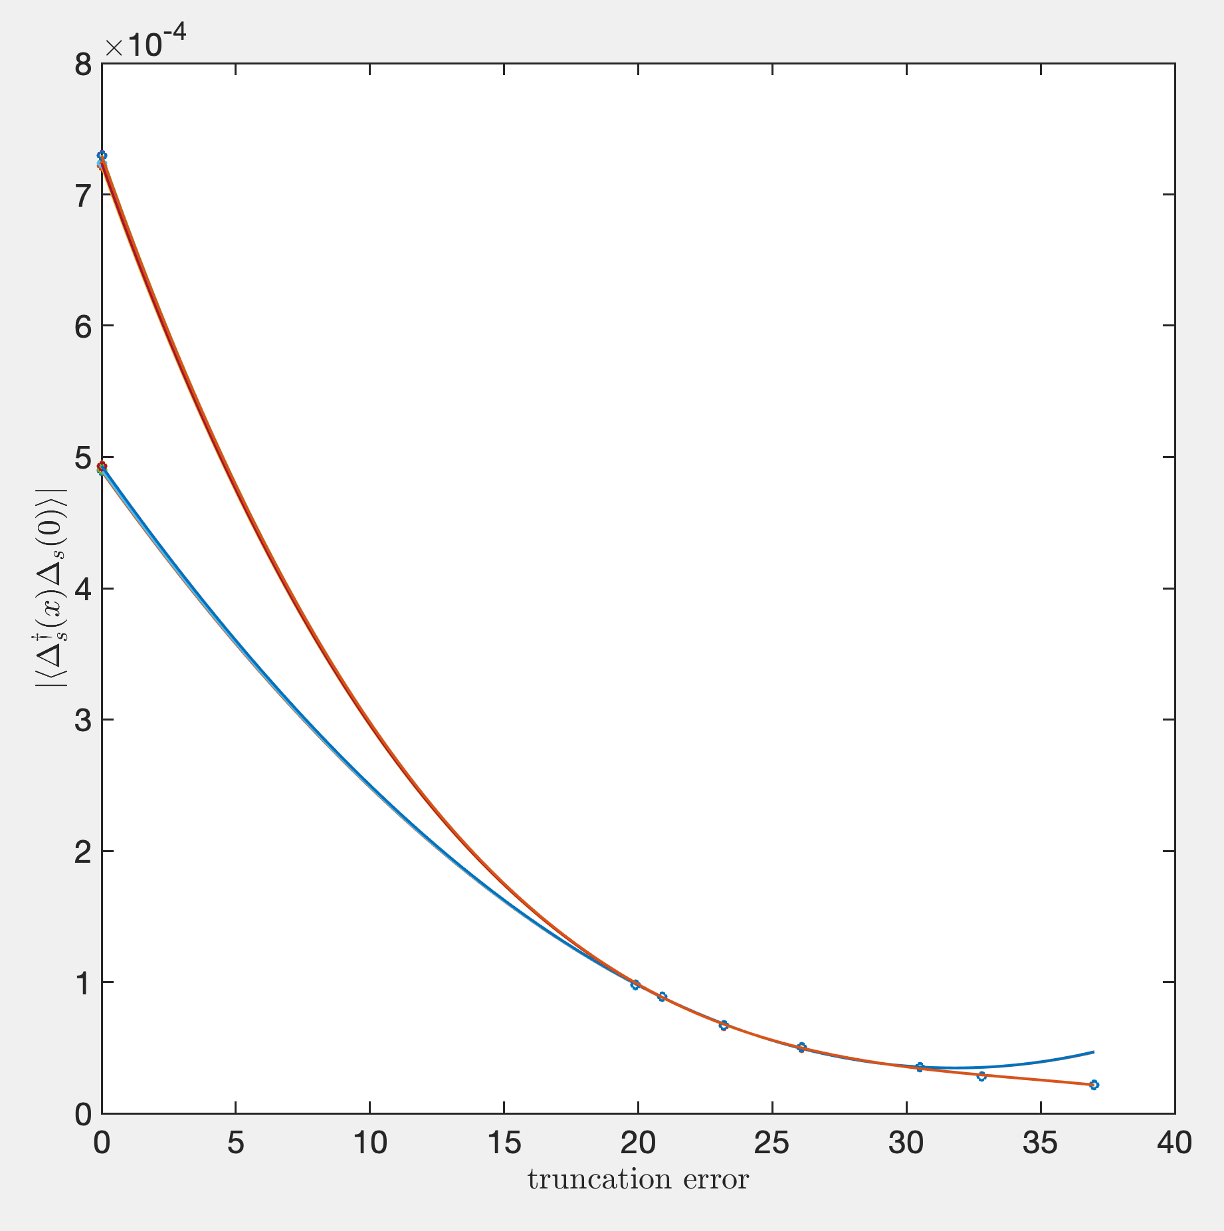
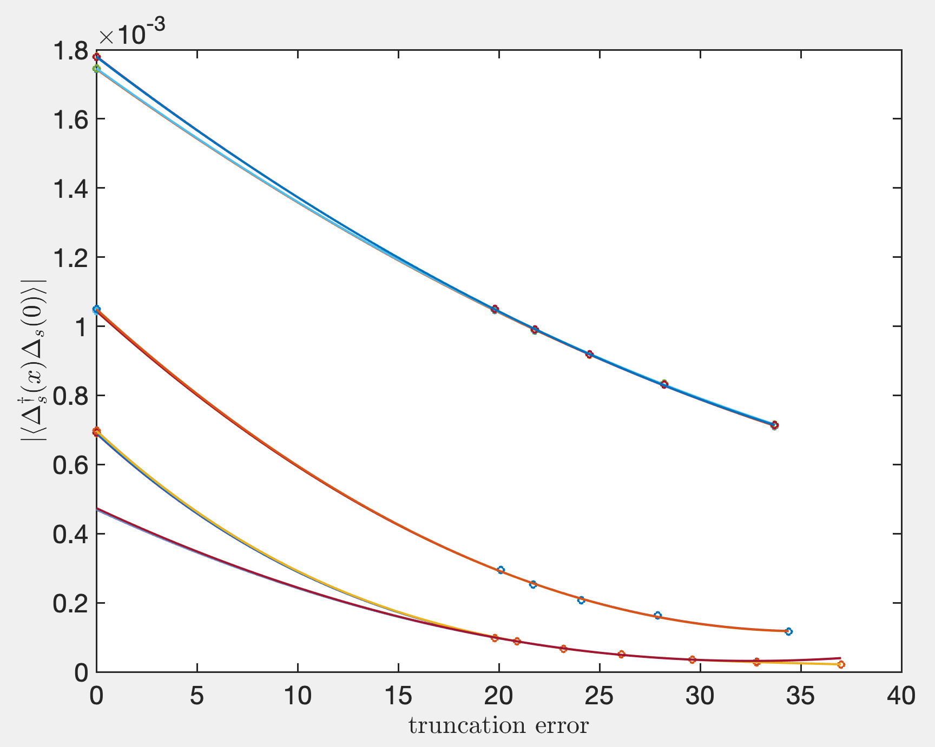
Extrapolate:
Lx = 32

Slide 8
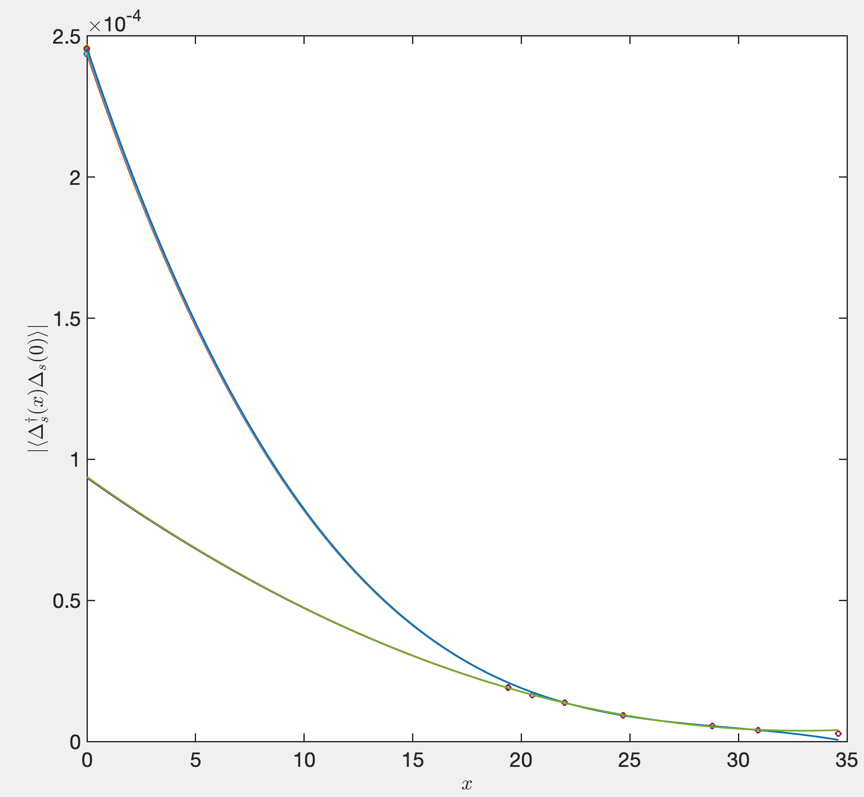
Lx = 40

Slide 9
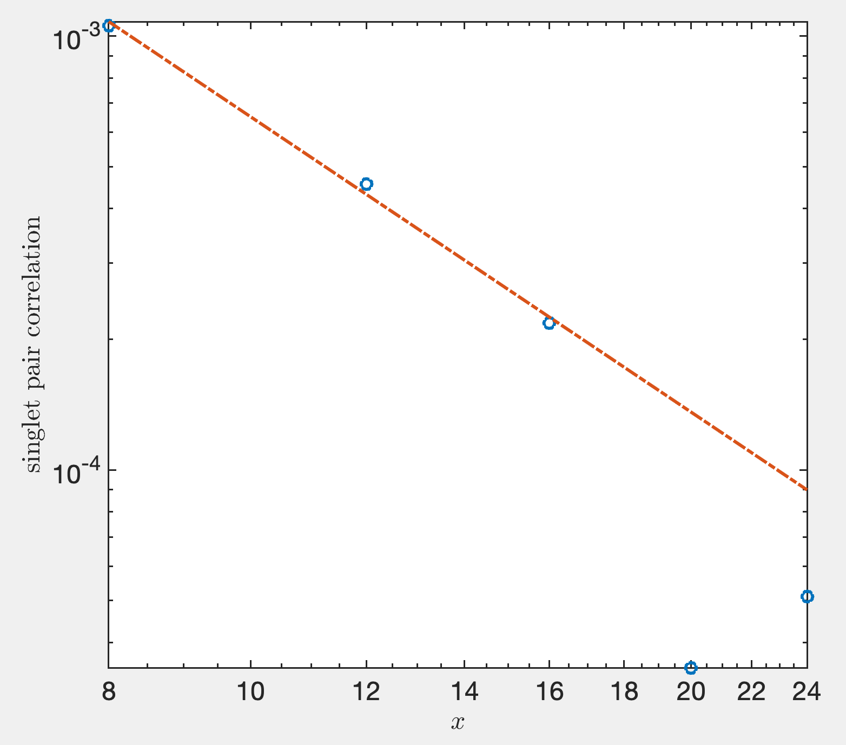
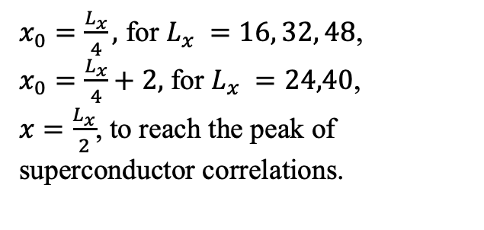
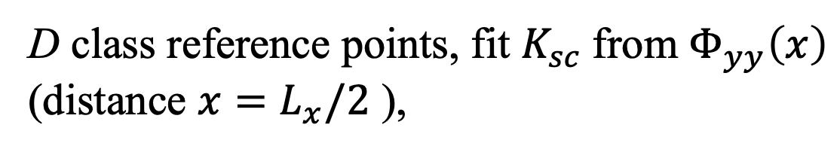
D class reference points, fit $K_{sc}$from $Φ_{yy}\left(x\right)$ (distance $x=L_{x}/2$ ),
$x_{0}=\frac{L_{x}}{4},$ for $L_{x} =16, 32, 48$,
$x_{0}=\frac{L_{x}}{4}+2,$ for $L_{x} =24,40$,
$x=\frac{L_{x}}{2}$, to reach the peak of superconductor correlations.
$$K_{sc}=2.26$$

Slide 10
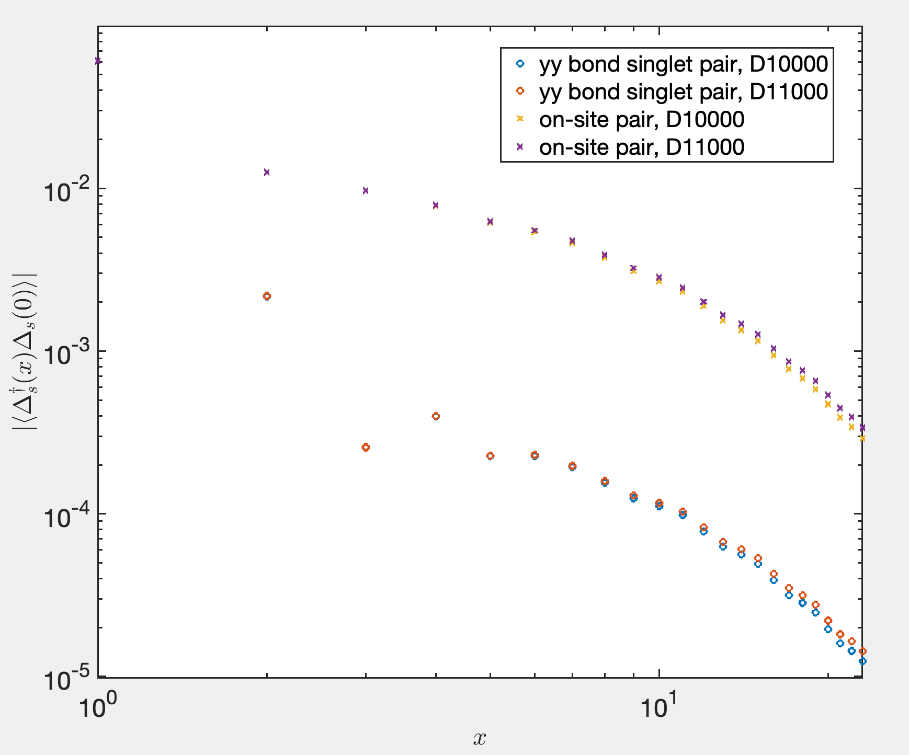
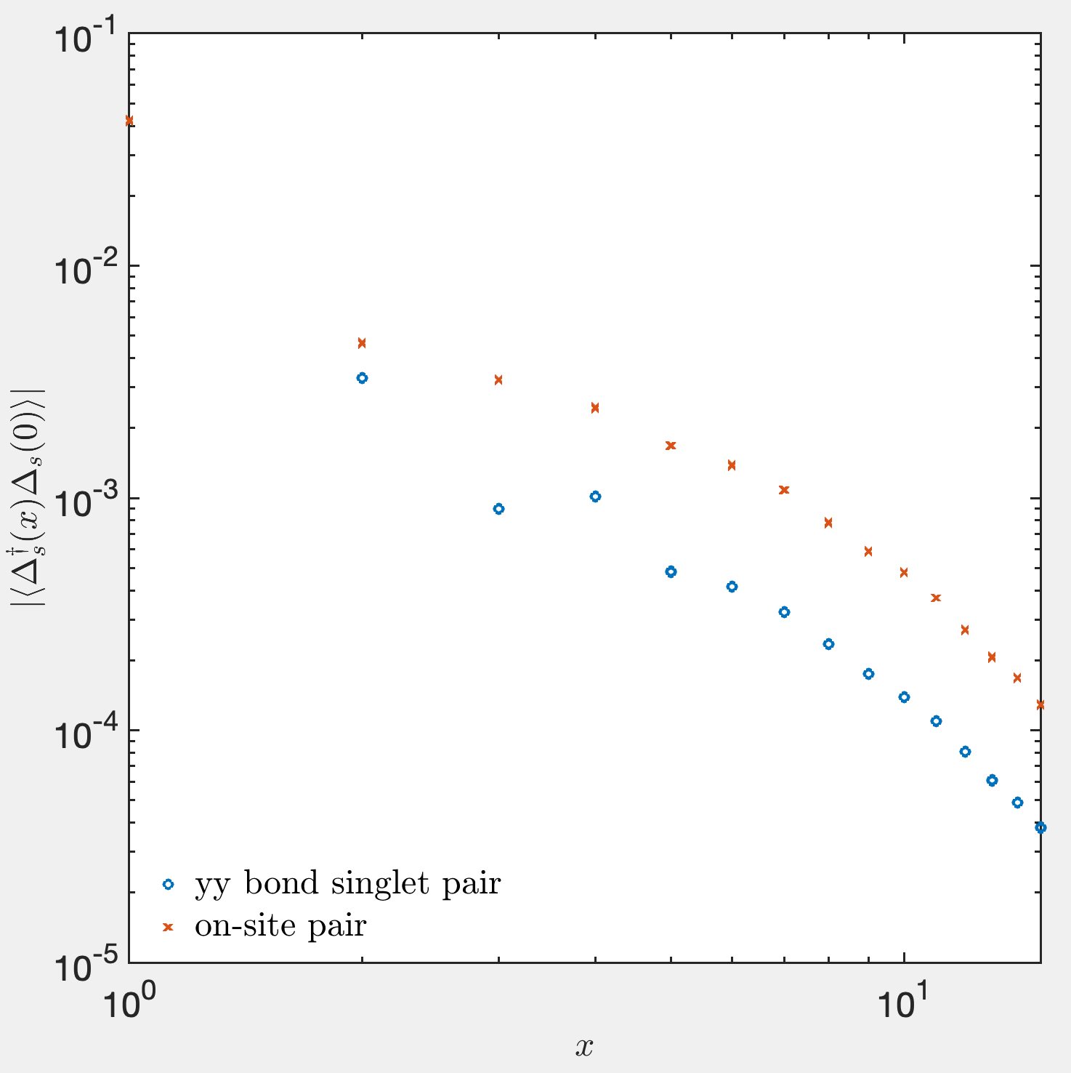
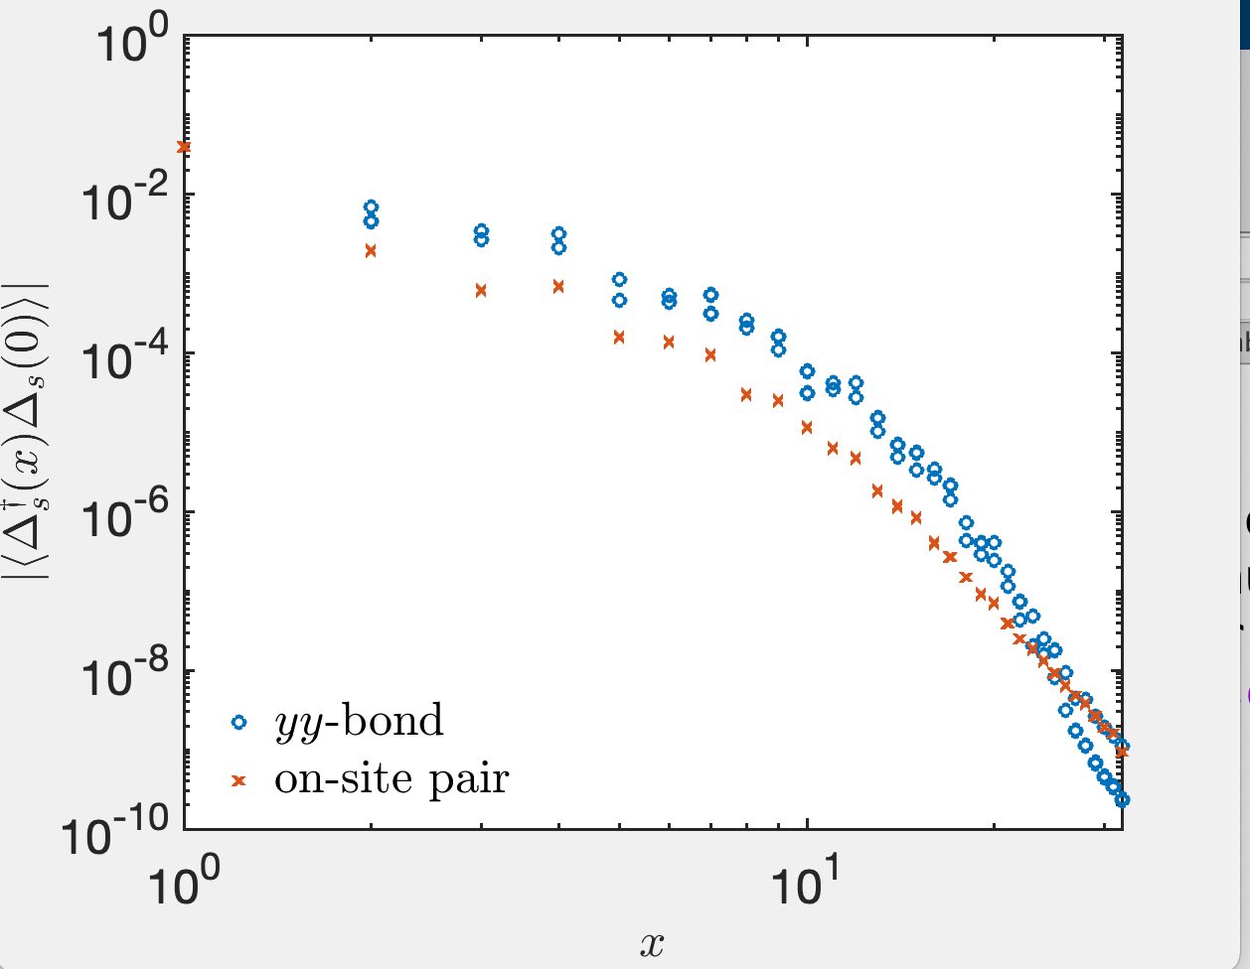




$λ=0.3, L_{x}=48, D=8000$, compare s-wave and d-wave
(although wave functions are not converged)
$$U$$
$$0$$
$$3$$
$$4$$

Slide 11
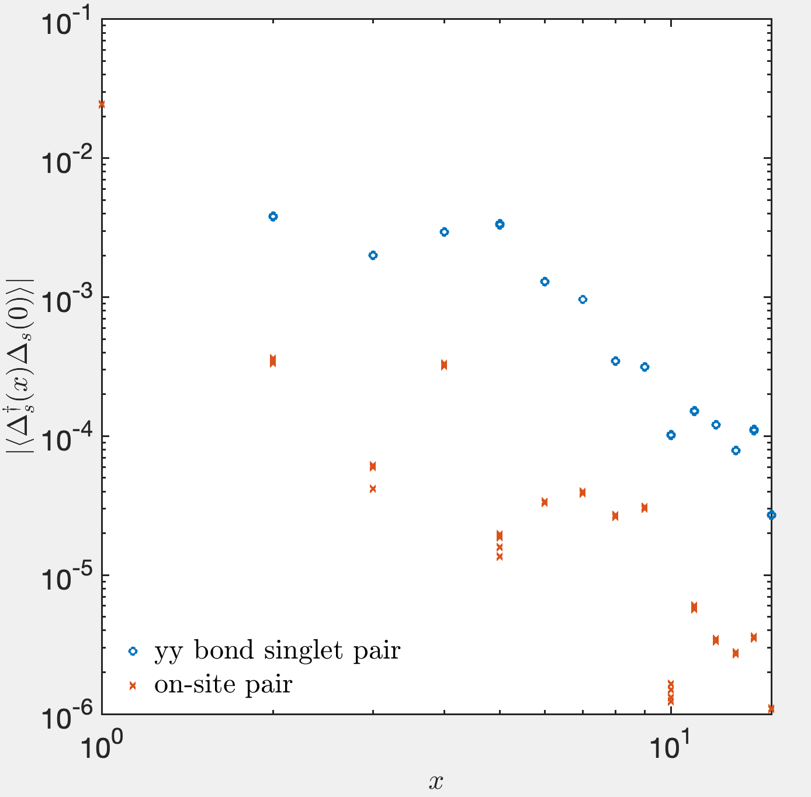
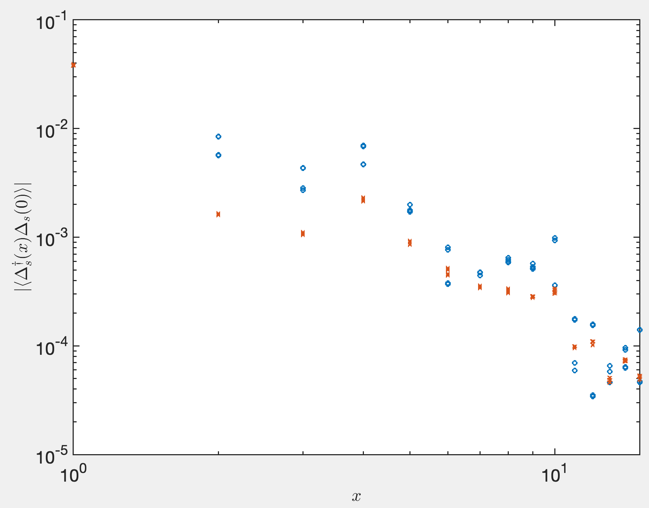
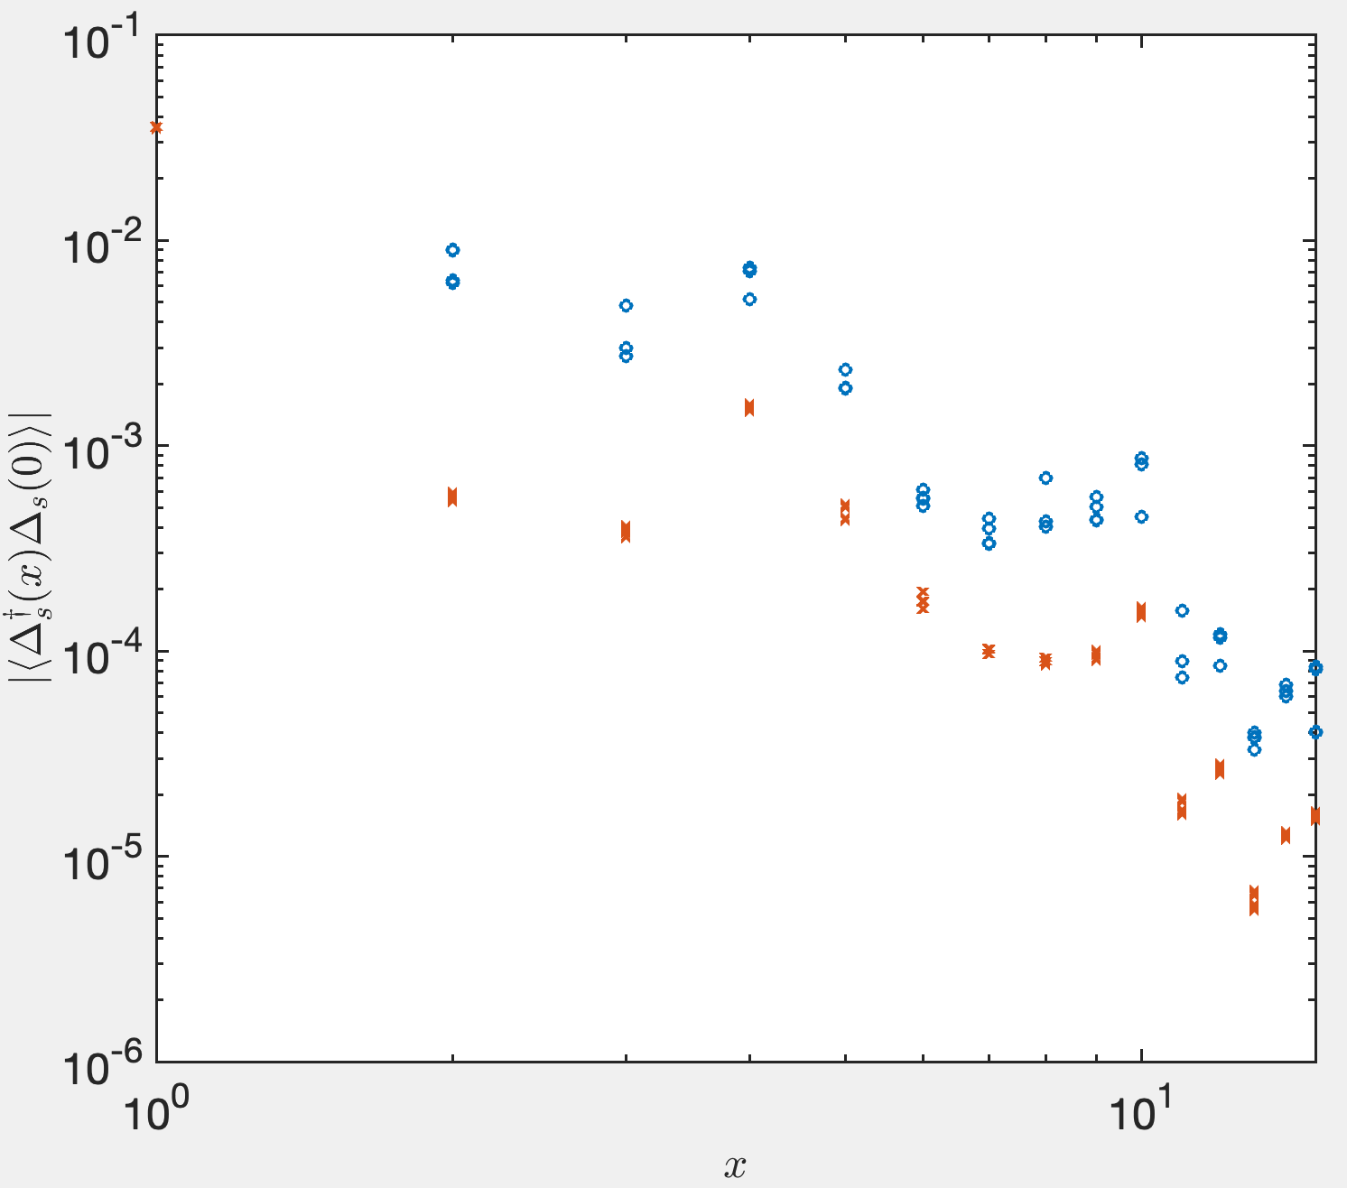



$λ=0.05, L_{x}=32, D=8000$, compare s-wave and d-wave
$$U$$
$$0$$
$$0.05$$
$$1$$
$$2$$

Slide 12
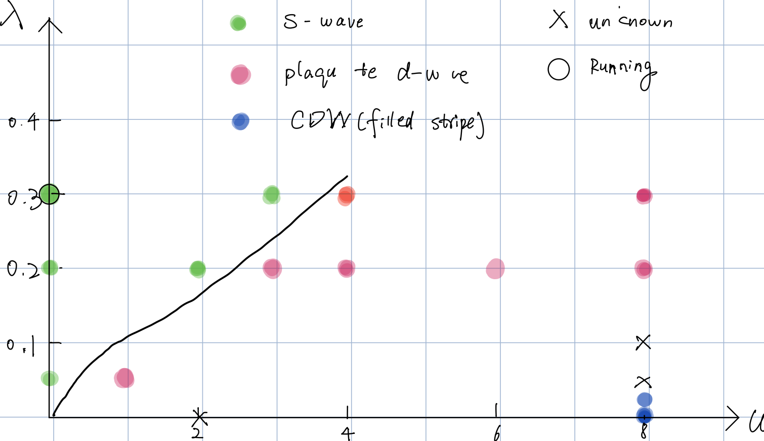

Landscape: 4-leg ladder, $δ=1/8$

Slide 13
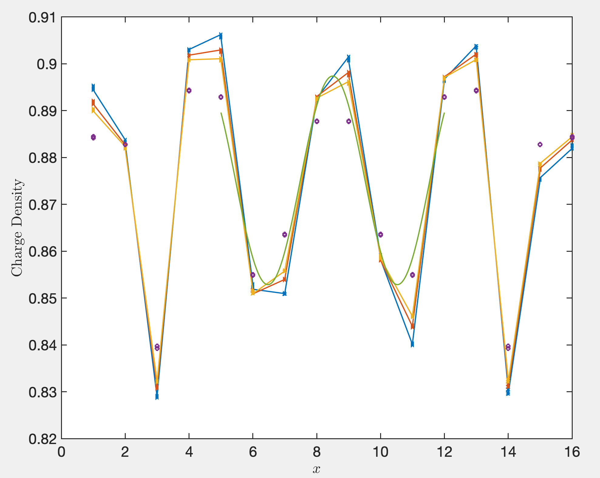
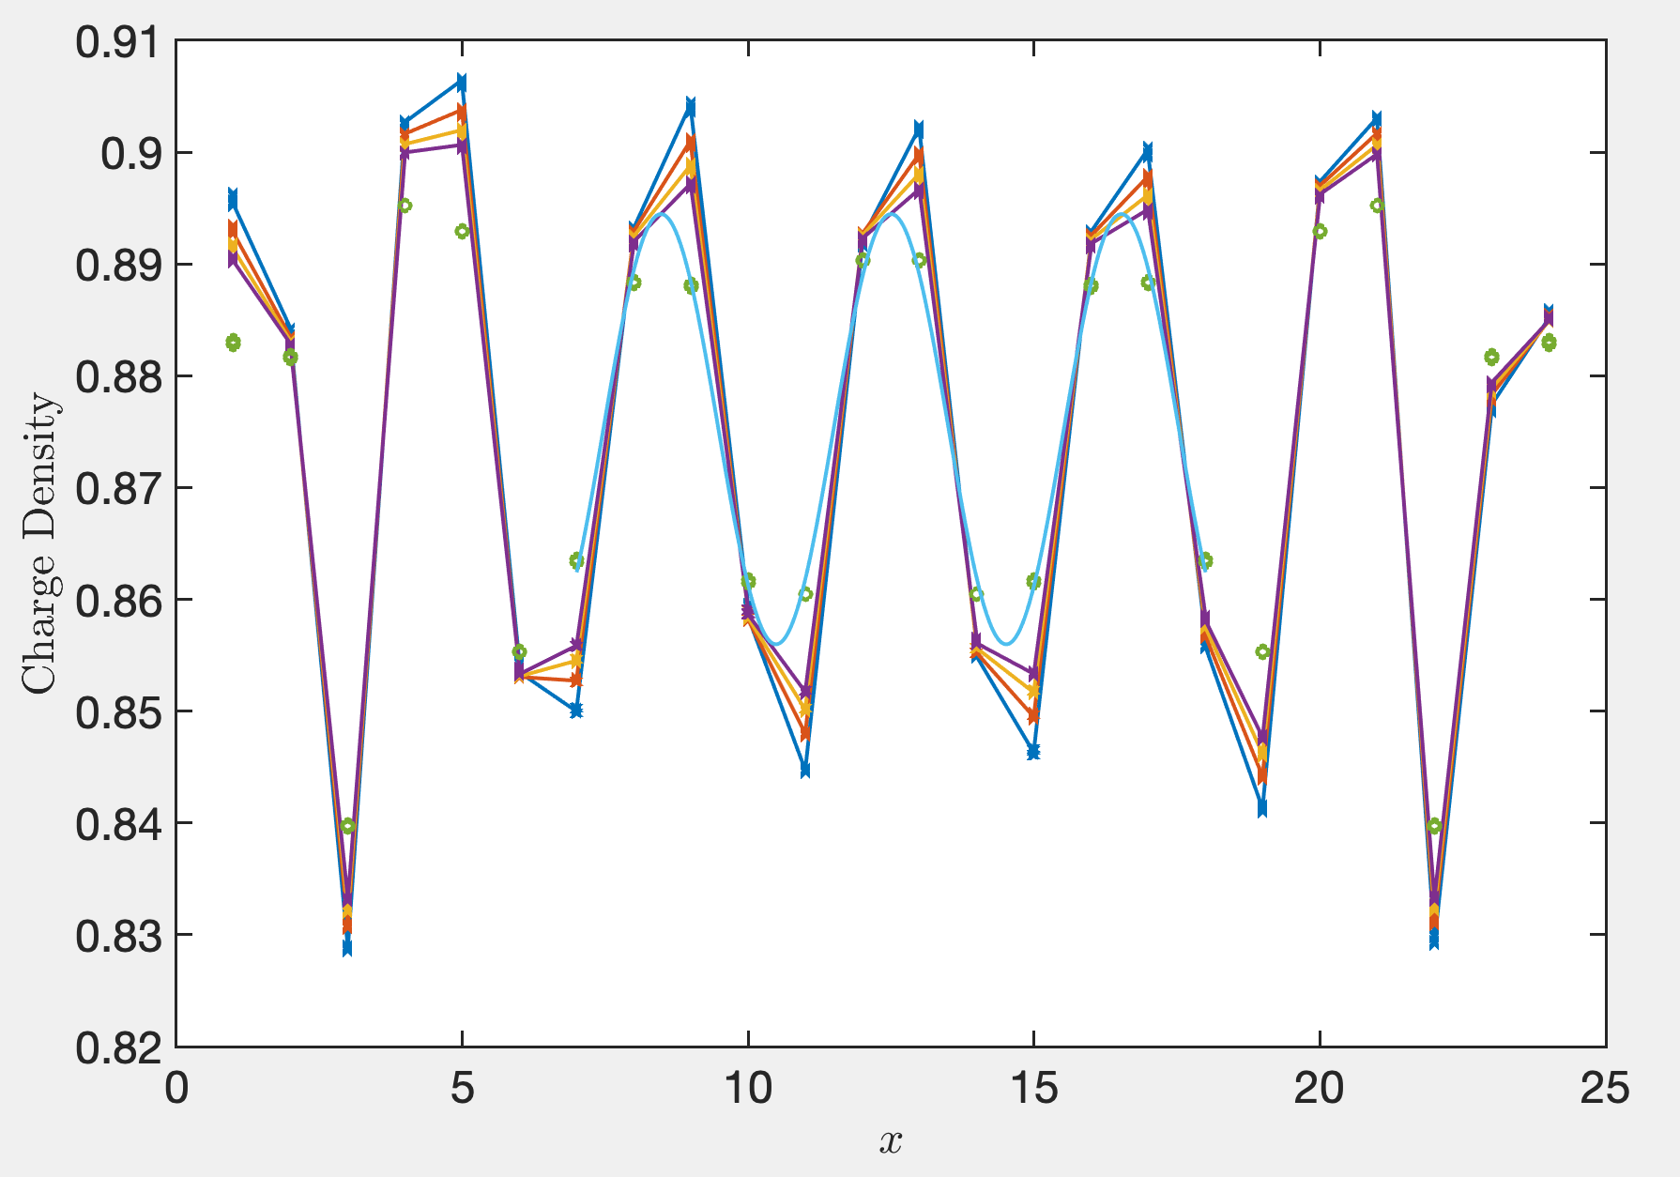
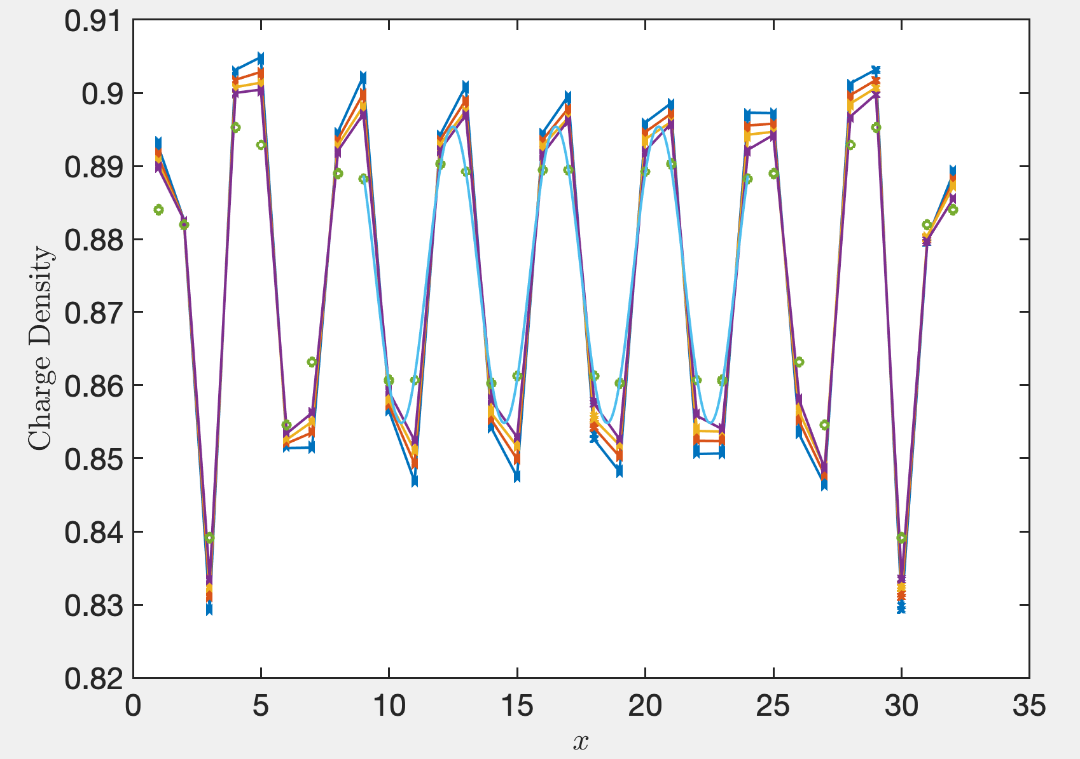
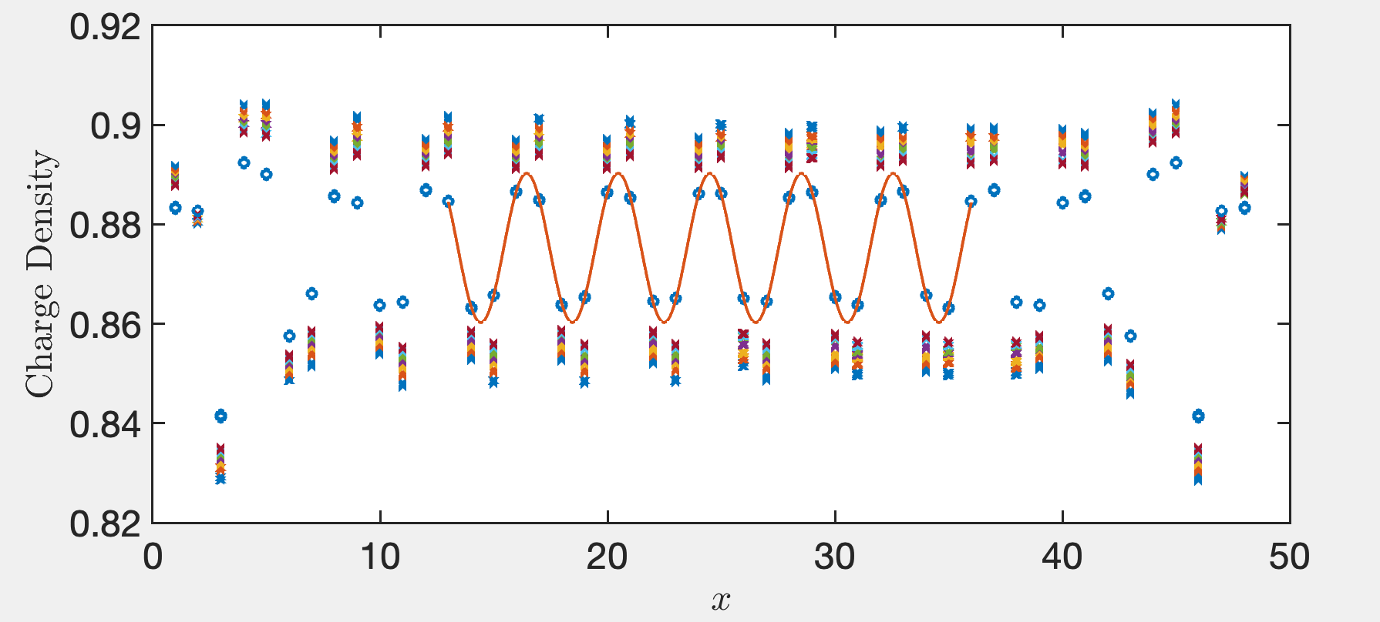




Charge density profile and reference point when measuring
$$L_{x}=16$$
$$L_{x}=24$$
$$L_{x}=32$$
8
4
8
$$L_{x}=48$$
12

Slide 14
4 class Reference points when measuring
D
A
B
C

Slide 15
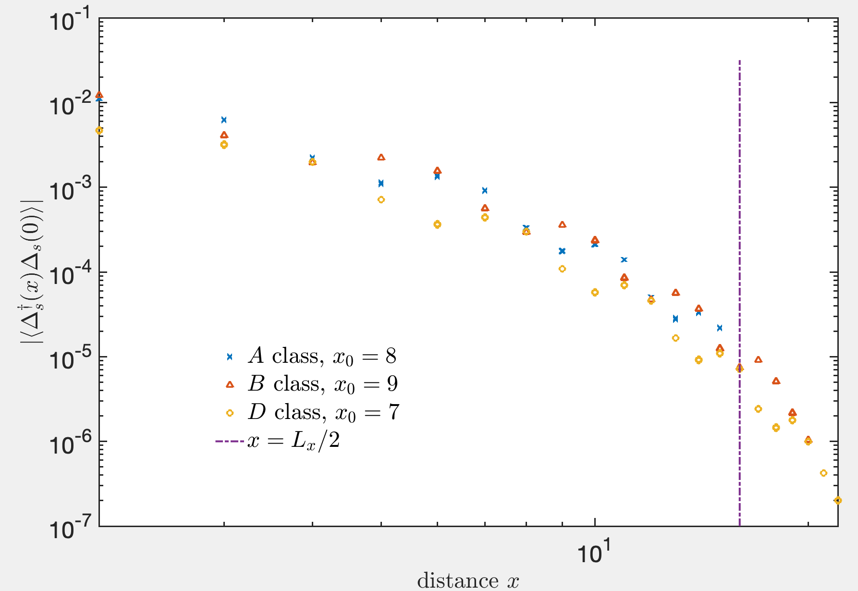
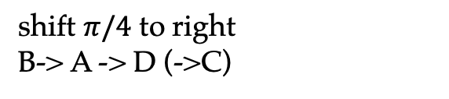


Compare correlations on different reference points
$$λ=0.3, U=8, D = 8000, L_{x}=32$$
$$\frac{L_{x}}{2}$$
shift $π/4$ to right
B-> A -> D (->C)

Slide 16
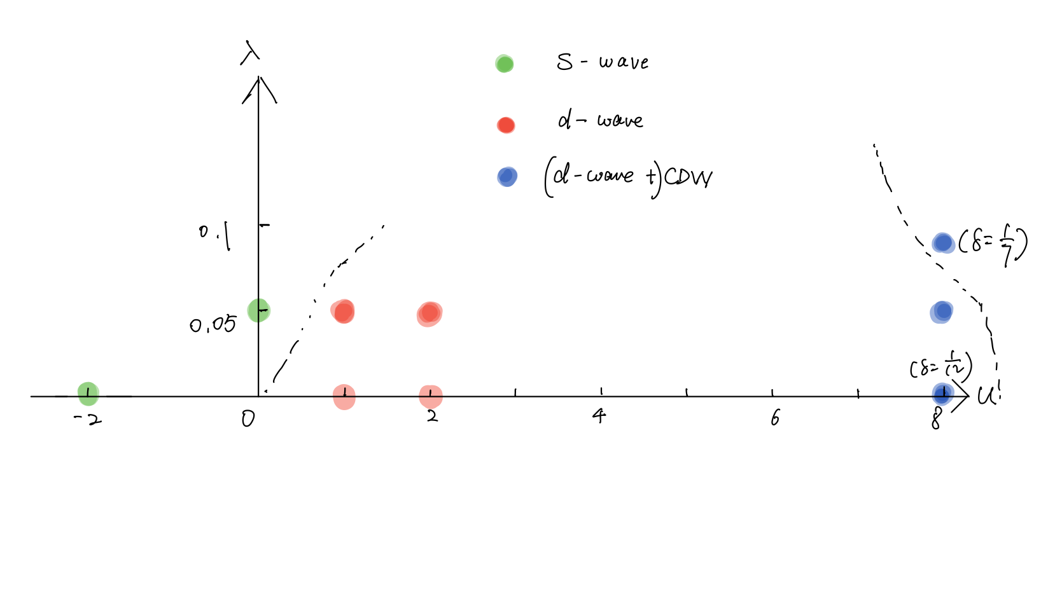
Landscape: 3-leg ladder, $δ=1/8$

