Slide 1
Preliminary Concept
TeaM4C (R Dominick, L Gogley, M Munoz, D Tran)

Slide 2
Requirements
The design shall map unknown coordinates through exploration.
  Location of choice should not dictate mapping method, i.e. a room vs a field.
The design shall not be limited to enclosed or man-made structures.
  The scans must be accurate enough to recognize a low profile object as an obstacle/structure in its map.
The design shall be capable of 2D SLAM.
  SLAM shall be used to handle 2D mapping.
The design shall be capable of 3D capture.
  3D capture can be pulled from samples or from real-time/soft real-time capture.
The design shall be powered from an independent power supply.
  This power source shall provide enough power to explore, at minimum, one floor of the ECS building.

Slide 3
Limitations
The design is not confined to color recognition of the surroundings.
  With use of LiDAR, the capture is not interested in color, therefore detail is lost of surroundings.
The design is not confined to autonomous navigation, simply the capability of such.
  The design will be capable of mapping and localization, but the platform may not drive autonomously as functionality of mapping is the first priority.
The design is not confined to real-time 3D mapping, due to limitations of price and available algorithms.
  Real-time 3D is sometimes limited to ability of hardware readout, and may be an unrealistic endeavor. 3D may instead be done from sampling.
The design is not interested in object recognition.
  Point clouds will be used to simply display raw data, and points on a 2D plane will only be used to determine the explored area.

Slide 4
Purpose of Design
For us:
Explore high performance embedded system design.
Expand territory into industry applications such as point cloud capture, machine vision, and SLAM.

Slide 5
Purpose of Design
For the consumer:
3D maps introduce depth to a panoramic capture, and allow for implementations such as virtual real estate, virtual visits to landmarks, and cave, ocean, or other exploration.
This platform will serve as a self-contained system capable of remembering where it began its journey, while also creating a map of the area it explores beyond that point.

Slide 6
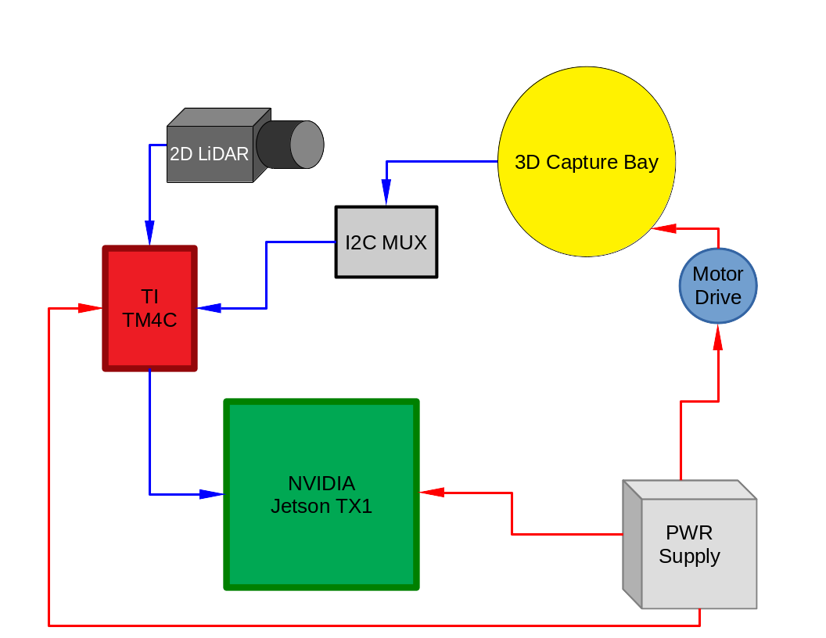
Top Level Block Diagram

