Slide 1
Linux Kernel Config Support
Han, Jing, Li, Aubrey, Li, Zhiquan, Hu, Zhiming
OSV/CSP Enabling, Intel
April 2022
Notes:
Simultaneous Multithreading

Slide 2
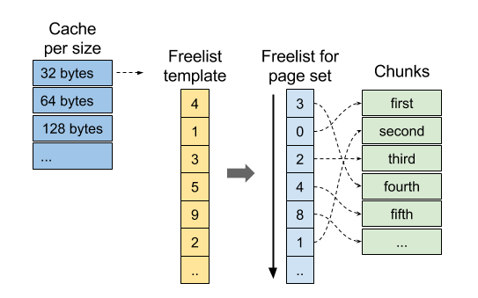
CONFIG_SLAB_FREELIST_RANDOM
Feature goal
Security feature against heap overflow
Reduce the predictability of the kernel SLAB/SLUB allocator
Design Principle
Randomize a SLAB/SLUB freelist
Fisher-Yates shuffle algorithm
Shuffling a list of unique numbers
kmalloc() return the object address is not continuous
Patch URL
https://lwn.net/Articles/685047/
Performance impact embedded

Slide 3
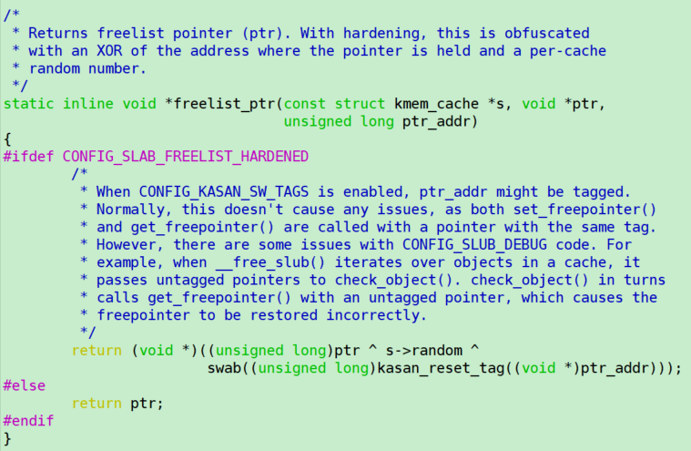
CONFIG_SLAB_FREELIST_HARDENED
Feature goal
Security feature against heap overflow
Frustrate the exploitation method of overwriting freelist
Design Principle
Obfuscate SLUB freelist pointer
Add a per-cache random value to SLUB caches that is XORed with their freelist pointers
The address saved on the free object is no longer the address of the next free object, it looks random now
Patch URL
https://patchwork.kernel.org/project/linux-hardening/patch/20170726041250.GA76741@beast/
Performance impact embedded

Slide 4
CONFIG_SLAB_MERGE_DEFAULT
Feature goal
Slab merging
Reduce kernel memory fragmentation
Avoid cache management overhead
Design Principle
Slab caches can be merged when they share the same size and other characteristics.
Drawbacks
Carry the risk of kernel heap overflows being able to overwrite objects from merged caches (and more easily control cache layout), which makes such heap attacks easier to exploit by attackers
Patch URL
https://lore.kernel.org/lkml/20170620230911.GA25238@beast/

Slide 5
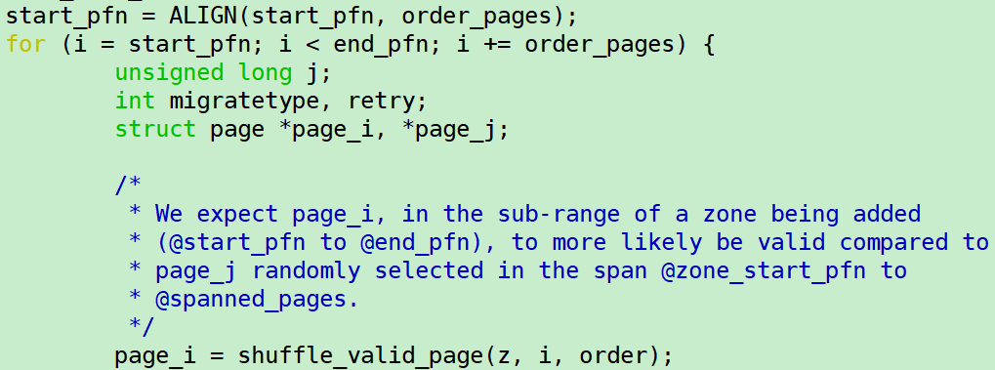
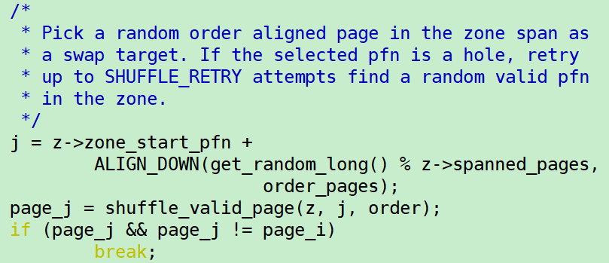
CONFIG_SHUFFLE_PAGE_ALLOCATOR
Feature goal
Provide uncertainty to memory layout for Security
Improve memory-side-cache average utilization for performance
Design Principle
Randomize page freelist
Fisher-Yates shuffle algorithm
Randomly swapping pfn within (start_pfn, end_pfn) in a zone
Granularity 4MB(SHUFFLE_ORDER)
Patch URL
https://lwn.net/Articles/776228/

Slide 6
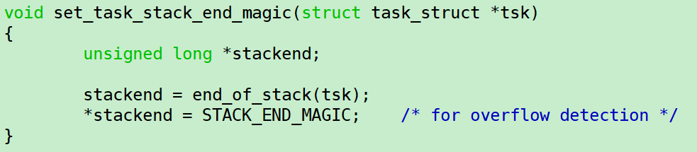
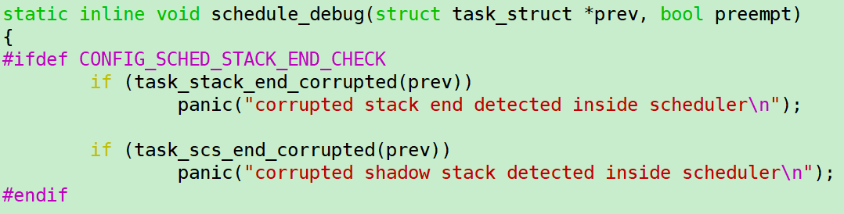
CONFIG_SCHED_STACK_END_CHECK
Feature goal
Ensure no erroneous behavior occurs which could result in data corruption or a sporadic crash at a later stage once the region is examined
Minimal runtime overhead
Design Principle
Check stack overrun on calls to schedule()
Panic if the stack end location is over written
Task STACK_END_MAGIC is assigned during fork
Patch URL
https://lore.kernel.org/lkml/1410527779-8133-4-git-send-email-atomlin@redhat.com/

Slide 7
CONFIG_VMAP_STACK
Description
Virtually Mapped Stack. It refers to kernel stack per process.
Disable
The pages for kernel stack are in directly mapped memory area. The pages for one stack must be physically continuous.
Enable
As the name indicates, the kernel stack is virtually mapped. The pages are allocated from vmalloc area, they can be physically scattered. Another important beneficial for enabling this option is that guard page for kernel stack is available. It makes kernel stack overflow detection easier and in an early stage.
Code flow:
(5.17) copy_process -> dup_task_struct -> alloc_thread_stack_node -> __vmalloc_node_range

Slide 8
CONFIG_THREAD_INFO_IN_TASK
Description
It relates to where the thread_info structure should be put.
Disable
thread_info structure locates in process kernel stack.
Enable
thread_info struct locates in task_struct struct. The beneficial to put it in task_struct is to avoid the stack clash to destroy thread_info struct.
Code reference (kernel version 5.17)
struct task_struct {
#ifdef CONFIG_THREAD_INFO_IN_TASK
/*
* For reasons of header soup (see current_thread_info()), this
* must be the first element of task_struct.
*/
struct thread_info thread_info;
#endif
};
union thread_union {
#ifndef CONFIG_THREAD_INFO_IN_TASK
struct thread_info thread_info;
#endif
unsigned long stack[THREAD_SIZE/sizeof(long)];
};

Slide 9
CONFIG_DEBUG_LIST
Principle
This option turns on extended checks in the linked-list walking routines.
It depends on DEBUG_KERNEL option.
Benefits
It will increase detect actions for illegal manipulations for linked list functions __list_add and __list_del.
Drawbacks
N/A.
Suggestion
Y. If unsure, say N

Slide 10
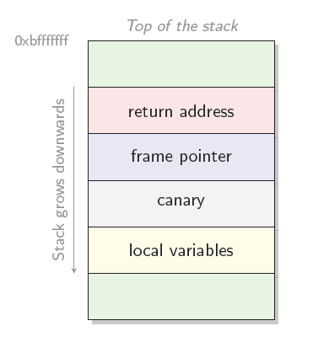

CONFIG_STACKPROTECTOR
Feature Goal
Stack Protector buffer overflow detection
Design Principle
Turns on the "stack-protector" GCC feature with -fstack-protector option
At the beginning of functions, put a canary value on the stack just before the return address, and validates the value just before actually returning
Stack based buffer overflows (that need to overwrite this return address) now also overwrite the canary, which gets detected and the attack is then neutralized via a kernel panic
Functions have an 8-byte or larger character array on the stack
Benefits
Stack buffer overflows are a longstanding problem for C programs that leads to all manner of ills, many of which are security vulnerabilities. Stack protection will catch a significant portion of real-world attacks.
Drawback
Increase image size Reference: the kernel with -fstack-protector turned on is 0.33% larger and covers 2.81% of the functions in the kernel.
Increase slightly overhead for additional logic GCC will insert addition logic for the protected functions which means there will be slightly overhead.
Notes:
CONFIG_STACKPROTECTOR: Stack Protector buffer overflow detection
Principle
This option turns on the "stack-protector" GCC feature with -fstack-protector option.
This feature puts, at the beginning of functions, a canary value on the stack just before the return address, and validates the value just before actually returning.
Stack based buffer overflows (that need to overwrite this return address) now also overwrite the canary, which gets detected and the attack is then neutralized via a kernel panic.
Functions will have the stack-protector canary logic added if they have an 8-byte or larger character array on the stack.
Benefits
Stack buffer overflows are a longstanding problem for C programs that leads to all manner of ills, many of which are security vulnerabilities. Stack protection will catch a significant portion of real-world attacks, while it certainly isn't a panacea for security woes.
Drawbacks
Increase image size Reference: the kernel with -fstack-protector turned on is 0.33% larger and covers 2.81% of the functions in the kernel.
Increase slightly overhead for additional logic GCC will insert addition logic for the protected functions which means there will be slightly overhead.
Suggestion: Y

Slide 11
CONFIG_STACKPROTECTOR_STRONG
Feature Goal
A stronger Stack Protector buffer overflow detection
Design Principle
Turns on the "stack-protector" GCC feature with -fstack-protector-strong option.
Functions will have the stack-protector canary logic added in any of the following conditions:
local variable's address used as part of the right-hand side of an assignment or function argument
local variable is an array (or union containing an array), regardless of array type or length (cover the CONFIG_STACKPROTECTOR option)
uses register local variables
Benefits
This option depends on the GCC -fstack-protector-strong flag to strike a better balance between security and performance. This flag protects more kinds of vulnerable functions than -fstack-protector does, but not every function, providing better performance than -fstack-protector-all.
Drawbacks
Increase image size Reference: for -fstack-protector-strong, those numbers are an increase of 2.4% in code size over an unprotected kernel, but 20.5% of the functions are covered.
Increase minor overhead for additional logic As per the data above, undoubtedly, the overhead of enabling this option is higher than CONFIG_STACKPROTECTOR option.
Notes:
CONFIG_STACKPROTECTOR_STRONG: A stronger Stack Protector buffer overflow detection
Principle
This option turns on the "stack-protector" GCC feature with -fstack-protector-strong option.
Functions will have the stack-protector canary logic added in any of the following conditions:
local variable's address used as part of the right hand side of an assignment or function argument
local variable is an array (or union containing an array), regardless of array type or length (cover the CONFIG_STACKPROTECTOR option)
uses register local variables
Benefits
This option depends on the GCC -fstack-protector-strong flag to strike a better balance between security and performance. This flag protects more kinds of vulnerable functions than -fstack-protector does, but not every function, providing better performance than -fstack-protector-all.
Drawbacks
Increase image size Reference: for -fstack-protector-strong, those numbers are an increase of 2.4% in code size over an unprotected kernel, but 20.5% of the functions are covered.
Increase minor overhead for additional logic
As per the data above, undoubtedly, the overhead of enabling this option is higher than CONFIG_STACKPROTECTOR option.
Suggestion: Y

Slide 12
CONFIG_ KMEM / DEVMEM / DEVPORT
Feature Goal
Export some memory information via devfs
Design Principle
CONFIG_KMEM: The /dev/kmem device is rarely used but can be used for certain kind of kernel debugging operations.
CONFIG_DEVMEM: The /dev/mem device is used to access areas of physical memory.
CONFIG_DEVPORT: The /dev/port device is similar to /dev/mem, but for I/O ports.
Enable
Some debugging tools may utilize these interfaces to implement their specific functions. Normally we no need to access these pseudo device files.
Disable
Disabling these options can reduce the risks to expose the memory information to use land.
Notes:
CONFIG_KMEM: The /dev/kmem device is rarely used, but can be used for certain kind of kernel debugging operations.
CONFIG_DEVMEM: The /dev/mem device is used to access areas of physical memory.
CONFIG_DEVPORT: The /dev/port device is similar to /dev/mem, but for I/O ports.
The benefit is the same, to disable them can reduce the opportunity to expose the memory information to use land for security reasons. However, we are not sure if there are applications which implement some functions basing on these interfaces. If the customer is very concerned about system security, we still suggest disable them.

Slide 13
CONFIG_ HARDENED_USERCOPY
Feature Goal
Harden memory copies between kernel and user space
Design Principle
The feature adds following tests for the kernel-space pointers while copy_to_user()and copy_from_user():
not bogus address (e.g., the range doesn’t wrap past end of memory and the kernel-space pointer is not null)
fully contained by stack (or stack frame, when available)
fully within specified heap object (or does not incorrectly span multiple pages)
not in kernel text
Benefits
As a proactive defense against bounds-checking flaws in the kernel's copy_to_user()/copy_from_user()interfaces,
If an attacker can influence the allocation of objects on the kernel's heap and then overwrite some of those objects, they may be able to escalate privileges, run arbitrary code, or crash the kernel.
Leaking the contents of kernel memory may result in critical data (e.g. keys) that could be exposed. Beyond that, determining the layout of kernel memory by way of an information leak can also provide information needed to exploit other kernel flaws.
Drawbacks
Increasing the overhead when copy_to_user() and copy_from_user() If your transactions involve a system-call-heavy workload, you need to run a benchmark to see if that had any measurable performance degradation, otherwise, we suggest enable it.
Notes:
CONFIG_ HARDENED_USERCOPY: Harden memory copies between kernel and user space
Principle The kernel often copies data from and to user space, which makes copy_to_user() and copy_from_user() (and friends) rather frequently used kernel functions. The user-space pointers are already checked in current kernels, but if the kernel can be tricked into copying too much data in either direction, security vulnerabilities can be the result. So the feature adds following tests for the kernel-space pointers:
not bogus address (e.g., the range doesn’t wrap past end of memory and the kernel-space pointer is not null)
fully contained by stack (or stack frame, when available)
fully within specified heap object (or does not incorrectly span multiple pages)
not in kernel text
Benefits As a proactive defense against bounds-checking flaws in the kernel's copy_to_user()/copy_from_user() interfaces, this feature reduces the risks as below:
If an attacker can influence the allocation of objects on the kernel's heap and then overwrite some of those objects, they may be able to escalate privileges, run arbitrary code, or crash the kernel.
Leaking the contents of kernel memory may result in critical data (e.g. keys) that could be exposed. Beyond that, determining the layout of kernel memory by way of an information leak can also provide information needed to exploit other kernel flaws.
Drawbacks
Increasing the overhead when copy_to_user() and copy_from_user(). As you can see, a couple of checks will be done when copy_to_user() and copy_from_user().
Suggestion
If your transactions involve a system-call-heavy workload, you need to run a benchmark to see if that had any measurable performance degradation, otherwise, we suggest enable it.
Note:
To check if they copy allocations that span multiple pages need to enable CONFIG_ HARDENED_USERCOPY_PAGESPAN.
CONFIG_ HARDENED_USERCOPY_FALLBACK has been removed since v5.16.

Slide 14


